Slide 1
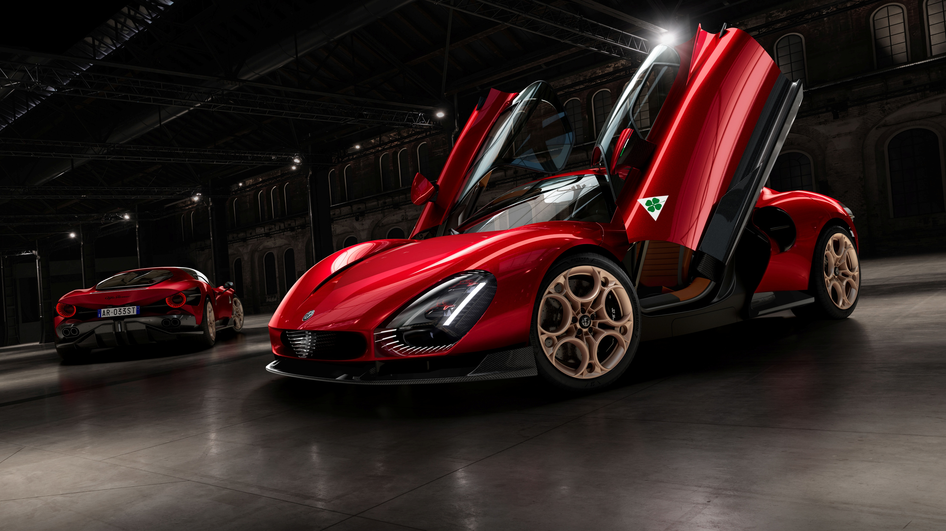

Alfa Romeo 33 Stradale
Refresh & Novelties

Slide 2
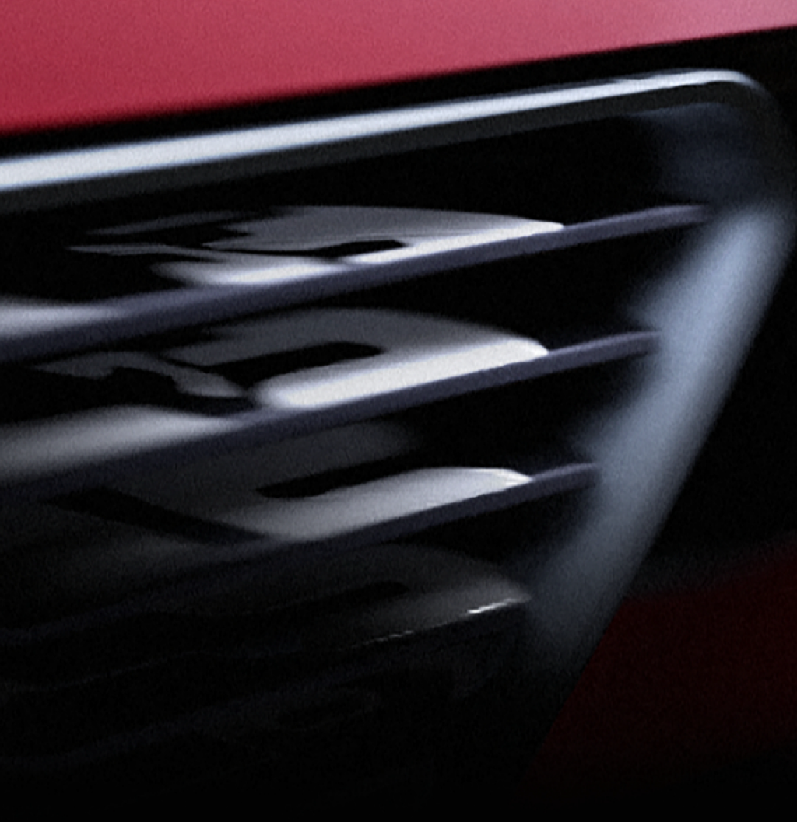

Alfa 33 Stradale, makes its debut on the street
The Alfa Legend starts the delivery,
let’s review the inspiring concepts and main features.

Slide 3
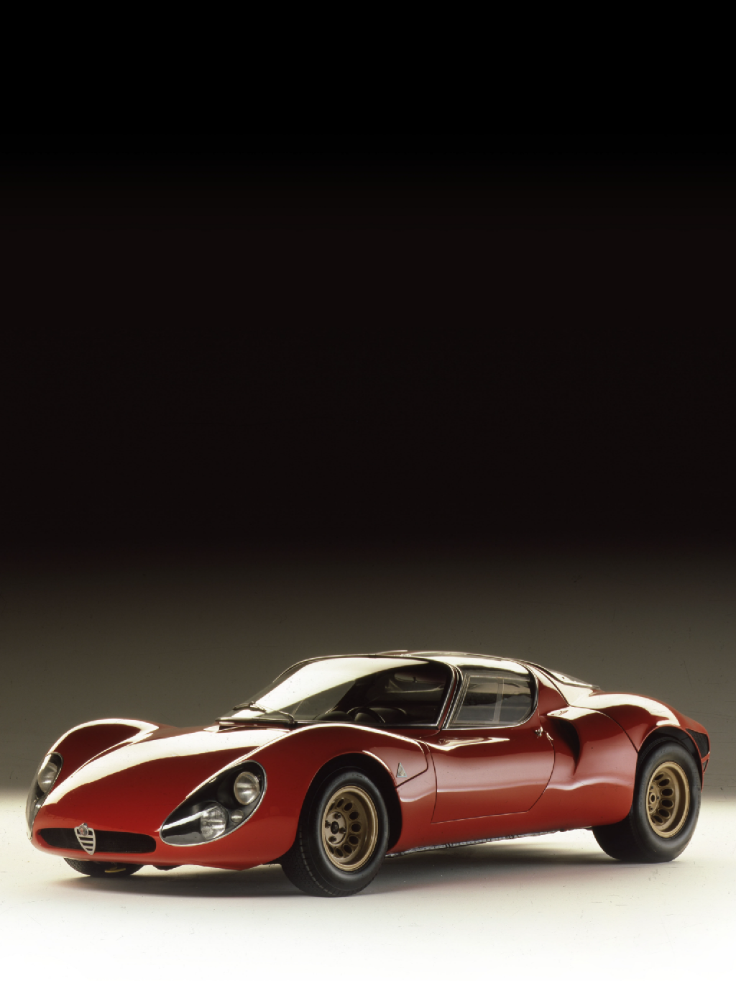
December 17th 1966
Dear Salesperson,
after a frantic wait lasting several months, the "Legend" of the Alfa Romeo brand finally makes its debut on the road.
The first delivery took place at the end of 2024, exactly on December 17th, to celebrate one of the Alfa Romeo historical dates: the release of the ﬁrst sketch of
Alfa Romeo 33 Stradale by the designer Franco Scaglione.

Slide 4
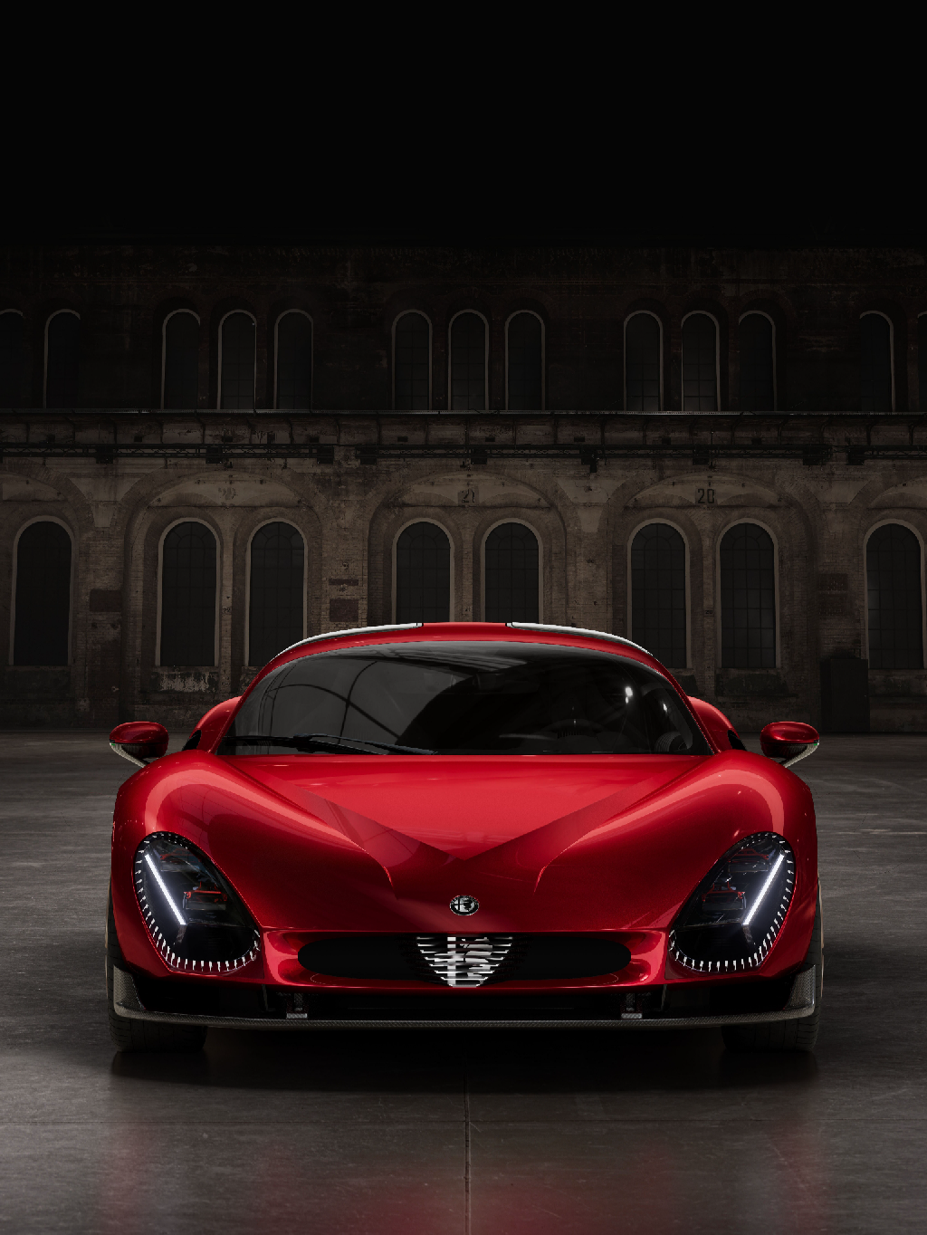
December 17th 2024
Exactly 58 years later, history is renewed with the delivery of the first model of the new generation of 33 Stradale, celebrating the legacy of an icon that still today enchants lovers of pure sportiness and timeless beauty.
We are talking about a Limited Production: only 33 units were produced, and they are already sold out.
You won't see many of the 33 Stradale around but each of them is a work of art thanks to the car's uniqueness, with a distinctive genesis and characteristics that set it apart from others.

Slide 5
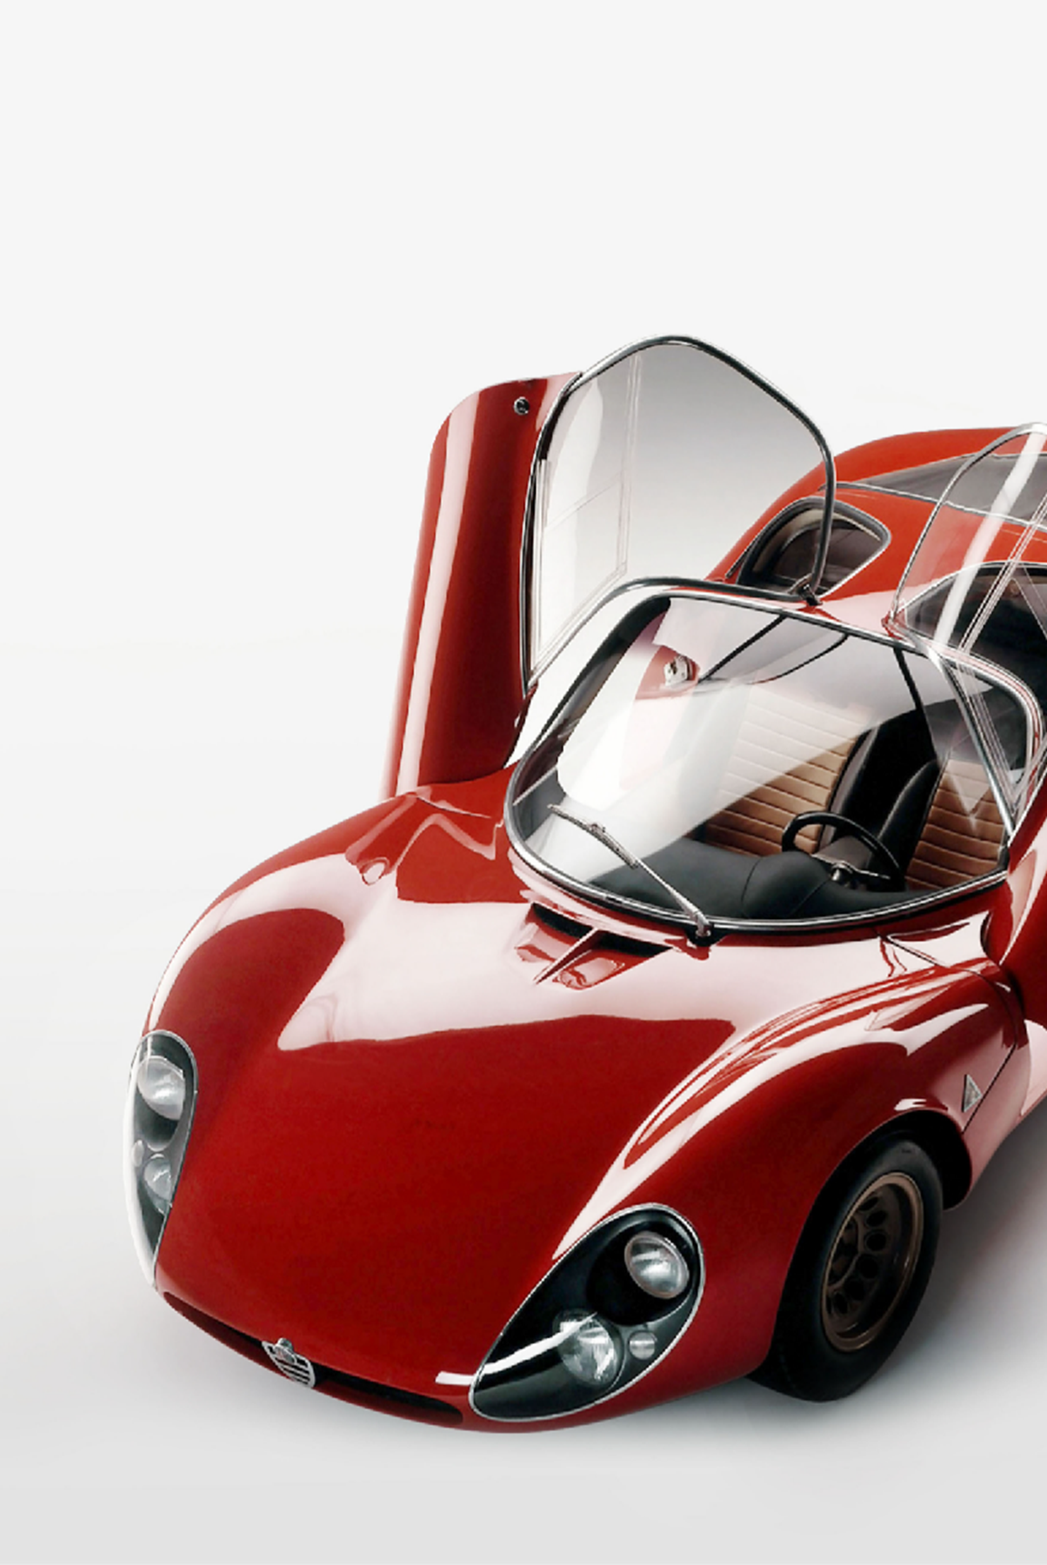
Selling Emotion
Because Alfa Romeo is not a brand like the others, it does not just sell the product, it sells an emotion that is made - even before the product - of intangible aspects of belonging:
a unique story
technological know-how
unique Italian Style
33 Stradale is all this, it is history, it is know-how, it is style... and it is pride.
Customers who come in to discover Junior or Tonale will talk to us, ask about this and we must be prepared!
So let's review this Alfa 33 Stradale together!

Slide 6
Just a few key pills
Alfa Romeo 33 Stradale was the street legal version based on the AR Tipo 33 racing car:
Engineered by Auto Delta, designed by Franco Scaglione and bodied by Carrozzeria Marazzi
A limited series production car built between 1967-1969
18 chassis produced: 6 of them were used for concept cars
Each car was unique due to the handmade and craftmanship of the past
Every 33 Stradale maintains the value of a true art masterpiece!

Slide 7
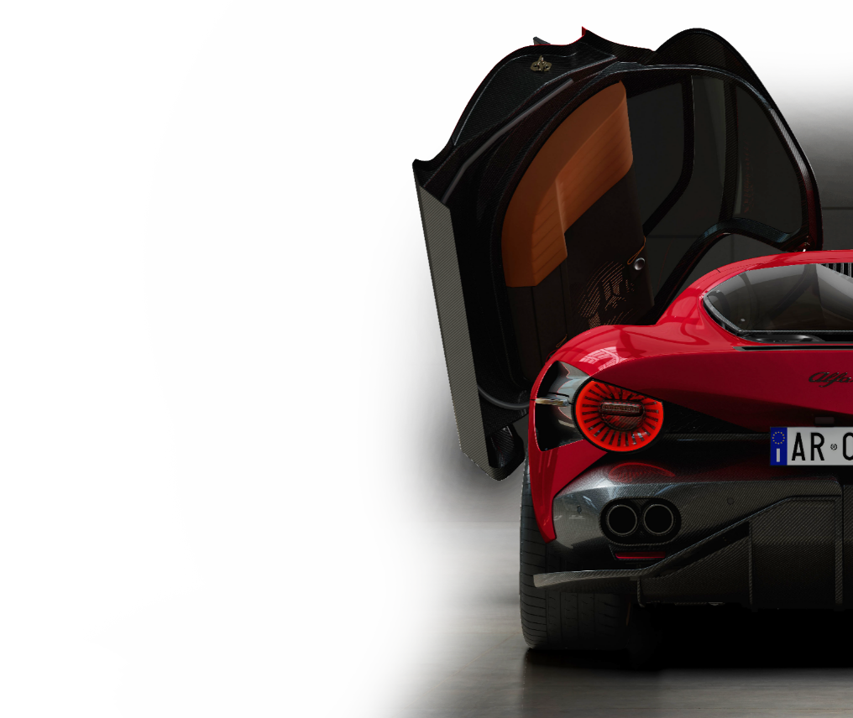
The red carpet to Alfa Romeo History.
3 Main pillars
1 Iconicity:
The only Fuoriserie by Alfa Romeo since 1969, since the 33 Stradale.
A new Icon of style: "Bellezza Necessaria": the ideal marriage between shape and function.
2 Uniqueness:
True essentiality leveraging hand made Italian craftmanship.
Signature singularity element.
3 Character:
Street legal supercar designed by Alfa Romeo developed with F1 racing.
Embossing coachbuilder tradition.

Slide 8
TODAY – Business card
BORN IN THE HEART OF ALFA ROMEO
Designed by Centro Stile Alfa Romeo
Engineered with the experience of F1
MANIAC ON LIGHT WEIGHTED MATERIALS
Aluminum H frame, carbon fiber monocoque and Top Hat
Carbon fiber and aluminum roof
LEADING CLASS AERODYNAMICS W/ F1 EXPERIENCE
CX=0,375 without any active aerodynamic systems
THE BEST HANDLING PIECE OF ART
Double wishbone suspensions with virtual steering axle
Top speed: 333 km/h
Acceleration: 0-100 km/h < 3s

Slide 9
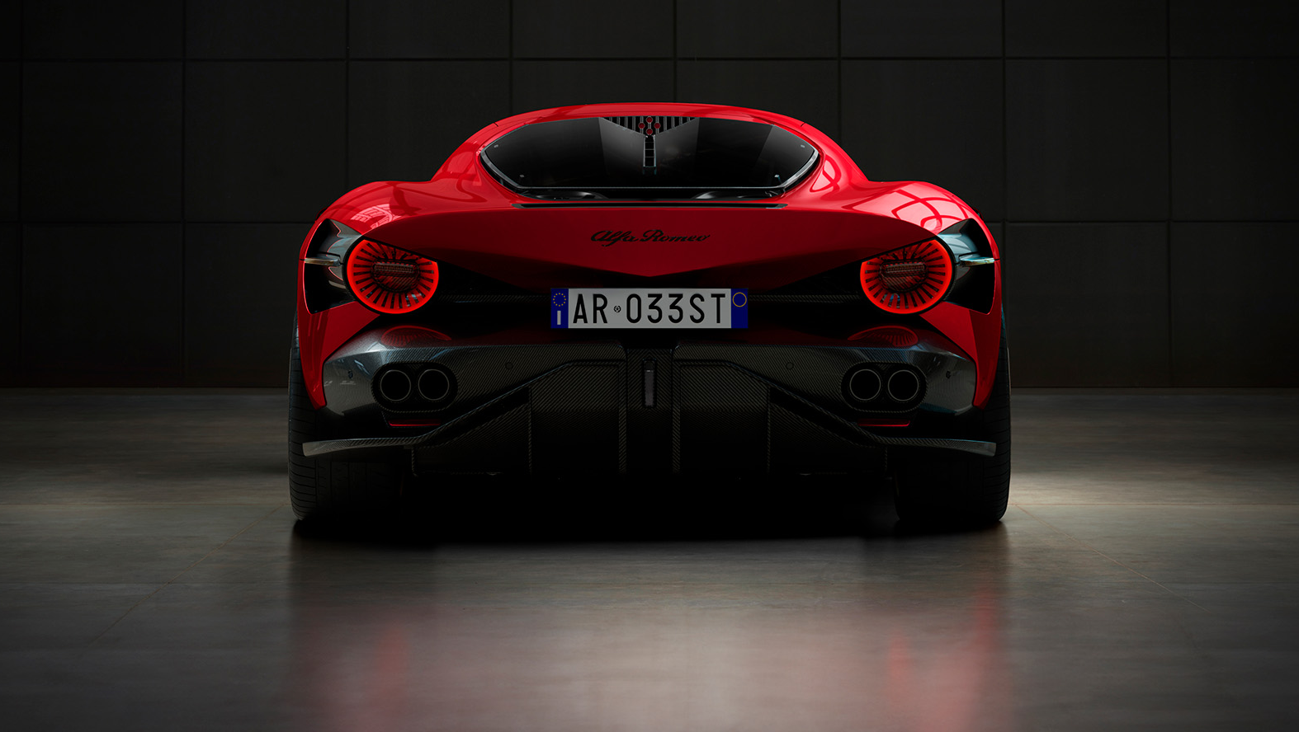
TODAY - Tech specs (1/3)
POWERTRAIN
While a BEV version was initially considered, all 33 exclusive members enthusiastically chose the ICE variant, highlighting their passion for performance and tradition.
So let’s review this version specs:
Gasoline
3.0L V6
620
LHD Twin-Turbo Engine
DCT 8 - RWD
Fuel Type
Layout
Max. power (HP)
Ignition system
Gearbox & Drive

Slide 10
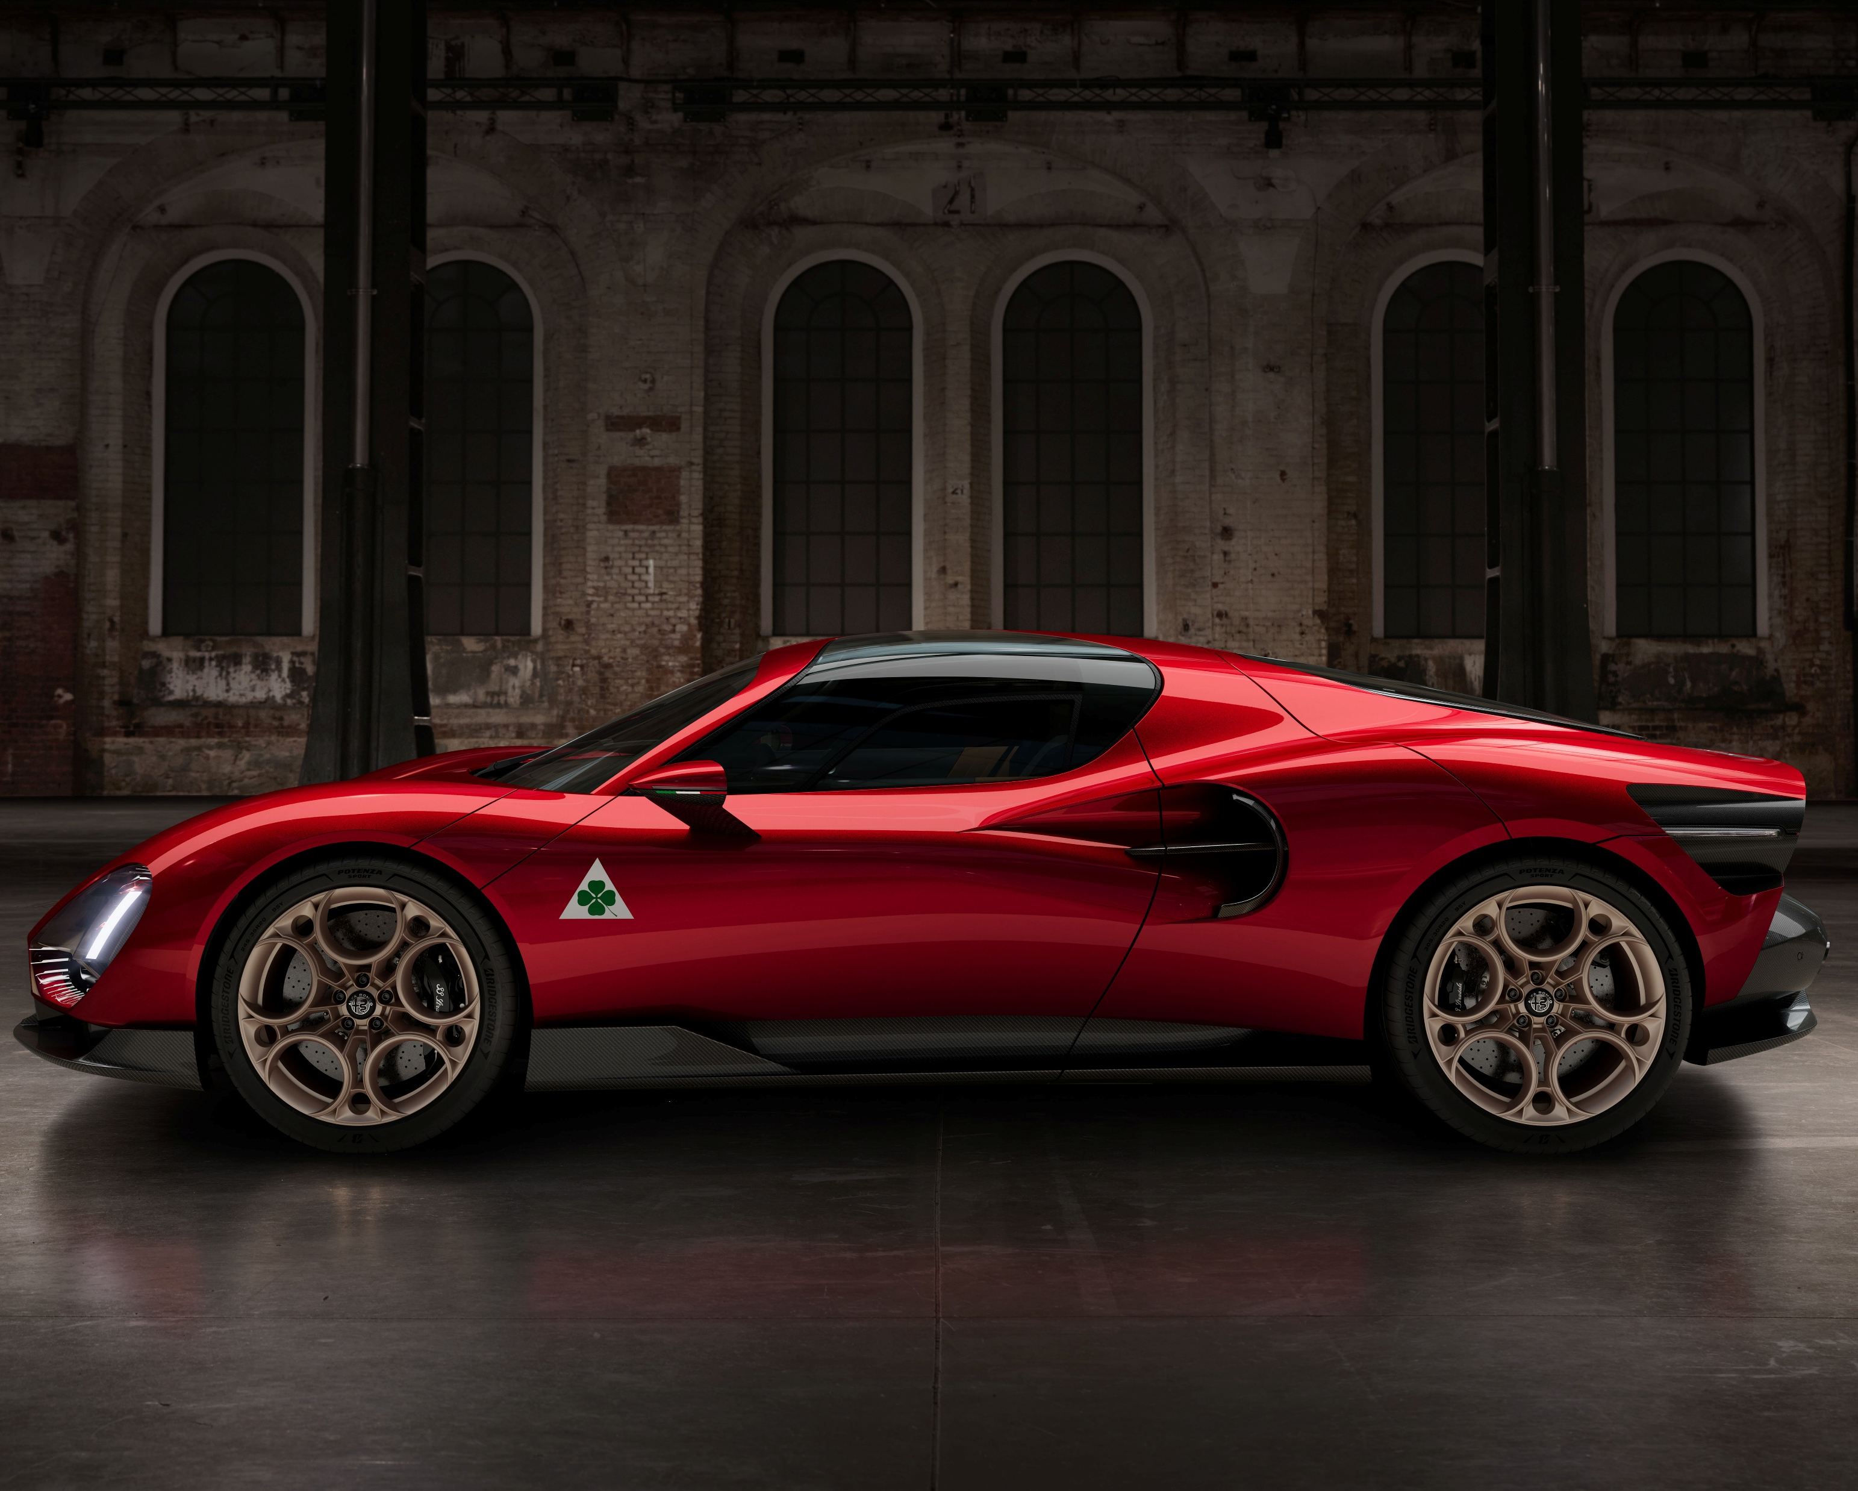
TODAY - Tech specs (2/3)
CHASSIS
Aluminium H frame
Carbon ﬁber monocoque
SUSPENSION
Front: double-wishbone with virtual steering axle, anti-roll bar (Lifter available)
Rear: double-wishbone with virtual steering axle, anti-roll bar

Slide 11
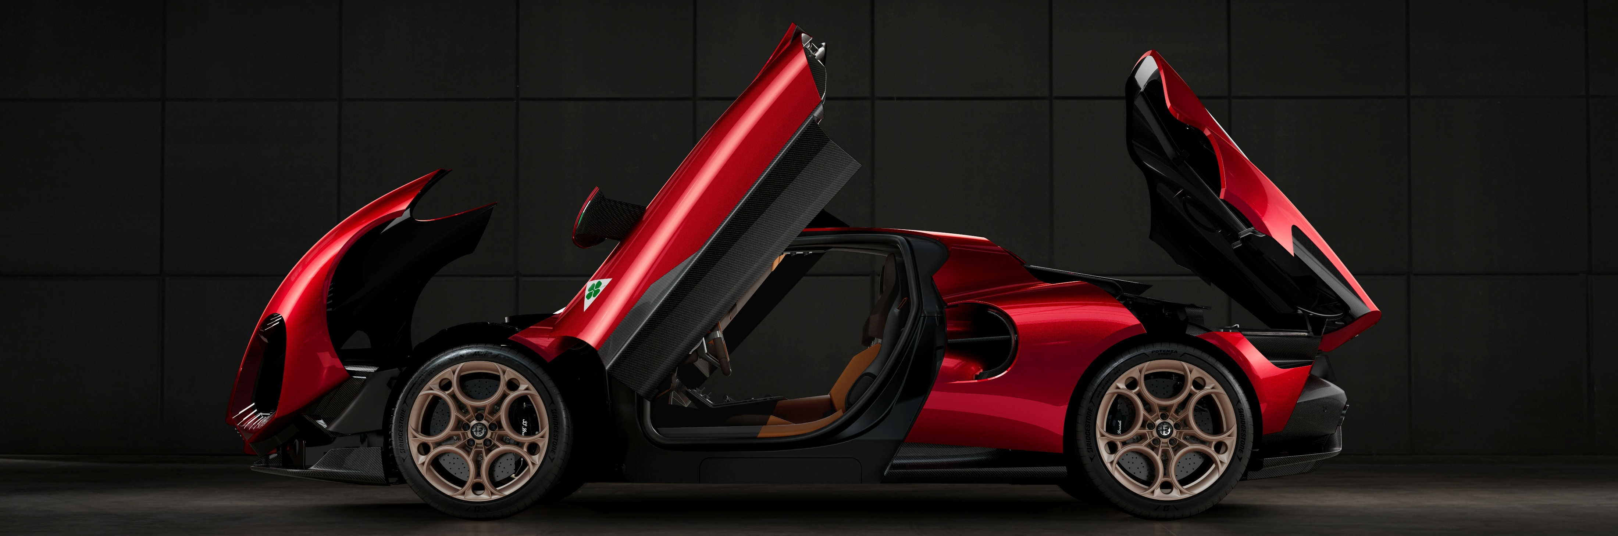
TODAY - Tech specs (3/3)
BRAKES
Front CCM Carbon Ceramic Brake by Brembo, ventilated and drilled 390x36 rotor with 6-piston monoblock aluminum caliper.
Rear CCM Carbon Ceramic Brake by Brembo, ventilated and drilled 360x28 rotor with 4-piston monoblock aluminum caliper.
WHEELS
Front: 245/35 R20
Rear: 305/30 R20

Slide 12
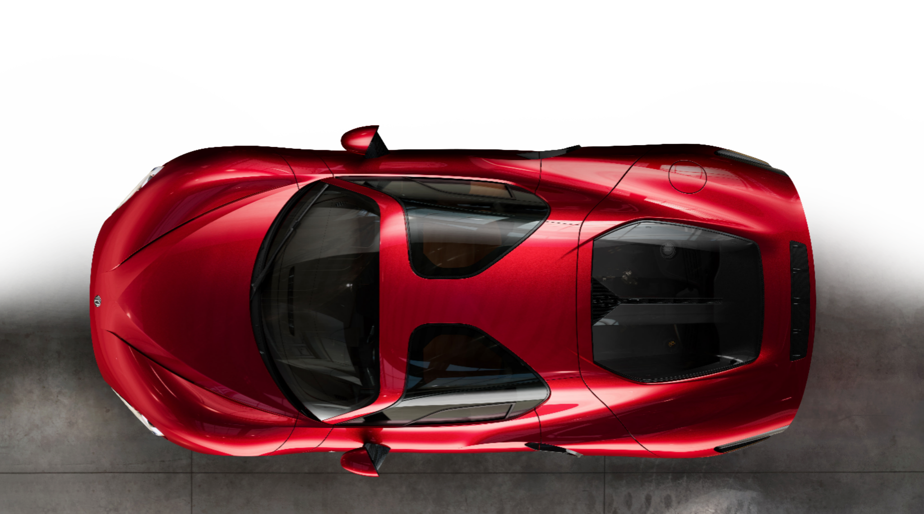
TODAY - No one like another
Thanks to an exclusive customization program by Centro Stile Alfa Romeo, each of the 33 Stradale units is a one of a kind creation, certified by Heritage. No two are alike, with customers even able to add their personal signature.
The customization areas are:
POWERTRAIN
INTERIOR
EXTERIOR
COMFORT & ACCESSORIES

Slide 13
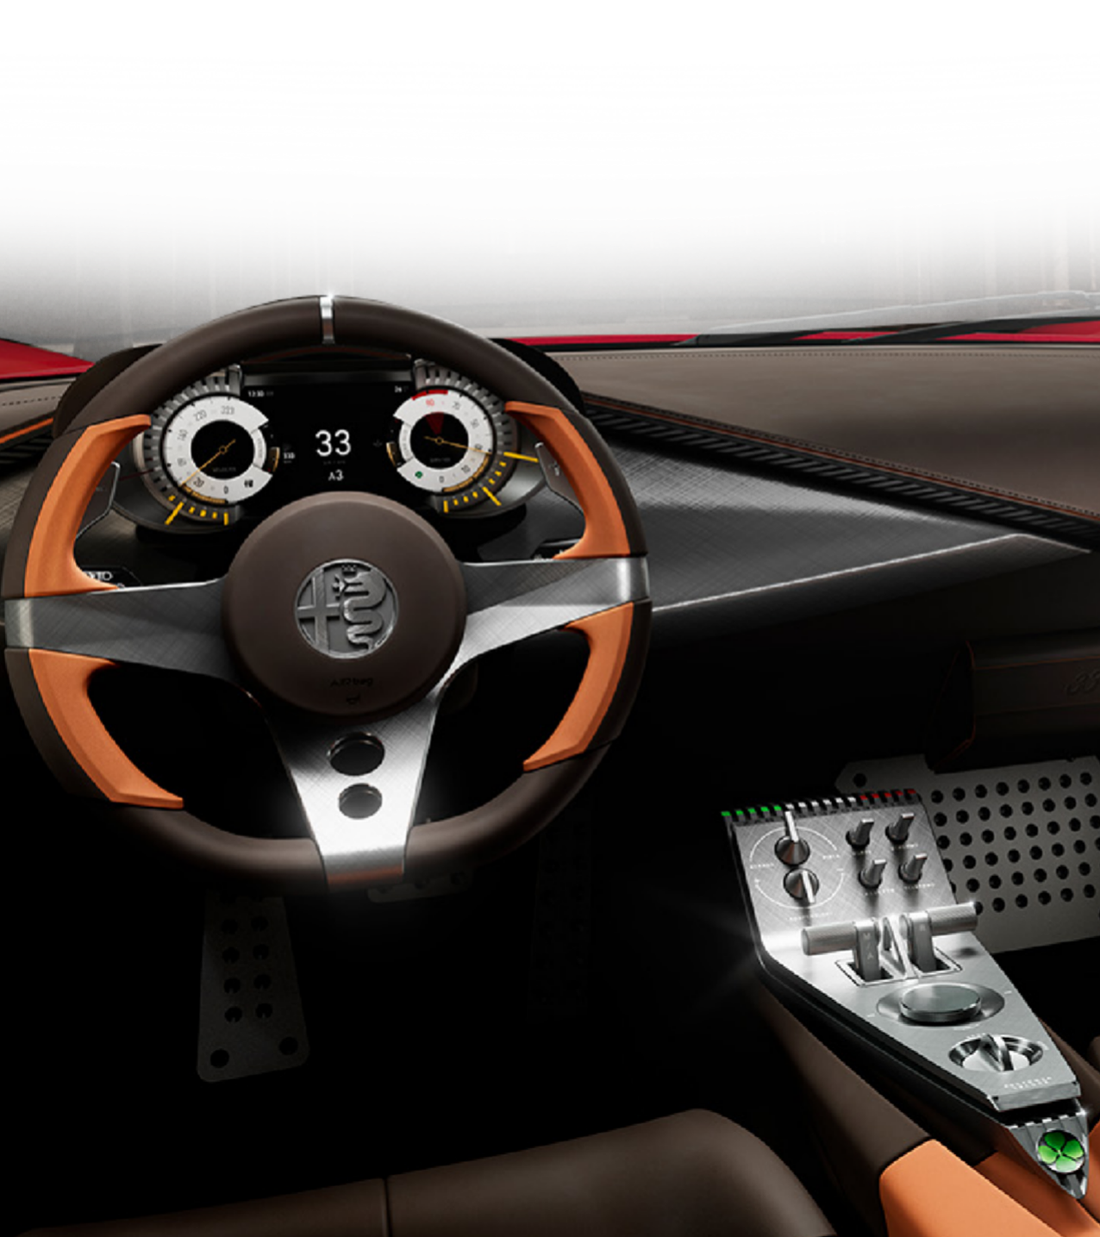
TODAY - A few words about technology
On Alfa Romeo 33 Stradale a special decision has been taken: since it’s a car born to be driven, only the commands and features strictly needed to drive are visible.
The infotainment is present, of course, but it’s hidden: display can be “extracted” just on demand.
Moreover, the ADAS equipment has been limited to essential, so to offer the most genuine driving experience with very limited system’s intervention.

Slide 14
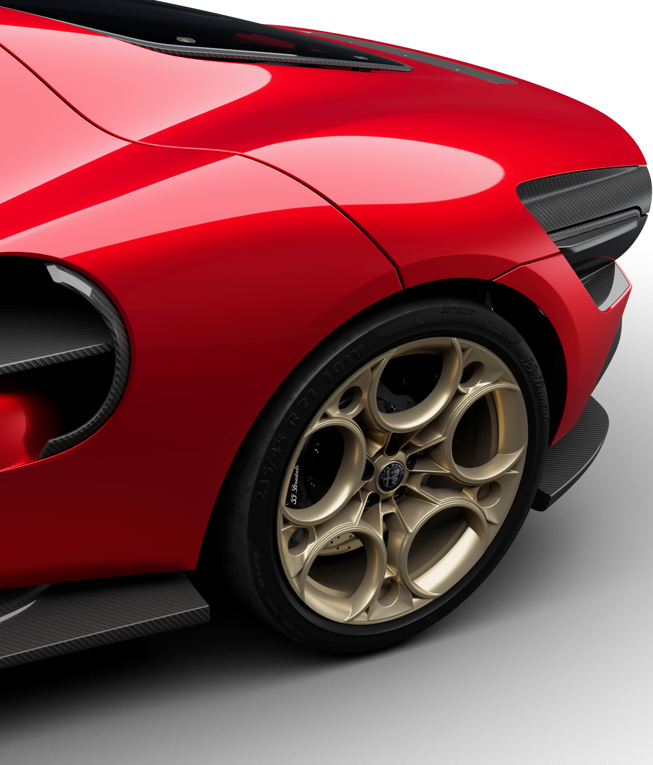
STYLE DETAILS: wheels (1/2)
Wheels are one of the most defining features of a car and - for the 33 Stradale - their design, engineering, and evolution represent the highest balance between aesthetics and performance.
Selecting rims carefully matched to the vehicle configuration ensures that the design is cohesive, completing its character and overall perceived appearance.
The 33 can have 3 different types of wheel named:
"TRIBUTO“
"HERITAGE“
"PROGRESSIVE".

Slide 15
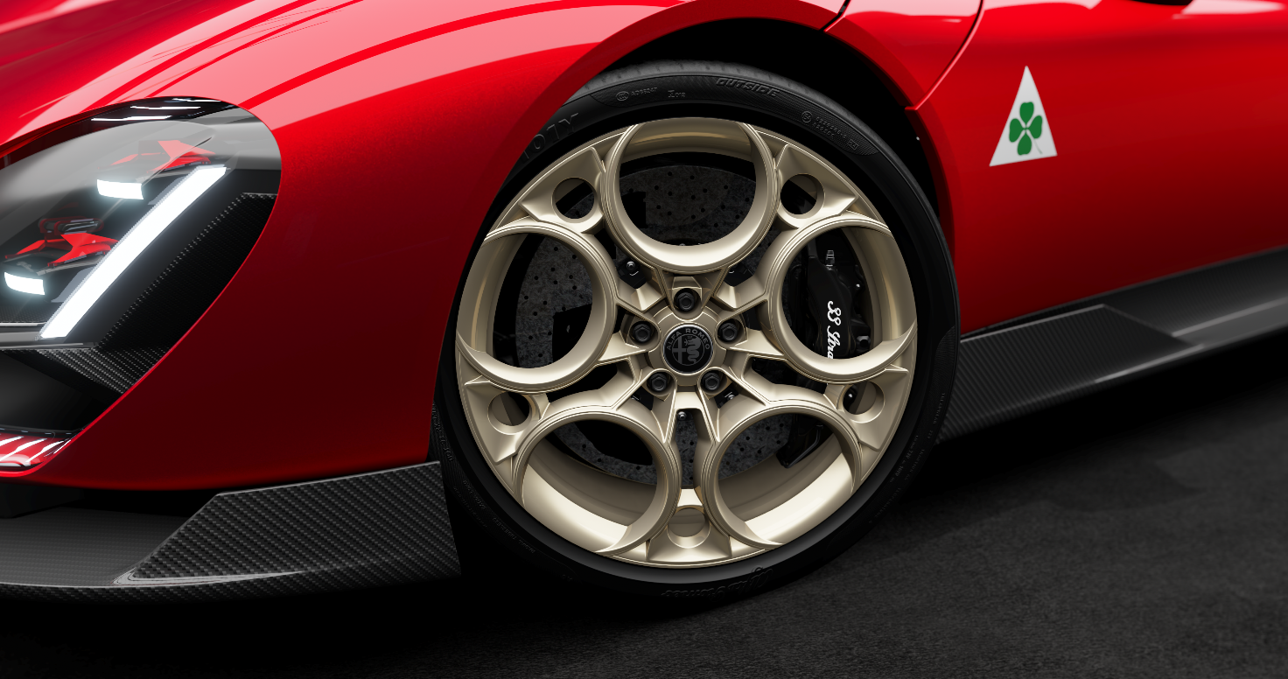
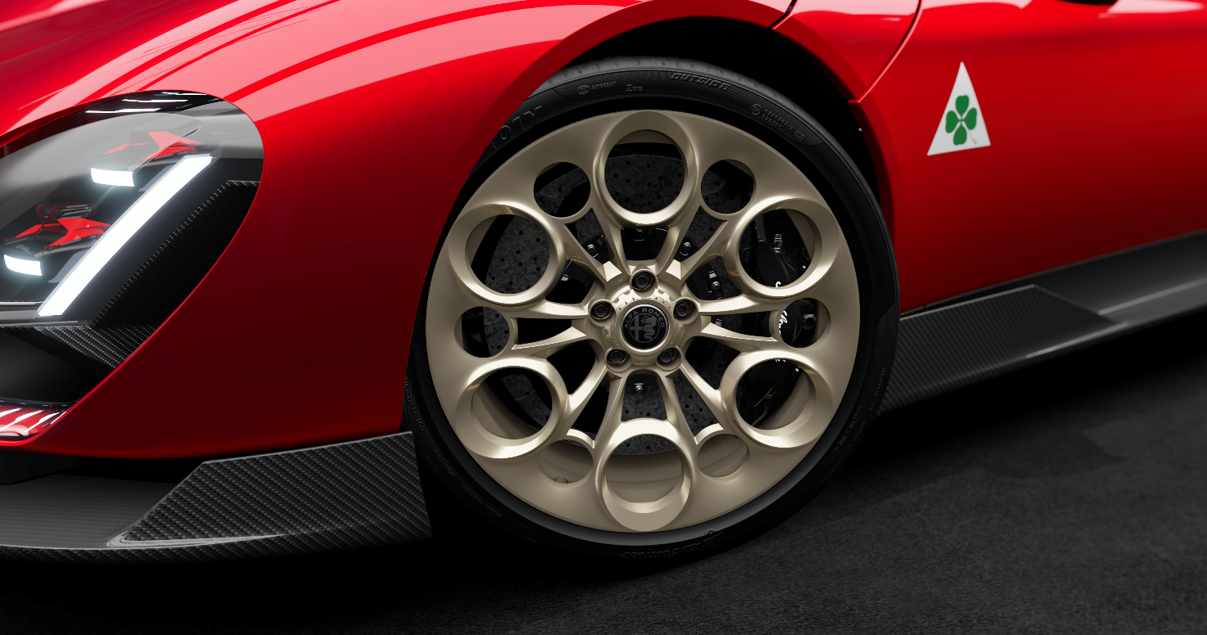
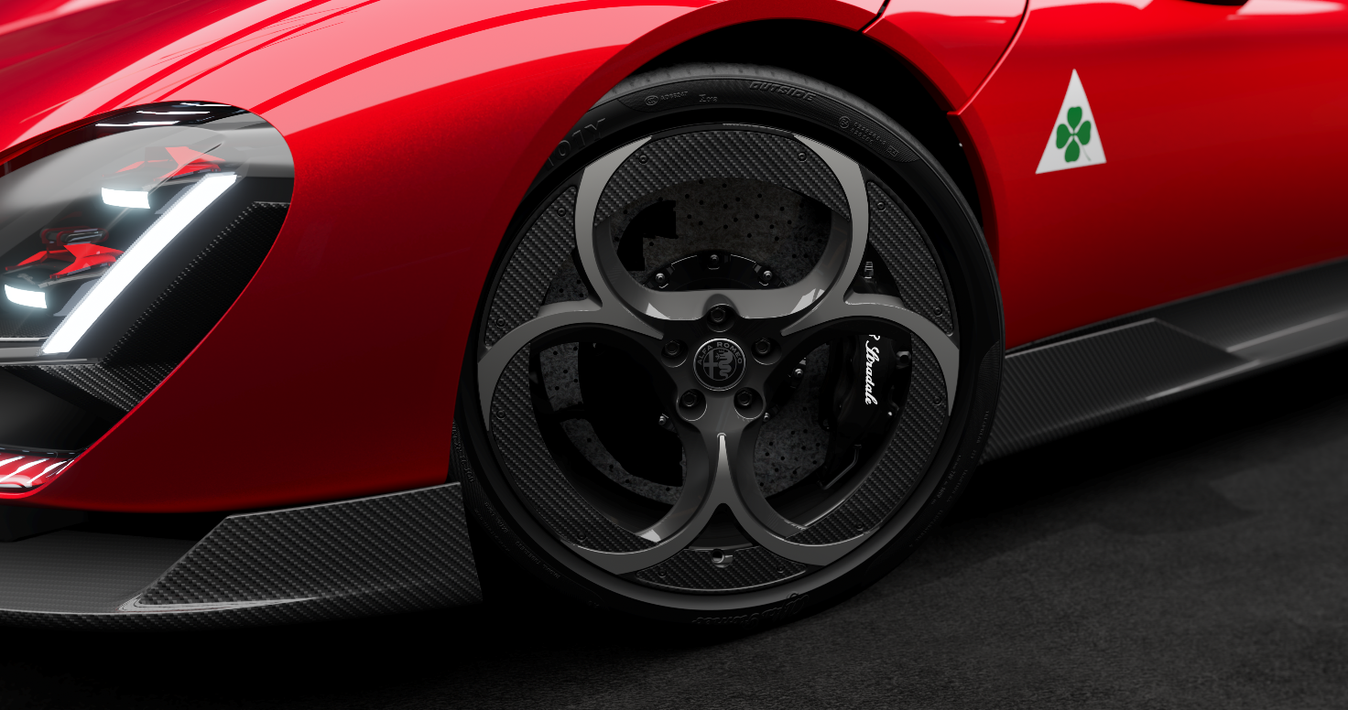
STYLE DETAILS: wheels (2/2)
TRIBUTO: represents a natural transformation, a modern evolution of Alfa Romeo classic wheel design, where the signature 'holes' have progressively grown larger over successive generations to enhance the cooling of the braking system.
HERITAGE: A tribute to the legendary 33 Stradale, honoring Alfa Romeo’s rich legacy.
PROGRESSIVE: A bold, modern interpretation featuring striking hole patterns, unique color schemes, and carbon fiber inserts: ideal for adventurous configurations.

Slide 16
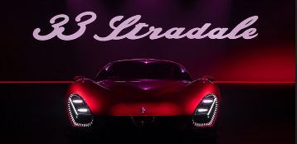
THANK YOU FOR YOUR ATTENTION
… AND ONCE MORE,
WE ARE ALFA ROMEO!

