Slide 1
SALES METHODS
Quick guide

Slide 2

Welcome to the Sales Methods Quick Guide
Your essential resource for mastering effective sales techniques.
This guide breaks down each stage of the sales process, offering practical tips to streamline your day and boost results.
Sales methods provide you a structured approach that will help you to build trust, overcome objections and close deals more effectively.

Slide 3
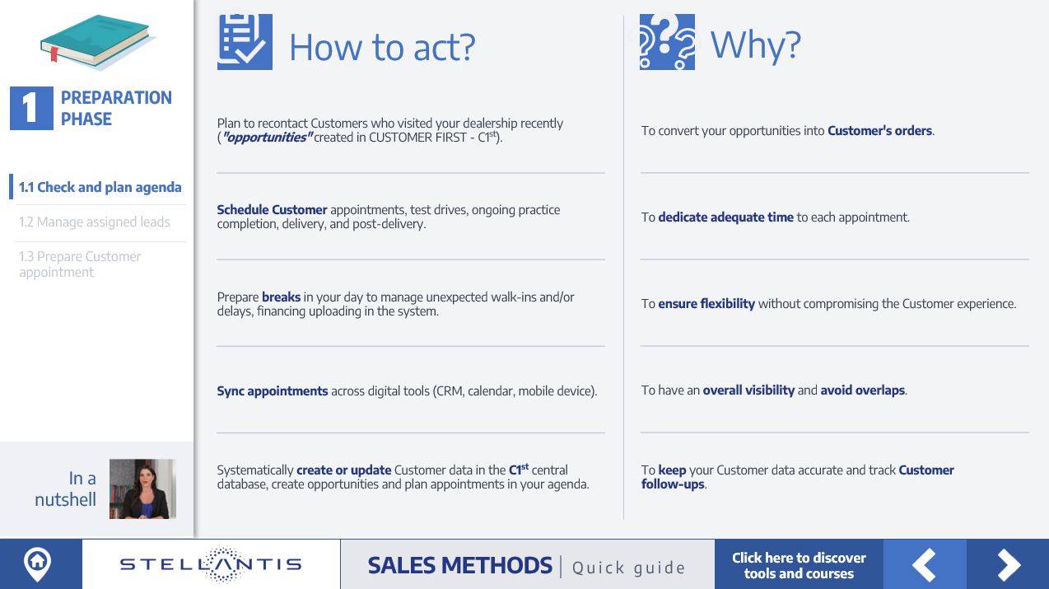
We have created a dedicated card for each identified action, which will include:
HOW TO ACT?: Clear methodology on how to proceed.
WHY?: An explanation of the importance of following the sales methods, emphasizing their benefits.
Within this WBT, you will find the four main phases of sales methods: Preparation Phase, Prospection and Retention, Customer Management, and Loyalty Management, along with their corresponding sub-phases and actions.
Additionally by clicking on "In a Nutshell" button, a short video summarizes important data, statistics, or insights related to each phase.
In each card (page) there is a LINK to existing tools, document and courses for more detailed information.

Slide 4


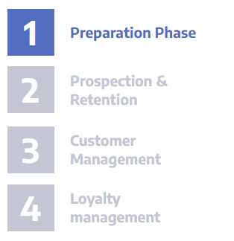
How to navigate the course
On this page, we’ll show you how to use the main buttons to move through the contents.
In a Nutshell: short videos summarize important data, statistics, insights related to each phase
EXERCISE: Prove your knowledge by the exercise
NEXT: it takes the user to the next slide
MENU: it shows the user the menu
BACK: it brings the user back to the previous slide

Slide 5
This online course complements the physical "Sales Methods Quick Guide" where you will find the same structure, and the same contents to have them always available on your desk!
You will receive a copy of the physical guide during the first live training session you will join!

Slide 6

How to start the month?
The start of each month is crucial to setting the pace of your performance. It is your opportunity to align your actions with commercial strategy, product updates, and individual sales targets assigned by your Sales Manager.
Proper planning from Day 1 ensures you:
stay aligned with business goals
maximize productivity
maintain control over your pipeline
increase your chances of success.

Slide 7
How to start the month?
What to do at the start of the month?
Set your priorities
Analyze your individual monthly objectives
Define your action plan using the sales funnel method
Focus first on high-potential ("warm") Customers.
Start with the easiest tasks (quick wins)
Focus on easy renewals, especially for best-selling models
Reach out to workshop Customers with tailored offers
More detailed info in the dedicated phase cards.
Work through your pipeline recontacting
Visitors from the previous few weeks
Unclosed opportunities in Customer First
"No-show" prospects from the previous month.
Dedicate time for strategic actions
Prepare strong BEV sales arguments
Develop your personal sales attitude (pitch)
Complete all training courses to boost your professionalism.

Slide 8







How to start the month?
Plan your month with your sales manager
Working with your Sales Manager, set the KPIs you need to achieve, following the Sales Funnel approach:
Number of contacts
Number of appointments
Number of test drives
Number of offers
Number of orders
Regularly check these indicators to plan & monitor:
your activities effectively
your performance
your time proactively.

Slide 9
POP UP
Sales advisor daily agenda
Following the definition of your monthly objectives in collaboration with your Sales Manager, we will now discover which sales methodologies should be implemented, and why they are fundamental, in your daily professional activities!
CONTINUE

Slide 10
Sales advisor daily agenda
1
Preparation Phase
1.1 Check and plan agenda
1.2 Manage assigned leads
1.3 Prepare Customer appointment
2
2.1 Financing renewals
Prospection & Retention
2.2 Workshop opportunities
2.3 Social media opportunities
2.4 Local event/activities to collect new leads
3.1 Interview - need analysis
3
3.2 Product experience - Test drive & Walk Around
Customer Management
3.3 Trade-in evaluation
3.4 Tailored offer presentation
3.5 Negotiation - Closure
3.6 From order to delivery regular update
3.7 Delivery
4
Loyalty management
4.1 Post Delivery recall
4.2 Regular touch points with Customers
4.3 Turn a Customer in an Ambassador
Link a pagina generale Murgia
Notes:
home page https://psa.csod.com/catalog/CustomPage.aspx?id=221000693

Slide 11



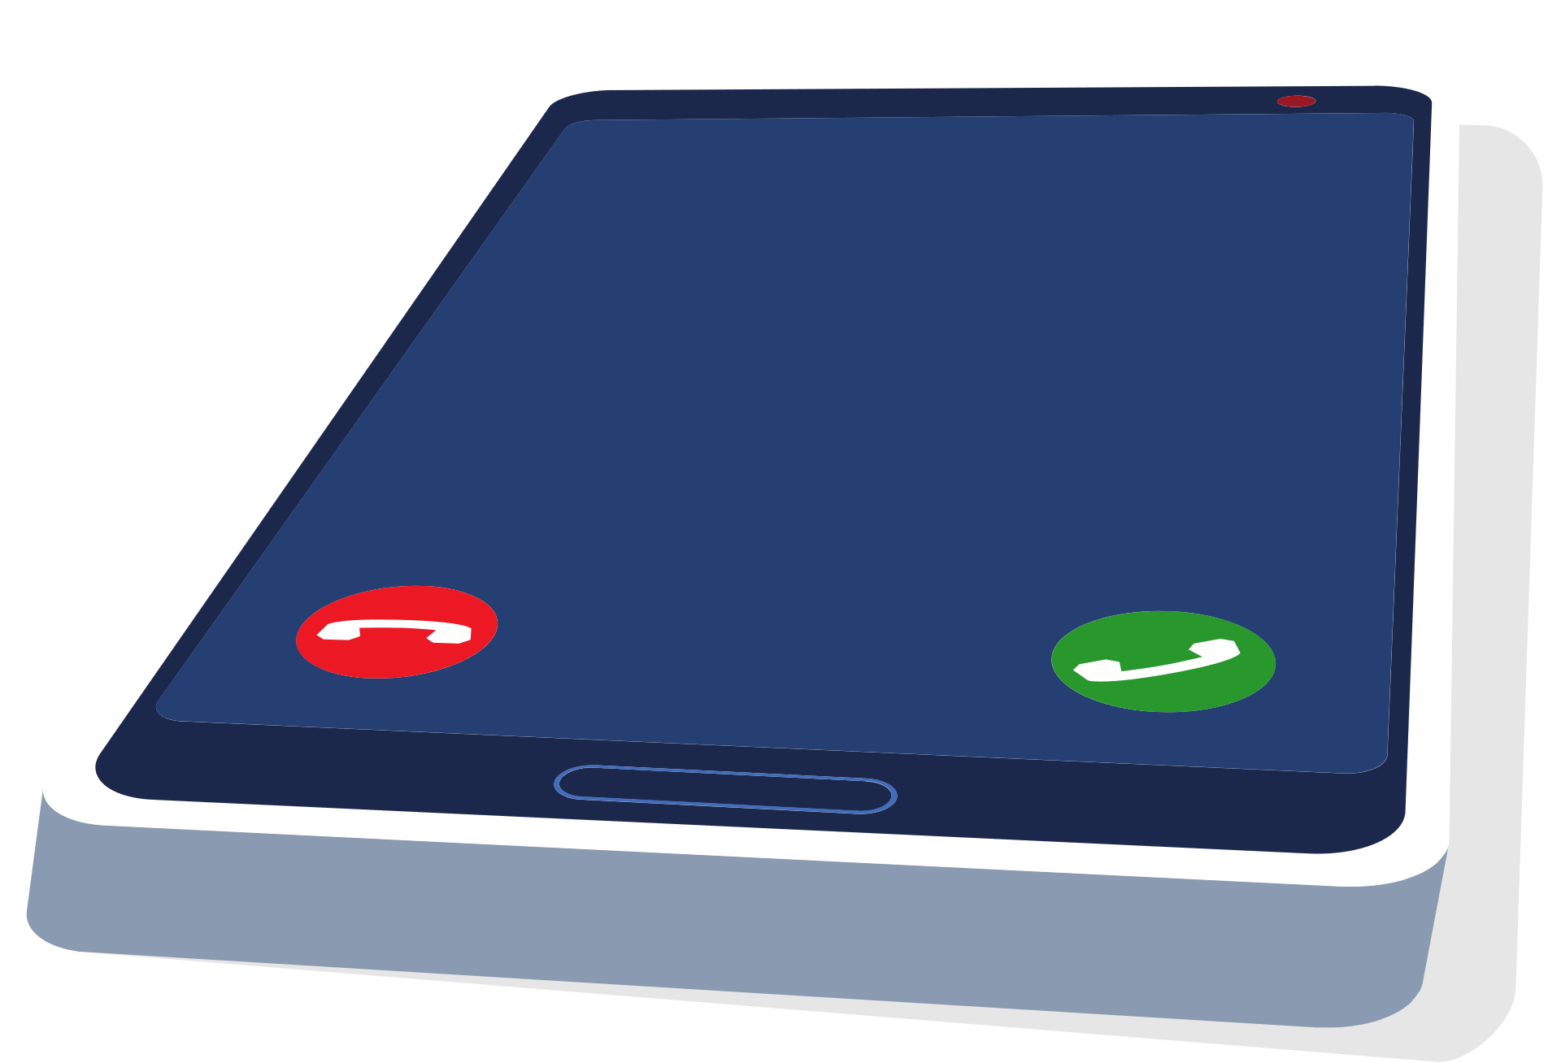
01 Preparation Phase

Slide 12
Plan to recontact Customers who visited your dealership recently ("opportunities" created in CUSTOMER FIRST - C1st).
Schedule Customer appointments, test drives, ongoing practice completion, delivery, and post-delivery.
Prepare breaks in your day to manage unexpected walk-ins and/or delays, financing uploading in the system.
Sync appointments across digital tools (CRM, calendar, mobile device).
Systematically create or update Customer data in the C1st central database, create opportunities and plan appointments in your agenda.
To convert your opportunities into Customer's orders.
To dedicate adequate time to each appointment.
To ensure flexibility without compromising the Customer experience.
To have an overall visibility and avoid overlaps.
To keep your Customer data accurate and track Customer follow-ups.
1.1 Check and plan agenda
1.2 Manage assigned leads
1.3 Prepare Customer appointment
Notes:
https://psa.csod.com/catalog/CustomPage.aspx?id=221000699 – fase 1

Slide 13
Check in C1st each morning to review your assigned leads (after your manager's assignments).
Contact 100% of leads, possibly in one hour from the assignment.
Check the Customer data and register it in the C1st database.
Qualify the leads received as positive or negative result and justify your choice from the list available in C1st.
Prepare and customize the first contact based on Customer profile and past interactions.
Schedule follow-up activities directly in C1st.
After 5 contact attempts using the predefined email and/or SMS templates, move the lead in C1st to "Cold or Unreachable".
To manage all leads as soon as possible, respecting brand's rule.
A quick response increases the probability to schedule an appointment by 3 times.
Maintaining data integrity ensures accurate Customer information.
To create an "opportunity" or a task to complete online with the Customer requirements.
A successful first phone contact with the Customer contributes 50% to a positive experience.
To ensure effective follow-ups and enhance task management efficiency.
To focus on more responsive prospects, avoiding to waste time.
1.1 Check and plan agenda
1.2 Manage assigned leads
1.3 Prepare Customer appointment

Slide 14
Check C1st database, test drive vehicles availabilities, configuration code to start the offer.
Schedule visits according to Customer’s availability and communicate their information to the reception staff.
Be organized to welcome the Customer within 3 minutes after entering the showroom.
Prepare the vehicle in advance for the test drive and select the most suitable route to the Customer needs.
Make sure all branded materials are available and verify that the digital screens installed in the showroom are properly configured and vehicles respect Brand's guidelines.
Prepare questions about Kilometers, Usage, Recharge, Budget, Energy, Environment (KURBEE questioning method) and about Customer needs.
Identify mobility solutions, trade-in price in line with market value and dealership rule, financing options suitable to Customer's needs.
Send a mail and a SMS 24 hours before the appointment to remind the Customer the time and location.
To get prepared for the Customer appointment.
To respect Customer availability and improve appointment success by offering 2 different slots.
To display your professionalism and demonstrate that everything has been prepared for the Customer.
To offer the Customer a seamless experience.
To ensure a professional and immersive presentation that complies with brands process and requirements.
To understand Customer's reason to purchase and build an offer that match with their expectations.
To expand opportunities and improve conversion.
To confirm commitment and prevent misunderstandings in order to reduce Customer no-show rates by up to 50%.
1.1 Check and plan agenda
1.2 Manage assigned leads
1.3 Prepare Customer appointment

Slide 15
EXERCISE
How much do increase the chances of making an appointment if you contact the Customer within an hour of receiving the Lead?
1.1 Check and plan agenda
1.2 Manage assigned leads
3 times
10 times
Does not change
1.3 Prepare Customer appointment

Slide 16
02 Prospection & Retention

Slide 17
Capture financing renewal from your Customer portfolio and leads in C1st.
At least once a month collect, select and contact Customers 6-9 months before contract end, checking contract status.
Assess and propose tailored renewal offers based on the former usage & new potential needs.
Use and highlight the Total Cost of Ownership (TCO) tool, along with the presentation of a double offer.
Consider loyalty bonus for early renewals.
Verify the vehicle return timing to be in line with the arrival of the new car.
To stay open to new opportunities and ensure precise follow-up.
To identify Customers intent and create awareness, encouraging them to visit the dealership.
To align the proposal with the Customer habits to improve conversion.
To facilitate a clear powertrain choice.
To encourage the Customer retention and speed the decision process up.
To ensure a smooth transition process for the Customer to avoid surprises.
2.1 Financing renewals
2.2 Workshop opportunities
2.3 Social media opportunities
2.4 Local event/activities to collect new leads

Slide 18
Collaborate closely with Aftersales staff on "critical" maintenance / repair.
Use workshop maintenance appointments to collect Customer's data and preferences.
Identify and target service Customers with vehicles 3 years or older.
Always offer a quotation on highly damaged or aged car.
Create "dedicated" flyer/offer to be personally handed to them when the vehicle is ready to be collected.
Follow up with the selected Customers via a phone call.
Display a Test Drive invitation at the workshop waiting area.
The Aftersales team is often the first to identify new sales opportunities.
To anticipate the Customer needs and prepare the most relevant options for them.
To prepare a personalized trade-in proposal matching with the new models available.
To offer the best mobility solution, demonstrating attention and empathy to the Customer.
It makes the Customer feel important, by offering a dedicated mobility solution.
To re-inforce the trade-in offer opportunity with empathy & trust.
To generate leads and interest on renewal / new opportunities.
2.1 Financing renewals
2.2 Workshop opportunities
2.3 Social media opportunities
2.4 Local event/activities to collect new leads

Slide 19
Create a professional profile on social media (Facebook, Instagram, TikTok...).
With Customers consent, share on social media the handover moment.
Use referral campaigns on social media (e.g., tag to win).
Repost main brand/dealer activities, event, product news updates.
Ask Customers to follow the dealer page and brand's profile, after the visit to the showroom and invite them to leave a review on social media and Google.
To increase your social media visibility to boost your Customers community.
To enhance authenticity and boost visibility through Customer Brand Ambassadors.
To leverage Customer interest to generate leads.
To strengthen the connection between a digital and real experience.
To keep the Customer warm, updated, and to maintain contact.
2.1 Financing renewals
2.2 Workshop opportunities
2.3 Social media opportunities
2.4 Local event/activities to collect new leads

Slide 20
Actively take part in dealership events: private sales days, local displays, new product launches.
Rank and select local events for engagement including: sporting events, public and private fairs, concerts, etc…
Schedule and send a "save the date" notification via calls, mailings, and social media campaigns one month, and again one week in advance.
Be ready to perform a test drive during an event by selecting the most suitable route with a wider range of cars.
Collect Customer data instantly.
Invite the Customer to a follow-up visit at the dealership.
Share on social media images of the events.
To leverage on dealership events to increase your Customer portfolio.
To increase visibility and become favored in the community.
To build interest and curiosity with the Customer.
To show and offer the Customers a complete product experience: ICE, Hybrid and Electric.
To improve Customer data into the central C1st database, converting it into qualified leads and preventing lead loss.
To build or maintain the relationship with the Customer.
To increase the visibility and remind the Customer that their experience continues at the dealership.
2.1 Financing renewals
2.2 Workshop opportunities
2.3 Social media opportunities
2.4 Local event/activities to collect new leads

Slide 21
EXERCISE
Why is it important to check and contact financing due 6-9 months in advance?
2.1 Financing renewals
2.2 Workshop opportunities
To identify Customer intent and create awareness, encouraging them to visit the dealership
To be ready for the end of the month to register at least 1 plate
To identify the financing provider
2.3 Social media opportunities
2.4 Local event/activities to collect new leads

Slide 22
03 Customer management

Slide 23
Start by creating a relaxed, professional atmosphere, asking if they are familiar with the brand and information on purchase options.
Ask open-ended questions to discover Customer needs: Kilometers, Usage, Recharge, Budget, Energy, Environment (KURBEE questioning method).
Verify if the Customer has already completed an online configuration.
Analyze the Customers travel behaviors and vehicle usage.
Let the Customer express their opinion freely and actively listen to them.
Ask the Customer which features on their current vehicle they find most useful and would like to have in their next car.
Ask which of the features presented for the new vehicle - not available in the previous one - are the most appreciated.
Ask about their current vehicle, ownership duration, installment, mileage, and maintenance history.
Summarize clearly the collected information.
Identify emotional and rational reasons to buy a vehicle.
To encourage open conversation and Customer trust.
To fully understand the Customer's needs.
It is the right starting point to fine tune the Customer needs and configure an offer.
To define the most suitable product and validate the powertrain to be considered with the Customers reasons for purchase.
This shows respect, drives honesty, and encourage genuine insights.
To create a sense of continuity with the current vehicle can increase the chances of selecting the new one.
To offer new features that enhance the experience building value in the new car.
To be ready for a complete trade-in offer, linking the features to the reasons for purchase.
To confirm the needs and creates alignment.
To increase engagement, build trust and storytelling.
3.1 Interview - need analysis
3.2 Product experience – Test drive & Walk Around
3.3 Trade-in evaluation
3.4 Tailored offer presentation
3.5 Negotiation - Closure
3.6 From order to delivery regular update
3.7 Delivery

Slide 24
Always pro-actively offer a test drive.
Check the availability for an immediate test drive or schedule one at the earliest opportunity.
Check the battery level for EV Test Drive / fuel level for ICE and Hybrid with vehicle connected to an EV charger, always maintain the optimum thermal pre-condition.
Select beforehand test drive routes that showcase the vehicle's characteristics or ask the Customer to drive in their preferred route.
Always take the steering wheel first and take advantage of a stop to hand the wheel to the Customer.
Make a recharging demo during the test drive at a public station using an RFID card or if not possible at the dealership.
Summarize with the Customer the key and most exciting points of the test drive.
Customers are always looking for a brand experience. The test drive is a key lever to confirm the Customers choice.
To dedicate adequate time to the test drive experience.
The Customer Experience should be unique and adaptable.
If the Customers choose their preferred usual route they are likely to feel more comfortable and confident even with a new car.
To ensure a more pleasant and comfortable drive, showing all the controls and the right adjustment of the driver's seat.
To reassure the Customer demonstrating clearly how simple and accessible the process is.
To reinforce the excitement and strengthen their connection with the car and detect hidden doubts.
3.1 Interview - need analysis
3.2 Product experience – Test drive & Walk Around
3.3 Trade-in evaluation
3.4 Tailored offer presentation
3.5 Negotiation - Closure
3.6 From order to delivery regular update
3.7 Delivery

Slide 25
Present the vehicle following the 5 steps: Front passenger corner, Passenger side, Rear, Drivers Side, Interior.
Use the "Features Advantages Benefits" (FAB) method.
Remind the brand image using the brand storytelling and the brand’s key words.
Show the roominess and boot space with examples of daily usage.
In the case of EVs illustrates, the cables on board, home or public charging with RFID card or App available.
Present driving position & cockpit: Steering wheel controls, central console controls, driving modes.
Remind the Customer what Connected Services are available and how to subscribe and use by smartphone APP.
The walk around is essential to improve the Customer's product experience.
To fully illustrate the characteristics focusing on advantages, and specific benefits for the individual Customer.
To reinforce the image of the brand and strengthen emotional engagement.
To underline the specific benefits for the Customer.
To reduce EV anxiety and promotes energy confidence.
Customer can start becoming familiar with their next car.
To boost digital familiarity and post-sale value.
3.1 Interview - need analysis
3.2 Product experience – Test drive & Walk Around
3.3 Trade-in evaluation
3.4 Tailored offer presentation
3.5 Negotiation - Closure
3.6 From order to delivery regular update
3.7 Delivery

Slide 26
Ask the Customers if they intend to trade-in a vehicle.
Explain to the Customers the methodology used for the trade-in pricing, handle objections, doubt and questions.
The trade-in must be a part of the final offer.
Inspect the vehicle condition in person if possible.
Check the documentation: ownership, mileage and service history.
Take clear photos of the exterior and the interior of the car.
Use the internal and national evaluation tools/databases.
Ask about the current vehicle, ownership duration, mileage, and maintenance history.
To enable early preparation and smoother integration into the sales process.
To build transparency and increase trust.
To enhance the value of the overall offer and reduce the risk of objections.
Verifying the real condition together with the Customer increases accuracy and trust on the valuation.
This helps to determine depreciation, wear and maintenance status.
To support remote valuation and ensure consistent documentation.
To guarantee a standard, market-aligned trade-in price.
To be ready for a complete trade-in offer, linking the features to the reasons for purchase.
3.1 Interview - need analysis
3.2 Product experience – Test drive & Walk Around
3.3 Trade-in evaluation
3.4 Tailored offer presentation
3.5 Negotiation - Closure
3.6 From order to delivery regular update
3.7 Delivery

Slide 27
Before presenting the offer, summarize the Customer's needs using the 5 YES method asking closed questions.​
Present the vehicle configuration with clarity.
Include the trade-in, the financing, the insurance, and the accessories in one complete proposal.
Adapt quotation structure and format to the Customer profile (private or business).
Use visual tools (tablet, configurator printout, accessories images).
Connect the elements of the offer to the emotional and rational purchase drivers.
Check if the Customer has understood clearly and is comfortable with the quotation.
Present with a copy of the quotation and explain the next steps, and request preferences (times or days) for recontact.
Customers need to be reassured with their choice.
To demonstrate that the proposed model reflects the Customer's preferences.
To increase value and simplify decision-making.
To enhance professionalism, trust and relevance.
To facilitate understanding and involve the Customer.
To reinforce reasons for buying and Customer benefits.
To builds transparency and prevent objections.
To reinforce the commitment and facilitate the follow-up.
3.1 Interview - need analysis
3.2 Product experience – Test drive & Walk Around
3.3 Trade-in evaluation
3.4 Tailored offer presentation
3.5 Negotiation - Closure
3.6 From order to delivery regular update
3.7 Delivery

Slide 28
Detect signs of hesitation or objections and address them with empathy.
Reaffirm key benefits tailored to the Customer's needs.
Let the Customer reflect, leave them in silence for a while.
Offer alternatives or value-added options before applying discounts.
If discount is needed, justify it with clear rationale and conditions.
Celebrate the decision and thank the Customer.
To build trust and help the Customer to feel listened to and not pressured.
To reinforce value and justify investment.
Silence often precedes decisions; interrupting can derail the process.
To preserve margins and focus on the value rather than price.
To keep pricing credible and highlight the exceptional value of the offer.
To enhance the emotional conclusion and satisfaction with the process.
3.1 Interview - need analysis
3.2 Product experience – Test drive & Walk Around
3.3 Trade-in evaluation
3.4 Tailored offer presentation
3.5 Negotiation - Closure
3.6 From order to delivery regular update
3.7 Delivery

Slide 29
Ask your Sales Manager to validate the sales order and make sure that the Customer data is updated in C1st.
Communicate expected delivery timing during the order.
Plan follow-up communications (at least once a month) from the confirmation of the order until the delivery date.
Regularly check the progress of production and delivery of the vehicle.
Inform the Customers immediately in case of any delays or status changes.
Use C1st to log each contact, document, and delivery milestone.
Schedule the handover when all the documentation, insurance, and services are ready.
Provide the Customer all the information to be ready for the delivery.
To prevent errors and ensure complete traceability.
To set clear Customer expectations.
To show proactivity and keep the Customer updated.
To keep the Customer constantly updated.
Transparency builds trust and avoids frustration.
To align the visibility of the sales team with the back office.
To minimize issues on the handover and enable a smooth Customer experience.
To empower the Customer and enhance professionalism.
3.1 Interview - need analysis
3.2 Product experience – Test drive & Walk Around
3.3 Trade-in evaluation
3.4 Tailored offer presentation
3.5 Negotiation - Closure
3.6 From order to delivery regular update
3.7 Delivery

Slide 30
Schedule a precise handover appointment with a time buffer.
Verify that all the contractual and financing documentation are ready.
Check in advance that the preparation of the car has been completed and that all software is up to date.
Perform a detailed walkaround with the Customer summarizing all the options.
Explain vehicle functions and infotainment configuration.
Provide Customer with welcome kit and loyalty program invitation.
Schedule the post-delivery follow-up or satisfaction call.
Remind about EV features and recharging.
Show the app and connect the services, pair the phone, check the activation of the services.
To ensure availability and attention to the Customer.
To prevent last-minute issues and frustration.
To provide the Customer with the most updated car and avoid recalling it shortly for updates or recall campaigns.
To increase product confidence and reduce complaints.
To increase Customer satisfaction and reduce post delivery confusion.
To strengthen the loyalty and emotional connection.
To monitor satisfaction and prevent early issues.
EVs are more complex, it is important to reinforce them by highlighting the benefits.
To give the Customer all they need to maximize their experience with their new car.
3.1 Interview - need analysis
3.2 Product experience – Test drive & Walk Around
3.3 Trade-in evaluation
3.4 Tailored offer presentation
3.5 Negotiation - Closure
3.6 From order to delivery regular update
3.7 Delivery

Slide 31
EXERCISE
Why is important to use the “Features Advantages Benefits” (FAB) method?
3.1 Interview - need analysis
3.2 Product experience – Test drive & Walk Around
To fully illustrate the characteristics focusing on advantages, and specific benefits for the individual Customer
To follow competitors behave
It is mandatory only in Europe
3.3 Trade-in evaluation
3.4 Tailored offer presentation
3.5 Negotiation - Closure
3.6 From order to delivery regular update
3.7 Delivery

Slide 32
04 Loyalty management

Slide 33
Call the Customer within few days after the delivery.
Ask about satisfaction and usage feedback.
Offer a second delivery if the Customer express some difficulties.
Thank the Customer sincerely for choosing the brand.
Clarify any doubts on vehicle functions, ADAS or infotainment and connected services.
Reconfirm the next service appointment or contact point.
Register the call details and actions taken in C1st.
To follow up with the Customer to ensure satisfaction and address any concerns in advance.
To open an emotional conversation.
To reinforce the knowledge and confidence with the new vehicle.
To build a long-term emotional relationship.
To prevent discontent and enhance Customer satisfaction with the product.
To ensure service continuity and integration with aftersales support.
To enable personalized and tracked follow-up.
4.1 Post Delivery recall
4.2 Regular touch points with Customers
4.3 Turn a Customer in an Ambassador
Link a pagina di argomento 4 Murgia

Slide 34
Plan contact campaigns monthly or quarterly.
Personalize each message tailored to the car and primary usage.
Include useful reminders (e.g., tire checks, inspections).
Celebrate delivery anniversaries, birthdays, etc...
Share tailored offers based on renewal timeframes.
Invite the Customer to private events and vehicle launches.
Alternate between phone, email and messaging apps.
To maintain a warm and responsive relationship with the Customer.
To build relevance and a Customer-centric approach.
To position yourself as a personal mobility partner, not just a salesperson.
To reinforce the connection with the brand through emotions.
To prepare future sales in a natural way.
To make them feel part of a community.
To increase effectiveness and Customer responsiveness.
4.1 Post Delivery recall
4.2 Regular touch points with Customers
4.3 Turn a Customer in an Ambassador

Slide 35
Identify highly satisfied Customers (e.g. via survey score).
Ask for public reviews or testimonials.
Encourage them to post handover photos and tag your dealership.
Offer small incentives for referrals (e.g., service discounts).
Invite them to exclusive experiences or early vehicle launches.
Celebrate their contribution publicly (e.g., testimonial wall).
These are ideal ambassadors for you and the brand.
To boost online reputation with zero advertising cost.
To increase visibility among peers and expand brand reach.
To motivate them to actively promote the brand.
To reinforce their VIP status and loyalty.
To strengthen the emotional connection.
4.1 Post Delivery recall
4.2 Regular touch points with Customers
4.3 Turn a Customer in an Ambassador

Slide 36
EXERCISE
Why you have to call the Customer within 7 days after the delivery?
4.1 Post Delivery recall
4.2 Regular touch points with Customers
To follow up with the Customer to ensure satisfaction and address any concerns in advance
To remind Customer to come back within 3 years to change the car
To ask Customer where he will drive the car in the next months
4.3 Turn a Customer in an Ambassador

Slide 37
THANK YOU FOR YOUR PARTICIPATION

