Slide 1

OPERATING SITUATION OF TRAINING PROJECTS
July 14th 2025
Koinè s.n.c
Via Fornasio, 5 - 10092 Beinasco (TO) ITALY
Phone: 011.397.10.99 - Mobile: 335.6896974
e-mail: koine@koine.it

Slide 2
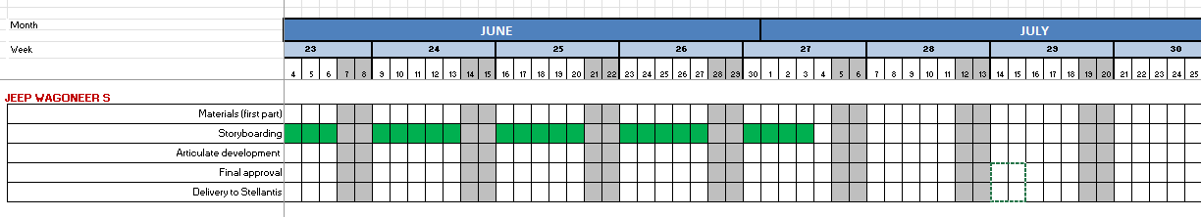
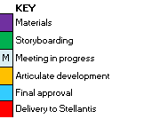
New Wagoneer S – WBT (Barbirato)
Storyboard with graphic layout was delivered to Product Managers on July 03rd to be checked.
Some changes are waited form U.S.
We are waiting for more changes.

Slide 3
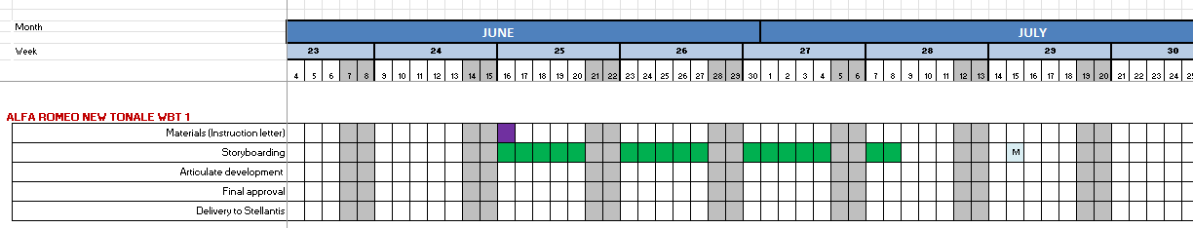
ALFA ROMEO NEW TONALE (Barbirato)
Synopsis of the wbt has been agreed
Storyboarding was delivered to PM on July 8.
Changes were sent on July 14th meeting in progress on July 15th

Slide 4
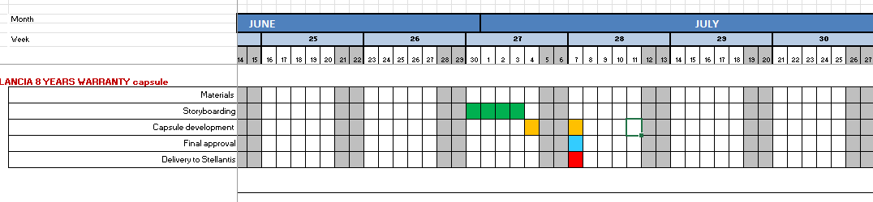
LANCIA 8 YEARS WARRANTY capsule (Barbirato)
Capsule approved and delivered on July 7th.

Slide 5
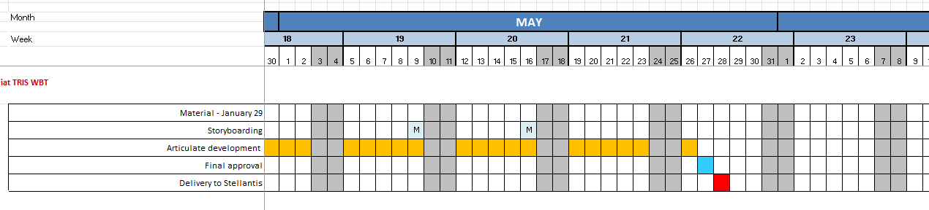
FIAT TRIS WBT (D’Aquino)
All the images of the vehicles have been changed according to the new updated instruction letter received from PM.
The WBT has been completed and delivered on the 28th of May.
The French version was delivered on June 9th

Slide 6
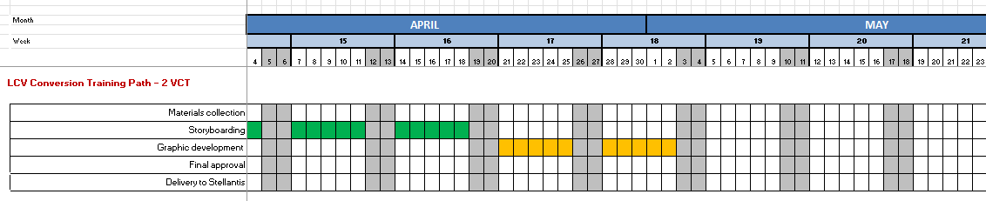
LCV Conversion Training Path – VCT (D’Aquino)
Request received: VCT of about 75 minutes
Storyboarding with graphic layout delivered.
We are waiting for the storyboard approval.
VCT postponed to September
Shooting of Conversion vehicles in Balocco was done on July 2nd

Slide 7
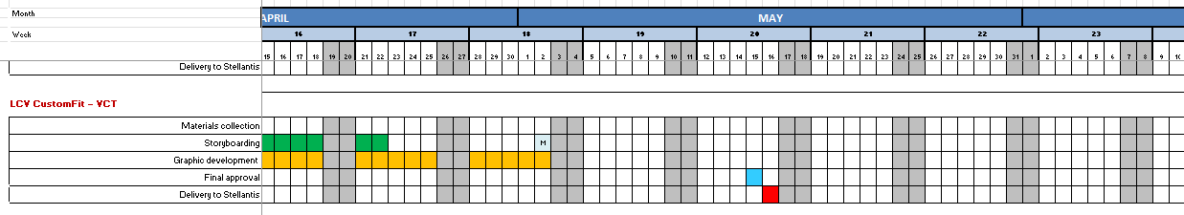
LCV CustomFit – VCT (D’Aquino)
Storyboarding and graphic development in progress, waiting for final approval of the tool screenshots.
Stop working on this module on May 2 because France is changing the VCT material.
We are waiting for new approved material about Custom Fit tool, some change will be needed.
Final delivery will be postponed.

Slide 8
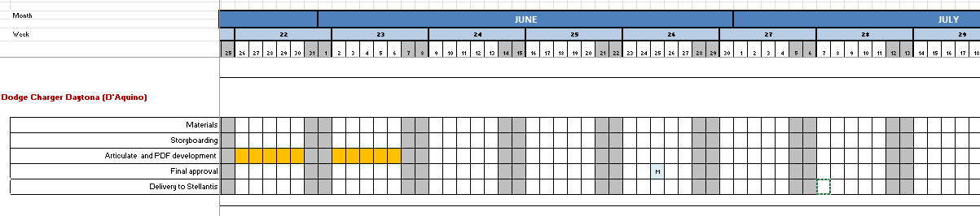
Dodge Charger Daytona– WBT (D’Aquino)
Storyboard completed and approved.
Articulate and PDF versions completed.
Waiting for some minor changes

Slide 9
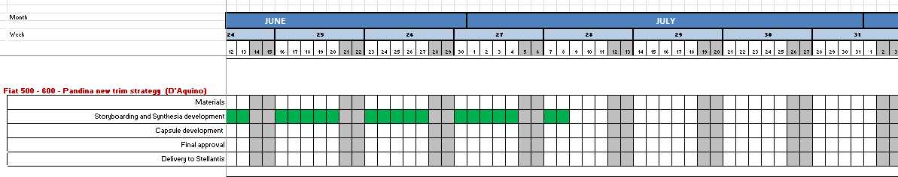
Fiat 500e - 600 - Pandina new trim strategy – Capsule + synthesia (D’Aquino)
Fiat 500e – 600 - Panda storyboards completed.
Synthesia and Beedeez versions completed.
Waiting changes by PM

Slide 10
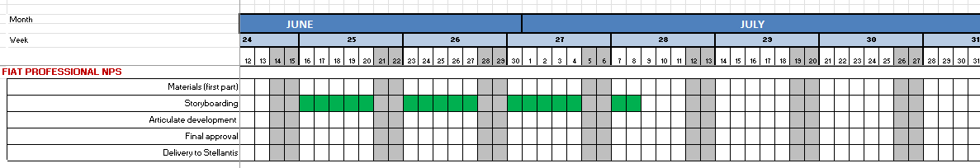
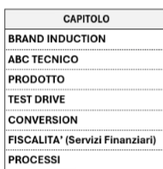
FIAT PROFESSIONAL NSP (D’Aquino)
Storyboards in progress.
Delivery deadline in September

Slide 11
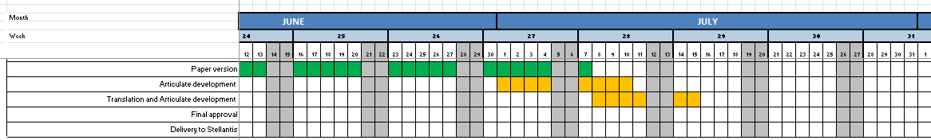
SALES METHOD (D’Aquino)
The project is composed by 2 versions: a paper copy and a WBT.
Paper version was delivered on July 7
WBT English development was completed on July 7th
WBT development in other languages will be completed on July 15th
We are waiting for videos in foreign languages

Slide 12
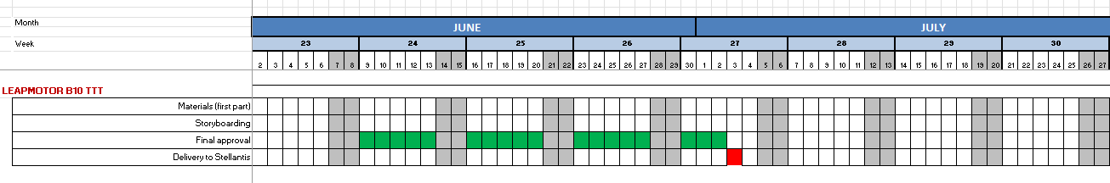
Leapmotor B10 – TTT (Barbirato)
Storyboarding and Pedagogical is in progress.
The TTT deadline is confirmed on July 3rd.

Slide 13
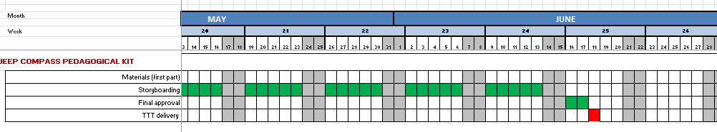
Jeep Compass Pedagogical Kit (Barbirato)
TTT was delivered on June 18th.

Slide 14
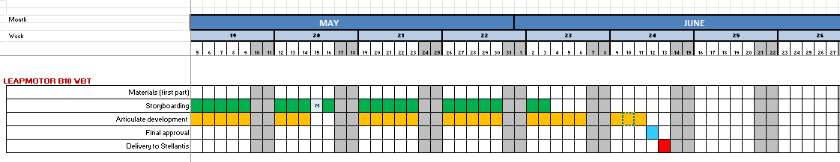
Leapmotor B10 – WBT (Barbirato)
The WBT has been completed and delivered on the 13rd of June.

Slide 15
Purchase orders
PURCHASE ORDER 31381148 |  | Invoice issued Q1 | To be invoiced
Variable costs Q1 | 312.413,00 | 65.289,80 | 247.123,20
Variable costs Q2 | 312.413,00
Variable costs Q3 | 312.412,00
Variable costs Q4 | 312.412,00
TOTAL ORDER | 1.249.650,00
Invoces issued
KOINE 012/2025 |  | 4.800,00
KOINE 014/2025 |  | 60.489,80
Total |  | 65.289,80

Slide 16
Purchase orders
PURCHASE ORDER 31381147 |  | Invoice issued Q1
Ex F Product training development - Fixe | 238.500,00 | 47.556,92
Amount order Q1 and Q2 | 119.250,00 | -47.556,92 | 71.693,08
Can we invoice the amount until June?
Invoces issued
KOINE 013/2025 Jan-March |  | 35.268,65
KOINE 015/2025 April |  | 12.288,66
 |  | 47.557,31
NEXT KOINE 0XX/2025 May |  | 13.832,91
 |  | 61.390,22

Slide 17
Purchase orders
PURCHASE ORDER 31381148 |  | Invoice issued Q1 | To be invoiced
Variable costs Q1 | 312.413,00 | 65.289,80 | 247.123,20
Variable costs Q2 | 312.413,00
Variable costs Q3 | 312.412,00
Variable costs Q4 | 312.412,00
TOTAL ORDER | 1.249.650,00
PURCHASE ORDER 31381147 |  | Invoice issued Q1 | To be invoiced
Ex F Product training development - Fixe | 238.500,00 | 47.556,92 | 190.943,08
Can we invoice the amount until June? |  |  | 71.963,08

Slide 18
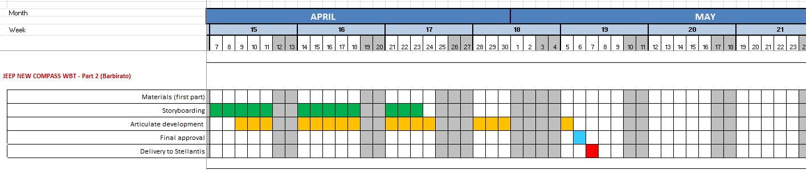
JEEP NEW COMPASS WBT - Part 2 (Barbirato) - WBT completion (Part 2 with focus on Style, Recharge, competitors)
The WBT has been completed and delivered on the 7th of May.

Slide 19
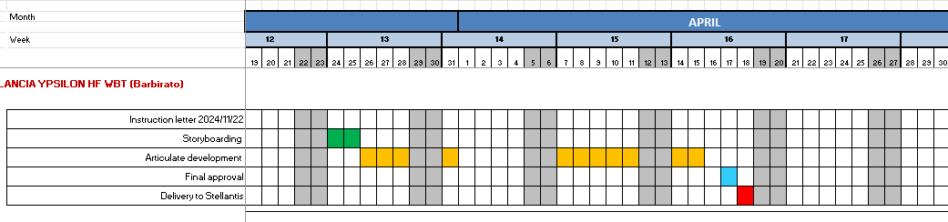
LANCIA YPSILON HF WBT (Barbirato)
The WBT has been completed and delivered.

Slide 20
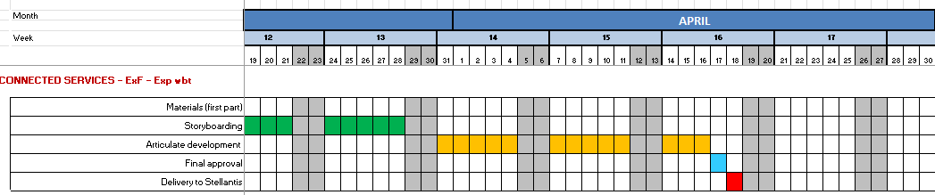
Connected Services - 1 WBT ExF Brands 1 WBT ExP Brands (Barbirato)
The WBTs have been completed and delivered.

Slide 21
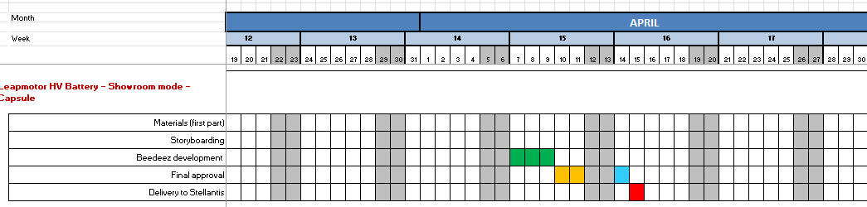
Leapmotor HV Battery - Showroom mode - capsule (Barbirato)
The capsule has been completed.

Slide 22
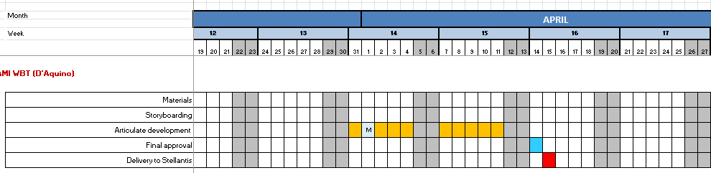
CITROËN AMI WBT (D'Aquino)
The WBT has been completed and delivered.

Slide 23
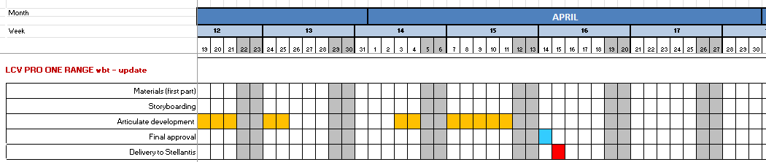
LCV PRO ONE RANGE Induction (D’Aquino)
New changes have been done.
The WBT has been completed and delivered.

Slide 24
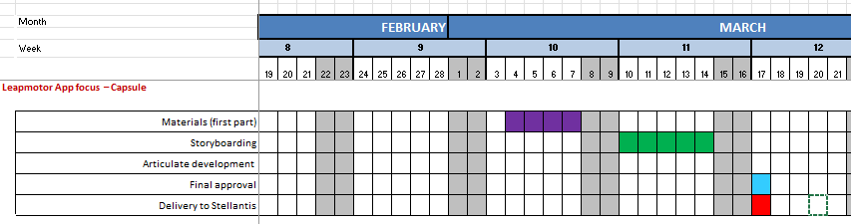
Leapmotor App focus - Memento inside My Learning App (Barbirato)
Capsule delivered

Slide 25
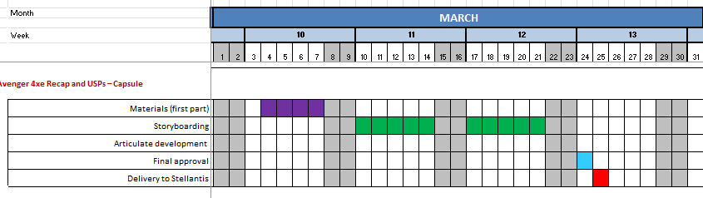
Jeep Avenger 4xe Recap and USPs – Capsule (Barbirato)
Capsule delivered
Memento file for markets not using Beedeez is in progress

Slide 26
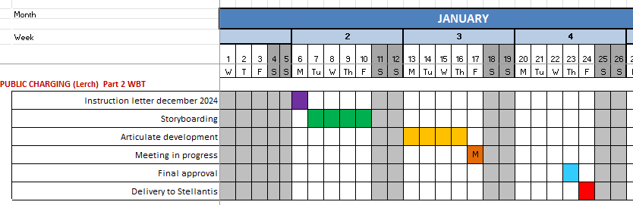
PUBLIC CHARGING WBT (Lerch) Part 2 WBT
Project concluded
Final memento development in progress

Slide 27
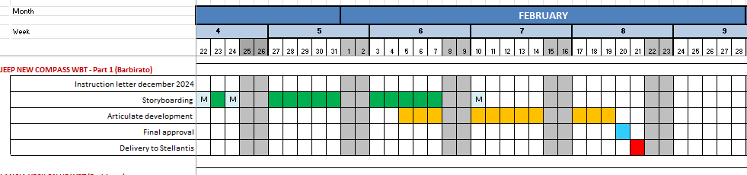
JEEP NEW COMPASS WBT - Part 1 (Barbirato)
Storyboard has been approved by PM.
The SCORM pack has been delivered

Slide 28
THANK YOU FOR YOUR ATTENTION

Slide 29
Meanwhile we are working on innovations and multimedia solutions.
As salespeople are working in a fast world full of meeting and deadlines, we are creating with Renzo and Dario some short and focused training videos designed to busy people who want to learn smartly with ready-to-use contents and practical tips.
These micro-videos of maximum 7 minutes with avatar tutors will explain some specific topics in a summarized way with focus on practical competences.
In this way we can produce more engaging, less textual materials suitable for faster and more engaging use

