Slide 1

OPERATING SITUATION OF TRAINING PROJECTS
March 18th 2026
Koinè s.n.c
Via Fornasio, 5 - 10092 Beinasco (TO) ITALY
Phone: 011.397.10.99 - Mobile: 335.6896974
e-mail: koine@koine.it

Slide 2
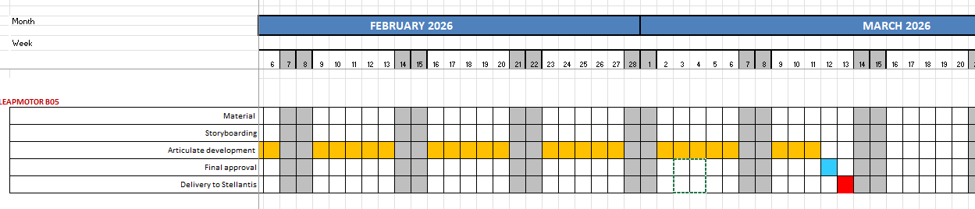
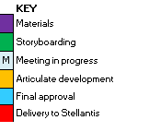
LEAPMOTOR B05 - WBT (Barbirato)
Development of new graphic layout inspired by the Leapmotor video: new character design and gamification to be approved. The learner should pass various levels of informations to acquire the vehicle knowledge.
Delivery om March 13

Slide 3
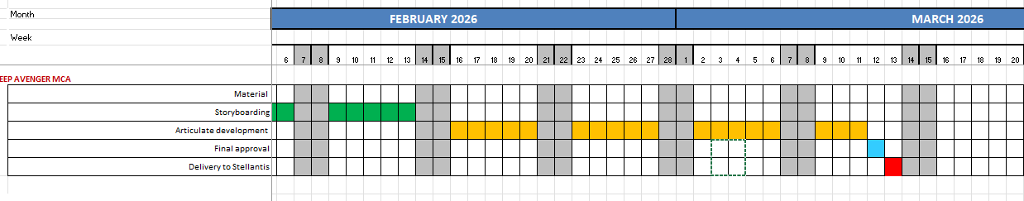
JEEP AVENGER MCA - WBT (Barbirato)
Graphic proposals approved on January 19th
Storyboarding in progress to be approved by brand
Development in progress to be approved by Brand
Delivery postponed to March 13th

Slide 4
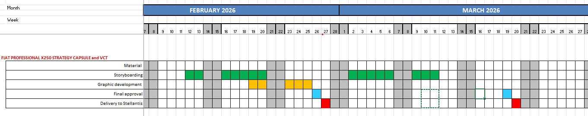
FIAT PROFESSIONAL X250 STRATEGY VCT (D'Aquino)
Capsule delivered on February 3rd
VCT storyboarding to be approved
VCT material delivery postponed

Slide 5
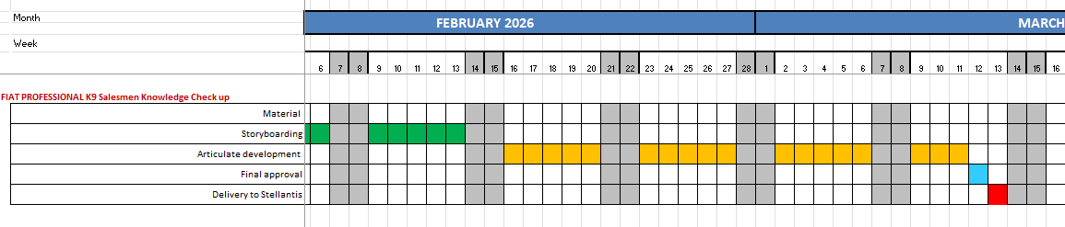
FIAT PROFESSIONAL K9 Salesmen Knowledge Check up WBT
FIAT PROFESSIONAL K0 Salesmen Knowledge Check up WBT (D'Aquino)
The course concept is based on the principle of a treasure hunt (chasse au trésor).
The learner will interact with questions/instructions shown in the driver compartement until she/he finds the vehicle key hidden somewhere in the vehicle.
By solving a series of challenges, he will practice her/his knowledge of the K9 vehicle and get ready to provide the best service to customers.
WBT delivery waiting for approval
K0 wbt index sent for approval

Slide 6
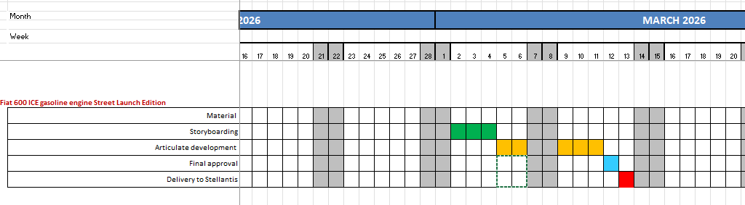
Fiat 600 ICE gasoline engine Street Launch Edition WBT (Barbirato)
Storyboarding and Storyline development in progress
Testing area sent for approval.
Waiting for added pages and changes.
WBT delivered on March 13th

Slide 7
INDUCTION COURSES (Barbirato – D'Aquino - Lerch)
LEAPMOTOR T03 – C10 – B10 – SCORM delivered
ALFA ROMEO GIULIA – STELVIO – QUADRIFOGLIO SCORM delivered
ALFA ROMEO JUNIOR SCORM delivered
ALFA ROMEO TONALE SCORM delivered
LANCIA Ypsilon SCORM delivered
JEEP Avenger SCORM delivered
JEEP Compass SCORM delivered
FIAT Topolino SCORM delivered
FIAT Pandina SCORM delivered
FIAT Grande Panda SCORM delivered
Fiat 500e & Hybrid SCORM delivered
Fiat 600e & Hybrid SCORM delivered
ABARTH 500e SCORM delivered
ABARTH 600° SCORM delivered
Connected Services exF – exP SCORM delivered
Home_public_charging_solutions SCORM delivered
Intro to LEV SCORM delivered
FIAT PROFESSIONAL RANGE (3 courses) SCORM delivered
FIAT PROFESSIONAL PASSENGER CARS SCORM delivered
LCV CONNECTED SERVICES SCORM delivered
All courses will be composed of an initial test:
If participants fail it, they are obliged to take the course
if participants pass it, they can exit or review the course
Delivery scheduled on mid-January 2026

Slide 8
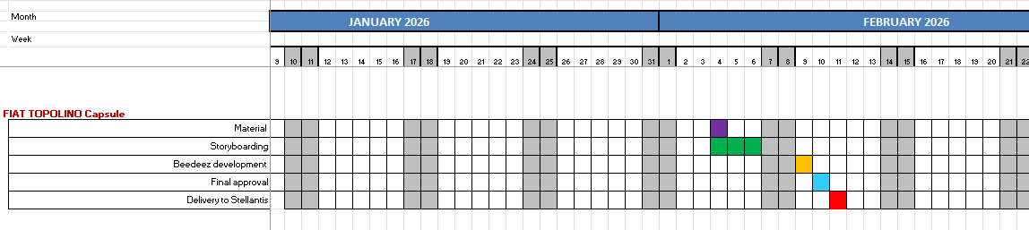
FIAT TOPOLINO capsule (Barbirato )
Storyboarding approved
Capsule development in progress
Delivery scheduled on February 13th
Delivered on February 10th

Slide 9
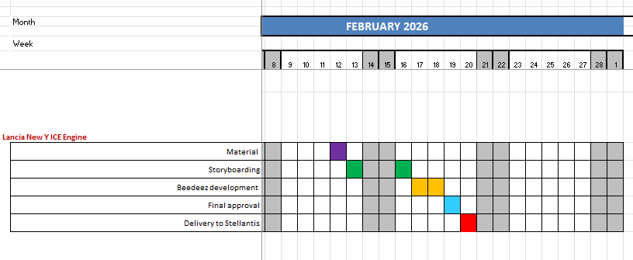
Lancia New Y ICE Engine capsule (Barbirato )
Storyboarding approved
Capsule development in progress
Delivery scheduled on February 20th

Slide 10
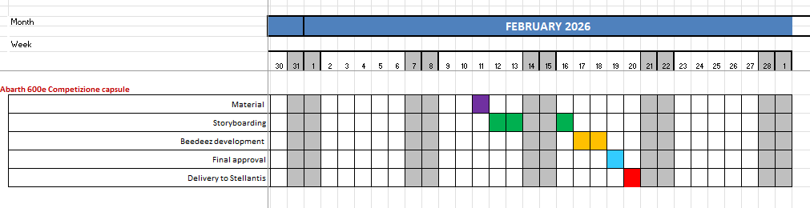
Abarth 600e Competizione capsule (Barbirato )
Storyboarding approved
Capsule development in progress
Delivery scheduled on February 20th

Slide 11
June accounting situation PURCHASE ORDER 31381148
PURCHASE ORDER 31381148
Variable costs Q1 | 312.413,00
Variable costs Q2 | 312.413,00
Variable costs Q3 | 312.412,00
Variable costs Q4 | 312.412,00
 | 1.249.650,00
Projects
 | Barbirato | 740.422,20
 | D'Aquino | 489.227,80
 | Lerch | 20.000,00
INVOICES ISSUED
KOINE 012/2025 March |  |  | 4.800,00
KOINE 014/2025 April |  |  | 60.989,80
KOINE 018/2025 June KOINE 020/2025 July KOINE 023/2025 September KOINE 031/2025 December |  |  | 246.623,20 312.413,00 312.412,00 226.539,80
Total amount invoiced |  |  | 1.163.777,80
Remaining amount to be invoiced |  |  | 85.873,20

Slide 12
June accounting situation PURCHASE ORDER 31381148
PROJECTS included in invoice 012_2025 Euro 4.800,00 BARBIRATO
5 | JEEP Avenger 4xe Recap and USPs | 1.000,00
9 | Leapmotor focus App Memento | 3.800,00
 | Amount | 4.800,00

Slide 13
June accounting situation PURCHASE ORDER 31381148
PROJECTS included in invoice 014_2025 Euro 60.989,80
 | BARBIRATO
10 | Leapmotor HV Battery capsule | 1.000,00
3 | 2025 Connected Services Overall Update ExF Brands | 19.600,00
4 | 2025 Connected Services Overall Update ExP Brands | 14.500,00
 | D'AQUINO
1 | Citroën Ami | 19.408,00
14 | Stellantis ProOne Range | 6.481,80
 | Amount | 60.989,80

Slide 14
June accounting situation PURCHASE ORDER 31381148
PROJECTS included in invoice 018_2025 Euro 246.623,20
 | BARBIRATO
8 | New Compass part 2 | 14.100,00
12 | Leapmotor B10 Launch WBT | 19.600,00
15 | Lancia 8 years Warranty | 1.000,00
16 | C10 REEV capsule | 1.000,00
17 | C10 REEV video | 3.900,00
18 | Alfa 33 Stradale | 1.000,00
19 | AR Logo 115° Anniversary | 1.000,00
20 | Jeep Renegade capsule | 1.000,00
21 | Connected Services ExP pill | 1.000,00
22 | Connected Services ExF pill | 1.000,00
24 | New Compass Pedagogical Kit with TTT | 74.500,00
25 | Leapmotor B10 Pedagogical Kit with TTT | 74.500,00
28 | Memo File x 33 Stradale Brand Ambassador | 2.700,00
29 | Leapmotor C10 REEV Energy Modes VCT | 14.700,00
 | Amount | 211.000,00
D'AQUINO
32 | FIAT 500 trim strategy | 5.000,00
33 | Pandina trim strategy | 5.000,00
34 | FIAT 600 trim strategy | 5.000,00
35 | FIAT 8 years warranty | 1.623,20
41/41 | Ami Handover + video | 10.000,00
42 | TRIS Handover memento | 9.000,00
 | Amount | 35.623,20
Total Amount Euro 246.623,20

Slide 15
Accounting situation PURCHASE ORDER 31381148
PROJECTS included in invoice 020_2025 Euro 312.413,00 BARBIRATO
D’AQUINO
2 | FIAT PRO 3-WHEELER | 19.513,00
6 | CustomFit WBT | 19.600,00
7 | Conversion Training Path 2 VCT | 39.200,00
13 | Dodge Charger Daytona | 19.538,00
31 | LCV Induction update | 29.400,00
36 | LCV connect services | 19.600,00
37 | LCV F2move pillars (FOUR) | 4.000,00
38 | LCV taxation wbt | 19.600,00
39 | Sales methods quick guide WBT | 19.600,00
40 | Sales methods quick guide BROCHURE | 6.000,00
43 | DODGE video shooting | 5.712,00
76 | 8-YEARS WARRANTY + service contracts LCV | 19.600,00
89 | Opel Induction WBT for passenger car of K9 and K0 - starting from Product induction 2025 | 10.000,00
90 | Peugeot Induction WBT for passenger car of K9 and K0 - starting from Product induction 2025 | 10.000,00
91 | Citroen Induction WBT for passenger car of K9 and K0 - starting from Product induction 2025 | 10.000,00
92 | Fiat Induction WBT for passenger car of K9 and K0 - starting from Product induction 2025 | 10.000,00
93 | WBT for Service people, how to activate the 8year warranty (Andy) | 19.600,00
 | Total amount | 280.963,00
30 | Alfa Romeo 8 years Warranty | 1.000,00
45 | Connected Services i-DOUV capsule | 1.000,00
77 | leapmotor 5 motion animation videos | 11.000,00
80 | Fiat 500e - HYBRID | 18.450,00
 | Amount | 31.450,00
Total Amount Euro 312.413,00

Slide 16
Accounting situation PURCHASE ORDER 31381148
PROJECTS included in invoice 023_2025 Euro 312.412,00
 | BARBIRATO
11 | Jeep Wagoneer S Launch WBT | 18.900,00
23 | Connected Services Videos (4 ExF by 9 languages) | 7.000,00
26 | Jeep New Compass Handover Memento | 9.000,00
27 | Leapmotor B10 Handover Memento | 9.000,00
44 | Alfa Romeo New Tonale part 1 | 18.200,00
46 | Jeep Avenger MY 26 & Safety update capsule | 1.000,00
47 | Leapmotor C10 AWD 6 800v battery capsule | 1.000,00
48 | Connected Services App Market capsule | 1.000,00
49 | Connected Services FLEET Management Platform | 1.000,00
50 | AR Junior MY'26 | 1.000,00
51 | Jeep 8 Years Warranty | 1.000,00
52 | AR Junior Serie Speciale | 1.000,00
53 | C.S. New EV features ExP | 1.000,00
54 | C.S. New EV features ExP | 1.000,00
55 | Jeep Compass Altitude capsule | 1.000,00
56 | Fiat 600 MY26 | 18.300,00
57 | FIAT GRANDE PANDA MY 26 capsule | 1.000,00
58 | AR Tonale MCE Launch WBT Part 2 | 19.400,00
59 | AR Tonale MCE Pedagogical Kit | 14.700,00
60 | AR Tonale MCE Pedagogical Kit | 19.600,00
61 | FIAT 500 HYBRID TORINO capsule | 1.000,00
62 | Leapmotor B10 with REEV Technology | 17.500,00
63 | 2025 C.S. Update VCT ExP | 19.600,00
64 | 2025 C.S. Update VCT ExF | 14.500,00
66 | Video Ficili shooting | 5.000,00
67 | Video Ficili x Synthesia | 4.000,00
78 | Shooting and animation post-production | 9.000,00
79 | Caps on AR Junior e Tonale SS Sport Speciale | 1.000,00
81 | AR Leaflet x Brand Ambassador | 500,00
84 | Capsule on Avenger SS Black Edition Pill | 1.000,00
 | Amount | 218.200,00
 | D'AQUINO
65 | Nuovo motore K0 - 2 pill + memento | 9.000,00
65 | Price list 5 pill | 5.000,00
68 | WBT on lcv technical bases | 19.600,00
69 | WBT ALLESTIMENTI BASE | 19.600,00
70 | Sales methods quick guide for B2B | 19.600,00
71 | Sales methods quick guide for Managers | 19.600,00
74 | EOT pills (from SFS) | 1.812,00
 | Amount | 94.212,00
Total amount Euro 312,412,00

Slide 17
Accounting situation PURCHASE ORDER 31381148
PROJECTS included in invoice 031_2025 Euro 226.539,80
 | BARBIRATO
82 | INDUCTION Product WBTs Update ExF Brands + Connected Services | 170.000,00
85 | Pill on Grande Panda with 1.2 engine MT gearbox | 1.000,00
86 | Pill on C.S. ExF EVAS system | 1.000,00
87 | Pill on C.S. ExP "New Activation Process" | 1.000,00
88 | Pill on Abarth 600e S.S. Competizione | 1.000,00
 | Amount | 174.000,00
 | D'AQUINO
72 | Knowledge chek by microlearning | 5.000,00
73 | VCT on behaviour for the NSP | 19.600,00
75 94 | LCV product indution update - 3 courses, K9 - K0 - X250 LCV X250 TRIM STRATEGY | 10.000,00 17.939,80
 | Amount | 52.539,80
Total amount Euro 226.539,80

Slide 18
Accounting situation PURCHASE ORDER 31381148
PROJECTS included in invoice TO BE ISSUED Euro 85.850,00
 | BARBIRATO
95 | INDUCTION Connected Services exF exP | 19.400,00
96 | Leapmotor B05 | 19.300,00
97 | ALFA ROMEO Giulia Luna rossa | 1.000,00
98 | Lancia Ypsilon ICE MT | 1.000,00
99 | Jeep Summit 4xe | 1.000,00
100 | Alfa Romeo Tonale Handover memento 1st part | 4.922,20
101 | Jeep Avenger mca 2026 | 19.250,00
 | Amount | 65.872,20
 | LERCH
95 | INDUCTION (Barbirato/Lerch) | 20.000,00
 | Amount | 20.000,00
Total amount Euro 85.873,20

Slide 19
June accounting situation PURCHASE ORDER 31381147
PURCHASE ORDER 31381147 |  | 238.500,00
Invoices issued by Koinè
KOINE 013/2025 March |  | 35.268,65
KOINE 015/2025 April |  | 12.288,66
KOINE 019/2025 May-June |  | 71.692,69
KOINE 021/2025 August |  | 23.850,00
KOINE 024/2025 Sept |  | 23.850,00
KOINE 025/2025 Oct |  | 23.850,00
KOINE 029/2025 Nov Dec |  | 13.848,65
Invoices issued |  | 204.648,65
Order remaining amount not invoiced |  | 33.851,35
Total 2025 amount |  | 206.466,30
Total 2025 amount to be invoiced |  | 1.817,65
1st months 2026 amount to be invoiced 31.512,02
Remaining amount to be invoiced 33.329,67

Slide 20
June accounting situation PURCHASE ORDER 31381147
ACTIVITY DONE
Month | ACTIVITY | DAYS | COST X DAY (€) | TOTAL | MANAGER | PRICE (€)
January-February-March | GOVERNANCE ACCOUNT MANAGEMENT ACTIVITY | 1st quarter 2025 |  |  |  | 20.000,00
January-February-March | JUNIOR PROJECT MANAGEMENT ACTIVITY (Lavinia Crivellari) | 4+20+21 | 295,18 | 13.283,10 | D'Aquino | 13.283,10
March | SENIOR PROJECT MANAGEMENT ACTIVITY (Stefano Genovesio) | 6 | 363,53 | 2.181,18 | Barbirato | 2.181,18
April | JUNIOR PROJECT MANAGEMENT ACTIVITY (Lavinia Crivellari) | 21 | 295,18 | 5.018,06 | D'Aquino | 6.198,78
April | SENIOR PROJECT MANAGEMENT ACTIVITY (Stefano Genovesio) | 20 | 363,53 | 7.270,60 | Barbirato | 7.270,60
April May June | GOVERNANCE ACCOUNT MANAGEMENT ACTIVITY | 2st quarter 2025 |  |  |  | 20.000,00
May - June - july | JUNIOR PROJECT MANAGEMENT ACTIVITY (Lavinia Crivellari) | 20+20+23 | 295,18 | 18.596,34 | D'Aquino | 18.596,34
May - June - july | SENIOR PROJECT MANAGEMENT ACTIVITY (Stefano Genovesio) | 20+20+20 | 363,53 | 21.811,80 | Barbirato | 21.811,80

Slide 21
June accounting situation PURCHASE ORDER 31381147
ACTIVITY DONE
Month | ACTIVITY | DAYS | COST X DAY (€) | TOTAL | MANAGER | PRICE (€)
July- August-September | GOVERNANCE ACCOUNT MANAGEMENT ACTIVITY | 3rd quarter 2025 |  |  |  | 20.000,00
August-September | JUNIOR PROJECT MANAGEMENT ACTIVITY (Lavinia Crivellari) | 11+21 | 295,18 | 9.445,76 | D'Aquino | 9.445,76
August-September | SENIOR PROJECT MANAGEMENT ACTIVITY (Stefano Genovesio) | 11+21 | 363,53 | 11.632,96 | Barbirato | 11.632,96
October- November-December | GOVERNANCE ACCOUNT MANAGEMENT ACTIVITY | 4th quarter 2025 |  |  |  | 20.000,00
October- November-December | JUNIOR PROJECT MANAGEMENT ACTIVITY (Lavinia Crivellari) | 23+20+20 | 295,18 | 18.596,34 | D'Aquino | 18.596,34
October- November | SENIOR PROJECT MANAGEMENT ACTIVITY (Stefano Genovesio) | 23+20+5 | 363,53 | 17449,44 | Barbirato | 17.449,44
Total amount of 2025 |  | 206.466,30

Slide 22
June accounting situation PURCHASE ORDER 31381147
ACTIVITY 1ST QUARTER 2026
Month | ACTIVITY | DAYS | COST X DAY (€) | TOTAL | MANAGER | PRICE (€)
January | JUNIOR PROJECT MANAGEMENT ACTIVITY (Lavinia Crivellari) | 19 | 295,18 | 5.608,42 | D'Aquino | 5.608,42
February | JUNIOR PROJECT MANAGEMENT ACTIVITY (Lavinia Crivellari) | 20 | 295,18 | 5.903,60 | D'Aquino | 5.903,60
1st quarter 2026 | GOVERNANCE ACCOUNT MANAGEMENT ACTIVITY | 1st quarter 2026 |  |  |  | 20.000,00
Total amount first months 2026 |  | 31.512,02

Slide 24
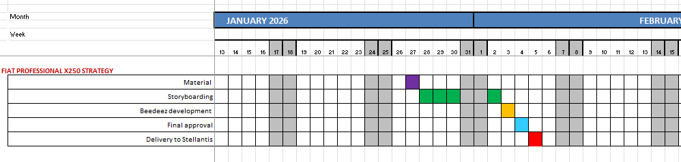
FIAT PROFESSIONAL X250 STRATEGY (D'Aquino)
Storyboarding approved
Capsule developed on January 3rd
Delivered on February 5th

Slide 25
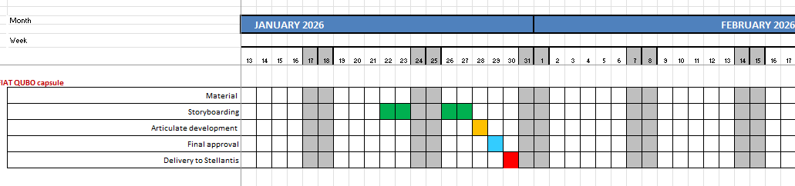
FIAT QUBO L capsule (Barbirato)
Capsule delivered on on January 30th

Slide 26
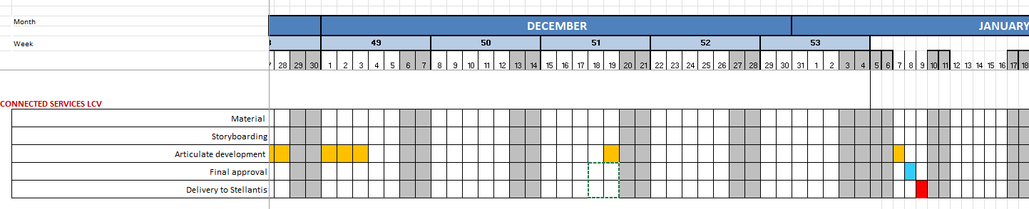
CONNECTED SERVICES LCV - WBT (D’Aquino)
Storyboard with graphic proposals delivered on October 20th
Waiting for Brand approval to develop the online version
Received new changes on November 14th
Testing area for approval sent on January 7th
Delivered on January 9th

Slide 27
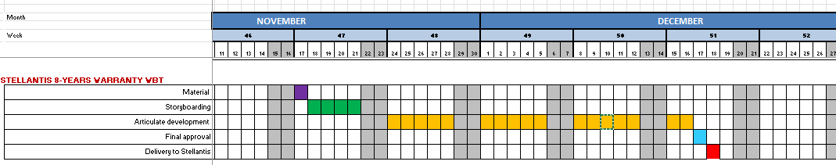
STELLANTIS 8-YEARS WARRANTY WBT (D’Aquino)
Material received on November 17th
Storyboard changes received on November 25th
Storyboard changes received on December 4th
More changes received on December 15th
Delivery scheduled on December 18th

Slide 28
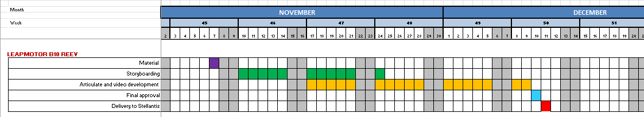
LEAPMOTOR B10 REEV WBT (Barbirato)
Storyboarding concluded and sent to Leapmotor PM for final approval.
Development of video and course in progress
Delivery on December 11th

Slide 29
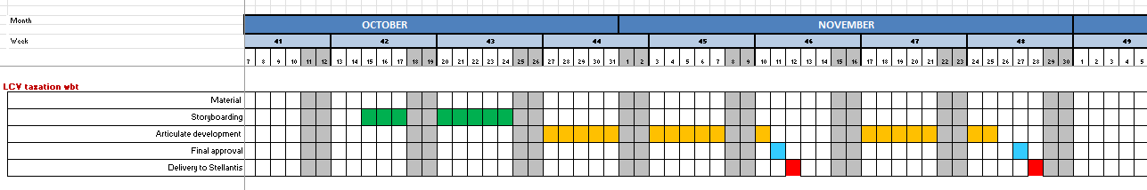
LCV TAXATION WBT (D’Aquino)
Graphic layout and storyboard approved
First delivery on November 13th
New changes required on November 18th and 24th
Delivery postponed to November 28th

Slide 30
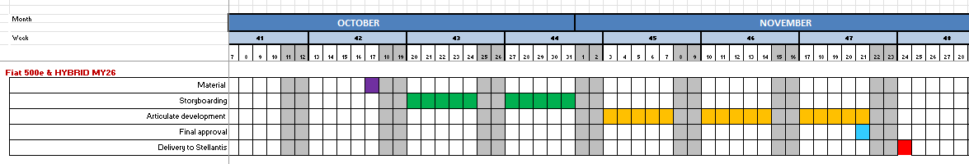
Fiat 500e & HYBRID MY26 WBT (Barbirato)
Graphic proposal was chosen:
Storyboarding in progress.
Embargo until November 21st
Delivery on November 24th

Slide 31
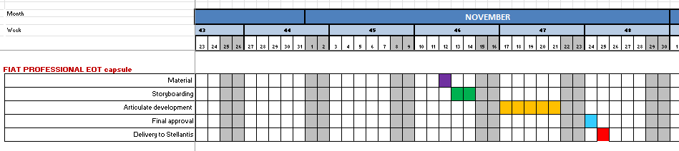
FIAT PROFESSIONAL EOT (End of term) capsule (D’Aquino)
Material received on November 12nd
Course composed of a video and a PDF document to maximize the customer loyalty to be delivered in 2 formats: Articulate Rise and Beedez capsule
Delivery scheduled on November 25th

Slide 32
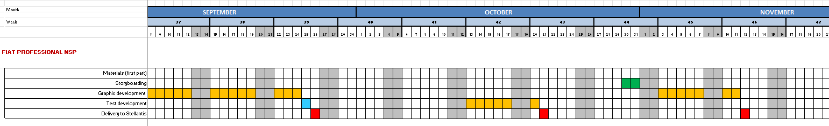
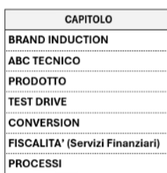
FIAT PROFESSIONAL NSP (D’Aquino)
Italian and English versions were delivered on October 1st.
Final tests (Beedeez and Articulate) added and delivered on October 21st
A new section (LCV SALES METHODS AND BEHAVIOURS) has been added
Delivered on November 12th

Slide 33
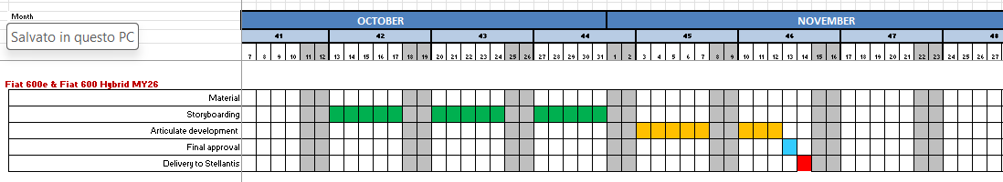
Fiat 600e & Fiat 600 Hybrid MY26 WBT (Barbirato)
Graphic proposal was chosen and storyboard was approved.
Embargo until November 11th
Delivered on November 14th

Slide 34
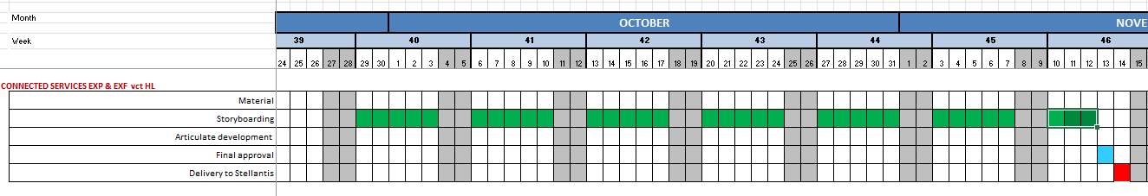
CONNECTED SERVICES EXP & EXF VCT HL (Barbirato)
VCT storyboards in progress
Delivery on November 14th

Slide 35
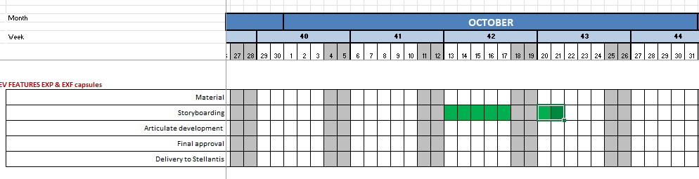
EV FEATURES EXP & EXF capsules (Barbirato)
Capsule development in progress
Delivery scheduled on October 20th

Slide 36
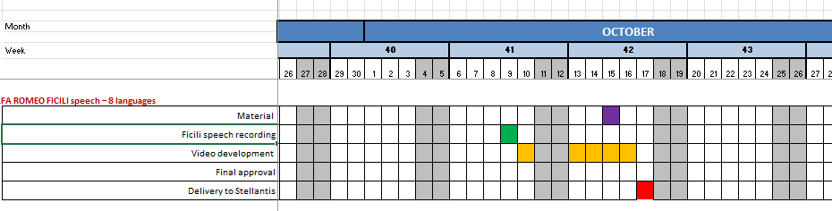
ALFA ROMEO FICILI speech – 8 languages (video)
Mr. Ficili speech recording on October 9th
Video development
Italian video delivered on October 16th
Translation made into 7 languages (EN-FR-DE-ES-NL-PL)
Video delivered with subtitles in AT- BFR-BNL-DE-EN-ES-DE-IT-NL-PL-PT languages on October 23rd

Slide 37
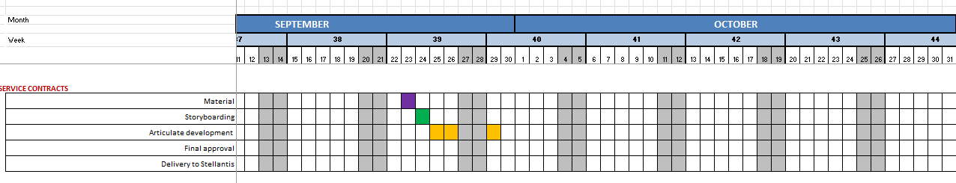
SERVICE CONTRACTS wbt (D’Aquino)
Storyboarding with graphic proposals and articulate testing area delivered on September 29th
The course will have 3 versions: English, French and Dutch versions due to the different contents for the markets.
Delivered on October 24.

Slide 38
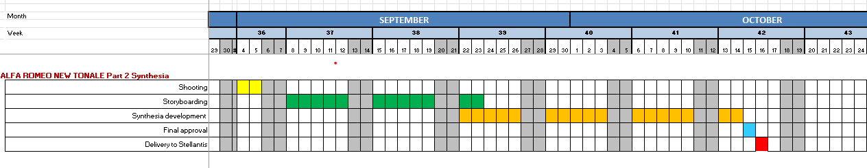
ALFA ROMEO NEW TONALE PART 2 (Synthesia – WBT ) (Barbirato)
Videos and WBT delivered on October 16th

Slide 39
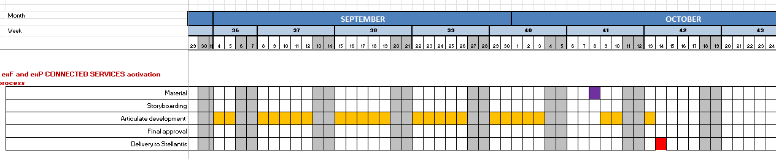
exF and exP CONNECTED SERVICES activation process capsules – all brands / 9 languages (Barbirato)
Development of 80 capsules with videos for Abarth – Alfa Romeo – Fiat – Jeep – Citroën – DS – Peugeot
Waiting for new videos to replace the old ones.
Delivered on October 20th

Slide 40
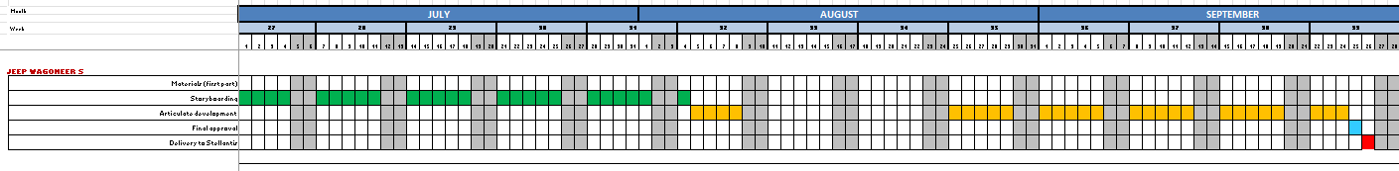
New Wagoneer S – WBT (Barbirato)
Storyboard with graphic layout was delivered to Product Managers on July 03rd and checked.
Some changes received from U.S. and made.
Storyboarding of Connected Services updated
Storyline development and testing area delivery on September 10th.
Delivery postponed to 2026

Slide 41
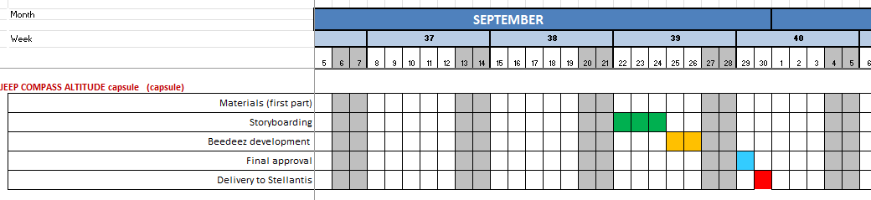
JEEP COMPASS ALTITUDE capsule (Barbirato)
Storyboard and Beedeez development concluded.
Delivered on September 30th.

Slide 42
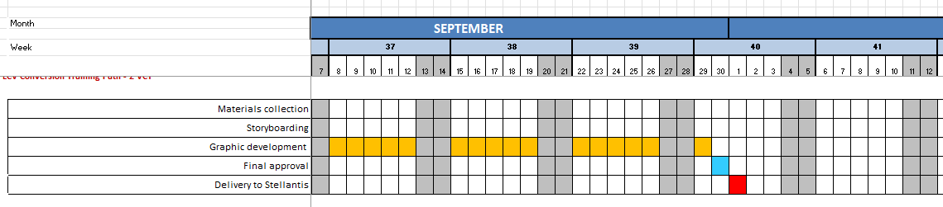
LCV Conversion Training Path – VCT (D’Aquino)
VCTs delivered on October 1st

Slide 43
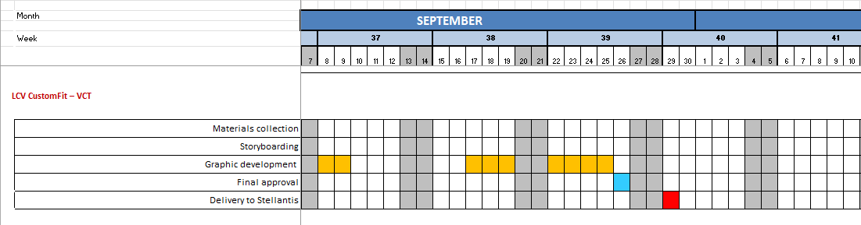
LCV CustomFit – VCT (D’Aquino)
Storyboarding and graphic development in progress, waiting for final approval of the tool screenshots.
Stop working on this module on May 2 because France is changing the VCT material.
We are waiting for new approved material about Custom Fit tool.
Some changes required on September 8th and 22nd
VCT delivered on September 29th

Slide 44
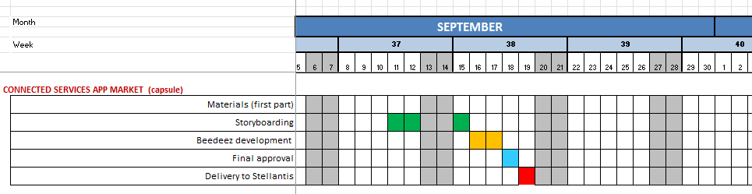
CONNECTED SERVICES APP MARKET capsule (Barbirato)
Storyboard and Beedeez development in progress
Delivered on September 23th.

Slide 45
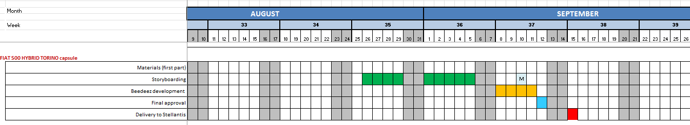
FIAT 500 HYBRID TORINO capsule (Barbirato-Perino)
Storyboard and Memento delivered on August 29
Waiting for approval meeting
Update with images (end of embargo) on September 18th
Delivered on September 18th

Slide 46
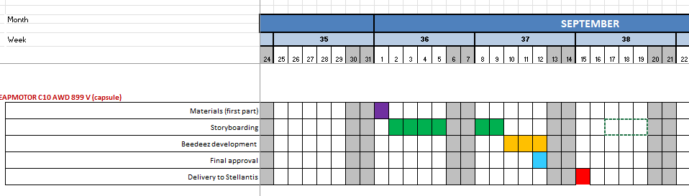
LEAPMOTOR C10 AWD 800 V (capsule) (Barbirato)
Storyboarding in progress
Delivered on September 18th

Slide 47
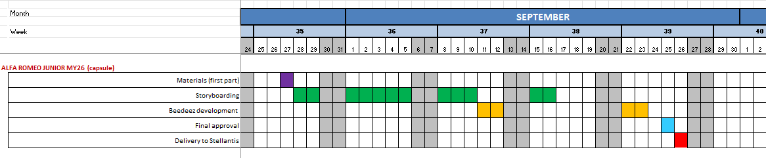
ALFA ROMEO JUNIOR MY26 (capsule) (Barbirato)
Storyboarding and Beedeez development in progress
Changes required
Delivery scheduled on September 25th

Slide 48
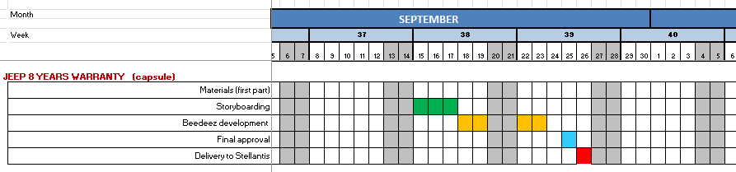
JEEP 8 YEARS WARRANTY capsule (Barbirato)
Storyboard and Beedeez development in progress
Delivery scheduled on September 25th.

Slide 49
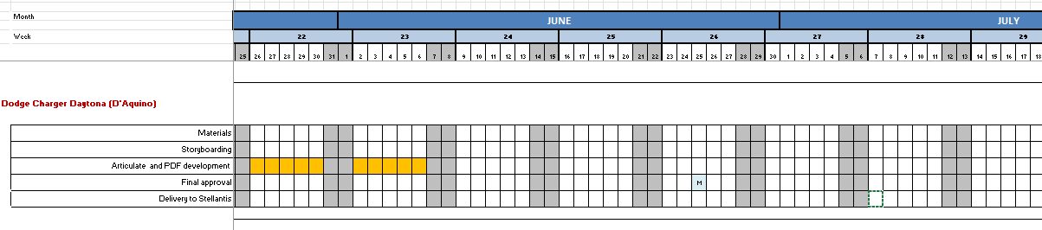
Dodge Charger Daytona– WBT (D’Aquino)
Storyboard completed and approved.
Articulate and PDF versions completed on June 18th
Waiting for some minor changes for 8 years warranty
VCT delivery postponed to end of September

Slide 50
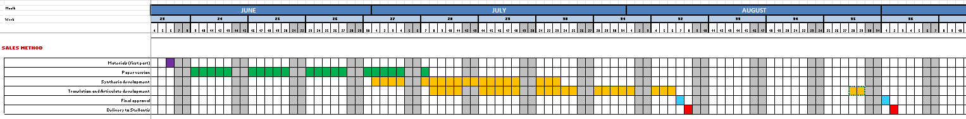
SALES METHOD (D’Aquino)
WBT development completed for Belgium, France, Germany, Italy, Spain, Portugal, Poland, UK, Austria, Importers on July 7th
WBT waiting for changes from The Netherlands
Brochure development completed for Belgium, France, Germany, Italy, Spain, Portugal, Poland, UK, Austria, Importers Brochure waiting for changes from The Netherlands
The Netherlands and Importers versions completed on September 2nd

Slide 51
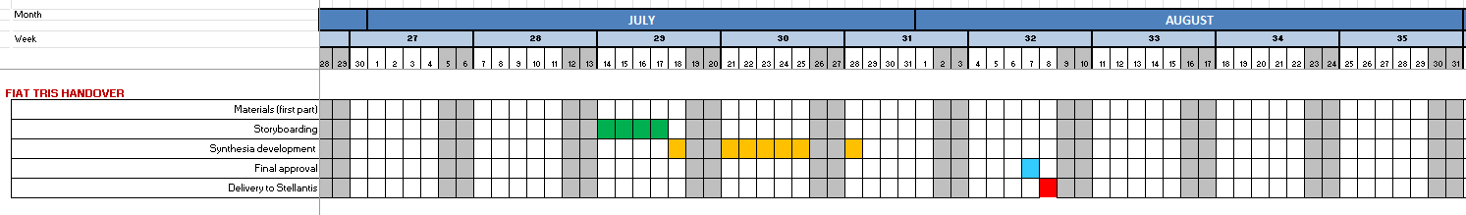
FIAT TRIS HANDOVER (D’Aquino)
Storyboarding and Synthesia file done on July 14
Changes required and delivery on August 8th.

Slide 52
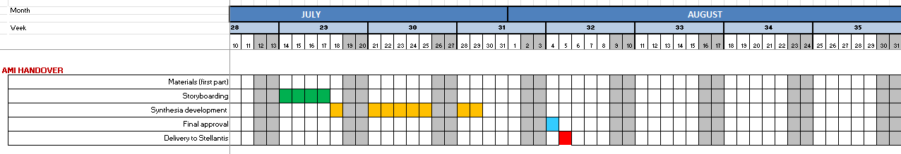
AMI HANDOVER (D’Aquino)
Shooting made on June 17th
Storyboarding and Synthesia file done on July 14th
Changes required and delivery on August 5th

Slide 53
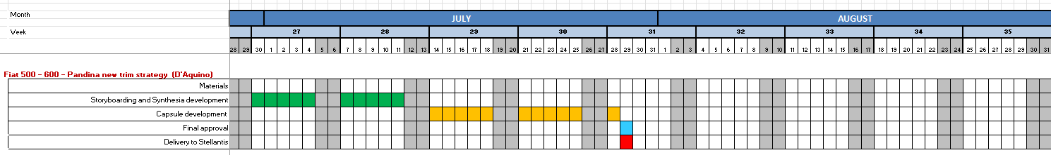
Fiat 500e – 600e - Pandina new trim strategy – Capsule + synthesia (D’Aquino)
Pandina pills completed and delivered
Fiat 600e Fiat 500e Synthesia and Beedeez versions completed
Final delivery July 29th

Slide 54
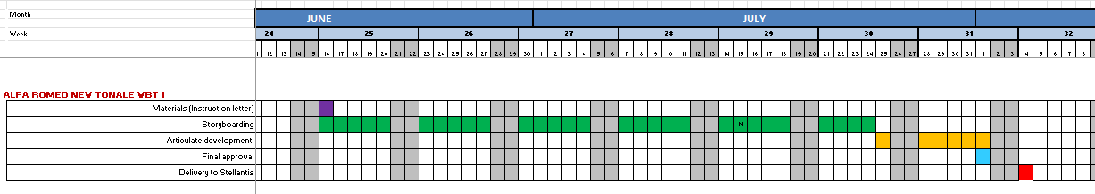
ALFA ROMEO NEW TONALE Part 1 WBT (Barbirato)
Synopsis of the wbt has been agreed
Storyboarding was delivered to PM on July 8.
Various changes have been done and the Storyline version has been completed
Final approval and delivery on August 4th

Slide 55
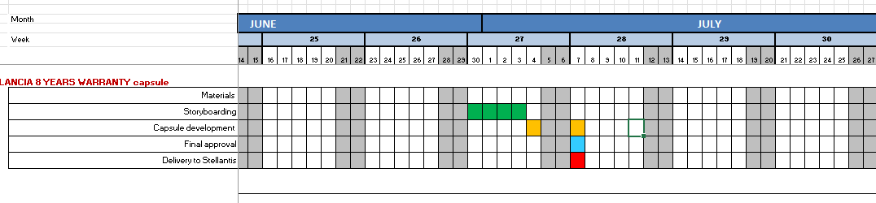
LANCIA 8 YEARS WARRANTY capsule (Barbirato)
Capsule approved and delivered on July 7th.

Slide 56
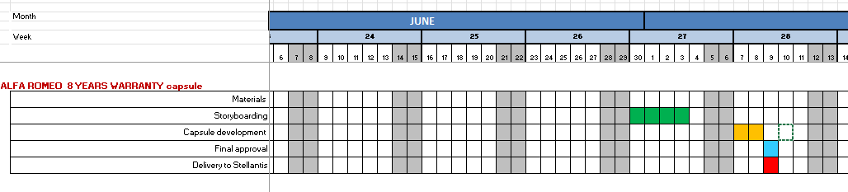
ALFA ROMEO 8 YEARS WARRANTY capsule (Barbirato)
Capsule approved and delivered on July 9th.

Slide 57
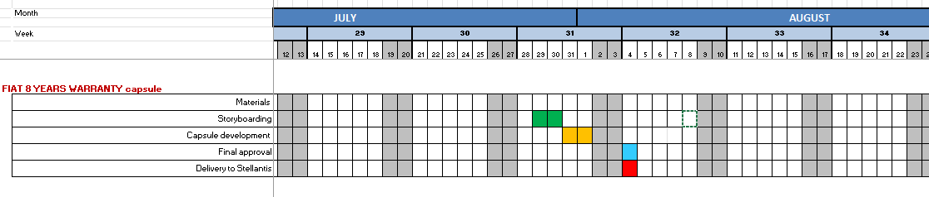
FIAT 8 YEARS WARRANTY capsule (Barbirato)
Capsule approved and delivered on August 4th.

Slide 58
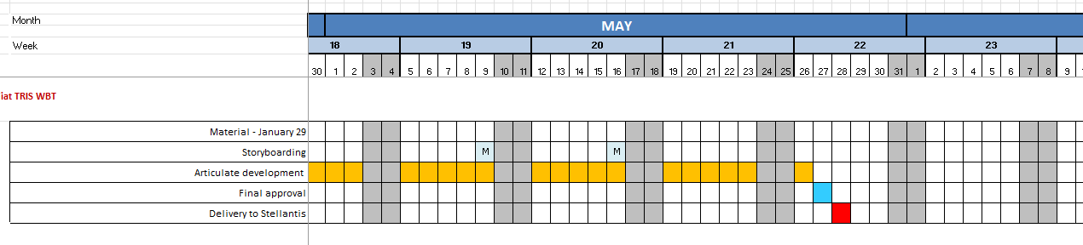
FIAT TRIS WBT (D’Aquino)
All the images of the vehicles have been changed according to the new updated instruction letter received from PM.
The WBT has been completed and delivered on the 28th of May.
The French version was delivered on June 9th

Slide 59
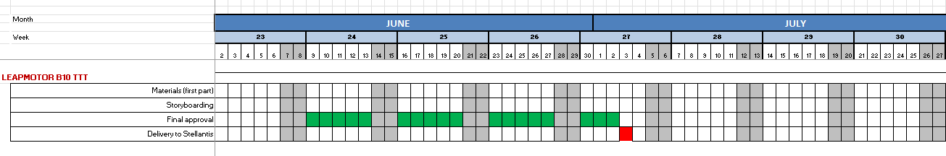
Leapmotor B10 – TTT (Barbirato)
Storyboarding and Pedagogical were completed.
The TTT deadline was delivered on July 3rd.

Slide 60
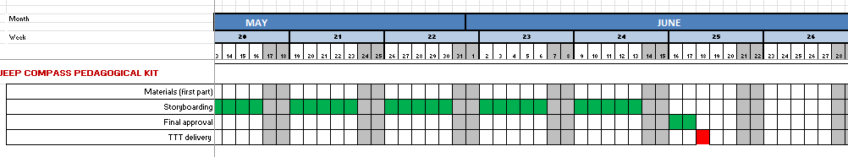
Jeep Compass Pedagogical Kit (Barbirato)
TTT was delivered on June 18th.

Slide 61
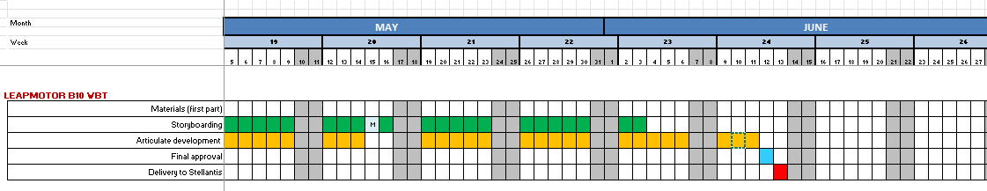
Leapmotor B10 – WBT (Barbirato)
The WBT has been completed and delivered on the 13rd of June.

Slide 62
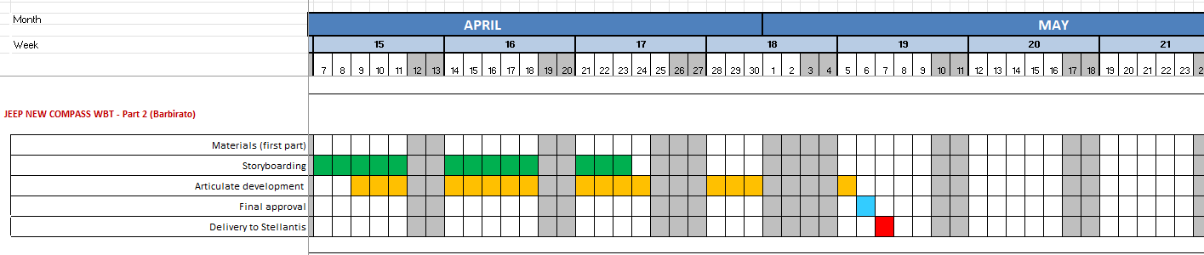
JEEP NEW COMPASS WBT - Part 2 (Barbirato) - WBT completion (Part 2 with focus on Style, Recharge, competitors)
The WBT has been completed and delivered on the 7th of May.

Slide 63
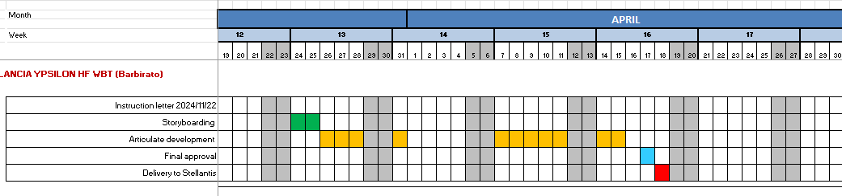
LANCIA YPSILON HF WBT (Barbirato)
The WBT has been completed and delivered.

Slide 64

Connected Services - 1 WBT ExF Brands 1 WBT ExP Brands (Barbirato)
The WBTs have been completed and delivered.

Slide 65

Leapmotor HV Battery - Showroom mode - capsule (Barbirato)
The capsule has been completed.

Slide 66

CITROËN AMI WBT (D'Aquino)
The WBT has been completed and delivered.

Slide 67

LCV PRO ONE RANGE Induction (D’Aquino)
New changes have been done.
The WBT has been completed and delivered.

Slide 68

Leapmotor App focus - Memento inside My Learning App (Barbirato)
Capsule delivered

Slide 69

Jeep Avenger 4xe Recap and USPs – Capsule (Barbirato)
Capsule delivered
Memento file for markets not using Beedeez is in progress

Slide 70

PUBLIC CHARGING WBT (Lerch) Part 2 WBT
Project concluded
Final memento development in progress

Slide 71

JEEP NEW COMPASS WBT - Part 1 (Barbirato)
Storyboard has been approved by PM.
The SCORM pack has been delivered

Slide 72
THANK YOU FOR YOUR ATTENTION

Slide 73
Meanwhile we are working on innovations and multimedia solutions.
As salespeople are working in a fast world full of meeting and deadlines, we are creating with Renzo and Dario some short and focused training videos designed to busy people who want to learn smartly with ready-to-use contents and practical tips.
These micro-videos of maximum 7 minutes with avatar tutors will explain some specific topics in a summarized way with focus on practical competences.
In this way we can produce more engaging, less textual materials suitable for faster and more engaging use

