Slide 1
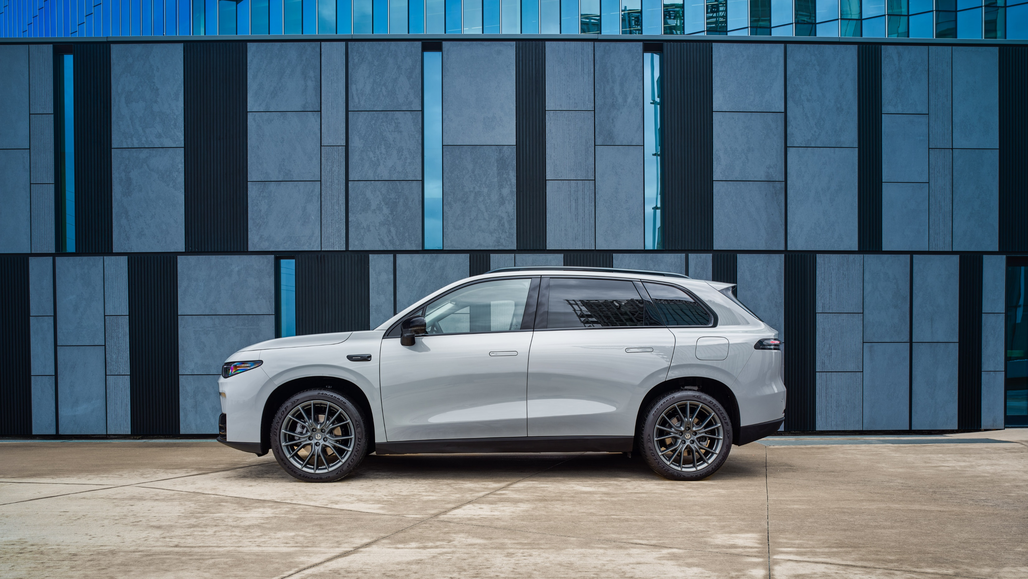


LEAPMOTOR C10 REEV FOLLOW-UP VCT
Mastering the Range Extended EV

Slide 2

Agenda
01
Introduction, why this VCT ?
02
What is a REEV – How it Works ? Quick Refresh!
03
Energy Modes – The right MODE at the right TIME QUIZ
04
Q&A Session
60
Min

Slide 3
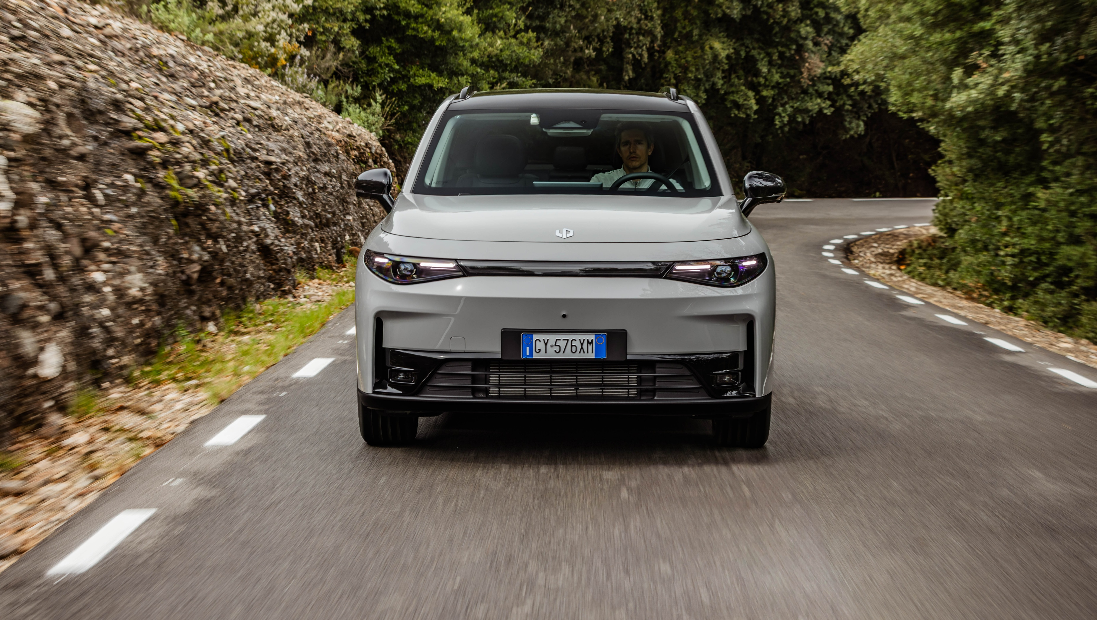
01
Introduction

Slide 4

Introduction – WHY this VCT ?
The REEV Technology on C10 REEV is a true novelty!
Range
Extended
Electric
Vehicle
We introduced the subject with a WBT
A CAPSULE has been published then, with a re-focus and insight on the Energy modes
Notes:
We introduced a WBT on the subject, to build the knowledge base and to understand what is a REEV Vehicle, plus discover the customer benefits
A brief CAPSULE has been published then, containing a re-focus about the technology and an insight of the available Energy modes, with an explanation about the most suitable setting to fit different real life Driving scenarios

Slide 5


Introduction – Did you try ?
Energy Modes ?
Did you have the chance to Test Drive the C10 REEV, using all the Energy Modes?
Did you do it with customers ?
Were there any doubts on customer’s side?
Please write in Chat!
Notes:
Salespersons are supposed to have tested the cars and the energy modes after the ACTION by the brand
NOW it’s time for a Follow-Up VCT….let me ask a few questions:

Slide 6
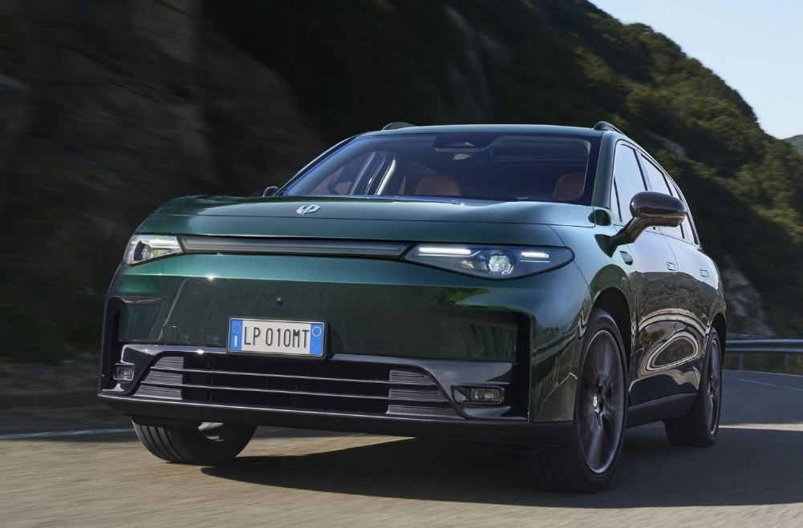
Introduction – How knowledge helps
A good knowledge of Energy Modes is key to provide the Customer with helpful information
To ensure a smooth and confident electric driving experience!
Notes:
A good knowledge of Driving Modes - and how they influence vehicle’s behavior - is key to provide the Customer with the right information to exploit C10 REEV’s full potentiality.

Slide 7

Introduction – How knowledge helps
Moreover, your competence will help preventing any doubt or managing any misjudgment about the product
Notes:
Moreover, should the customer have any complaint or misjudgment on the car’s performance, your competence will help preventing any doubt or managing any misjudgment that may arise about the product.

Slide 8
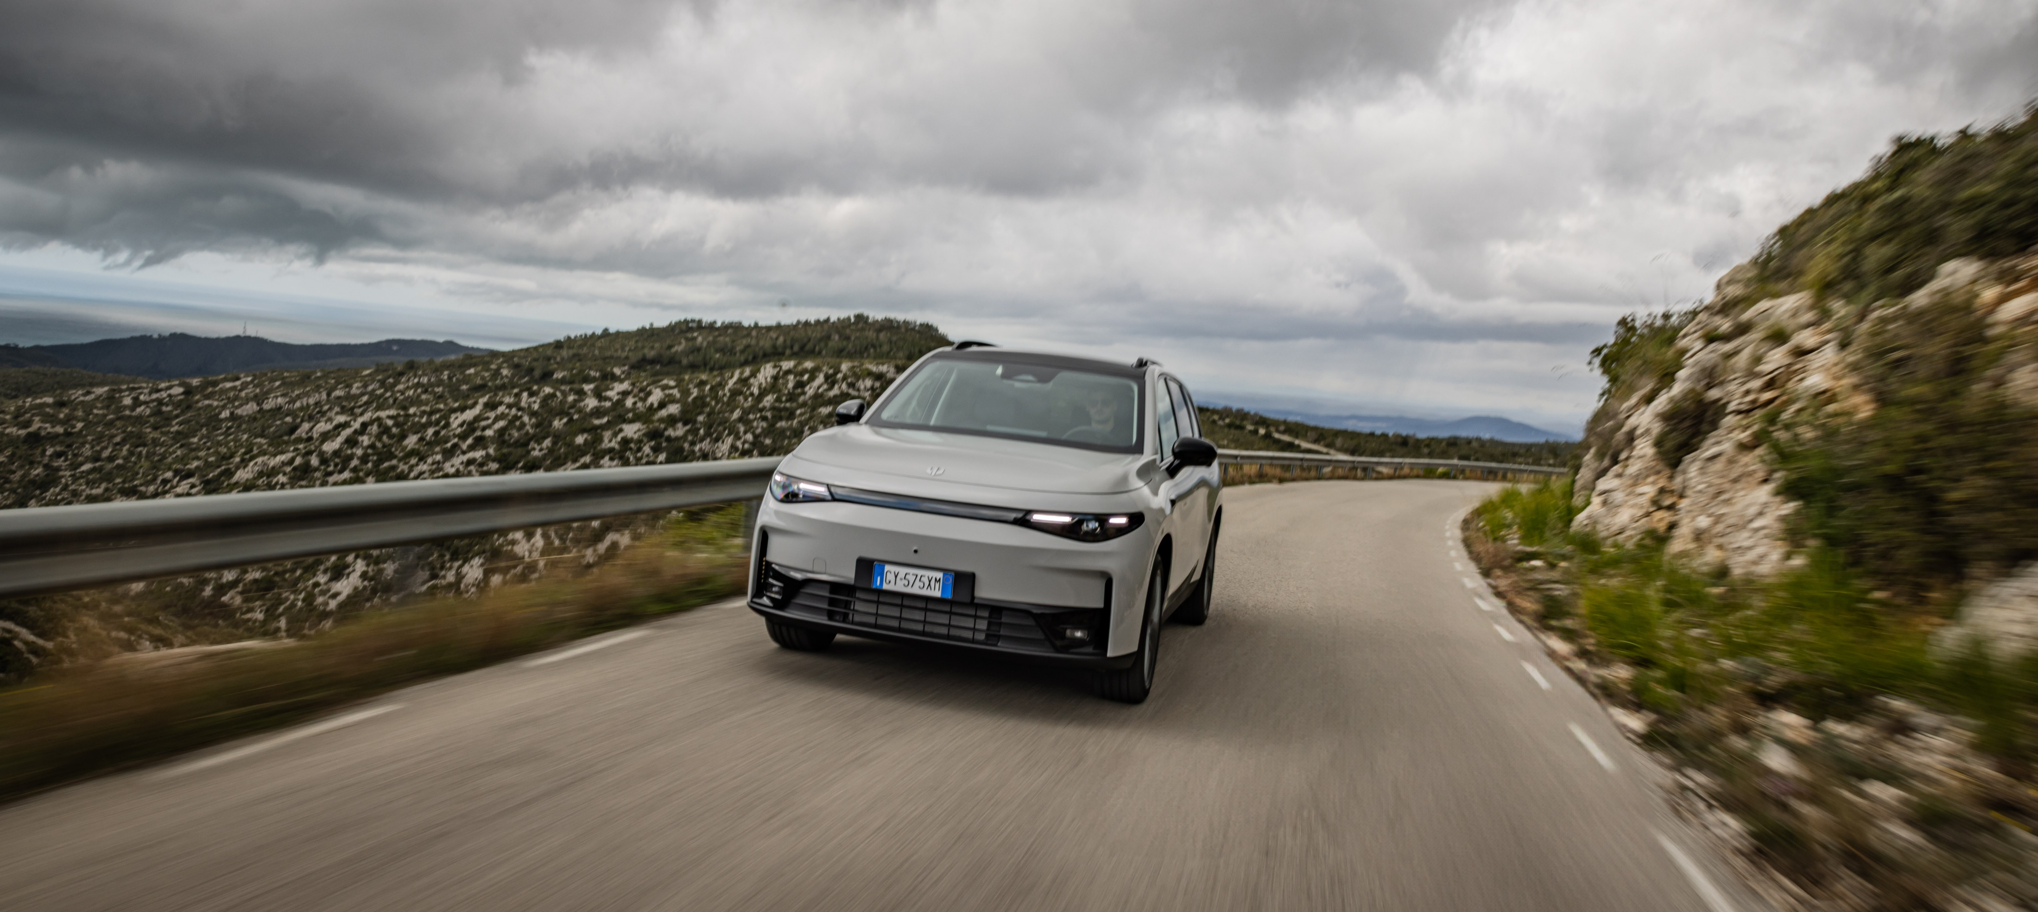
What is a REEV?
How does it Work?
Quick Refresh!
02

Slide 9



Is the REEV driving experience
more BEV-like or Hybrid-like ?
BEV-like
Hybrid-like
Please Vote!
Notes:
Is the REEV driving experience BEV like or Hybrid Like ?

Slide 10






Quick RECAP – What is a REEV ?
A REEV is an EV Car, with onboard an ICE engine that works ONLY as a GENERATOR.
ICE Engine
It ensures high mileage without range anxiety
Pedal feeling and driving experience are purely electric
Electric Motor
Notes:
A Range Extended Electric Vehicle (REEV) is an EV Car, equipped with an internal combustion engine (ICE) that acts ONLY as a GENERATOR.
It ensures extended mileage without range anxiety, as the ICE steps-in only to generate electricity when the battery is running low
The ICE engine don’t send torque directly to the wheels
It ensures extended mileage without range anxiety
The throttle pedal feeling and driving experience are purely electric.

Slide 11
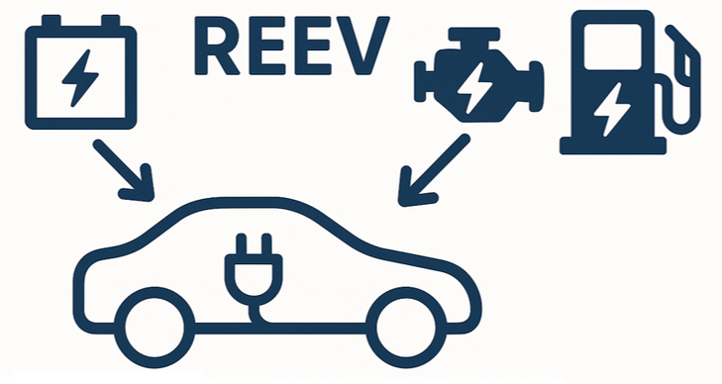
Quick RECAP – Full EV, or Full FLEXIBILITY ?
The Car can be used as a BEV day-by-day
- 145 km EV range
During long trips, it can be simply refueled as an hybrid
- 970 km overall range
Notes:
if recharged from a plug, the Car can be used as a BEV day-by-day
If driven for long trips, it can be refueled simply as an hybrid, without the need for charging stops
E-Motor is on the rear axle to propel the vehicle as a RWD in Full EV driving

Slide 12

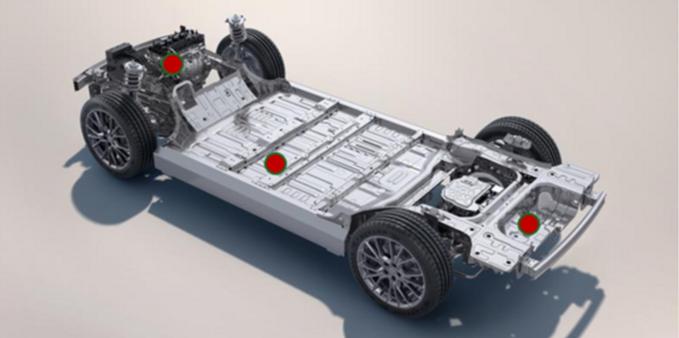
Quick RECAP - HOW does it work ?
The C10 REEV is propelled by a rear mounted e-motor and a battery, and fitted with an on-board ICE “generator” on the front
No clutch, no driving harshness, no gear shifting
Backup for Trainer to deepen the debrief
Notes:
The rear ELECTRIC MOTOR always drives the car in a smoothness and quiet way typical of the electric drive.
The BATTERY powers the electric motor.
When the battery charge drops to low levels, an ICE ENGINE automatically turns on; it produces electricity to recharge the battery and/or power supply the electric engine.

Slide 13
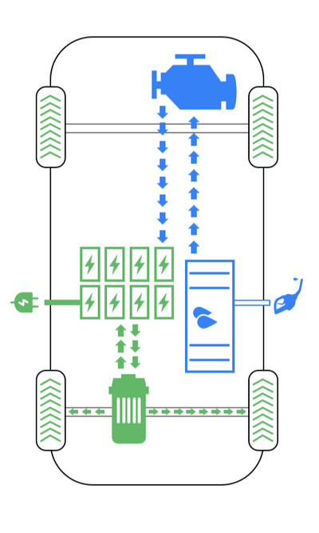
C10 REEV Technology
How does it work?
The rear ELECTRIC MOTOR always drives the car in a smoothness and quiet way typical of the electric drive.
The BATTERY powers the electric motor.
When the battery charge drops to low levels, an ICE ENGINE automatically turns on; it produces electricity to recharge the battery and/or power supply the electric engine.
Driving feeling is always fully electric!
No clutch, no driving harshness, no gear shifting
Backup for Trainer to deepen the debrief
Notes:
In REEVs the wheels are always driven by the e-Motor, the ICE engine works only as a generator, meaning the driving feeling is always fully electric, with no clutch or gear shifting.
On the contrary in PHEVs the ICE engine can directly send torque to the wheels and drive the vehicle together with the electric motor.

Slide 14
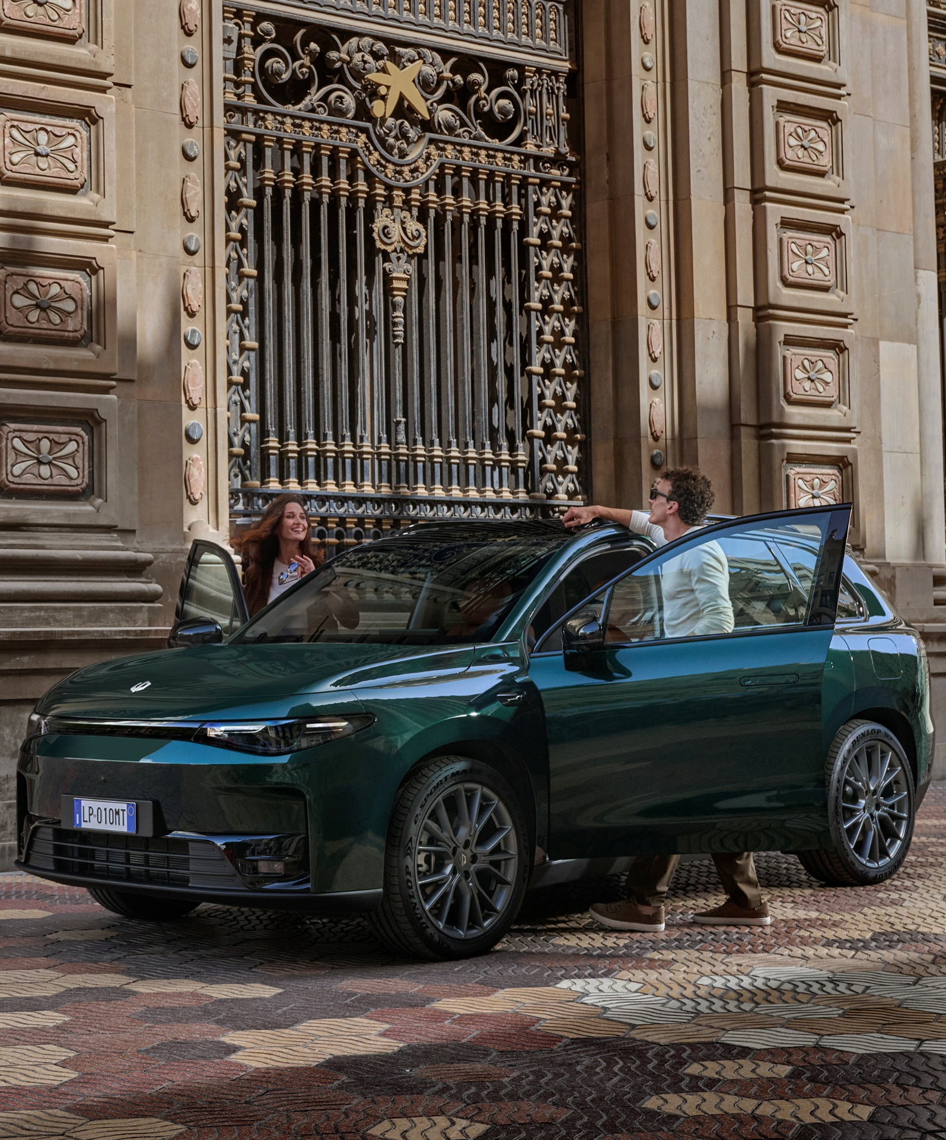
C10 REEV Main Technical Features
Electric Motor Power | 158 kW
Battery Capacity | 28.4 kWh
AC Charging | 6.6 kW
DC Charging | 65 kW
Fuel Tank | 50 Lt
EV Range | 145 km
Total Range | up to 970 km
Backup for Trainer to deepen the debrief

Slide 15

Optional additional Question
Speaking about the difference
between a REEV and a PHEV…
In REEVs the ICE engine can directly send torque to the wheels and drive the vehicle, together with the electric motor
  FALSE
  TRUE
Please Vote!

Slide 16
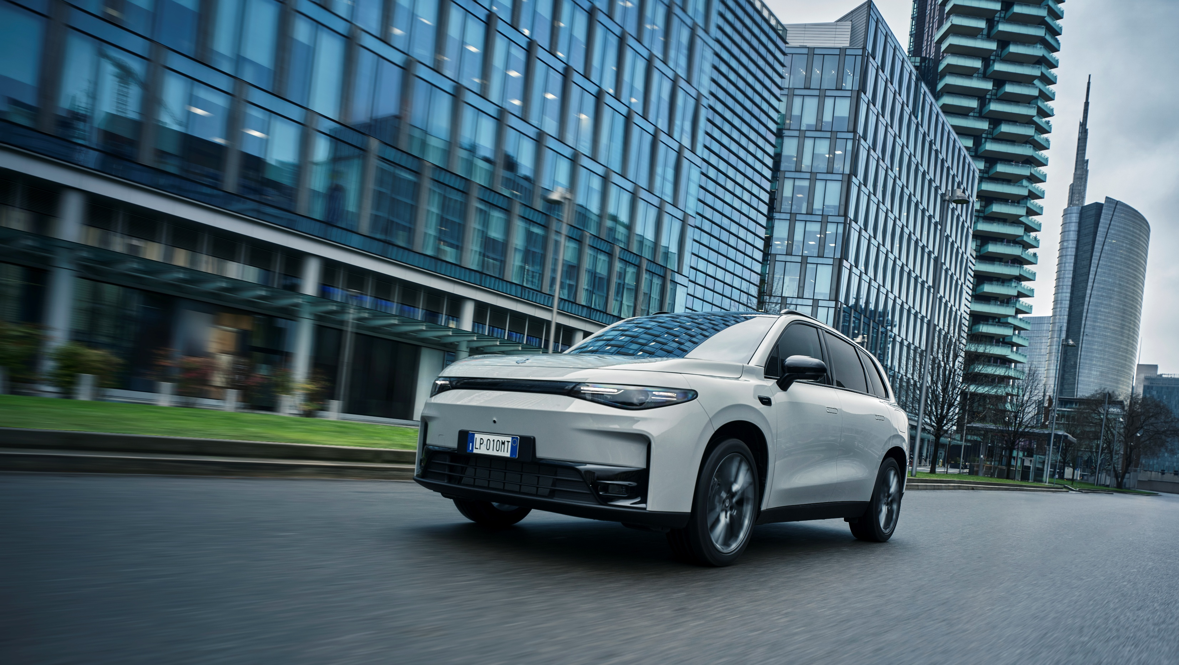
03
Energy Modes
The right MODE at the right TIME

Slide 17

You have tested the car, so at this point you should know how-to engage a specific Energy Mode…
How do you select one?
Please write in Chat!
Notes:
for key on key off energy mode memory remains

Slide 18
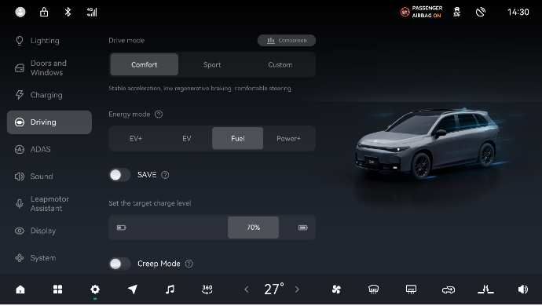
Selecting the Energy Modes is EASY
On the infotainment Screen → Settings → Driving

Slide 19
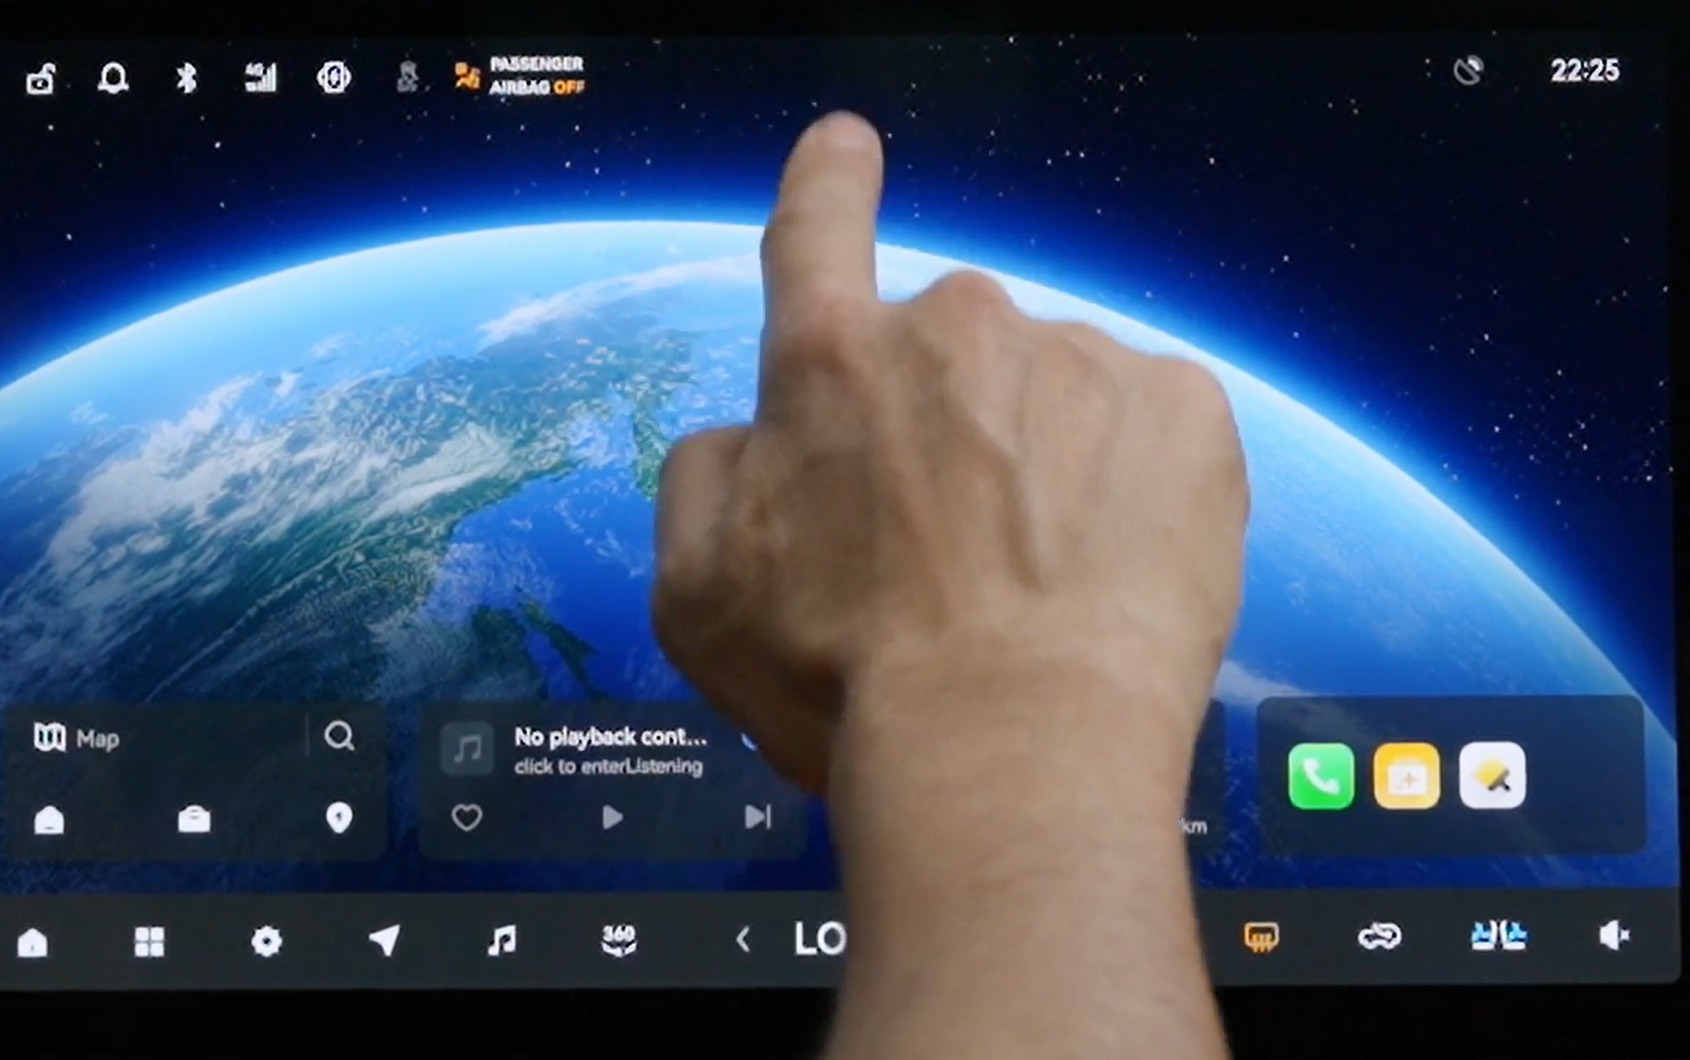
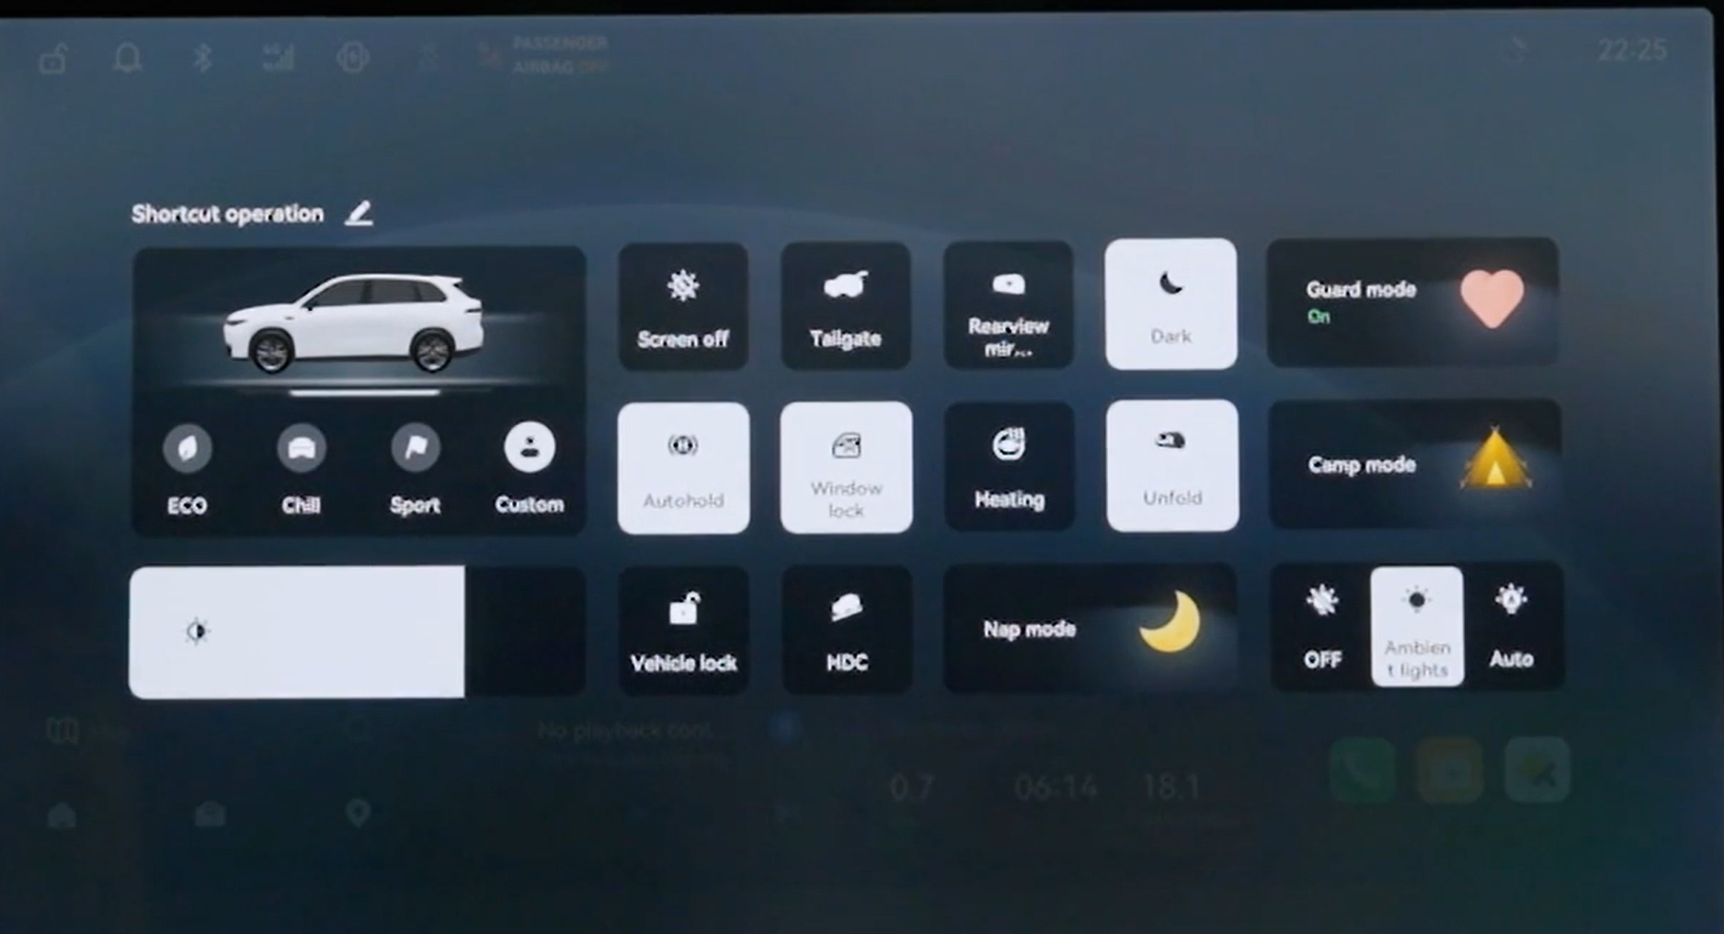
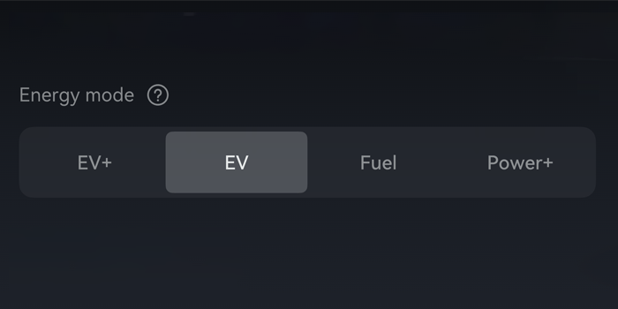
Selecting the Energy Modes is EASY
On the infotainment Screen → “QUICK ACTION” menu

Slide 20

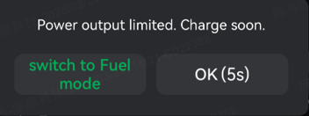
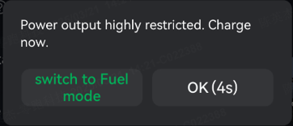
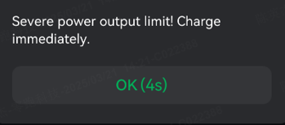
Battery and Performance - Cluster messages
Like on any EV car, performance are influenced by the Battery State of Charge (SoC) and other environmental conditions.
When battery level is low, The car has some suggestions for you, proactively ☺
LOW 19% SoC: Power output limited. Charge soon.
VERY LOW 14% SoC: Power output highly restricted. Charge now.
EXTREMELY LOW 9% SoC: severe power output limit! Charge immediately.
Notes:
“Like every EV car, actual performance are influenced by Battery State of Charge (SoC) and other environmental conditions (weather, etc.)”
NOTE: with the first two alerts (LOW 19% ad VERY LOW 14%) the driver can decide to switch or not to Fuel Mode, while with the last one (EXTREMELY LOW 9%) the switch to Fuel Mode is automatic.

Slide 21
Which are the 2 energy modes that we suggest for the best part of driving situations ?
EV+ EV Fuel Power+
Please vote! Multiple choices
Notes:
Inserire foto

Slide 22
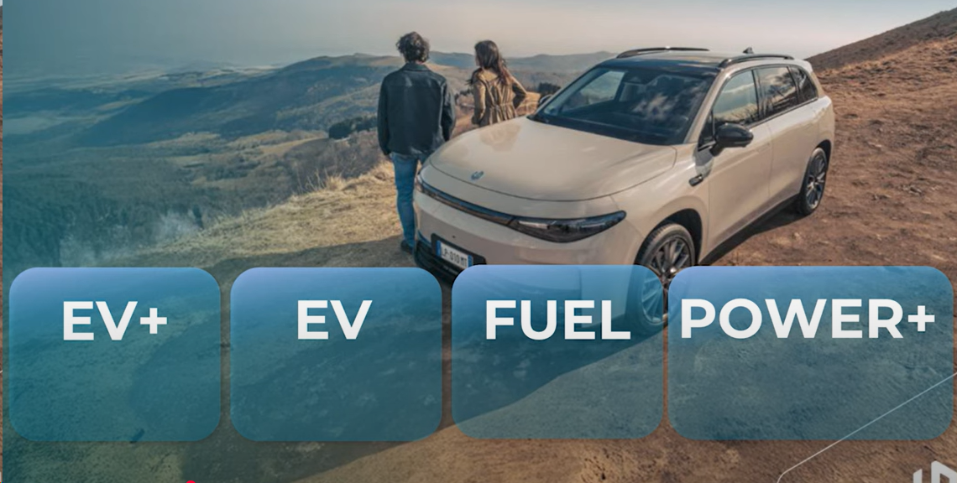
Adaptive Energy Modes
The C10 REEV offers four adaptive Energy Modes
EV Mode
Fuel Mode
EV+ Mode
Power+ Mode
Notes:
The C10 REEV offers four adaptive Energy Modes to tailor energy management and vehicle's behaviour to driver's needs:

Slide 23


Main Modes for common operation
2 modes can be suggested to the customer for common operation
Electric Driving pleasure with energy and cost efficiency, day by day
EV
Fuel
Smooth driving with no charging constrain
Notes:
When it comes to everyday driving 2 modes can be suggested to the customer for common operation
EV Mode Which allows to combine Electric Driving pleasure with energy and cost efficiency, day by day
Fuel Mode Which enables smooth driving in case of limited access to charging station

Slide 24


Specific Situations Modes
2 “+” modes for specific situations
EV+
Power+
Used to manage specific needs/scenarios that may happen while driving…
Notes:
The other 2 modes are instead used to manage specific needs/situations that may happen while driving
We will talk about it in a few minutes

Slide 25
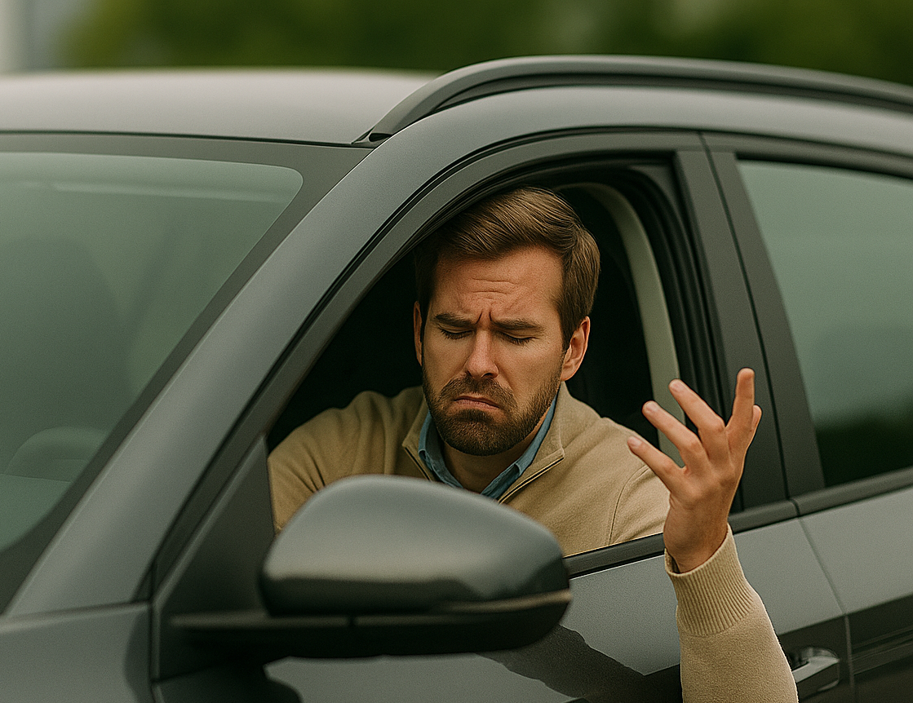
Let's exploit the potential
Energy Modes provide flexibility when driving conditions change…
This must be clear to the driver!
otherwise:
Car’s full potential is unexploited
Customer dissatisfaction might occur
Notes:
As we have seen, the Energy Modes developed are aimed to tackle different driving conditions.

Slide 26

Your role is the key
It’s crucial to advise our Customers of the correct use of Energy Modes.
Always provide information:
What are the 4 energy modes, and how to select them
Which missions they are best suited for
Use practical real-world examples
Notes:
For this reason, is crucial to advise our Customers about the correct use of Energy Modes.
Which are the energy modes of the C10 REEV and how they work
Which missions and scenarios they are best suited for

Slide 27

Your role is the key…practice helps!
We’ve listed some sample scenarios
Let’s try an exercise:
Suggest which is the most suitable Energy Mode for the described customer use…
Notes:
To support your learning, and your job, we’ve listed some sample scenarios that you can use for reference.
Suggest which is the most suitable Energy Mode and driving behavior to have a satisfactory experience at the wheel….

Slide 28




Scenario 1 - Daily Commute
From the suburbs to the town…and back
DAILY COMMUTE TO THE CITY
Starting early the day at 7 am, leaving the house in the suburbs
50 km to reach the city…to work all day
And late afternoon thankfully back home!
Recommended Mode?
Please Vote!

Slide 29
Scenario 1 - Daily Commute
From the suburbs to the town…and back
DAILY COMMUTE TO THE CITY
Recommended Mode?
How it works:
Full EV Driving with ICE start supporting only when needed
(SOC below 25%)
Enjoy the EV drive, most of the time!
Notes:
Customer benefits:
EV driving Confort
Low operating cost
- Zero pollution
Access to Low Emission Zone
Other (taxes, free parking)

Slide 30
EV
1. EV → Priority to EV Driving
The vehicle will prioritize pure Electric Power Drive, and automatically start the ICE generator only when the battery is below 25%
This is the Mode recommended for DAILY COMMUTE, which allows to combine Electric Driving pleasure with energy and cost efficiency.
Backup for Trainer to deepen the debrief
Notes:
The vehicle will prioritize pure Electric Power and automatically start the ICE generator when the battery is low (below 25%).
This is the Mode recommended for DAILY COMMUTE, which allows to combine the Electric Driving pleasure with low operating cost.

Slide 31



Scenario 2 - Long Range
No Range Anxiety during trips
JOURNEY WITH LIMITED CHARGING STOPS
It’s time to leave home and enjoy holidays, but our destination is not so close…
on the Highway…then a long stretch of country roads to reach the spot!
Recommended Mode?
Please Vote!

Slide 32
Scenario 2 - Long Range
No Range Anxiety during trips
JOURNEY WITH LIMITED CHARGING STOPS
Recommended Mode:
How it works:
It uses the ICE generator proactively
SMOOTH DRIVING on highway trips or in country roads to limit the number of charging stops, goodbye range anxiety
Notes:
This mode enables smooth driving on long distance highways or in mountain roads in case of limited access to charging station or to limit the number and the time of stops.
Customer Benefits:
No range anxiety
Long distance flexibility
No time loss for charging stops

Slide 33
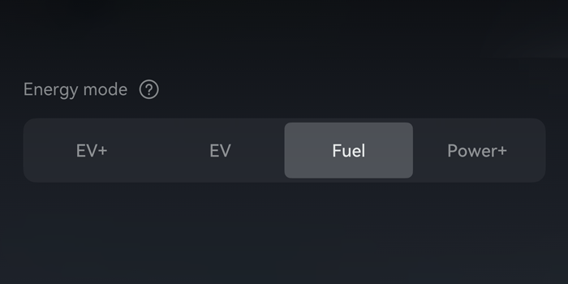
Fuel
2. FUEL → Priority Fuel Driving
The vehicle works in full EV Driving till the battery charge is above 80%.
Below this charge threshold the ICE generator automatically starts to generate electricity.
With C10 REEV long distance trips are not a problem
with 970 km of range
Backup for Trainer to deepen the debrief

Slide 34
When driving in FUEL mode in a LONG TRIP, what can I do to maintain the Battery SOC at a DESIRED level ?
Please write in Chat!

Slide 35
Scenario 2 - Long Range
A far away destination, long road…long time!
LONG-DISTANCE JOURNEY
WITH LIMITED CHARGING STOPS
SAVE
Function activated
Recommended Mode:
Notes:
This mode enables smooth driving on long distance highways or in mountain roads in case of limited access to charging station or to limit the number and the time of stops.
Customer Benefits:
No range anxiety
Long distance flexibility
No time loss for charging stops

Slide 36

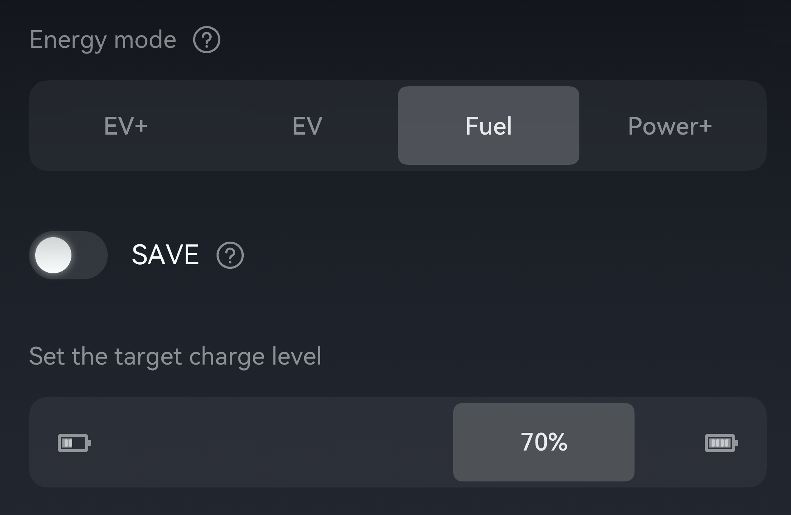
Fuel – SAVE function
The driver can customize its own battery charge target between 30% to 80% with the SAVE function.
Extend Driving experience in Full EV, with desired Battery level backup:
  To enter LOW EMISSION ZONE
  To have EV range at destination if no charging stations are available
  etc...
Notes:
Extend Driving experience in Full EV, but being sure to have a good Battery level left all the time:
Note: even if the driver can modify the target charge level, the customized threshold is considered only if the SAVE function is activated​.
Note: The SAVE function won’t work when the speed is continuously over 130 km/h

Slide 37




Scenario 3 - Last miles EV
EXTENDED FULL EV DRIVING
A day longer than the usual one…works, kids & errands, always on the go!
The battery is running low (30%)...but you are almost there and soon you’ll be back home to recharge car’s battery….and yours!
You want to relax and enjoy at most the smooth EV experience
Please Vote!
Recommended Mode?

Slide 38
Scenario 3 - Last miles EV
EXTENDED FULL EV DRIVING
Recommended Mode:
How it works:
Switch to EV+ mode will allow to maximize the use of battery energy for the longest possible EV drive experience
Max Priority to EV: Zero emissions, ultra-silent and smooth driving

Slide 39
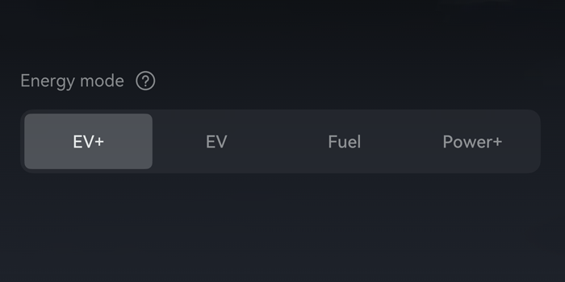
Backup for Trainer to deepen the debrief
EV+
EV+ → Max EV
The priority is EV Driving, the system allows for an almost full use of the battery
ICE generator automatically starts only when battery charge is less than 9% to ensure the longest operation and range in FULL EV
At the destination, however, it is important to ensure that battery recharging is possible!
Notes:
This mode lets you drive longer on electric power - for example for the last few remaining kms before destination - by using the battery as much as possible. By switching to EV + mode, ICE generator will start under 9% instead of under 25% with EV mode.
At the destination, however, it is important to ensure that battery recharging is possible; otherwise, it could negatively affect the vehicle's performance.

Slide 40



Scenario 4 - Demanding Drive
When propulsion is needed
DEMANDING DRIVING SITUATIONS
It’s winter, and you have to face a long and steep climb on a mountain road
You didn’t have the chance to recharge the car before you left home
Recommended Mode?
Please Vote!

Slide 41
Scenario 4 - Demanding Drive
When propulsion is needed
DEMANDING DRIVING SITUATIONS
Recommended Mode:
How it works:
The ICE engine is always running, prioritizing the vehicle's propulsion needs
Maximum power output of the ICE Generator
Right performance level in severe conditions: cold, low battery level, etc.
Notes:
Keep the right level of performance during demanding driving in any situation (cold, low battery level, etc.).
Customer Benefits:
Power always available
Safe and stress-free drive no matter the condition

Slide 42
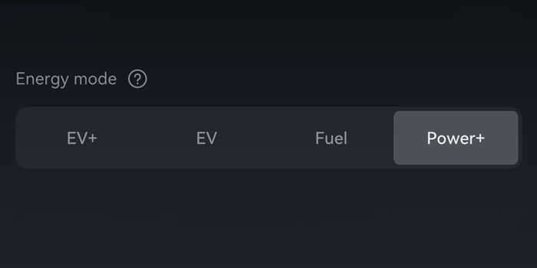
Backup for Trainer to deepen the debrief
Power+
Power+ → Power Priority
Here the priority is to maintain the performance in specific condition:
Low Battery Level
Very cold start conditions
Demanding power situations
the ICE Engine will run continuously to generate electricity at full capacity
This Mode ensures ENOUGH POWER even at low battery levels (State of Charge below 15%)
Notes:
Here the priority is to maintain the performance in specific condition: at low Battery Level or in very cold start conditions, the engine will run continuously to generate electricity at full capacity and directly power the electric drive system.*
With this mode the ICE generator is always ON.
This Mode ensures sufficient power even at low battery levels (State of Charge below 15%).
* If the engine does not work or the Drive system is faulty, the Power+ Mode is not available.

Slide 43
04
Q&A Session
To solve any doubt…

Slide 44
For Trainers ONLY
Q&A Session Hints
Use of the following INFO Slides
This Q&A Session can be carried out using various methodology
The Questions can be asked to participants, and they can try to answer (chat, voice, etc.), then debrief from the trainer will follow. Useful Info for the debrief are in the notes
The trainer can select some significant cases and explain them to the audience, then invite participants to ask any question that comes to their mind about the subject
Build a Quiz with the following questions, using the information provided in the Notes to create possible answers
Notes:
For trainer ONLY istruzioni per gestire il Q&A successivo

Slide 45

Customer Inquire n.1
Mountain Road
Driving uphill with a full load of luggage and a family with 2-3 children, in winter with heating etc….
Does the vehicle generate more energy than it consumes, when the battery is low and the power requirement is high?
What can we answer?
Notes:
In a range-extended vehicle like ours, the powertrain is designed to handle such peak load situations. When the battery is low and the power demand is high — for example, driving uphill in winter with the full family onboard, luggage, heating, etc. — the range extender activates to supply electrical energy to the drive motor and, when possible, to partially recharge the battery.
However, it’s important to clarify: the range extender is not meant to fully "generate more energy than the vehicle consumes" in real time under extreme loads. Instead, it's designed to supply sufficient power to maintain drive performance and prevent battery depletion.

Slide 46

Customer Inquire n.2
Battery is running low
In "EV" driving mode, when the battery drops to 25% capacity, the combustion engine starts operating….
At this stage, is it possible to charge the battery, or is the energy generated by the (combustion) engine entirely consumed by the vehicle’s movement?
What can we answer?
Notes:
It depends on the power request. If it is lower than the range extender maximum power output the difference is used to charge the battery.

Slide 47

Customer Inquire n.3
Engine rpm and sound
When the combustion engine is running, does the throttle inputs on the accelerator pedal cause an increase in the combustion engine’s RPM?
What can we answer?
Notes:
No, pressing the accelerator pedal does not necessarily cause the combustion engine RPM to rise directly.
The electric motor handles all traction and acceleration — it reacts immediately and proportionally to the driver’s pedal input.
The combustion engine runs at a speed optimized for power generation, not for vehicle speed. Its RPM is managed by the vehicle's energy management system to match the electrical power demand, not the driver’s foot position.
This means the combustion engine may run at steady or variable RPMs, depending on battery SOC and load, but it won’t “rev up” like in a traditional car when the driver accelerates.

Slide 48

Customer Inquire n.4
Max rpm
What are the maximum rpms under maximum load….does it surpass 3000 rpms we can see on the screen?
Is there any situation when it could go higher and therefore it will be loud and unpleasant for passengers?
What can we answer?
Notes:
Then engine reaches max. power output at 5000rpm. In principle, yes — during full power demand scenarios (e.g. battery depleted + high load + etc.), the engine may operate at higher RPMs and thus produce more noticeable noise. However:
These situations are rare and temporary;
The engine is decoupled from the drivetrain, so there's no direct vibration;
We've implemented sound insulation and smart engine calibration to minimize noise intrusion even at high RPM.

Slide 49

Customer Inquire n.5
Emergency Mode
Does the vehicle operate as if in “emergency mode” when the battery charge drops to a level below 5%?
Is the power limited? If yes how much?
Is there any “turtle mode” as in EVs when the SOC is limited?
What can we answer?
Notes:
The power output is limited. Performance is downgraded. The driver should either stop and recharge or use the Power+ mode to charge the battery.

Slide 50

Customer Inquire n.6
Highway at high speed
What happens when you drive in EV mode for long period of time on highway at high speed?
How quick is the battery depletion ?
What can we answer?
Notes:
The battery drainage will depend on the road conditions and driver behaviour. At 25% of SoC (State of Charge) the range extender will start working.

Slide 51

Customer Inquire n.7
NVH performance with ice engine ON
The battery is running low (<15%)….and the ice engine is already active.
The NVH performance is low: noise, etc.
What can we answer?
Notes:
Leapmotor C10 REEV should not be driven in such a way. The SOC should never drop below 15% since in this case the power output is limited and the ICE will start working at max load to compensate, so it will be noisy and uncomfortable.

Slide 52

Customer Inquire n.8
Battery Health
Can we cause any damage to the vehicle or the batteries if, when SOC is low, we drive for long periods using only the combustion engine without recharging the batteries?
What can we answer?
Notes:
No damage will occur, and the vehicle is fully capable of operating this way for extended periods when necessary.
Of course, for optimal efficiency and quieter driving, plug-in charging is recommended when convenient — but it’s not mandatory for protecting the system.

Slide 53

Customer Inquire n.9
ICE engine Health
Can we cause any damage to the ICE engine if we always use the car ONLY in EV for a long period of time ?
What can we answer?
Notes:
No problem at all: Automatic procedure will start after 45 days of ICE engine stop, launching an ICE engine running cycle to maintain internal combustion engine health

Slide 54
What about YOU ?
Do you have any doubt left about Energy Modes or vehicle’s behaviour, or any customer experience to tell ?
Would you like to share it ?
Please share!
Notes:
This slide must be used by the trainer to ask participants if, according to their experience at the wheel of C10 REEV or after Customers’ inquires or shared test drive, is there any doubt left about Energy Modes and vehicle behaviour
Invite participants to share their thoughts.

Slide 55
Thank you

