Slide 1
NEW ALFA ROMEO TONALE
Ready for new business opportunities?

Slide 2
WELCOME
Welcome back to the world of the new Alfa Romeo Tonale.
In WBT Part 1 we discovered all the characteristics,
so our knowledge base is in place...
... now it's time to get excited because we're going
to discover the design.

Slide 3

WELCOME
Part 1 – Onboarding WBT
(to support the Orders Opening Phase)
Part 2 – Design and Connected Services
01. INTRODUCTION
An appealing profit pool
The Customer
The 4 Tonale pillars
Led by Quality
01. INTRODUCTION
360° Improvement
The Tonale 4 pillars
02. What's new
Track increase
Exterior dimensions
Powertrain line-up
Rotary shifter
02. New Design
360° Overview
New exterior details
New interior details
03. Range evolution
The new Tonale Range… in a nutshell
More market coverage, more business opportunities
Trims, one by one
Launch Edition
03. Connected Services
04. Understanding the C-SUV Segment Players

Slide 4
INTROdUCTION

Slide 5





360° IMPROVEMENT
01 | Introduction
Before getting into the heart of the WBT and talking about the new Design, let's review the main product novelties introduced on New Tonale, driven by the attitude of the Brand in continuous improvement, always listening to its customers. Hence, New Tonale is bound to be an exceptional quality product.
Improved mechanics
Perfect size
More customization
New wheels
New range
Click on each label to see some details.

Slide 6
360° IMPROVEMENT
IMPROVED MECHANICS: mechanical elements are key to improve an Alfa Romeo.
Track increase (+ 8 mm on 19” and 20”)
Complete engine line-up updated to Euro 6E Bis homologation (1.6 TURBO DIESEL
130 HP, 1.5 IBRIDA 175 HP, 1.3 IBRIDA PLUG-IN Q4 270 HP)
1.6 TURBO
DIESEL 130 HP
1.5 IBRIDA
175 HP
1.3 IBRIDA PLUG-IN
Q4 270 HP
No change with respect to the previous Euro 6E homologation
Improved declared power thanks to the combined value (+15hp)
Improved 0-100 km/h value
(-0.3 s)
Modifications to the aftertreatment for Euro 6E Bis compliance
Effect on combined power and declared CO₂ (no impact on the customer perceived fuel consumption)
What’s new?
Mission
High mileage version
Perfect balance between performance & efficiency
Maximum performance
& efficiency
+8 mm (4 mm by side)
Improved look, roadholding & driving dynamics.
The right engine for each customer!

Slide 7


360° IMPROVEMENT
PERFECT SIZE: New Tonale has "the right size“, not too long, not too short, not too wide. In a moment in which the new SUV are becoming wider, bigger and hard to fit in your garage, Tonale is compact, with a generous trunk and easy to park, the ideal C-SUV.
Sostituirei con tabella, più semplice che scrivere…la carreggiata non la ripeterei
New Tonale
Current Tonale
Length [mm] | 4,522 (-6)
Height [mm] | 1,601
Width - no mirrors / mirrors folded / with mirrors [mm] | 1,841 / 1,937 / 2,082
Trunk [L] | Min 500 / Max 1550 385 / 1430 (PHEV)
NEW TONALE
4,52m

Slide 8


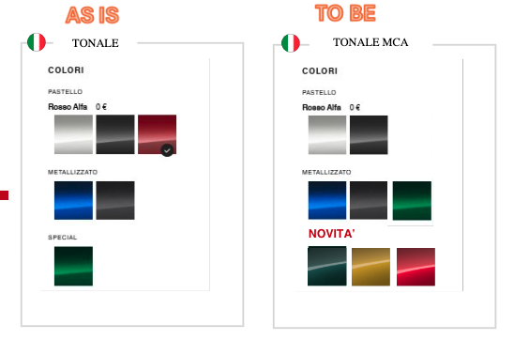
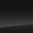


360° IMPROVEMENT
MORE CUSTOMIZATION: new Tonale takes inspiration from customers’ (and salesmen’s) inputs, asking for more customization and greater choice.
MORE COLORS
+ 3 metallic paints
+ black roof option
MORE INTERIOR COLORS
+ red leather
+ black /white Alcantara
Solid
Bianco Alfa
Nero Alfa
Metallic
Black cloth & Scuba leatherette ‘’Biscione"
Black leather
NEW
NEW
NEW
Schiarire un pochino l’immagine, si capisce poco che è rosso
NEW
NEW
Rosso Brera
Verde Monza
Giallo Ocra
Blu Misano
Grigio Vesuvio
Verde Montreal
Red leather
Black & white Alcantara

Slide 9
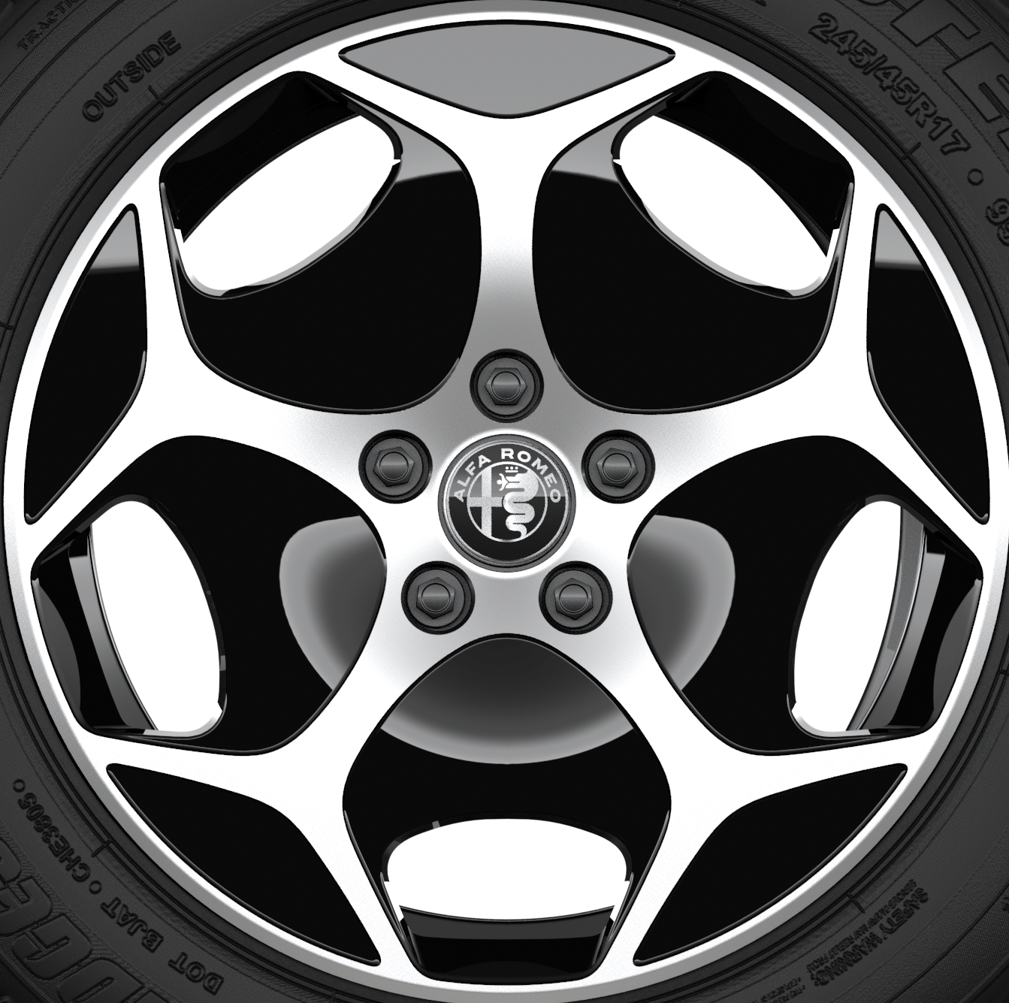
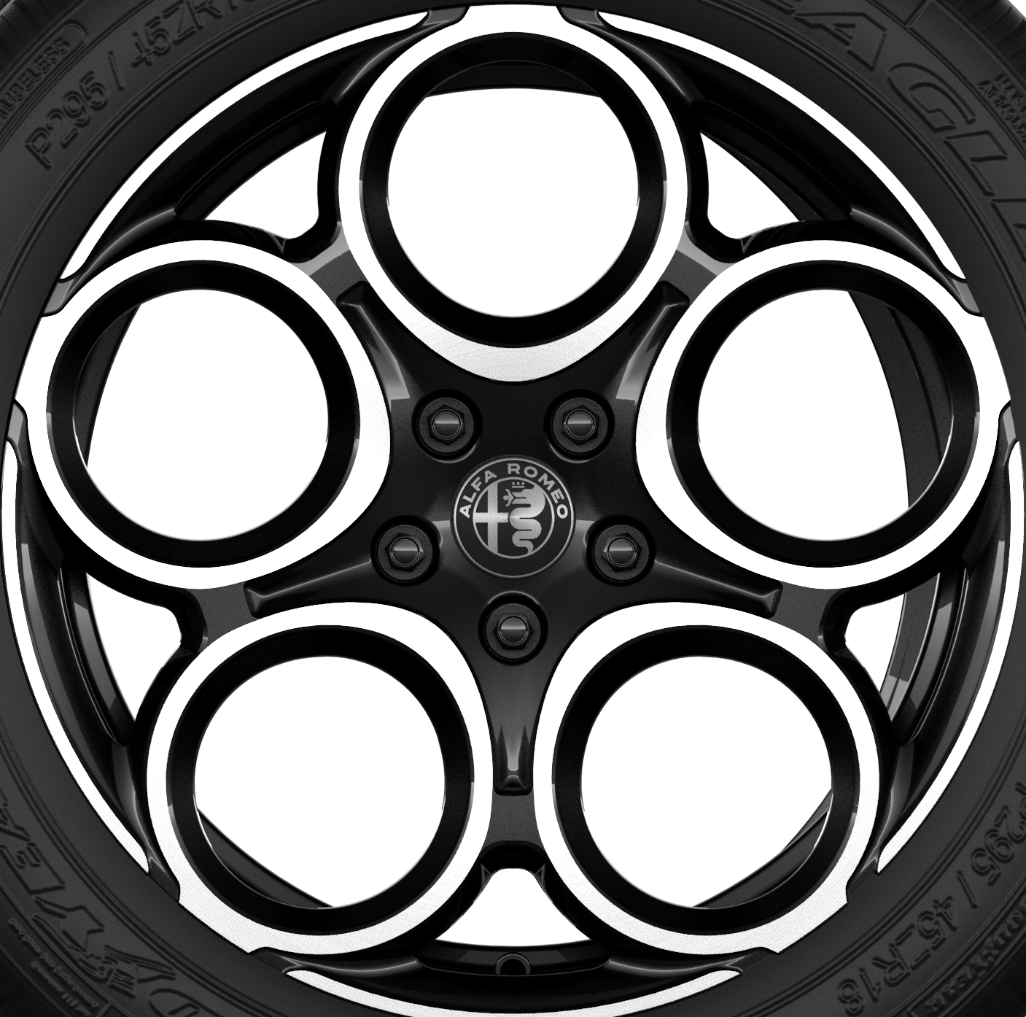


360° IMPROVEMENT
NEW WHEELS: Wheels are not just a detail, they define the character and presence of the car. The wheel range of the New Tonale goes from 17” to 20“ and features 2 new wheel designs for the 19” and 20” sizes.
Tonale
Sprint ant Ti
Veloce
Sport Speciale
NEW
NEW
Metterei le immagini, anche se i cerchi vengono poi svelati nel video. Così è poco significativo il visual…oppure mettiamo le slide con il recap delle novità estetiche dei colori e dei cerchi dopo i video
17” Aerodinamico
18” Petali
19” Stile
20” Fori

Slide 10
360° IMPROVEMENT
NEW RANGE to answer the need of a wider market coverage and to have a tailored offer for each customer.
Range
Reasons why
Veloce
Hero version
No content changes vs MY 25 version
Ti
To reinforce the upper range between Veloce and Sprint
Iconic name
Sprint
Improved style and perceived quality
Tonale
More affordable entry price (but NOT a NAKED version)
Aligned to competitors’ range
MORE MARKET COVERAGE, MORE BUSINESS OPPORTUNITIES

Slide 11
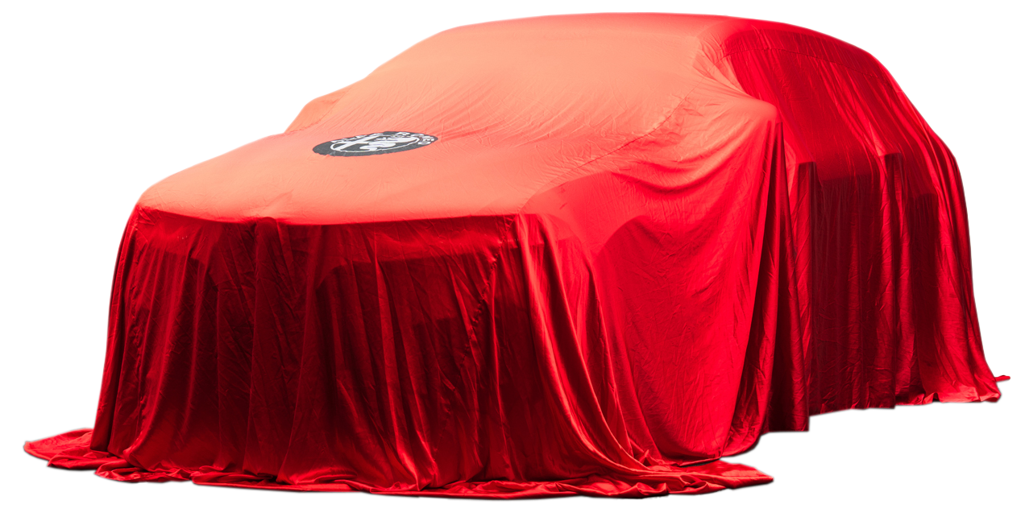
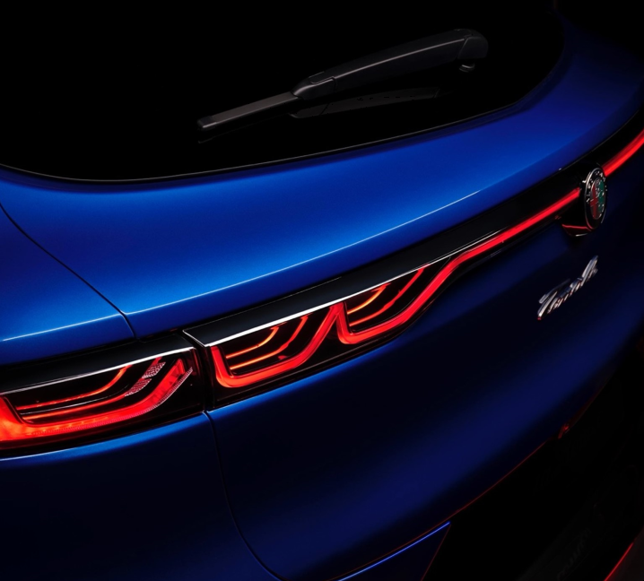
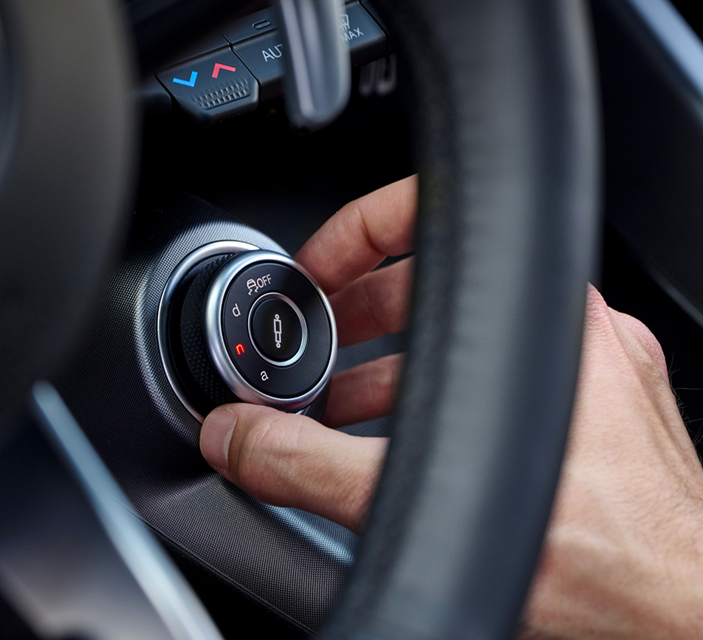
ARE WE READY?
01 | Introduction
The time has come for us to finally get a glimpse of the New Tonale.
The design of every New Alfa Romeo is vital because it strengthens its brand image and values.
It is no coincidence that Design represents for Tonale the first of the 4 Pillars on which it was thought and conceived.
Even more character and sportiness on a design that is already a strength for the Tonale… Wait for WBT Part 2 and “touch with your hand” !
True Alfa Romeo DNA, translated into emotion at first drive. Dedicated mechanical solutions create the recipe that an Alfista would expect.
Cutting edge technology, latest generation infotainment & connectivity, best in class safety (5 stars EuroNCAP) & ADAS.
Harman Kardon 14-speakers premium Hi-Fi, ventilated front seats, semi-autonomous parking…these are some of the premium features you can find on Tonale.
DESIGN
DRIVING DYNAMICS
ENHANCED SOFTWARE EXPERIENCE
PREMIUMNESS
& QUALITY
So let's start from here to discover the New Tonale... let's enter the future of Alfa Romeo.

Slide 12
NEW TONALE DESIGN

Slide 13

360° OVERVIEW
02 | Design
We tried to describe the design of the new Tonale. Then we realized it’s beyond words.
But the solution is easy: using the power of images.
360°
Overview
New exterior
details
New interior
details
Click on the icons

Slide 14

CONNECTED SERVICES

Slide 15
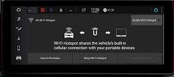

Advanced Hardware and Software equipment
03 | Connected Services
The new Tonale blends advanced hardware and intelligent software for a truly next-generation tech experience.
Its Connected Services take driving to a new level: smarter, smoother, and more intuitive.
Everything works seamlessly across multiple connected channels, for a driving experience that’s always in sync with you.
USING
Alfa Romeo APP
ON BOARD
From Infotainment system
For smartphones and smartwatches,
giving access to all the services

Slide 16
A first-class offer
03 | Connected Services
Connected Services are clustered in two different commercial offer with the following objectives:
Improving customer satisfaction and customer experience, thanks to on board and off board services
Offering EV features included in the vehicle price to facilitate the management of PHEV vehicle
Immagino che questo materiale sia arrivato dai colleghi dei connected services, ma lo trovo un po’ poco esplicativo…cosa vuol dire «elementary features»?
CONNECT
ONE
CONNECT
PLUS
Elementary features
Remote interaction with vehicle
Activation: already active
Duration: e-Call: lifetime
Other services: 10 years
Activation: Care of Sales Consultant at car delivery phase
Duration: included in the vehicle price. Trial period of 36 months.
Safety & Security features
Vehicle monitoring
Maintenance optimization
Navigation optimization
EV specific features:
        e-Control (charging)
Theft Alarm Notification and Stolen Vehicle Tracking Assistance
Alexa in Vehicle
Non è nemmeno chiaro cosa sia gratuito e cosa a pagamento, con i venditori bisogna essere chiari

Slide 17





Service list details
03 | Connected Services
CONNECT
ONE
CONNECT
PLUS
SOS Call
Roadside Assistance
Customer Care
Vehicle Health Report
Over The AirUpdates (OTA)
In vehicle Notifications
E-Coaching
AppMarket
E-Control (charging)
Remote Operations
Find my Car
My Trip Report
Drive Alerts
Vehicle finder
Alexa Home to Vehicle
Vehicle info
Vehicle health alert
Connected Navigation:
Real Time Traffic / Live Weather /Speedcams
Charging station Locator/Fuel Finder
POI Search
Last mile navigation
Maps Update over the air (MOTA)
Parking Finder
Send & Go
Dynamic Range Mapping
Alexa Voice Service (Alexa in vehicle)
Theft Alarm Notification
Stolen Vehicle Tracking Assistance
NEW

Slide 18
UNDERSTANDING THE C-SUV PLAYERS
PICTURE TBD

Slide 19
A LOOK at the market
04 | Understanding the C-SUV Segment Players
As we know, Alfa Romeo is a unique brand, from every point of view. Each of its models embodies features that make it special and allow it to stand out... always!
Accordingly, the Alfa Romeo Customer is extremely demanding when it comes to design, technology and quality.
This has driven us not to settle for our work until we have achieved the best possible balance in terms of Performance and Driving dynamics. We have urged ourself and our partners to develop New Tonale with the best technical package possible, comprehensive in every aspect to ensure the best Customer experience & benefits.
And all this becomes even more evident when we compare the New Tonale with the best players on the C-SUV segment market… without forgetting to also take a look "inside Stellantis", for internal competitors such as the new Jeep Compass.
Let’s go

Slide 20
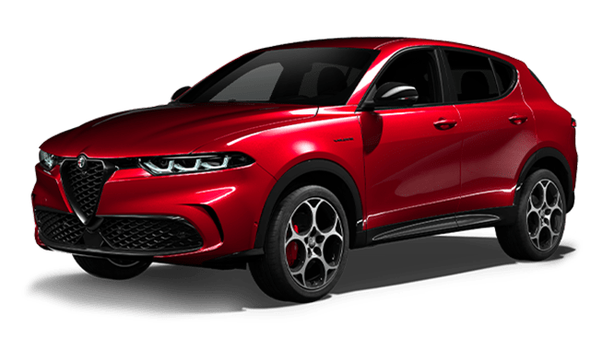







ALFA ROMEO TONALE
TONALE VS C-SUV BENCHMARK
VS
A look inside Stellantis
BMW
X1
MERCEDES
GLA
AUDI
Q3
VW TIGUAN
JEEP COMPASS
Higher prices & less equipped versions
HMI: less customizable cluster and no physical buttons for the A/C
Very high prices & less equipped versions
Outdated PHEV version: small tank & battery
Less thrilling drive
Small trunk
Higher prices & less equipped versions
HMI: no physical buttons for the A/C
«Hard» suspension tuning
Small rear row roominess
Higher prices
HMI: no physical buttons for the A/C
Turistic drive
No diesel
Less performing powertrain
Heavier
Very wide (larger than a Stelvio)
BEV offer
More powertrain choice
Perceived quality
High performance version (AMG)
More powertrain choice
All new model
Reconfigurable headlights
Latest generation ADAS systems
Fresh model
Bigger trunk
Big radio display on top trims (up to 15")
Big radio display (16")
Competitive price
BEV offer

Slide 21
100% Alfa Romeo DNA
CONCLUSION
This second WBT module revealed the new Tonale’s design, more aggressive and sporty, perfectly evolving the iconic and well appreciated design of the model.
Indeed Design is the first pillar of the new Tonale.
Even more character and sportiness on a design that is already a strength for the Tonale… Wait for WBT Part 2 and “touch with your hand” !
True Alfa Romeo DNA, translated into emotion at first drive.
Dedicated mechanical solutions create the recipe that an Alfista would expect.
Cutting edge technology, latest generation infotainment & connectivity, best in class safety (5 stars EuroNCAP) & ADAS.
Harman Kardon 14-speakers premium Hi-Fi, ventilated front seats, semi-autonomous parking…these are some of the premium features you can find on Tonale.
DESIGN
DRIVING DYNAMICS
ENHANCED SOFTWARE EXPERIENCE
PREMIUMNESS
& QUALITY
With its bold and unmistakable design, the new Tonale stands apart, created to capture attention and embody Alfa Romeo’s leading spirit.
Click on the images

Slide 22

100% Alfa Romeo DNA
CONCLUSION
New Tonale is the right-sized C-SUV with emotional design and driving pleasure, 100% Alfa Romeo DNA, perfectly matched with the comfort and roominess typical of an SUV.
What is important now is to be prepared for the appointment with customers who will come to look for New Tonale at the dealership.
Let's take full advantage of this Training and it will certainly be a success!

