Slide 1

OPERATING SITUATION OF TRAINING PROJECTS
February 17th 2026
Koinè s.n.c
Via Fornasio, 5 - 10092 Beinasco (TO) ITALY
Phone: 011.397.10.99 - Mobile: 335.6896974
e-mail: koine@koine.it

Slide 2
INDUCTION COURSES (Barbirato – D'Aquino - Lerch)
LEAPMOTOR T03 – C10 – B10 – SCORM delivered
ALFA ROMEO GIULIA – STELVIO – QUADRIFOGLIO SCORM delivered
ALFA ROMEO JUNIOR SCORM delivered
ALFA ROMEO TONALE SCORM delivered
LANCIA Ypsilon SCORM delivered
JEEP Avenger SCORM delivered
JEEP Compass SCORM delivered
FIAT Topolino SCORM delivered
FIAT Pandina SCORM delivered
FIAT Grande Panda SCORM delivered
Fiat 500e & Hybrid SCORM delivered
Fiat 600e & Hybrid SCORM delivered
ABARTH 500e SCORM delivered
ABARTH 600° SCORM delivered
Connected Services exF – exP SCORM delivered
Home_public_charging_solutions SCORM delivered
Intro to LEV SCORM delivered
FIAT PROFESSIONAL RANGE (3 courses) SCORM delivered
FIAT PROFESSIONAL PASSENGER CARS SCORM delivered
LCV CONNECTED SERVICES SCORM delivered
All courses will be composed of an initial test:
If participants fail it, they are obliged to take the course
if participants pass it, they can exit or review the course
Delivery scheduled on mid-January 2026

Slide 3
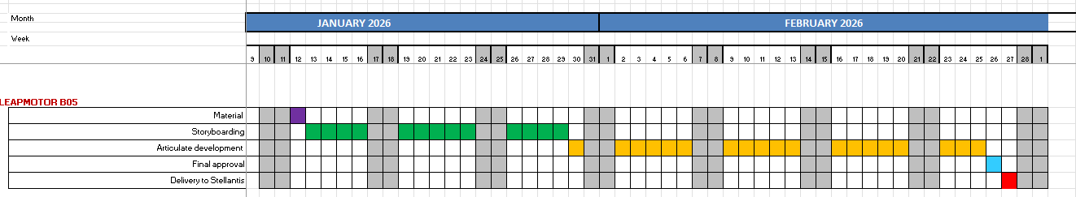
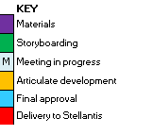
LEAPMOTOR B05 - WBT (Barbirato)
Graphic proposals delivered on January 13th
Storyboard with graphic layout delivered on February 2nd to be approved
Development of new graphic layout inspired by the Leapmotor video: new character design and gamification to be approved. The learner should pass various levels of informations to acquire the vehicle features.
Delivery postponed

Slide 4
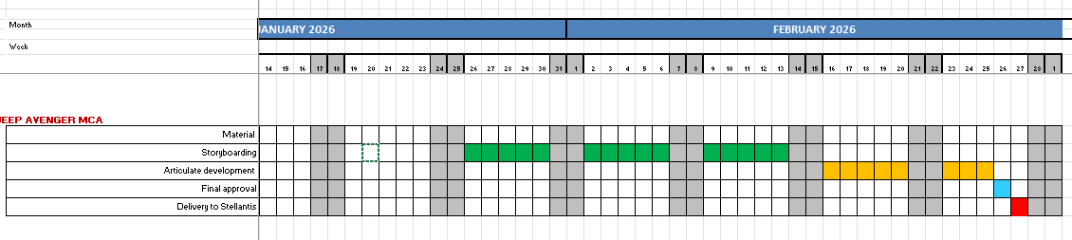
JEEP AVENGER MCA - WBT (Barbirato)
Graphic proposals approved on January 19th
Storyboarding in progress to be approved by brand
Delivery scheduled on February 27th

Slide 5
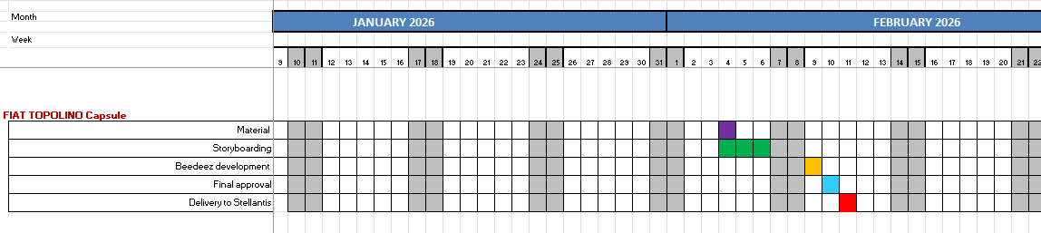
FIAT TOPOLINO capsule (Barbirato )
Storyboarding approved
Capsule development in progress
Delivery scheduled on February 13th
Delivered on February 10th

Slide 6
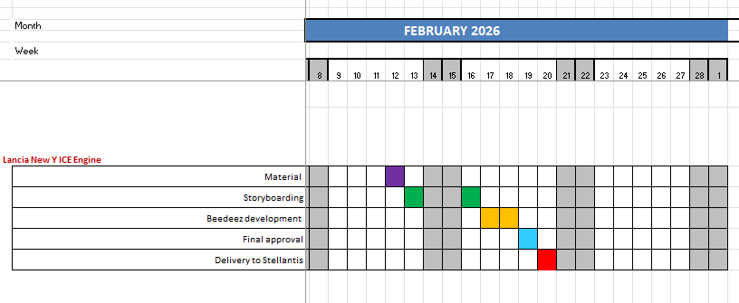
Lancia New Y ICE Engine capsule (Barbirato )
Storyboarding approved
Capsule development in progress
Delivery scheduled on February 20th

Slide 7
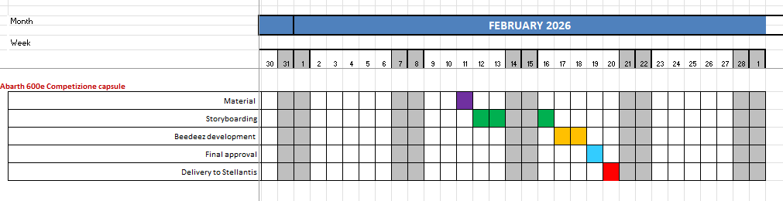
Abarth 600e Competizione capsule (Barbirato )
Storyboarding approved
Capsule development in progress
Delivery scheduled on February 20th

Slide 8
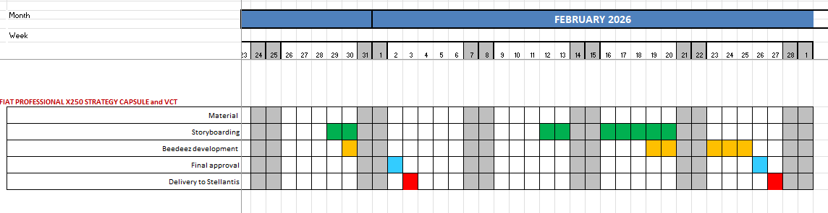
FIAT PROFESSIONAL X250 STRATEGY VCT (D'Aquino)
Capsule delivered on January 3rd
VCT storyboarding in progress
VCT material delivery scheduled on February 27th

Slide 9
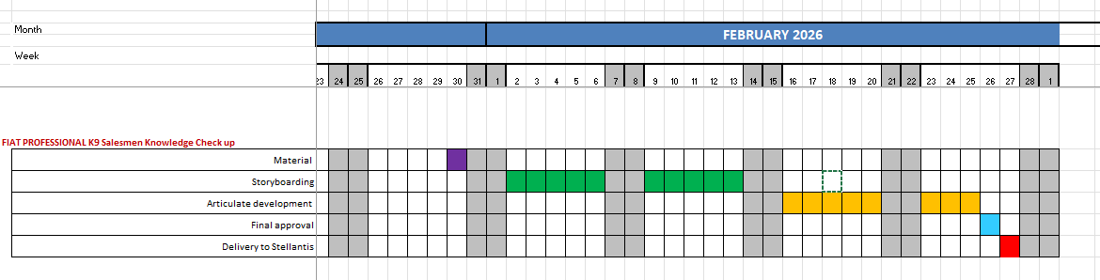
FIAT PROFESSIONAL K9 Salesmen Knowledge Check up WBT (D'Aquino)
Storyboarding and Storyline development in progress
The course concept is based on the principle of a treasure hunt (chasse au trésor).
The learner will interact with questions/instructions shown in the driver compartement until she/he finds the vehicle key hidden somewhere in the vehicle.
By solving a series of challenges, he will practice her/his knowledge of the K9 vehicle and get ready to provide the best service to customers.
WBT delivery scheduled on February 27th

Slide 11
June accounting situation PURCHASE ORDER 31381148
PURCHASE ORDER 31381148
Variable costs Q1 | 312.413,00
Variable costs Q2 | 312.413,00
Variable costs Q3 | 312.412,00
Variable costs Q4 | 312.412,00
 | 1.249.650,00
Projects
 | Barbirato | 740.422,20
 | D'Aquino | 489.227,80
 | Lerch | 20.000,00
INVOICES ISSUED
KOINE 012/2025 March |  |  | 4.800,00
KOINE 014/2025 April |  |  | 60.989,80
KOINE 018/2025 June KOINE 020/2025 July KOINE 023/2025 September KOINE 031/2025 December |  |  | 246.623,20 312.413,00 312.412,00 226.539,80
Total amount invoiced |  |  | 1.163.777,80
Remaining amount to be invoiced |  |  | 85.873,20

Slide 12
June accounting situation PURCHASE ORDER 31381148
PROJECTS included in invoice 012_2025 Euro 4.800,00 BARBIRATO
5 | JEEP Avenger 4xe Recap and USPs | 1.000,00
9 | Leapmotor focus App Memento | 3.800,00
 | Amount | 4.800,00

Slide 13
June accounting situation PURCHASE ORDER 31381148
PROJECTS included in invoice 014_2025 Euro 60.989,80
 | BARBIRATO
10 | Leapmotor HV Battery capsule | 1.000,00
3 | 2025 Connected Services Overall Update ExF Brands | 19.600,00
4 | 2025 Connected Services Overall Update ExP Brands | 14.500,00
 | D'AQUINO
1 | Citroën Ami | 19.408,00
14 | Stellantis ProOne Range | 6.481,80
 | Amount | 60.989,80

Slide 14
June accounting situation PURCHASE ORDER 31381148
PROJECTS included in invoice 018_2025 Euro 246.623,20
 | BARBIRATO
8 | New Compass part 2 | 14.100,00
12 | Leapmotor B10 Launch WBT | 19.600,00
15 | Lancia 8 years Warranty | 1.000,00
16 | C10 REEV capsule | 1.000,00
17 | C10 REEV video | 3.900,00
18 | Alfa 33 Stradale | 1.000,00
19 | AR Logo 115° Anniversary | 1.000,00
20 | Jeep Renegade capsule | 1.000,00
21 | Connected Services ExP pill | 1.000,00
22 | Connected Services ExF pill | 1.000,00
24 | New Compass Pedagogical Kit with TTT | 74.500,00
25 | Leapmotor B10 Pedagogical Kit with TTT | 74.500,00
28 | Memo File x 33 Stradale Brand Ambassador | 2.700,00
29 | Leapmotor C10 REEV Energy Modes VCT | 14.700,00
 | Amount | 211.000,00
D'AQUINO
32 | FIAT 500 trim strategy | 5.000,00
33 | Pandina trim strategy | 5.000,00
34 | FIAT 600 trim strategy | 5.000,00
35 | FIAT 8 years warranty | 1.623,20
41/41 | Ami Handover + video | 10.000,00
42 | TRIS Handover memento | 9.000,00
 | Amount | 35.623,20
Total Amount Euro 246.623,20

Slide 15
Accounting situation PURCHASE ORDER 31381148
PROJECTS included in invoice 020_2025 Euro 312.413,00 BARBIRATO
D’AQUINO
2 | FIAT PRO 3-WHEELER | 19.513,00
6 | CustomFit WBT | 19.600,00
7 | Conversion Training Path 2 VCT | 39.200,00
13 | Dodge Charger Daytona | 19.538,00
31 | LCV Induction update | 29.400,00
36 | LCV connect services | 19.600,00
37 | LCV F2move pillars (FOUR) | 4.000,00
38 | LCV taxation wbt | 19.600,00
39 | Sales methods quick guide WBT | 19.600,00
40 | Sales methods quick guide BROCHURE | 6.000,00
43 | DODGE video shooting | 5.712,00
76 | 8-YEARS WARRANTY + service contracts LCV | 19.600,00
89 | Opel Induction WBT for passenger car of K9 and K0 - starting from Product induction 2025 | 10.000,00
90 | Peugeot Induction WBT for passenger car of K9 and K0 - starting from Product induction 2025 | 10.000,00
91 | Citroen Induction WBT for passenger car of K9 and K0 - starting from Product induction 2025 | 10.000,00
92 | Fiat Induction WBT for passenger car of K9 and K0 - starting from Product induction 2025 | 10.000,00
93 | WBT for Service people, how to activate the 8year warranty (Andy) | 19.600,00
 | Total amount | 280.963,00
30 | Alfa Romeo 8 years Warranty | 1.000,00
45 | Connected Services i-DOUV capsule | 1.000,00
77 | leapmotor 5 motion animation videos | 11.000,00
80 | Fiat 500e - HYBRID | 18.450,00
 | Amount | 31.450,00
Total Amount Euro 312.413,00

Slide 16
Accounting situation PURCHASE ORDER 31381148
PROJECTS included in invoice 023_2025 Euro 312.412,00
 | BARBIRATO
11 | Jeep Wagoneer S Launch WBT | 18.900,00
23 | Connected Services Videos (4 ExF by 9 languages) | 7.000,00
26 | Jeep New Compass Handover Memento | 9.000,00
27 | Leapmotor B10 Handover Memento | 9.000,00
44 | Alfa Romeo New Tonale part 1 | 18.200,00
46 | Jeep Avenger MY 26 & Safety update capsule | 1.000,00
47 | Leapmotor C10 AWD 6 800v battery capsule | 1.000,00
48 | Connected Services App Market capsule | 1.000,00
49 | Connected Services FLEET Management Platform | 1.000,00
50 | AR Junior MY'26 | 1.000,00
51 | Jeep 8 Years Warranty | 1.000,00
52 | AR Junior Serie Speciale | 1.000,00
53 | C.S. New EV features ExP | 1.000,00
54 | C.S. New EV features ExP | 1.000,00
55 | Jeep Compass Altitude capsule | 1.000,00
56 | Fiat 600 MY26 | 18.300,00
57 | FIAT GRANDE PANDA MY 26 capsule | 1.000,00
58 | AR Tonale MCE Launch WBT Part 2 | 19.400,00
59 | AR Tonale MCE Pedagogical Kit | 14.700,00
60 | AR Tonale MCE Pedagogical Kit | 19.600,00
61 | FIAT 500 HYBRID TORINO capsule | 1.000,00
62 | Leapmotor B10 with REEV Technology | 17.500,00
63 | 2025 C.S. Update VCT ExP | 19.600,00
64 | 2025 C.S. Update VCT ExF | 14.500,00
66 | Video Ficili shooting | 5.000,00
67 | Video Ficili x Synthesia | 4.000,00
78 | Shooting and animation post-production | 9.000,00
79 | Caps on AR Junior e Tonale SS Sport Speciale | 1.000,00
81 | AR Leaflet x Brand Ambassador | 500,00
84 | Capsule on Avenger SS Black Edition Pill | 1.000,00
 | Amount | 218.200,00
 | D'AQUINO
65 | Nuovo motore K0 - 2 pill + memento | 9.000,00
65 | Price list 5 pill | 5.000,00
68 | WBT on lcv technical bases | 19.600,00
69 | WBT ALLESTIMENTI BASE | 19.600,00
70 | Sales methods quick guide for B2B | 19.600,00
71 | Sales methods quick guide for Managers | 19.600,00
74 | EOT pills (from SFS) | 1.812,00
 | Amount | 94.212,00
Total amount Euro 312,412,00

Slide 17
Accounting situation PURCHASE ORDER 31381148
PROJECTS included in invoice 031_2025 Euro 226.539,80
 | BARBIRATO
82 | INDUCTION Product WBTs Update ExF Brands + Connected Services | 170.000,00
85 | Pill on Grande Panda with 1.2 engine MT gearbox | 1.000,00
86 | Pill on C.S. ExF EVAS system | 1.000,00
87 | Pill on C.S. ExP "New Activation Process" | 1.000,00
88 | Pill on Abarth 600e S.S. Competizione | 1.000,00
 | Amount | 174.000,00
 | D'AQUINO
72 | Knowledge chek by microlearning | 5.000,00
73 | VCT on behaviour for the NSP | 19.600,00
75 94 | LCV product indution update - 3 courses, K9 - K0 - X250 LCV X250 TRIM STRATEGY | 10.000,00 17.939,80
 | Amount | 52.539,80
Total amount Euro 226.539,80

Slide 18
Accounting situation PURCHASE ORDER 31381148
PROJECTS included in invoice TO BE ISSUED Euro 85.850,00
 | BARBIRATO
95 | INDUCTION Connected Services exF exP | 19.400,00
96 | Leapmotor B05 | 19.300,00
97 | ALFA ROMEO Giulia Luna rossa | 1.000,00
98 | Lancia Ypsilon ICE MT | 1.000,00
99 | Jeep Summit 4xe | 1.000,00
100 | Alfa Romeo Tonale Handover memento 1st part | 4.922,20
101 | Jeep Avenger mca 2026 | 19.250,00
 | Amount | 65.872,20
 | LERCH
95 | INDUCTION (Barbirato/Lerch) | 20.000,00
 | Amount | 20.000,00
Total amount Euro 85.873,20

Slide 19
June accounting situation PURCHASE ORDER 31381147
PURCHASE ORDER 31381147 |  | 238.500,00
Invoices issued by Koinè
KOINE 013/2025 March |  | 35.268,65
KOINE 015/2025 April |  | 12.288,66
KOINE 019/2025 May-June |  | 71.692,69
KOINE 021/2025 August |  | 23.850,00
KOINE 024/2025 Sept |  | 23.850,00
KOINE 025/2025 Oct |  | 23.850,00
KOINE 029/2025 Nov Dec |  | 13.848,65
Invoices issued |  | 204.648,65
Order remaining amount not invoiced |  | 33.851,35
Total 2025 amount |  | 206.466,30
Total 2025 amount to be invoiced |  | 1.817,65
1st months 2026 amount to be invoiced 31.512,02
Remaining amount to be invoiced 33.329,67

Slide 20
June accounting situation PURCHASE ORDER 31381147
ACTIVITY DONE
Month | ACTIVITY | DAYS | COST X DAY (€) | TOTAL | MANAGER | PRICE (€)
January-February-March | GOVERNANCE ACCOUNT MANAGEMENT ACTIVITY | 1st quarter 2025 |  |  |  | 20.000,00
January-February-March | JUNIOR PROJECT MANAGEMENT ACTIVITY (Lavinia Crivellari) | 4+20+21 | 295,18 | 13.283,10 | D'Aquino | 13.283,10
March | SENIOR PROJECT MANAGEMENT ACTIVITY (Stefano Genovesio) | 6 | 363,53 | 2.181,18 | Barbirato | 2.181,18
April | JUNIOR PROJECT MANAGEMENT ACTIVITY (Lavinia Crivellari) | 21 | 295,18 | 5.018,06 | D'Aquino | 6.198,78
April | SENIOR PROJECT MANAGEMENT ACTIVITY (Stefano Genovesio) | 20 | 363,53 | 7.270,60 | Barbirato | 7.270,60
April May June | GOVERNANCE ACCOUNT MANAGEMENT ACTIVITY | 2st quarter 2025 |  |  |  | 20.000,00
May - June - july | JUNIOR PROJECT MANAGEMENT ACTIVITY (Lavinia Crivellari) | 20+20+23 | 295,18 | 18.596,34 | D'Aquino | 18.596,34
May - June - july | SENIOR PROJECT MANAGEMENT ACTIVITY (Stefano Genovesio) | 20+20+20 | 363,53 | 21.811,80 | Barbirato | 21.811,80

Slide 21
June accounting situation PURCHASE ORDER 31381147
ACTIVITY DONE
Month | ACTIVITY | DAYS | COST X DAY (€) | TOTAL | MANAGER | PRICE (€)
July- August-September | GOVERNANCE ACCOUNT MANAGEMENT ACTIVITY | 3rd quarter 2025 |  |  |  | 20.000,00
August-September | JUNIOR PROJECT MANAGEMENT ACTIVITY (Lavinia Crivellari) | 11+21 | 295,18 | 9.445,76 | D'Aquino | 9.445,76
August-September | SENIOR PROJECT MANAGEMENT ACTIVITY (Stefano Genovesio) | 11+21 | 363,53 | 11.632,96 | Barbirato | 11.632,96
October- November-December | GOVERNANCE ACCOUNT MANAGEMENT ACTIVITY | 4th quarter 2025 |  |  |  | 20.000,00
October- November-December | JUNIOR PROJECT MANAGEMENT ACTIVITY (Lavinia Crivellari) | 23+20+20 | 295,18 | 18.596,34 | D'Aquino | 18.596,34
October- November | SENIOR PROJECT MANAGEMENT ACTIVITY (Stefano Genovesio) | 23+20+5 | 363,53 | 17449,44 | Barbirato | 17.449,44
Total amount of 2025 |  | 206.466,30

Slide 22
June accounting situation PURCHASE ORDER 31381147
ACTIVITY 1ST QUARTER 2026
Month | ACTIVITY | DAYS | COST X DAY (€) | TOTAL | MANAGER | PRICE (€)
January | JUNIOR PROJECT MANAGEMENT ACTIVITY (Lavinia Crivellari) | 19 | 295,18 | 5.608,42 | D'Aquino | 5.608,42
February | JUNIOR PROJECT MANAGEMENT ACTIVITY (Lavinia Crivellari) | 20 | 295,18 | 5.903,60 | D'Aquino | 5.903,60
1st quarter 2026 | GOVERNANCE ACCOUNT MANAGEMENT ACTIVITY | 1st quarter 2026 |  |  |  | 20.000,00
Total amount first months 2026 |  | 31.512,02

