Slide 1

ACCOUNTING SITUATION OF TRAINING PROJECTS
February 2026
Koinè s.n.c
Via Fornasio, 5 - 10092 Beinasco (TO) ITALY
Phone: 011.397.10.99 - Mobile: 335.6896974
e-mail: koine@koine.it

Slide 2
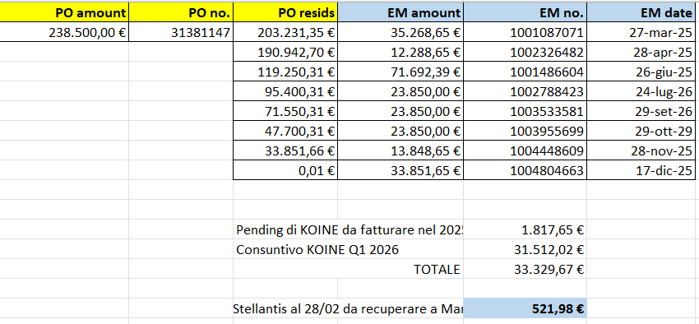
June accounting situation PURCHASE ORDER 31381147
PURCHASE ORDER 31381147 |  | 238.500,00
Invoices issued by Koinè
KOINE 013/2025 March |  | 35.268,65
KOINE 015/2025 April |  | 12.288,66
KOINE 019/2025 May-June |  | 71.692,69
KOINE 021/2025 August |  | 23.850,00
KOINE 024/2025 Sept |  | 23.850,00
KOINE 025/2025 Oct |  | 23.850,00
KOINE 029/2025 Nov Dec KOINE 002/2026 |  | 13.848,65 33.851,65
Invoices issued |  | 238.500,30
Total 2025 amount |  | 206.466,30
Total 2025 amount to be invoiced |  | 1.817,65
1st months 2026 amount to be invoiced 31.512,02
Total amount to be invoiced 33.329,67
RESTO DI ORDINE a credito x marzo |  | 521,98

Slide 3
June accounting situation PURCHASE ORDER 31381147
ACTIVITY DONE
Month | ACTIVITY | DAYS | COST X DAY (€) | TOTAL | MANAGER | PRICE (€)
January-February-March | GOVERNANCE ACCOUNT MANAGEMENT ACTIVITY | 1st quarter 2025 |  |  |  | 20.000,00
January-February-March | JUNIOR PROJECT MANAGEMENT ACTIVITY (Lavinia Crivellari) | 4+20+21 | 295,18 | 13.283,10 | D'Aquino | 13.283,10
March | SENIOR PROJECT MANAGEMENT ACTIVITY (Stefano Genovesio) | 6 | 363,53 | 2.181,18 | Barbirato | 2.181,18
April | JUNIOR PROJECT MANAGEMENT ACTIVITY (Lavinia Crivellari) | 21 | 295,18 | 5.018,06 | D'Aquino | 6.198,78
April | SENIOR PROJECT MANAGEMENT ACTIVITY (Stefano Genovesio) | 20 | 363,53 | 7.270,60 | Barbirato | 7.270,60
April May June | GOVERNANCE ACCOUNT MANAGEMENT ACTIVITY | 2st quarter 2025 |  |  |  | 20.000,00
May - June - july | JUNIOR PROJECT MANAGEMENT ACTIVITY (Lavinia Crivellari) | 20+20+23 | 295,18 | 18.596,34 | D'Aquino | 18.596,34
May - June - july | SENIOR PROJECT MANAGEMENT ACTIVITY (Stefano Genovesio) | 20+20+20 | 363,53 | 21.811,80 | Barbirato | 21.811,80

Slide 4
June accounting situation PURCHASE ORDER 31381147
ACTIVITY DONE
Month | ACTIVITY | DAYS | COST X DAY (€) | TOTAL | MANAGER | PRICE (€)
July- August-September | GOVERNANCE ACCOUNT MANAGEMENT ACTIVITY | 3rd quarter 2025 |  |  |  | 20.000,00
August-September | JUNIOR PROJECT MANAGEMENT ACTIVITY (Lavinia Crivellari) | 11+21 | 295,18 | 9.445,76 | D'Aquino | 9.445,76
August-September | SENIOR PROJECT MANAGEMENT ACTIVITY (Stefano Genovesio) | 11+21 | 363,53 | 11.632,96 | Barbirato | 11.632,96
October- November-December | GOVERNANCE ACCOUNT MANAGEMENT ACTIVITY | 4th quarter 2025 |  |  |  | 20.000,00
October- November-December | JUNIOR PROJECT MANAGEMENT ACTIVITY (Lavinia Crivellari) | 23+20+20 | 295,18 | 18.596,34 | D'Aquino | 18.596,34
October- November | SENIOR PROJECT MANAGEMENT ACTIVITY (Stefano Genovesio) | 23+20+5 | 363,53 | 17449,44 | Barbirato | 17.449,44
Total amount of 2025 |  | 206.466,30

Slide 5
June accounting situation PURCHASE ORDER 31381147
ACTIVITY 1ST QUARTER 2026
Month | ACTIVITY | DAYS | COST X DAY (€) | TOTAL | MANAGER | PRICE (€)
January | JUNIOR PROJECT MANAGEMENT ACTIVITY (Lavinia Crivellari) | 19 | 295,18 | 5.608,42 | D'Aquino | 5.608,42
February | JUNIOR PROJECT MANAGEMENT ACTIVITY (Lavinia Crivellari) | 20 | 295,18 | 5.903,60 | D'Aquino | 5.903,60
1st quarter 2026 | GOVERNANCE ACCOUNT MANAGEMENT ACTIVITY | 1st quarter 2026 |  |  |  | 20.000,00
Total amount first months 2026 |  | 31.512,02

Slide 6
June accounting situation PURCHASE ORDER 31397323
ACTIVITY 2nd QUARTER 2026
Month | ACTIVITY | DAYS | COST X DAY (€) | TOTAL | MANAGER | PRICE (€)
March | JUNIOR PROJECT MANAGEMENT ACTIVITY (Lavinia Crivellari) | 22 | 295,18 | 6.493,96 | D'Aquino | 6.493,96
April | JUNIOR PROJECT MANAGEMENT ACTIVITY (Lavinia Crivellari) | 22 | 295,18 | 6.493,96 | D'Aquino | 6.493,96
May | JUNIOR PROJECT MANAGEMENT ACTIVITY (Lavinia Crivellari) | 20 | 295,18 | 5.903,60 | D'Aquino | 5.903,60
April- May-June | GOVERNANCE ACCOUNT MANAGEMENT ACTIVITY | 2nd quarter 2025 |  |  |  | 20.000,00
Total amount first months 2026 |  | 38.891,52 da fatturare

