Slide 1


FREE2MOVE CHARGE BUSINESS SOLUTIONS
FINAL QUIZ

Slide 2
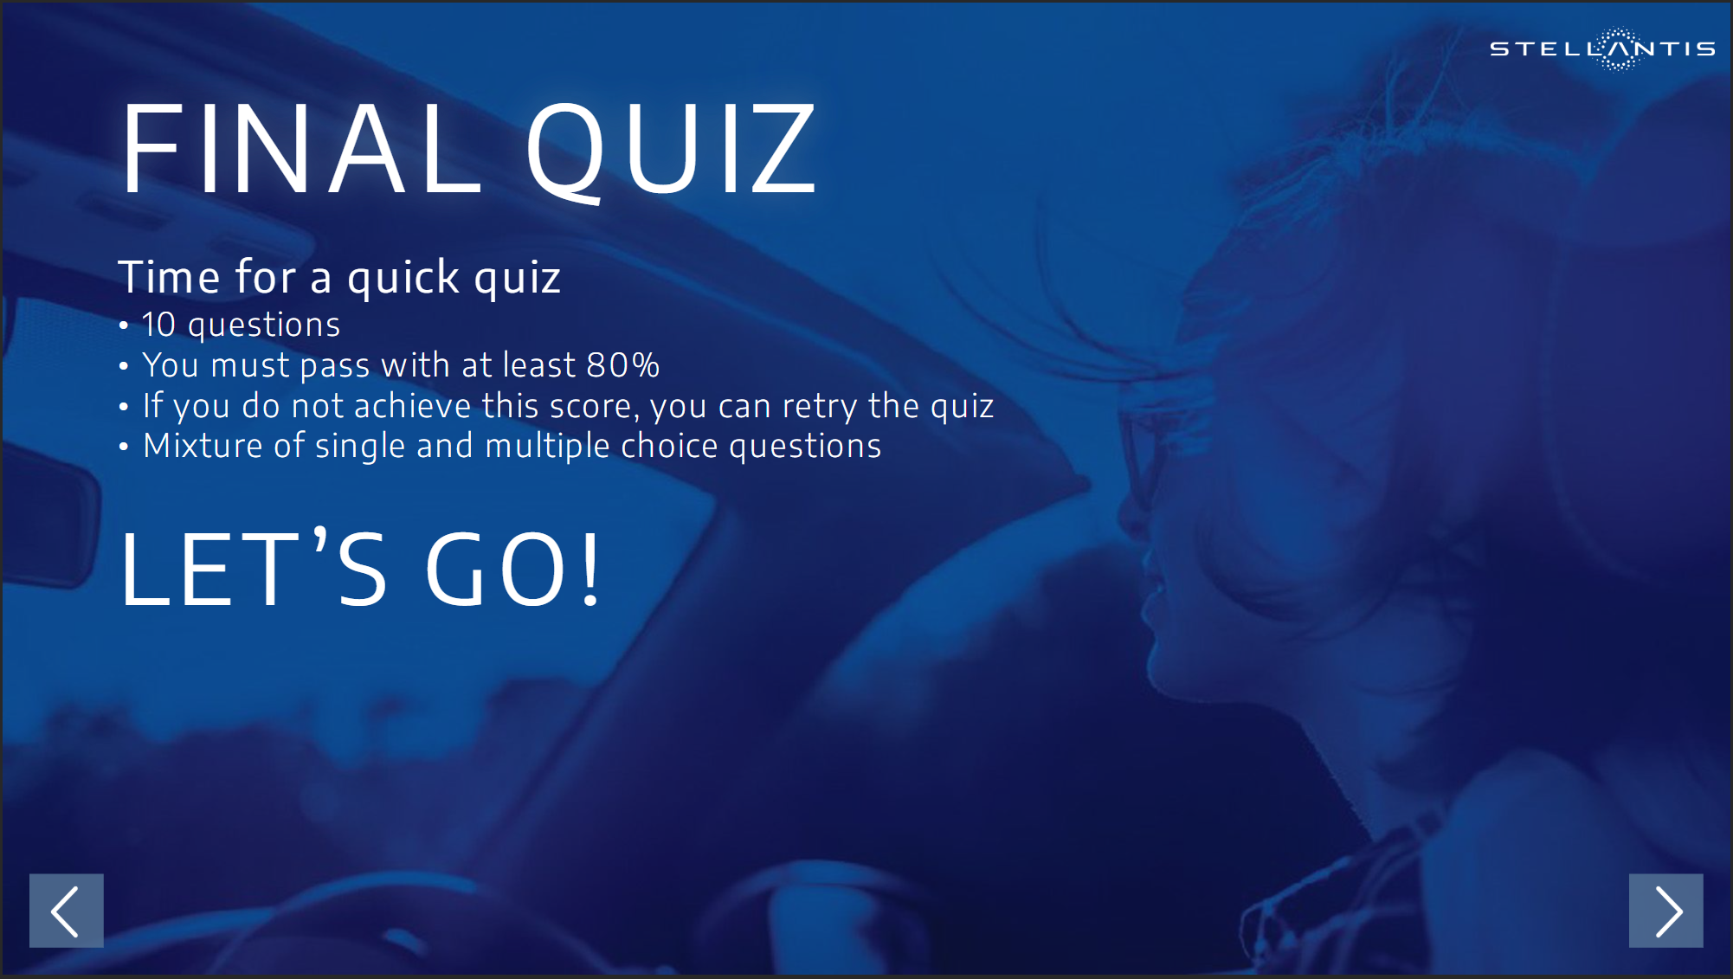
START

Slide 3
QUESTION 1/10
What aftersales services are offered by Free2move Charge Business?
Please select all the correct options.
Preventive maintenance
Legal warranty (2 or 3 years, depending on the country)
Technical assistance
Warranty extension for chargers (up to five years)
SUBMIT

Slide 4




QUESTION 1/10
What aftersales services are offered by Free2move Charge Business?
Please select all the correct options.
Preventive maintenance
Legal warranty (2 or 3 years, depending on the country)
Technical assistance
Warranty extension for chargers (up to five years)
SUBMIT

Slide 5
QUESTION 2/10
Using an 11kW wallbox, how long does it take to recover 100 km of range for an EV
equipped with an 11kW on-board charger?
Please select the correct option.
1h 40m
2h 30m
2h 50m
SUBMIT

Slide 6
QUESTION 2/10
Using an 11kW wallbox, how long does it take to recover 100 km of range for an EV
equipped with an 11kW on-board charger?
Please select the correct option.
1h 40m
2h 30m
2h 50m
SUBMIT

Slide 7
QUESTION 3/10
What is the Free2move Charge supervision platform?
Please select the correct option.
It designates the sales organization of Free2move Charge
It is a fleet management tool
It is a web-based tool to monitor and manage the charging infrastructure
SUBMIT

Slide 8
QUESTION 3/10
What is the Free2move Charge supervision platform?
Please select the correct option.
It designates the sales organization of Free2move Charge
It is a fleet management tool
It is a web-based tool to monitor and manage the charging infrastructure
SUBMIT

Slide 9
QUESTION 4/10
What type of locations are covered by Free2move Charge Business Solutions?
Please select all the correct options.
Company sites
Employee homes
On-the-go
SUBMIT

Slide 10
QUESTION 4/10
What type of locations are covered by Free2move Charge Business Solutions?
Please select all the correct options.
Company sites
Employee homes
On-the-go
SUBMIT

Slide 11
QUESTION 5/10
For company site equiptment, besides the Free2move Charge eProWallbox, what are the
advantages of the new wallboxes (EVE S-Line & EVE Pro-Line)?
Please select the correct option.
Enhanced load management capabilities
Better suited for billing charging sessions
Both of the above
SUBMIT

Slide 12
QUESTION 5/10
For company site equiptment, besides the Free2move Charge eProWallbox, what are the
advantages of the new wallboxes (EVE S-Line & EVE Pro-Line)?
Please select the correct option.
Enhanced load management capabilities
Better suited for billing charging sessions
Both of the above
SUBMIT

Slide 13
QUESTION 6/10
Which service can prevent an increase in a company’s electricity supply contract or avoid
Upgrading the local electricity network when charging a fleet of EVs?
Please select the correct option.
Supervision platform
Dynamic Load Management
Smart Charging
eProWallbox Full
SUBMIT

Slide 14
QUESTION 6/10
Which service can prevent an increase in a company’s electricity supply contract or avoid
Upgrading the local electricity network when charging a fleet of EVs?
Please select the correct option.
Supervision platform
Dynamic Load Management
Smart Charging
eProWallbox Full
SUBMIT

Slide 15
QUESTION 7/10
To provide a quote for installing charging points at a company site, does the installation
partner organise an on-site visit?
Please select the correct option.
No, it is a fully digital process
Yes, systematically
Yes, but not systenatically
SUBMIT

Slide 16
QUESTION 7/10
To provide a quote for installing charging points at a company site, does the installation
partner organise an on-site visit?
Please select the correct option.
No, it is a fully digital process
Yes, systematically
Yes, but not systenatically
SUBMIT

Slide 17
QUESTION 8/10
Does Free2move Charging Business facilitate reimbursement of electricity costs for
professional wallbox use at the employee’s home?
Please select the correct option.
No, reimbursement process always remains manual
Yes, notably thanks to an automatic reimbursment service
SUBMIT

Slide 18
QUESTION 8/10
Does Free2move Charging Business facilitate reimbursement of electricity costs for
professional wallbox use at the employee’s home?
Please select the correct option.
No, reimbursement process always remains manual
Yes, notably thanks to an automatic reimbursment service
SUBMIT

Slide 19
QUESTION 9/10
To create a lead and receive support from your Free2move Charging Business consultant, what
is the first step?
Please select the correct option.
Call your Free2move Charge consultant
Email your Free2move Charge consultant
Complete the Free2move Charge Type Form
SUBMIT

Slide 20
QUESTION 9/10
To create a lead and receive support from your Free2move Charging Business consultant, what
is the first step?
Please select the correct option.
Call your Free2move Charge consultant
Email your Free2move Charge consultant
Complete the Free2move Charge Type Form
SUBMIT

Slide 21
QUESTION 10/10
With the Free2move Charge Business App, what functionalities are available?
Please select all the correct options.
Start and pay for charging sessions at company sites
Control and manage your home charger
Start and pay for public charging sessions
Locate and select a public charging point
SUBMIT

Slide 22
QUESTION 10/10
With the Free2move Charge Business App, what functionalities are available?
Please select all the correct options.
Start and pay for charging sessions at company sites
Control and manage your home charger
Start and pay for public charging sessions
Locate and select a public charging point
SUBMIT

Slide 23


Slide 24
