Slide 1

TRAINER PREPARATION
WARNING:
The Free2move Charge Business Solution discussed in this document shows all the features and benefits of the complete solution.
Features will vary dependent on the country, so please check that all the features and benefits are available before presenting, making adjustments where necessary.

Slide 2
Free2move CHARGE BUSINESS SOLUTION
Trainer name
Updated on 17/11/2024
Notes:
Time: 00:00
Chapter duration: 5 minutes.
Total duration: 1 hour 15 minutes
Chapter objectives:
To ensure that participants feel comfortable and confident in the objectives of the session.
Trainer notes:
Holding slide as delegates join the session
Start the official introduction:
Introduce yourself and the session
Explain that we will first make the delegates comfortable before looking at the objectives of the session and then the agenda.
This session is designed to be run on Adobe Connect.

Slide 3




For your comfort
Silence Mobile Phones
Silence Microphones
Refreshments
This training is being recorded
Notes:
Trainer guide:
Run through the points on this slide, emphasizing the importance of taking part by answering questions and asking any that occur to them through the chat function.
We will now look at the objectives of the session.

Slide 4
Objectives
To understand the Free2move Charge Business solution
To know how the offer expands our opportunity to sell EVs to fleet customers
To feel reassured that support is available to help guide customers with their charging options
To recognize that including Free2move Charge solutions in sales, requires very little extra effort from you
To ensure that the offer is introduced in every new client presentation
Notes:
Trainer guide:
Run through the objectives on-screen.
To achieve these objectives, we have the following structure…

Slide 5
AGENDA
WELCOME
1
THE ELECTRIC FLEET DREAM
2
THE BARRIERS TO EV FLEET TRANSITION
3
THE FREE2MOVE CHARGE BUSINESS SOLUTION
4
4
OUR ROLE
5
CLOSE
6
Notes:
Trainer guide:
We are currently in the welcome and are about to enter ‘The Electric Fleet Dream’. Run through the rest of the agenda.
So, lets now consider the Electric Fleet Dream…

Slide 6
AGENDA
WELCOME
1
THE ELECTRIC FLEET DREAM
2
THE BARRIERS TO EV FLEET TRANSITION
3
THE FREE2MOVE CHARGE BUSINESS SOLUTION
4
4
OUR ROLE
5
CLOSE
6
Notes:
Time: 00:05
Chapter duration: 15 minutes.
Chapter objective:
To reinforce understanding of the benefits of fleets moving to electric, overcoming any gaps in knowledge.
Trainer guide:
We will start with the question; From the benefits on the next slide, which are the benefits of transitioning a fleet (whole or just part of it) to electric vehicles? This exercise is designed to be quick, so can either be run as a poll or using the chat function.

Slide 7

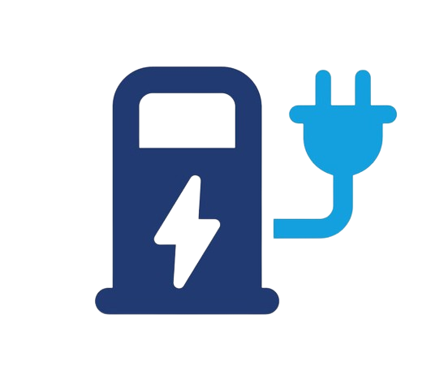
THE ELECTRIC FLEET DREAM
Benefits of transitioning to EVs?
Cost savings
Environmental benefits
Regulatory compliance
Employee attraction and retention
Brand differentiation
Notes:
Trainer guide:
Confirm that all the benefits shown are correct <animation build>. Thank delegates for their input.
Running an electric vehicle (EV) fleet can offer several benefits to a business, including:
Cost Savings
Regulatory Compliance
Brand Differentiation
Employee Attraction and Retention
Environmental Benefits
Overall, transitioning to an EV fleet can lead to significant cost savings, environmental impact reduction, and a competitive edge in a rapidly evolving market. So, let’s look into each benefit in a bit more detail.

Slide 8




THE ELECTRIC FLEET DREAM
Cost savings
Government
Incentives
Fuel Costs
Maintenance
Initial costs
Notes:
Trainer guide:
Cost Savings:
Lower Fuel Costs <animation build>: Electricity is typically cheaper than gasoline or diesel (assuming the charging is done on-site or at home). However, even charging on public chargers can be cheaper than using petrol.
Reduced Maintenance Costs <animation build>: EVs have fewer moving parts, leading to less wear and tear and lower maintenance costs over their lifespan.
Government Incentives <animation build>: Many governments offer tax credits, rebates, and grants for businesses adopting electric vehicles, which can reduce the upfront investment.
Naturally there are initial start-up costs and the perception that there is a large price difference between EVs and ICE vehicles, but we can overcome these through the sales process.

Slide 9


THE ELECTRIC FLEET DREAM
Regulatory compliance:
Emissions standards
Zero emission zones
Notes:
Trainer guide:
Regulatory Compliance:
Meeting Emission Standards <animation build>: As governments tighten emissions regulations, businesses with electric fleets are more likely to stay ahead of compliance requirements.
Zero and low emission zones <animation build>: Electric vehicles are now becoming necessary in large cities, where ICE vehicles are either banned or heavily taxed.

Slide 10




THE ELECTRIC FLEET DREAM
Brand differentiation:
Employee attraction and retention:
Environmental and Image benefits:
Competitive advantage
Attractive benefits for staff
Reduced carbon emissions
‘Green’ and sustainability image
Notes:
Trainer guide:
Brand Differentiation:
Competitive Advantage <animation build>: Businesses that operate EV fleets can differentiate themselves in the market as leaders in sustainability, which can appeal to eco-conscious consumers and partners.
Employee Attraction and Retention <animation build>:
Attractive Benefits for Staff <animation build>: Companies can use EV fleets to attract and retain employees who prioritize sustainability and innovation. Offering EV incentives to employees can also enhance satisfaction.
Environmental Benefits <animation build>:
Reduced Carbon Emissions <animation build>: EVs produce zero tailpipe emissions, helping businesses reduce their carbon footprint and support sustainability initiatives
Sustainability and Green Image <animation build>: Adopting EVs can improve a company’s public image by demonstrating commitment to environmental responsibility, which may be attractive to customers, investors, and employees.

Slide 11

THE ELECTRIC FLEET DREAM
What percentage of total BEV sales in Europe were B2B in 2024?
(0ctober year-to-date)
Total Market:
50%
BEV sales accounted for 18% of the B2B market, 14% of the B2C market.
Source: Dataforce
Stellantis:
38%
11% of B2B
14% of B2C
Source: Dataforce
Notes:
Trainer guide:
This slide should be tailored to the country.
As at October year-to-date, B2B sales (fleet and short-term rental) accounted for 50% of total BEV sales. With BEV sales accounting for 14% of the total B2B market and 18% for the B2C market. This shows that there is an opportunity in the B2B market to grow sales further.
When we look at Stellantis sales <animation build>, you can see that we are tracking behind these figures in percentage of B2B sales and, therefore percentage of BEV sales that are B2B. So we have a real opportunity to improve <animation build>.
(Note: we must insist on this point!, using the red box build to highlight these figures more)
However, we don’t just want to follow the market, we want to be leading the market. What we will see shortly will help us do just this.
Before we go that far, lest now look at what stops our customers from buying BEVs…

Slide 12
AGENDA
WELCOME
1
THE ELECTRIC FLEET DREAM
2
THE BARRIERS TO EV FLEET TRANSITION
3
THE FREE2MOVE CHARGE BUSINESS SOLUTION
4
4
OUR ROLE
5
CLOSE
6
Notes:
Time: 00:20
Duration: 15 minutes.
Chapter objective:
To improve delegate understanding of the considerations business managers must review when moving their fleets across from ICE vehicles to EVs. This session will begin the process of getting delegates to open up their qualification criteria for customers moving to EV.
Trainer guide:
At this point ask delegates to enter into the chat why they believe customers may avoid electric vehicles. This will be discussed shortly.
Before we move specifically to electric vehicles, we will consider why businesses (and people) fail to purchase at times…

Slide 13


THE BARRIERS TO EV FLEET TRANSITION
What prevents business managers from making a purchase or change?
LOSS AVERSION THEORY
Daniel Kahneman and Amos Tversky
Missed threat
vs
missed opportunity
Notes:
Trainer guide:
So what does prevent business managers from making a purchase or a change?
The answer lies in ‘Loss Aversion Theory’ as developed by Daniel Kahneman and Amos Tversky <animation build>. The model shows that we are more likely to be aware of the danger a threat <animation build> and, therefore, missing that threat, than we are aware of the reward from a success or opportunity <animation build> . Indeed, we can be up to 2.5 times more aware of avoiding a loss than gaining a reward.
Let’s demonstrate this….

Slide 14

THE BARRIERS TO EV FLEET TRANSITION
Notes:
Image from: https://unsplash.com/photos/golf-course-near-body-of-water-XhQahuFDq1E
Trainer guide:
Ask delegates to raise their hands if they play golf. Then ask for a chat response “If you were faced with this scene and were about to play a ball, what would you be focused on?”
The answer for most is that they would be focused on avoiding the water, rather than on sinking the ball in the appropriate hole. This is an exact example of ‘Loss Aversion Theory’.
So, how does it apply to the world of buying?...

Slide 15
THE BARRIERS TO EV FLEET TRANSITION
What prevents business managers from making a purchase or change?
LOSS AVERSION THEORY
Daniel Kahneman and Amos Tversky
Missed threat
vs
missed opportunity
Consumers – avoid regret
Managers – avoid blame
Notes:
Trainer guide:
Well, in the consumer world <animation build>, customer avoid purchasing in order to avoid regret, better known as ‘buyers remorse’.
In the business world, managers avoid purchasing to <animation build> avoid blame. They don’t want to be the person that everyone accuses of creating the problems they have.
So, what are the things they could be blamed for when purchasing electric vehicles? Review the answers provided in the chat earlier by the delegates.
Then align to the next slide…

Slide 16

THE BARRIERS TO EV FLEET TRANSITION
Avoiding blame with electric vehicles:
Increased
costs
Vehicle
range
Increased
costs
Government incentives
Increased
journey times
Increased
journey times
Charging
issues
Total Cost of Ownership
Charging
issues
Notes:
Trainer guide:
Use the following notes to run through each point on the slide; there is an animation build for each key concern.
Of these concerns, the top 3 are increased costs, increased journey times (due to their range anxiety) and charging issues.
Explain that the customer buys from the business that can minimize the most of these concerns.
Trainer to ask: Is that business, your dealership and, specifically, you?... Next slide.
Increased Costs <animation build>
Higher Purchase Price: Although operating costs tend to be lower, EVs traditionally have a higher initial purchase price compared to traditional gasoline or diesel vehicles. This can be a significant barrier for small and medium-sized businesses with limited capital.
Charging Infrastructure: Businesses need to invest in charging infrastructure, which can add substantial upfront costs, especially for fleets that require multiple charging stations.
Increased journey times <animation build>
Limited Range: While EV range is improving, many electric vehicles still can’t match the long-range capabilities of gasoline or diesel vehicles, particularly for businesses requiring vehicles to cover long distances or operate in remote areas.
Charging issues <animation build>
Charging Infrastructure: Access to charging stations—especially fast chargers—can be a problem, particularly for businesses operating outside of urban areas or in locations where public charging infrastructure is limited. Even businesses with on-site charging stations may face operational challenges, such as managing downtime for charging.
Total Cost of Ownership (TCO). <animation build>
Unclear Long-Term Savings: Although many studies show that EVs can lead to cost savings over time, some businesses may struggle to calculate the true total cost of ownership (TCO) due to factors like charging infrastructure investment, potential battery replacement, or the unknown lifespan of the vehicle in a commercial environment.
Battery Degradation: Over time, EV batteries degrade, reducing vehicle range and efficiency. Although modern EVs come with warranties, businesses may worry about the long-term reliability and performance of the batteries, especially in high-use environments.
Resale Value: The depreciation rate of EVs, particularly those with older battery technology, can be a concern for businesses looking to maintain or refresh their fleet over time.
Energy Costs: While electricity is cheaper than gas or diesel in most cases, fluctuating energy prices, especially during peak demand times, can affect overall operating costs, particularly if a fleet depends on expensive public charging stations.
Government incentives <animation build>
Emissions Regulations: In some regions, regulations may not yet be strict enough to push businesses to adopt EV fleets, or there may be concerns about future compliance with emissions standards.
Government Incentives: The availability of government incentives (e.g., tax rebates, grants) can be a strong motivator for businesses to transition to EVs. However, these incentives can vary by location and may change or expire over time, creating uncertainty for long-term planning.
Vehicle range <animation build>
Fleet-Specific Requirements: Not all businesses can find EV models that suit their specific fleet needs. For example, larger commercial vehicles like trucks, delivery vans, or specialized vehicles may not yet have EV equivalents that match the performance, payload, or other capabilities of their internal combustion counterparts.
Variety of Models: While the variety of EVs on the market is growing, it may not yet cover all vehicle categories that some businesses require, limiting the options for fleets in specific industries.

Slide 17


OUR ROLE
Today
Specification
Performance
Finance
Maintenance
B2B Sales Advisor
Fleet Manager
Notes:
Trainer guide:
You see, traditionally, the B2B Sales Advisors <animation build> works specifically with the customer’s Fleet Managers <animation build> , focusing on vehicle specification <animation build> , performance, finance and maintenance.
However, does this answer all the concerns of the customer?

Slide 18

THE BARRIERS TO EV FLEET TRANSITION
Which concerns can we minimize?
Vehicle
range
Increased
costs
Government incentives
Increased
journey times
Total Cost of Ownership
Charging
issues
Notes:
Trainer guide:
Well, if we look at each of the concerns, then we see that:
Increased costs <animation build> – through our knowledge of the vehicle range, we can overcome some of the customer’s cost concerns. However, we cannot overcome them all, as we are not experts in charging point installation
Increased journey times <animation build> – Knowledge of the practical range of the vehicles and to manage the vehicle charge will help overcome some concerns, but not all
Charging issues – We have little knowledge of chargers and how to maximize their performance, so cannot build value here
Total cost of ownership <animation build> – Thorough knowledge of our models will allow us to manage customer expectations about TCO, however, we have
Government incentives <animation build> – Again, we have some knowledge related to the vehicles but how much do we know related to charging points?
Vehicle range <animation build> – this is our expert subject, so we will be able to put customer minds at rest – especially given the range of electric model available from Stellantis
So, yes we can put some of the customer’s concerns to rest but can we truly give them the confidence they need to move forwards, especially since many customers will not have experienced the transition to electric vehicles themselves and the top 3 concerns are not really answered? However, through a little research, we can expand our knowledge. For example…

Slide 19
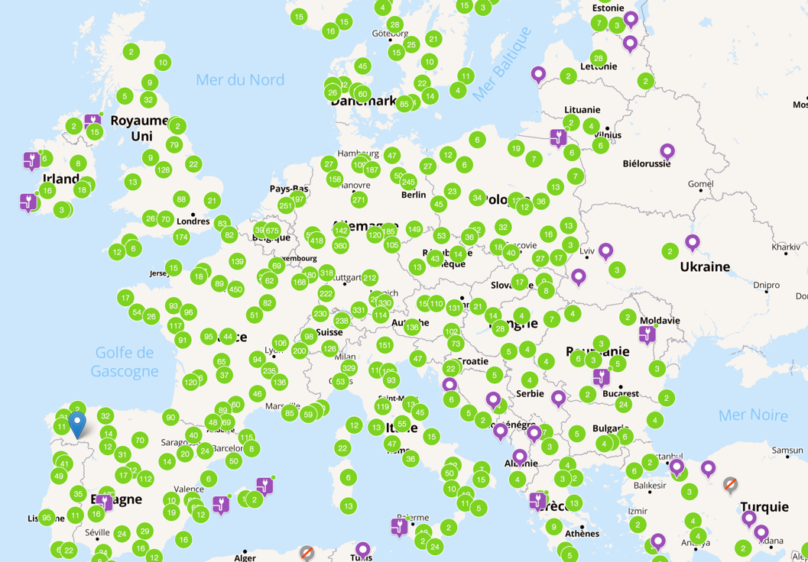
THE BARRIERS TO EV FLEET TRANSITION
2026 European target: a supercharger every 60 km on highway
2 000 000
800 000
127 000
2020
2023
2030
Notes:
Trainer guide:
We know that the European target for 2026 is to have a supercharger every 60 kilometers on highways.
This fact alone means that…

Slide 20


THE BARRIERS TO EV FLEET TRANSITION
Which concerns can we minimize?
Vehicle
range
Increased
costs
Government incentives
Increased
journey times
Total Cost of Ownership
Charging
issues
Notes:
Trainer guide:
We are even more capable of answering customer concerns regarding <animation build> 2 of the top 3 concerns (increased journey times and charging issues), however we still cannot put the customer’s mind to rest.
It is for this reason, that we have created the Free2move Charge business solution…

Slide 21
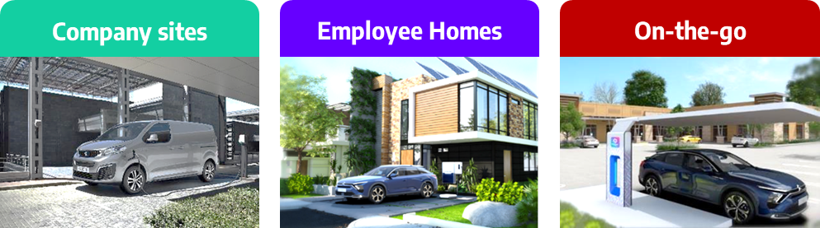
OUR ROLE
– EV Ecosystem
Tomorrow
B2B Sales Advisor
Fleet Manager
Notes:
Trainer guide:
We know that our fleet customers are ever more concerned regarding charging. <animation build> Should they use on-site chargers, employee home chargers and / or on-the-go chargers? What can they install? What will be best for them?
The great news is that we are providing customers with a solution that can answer their additional needs.
Before we look at what we will need to do, let’s first understand what the ‘Free2move Charge Business Solution is.

Slide 22
AGENDA
WELCOME
1
THE ELECTRIC FLEET DREAM
2
THE BARRIERS TO EV FLEET TRANSITION
3
THE FREE2MOVE CHARGE BUSINESS SOLUTION
4
4
OUR ROLE
5
CLOSE
6
Notes:
Time: 00:35
Duration: 15 minutes.
Chapter objective:
Delegates will understand the offer provided by the Free2Move Charge business solution and how essential it is to their sales success in the future.
Trainer guide:
So, we will now consider what the new ‘Free2move Charge Business Solution’ is.

Slide 23

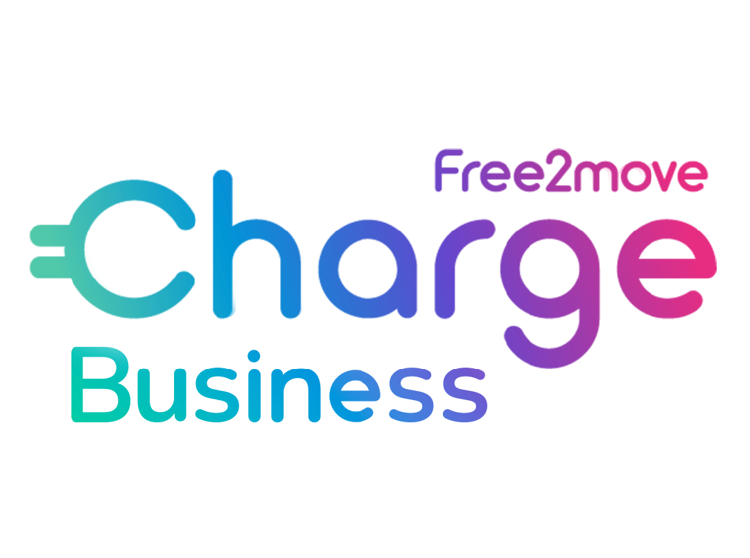
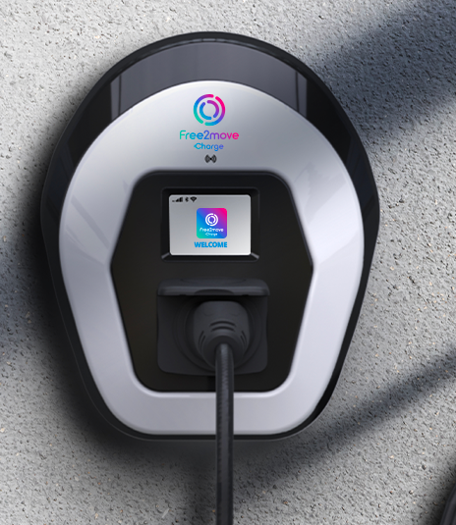
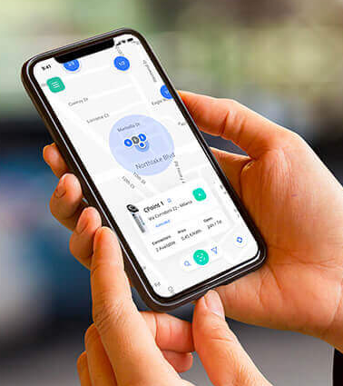

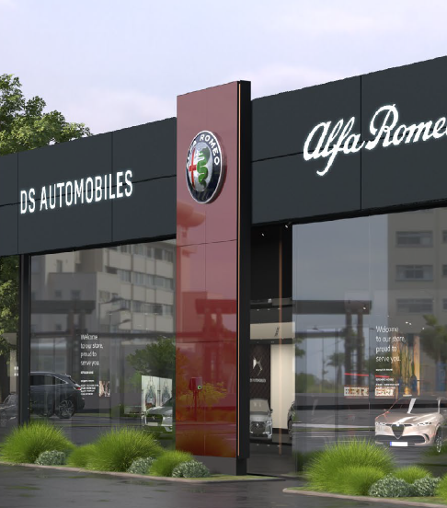
THE FREE2MOVE CHARGE BUSINESS SOLUTION
Free2move Charge
x RETAIL
Free2move Charge
BUSINESS
Free2move Charge
HOME
Free2move Charge
GO
CHARGING DEVICES
& INSTALLATION
+700.000 CHARGING POINTS IN EUROPE
LEV CHARGING STANDARDS & FAST CHARGING
BUSINESS SOLUTIONS & EMPLOYEE CHARGING
Notes:
Trainer Guide:
As you may know, Free2move Charge proposes solutions for all Stellantis brands and Networks.
For B2C customers, you are already familiar with Home charging offer (wall boxes line-up) and with the Public charging offer through our App: Free2move Charge (previously-e-Solutions Charging), that gives an access to the largest European public charging Network.
These two pillars are systematically presented in new product launch training modules.
To sum-up the 4 pillars proposed by Free2move Charge:
Home: charging HW/Installation/SW and energy services
Go: access to the largest European public charging network + digital eco-system
Retail: develops Charging & energy services in our dealer networks (we’ve greyed this one out as it is not customer facing)
The last one is simply names “Business” and this is what we will deep dive in <animation build>
So, what are the benefits we are providing through the Business pillar?

Slide 24
THE FREE2MOVE CHARGE BUSINESS SOLUTION
Customer benefits:
Advice on EV charging solutions
One-stop-shop experience
Turnkey and tailor-made solutions
Outstanding products and services
Optimization of total cost of ownership
Notes:
Trainer Guide:
As business sales advisor during your meetings, you will start with the discovery phase and the identification of the specific needs, objections and concerns of your customer.
Beyond presentation of the BEV car specifications, you will need to have a broader approach taking into account the needs for charging solutions. Free2move Charge will support you with this.
Run through the bullet points on-screen using the information below:
Free2move Charge brings unique benefits to your business customers, solving their key concerns:
Advice on EV charging solutions: customers will get the advice of a EV charging expert to identify the best solutions for charging their EVs based on their usage, current and future needs
One-stop-shop experience: they will get a comprehensive answer to all their needs, simplifying the transition plan. No needs to search and coordinate different suppliers, we do it for them
Turnkey and white-glove solutions: they will get turnkey solutions for home charging and on-the-go charging, and tailor-made solutions to equip their company sites
Outstanding products & services: they will benefit from the best-in-class products and services, reliable, innovative and easy to use, perfectly fitting business use cases and expectations
Control on TCO: products and services offered will contribute to control and optimize the total cost of ownership for the vehicle fleet, thanks to dashboarding on energy costs, smart charging features, revenue generation
So, lets now look at what the solution is in greater depth…

Slide 25

THE FREE2MOVE CHARGE BUSINESS SOLUTION
Free2move Charge & eSolutions – UN ECOSISTEMA
BASED ON:
OPERATED BY:
Comprehensive ecosystem fulfilling EV charging and energy needs, both for private and business customers.
A strategic partner of Stellantis, supporting the development of Free2move Charge.
The customer facing ecosystem for hardware, software and services
Setting product requirements and timing of commercialization
Go-to-market strategy & commercialization execution
Leading private charging solutions, with latest smart chargers and installation services
Advanced software and digital products, ensuring easy access to public chargers
Charging Point Operators (CPOs) management
Notes:
Trainer Guide:
As the pace of mainstream EV adoption accelerates, our customers need us to be more than just an electric vehicle provider.
Free2move Charge, together with all the Stellantis Brands, accompany customers in the transition to electric mobility, by providing a 360° ecosystem that delivers charging and energy management solutions.
The Free2move Charge Business eco-system has been created based on Free2move Charge requirements and is operated by <animation build> our strategic partner Free2move e-Solutions.

Slide 26
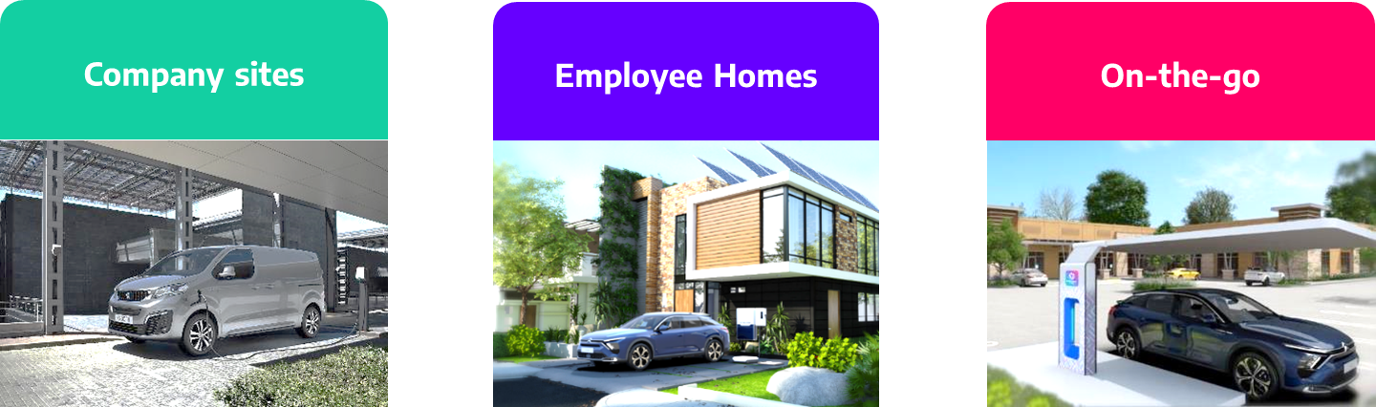
THE FREE2MOVE CHARGE BUSINESS SOLUTION
Free2move Charge
BUSINESS
11
Advisory services - Hardware - Installation - Digital services - Customer care
BUSINESS SOLUTIONS & EMPLOYEE CHARGING
Company sites
Employee Homes
On-the-go
With Free2move Charge Business, it is e-ABC : easy to Always Be Charged !
Notes:
Trainer Guide:
So Free2move Charge Business is a 360° eco-system in Europe, to support Energy Transition of Fleet Customers.
The Eco-system is composed of charging devices, digital services, installation and aftersales services which provide relevant charging solutions and an optimal customer experience.
Charging topics need to be approached through three parameters on which Free2move Charge has built its expertise :
Solutions to use electric vehicles, charging them on the company site(s)
Solutions to make electric vehicle usage easier at each employee’s home
Solutions to support each employee’s mission when they are on the go
Hence, we say that <animation build> with Free2move Charge business, it is e-ABC: easy to Always Be Charged!
It is a comprehensive solution that includes…

Slide 27
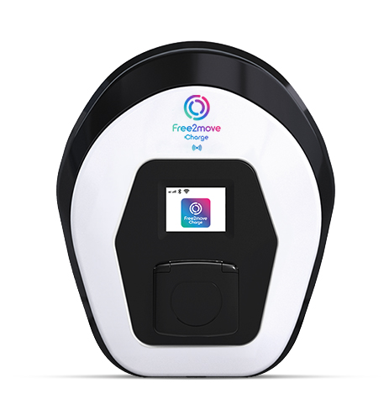
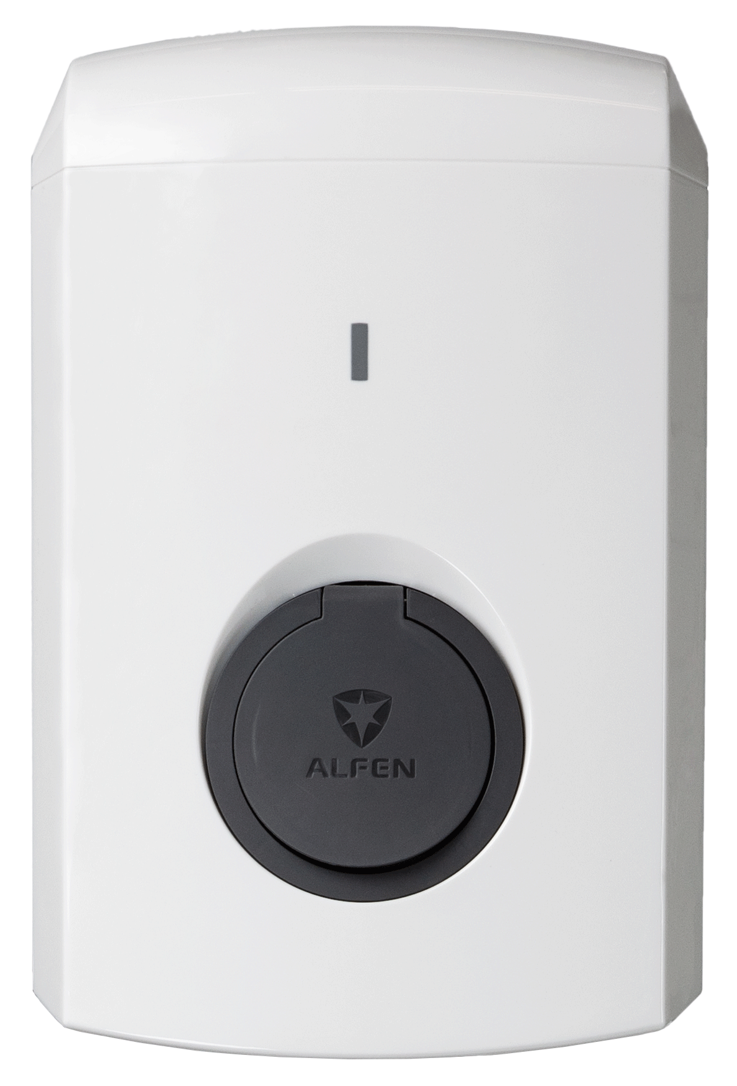

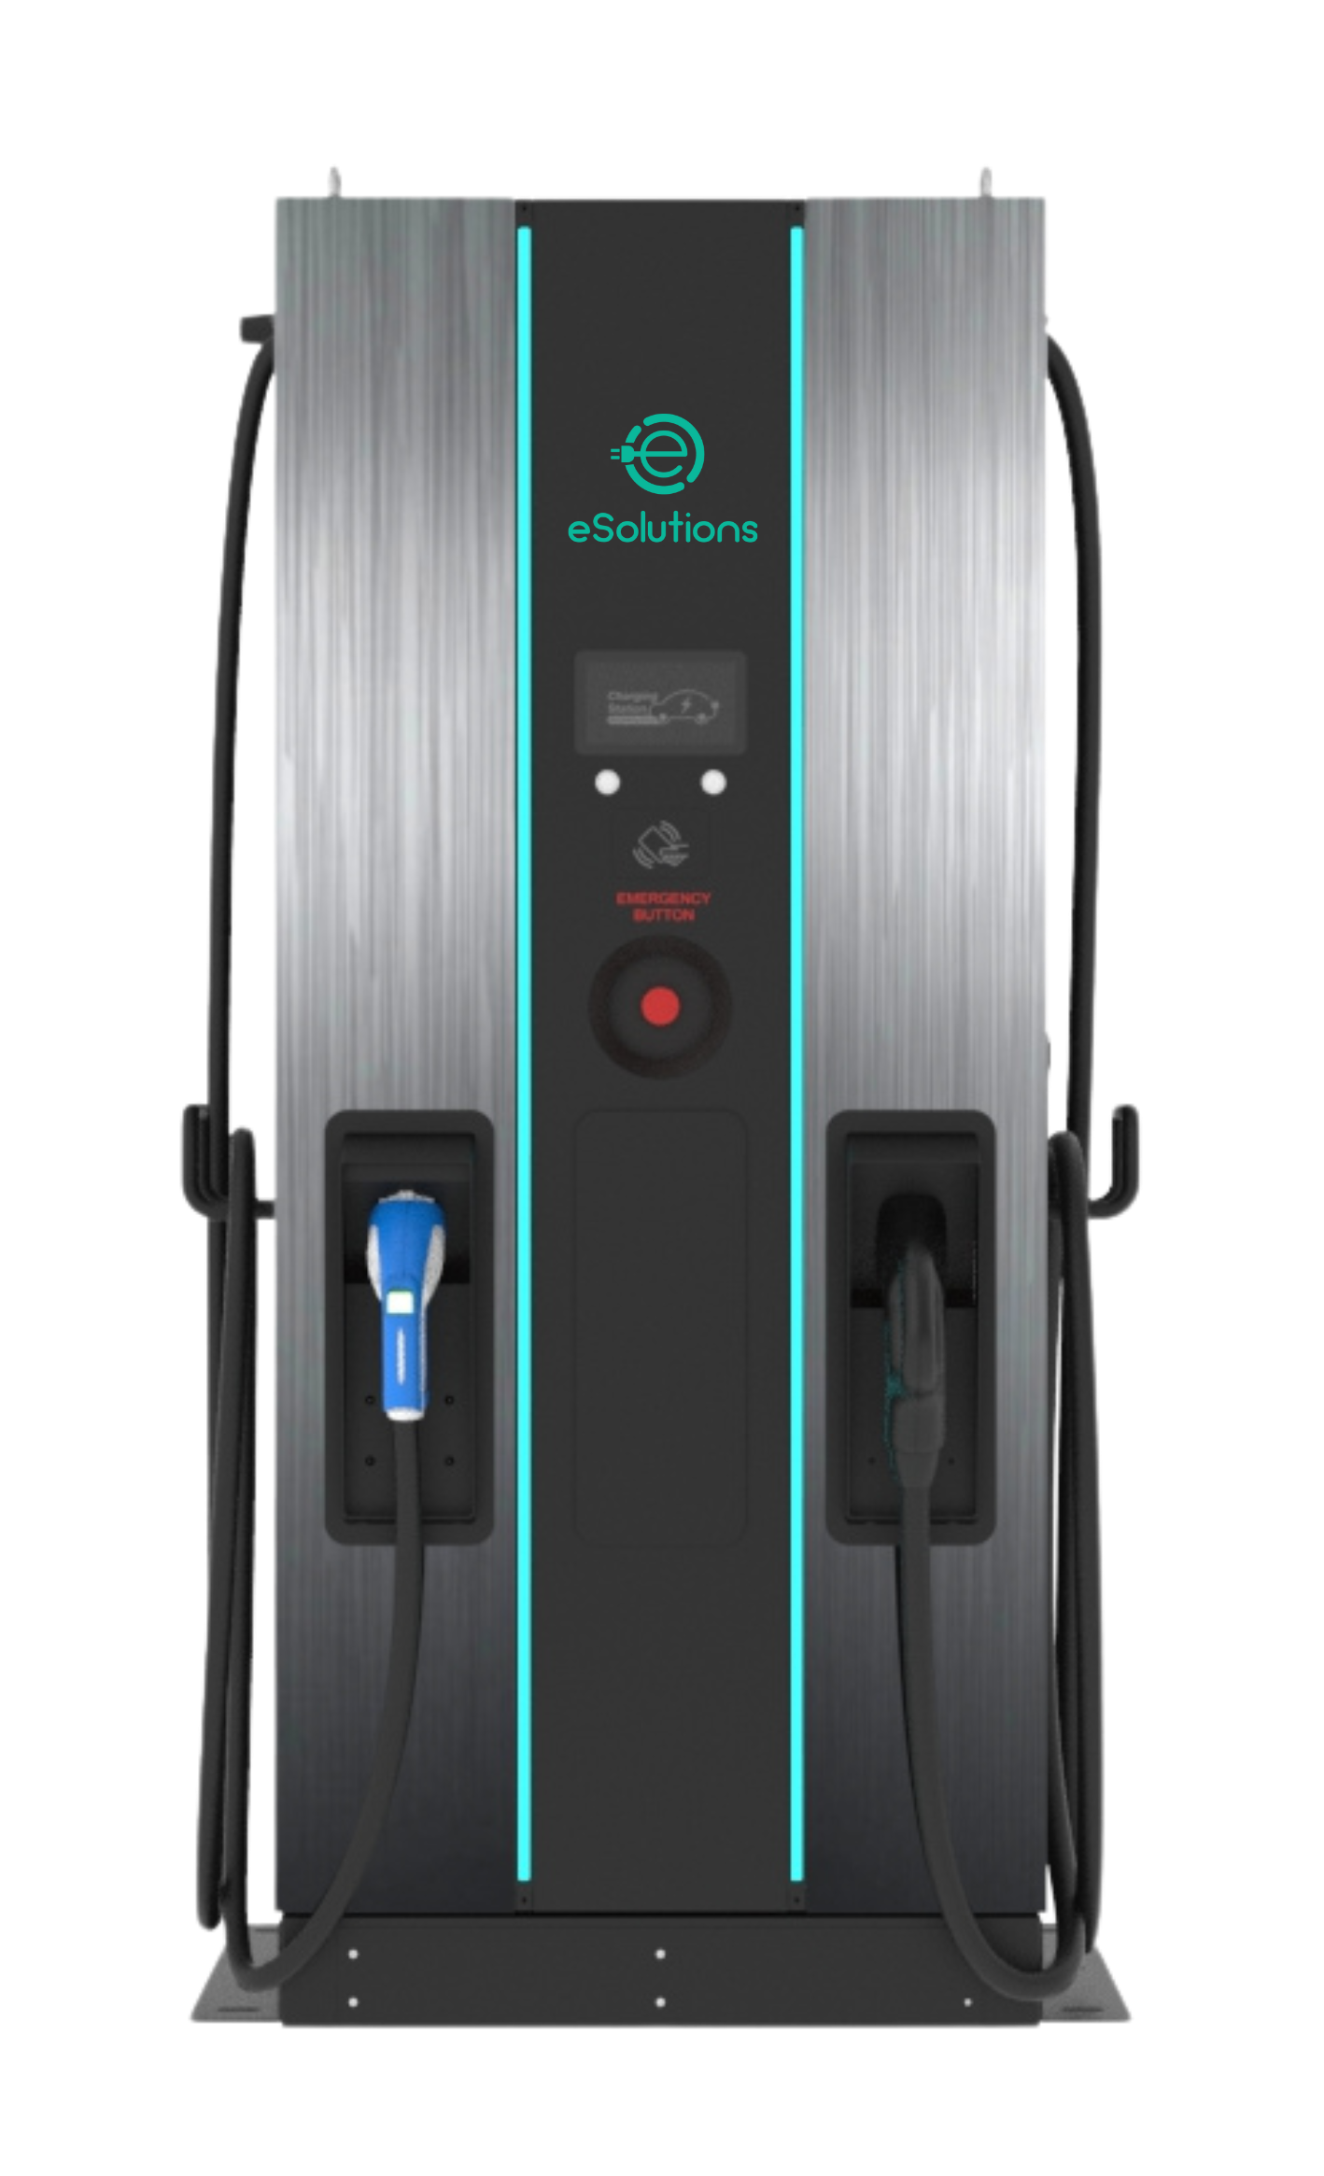
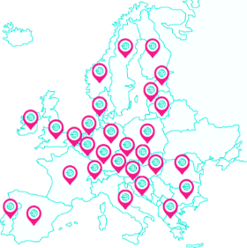

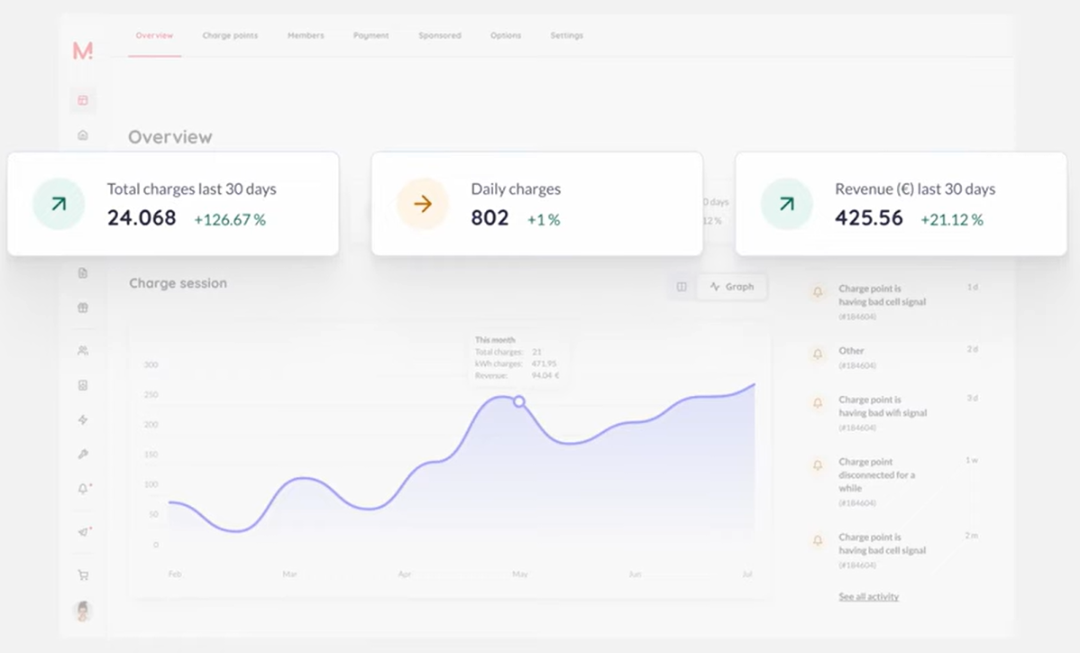
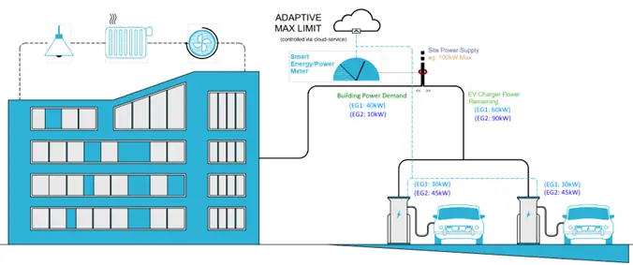
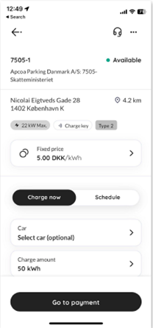
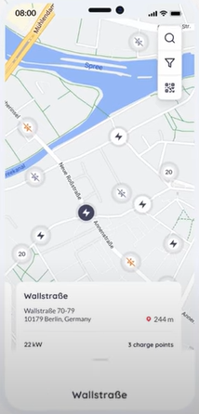
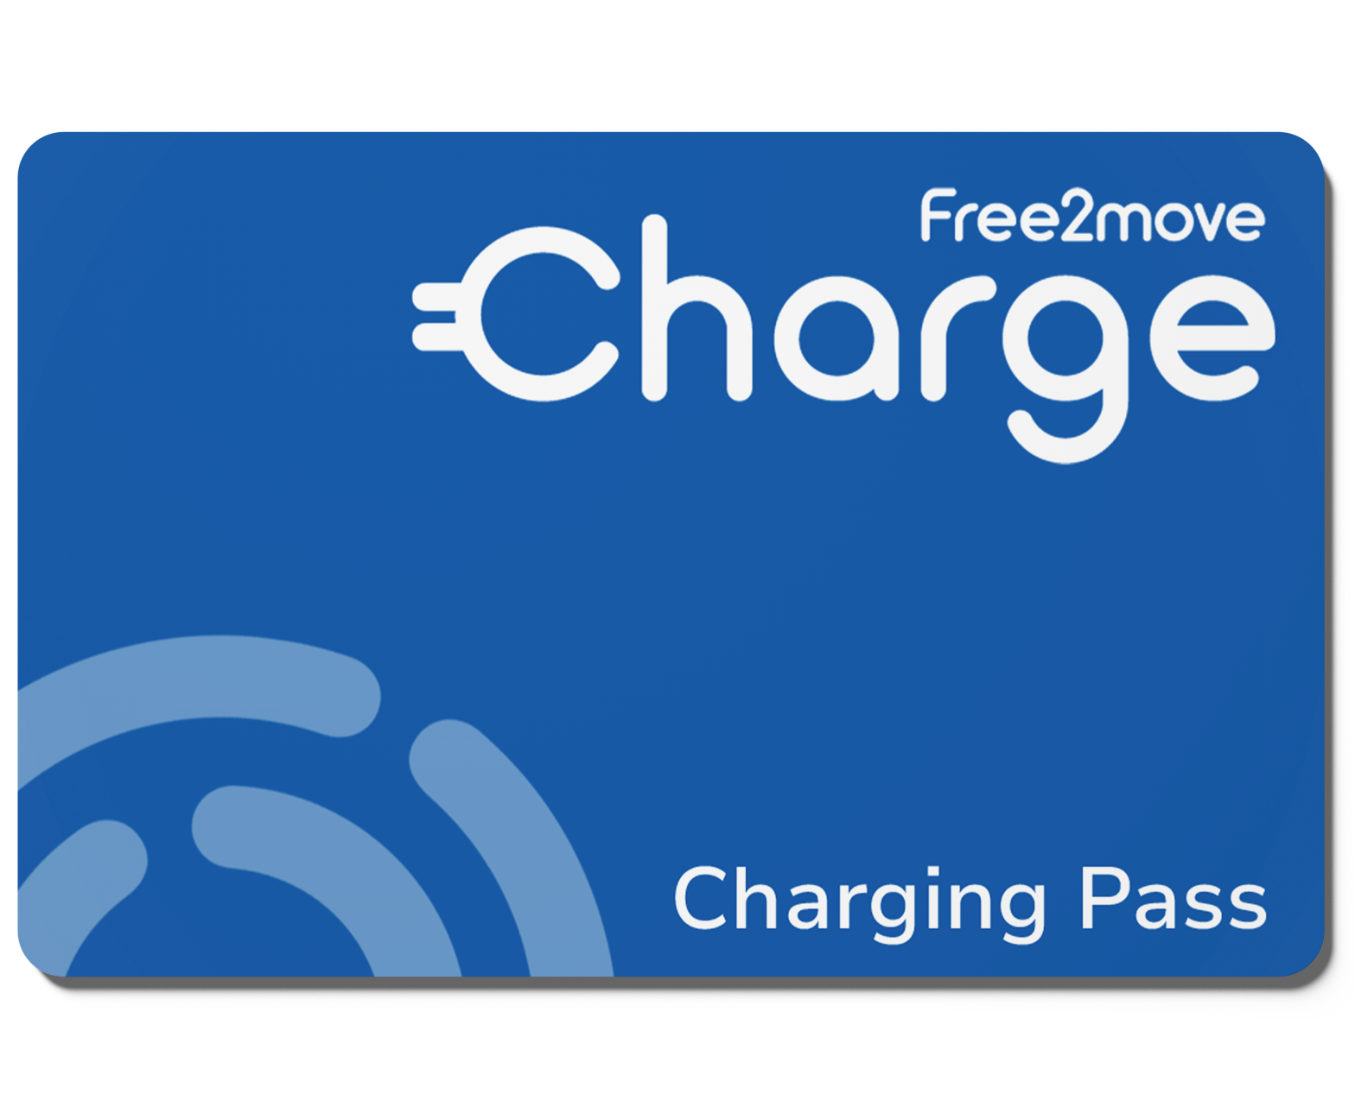











THE FREE2MOVE CHARGE BUSINESS SOLUTION
COMPANY SITE CHARGING
Tailor-made offers
HOME CHARGING
Packaged offers
PUBLIC CHARGING
Flexible offers
AC and DC chargers
AC chargers
Europe-wide network
> 760 000 charge points
Charging and energy services
Charging and energy services
Charging services
Supervision platform
Dynamic load management
Charging app
RFID card
Charging app
RFID card
Automatic reimbursement
Charging app
RFID card
Flexible payment options
Installation services
Installation services
Site
evaluation
Permitting
Civil
works
Hardware installation
Commissioning
Site
evaluation
Hardware installation
Commissioning
-
Aftersales Services
Aftersales Services
Aftersales Services
Warranty Coverage
Maintenance / Optional Coverage
Customized
SLA
Assistance
Warranty Coverage
Assistance
Assistance
Notes:
Trainer Guide:
Please note: Charger images will need to be changed to match the offer in your region / country.
…focus on the there key domains of expertise that customers are looking for support in; on-site charging, home charging and on-the-go charging.
Under the four subheadings of chargers, charging and energy services, installation services and aftersales services, there are aspects that you will recognize and some that will be new. In this presentation, we will look at the new aspects.
Let’s start by looking under the ‘Company Site Charging’ domain…

Slide 28
THE FREE2MOVE CHARGE BUSINESS SOLUTION
COMPANY SITE CHARGING
Taylor-made offers
AC and DC chargers:
AC and DC chargers
DC chargers
AC chargers
coming soon
eProWallbox
EVE S-line
EVE Pro-line
Charging and energy services
Supervision platform
Dynamic load management
Charging app
RFID card
Installation services
Up to 22 kW (3-ph)
Up to 7,4 kW (1-ph)
RFID reader
4G/WiFi
Up to 11 kW (3-ph)
Up to 7,4 kW (1-ph)
RFID reader
Ethernet
Built-in MID meter
Load balancing
Up to 22 kW (3-ph)
Up to 7,4 kW (1-ph)
RFID reader
Ethernet / 4G
Built-in MID meter
Load balancing
Up to 200+ kW (tbc)
2 cables
RFID reader
Ethernet / WIFI / 4G
Built-in MID meter
Load balancing
Site
evaluation
Permitting
Civil
works
Hardware installation
Commissioning
Aftersales Services
Warranty Coverage
Maintenance / Optional Coverage
Customized
SLA
Assistance
Please note: The DC charger image is for illustration purposes only. It is due Q4 2024
Notes:
Trainer Guide
(Trainer note: the information in this slide is designed to provide confidence in delegates, it is not for an in-depth discussion regarding the different types of charger.)
Our powerful, qualitative, evolutive and scalable chargers will cover the current and future needs of your customer.
They are easy-to-use and reliable; they enable top-notch charging and energy services. In addition, EVE S line and Pro line allow dynamic load management at company site where power supply is too limited to allow satisfying charging times during peak hours. The new two WallBoxes have better load management capabilities and are more suitable to invoicing of charging sessions.
The DC Charger is coming soon, to allow on-site fast charging.
So…
Let’s start with what is supposed to be already known (wallboxes) : eProWallbox Full: powerful and easy to use, for charging infrastructure not requiring evolved dynamic load management (charging times acceptable with available power supply and static load management)
<animation build>< Insist on what is new vs the previous line-up>
<animation build> A DC Charger is also coming soon to allow on-site fast charging
With these new charging solutions, you are able to propose a full line-up covering all charging needs of companies.

Slide 29
THE FREE2MOVE CHARGE BUSINESS SOLUTION
COMPANY SITE CHARGING
Taylor-made offers
AC and DC chargers:
AC and DC chargers
Customer Benefits
Easy to use
Easy to manage
Optimized charging times and costs
Easy to maintain
Robust
Fast charging times
  AC:
      2 hours 10 mins per 100 km with 7,4 kW charger
      1 hour 40 mins per 100 km with 11 kW charger
  DC:
      10 minutes per 100 km with 100 kW
Charging and energy services
Supervision platform
Dynamic load management
Charging app
RFID card
Installation services
Site
evaluation
Permitting
Civil
works
Hardware installation
Commissioning
Aftersales Services
Warranty Coverage
Maintenance / Optional Coverage
Customized
SLA
Assistance
Notes:
Trainer Guide
In terms of benefits to the customer…
Easy to use: access via app or RFID card, display/led
Easy to manage: connectivity for remote control of chargers
Optimized charging times and costs: load management
Easy to maintain: remote troubleshooting & firmware update
Robust: resistance to water and dust
Fast charging times
AC:
2h10 per 100 km with 7,4 kW charger
1h40 per 100 km with 11kW charger
DC:
10 minutes per 100 km with 100 kW
To summarise, from now we are able to propose a full charger line-up, covering all customer charging needs.
There’s further good news for managers, as these link to the charge point supervision platform…

Slide 30
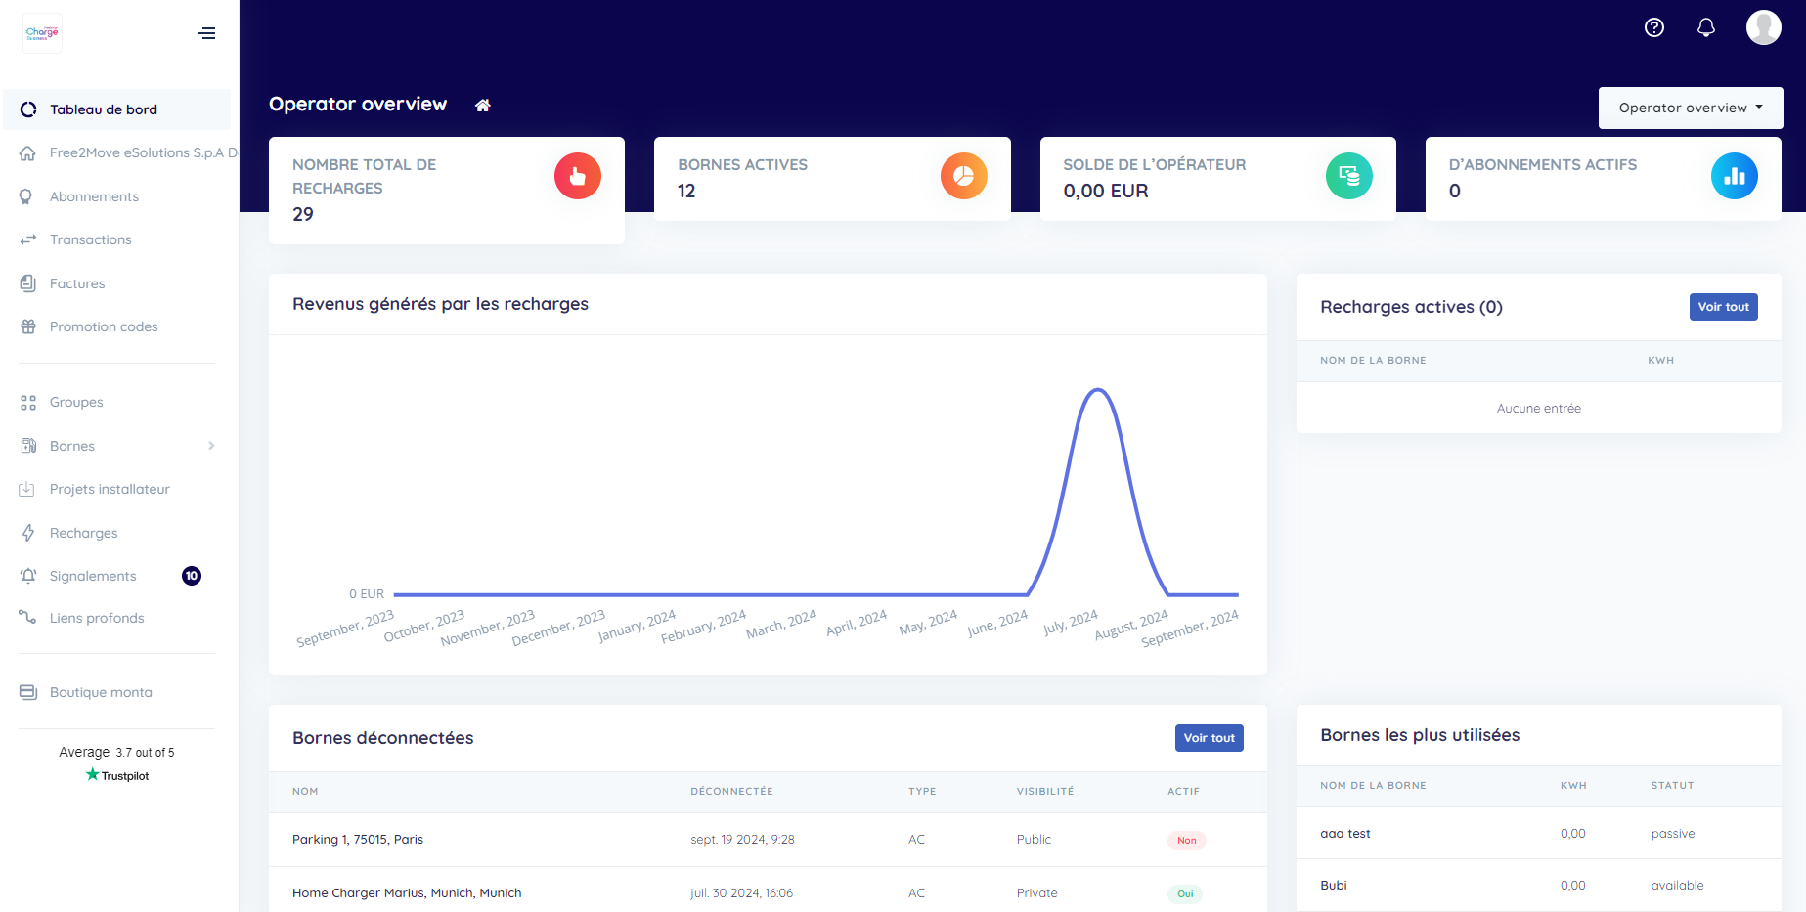
THE FREE2MOVE CHARGE BUSINESS SOLUTION
COMPANY SITE CHARGING
Taylor-made offers
Charge point supervision platform:
AC and DC chargers
Charging and energy services
Supervision platform
Dynamic load management
Charging app
RFID card
Benefits:
Flexible access and tariffs settings
Smart queuing
Dynamic power sharing
Charger performance and usage monitoring
Remote command and maintenance
Automatic payments and billing
Consumption, costs and revenue tracking
Subscription cost: 9 € / month / charge point
Installation services
Site
evaluation
Permitting
Civil
works
Hardware installation
Commissioning
Aftersales Services
Warranty Coverage
Maintenance / Optional Coverage
Customized
SLA
Assistance
30
Notes:
Trainer Guide:
Charge point supervision platform
We are excited to present the best-in-class charge point supervision platform that guarantees fast and cost-effective charging as well as full control of the Company’s chargers.
It gives the flexibility to tailor how the charging infrastructure functions, in accordance to company’s requirements in terms of access, tariffs, and power management.
This is a totally new service provided by F2MC, giving our customer managers <animation build> :
Flexible access and tariffs settings; Select who can access the chargers and the price paid for usage
Smart queuing to improve usage rate; allowing users to schedule their slots for usage, with the system notifying them when the charger is ready for them and when they are disconnected
Dynamic power sharing between chargers in use; balancing the power going to the chargers to maximise charging performance
Monitoring of chargers performance & usage; allowing the business to keep all chargers working at the peak of their performance
Remote command and maintenance; the ability to reset chargers when required and adjust the performance from the app
Automatic payments & billing; reducing administration for both the business and the user
Tracking of consumptions, costs and revenues; allowing managers to more accurately forecast fleet costs, as well as find ways to minimize costs in the future
All of this in just one app.
This is just what it does with the on-site chargers. There’s more it will help managers with with home and on-the-go charging, as will be revealed in the coming slides.
Let’s stay with on-site charging for the moment and look at load balancing…
Support information:
Smart Queueing
Driver can register in a virtual queue line at a company charging point
Drivers are notified by Free2move Charge Business when their charging session is over to organise for the next turn.
Built-in messaging system even allows users to discuss between them.

Slide 31
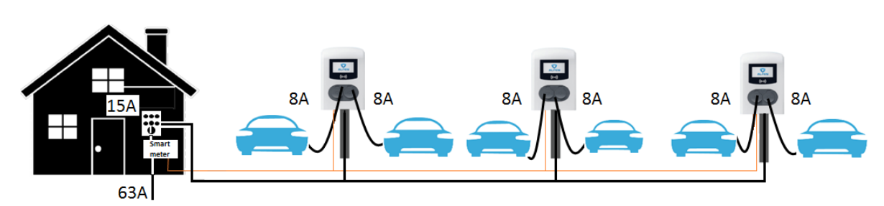
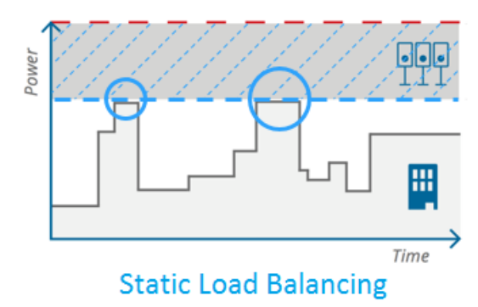
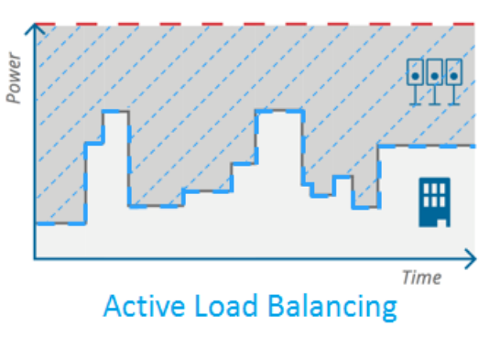
THE FREE2MOVE CHARGE BUSINESS SOLUTION
COMPANY SITE CHARGING
Taylor-made offers
Dynamic load management:
AC and DC chargers
Charging and energy services
Supervision platform
Dynamic load management
Charging app
RFID card
Installation services
Site
evaluation
Permitting
Civil
works
Hardware installation
Commissioning
Benefits:
Reduce investment in electricity installations and contracts
Optimize charging times
Aftersales Services
Warranty Coverage
Maintenance / Optional Coverage
Customized
SLA
Assistance
31
Notes:
Trainer Guide:
Load management:
Often, power available at the company site is not enough to cover the electricity needs of the facility and of the charging infrastructure, notably during peak hours.
Upgrading the utility contract and installation can be expensive, long, and sometimes just impossible. Our load management solution addresses this problem by distributing the maximum power available between the vehicles which are charging on site.
The system does not just balance the power based on the maximum power available at peak consumption (static load balancing), it uses active load balancing.
Active load balancing is a more evolved solution which allows to adapt power available to charging infrastructure based on real-time analysis of power consumption of other essential equipment of your facility / site thanks to EMS or energy meter.
So in terms of benefits <animation build>, customers will be able to minimize investment in their electricity installation and contracts. They will also be able to optimize charging times based on their business needs.
That’s not all though, because our customers need the systems to be easy to use for the vehicle drivers too and it is…

Slide 32
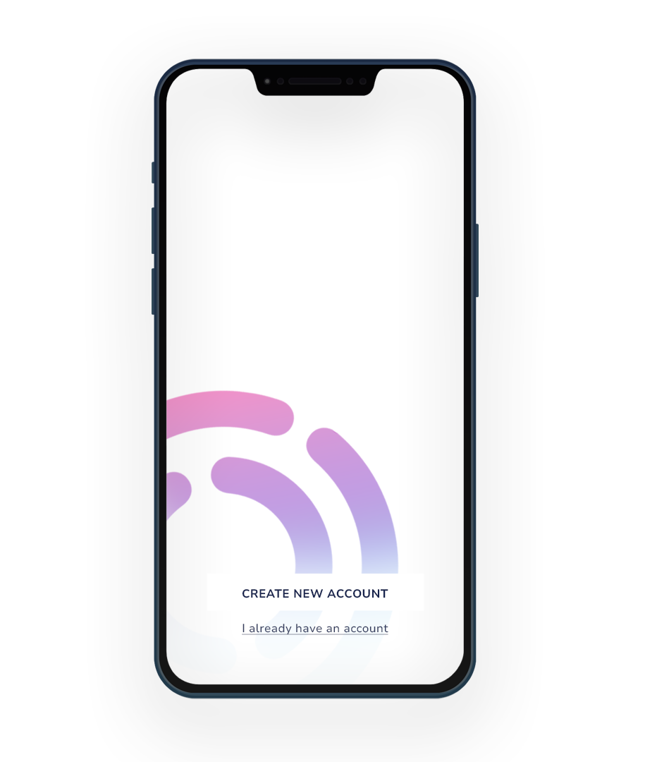

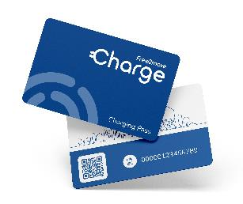
THE FREE2MOVE CHARGE BUSINESS SOLUTION
COMPANY SITE CHARGING
Taylor-made offers
Specific Free2move Charge Business app and Charging Pass Business (RFID Card):
AC and DC chargers
Charging and energy services
Supervision platform
Dynamic load management
Charging app
RFID card
Installation services
Site
evaluation
Permitting
Civil
works
Hardware installation
Commissioning
Benefits:
New B2B focused app
One app / charging pass
Easy to use ‘do-it-all’ app
Smart Queueing
Aftersales Services
Warranty Coverage
Maintenance / Optional Coverage
Customized
SLA
Assistance
32
Notes:
Trainer Guide:
Free2move Charge Business app Charging Pass Business (RFID Card):
A new Free2move Charge Business App (different to the B2C app) and Charging Pass Business (RFID card), allow employees to charge at chargers on the company site.
Moreover, the same app and Pass can be used when charging at home or on-the-go.
On receipt of their RFID card, users can add their card to their app, so they no longer need to carry the physical card. This facility allows users to use multiple cards, so cards can be linked to vehicles or users, dependent on how the business wants to manage them.
Once set up the app communicates with the ‘Charge point supervision platform’ allowing the user to:
Book an on-site charging station and manage the charging session remotely
Pay (according the company policy) in case of personal car use
Access charging history and invoices
Book charge point and be notified when it’s available (Smart Queueing).
Receive a message when charging is over
The Charging Pass Business (RFID) Card can:
Start a charging session with just a swipe, ideal if giving a visitor access to charging on-site
Work even when 4G network not available
In summary, we provide users with <animation build>:
One app / charging pass
Easy to use ‘do-it-all’ app
Smart Queueing for on-site charging
So, in operation, both managers and users have a class leading, easy to use experience. However, it is fundamental that the experience is right from the very beginning, so we help the customer through their EV installation too…

Slide 33

THE FREE2MOVE CHARGE BUSINESS SOLUTION
COMPANY SITE CHARGING
Taylor-made offers
Expert partners:
AC and DC chargers
Systematic on-site technical analysis
Project management
Permits
Charging and energy services
Supervision platform
Dynamic load management
Charging app
RFID card
Civil works
and electric installation upgrade
Hardware installation
Activation of connected services
Installation services
Site
evaluation
Permitting
Civil
works
Hardware installation
Commissioning
Benefits
Reliable partners, fully skilled to equip company sites
Systematic on-site technical analysis
Tailored comprehensive solutions
Dedicated project management for complex and large projects
Aftersales Services
Warranty Coverage
Maintenance / Optional Coverage
Customized
SLA
Assistance
33
Notes:
Trainer Guide:
Expert Partners:
As part of the one-stop-shop experience, our Installation Partners will take care of the implementation of the charging infrastructures at customers premises.
Installation partners have been specifically selected and trained to ensure smooth and qualitative implementation.
As you can understand from the different steps on screen, from the moment they are introduced to customers, Free2move Charge Business partners are able to take care of all operations needed to implement a charging infrastructure, including permitting, civil works, and upgrade of electric installation.
The benefits, therefore, include: <animation build>:
Reliable partners, fully skilled to equip company sites – just like the customer can trust your dealership will service all their needs with regards to obtaining their electric vehicles, Free2move Business will service all their needs when it comes to understanding, planning and installing their charging systems
Systematic on-site technical analysis - Installation partner or its contractors may support customer in the permitting activities, civil works and upgrade of electric installation
Tailored comprehensive solutions - Each project will start with an on-site technical survey in order to understand the specific set-up of the site, assess feasibility and provide a tailor-made solution
Dedicated project management for complex and large projects - When size and complexity of the project requires it, a dedicated project management will be put in place to ensure the proper execution
Similarly, customers need to be looked after once they are operational, so we offer a full aftersales service too…

Slide 34
THE FREE2MOVE CHARGE BUSINESS SOLUTION
COMPANY SITE CHARGING
Taylor-made offers
Aftersales services:
AC and DC chargers
Maintenance / Optional Coverage
Warranty Coverage
Charging and energy services
2-year Parts warranty for AC and DC chargers
Optional 5-year parts and labor coverage with annual maintenance
Supervision platform
Dynamic load management
Charging app
RFID card
Customized Service Level Agreement (SLA)
Assistance
Installation services
Site
evaluation
Permitting
Civil
works
Hardware installation
Commissioning
Tailor-made service agreement to meet business needs
Dedicated team to provide technical assistance
Onsite intervention when required
Aftersales Services
Warranty Coverage
Maintenance / Optional Coverage
Customized
SLA
Assistance
Benefits:
Complete cover for all your customer’s needs
Tailor-made solutions for specific needs
Notes:
Trainer Guide:
For an always up and running fleet, Free2move Charge provide maintenance plan and warranty extension in addition to the standard 2-year warranty on the chargers. The creation of a customized ensures that every customer has the level of service that they expect, accounting for their different needs.
Should anything go wrong, then they can also be assured of technical assistance either on email or via the telephone, during working hours.
So, for your customer, this means <animation build>:
Complete cover for all your customer’s needs – you know they will be in safe hands that will give them the best support structure possible to get their electric vehicle fleet running
Tailor-made solutions for specific needs – ensures that customers get the best fit solution for their business needs
This will add the final element in giving customers peace of mind with regards to office installations and operation. Yet, the service offers even more, starting with home charging…

Slide 35
THE FREE2MOVE CHARGE BUSINESS SOLUTION
HOME CHARGING
Packaged offers
Automatic reimbursement service:
AC chargers
Sponsor employees’ home chargers
Automatic consumption reporting
Costs are calculated according to company policy:
  Real cost or
  Fixed cost per kWh
Automatically debits company virtual wallet
Automatically credits employee’s virtual wallet
Charging and energy services
Charging app
RFID card
Automatic reimbursement
Benefits:
Easy to use and fully automated solution
Relieves companies from administrative tasks
Flexible parameters to define reimbursement rules
Full visibility and control on transactions through the supervision platform
Transparent packages (wallbox + installation + aftersales)
Installation services
Site
evaluation
Hardware installation
Commissioning
Aftersales Services
Warranty Coverage
Assistance
35
Notes:
Trainer Guide:
As with all Free2move Charge offers, customers and users will find our solutions to be clear and transparent.
One of the key aspects of the Free2move Charge Business solution at the employee’s home is the capacity to manage automated reimbursement when the employee uses the charger for professional usage.
It is important to note that the actual hardware offer (wall boxes) is the same as we already see in the Free2move Charge Home offer. With Free2move Charge Business, the offer includes both installation and aftersales / customer care. (Trainer note: The offer varies by country, so please confirm the offer in your country).
The automated reimbursement service will enable businesses to set up hassle-free charging solutions at employee homes. Employees are sure to be reimbursed quickly, with the company not having to manage expense claims and reimbursements, everything is automated!
The system allows businesses to:
Sponsor employee home chargers
Have energy consumption automatically reported to them via the supervision platform; improving accuracy and timeliness of information
Pay costs according to company policy ( either based on real cost or fixed cost per kWh for all employees)
With the ability to differentiate between business and private charging, the solution can automatically debit costs from the company virtual wallet (provided that credit is sufficient) and into the the employee’s virtual wallet.
So, the benefits of this service is <animation build>:
Easy to use and fully automated solution
Relieves companies from administrative tasks
Flexible parameters to define reimbursement rules
Full visibility and control on transactions through the supervision platform
Transparent packagey (Wallbox+Installation+ Aftersales/customer Care). The package content may vary according country, but it always be very clear & transparent packages
Let’s not forget that the user has full control of their charging via the App too, so both the business and user have a truly simple, transparent system to use.
The benefits don’t stop there though, as we still need to consider the on-the-go domain…

Slide 36
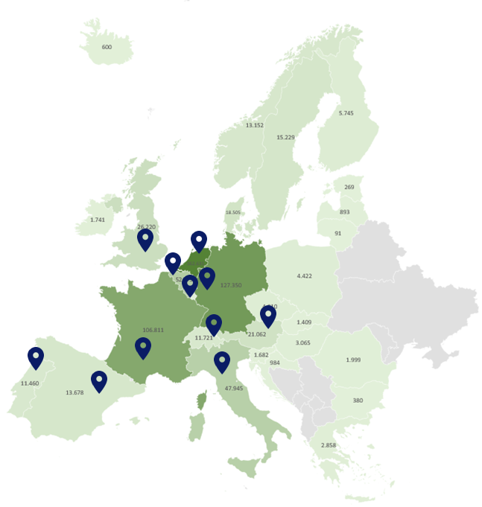
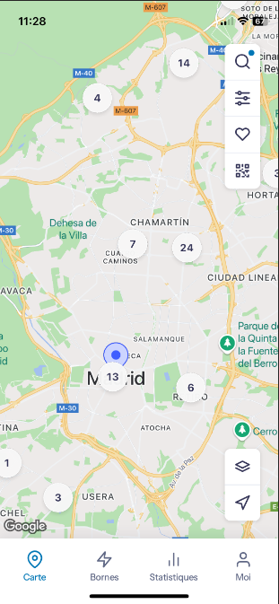
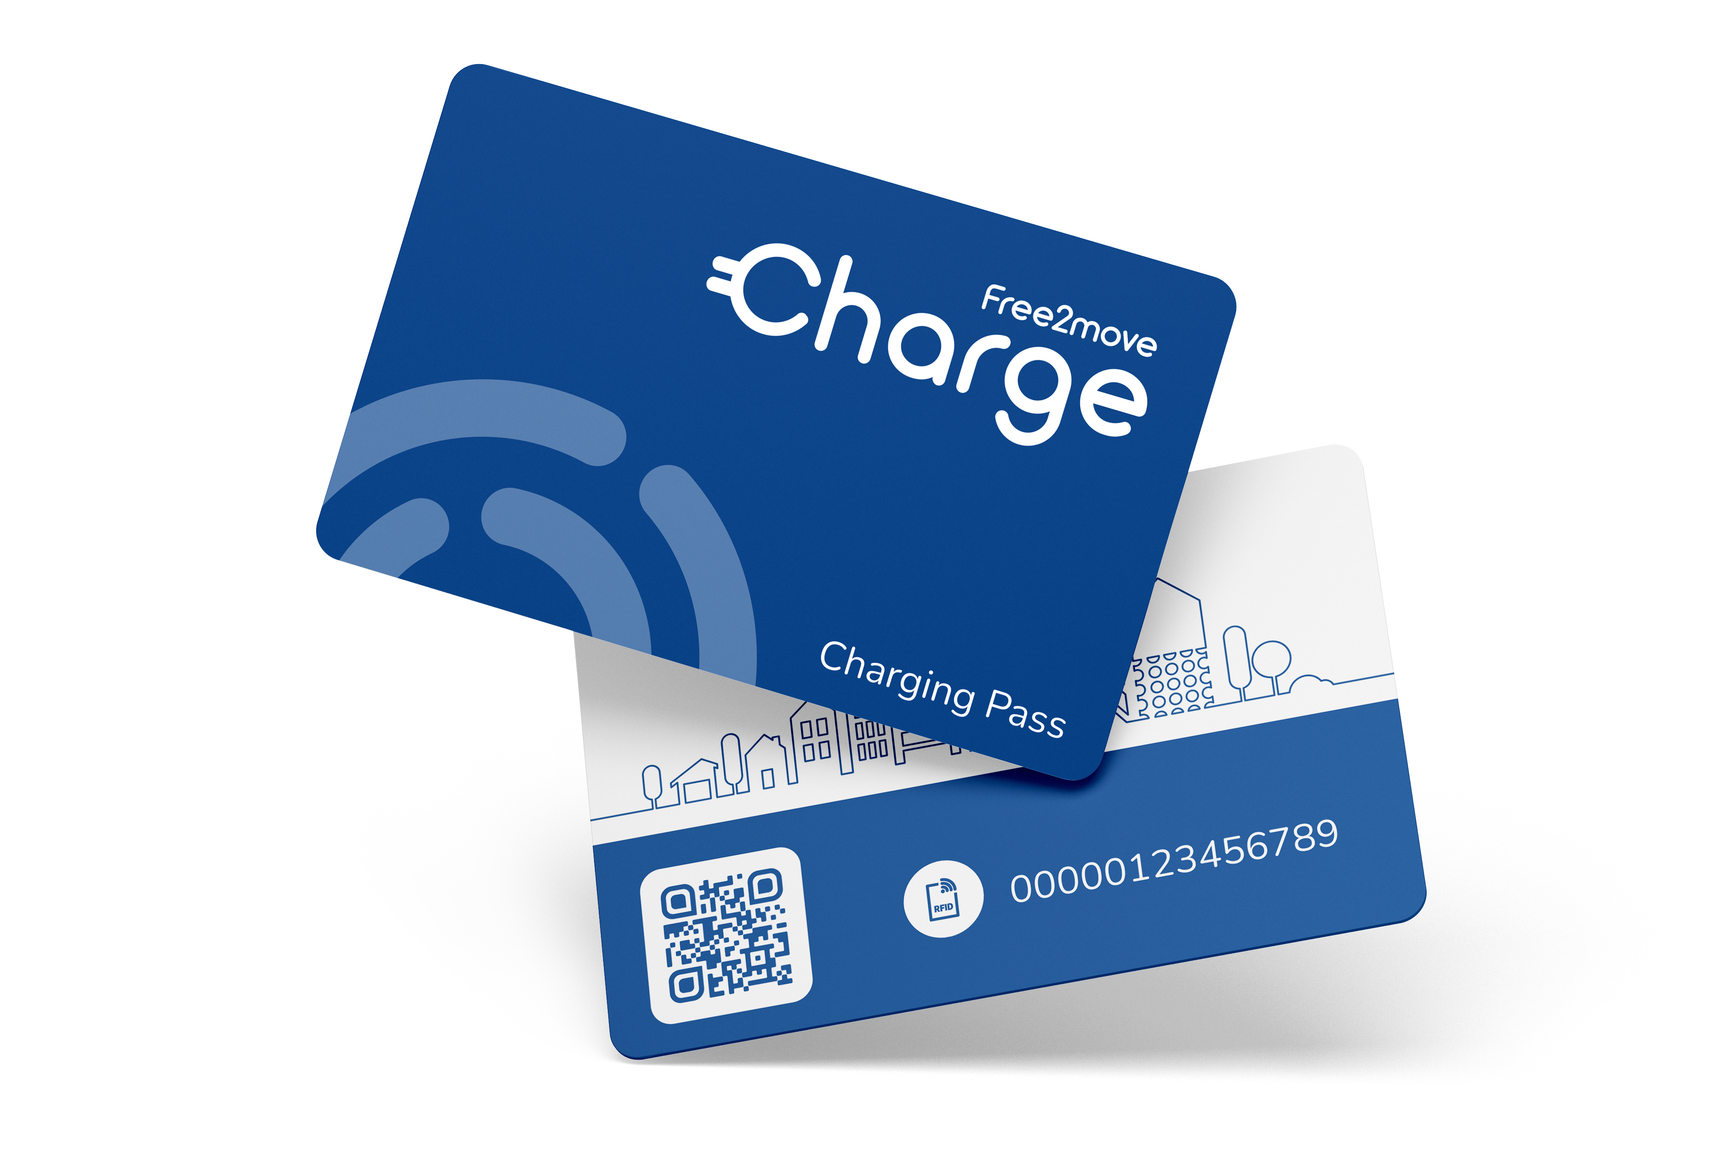
THE FREE2MOVE CHARGE BUSINESS SOLUTION
PUBLIC CHARGING
Flexible offers
Free2move Charge Business app and Charging Pass Business (RFID Card):
Europe-wide network
> 760 000 charge points
BEST IN CLASS COVERAGE
FREE2MOVE CHARGE BUSINESS APP
Charging services
Charging app
RFID card
Flexible payment options
CHARGING PASS BUSINESS
(RFID CARD)
DIRECT INVOICING
-
Aftersales Services
Benefits:
Easy to manage for the company
Easy to use for the employees
Consolidated reporting and invoicing
Assistance
36
Notes:
Trainer Guide:
Free2move Charge Business app and Charging Pass Business (RFID Card):
Just as with home charging, the same app and Charging Pass Business will allow users to access over 760,000 charge points Europe-wide – that a best in class!
The app provides location, availability, prices of charging points and allows payment for sessions to be made. It allows the company to sponsor employees charging company cars in the public network. This way, charging sessions will be invoiced directly to the company, providing managers with exact access to charging sessions details directly from their surpervision platform. Employees can even reserve some chargers before they reach them, ensuring they can recharge when they want to.
So, simply select the charger you want to visit, pre-book it if viable, be directed there, plug in and swipe to start charging, swipe and unplug when finished and pull away. No one to pay, no receipts to log and all the information is sat on the Charge Point Supervision Platform, ready for the manager to review. How easy is that?
The benefits? <animation build>:
Easy to manage for the company manager(s)
Easy to use for the employees
Consolidated reporting and invoicing
As you can see just from the examples we have been through, the Free2move Charge Business solution provides a complete, 360° electric vehicle management solution…

Slide 37
THE FREE2MOVE CHARGE BUSINESS SOLUTION
COMPANY SITE CHARGING
Taylor-made offers
HOME CHARGING
Packaged offers
PUBLIC CHARGING
Flexible offers
AC and DC chargers
AC chargers
Europe-wide network
> 760 000 charge points
Charging and energy services
Charging and energy services
Charging services
Supervision platform
Dynamic Load management
Charging app
RFID card
Charging app
RFID card
Automatic reimbursement
Charging app
RFID card
Flexible payment options
Installation services
Installation services
Site
evaluation
Permitting
Civil
works
Hardware installation
Commissioning
Site
evaluation
Hardware installation
Commissioning
-
Aftersales Services
Aftersales Services
Aftersales Services
Warranty Coverage
Maintenance / Optional Coverage
Customized
SLA
Assistance
Warranty Coverage
Assistance
Assistance
Notes:
Trainer Guide:
One that ensures that managing and living with an electric vehicle is made easy, from the first moment a business advisor introduces electric vehicle fleets, to the on-going management and use of the vehicles.
What this does is…

Slide 38

THE FREE2MOVE CHARGE BUSINESS SOLUTION
Which concerns can we minimize?
Vehicle
range
Increased
costs
Government incentives
Increased
journey times
Total Cost of Ownership
Charging
issues
Notes:
Trainer Guide:
Helps us answer all of the concerns that a business manager may have, including the ones that customers may not have thought of!
It should, therefore, provide you with the confidence to know that you can satisfy any business fleet demand. The good news does not stop here, though, because it is also provided to help you in your role.
<animation build>

Slide 39
AGENDA
WELCOME
1
THE ELECTRIC FLEET DREAM
2
THE BARRIERS TO EV FLEET TRANSITION
3
THE FREE2MOVE CHARGE BUSINESS SOLUTION
4
4
OUR ROLE
5
CLOSE
6
Notes:
Time: 00:50
Duration: 20 minutes.
Chapter objective:
To recognise the additional information that is required when selling the Free2Move Charge business solution, the process that is required and the importance of following the process, in order to improve sales of Stellantis EV models in the future.
Trainer Guide:
So, let’s consider how it impacts your role.

Slide 40



OUR ROLE
Tomorrow
– EV Ecosystem
Company
HR
Company’s Head
B2B Sales Advisor
Free2move Charge Business Consultant
Fleet Manager
Notes:
Trainer Guide:
You will remember when we last looked at this slide, we were starting the discussion about how the conversation is evolving from just about the car fleet itself, to include the charging structure.
This will result in the conversation moving from being purely with the Fleet Manager, to including others such as <animation build> the Company Administrator and Company HR manager. The conversations could move towards subjects outside of your comfort zone. However, there is no need to worry.
For this reason, you will have the support of a ‘Free2move Charge Business Consultant’ <animation build>, an expert in the field of charging solutions. They will be able to support you <animation build> and communicate direct with your customers, instantly enhancing the value of your conversations.
How will this work? Well, let’s look at the additional process involved in moving a fleet from ICE vehicles to EVs…

Slide 41

OUR ROLE
The additional EV conversion process:
1
2
3
4
Present Free2move Charge Business
solution to Customer
Complete Type Form and forward to Free2move Charge
Contact large customers to analyze needs and advise
on comprehensive
solution
Perform on-site technical survey - company site installation
(virtual check for homes)
5
6
7
8
Provide comprehensive customer offer
(including chargers, installation and digital services)
Offer accepted
(different contracts for HW + installation and for digital services)
Implement the charging solutions
Ongoing invoicing, customer support and maintenance of charging solutions
Notes:
Trainer Guide:
Run through the process, giving the basic information of each step but not mentioning who does what.
Present Free2move Charge Business offer to Customer
Complete Type Form and forward to Free2move Charge
Contact large customers to analyze needs and advise on comprehensive solution
Perform on-site technical survey - company site installation (virtual check for homes)
Provide comprehensive customer offer (including chargers, installation and digital services)
Offer accepted (different contracts for HW + installation and for digital services)
Perform implementation of the charging solutions
Ongoing invoicing, customer support and maintenance of charging solutions
Then move to the next slide and ask the question…. Where do you fit in?

Slide 42
OUR ROLE
1
2
3
3
4
4
Present Free2move Charge Business
solution to Customer
Complete Type Form and forward to Free2move Charge
Contact large customers to analyze needs and advise
on comprehensive
solution
Contact large customers to analyze needs and advise
on comprehensive
solution
Perform on-site technical survey - company site installation
(virtual check for homes)
Perform on-site technical survey - company site installation
(virtual check for homes)
5
5
6
6
7
7
8
8
Provide comprehensive customer offer
(including chargers, installation and digital services)
Provide comprehensive customer offer
(including chargers, installation and digital services)
Offer accepted
(different contracts for HW + installation and for digital services)
Offer accepted
(different contracts for HW + installation and for digital services)
Implement the charging solutions
Implement the charging solutions
Ongoing invoicing, customer support and maintenance of charging solutions
Ongoing invoicing, customer support and maintenance of charging solutions
Notes:
Trainer Guide:
Please put your answers to this question on the chat; Which of these steps are managed by you, as the Business Sales Advisor? Leave time for delegates to answer the question on the chat.
The answer is that you are only involved in the very first 2 steps <animation build>; 2 steps that are critical to the success of both the EV sale and integration of the Free2move Charge Business solution.
Steps 3 to 8 will be handled by the Free2move Charge partner, so require no involvement from you.
It is essential that we build value in the Free2move Charge Business solution in the first meetings that we have with the customer. It is also essential that we accurately complete the ‘Type Form’ necessary to initiate a Free2move Charge Business solution response. Once done, then the team will manage the rest of the process, keeping you informed and helping you to sell the fleet of vehicles the customer needs.
However, please remember…

Slide 43
OUR ROLE
Our fit?
1
2
3
3
4
4
Present Free2move Charge Business
solution to Customer
Complete Type Form and forward to Free2move Charge
Recontact large customers to analyze needs and advise
on comprehensive
solution
Contact large customers to analyze needs and advise
on comprehensive
solution
Perfom on-site technical survey - company site installation
(virtual check for homes)
Perform on-site technical survey - company site installation
(virtual check for homes)
Remember:
Your role is to maximize the number of leads for charging solutions
It will support your EV sales and fleet customer satisfaction
You and your dealership remain responsible for any questions & concerns about electric vehicles
5
5
6
6
7
7
8
8
Provide comprehensive customer offer
(including chargers, installation and digital services)
Provide comprehensive customer offer
(including chargers, installation and digital services)
Offer accepted
(different contracts for HW + installation and for digital services)
Offer accepted
(different contracts for HW + installation and for digital services)
Perform implementation of the charging solutions
Implement the charging solutions
Ongoing invoicing, customer support and maintenance of charging solutions
Ongoing invoicing, customer support and maintenance of charging solutions
Notes:
Trainer Guide:
While the Free2move Charge Business team are there for all the customer’s charging needs, you and your dealership are still responsible for your customer’s vehicle questions and concerns, both during and after the sale.
We expect from you to maximize the number of leads for charging solutions, as it will Free2move Charge advisors to propose the right solutions to your customers, supporting your EV sales and increasing customer satisfaction.
What is the impact of this on our qualification questions?

Slide 44

OUR ROLE
What information do we seek about customers normally?
WHAT ARE THEIR EXPECTATIONS?
WHO ARE THE DRIVERS?
Customer type
Private, professional
Contact person
Decision maker
Company
  Sector, trade(s), size, history
Fleet
  Size, brands / models, acquisition procedure(s), renewal plan
Use
  Where they go / distance? Annual mileage
  Current fleet
  Likes / dislikes, TCO, finance, advantages / disadvantages
New vehicle criteria
  Priorities, constraints, CO₂ emissions, competition
Business criteria
  Taxes, risk management, management requirements
Profile
Age range, driving experience, licenses,
Status
  Vehicle image, role differentiation
Vehicle usage
  Personal / private, number of people / size / weight of equipment carried, low emission zones, parking, storage
WHO IS MY CUSTOMER?
WHAT IS THEIR BUDGET?
Financing method
Type, parameters, Deposit / 1st rental, duration / mileage, purchase option
Budget components
Included services, TCO criteria
Services (vehicle, mobility)
  Vehicle services, driver-related services
Notes:
Trainer Guide:
Well, the questions you currently ask will still be valid; the information that you seek is still valid. We are still looking for details around:
The customer themselves <animation build> – type of business, key contact person and details, company information and the fleet they run
Their budget <animation build> – Financing method they are looking for, what they are / have budgeted for, the services they are seeking
Their expectations <animation build> – vehicle use, fleet information, new vehicle and business criteria
Their drivers <animation build> - their age range, driving experiences, the importance of status, their vehicle usage… where do the vehicles generally get used?
So what other information will the Free2Move team need to help them satisfy the customer? Ask the delegates to add their ideas in the chat.

Slide 45

OUR ROLE
Additional Information Free2Move Charge Business needs specific to EV:
RANGE ANXIETY?
Experience / Knowledge
Driving experience, running experience, management experience, maintenance
Awareness
Government or local/regional incentives, electricity supply restrictions, Taxation & regulation
Travel distances
Maximum travel mileage, destinations, climate considerations, topography, speed, highway vs urban/peri-urban journey
EV UNDERSTANDING?
Site
Regularity of office attendance, other regular destinations, location of parking, volume of carpark traffic, who’s vehicles will be charged (employees, visitors,..) and who is responsible?
Home
Location, suitability for charging point
On-the-go
Destinations, requirements, distances
CHARGING NEEDS?
Weekend / road trips
Personal usage profile
Driver experience
automatic gearbox experience
DRIVING NEEDS?
ENVIRONMENTAL CONSIDERATIONS?
Sustainability goals
Carbon footprint, business aspirations
Notes:
Trainer Guide:
Give the delegates some time to enter their thoughts into the chat and then start the debrief, using this slide and incorporating their feedback as you do.
The additional information required by the Free2move Charge Business team include:
EV understanding <animation build> – What is the customer’s experience with electric vehicle? Have they even driven one? How aware are they of any Government / Regional or local incentives or electricity supply restrictions?
Driving needs <animation build> – What do the users do with their vehicles when not working? Where do they go with the vehicles? What is their experience of driving automatic vehicles (as all electric vehicles are automatic).
Charging needs <animation build> – How regularly do the team attend the office? What facilities do they have in terms of parking and where is the parking located? Will the team need to charge at home? What about on-the-go, do they need to travel far? Are there common places that they travel to? Who’s vehicles need to be charged and who is responsible for charging these vehicles (employees / customers / vehicles)?
Environmental considerations <animation build> – How do the vehicles fit with the goals and aspirations of the business?
Travel distance <animation build> – What is the maximum distance they travel? Where are they going? Want is the climate like (how hot or cold does it get)? What is the topography of the area (the landscape features)? What speeds will the vehicle be travelling at (highway vs urban / extra-urban journies)
These are not questions we need to ask, as the Free2move Charge Business team will be asking them. However, some of this information will also help with how we build our business cases. For example:
If the fleet manager has never driven an electric car, or run one for a few days, then it will be important to give them a test-drive to ensure they understand the benefits. Similarly it will be important to help them sell the electric fleet into their team, some of whom may feel concerned about the change
If the drivers use their vehicles for personal use, then this will influence their acceptance of the EVs, so this will need to be considered by the fleet manager and, therefore, they will need to be supported by information from you.
The business sustainability and carbon footprint goals will be an important influence within the vehicle sales proposal.
In fact, there are a number of questions here that could help in building the business case for an EV fleet…

Slide 46

OUR ROLE
Additional information we need:
For your Free2move Charge contact :
Company name & address
Contact person:
  First name / last name
  Position
  Phone number
  E-mail
Type of charging solution needed: workplace; home; on-the-go
Fleet size: number of expected EV vehicles
B2B Sales Advisor contact details:
  First name/Last name
  Phone number
  E-mail
Notes:
Trainer Guide:
Please note: that there should be an image of the actual form on this page.
As you can see, the questions asked are minimal but none-the-less essential to the introduction, so please make sure that you complete the form accurately before passing it on to the Free2move Charge Business team.
So, having now seen this presentation, let’s consider a case study. We will review a customer profile. What EV specific information would be useful to improve the EV proposal that you make to the customer.

Slide 47

OUR ROLE
Case Study:
Customer: VirtuFinance
Address: XXX (City Centre)
Business: Finance Company
Vehicles: 12 company cars
Contact: YYY (Just first name)
Telephone: ZZZ
Notes: YYY doesn’t know a lot about electric cars and looking for advice. The 12 cars are split between 3 managers and 9 consultants. Managers are in the office 3 days a week on average. Consultants work from home, visiting the office once a month. The rest of the time they are either working from home or visiting clients. The office is in a building shared with 2 other businesses and has allocated parking for 4 cars.
What additional information will be useful in selling the electric vehicle and the Free2move Charge business solution?
Notes:
Trainer Guide:
Please write your thoughts into the chat.
Give the delegates time to add their thoughts to the

Slide 48
OUR ROLE
Additional Information we need for EV fleets:
ENVIRONMENTAL CONSIDERATIONS?
Site
Distance from user homes
Home
Sponsor home chargers
Split between business / personal charging
Automated invoicing
On-the-go
Destinations
Requirements
Cities visited – restrictions
Centralized control
Charge point supervision platform
One user app for all charging needs
Easy installation
A single, expert team to guide and install a personalized charging solution
Sustainability goals
Carbon footprint?
Business aspirations?
EV UNDERSTANDING?
CHARGING NEEDS?
Awareness
Government incentives
DRIVING NEEDS?
Weekend / road trips
Personal usage profile
Driver experience
Driving experience
Automatic car experience
Notes:
Trainer Guide:
The delegates will bring up reasons shown on this slide and additional ones. Review their feedback, adding those from the slide where required.
The notes on the slide consider the following:
EV understanding:
Are they aware of any national or local incentives that will impact on their choice of an electric fleet?
Driving needs
What are the drivers using their vehicles for outside of work (the types of trips, speeds and topography of the landscape they drive through)?
Have the users driven automatic vehicles before?
Charging needs
On-site charging:
As the majority of the team work from home, how far from the office are they?
Will this mean that they need to have access to a charger at the office or will their home charger be sufficient?
Home charging:
Home chargers would appear to be important to this business, given that 9 of the vehicles are home based; is this assumption correct?
Is the customer aware of the availability of charger solutions that can separate business charging from private?
How would they feel about having automated charging cost invoicing / processing?
On-the-go charging
How do the consultants structure their client visits?
Are they local so they can always return home?
Do some visits require day trips? Do they find themselves planning a weekly route to visit clients, staying away from home? Dependent on the answers to this, on-the-go charging may be more important.
Centralized control
How would the customer feel about having one central system that can monitor and control all charging costs, in the office, at home and on-the-go?
Would their vehicle users find it easier to use one app to access all their charging needs, accessing work, home and over 760,00 public chargers across Europe?
Easy installation
How would the customer feel about having a single expert team, able to guide them on the right solution for their business, and install all the hardware and software to make the transition to BEVs easy?
Environmental considerations
What are the company’s aspirations?
How do they present their green credentials?
Note: Their website will give a good indication, but they may be focused on changing their current perception, so be looking at an EV fleet to spearhead their increased focus on their environmental footprint.
The list here is not exhaustive but it is designed to get delegates thinking more openly about customer needs when it comes to their EV fleets.
Emphasize the point that we are not looking for the delegates to become experts on charging (we will leave this to the Free2move Charge Business consultants) but we do need to show greater interest in the broader understandings of the customer and their needs, so that we can overcome their concerns more effectively.

Slide 49
AGENDA
WELCOME
1
THE ELECTRIC FLEET DREAM
2
THE BARRIERS TO EV FLEET TRANSITION
3
THE FREE2MOVE CHARGE BUSINESS SOLUTION
4
4
OUR ROLE
5
CLOSE
6
Notes:
Time: 01:10
Duration: 5 minutes.
Chapter objective:
Delegates will be reminded of learning from the session.
Trainer Guide:
Review the session, reminding delegates of what we have discussed in each section.

Slide 50
CLOSE
A complete customer solution:
Advice on EV charging solutions
One-stop-shop experience
Turnkey and tailor-made solutions
Outstanding products and services
Optimization of total cost of ownership
Notes:
Trainer Guide:
Remind delegates of the benefits of the Free2move Charge Business solution to their customers.

Slide 51
Close
Understand the Free2move Charge Fleet offer
The offer expands our opportunity to sell EVs to fleet customers
Reassured that support is available to help guide customers with their charging options
Recognize that including Free2move in sales, requires very little extra effort from you
Ensure that the introduction of the offer is built into every new client presentation
Notes:
Trainer Guide:
Review the objectives of the training session, confirming that they have been covered.
Following this, ask each delegate to place on action they are willing to take from the session in the chat. Wait for them to start, picking out the odd one to read out.

Slide 52
Free2move CHARGE BUSINESS SOLUTION
THANK YOU
Notes:
Trainer Guide:
Close the session and thank the delegates for their attention.

