Slide 1
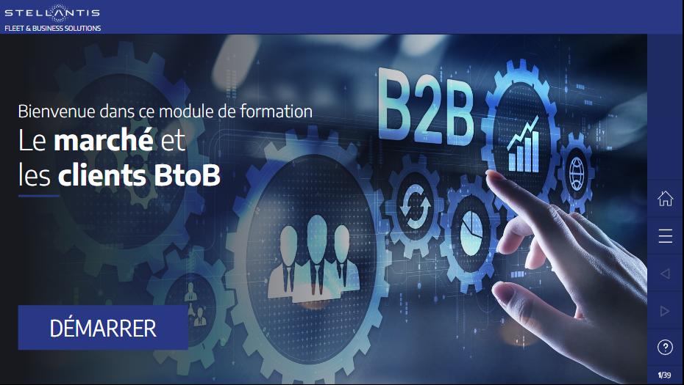
Welcome to this training module
The market and
B2B customers
START

Slide 2
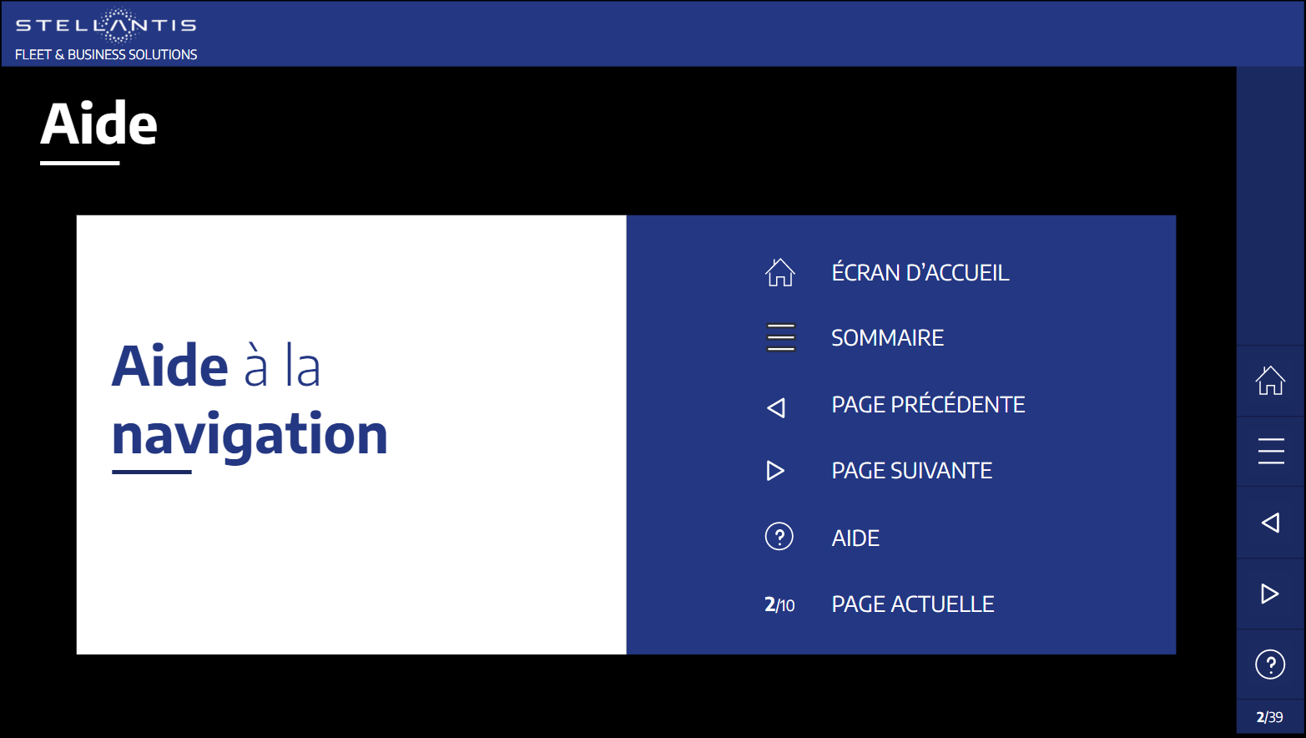

Help
WELCOME
Browsing
help
OVERVIEW
PREVIOUS PAGE
NEXT PAGE
HELP
CURRENT PAGE

Slide 3
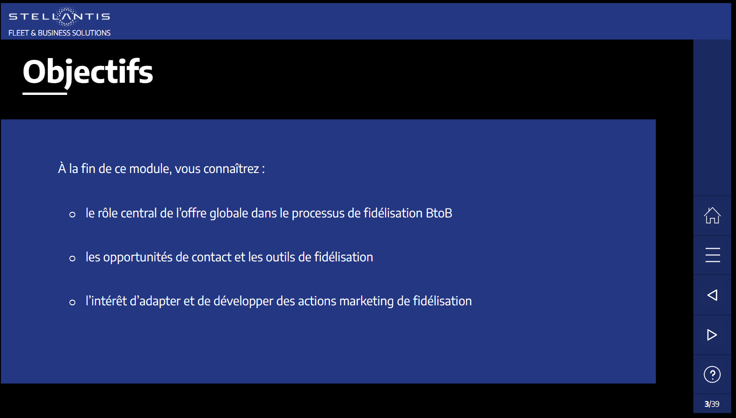
Objectives
By the end of this module, you will have learned about:
recent developments in the sector that affect your B2B customers and your role as a sales consultant
the Stellantis strategy to implement these changes
the specifics of the B2B market and the expectations of different types of B2B customers

Slide 4





Overview
01
Recent developments in the automotive sector
02
The Stellantis strategy
03
The B2B market and customer expectations
Conclusion
Learning assessment

Slide 5
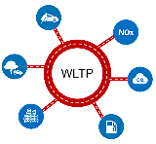

01 - Recent developments in the automotive sector
Regulatory developments
As the world faces climate change, mindsets have evolved. The energy transition has become a priority.
The authorities have set regulations, standards and targets to combat the emissions that are responsible for global warming.
The WLTP standards have taken over from the NEDC standards.
They involve new technical constraints, resulting in streamlining the ranges offered to customers.
WLTP standard
Click on the left and right arrows

Slide 6

01 - Recent developments in the automotive sector
Regulatory developments
As the world faces climate change, mindsets have evolved. The energy transition has become a priority.
The authorities have set regulations, standards and targets to combat the emissions that are responsible for global warming.
Since 2020, the European Corporate Average Fuel Economy (CAFE) standard can impose heavy fines on manufacturers that do not meet the targets, i.e. €95 per vehicle for every gram they exceed the target by.
CAFE plan
Click on the left and right arrows

Slide 7

01 - Recent developments in the automotive sector
Regulatory developments
As the world faces climate change, mindsets have evolved. The energy transition has become a priority.
The authorities have set regulations, standards and targets to combat the emissions that are responsible for global warming.
The Green Deal target is to ensure no net emissions of greenhouse gases by 2050.​
The aspects of the Green Deal for the automotive industry are known as “Plan Fit for 55”.
It aims towards a 55% reduction in CO₂ emissions by 2030​.
This corresponds to target average emissions per new car falling from 95 g of CO₂ per km (2020) to 43 g​ of CO₂ (2030).
Plan Fit for 55
This means that the accelerated electrification of ranges and the development of charging infrastructure are essential.
Click on the left and right arrows

Slide 8
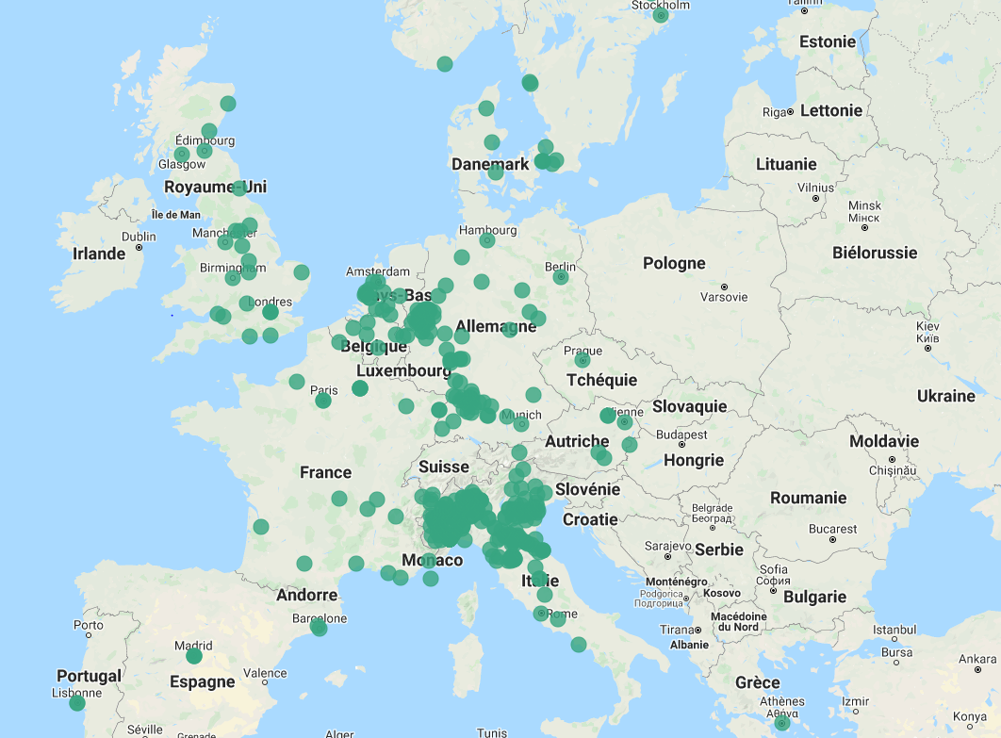
01 - Recent developments in the automotive sector
Regulatory developments
As the world faces climate change, mindsets have evolved. The energy transition has become a priority.
The authorities have set regulations, standards and targets to combat the emissions that are responsible for global warming.
Local driving restrictions : Low Emission Zones (LEZ), aiming at:
  Gradual bans on vehicles considered to cause pollution (e.g. no more diesel in Paris from 2024)Reorganisation of last-mile transport of goods (electric and
  hydrogen-powered light commercial vehicles (LCVs))Reductions in emissions of pollutants, resulting in improved air quality
Example for France – Adapt for each country
Anti-car laws
Click on the left and right arrows

Slide 9

01 - Recent developments in the automotive sector
Regulatory developments
As the world faces climate change, mindsets have evolved. The energy transition has become a priority.
The authorities have set regulations, standards and targets to combat the emissions that are responsible for global warming.
Mobility Orientation Law (LOM) - Example for France – ADAPT FOR EACH COUNTRY
Three objectives:
To encourage the transition towards cleaner mobility in business
To facilitate the deployment of new travel solutions
To invest more and better in everyday transport​
For whom?
Companies with 50+ employees and 100+ vehicles (at group level)
> Gradual introduction of renewal quotas with low-emission models (less than 60 g CO₂/km)
National laws
Companies will be obliged to implement a clear policy for a progressive electrification of their fleet
Click on the left and right arrows

Slide 10

01 - Recent developments in the automotive sector
Regulatory developments
As the world faces climate change, mindsets have evolved. The energy transition has become a priority.
The authorities have set regulations, standards and targets to combat the emissions that are responsible for global warming.
The energy transition has become a social responsibility issue for manufacturers, but also for B2B customers (Corporate Social Responsibility (CSR) concept).
In this context, the choice and usage of vehicles must be aligned with the company mobility policy.
Click on the left and right arrows

Slide 11
01 - Recent developments in the automotive sector
Regulatory developments – Summary exercise
Match the acronyms below with their definition
CAFE
The choice and usage of vehicles must be aligned with the company mobility policy.
LEZ
To encourage businesses with more than 50 employees and more than 100 vehicles in the transition to cleaner mobility, to facilitate the deployment of new travel solutions and invest more and better in everyday transport.
LOM
Local driving restrictions ​ aimed at banning vehicles that cause pollution, reorganising last-mile transport of goods and reducing emissions of pollutants.
CSR
European standard imposing heavy fines on manufacturers that do not meet the targets set for CO₂/km emissions from new vehicles.
SUBMIT
Drag and drop the blue boxes on the left to match the definitions on the right, then submit your response

Slide 12
01 - Recent developments in the automotive sector
Regulatory developments – Summary exercise
Match the acronyms below with their definition
CSR
The choice and usage of vehicles must be aligned with the company mobility policy.
LOM
To encourage businesses with more than 50 employees and more than 100 vehicles in the transition to cleaner mobility, to facilitate the deployment of new travel solutions and invest more and better in everyday transport.
LEZ
Local driving restrictions ​ aimed at banning vehicles that cause pollution, reorganising last-mile transport of goods and reducing emissions of pollutants.
CAFE
European standard imposing heavy fines on manufacturers that do not meet the targets set for CO₂/km emissions from new vehicles.
Drag and drop the blue boxes on the left to match the definitions on the right, then submit your response

Slide 13


01 - Recent developments in the automotive sector
Regulatory developments – Summary exercise
Match the acronyms below with their definition
Oh no!
That’s not the right answer.
The aim of Corporate Social Responsibility is to align the choice and usage of vehicles with the company mobility policy.
The purpose of the LOM law is to encourage businesses to adopt a cleaner mobility​.
Local driving restrictions for vehicles that cause pollution are in place in Low Emission Zones (LEZ).
The aim of the EU CAFE standard is to limit CO₂/km emissions from new vehicles.
Click on “NEXT” to continue the training.
That's the right answer!
Click on “NEXT” to continue the training.
NEXT
NEXT
Drag and drop the blue boxes on the left to match the definitions on the right, then submit your response

Slide 14
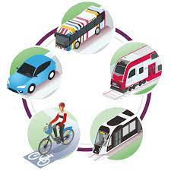


01 - Recent developments in the automotive sector
New mobility solutions
Several manufacturers no longer define themselves as car makers, but as contributors of mobility solutions.
The product range is shifting towards “cleaner” technologies to reduce CO₂ emissions:
  hybrid vehicles (HEVs)
  rechargeable hybrid vehicles (PHEVs)
  full-electric vehicles (BEVs)
  hydrogen-powered vehicles (FCEVs)
The end of the production of vehicles with internal combustion engines is coming closer.
LEV
ZEV
Multimobility
Click on the left and right arrows

Slide 15

01 - Recent developments in the automotive sector
New mobility solutions
Several manufacturers no longer define themselves as car makers, but as contributors of mobility solutions.
The aim of MAAS – “Mobility as a Service” – is to provide a global intermodality service where customers pay for mobility by the mile.This involves less use of private cars in cities, in favour of more environmentally friendly solutions.
Its success will depend on:
real-time access to different vehicles (cars, shared bikes, scooters, etc.) to get around
tariff integration via mobility platforms
data sharing between all operators (private/public)
MAAS
Multimobility
Click on the left and right arrows

Slide 16

01 - Recent developments in the automotive sector
New mobility solutions
Several manufacturers no longer define themselves as car makers, but as contributors of mobility solutions.
The electrification of product ranges requires a network of charging infrastructure and includes:
Private facilities (at employees’ homes or their offices)
Public facilities
Fast charging stations (motorways)
Multimobility
Charging infrastructure
Click on the left and right arrows

Slide 17
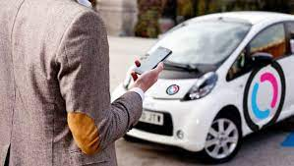
01 - Recent developments in the automotive sector
New mobility solutions
Several manufacturers no longer define themselves as car makers, but as contributors of mobility solutions.
Car sharing lets users access mobility on demand at a limited cost.
Many cities and companies are developing this kind of scheme.
Multimobility
Car sharing
Click on the left and right arrows

Slide 18
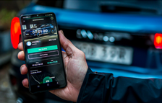
01 - Recent developments in the automotive sector
New mobility solutions
Several manufacturers no longer define themselves as car makers, but as contributors of mobility solutions.
Two types of new players
New OEMs: POLESTAR, LYNK & CO, FISKER, MAXUS, etc.
APPLE and XIAOMI, which could launch vehicles based on their services
New Players
Multimobility
Click on the left and right arrows

Slide 19
01 - Recent developments in the automotive sector
Impact on TCO and corporate budgets
Definition of TCO before
From the list below, select the four concepts that you think are the best fit for a TCO approach
Depreciation
Taxation
Discount
List price
Type approval
Maintenance
TCO approach
Consumption
Lease payments
SUBMIT
Drag and drop the statements into the box on the right, then click SUBMIT to confirm your answer

Slide 20
01 - Recent developments in the automotive sector
Impact on TCO and corporate budgets
From the list below, select the four concepts that you think are the best fit for a TCO approach
Depreciation
Fiscalité
Lease payments
Taxation
Discount
List price
Type approval
Consumption
Maintenance
Maintenance
TCO approach
SUBMIT
Drag and drop the statements into the box on the right, then click SUBMIT to confirm your answer

Slide 21
01 - Recent developments in the automotive sector
Impact on TCO and corporate budgets
From the list below, select the four concepts that you think are the best fit for a TCO approach
Depreciation
Fiscalité
Oh no!
That’s not the right answer.
“Total Cost of Ownership” is an approach to the total cost of running a vehicle, including:
Lease payments
Maintenance
Consumption
Taxation
Click on “NEXT” to continue the training.
That's the right answer!
Click on “NEXT” to continue the training.
Lease payments
Taxation
Discount
List price
Type approval
Consumption
Maintenance
Maintenance
NEXT
TCO approach
NEXT
SUBMIT
Drag and drop the statements into the box on the right, then click SUBMIT to confirm your answer

Slide 22
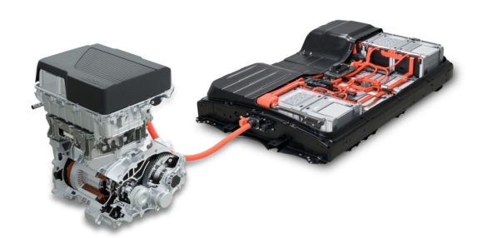
01 - Recent developments in the automotive sector
Impacts sur le TCO & le budget des entreprises
The ability to fit into customer budgets is a key factor for success.
Many customers are shifting from a budget based on vehicle possession to one based on usage cost.
As electrified vehicles are more expensive to buy, the sales approach must relate to usage cost (TCO), by focusing on their benefits in terms of taxation, subsidies and usage cost (consumption, maintenance).
New powertrains
TCO / Budget
Takeaways

Slide 23
01 - Recent developments in the automotive sector
Impacts sur le TCO & le budget des entreprises
The ability to fit into customer budgets is a key factor for success.
Many customers are shifting from a budget based on vehicle possession to one based on usage cost.
As electrified vehicles are more expensive to buy, the sales approach must relate to usage cost (TCO), by focusing on their benefits in terms of taxation, subsidies and usage cost (consumption, maintenance).
New powertrains
TCO / Budget
Takeaways
A higher purchase cost does not necessarily mean a higher cost of use (TCO)
Click on the left and right arrows

Slide 24

01 - Recent developments in the automotive sector
Impacts sur le TCO & le budget des entreprises
The ability to fit into customer budgets is a key factor for success.
Many customers are shifting from a budget based on vehicle possession to one based on usage cost.
The various taxes, fiscal aids and incentives for electrified vehicles can have a decisive impact on the TCO of a vehicle and on the decision to buy an internal combustion or electrified vehicle.
Subsidies & Taxation
TCO / Budget
Click on the left and right arrows

Slide 25

01 - Recent developments in the automotive sector
Impacts sur le TCO & le budget des entreprises
The ability to fit into customer budgets is a key factor for success.
Many customers are shifting from a budget based on vehicle possession to one based on usage cost.
On average, the running costs of full-electric vehicles are 30% lower than for an equivalent model with an internal combustion engine.
Maintenance
TCO / Budget
Click on the left and right arrows

Slide 26

01 - Recent developments in the automotive sector
Impacts sur le TCO & le budget des entreprises
The ability to fit into customer budgets is a key factor for success.
Many customers are shifting from a budget based on vehicle possession to one based on usage cost.
Fuel/energy consumption is affected by
Charging frequency for PHEVs
Price of electricity according to the facilities used, whether private or public
Speed
Use of heating and air conditioning
Driver’s driving style, route topography, load carried, tyre pressure, outside temperature, etc.
Energy consumption
TCO / Budget
Takeaways
Click on the left and right arrows

Slide 27
01 - Recent developments in the automotive sector
Impacts sur le TCO & le budget des entreprises
The ability to fit into customer budgets is a key factor for success.
Many customers are shifting from a budget based on vehicle possession to one based on usage cost.
Fuel/energy consumption is affected by
Charging frequency for PHEVs
Price of electricity according to the facilities used, whether private or public
Speed
Use of heating and air conditioning
Driver’s driving style, route topography, load carried, tyre pressure, outside temperature, etc.
Energy consumption
TCO / Budget
Takeaways
100 km in a 100% electric vehicle cost about four times less than in an equivalent vehicle with an internal combustion engine!
Click on the left and right arrows

Slide 28

01 - Recent developments in the automotive sector
Impacts sur le TCO & le budget des entreprises
The ability to fit into customer budgets is a key factor for success.
Many customers are shifting from a budget based on vehicle possession to one based on usage cost.
A financing scheme experiencing growth, because:
It offers vehicle use for a controlled monthly budget.
“All-inclusive” lease payments, so the customer only pays for the actual usage of their vehicle. That’s why this product is suitable for LEVs and their higher purchase costs.
It limits the risk associated with resale. It is therefore particularly attractive for LEVs whose resale value can be unclear.
It offers tax and accounting optimisation (control over deductibles and cash flow)
Operational leasing
TCO / Budget
Click on the left and right arrows

Slide 29

01 - Recent developments in the automotive sector
Impacts sur le TCO & le budget des entreprises
The ability to fit into customer budgets is a key factor for success.
Many customers are shifting from a budget based on vehicle possession to one based on usage cost.
Lower average mileage as a result of the overall increase in remote working.
Changing habits for holidays and leisure (rail rather than motorways).
These factors contribute to reducing TCO.
New behaviours
TCO / Budget
Click on the left and right arrows

Slide 30

01 - Recent developments in the automotive sector
Takeaways
The automotive sector is experiencing a major revolution and is offering new opportunities:
  The “greening” of product ranges lies at the heart of the energy transition
  Electrification involves the development of mobility solutions
  Plug-in hybrid and 100% electric vehicles require a specific sales approach, different from the internal combustion vehicles one.
Key points

Slide 31
01 - Recent developments in the automotive sector
Takeaways
The automotive sector is experiencing a major revolution and is offering new opportunities:
  The “greening” of product ranges lies at the heart of the energy transition
  Electrification involves the development of mobility solutions
  Plug-in hybrid and 100% electric vehicles require a specific sales approach, different from the internal combustion vehicles one.
Key points:
The role of the sales force must be refocused on ADVICE.
In this context, focus on the dual internal combustion/LEV product range.
Don’t miss the boat as these changes progress.
The transition is already underway!
Key points

Slide 32
Overview
01
Recent developments in the automotive sector
02
The Stellantis strategy
03
The B2B market and customer expectations
Conclusion
Learning assessment

Slide 33



02 - The Stellantis strategy
The customer at the heart of the strategy
As it electrifies its product ranges and processes, using scalable solutions, Stellantis is putting its customers at the heart of its strategy, by ensuring their mobility
Customer mobility
Electrification strategy
Turn over the cards

Slide 34
02 - The Stellantis strategy
The customer at the heart of the strategy
As it electrifies its product ranges and processes, using scalable solutions, Stellantis is putting its customers at the heart of its strategy, by ensuring their mobility
The customer at the heart of the strategy
2026
100% of new launches will be
full-electric
Customer satisfaction
More and more mobility services
Turn over the cards

Slide 35
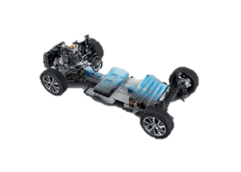

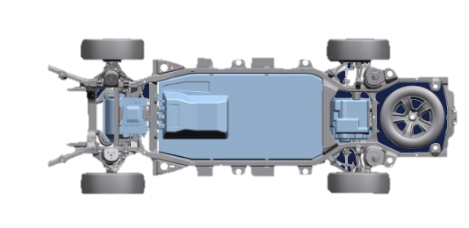







02 - The Stellantis strategy
Keys to success
Customer MOBILITY
Click on each symbol

Slide 36

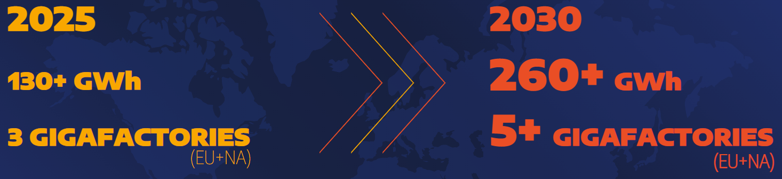
02 - The Stellantis strategy
Keys to success
X
Five battery gigafactories
Entering into global partnerships, to deal with increase in demand for batteries
La MOBILITE
des clients
Click on each symbol

Slide 37


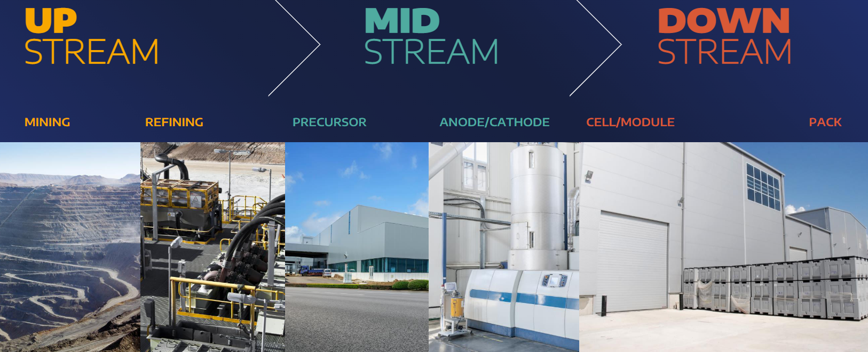
02 - The Stellantis strategy
Keys to success
Purchase and partnership policy
X
In 2030, energy production requirements will be 20 times higher than in 2021 => supply chain becomes critical.
Agreements with suppliers to meet needs for components and raw materials (lithium, cobalt, nickel, graphite).
La MOBILITE
des clients
Click on each symbol

Slide 38
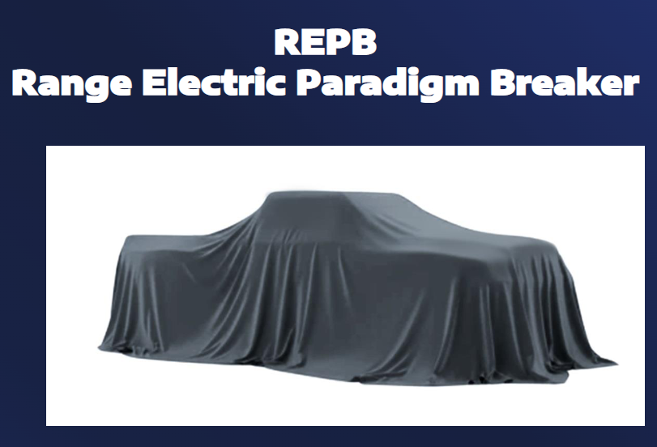
02 - The Stellantis strategy
Keys to success
Innovations in technology
X
Constant innovations in hardware and software, to increase range and power even further.
Development of different battery technologies (nickel/cobalt-free, solid-state), to increase power and reduce costs.
La MOBILITE
des clients
New innovative developments in the future
Click on each symbol

Slide 39
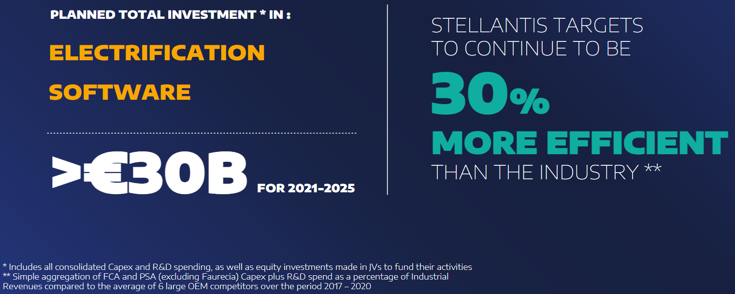
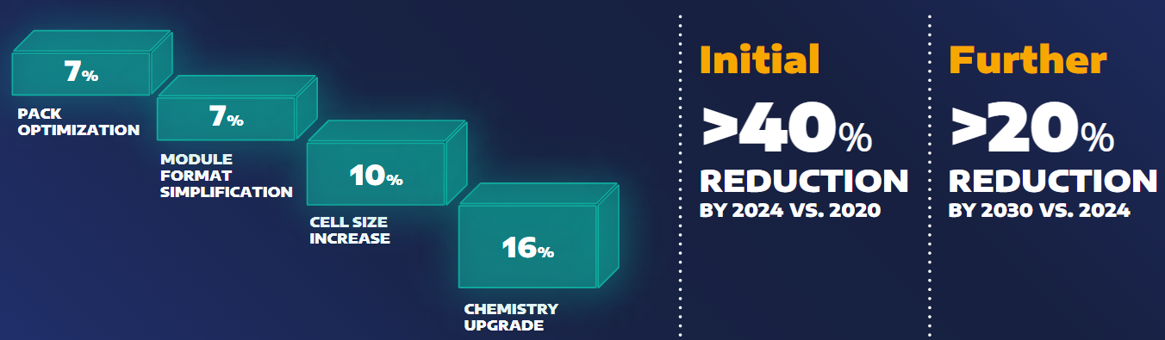
02 - The Stellantis strategy
Keys to success
Financial investment
X
Over €30 billion invested in five years (2021-25).
Developments in technology will result in a decrease in costs (40% down by 2024 and another 20% down by 2030).
La MOBILITE
des clients
Click on each symbol

Slide 40
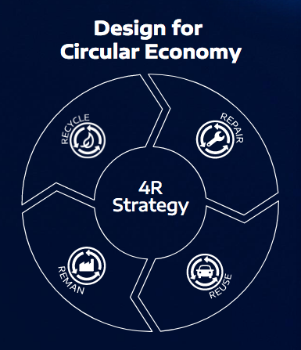
02 - The Stellantis strategy
Keys to success
Circular approach to battery repair, reuse and recycling
X
Checking battery health
Repairs at authorised centres
Recycling into other types of batteries or components
Sustainable approach
La MOBILITE
des clients
Click on each symbol

Slide 41

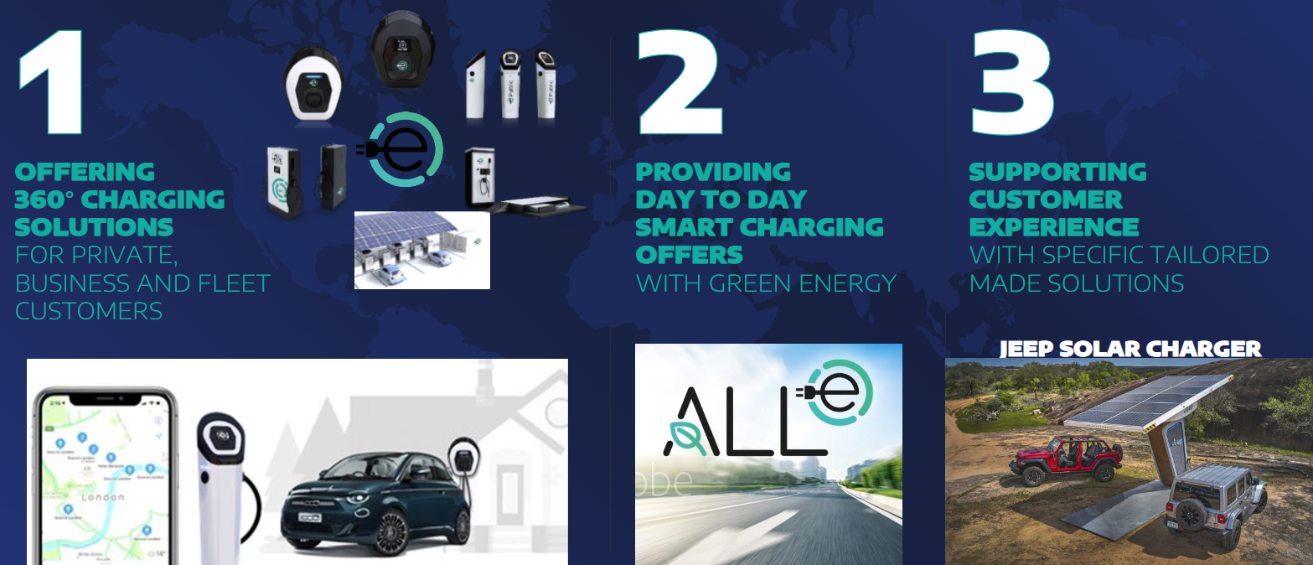
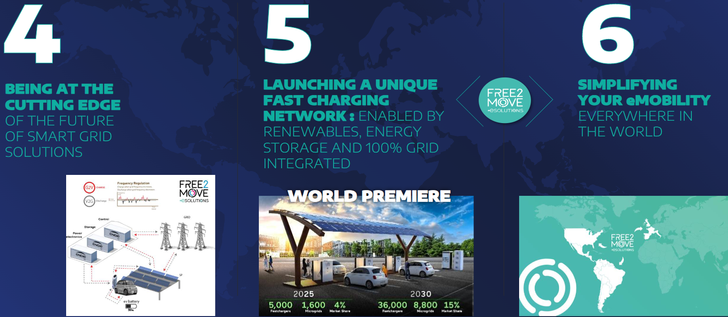
02 - The Stellantis strategy
Keys to success
X
Charging services
Integrated solutions:
  Wallboxes
  charging points
  smart charging
  fast charging network
  smart grid management
  solar charging, etc.
La MOBILITE
des clients
Key points
Click on each symbol

Slide 42
02 - The Stellantis strategy
Keys to success
X
Charging services
Key points
It is important to offer B2B customers a complete ecosystem of associated services:
charging station location apps
charging cards
installation of infrastructure, etc.
Integrated solutions:
  Wallboxes
  charging points
  smart charging
  fast charging network
  smart grid management
  solar charging, etc.
La MOBILITE
des clients
Key points
Click on each symbol

Slide 43
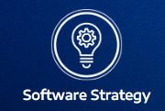
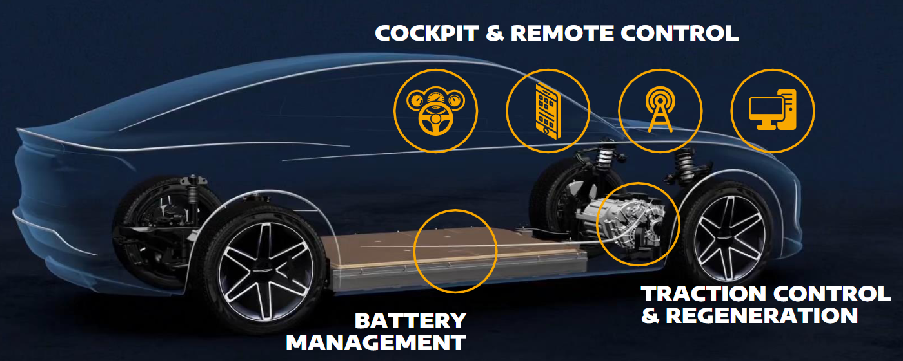
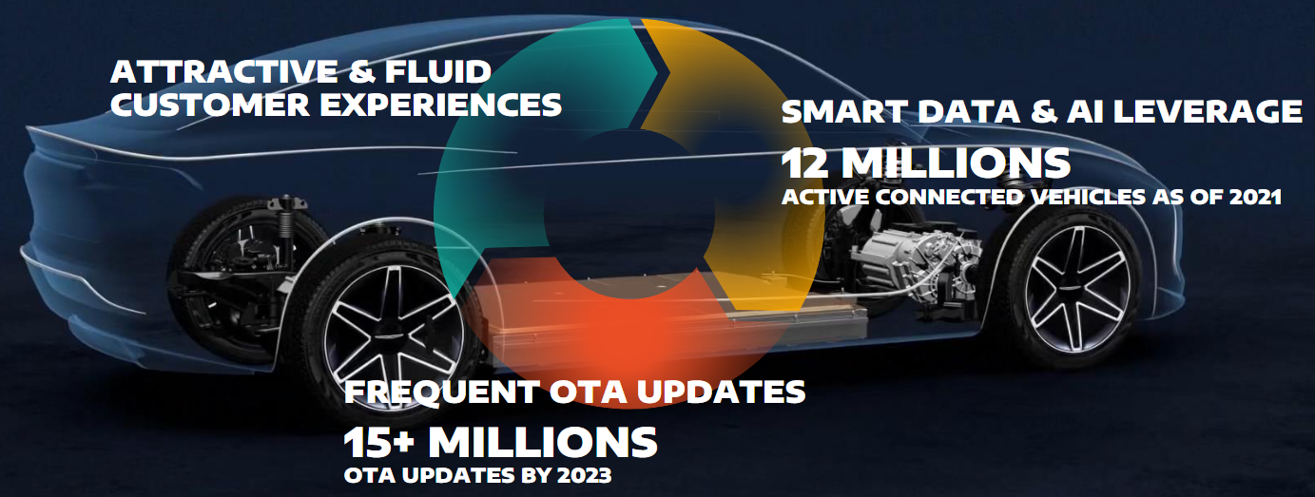
02 - The Stellantis strategy
Keys to success
X
Dedicated Software Unit
Software plays a crucial role in optimizing power consumption.
➔ Desire to become a company with high-tech skills (processing of user data, artificial intelligence).
La MOBILITE
des clients
Click on each symbol

Slide 44
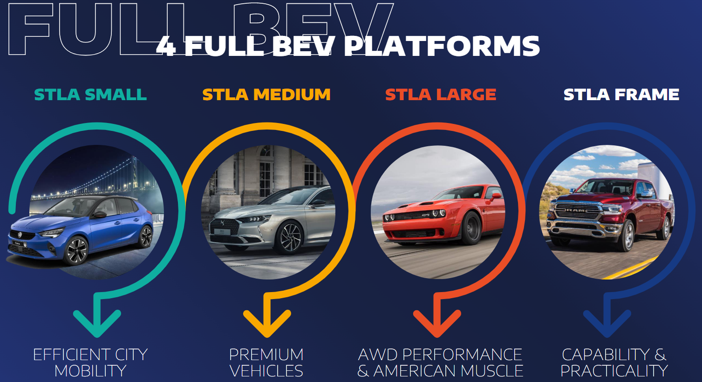
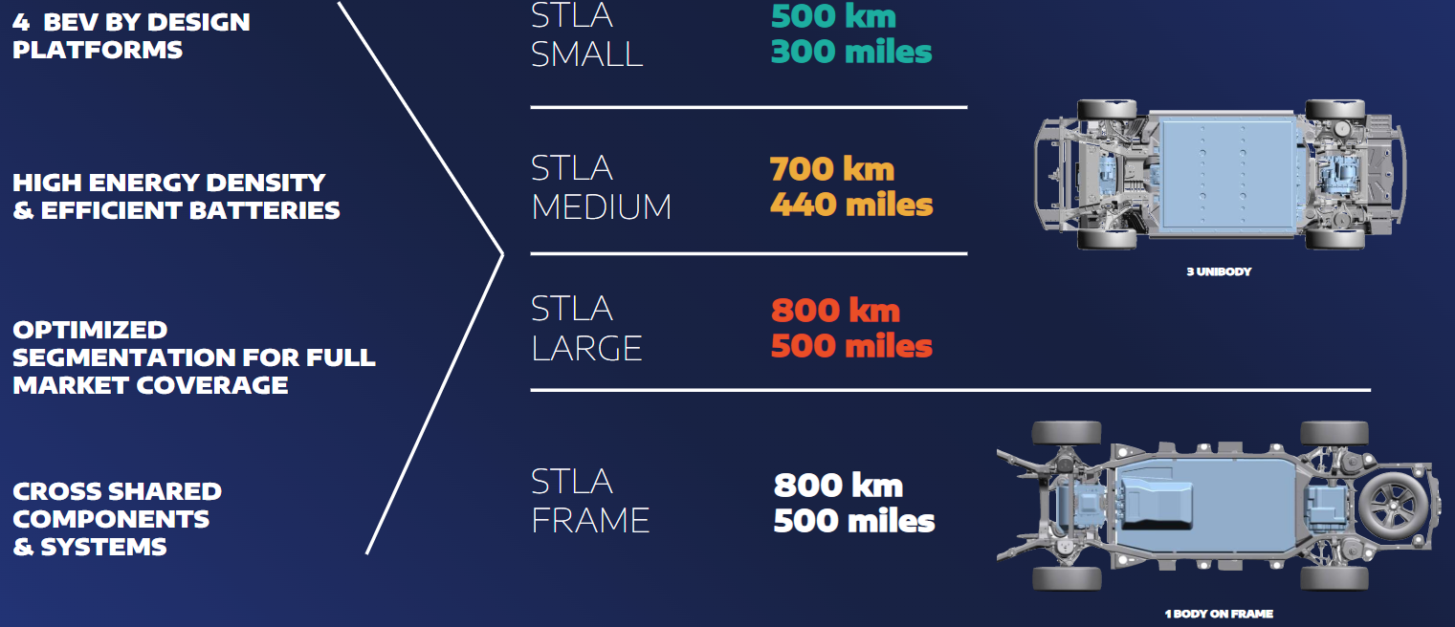
02 - The Stellantis strategy
Keys to success
X
Four platforms
Full-electric platforms, providing ranges between 500 and 800 km.
Each platform meets specific needs (no standard, “one-size-fits-all” approach).
La MOBILITE
des clients
Click on each symbol

Slide 45


02 - The Stellantis strategy
Keys to success
Mise en oeuvre business
2026
2030
2038
Your action
Drag the slider to the different dates

Slide 46
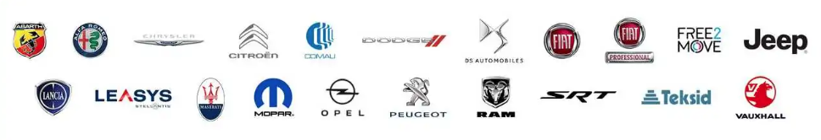
02 - The Stellantis strategy
Keys to success
Mise en oeuvre business
2026
  100% of models launched to be electric
2026
2030
2038
Your action
Drag the slider to the different dates

Slide 47




02 - The Stellantis strategy
Keys to success
Mise en oeuvre business
2030
  100% of PCs sold to be 100% electric (90 launches, 60+ BEV models)
  50% of PCs and LCVs sold to be 100% electric (35 launches, 25+ BEV models)
  LCV and pickup ranges to be 100% electrified in Europe and the US40% of sales to be 100% electric (excluding heavy-duty vehicles)
  No. 1 for customer experience (mobility solutions, autonomous driving, artificial intelligence)
  50% reduction in carbon footprint (vs 2021)
  Increase in profit based on high-tech mobility positioning
2026
2030
2038
Your action
Drag the slider to the different dates

Slide 48
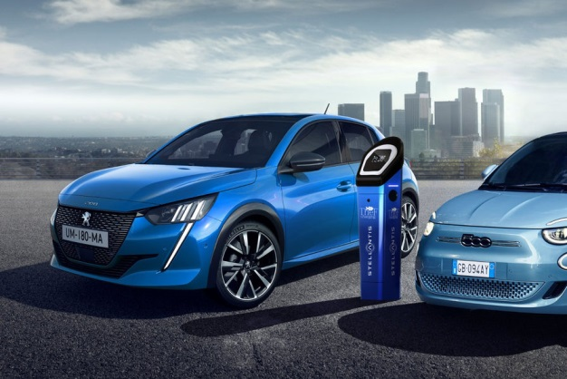
02 - The Stellantis strategy
Keys to success
Mise en oeuvre business
2038
  Carbon Net Zero
2026
2030
2038
Your action
Drag the slider to the different dates

Slide 49

02 - The Stellantis strategy
Keys to success
Mise en oeuvre business
Your action
Knowing how to adapt to this new context is a great opportunity to develop your sales of electrified vehicles and associated services.
You’ll be able to make a difference by adopting a TCO approach and positioning yourself as a solution advisor.
2026
2030
2038
Your action
Drag the slider to the different dates

Slide 50
02 - The Stellantis strategy
Keys to success – Summary exercise
Avez-vous été attentif ?
Stellantis strategic objectives: match the figures
5
Decrease in costs between 2020 and 2024
40%
Carbon Net Zero
30 billion
Full-electric LCV launches by 2030
26
Full-electric vehicles in Europe by 2030
100%
Battery gigafactories by 2030
2038
Investment in euros over 5 years
SUBMIT
Drag and drop exercise – Match each figure with the right entry. Don’t forget to submit your answer.

Slide 51
02 - The Stellantis strategy
Keys to success – Summary exercise
Avez-vous été attentif ?
Stellantis strategic objectives: match the figures
40%
Decrease in costs between 2020 and 2024
2038
Carbon Net Zero
26
Full-electric LCV launches by 2030
100%
Full-electric vehicles in Europe by 2030
5
Battery gigafactories by 2030
30 billion
Investment in euros over 5 years
SUBMIT
Drag and drop exercise – Match each figure with the right entry. Don’t forget to submit your answer.

Slide 52
02 - The Stellantis strategy
Keys to success – Summary exercise
Avez-vous été attentif ?
Stellantis strategic objectives: match the figures
40%
Decrease in costs between 2020 and 2024
2038
Carbon Net Zero
Oh no!
That’s not the right answer.
Decrease in costs by 40% between 2020 and 2024
Net zero carbon objective in 2038
26 Full-electric LCV launches by 2030
100% full-electric vehicles in Europe by 2030
5 battery gigafactories
30 billion euros of investment over 5 years
Click on “NEXT” to continue the training.
That's the right answer!
Click on “NEXT” to continue the training.
26
Full-electric LCV launches by 2030
100%
NEXT
Full-electric vehicles in Europe by 2030
5
Battery gigafactories by 2030
30 billion
Investment in euros over 5 years
NEXT
SUBMIT
Drag and drop exercise – Match each figure with the right entry. Don’t forget to submit your answer.

Slide 53


02 - The Stellantis strategy
Takeaways
Avez-vous été attentif ?
Customer
Mobility
Approach
Turn over the cards

Slide 54
02 - The Stellantis strategy
Takeaways
Avez-vous été attentif ?
To respond to changes in the automotive sector and the needs of its customers, Stellantis has adopted a 360° approach to electrification by investing heavily in:
Battery factories
Innovations in terms of vehicle platforms and IT systems
Installations and services for battery charging and services
Stellantis is placing its customers’
MOBILITY
at the heart of the strategy
FIND OUT MORE
Turn over the cards

Slide 55
02 - The Stellantis strategy
Takeaways
Avez-vous été attentif ?
Why are business customers on the front line of these transformations?
We’ll be looking at that in the next section
To respond to changes in the automotive sector and the needs of its customers, Stellantis has adopted a 360° approach to electrification by investing heavily in:
Battery factories
Innovations in terms of vehicle platforms and IT systems
Installations and services for battery charging and services
Stellantis is placing its customers’
MOBILITY
at the heart of the strategy
FIND OUT MORE
Turn over the cards

Slide 56
Overview
01
Recent developments in the automotive sector
02
The Stellantis strategy
03
The B2B market and customer expectations
Conclusion
Learning assessment

Slide 57
03 - The B2B market and customer expectations
Specifics of B2B vs B2C
Avez-vous été attentif ?
Business customers and private customers should be approached differently:
+
Contact person(s)
+
Expectations
+
Purchase process
+
Sales cycle duration
+
Contract term
Open the drop-downs for further details

Slide 58

03 - The B2B market and customer expectations
Specifics of B2B vs B2C
Avez-vous été attentif ?
Business customers and private customers should be approached differently:
-
Contact person(s)
B2B
Multiple
Boss
Financial Director
Purchasing Director
Marketing Director
Human Resources Director
Fleet Manager
Driver
B2C
One person
Ms / Mr / Mx …
Open the drop-downs for further details

Slide 59
03 - The B2B market and customer expectations
Specifics of B2B vs B2C
Avez-vous été attentif ?
Business customers and private customers should be approached differently:
-
Expectations
B2B
Complex, precise and objective
TCO
Services
Taxes
Car policy (according to fleet size)
Benefits of any kind
B2C
Simple but subjective
Price / Discount
Equipment
Driving pleasure
Open the drop-downs for further details

Slide 60


03 - The B2B market and customer expectations
Specifics of B2B vs B2C
Avez-vous été attentif ?
Business customers and private customers should be approached differently:
-
Purchase process
B2B
Multiple stages
B2C
One single stage
Open the drop-downs for further details

Slide 61
03 - The B2B market and customer expectations
Specifics of B2B vs B2C
Avez-vous été attentif ?
Business customers and private customers should be approached differently:
-
Sales cycle duration
B2B
Long
B2C
Short
Multiple stages over quite a long period of time
Limited number of stages in a relatively short period of time
Open the drop-downs for further details

Slide 62
03 - The B2B market and customer expectations
Specifics of B2B vs B2C
Avez-vous été attentif ?
Business customers and private customers should be approached differently:
-
Contract term
B2B
Short
B2C
Long
Frequent renewal (36 months)
Longer retention period
Unclear renewal date
Takeaways
Open the drop-downs for further details

Slide 63
03 - The B2B market and customer expectations
Specifics of B2B vs B2C
Avez-vous été attentif ?
Business customers and private customers should be approached differently:
X
Takeaways
-
Contract term
Approaches need to differ for private and business customers:
Their expectations are different.
The sales cycle is longer and more complex.
What are the specifics of the B2B market?
What expectations do business customers have?
→ We’ll be looking at that in the next few pages
B2B
Short
B2C
Long
Frequent renewal (36 months)
Longer retention period
Unclear renewal date
Takeaways
Open the drop-downs for further details

Slide 64



03 - The B2B market and customer expectations
B2B market and customer types
Avez-vous été attentif ?
The size of the B2B market has been increasing consistently for over 10 years.
In various markets, it now represents around half of sales.
(Figures for France – adapt for each country)
 B2B + 10 points in 10 years!
B2B
57%
B2B
47%
Year n
Year n+10
B2C
43%
B2C
66%
Click on the magnifying glass

Slide 65
03 - The B2B market and customer expectations
B2B market and customer types
Avez-vous été attentif ?
The size of the B2B market has been increasing consistently for over 10 years.
In various markets, it now represents around half of sales.
(Figures for France – adapt for each country)
:
 B2B + 10 points in 10 years!
B2B sales are divided into three categories:
Vehicles registered directly by manufacturers for their own networks
Short-term rental vehicles
Vehicles registered in the name of an end customer (company, rental company, etc.)
Short-term rental:
B2B
57%
B2B
47%
57%
Year n
Year n+10
You need to focus on the third category
B2C
43%
B2C
66%
Click on the magnifying glass

Slide 66
03 - The B2B market and customer expectations
B2B market and customer types
Avez-vous été attentif ?
B2B customers are divided into three categories depending on the size of their fleets
(B2B NV figures for France – Adapt for each country)
Click on the three steps in the pyramid

Slide 67


03 - The B2B market and customer expectations
B2B market and customer types
Avez-vous été attentif ?
B2B customers are divided into three categories depending on the size of their fleets
(B2B NV figures for France – Adapt for each country)
Fleet size
% business customers
Sales volume
84%
28%
1 to 4 vehicles
VSBs, traders, liberal professions
Click on the three steps in the pyramid

Slide 68

03 - The B2B market and customer expectations
B2B market and customer types
Avez-vous été attentif ?
B2B customers are divided into three categories depending on the size of their fleets
(B2B NV figures for France – Adapt for each country)
Fleet size
% business customers
Sales volume
15,6%
38%
SMEs
5 to 100 vehicles
84%
28%
1 to 4 vehicles
VSBs, traders, liberal professions
Click on the three steps in the pyramid

Slide 69

03 - The B2B market and customer expectations
B2B market and customer types
Avez-vous été attentif ?
B2B customers are divided into three categories depending on the size of their fleets
(B2B NV figures for France – Adapt for each country)
Fleet size
% business customers
Sales volume
Conclusion
0,4%
35%
Key accounts represent 1/3 of sales volume
Key accounts
> 100 vehicles
SMEs represent 38% of sales, but only 15.6% of B2B customers
15,6%
38%
SMEs
5 to 100 vehicles
The vast majority of B2B customers consist of VSBs, crafts and liberal professions
84%
28%
1 to 4 vehicles
VSBs, traders, liberal professions
Click on the three steps in the pyramid

Slide 70
03 - The B2B market and customer expectations
B2B market and customer types – Summary exercise
Avez-vous été attentif ?
Drag and drop the figures into the two columns on the right.
Fleet size
% business customers
Sales volume
Figures
+100
0.4%
84%
15.6%
Key accounts
38%
28%
35%
5 -100
SMEs
SUBMIT
1-5
1-4
VSBs, crafts and liberal professions
Then click on SUBMIT to confirm your answer

Slide 71
03 - The B2B market and customer expectations
B2B market and customer types – Summary exercise
Avez-vous été attentif ?
Drag and drop the figures into the two columns on the right.
Fleet size
% business customers
Sales volume
Figures
0,1%
4,9%
95%
+100
0.4%
35%
Key accounts
32%
33%
35%
5 -100
15.6%
38%
SMEs
SUBMIT
1-4
84%
28%
1-5
VSBs, crafts and liberal professions
Then click on SUBMIT to confirm your answer

Slide 72
03 - The B2B market and customer expectations
B2B market and customer types – Summary exercise
Avez-vous été attentif ?
Drag and drop the figures into the two columns on the right.
Fleet size
% business customers
Sales volume
Figures
That's the right answer!
VSBs, traders and the liberal professions represent 84% of B2B customers and account for 28% of sales
SMEs represent 15.6% of B2B customers and account for 38% of sales
Key accounts represent 0.4% of B2B customers and account for 35% of sales
Click on “NEXT” to continue the training.
Oh no!
That’s not the right answer.
VSBs, traders and the liberal professions represent 84% of B2B customers and account for 28% of sales
SMEs represent 15.6% of B2B customers and account for 38% of sales
Key accounts represent 0.4% of B2B customers and account for 35% of sales
Click on “NEXT” to continue the training.
0,1%
4,9%
95%
+100
0.4%
35%
Key accounts
32%
33%
35%
5 -100
15.6%
38%
SMEs
SUBMIT
1-4
84%
28%
1-5
VSBs, crafts and liberal professions
NEXT
NEXT
Then click on SUBMIT to confirm your answer

Slide 73

03 - The B2B market and customer expectations
Your B2B contacts
Avez-vous été attentif ?
Identify your contact and their role in purchasing the vehicle.
Decision maker
Influencer
User
Who are you going to meet?
What interests them?
Click on each profile for further details

Slide 74
03 - The B2B market and customer expectations
Your B2B contacts
Avez-vous été attentif ?
Identify your contact and their role in purchasing the vehicle.
Decision maker
Influencer
User
  Managing Director
    Final decision maker. They rely on opinions and recommendations from the Board of Directors.
  Human Resources Director
    Concerned about “social harmony”, employee safety and motivation.
  Financial / Purchasing Director
    Concerned about costs and remaining within budget.
  Marketing Director
    Concerned about the company’s (green) image and the fleet remaining in good condition.
Click on each profile for further details

Slide 75
03 - The B2B market and customer expectations
Your B2B contacts
Avez-vous été attentif ?
Identify your contact and their role in purchasing the vehicle.
Decision maker
Influencer
User
  Accountant
    Concerned about the financing method
    Concerned about impacts on cash flow and taxes
    Looking for easiness of management
  Fleet Manager
    Knowledge of vehicles and services offered by suppliers (in relation to the company’s car policy)
  CSR Officer
    Optimisation of (multi)mobility
    Green mobility
Click on each profile for further details

Slide 76
03 - The B2B market and customer expectations
Your B2B contacts
Avez-vous été attentif ?
Identify your contact and their role in purchasing the vehicle.
Decision maker
Influencer
User
  Employee with or without power of influence
    Catalogue of vehicles selected by the company
    Budget by category
  User-Chooser
    Chooses their model and configuration
Click on each profile for further details

Slide 77






03 - The B2B market and customer expectations
Your B2B contacts
Avez-vous été attentif ?
For SMEs and Key Accounts:
≠
≠
≠
Driver
Fleet Manager
Decision maker(s)
Click on the exclamation mark for further details

Slide 78
03 - The B2B market and customer expectations
Your B2B contacts
Avez-vous été attentif ?
For SMEs and Key Accounts:
≠
≠
≠
Driver
Fleet Manager
Decision maker(s)
For efficient interactions, I need to:
  know who I’m talking to: driver / fleet manager / decision maker(s)
  focus on what interests them, to be more effective
Click on the exclamation mark for further details

Slide 79
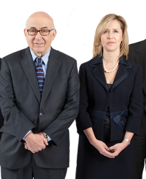




03 - The B2B market and customer expectations
Features and expectations of B2B customers
Avez-vous été attentif ?
SMEs
VSBs
Key Accounts
Liberal Professions
Craftsmen & Traders
Click on the people for further details

Slide 80
03 - The B2B market and customer expectations
Features and expectations of B2B customers
Avez-vous été attentif ?
SMEs
VSBs
X
Key Accounts
Liberal Professions
X
For mixed use
Vehicle => tax-deductible
Income above average
Social status and differentiation
Craftsmen & Traders
Liberal Professions
Vehicle = tool for work
Sensitive to cost (per mile)
Financial capacity often limited
Search for the best financing scheme
Quick decision-making process
Craftsmen & Traders
Click on the people for further details

Slide 81
03 - The B2B market and customer expectations
Features and expectations of B2B customers
Avez-vous été attentif ?
X
SMEs
SMEs
X
VSBs
Decision maker ≠ driver
Bigger challenges (discount, cost management, etc.)
Fleet manager issues
VSBs
Grands Comptes
Decision maker = driver (usually)
Rarely think in terms of total cost of ownership
Sensitive to tax
Search for the best way to buy
Liberal Professions
Craftsmen & Traders
Click on the people for further details

Slide 82
03 - The B2B market and customer expectations
Features and expectations of B2B customers
Avez-vous été attentif ?
X
SMEs
Key Accounts
Complex decision-making process
Car policy with selection criteria
Contact = fleet manager
Sensitive to usage cost (TCO)
Balance between “cost – green image/taxation – driver motivation”
VSBs
Key Accounts
Liberal Professions
Craftsmen & Traders
Click on the people for further details

Slide 83
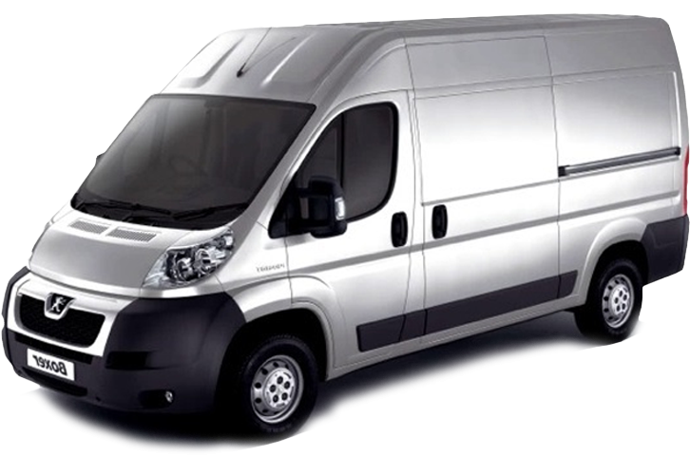

03 - The B2B market and customer expectations
Features and expectations of B2B customers
Focus on specific “business” expectations for the use of an LCV
Click the magnifying glasses for further details

Slide 84
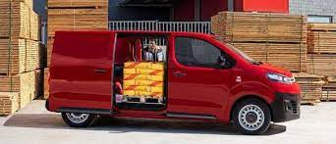
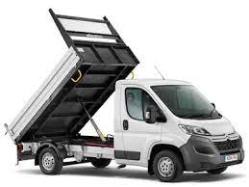
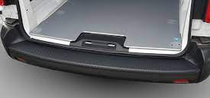
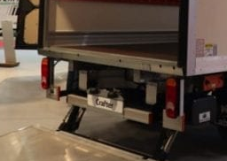
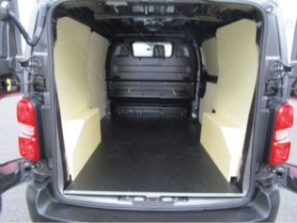
03 - The B2B market and customer expectations
Features and expectations of B2B customers
Focus on specific “business” expectations for the use of an LCV
X
Volume and payload needed?
X
Need for conversion?
Height of loading platform?
X
Interior improvements and setup?
X
Click the magnifying glasses for further details

Slide 85
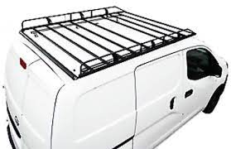
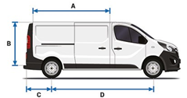
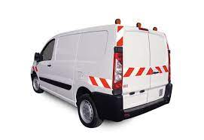

03 - The B2B market and customer expectations
Features and expectations of B2B customers
Focus on specific “business” expectations for the use of an LCV
X
Length, width and height needed?
X
Roof racks and bars?
X
Signage and marking?
X
Electrification for LEZ deliveries?
Click the magnifying glasses for further details

Slide 86

03 - The B2B market and customer expectations
Features and expectations of B2B customers
Focus on specific “business” expectations for the use of an LCV
Be prepared to meet the “business” expectations of your LCV customers
Click the magnifying glasses for further details

Slide 87







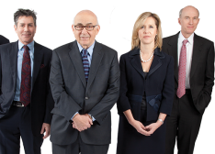



03 - The B2B market and customer expectations
Features and expectations of B2B customers
Summary
Vehicle + options
(+ conversion)
Financing
Craftsmen / Traders
Expectations
=
Global business solution
+
Small and Medium-sized Enterprises
Your business advice
Liberal Professions
Management / Optimisation
Services
Key Accounts
Very Small Businesses
Click on the cards

Slide 88
03 - The B2B market and customer expectations
Features and expectations of B2B customers
Summary
Vehicle:
Type (PC/LCV)
Use
Options / Trim / Setup / Conversion
CO₂ emissions (consumption / taxation)
Driver compatibility with electrification
Budget :
Type (price, monthly cost)
Payment method (cash, credit, card, long-term leasing)
Contribution
Craftsmen / Traders
Expectations
=
Global business solution
+
Small and Medium-sized Enterprises
Your business advice
Liberal Professions
Management / Optimisation:
Taxation
Financial
Operating risk
Services:
  Vehicle
  Fleet
  Mobility
Key Accounts
Very Small Businesses
Your role
Click on the cards

Slide 89
03 - The B2B market and customer expectations
Features and expectations of B2B customers
Summary
Vehicle:
Type (PC/LCV)
Use
Options / Trim / Setup / Conversion
CO₂ emissions (consumption / taxation)
Driver compatibility with electrification
Budget :
Type (price, monthly cost)
Payment method (cash, credit, card, long-term leasing)
Contribution
Craftsmen / Traders
Expectations
=
Global business solution
Your role:
adapt to the person you're dealing with
tailor your arguments to their specific concerns and needs
add value by positioning yourself as a sales advisor
all as part of a global offer
X
+
Small and Medium-sized Enterprises
Your business advice
Liberal Professions
Management / Optimisation:
Taxation
Financial
Operating risk
Services:
  Vehicle
  Fleet
  Mobility
Key Accounts
Very Small Businesses
Your role
Click on the cards

Slide 90



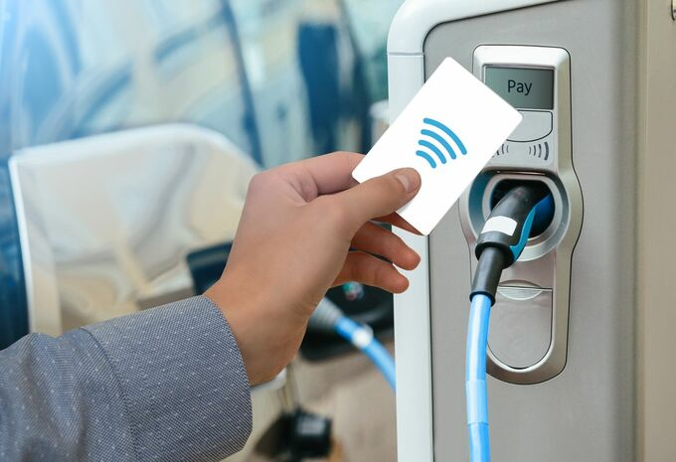

03 - The B2B market and customer expectations
“Needs analysis” checklist
Let your customer express their needs but ensure that all the topics listed below have been thoroughly dealt with:
Who is my customer (profile)?
What expectations do they have?
What is their budget?
Compatibility with electrification?
Turn over the cards for further details on the topics to be addressed during needs analysis for your B2B customers

Slide 91
03 - The B2B market and customer expectations
“Needs analysis” checklist
Let your customer express their needs but ensure that all the topics listed below have been thoroughly dealt with:
Who is my customer (profile)?
What expectations do they have?
What is their budget?
Compatibility with electrification?
Contact person
Company
Fleet
Use
Renewal
New vehicle criteria
Business criteria
Budget type
Monthly budget available
Variable financing parameters
Services
Daily mileage
Frequency of long journeys (> 250 km) & Usage
Charging options
Turn over the cards for further details on the topics to be addressed during needs analysis for your B2B customers

Slide 92









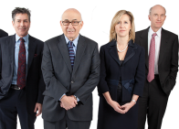
03 - The B2B market and customer expectations
Summary
Profile
Expectations
Profil
Role
Needs
Fleet size
Craftsmen /
Traders
≠
Decision maker
Vehicle
≠
+
Liberal professions
≠
≠
≠
Influencer
Financing
≠
+
Very Small Businesses
User
Services
≠
+
Management
Small and Medium-sized Enterprises
≠
+
Your advice
Key Accounts
Click on the arrows

Slide 93
Overview
01
Recent developments in the automotive sector
02
The Stellantis strategy
03
The B2B market and customer expectations
Conclusion
Learning assessment

Slide 94




Conclusion
Key takeaways
Click on the images

Slide 95
Conclusion
Key takeaways
The energy transition is underway and it is developing faster and faster! There is an urgent need to renew fleets according to environmental constraints.
The Stellantis positioning fully meets these new challenges, focusing its strategy around customer mobility.
Customer expectations are changing: vehicle usage is now taking the form of use of mobility services.
B2B customers represent a major development challenge for the sales of LEVs and mobility services.
Click on the images

Slide 96





Conclusion
Key takeaways
≠
≠
≠
≠
Craftsmen / Traders
Liberal Professions
VSBs
SMEs
Key Accounts
Know how to adapt to the profile and expectations of each of your B2B customers.
Your ADVICE will make the difference!

Slide 97
Overview
01
Recent developments in the automotive sector
02
The Stellantis strategy
03
The B2B market and customer expectations
Conclusion
Learning assessment

Slide 98
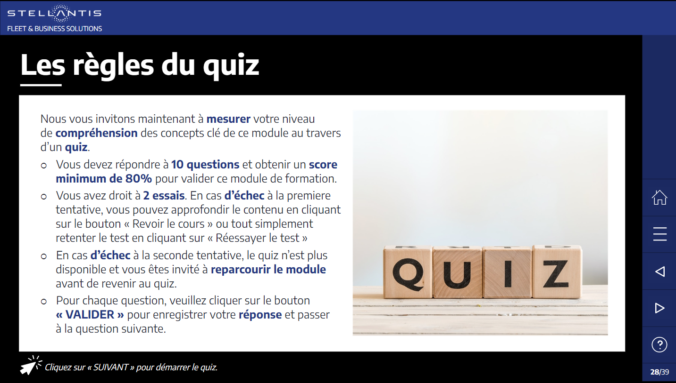
LEARNING ASSESSMENT
Quiz rules
It’s now time to measure to what extent you understand the key concepts in this module, via a quiz.
  You’ll need to answer 10 questions and obtain a minimum score of 80% to pass this training module.
  You have two goes. If you don't pass the first time, you can go back through the content by clicking on the “Review the course” button, or just have another go at the test by clicking on “Take the test again".
  If you don't pass the second time, the quiz will no longer be available and you’ll have to go back over the module before returning to the quiz.
  After each question, click on the “SUBMIT” button to save your answer and move to the next question.
Click on “NEXT” to start the quiz

Slide 99
That’s the right answer.
Click on “NEXT” to continue the quiz.
Oh no!
That’s not the right answer.
The correct answer is:
xxx
Click on “NEXT” to continue the quiz.
NEXT

Slide 100
The aim of the Green Deal is:
Reductions in CO₂ emissions in the European Union of 55% by 2030.
The requirement to set up Low Emission Zones in major city centres in Europe.
Carbon net zero in Europe by 2050.
A ban on vehicles emitting more than 60 grams of CO₂ per km in Europe.

Slide 101
Which of these statements is false?
TCO stands for “Total Cost of Ownership”.
The TCO approach is used to estimate the full cost of using a vehicle.
If the sales price of a vehicle is higher, its TCO will be proportionally higher as well.
Energy consumption and taxation play a major role in calculating TCO.

Slide 102
Which of these factors is the starting point for the strategic approach at Stellantis?
The customer.
Electrification.
The environmental transition.
The diversity of its iconic brands.

Slide 103
By 2030, the proportion of electric vehicle sales as part of total Stellantis sales in Europe will be:
55%
100%
80%
70%

Slide 104
Craftsmen / Traders, Liberal Professions, VSBs and SMEs are your preferred target.
All together, which part of the new vehicles sales do they represent?
15% of the sales volume.
25% of the sales volume.
45% of the sales volume.
65% of the sales volume.

Slide 105
Why do you need to focus on the TCO rather than the vehicle price when presenting an offer to a B2B customer?
No reason, it's only a matter of vocabulary. Price and cost are almost identical notions.
Because price is only one of the factors in TCO and the most expensive vehicle can be the cheapest in terms of TCO (e.g. electric vehicles).
Because it makes the message more confusing for the customer.
Because B2B customers always think about the cost before tax.

Slide 106
What does it mean to provide a B2B customer with a “global offer”?
To offer them the best price as quickly as possible to avoid them going elsewhere.
To offer them a solution that includes the vehicle, financing budget and services.
To present the technical arguments relating to the vehicle, to demonstrate your skills.
To focus on selling the vehicle without addressing the various financial solutions available.

Slide 107
The liberal professions follow a similar approach to private customers, but there are differences. Select one of them from the statements below:
The liberal professions still operate in the form of a company.
For the liberal professions, car costs are tax-deductible business expenses.
The liberal professions are often looking for integrated fleet management solutions.
The liberal professions are almost always interested in mileage allowances.

Slide 108
Why is it important to be aware of the position of the person you're dealing with within their company?
To adapt to their approach and arguments.
To find out how much they know about the automotive sector.
To work out whether I should make an offer immediately.
None of the three answers above.

Slide 109
During a sales conversation with a B2B customer, what essential information do you need to obtain?
To find out whether the customer has previous experience with the brand.
To find out whether I’m competing with another brand.
To find out whether the customer intends to use their vehicle at the weekend and during holidays.
To find out who the customer is, their expectation, budget and compatibility with electrification.

Slide 110
Results
You've come to the end of this training session.
Your score for the quiz is XXX%
If your score is 80% or higher, well done! You've completed the module.
You fully understand the concepts of the B2B market.
Please close this page by clicking the “CLOSE” button, then you can move on to the next module.
CLOSE
If your score is less than 80%, you haven't completed the module.
Please go back over the module and have another go at the quiz, to learn more about the concepts of the B2B market.
REVIEW THE COURSE
TAKE THE TEST AGAIN!

