Slide 1
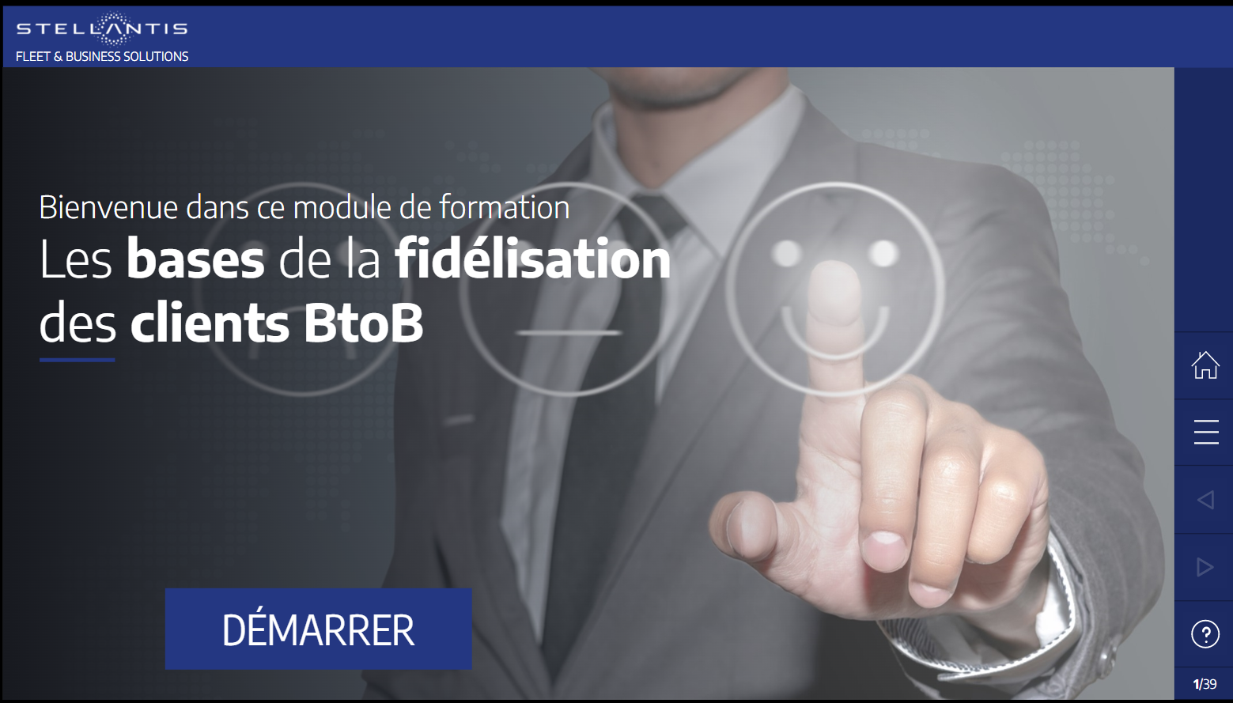
Welcome to this training module
B2B Financial Products
START

Slide 2
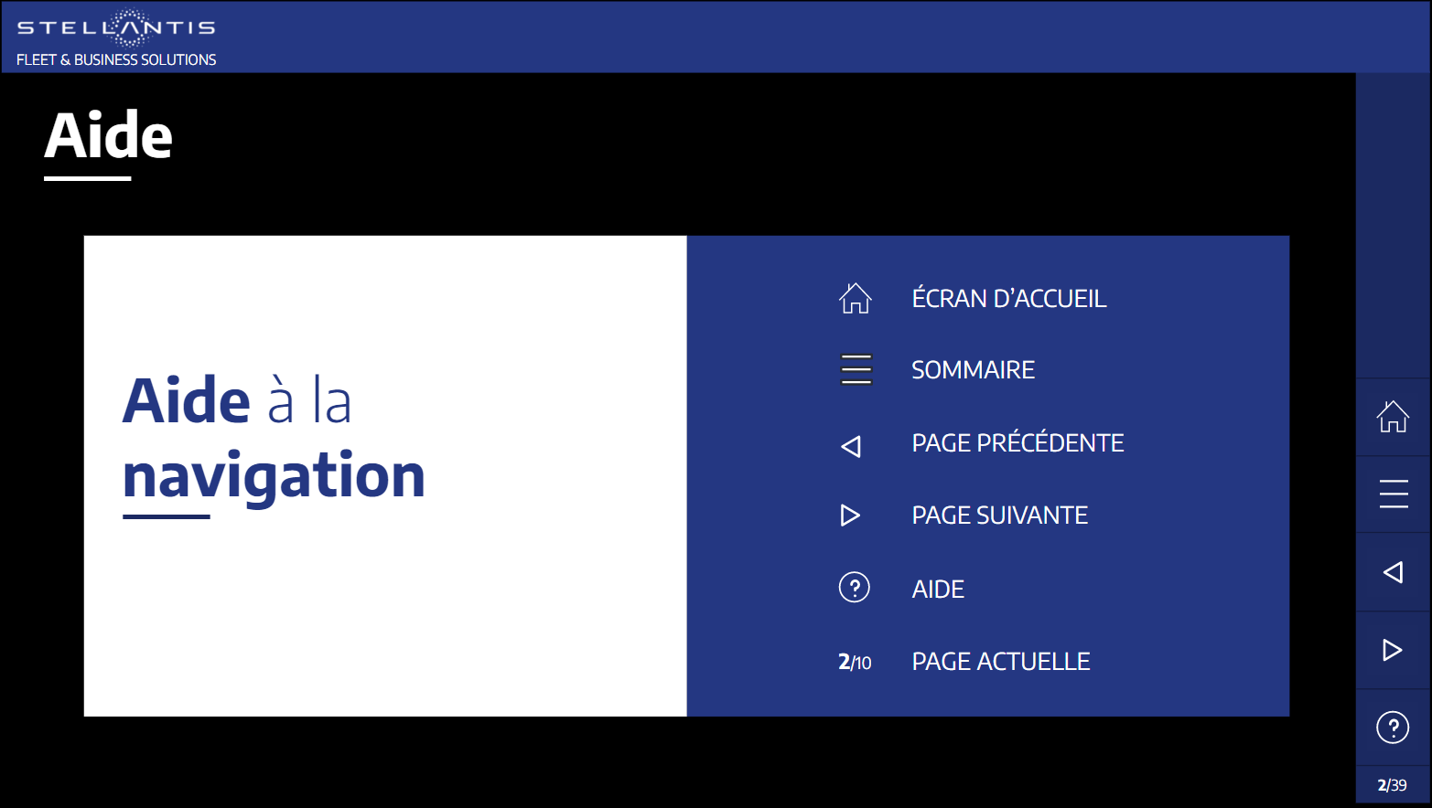

Help
WELCOME
Browsing
help
OVERVIEW
PREVIOUS PAGE
NEXT PAGE
HELP
CURRENT PAGE

Slide 3
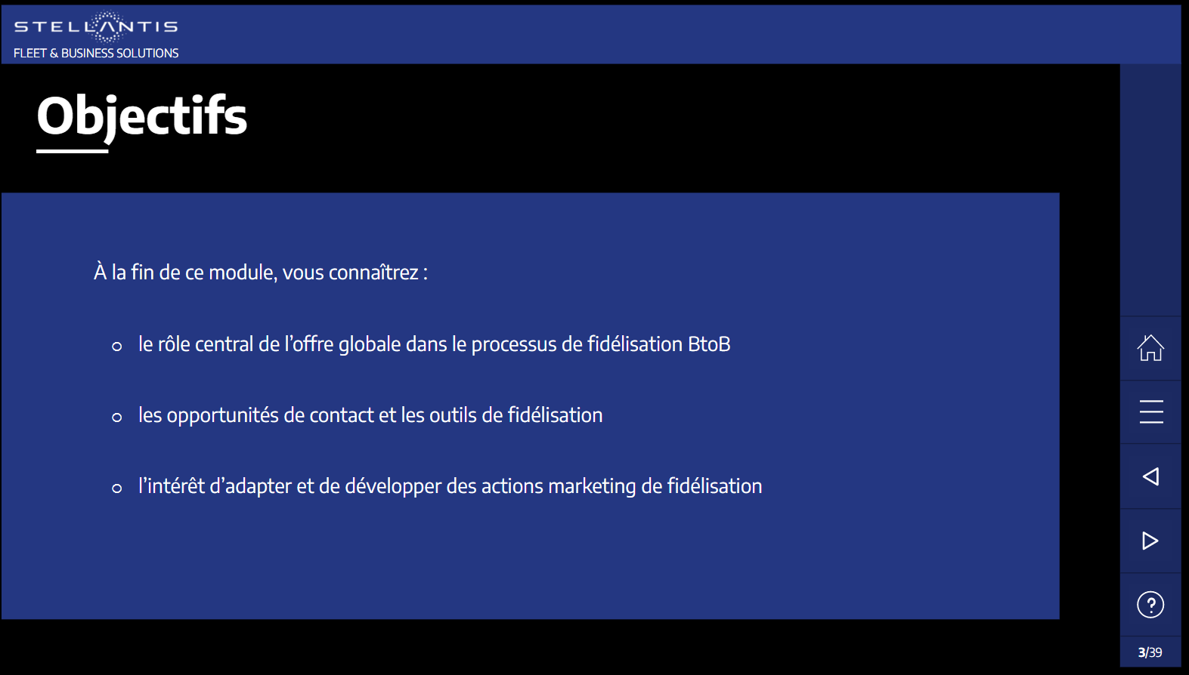
Objectives
By the end of this module, you will be able to:
Understand the different financial products and their parameters
Fine-tune the financial parameters to fit into the customer budget
Select the main services that can be packaged with these financial products into a global offer

Slide 4






OVERVIEW
01
Introduction
02
Classic financing
03
Leasing products
04
Related services
Conclusion
Learning assessment

Slide 5







01 – Introduction
What type of financing do B2B Customers resort to?
B2B Customers
Passenger vehicles
Light commercial vehicles
Takeaways
Craftspeople / Traders
Nearly 2/3rds of sales to B2B customers are made through financing (loans, financial leasing, operational leasing).
With a market share of more than 50%, leasing products (financial and operational leasing) are the payment methods most commonly used by your B2B Customers.
Liberal Professions
Very small businesses
Small and medium-sized businesses
Cash purchase
Classic financing
Financial leasing
Operational leasing
Cash purchase
Classic financing
Financial leasing
Operational leasing
Key accounts
Click on the arrows

Slide 6





01 – Introduction
Financial products, a sales tool towards B2B customers
Drag the slider to the different icons

Slide 7
01 – Introduction
Financial products, a sales tool towards B2B customers
  What are the main features of these financial products?
Drag the slider to the different icons

Slide 8
01 – Introduction
Financial products, a sales tool towards B2B customers
  What levers should we activate to fit into the customer budget?
Drag the slider to the different icons

Slide 9
01 – Introduction
Financial products, a sales tool towards B2B customers
  What services should we offer with these products?
Drag the slider to the different icons

Slide 10
01 – Introduction
Financial products, a sales tool towards B2B customers
  That’s what we’ll be looking at in this module.
Drag the slider to the different icons

Slide 11
OVERVIEW
01
Introduction
02
Classic financing
03
Leasing products
04
Related services
Conclusion
Learning assessment

Slide 12


02 – Classic financing
Key features of classic financing
Definition
Provision of a sum of money to a customer by a lending financial institution for the purchase of an asset, such as a vehicle.
In return, the customer undertakes to reimburse the sums lent according to the terms and conditions set out in the contract:
Amount borrowed
Duration
Payment frequency
Interest rate
Click on the left and right arrows

Slide 13

02 – Classic financing
Key features of classic financing
Legal aspects
The customer is the legal owner of the asset upon delivery (vehicle registered in the customer name).
Contract duration = min. 12 months
Financed capital = min. €3,500
Capital outstanding at the end of the contract = €0
Interest rate explicitly mentioned in the financing offer (APR = Annual Percentage Rate)
Consumer credit law does not apply to professional loans.
Payment of 100% of the VAT upon delivery of the vehicle (no smoothing over the duration of the contract).
Click on the left and right arrows

Slide 14

02 – Classic financing
Key features of classic financing
Accounting and tax aspects
Accounting aspects
Vehicle on the customer’s balance sheet as a fixed asset (must be depreciated).
Increase in liabilities on the balance sheet (negative impact on the company’s borrowing capacity).
Tax aspects
Depreciation + interest = tax-deductible (up to the caps set by law).
Taxable capital gain on the resale of the vehicle if the selling price of the used car is higher than its value in the company’s accounts (net book value).
Click on the left and right arrows

Slide 15

02 – Classic financing
Classic financing levers – Exercise
Exercise
A customer asks you to make an offer with a classic financing over 36 months for a vehicle costing €25,000.
Your first simulation comes out at €740 per month. That doesn't fit into the customer’s budget.
Rank the three classic financing levers here above, from the most effective to the least effective, according to their impact on the decrease in the monthly payment amount.
Reduce the interest rate by 0.5%
Suggest the customer to make a down payment of 20%
Suggest the customer to increase the duration (go over 48 months)
Click on the up and down arrows; then submit your answer
SUBMIT
Notes:
25,000 sans apport au taux de 4,25% = 36 x 739,98

Slide 16



Oh no!
That’s not the right answer.
The right order to offer them in is:
Suggest the customer to increase the duration (go over 48 months)
Suggest the customer to make a down payment of 20%
Reduce the interest rate by 0.5%
Click on “Next”
Congratulations, that’s the right answer!
Click on “Next”
Next
Next

Slide 17




02 – Classic financing
Classic financing levers – Summary
Duration
Down Payment
Interest Rate
Turn over the cards

Slide 18
02 – Classic financing
Classic financing levers – Summary
Duration
Down Payment
Interest Rate
The longer the term, the lower the monthly payment.
E.g.: moving from 36 to 48 months results in lowering the monthly payment by €174 per month.
Over 36 months, a deposit of 20% (€5,000) = Δ€148 per month compared to a monthly payment without down payment.
Few customers finance 100% of their vehicle. Most of the time, they make a down payment.
Might there be a vehicle to trade in as a contribution?
Apart from promotion campaigns, adjusting the interest rate will have a limited impact on the amount of the monthly payment.
Over 48 months, reducing the rate by 0.5% represents an impact of approximately €5 per month.

Slide 19

02 – Classic financing
Takeaways
To fit into the customer’s budget
Focus on duration and down payment, the two levers with a significant impact on the amount of the monthly payment
Avoid focusing on the interest rate, which has a very limited impact
Customers interested in classic financing want:
to own the vehicle upon delivery
to spread their expenses over time and preserve their cash flow
to depreciate the vehicle in their books

Slide 20
OVERVIEW
01
Introduction
02
Classic financing
03
Leasing products
04
Related services
Conclusion
Learning assessment

Slide 21

03 – Leasing products
Financial and operational leasing key features
What you need to know about financial leasing
Definition
Financial leasing is a form of contract whereby a customer leases a vehicle from a financial institution.
Specifics
Any financial leasing must legally include a buyback option (BO), for the customer to take ownership of the vehicle at the end of the contract if they wish.
Generally, the BO is between 1% and 10% of the investment value of the vehicle (the commonest occurrence).
However, the BO can sometimes be more than 10%.
Services can be combined within a financial leasing contract.
Transfer of ownership
The financial institution retains legal ownership until the customer takes up the buyback option.
Financial Leasing
Click on the left and right arrows

Slide 22

03 – Leasing products
Financial and operational leasing key features
What you need to know about operational leasing
Definition
Operational leasing is a form of contract whereby a rental company, in return for a set lease payment, undertakes to provide a vehicle to a customer for a specified period and on the basis of a set mileage.
Depending on the customer’s requirements, the lessor also provides “à la carte” services.
Specific features
The customer only finances their actual use of the vehicle.
The customer doesn't need to worry about reselling the vehicle at the end of the contract: they return the vehicle to the retailer and the brand or dealership is required to take it back
Transfer of ownership
Not included in the contract. The lessor keeps ownership of the vehicle at the end of the contract.
Operational Leasing
Click on the left and right arrows

Slide 23
03 – Leasing products
Financial and operational leasing key features
Let’s look at these two leasing products while comparing them
+
Common features of financial and operational leasing
+
Parameters
+
Customer benefits
+
Points of attention
+
Which product for which customer?
Open the drop-downs for further details

Slide 24
03 – Leasing products
Financial and operational leasing key features
Let’s look at these two leasing products while comparing them
-
Common features of financial and operational leasing
-
The customer has the option:
  to budget for the cost of using the vehicle by adding “à la carte” services to the financial aspect of the contract
  to pay an increased 1st instalment
Entry of lease payments as expenses in the income statement (no debt appears on the customer’s balance sheet: borrowing capacity preserved)
If the customer is subject to corporate income tax, the financial lease payments are tax-deductible within the limits set by law.
VAT applicable to the periodic lease payments
Pricing scale (interest rate) not communicated to the customer
Open the drop-downs for further details

Slide 25
03 – Leasing products
Financial and operational leasing key features
Let’s look at these two leasing products while comparing them
-
Parameters
Financial leasing
Duration (24-60 months)
Option of an increased 1st payment
Buyback option
Price scale
Services included in the offer
Operational leasing
Duration (12-60 months)
Option of an increased 1st payment
Mileage
Price scale / Protocol customers
Services included in the offer
Open the drop-downs for further details

Slide 26
03 – Leasing products
Financial and operational leasing key features
Let’s look at these two leasing products while comparing them
-
Customer benefits
Financial leasing
Freedom of choice at the end of the contract:
  take up the buyback option and become the legal owner of the vehicle OR
  return the vehicle to the retailer
If the buyback option is taken up, option of:
  keeping and using the vehicle beyond the end of the contract
  making a capital gain on resale on the used car market (taxable capital gain)
Operational leasing
Simplified management (only one invoice per month, services included)
Total flexibility depending on:
  service requirements
  actual use (term / mileage scheme)
Term / mileage parameters can be adapted during the contract
Open the drop-downs for further details

Slide 27
03 – Leasing products
Financial and operational leasing key features
Let’s look at these two leasing products while comparing them
-
Points of attention
Financial leasing
Duration and buyback option parameters cannot be changed during the contract
Customer needs to keep cash in hand to take up the buyback option
Operational leasing
Option to adjust initial mileage and duration parameters during the contract according to circumstances
Risk of invoicing for repair costs upon return at the end of the contract, depending on the condition of the vehicle and/or additional invoicing according to actual use of the vehicle (e.g. excess mileage; see services section)
Early contract termination indemnities
Open the drop-downs for further details

Slide 28
03 – Leasing products
Financial and operational leasing key features
Let’s look at these two leasing products while comparing them
-
Which product for which customer?
Financial leasing
I offer financial leasing to customers who:
want to take ownership, for example by continuing to use a converted vehicle after the end of the contract
want to finance their vehicle over a long period of time (60 months)
want to renew their vehicle, taking advantage of the trade-in commitment.
Operational leasing
I offer operational leasing to customers who:
regularly renew their vehicle(s)
use their vehicle extensively
are looking for a global mobility solution (vehicle + fleet management + employee mobility)
are sensitive to optimised fleet management (fleet management software, single invoicing, dynamic vehicle monitoring, etc.).
Open the drop-downs for further details

Slide 29


03 – Leasing products
Financial and operational leasing levers – Summary
By adjusting the specific parameters of financial and operational leasings, you can suggest monthly lease payments much lower than for car loans.
It is therefore an excellent gateway for discussions with the customer on:
moving upmarket (trim level, engine type, options, etc.)
extra services
Financial Leasing
Operational Leasing
Turn over the cards

Slide 30
03 – Leasing products
Financial and operational leasing levers – Summary
By adjusting the specific parameters of financial and operational leasings, you can suggest monthly lease payments much lower than for car loans.
It is therefore an excellent gateway for discussions with the customer on:
moving upmarket (trim level, engine type, options, etc.)
extra services
Financial Leasing
Operationl Leasing
The “duration / mileage” scheme sets the residual value of the vehicle at the end of the contract.
For example, the residual value on a 3-year/90,000-km contract will be significantly higher than on a 5-year/200,000-km contract.
The buyback option and an increased 1st payment are levers that can be activated to fit into the customer’s budget.
Turn over the cards

Slide 31



03 – Leasing products
Takeaways
B2B Customers
Financial Leasing
Operational Leasing
Key features
Craftspeople / Traders
Liberal Professions
Customers interested in financial leasing want:
to have the option to take ownership of the vehicle at the end of the contract
Customers interested in operational leasing want:
to benefit from an all-inclusive mobility solution (vehicle + financing + services + management)
to pay for the actual use of the vehicle only.
not to be worried about the resale of the vehicle at the end of the contract (risk borne by the brand or dealership)
Competitive lease monthly payments make it possible to offer the customer:
a move upmarket
extra services
And fit into their budget at the same time!
What services should we suggest? Let’s have a look at them in more details.
Very small businesses
Small and medium-sized businesses
Key accounts
Click on the arrows

Slide 32
OVERVIEW
01
Introduction
02
Classic financing
03
Leasing products
04
Related services
Conclusion
Learning assessment

Slide 33






04 – Related services
Importance of the services in a global offer
CAFE plan
Drag the slider to the different icons

Slide 34
04 – Related services
Importance of the services in a global offer
  65% of new vehicle deliveries to companies (including key accounts) include at least one service contract
CAFE plan
Drag the slider to the different icons

Slide 35
04 – Related services
Importance of the services in a global offer
  80% of new vehicle deliveries to craftspeople, traders, liberal professions and SMEs/SBs include at least one service contract
CAFE plan
Drag the slider to the different icons

Slide 36
04 – Related services
Importance of the services in a global offer
Maintenance (care, wear and tear) is the service most frequently subscribed by B2B customers
CAFE plan
Drag the slider to the different icons

Slide 37
04 – Related services
Importance of the services in a global offer
New services have been developed around electric vehicles and mobility solutions
CAFE plan
Drag the slider to the different icons

Slide 38
04 – Related services
Importance of the services in a global offer
The global offer (modular approach) makes it possible to package the different services according to each customer requirement
CAFE plan
Drag the slider to the different icons

Slide 39
04 – Related services
Importance of the services in a global offer
The nature and range of services offered in addition to financing solutions make it possible for you to meet the expectations of your B2B customers, and provide you strong USPs
CAFE plan
Drag the slider to the different icons

Slide 40
04 – Related services
Services related to leasing products
Drag and drop each service into one of the three categories of leasing products below
Common services for
financial leasing and operational leasing
Specific services for financial leasing
Specific services
for operational leasing
Restitution Pass
Warranty extension
Death/disability cover
Car insurance
Financial loss guarantee
Maintenance
Fleet management
Drag and drop your answers into the right box, then click on SUBMIT to confirm your answer.
SUBMIT

Slide 41
04 – Related services
Services related to leasing products
Drag and drop each service into one of the three categories of leasing products below
Common services
financial leasing and operational leasing
Specific services for financial leasing
Specific services
for operational leasing
Maintenance
Car insurance
Warranty extension
Restitution Pass
Financial loss guarantee
Fleet management
Death/disability cover
Provision pour frais de restitution
Extension de garantie
Assurance décès/invalidité
Perte financière sur option d’achat
Gestion de parc
Assistance
Maintenance
Perte financière sur indemnité résiliation
Assurance tous Risques
Drag and drop your answers into the right box, then click on SUBMIT to confirm your answer.
SUBMIT

Slide 42


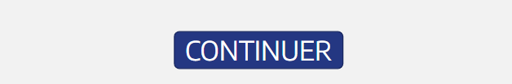

04 – Related services
Services related to leasing products
Congratulations, that’s the right answer!
Click on “NEXT” for more details on these different services.
Oh no!
That’s not the right answer.
The four services shared by operational and financial leasings are:
  Maintenance
  Car insurance
  Financial loss guarantee
  Death/disability cover
Specific service for financial leasing:
  Warranty extension
The two specific services for operational leasing are:
  Restitution Pass
  Fleet management
Next
Next

Slide 43
04 – Related services
Focus on services shared by financial and operational leasing
Financial Leasing
Maintenance
Routine maintenance according to the manufacturer’s schedule
Worn spare parts (e.g. windscreen wiper blades)
Labour
✓
Car insurance
“À la carte” insurance with the premium included in the leasing invoice
Wide range of covers: civil liability, windscreen damage, fire and theft, comprehensive damage cover, vandalism, storms, driver cover, legal protection, etc.
Operational Leasing
Financial loss guarantee
Guarantee in addition to damage cover
Compensates for financial loss in the event of theft or total loss due to fire, accident or natural disaster
Reimburses the difference between the expert valuation and the early termination indemnity to be paid to settle the financial or operational leasing contract and the expert valuation
✓
Death/disability cover
Coverage of balance due in the event of total and irreversible autonomy loss as a result of an accident or death due to illness or accident
Click on each “Service” block

Slide 44
04 – Related services
Focus on specific services for financial leasing
Financial Leasing
Warranty extension
Extension to the two-year manufacturer warranty: replacement or repair of mechanical, electronic and electrical parts recognised as defective
Labour included
✓
Operational Leasing
✗
Click on each “Service” block

Slide 45
04 – Related services
Focus on specific services for operational leasing
Financial Leasing
✗
Operational Leasing
Coverage of any repair costs at the end of the contract
Via incremental build-up of a fund (reimbursed if unused)
Restitution Pass
✓
Software to manage contract discrepancies, plan renewals, etc.
Receipt of real-time information for connected vehicles
Provides a view of total cost of ownership
Fleet management
Click on each “Service” block

Slide 46
OVERVIEW
01
Introduction
02
Conventional loans
03
Rental products
04
Related services
Conclusion
Learning assessment

Slide 47

04 – Conclusion
B2B financial products at a glance
CLASSIC FINANCING
FINANCIAL LEASING
OPERATIONAL LEASING
Management | Separate invoicing of financing and services Operational management by the customer |  | Separate invoicing of financing and services Operational management by the customer |  | One global invoice per month Operational management by the lessor
Vehicle resale and depreciation risk (residual value) | Borne by the customer |  | Borne by the customer if the buyback option is taken up |  | Borne by the brand or dealership
Running costs | When needed, unless services have been subscribed |  | When needed, unless services have been subscribed |  | Extent of coverage depends on subscribed services
Impact on taxes | Depreciation + interest |  | Lease payments |  | Lease payments
Impact on accounting | On balance sheet |  | Off balance sheet |  | Off balance sheet
Impact on cash flow | Down payment Monthly instalments |  | Increased 1st payment Lease payments / Buyback option |  | Lease payments
Ownership | Upon delivery |  | Yes, if buyback option taken out |  | Not included in the contract
Extent of commitment | Term-related |  | Term-related |  | Related to a “term / mileage” scheme Can be changed during the contract
Financial levers | Down payment Duration |  | Increased 1st payment Term / buyback option |  | “Term / mileage” scheme Services included

Slide 48




04 – Conclusion
Levers available to meet your B2B customers expectations
A good discovery of your customer needs, together with the financing and service solutions offered by the captive bank and leasing company, are appropriate levers allowing you to suggest a global offer to your B2B customers.
B2B Solution
(Global Offer)
Vehicle(s)
Financing
Services
Advice
Through carefully adjusting the parameters of financial products, you will create an excellent opportunity for discussing with you customer on:
a move upmarket
extra services
Click on the grey arrows

Slide 49
OVERVIEW
01
Introduction
02
Conventional loans
03
Rental products
04
Related services
Conclusion
Learning assessment

Slide 50
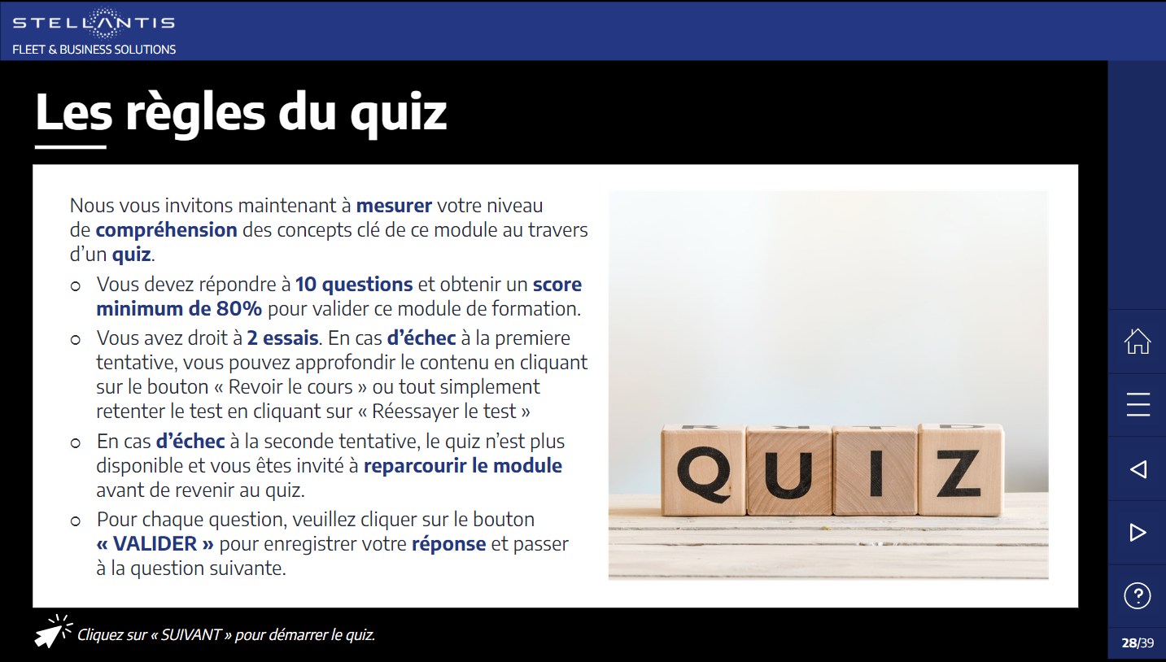
Learning Assessment
Quiz rules
We’d now like you to check how much you understand of the key concepts in this module, via a quiz.
You’ll need to answer 10 questions and achieve a score of at least 80% to pass this training module.
You have two goes. If you don't pass the first time, you can go back through the content by clicking the “Review the course” button, or just have another go at the test by clicking “Retry the test”.
If you don’t pass a second time, the quiz will no longer be available, and you’ll have to go back over the module before returning to the quiz.
For each question, please click on the “SUBMIT” button to save your answer and go to the next question.

Slide 51
Quiz
Q1 Financial leasing is regulated by a specific legislation. What does it specify?
That this type of financing is only available to customers subject to VAT
That this type of financing must include a buyback option
That the minimum duration of contracts must be set at 18 months
That this type of financing is accessible to both professional and private customers

Slide 52
Quiz
Q2 In operational leasing, why is the contractually defined mileage essential?
Because, in operational leasing, the contract can no longer be amended once the vehicle is on the road
Because mileage affects the percentage of residual value
Because the comprehensive car insurance premium is calculated based on annual mileage driven
Because the courtesy vehicle option is only available for contracts of at least 70,000 km

Slide 53
Quiz
Q3 The potential resale value of your customer’s vehicle on the used car market has fallen sharply.
What impact will this decrease have on the conditions of their current operational leasing contract?
Their monthly payment will increase
No impact because the risk of depreciation is borne by the lessor
They will have to return their vehicle to the lessor earlier than initially provided for in the contract
The leasing company will automatically extend the term of their contract

Slide 54
Quiz
Q4 In which case(s) does the customer never take ownership of the vehicle?
Financial leasing and classic financing
Classic financing
Operational leasing
Financial leasing and operational leasing
Classic financing and operational leasing

Slide 55
Quiz
Q5 Which financial product(s) preserve(s) the company’s borrowing capacity?
Financial leasing and car loan
Classic financing
Operational leasing
Financial leasing and operational leasing
Classic financing and operational leasing

Slide 56
Quiz
Q6 A vehicle costs €25,000, financed with financial leasing over 36 months. No increased 1st payment and buyback option is set at 5%. The monthly lease payment is set at €716. By how much is this monthly payment reduced if the term is increased to 48 months?
Approximately €50 per month
Approximately €100 per month
Approximately €165 per month
Approximately €225 per month

Slide 57
Quiz
Q7 In operational leasing, the residual value of the vehicle is determined by:
Total duration and annual mileage specified in the contract
Amount of increased 1st payment
Number of claims (accidents/repairs) during the contract
Vehicle value on the used car market at the end of the contract

Slide 58
Quiz
Q8 The amount of the financial leasing payment is significantly affected by (more than one answer may be selected):
Increased 1st payment
Annual mileage
Interest rate
Buyback option
VAT deductibility

Slide 59
Quiz
Q9 Among the services listed below, which one cannot be taken out as part of an operational leasing contract?
Warranty extension
Comprehensive car insurance
Roadside assistance
Maintenance

Slide 60
Quiz
Q10 A vehicle costs €25,000, financed with a financial leasing over 36 months. No increased 1st payment and buyback option is set at 5%. The monthly lease payment is set at €716. By how much is this monthly payment reduced if the buyback option is increased to 20%?
Approximately €50 per month
Approximately €100 per month
Approximately €150 per month
Approximately €200 per month
Notes:
Taux = 3,53%
697-551= 146 eur

Slide 61
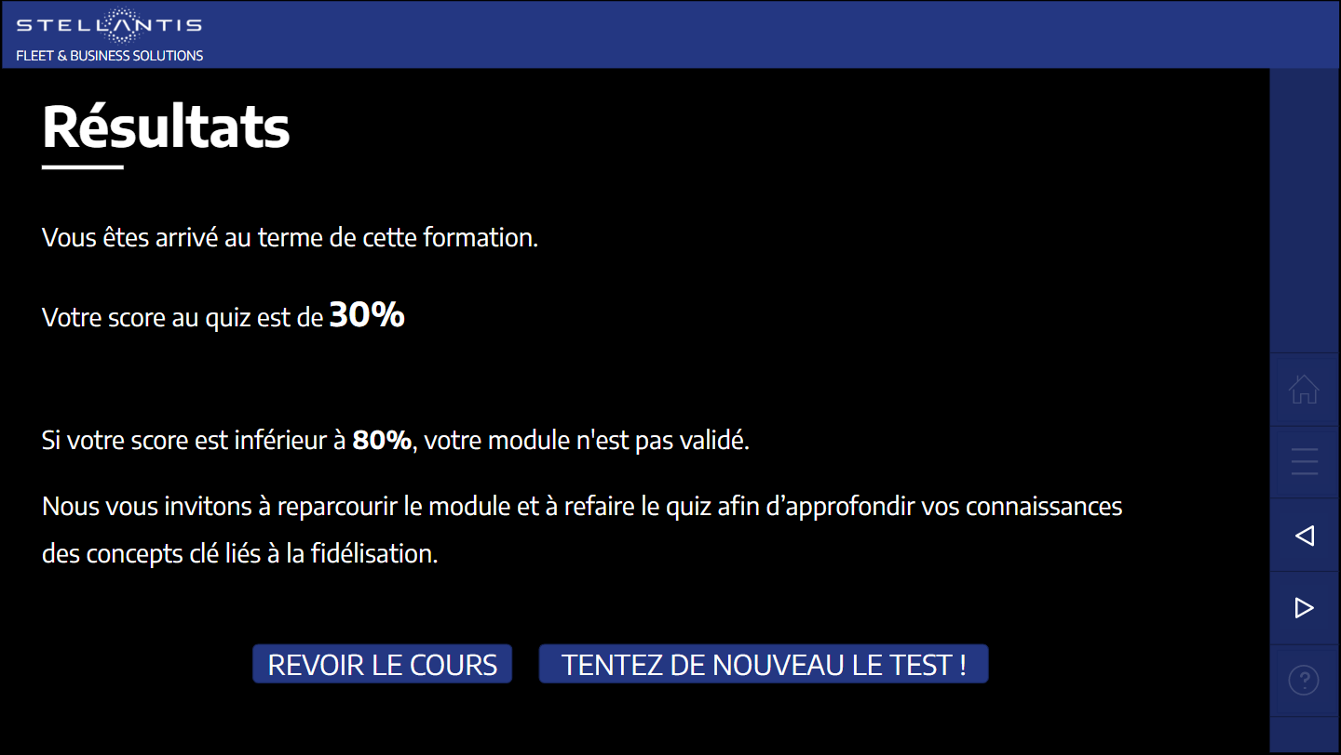
Results
You’ve come to the end of this training session.
Your score for the quiz is 30%
If your score is less than 80%, you haven't completed the module.
Please go back over the module and have another go at the quiz, to learn more about the key concepts relating to the B2B financial products.
REVIEW THE COURSE
TAKE THE TEST AGAIN!

