Slide 1
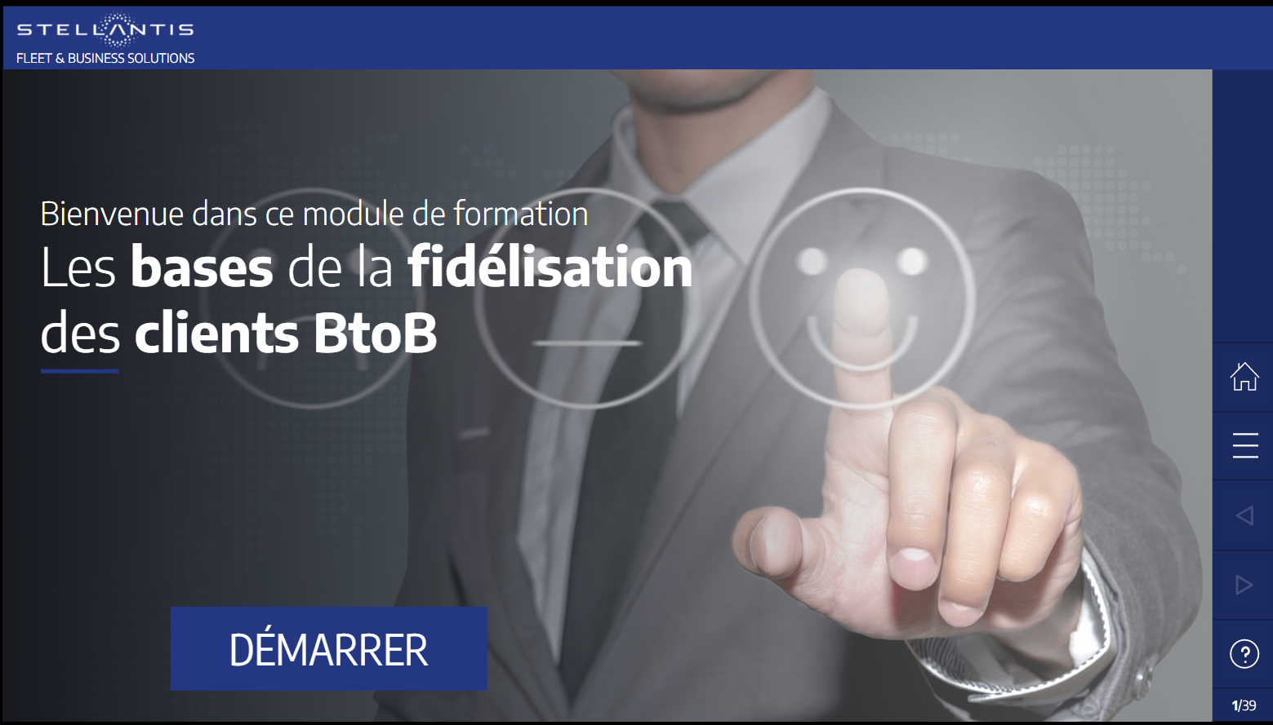

Welcome in the training module
B2B New Business Conquest
START

Slide 2
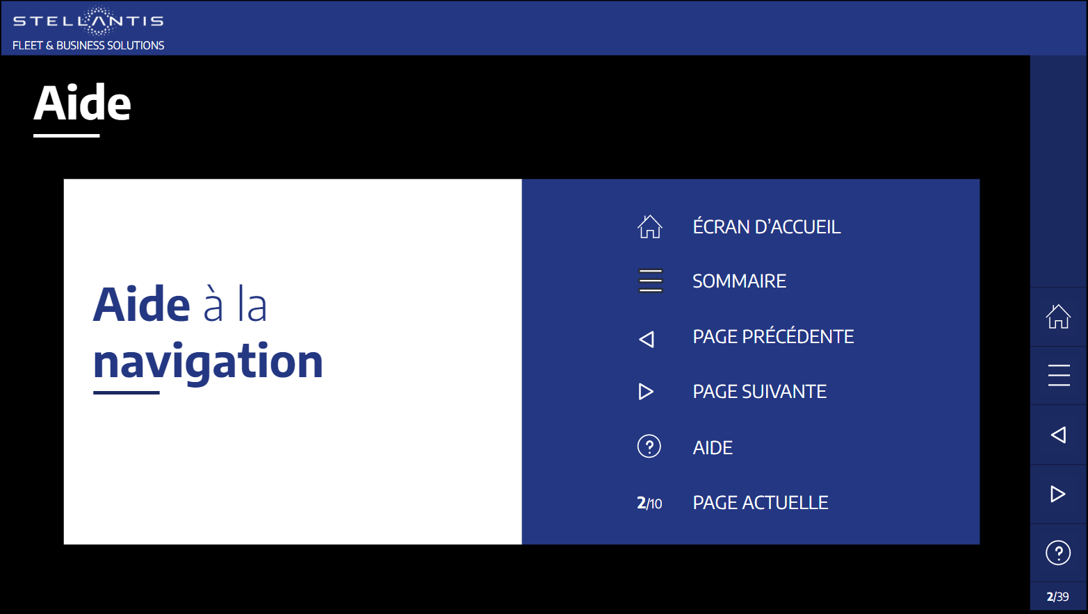

HELP
HOME PAGE
MENU
How to navigate in this module
PREVIOUS PAGE
NEXT PAGE
HELP
CURRENT PAGE

Slide 3
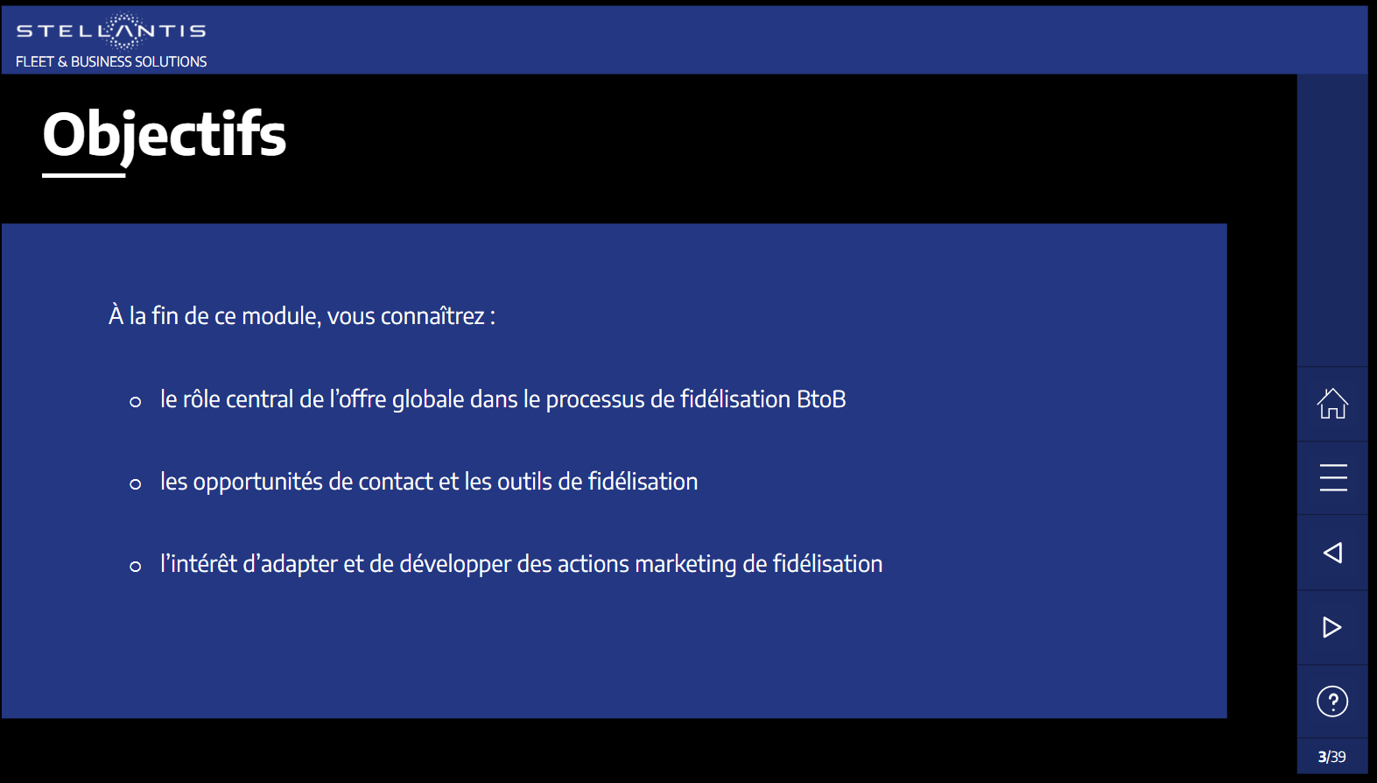
Objectives
At the end of this module, you will be able to:
les évolutions récentes du secteur impactant vos clients BtoB et votre métier de conseiller commercial
Understand the stakes of new business conquest
Apply the 6 steps of a successful new business conquest approach
Master the good practices of new business conquest
la stratégie de Stellantis pour intégrer ces changements
les spécificités du marché BtoB et les attentes des différents types de clients BtoB

Slide 4



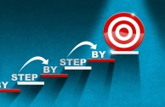




Overview
01
Stakes of New Business Conquest
02
B2B New Business Conquest in 6 steps
03
Zoom on step #6: The First Visit
Conclusion
Learning Assessment

Slide 5




01 - CHALLENGES OF NEW BUSINESS CONQUEST
The context of B2B New Business Conquest
Lack of time
Avoid risk of sales decrease
Being proactive
Flip over the cards

Slide 6
01 - CHALLENGES OF NEW BUSINESS CONQUEST
The context of B2B New Business Conquest
Lack of time
Avoid risk of sales decrease
Being proactive
Just like you, B2B customers have one thing in common: the lack of time
They must make their decisions quickly
They often lack time to visit several dealerships when they are considering renewing their vehicle(s)
The renewal will never reach 100%. That’s why you must include new business conquest in your sales approach to avoid any RISK of:
  Losing sales volumes
  Losing customers to competitors soliciting new business prospects (e.g.: long-term hire lessors contacting SME’s)
To make yourself and your dealership known and sell your products to business customers, you must BE PROACTIVE:
Contact your existing and new customers
Dedicate time and specific slots to conquest tasks
Flip over the cards

Slide 7


01 - CHALLENGES OF NEW BUSINESS CONQUEST
Exercise
Rate your agreement with the statement below
  NEW BUSINESS CONQUEST
  =
  SALES
?
TCO & Budget
I agree
I don’t agree
Validate
Make your choice, then validate your answer

Slide 8
01 - CHALLENGES OF NEW BUSINESS CONQUEST
Exercise
Rate your agreement with the statement below
  NEW BUSINESS CONQUEST
  =
  SALES
?
TCO & Budget
I agree
I don’t agree
Validate
Make your choice, then validate your answer

Slide 9

01 - CHALLENGES OF NEW BUSINESS CONQUEST
Exercise
Rate your agreement with the statement below
  NEW BUSINESS CONQUEST
  =
  SALES
?
Make your choice, then validate your answer
Good answer!
  NEW BUSINESS CONQUEST
  =
  SALES
=
?
  NEW BUSINESS CONQUEST
  SALES
Proactive approach
Main targets =
  Appointment
  Create an opportunity to better know your prospect and to raise desire to do business together
Initiate a process of change
Requesting customer. Your ability to understand their needs and meet their expectations will make the difference
Main target = order form
Process of change already initiated
TCO & Budget
I agree
I don’t agree
TCO & Budget
I agree
I don’t agree
Validate
Click on NEXT
NEXT
Make your choice, then validate your answer

Slide 10

01 - CHALLENGES OF NEW BUSINESS CONQUEST
Exercise
Rate your agreement with the statement below
  NEW BUSINESS CONQUEST
  =
  SALES
?
Make your choice, then validate your answer
Sorry!
Wrong answer
  NEW BUSINESS CONQUEST
  =
  SALES
=
?
  NEW BUSINESS CONQUEST
  SALES
Proactive approach
Main targets =
  Appointment
  Create an opportunity to better know your prospect and to raise desire to do business together
Initiate a process of change
Requesting customer. Your ability to understand their needs and meet their expectations will make the difference
Main target = order form
Process of change already initiated
TCO & Budget
I agree
I don’t agree
TCO & Budget
I agree
I don’t agree
Validate
Click on NEXT
NEXT
Make your choice, then validate your answer

Slide 11


01 - CHALLENGES OF NEW BUSINESS CONQUEST
To remember
The first objective of B2B New Business Conquest =
Initiate a process of change in the mind of a customer by convincing her/him that you can understand and meet their expectations.
To be successful with new business conquest, you must be patient, plan your actions and act methodically.
A professionally conducted B2B new business conquest approach consists of 6 steps that must be followed in a chronological order.

Slide 12
Overview
01
Stakes of New Business Conquest
02
B2B New Business Conquest in 6 steps
03
Zoom on step #6: The First Visit
Conclusion
Learning Assessment

Slide 13
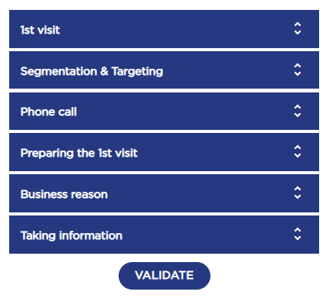

02 - B2B NEW BUSINESS CONQUEST IN 6 STEPS
Exercise
The 6 steps approach of B2B New Business Conquest
First visit
Segmentation & Targeting
Cold calling
Preparing the 1st visit
Business reason
Taking information
VALIDATE
Sort in chronological order the various steps of new business conquest, then click on Validate to confirm your answer.

Slide 14
02 - B2B NEW BUSINESS CONQUEST IN 6 STEPS
Exercise
B2B New Business Conquest, an approach in 6 steps
Cold calling
Good answer!
Click on NEXT to explore more details.
NEXT
Sort in chronological order the various steps of new business conquest, then click on Validate to confirm your answer.

Slide 15
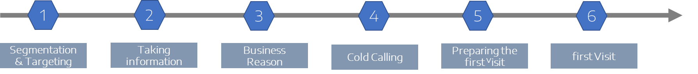
02 - B2B NEW BUSINESS CONQUEST IN 6 STEPS
Exercise
B2B New Business Conquest, an approach in 6 steps
Sorry!
Wrong answer
Cold calling
Take a look at the correct order, then click on NEXT to explore more details.
NEXT
Sort in chronological order the various steps of new business conquest, then click on Validate to confirm your answer.

Slide 16
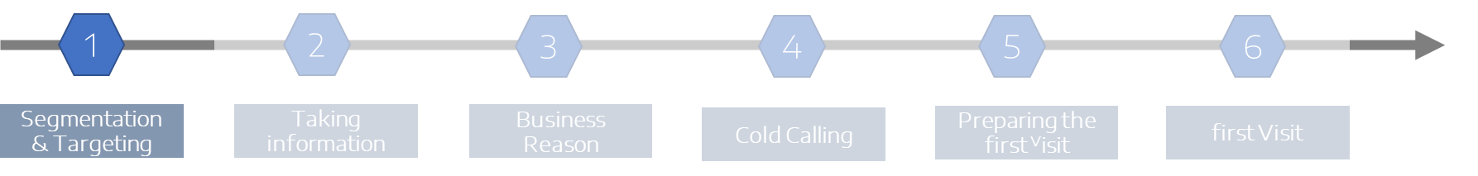


02 - B2B NEW BUSINESS CONQUEST IN 6 STEPS
Step 1 - Segmentation & Targeting
1
SEGMENTATION
&
TARGETING
Multi-mobilité
Click on the arrows to slide through the different screens

Slide 17

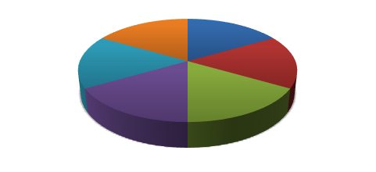

02 - B2B NEW BUSINESS CONQUEST IN 6 STEPS
Step 1 - Segmentation & Targeting
What does “segmentation” mean?
Segmentation = the process of defining and subdividing a large homogenous market into clearly identifiable segments having similar needs, wants, or demand characteristics. Its objective is to design a marketing mix that precisely matches the expectations of customers in the targeted segment.
The basic market segmentation-strategies are based on behavioural, demographic and geographical differences.
Multi-mobilité
B2B market
B2B market segments
TCO & Budget
Click on the arrows to slide through the different screens

Slide 18
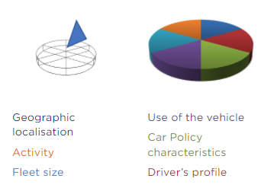
02 - B2B NEW BUSINESS CONQUEST IN 6 STEPS
Step 1 - Segmentation & Targeting
The segmentation criteria
The business customer’s market can be segmented based on the following criteria:
Geographic situation, e.g.: “less than 10 km around the dealership”
Activity, e.g.: “doctor, florist, industrial cleaning, ...”
Fleet size, e.g.: “fleet size 10 to 500 vehicles”
Use of the vehicle, e.g.: “converted van for the building sector” / “refrigerated van for the catering sector”
Car Policy characteristics, e.g.: “CO₂ max / vehicle category”
Driver’s profile, e.g.: “sales, internal staff, management, …”
Multi-mobilité
Click on the arrows to slide through the different screens

Slide 19
02 - B2B NEW BUSINESS CONQUEST IN 6 STEPS
Step 1 - Segmentation & Targeting
What does “targeting” mean?
Examples of targeting
Passenger Cars
Targeting is a policy that defines the focus and the effort of a dealership to concentrate on specific products and/or specific types of prospects.
Targeted new business customers | Vehicle to put forward
Medical sector: Doctor Visiting nurse | Statutory vehicle 2-seater vehicle
IT sector : Inhouse personnel | “Salary-package” vehicle
Real estate | Vehicle with strong image
Multi-mobilité
Click on the arrows to slide through the different screens

Slide 20
02 - B2B NEW BUSINESS CONQUEST IN 6 STEPS
Step 1 - Segmentation & Targeting
What does “targeting” mean?
Examples of targeting
LCVs
Targeting is a policy that defines the focus and the effort of a dealership to concentrate on specific products and/or specific types of prospects.
Targeted new business customers | Vehicle to put forward
Plumber / Heating installer Carpenter Express delivery Industrial cleaning Florist | Chassis cab vehicle, Platform cab vehicle, depending on desired volume and payload
Forestry company | SUV, 4WD powertrain
Construction company Contractor | Tipper, tray and double cab vehicle
Multi-mobilité
Click on the arrows to slide through the different screens

Slide 21
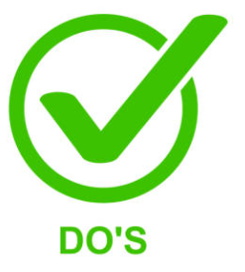

02 - B2B NEW BUSINESS CONQUEST IN 6 STEPS
Step 1 - Segmentation & Targeting – Do’s & Don’ts summary
According to what you saw in the previous screens, which of the following actions would you describe as "best practices"?
Set a priority target group
Skip segmentation study
Targeting upon your « feeling »
Plan your new business activity
Targeting before segmentation
VALIDATE
Drag and drop the proposals below in the DO’S or DON’TS boxes. Then click on VALIDATE to confirm your answer

Slide 22



02 - B2B NEW BUSINESS CONQUEST IN 6 STEPS
Step 1 - Segmentation & Targeting – Do’s & Don’ts summary
According to what you saw in the previous screens, which of the following actions would you describe as "best practices"?
Set a priority target group
Skip segmentation study
Plan your new business activity
Targeting before segmentation
Targeting upon your « feeling »
Sorry! Wrong answer
Good answer!
VALIDATE
Drag and drop the proposals below in the DO’S or DON’TS boxes. Then click on VALIDATE to confirm your answer

Slide 23
02 - B2B NEW BUSINESS CONQUEST IN 6 STEPS
Step 1 - Segmentation & Targeting – Do’s & Don’ts summary
According to what you saw in the previous screens, which of the following actions would you describe as "best practices"?
Please read the summary hereunder for more details. Then move forward.
Set a priority target group
Skip segmentation study
Set a priority target group, i.e. the one that offers the greatest potential within your dealership constraints (stock, margins…)
Plan your new business activity in your diary by setting a realistic planning and dedicating time frames for prospecting new customers
Starting new business conquest without prior segmentation
Targeting before segmentation
Identifying targets based upon your « feeling », i.e. without analysis
Plan your new business activity
Targeting before segmentation
Targeting upon your « feeling »
Drag and drop the proposals below in the DO’S or DON’TS boxes. Then click on VALIDATE to confirm your answer

Slide 24
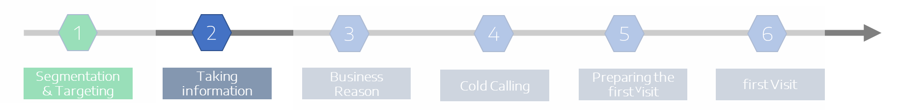

02 - B2B NEW BUSINESS CONQUEST IN 6 STEPS
Step 2 - Taking information
2
TAKING
INFORMATION
Multi-mobilité
Click on the arrows to slide through the different screens

Slide 25

02 - B2B NEW BUSINESS CONQUEST IN 6 STEPS
Step 2 - Taking information
What does taking information imply?
Gather information about the prospect:
Qualified database (i.e. containing certified and valid information) provided by your management
AND / OR
Individual research to enrich your knowledge of the new business customer (main source = Internet)
Multi-mobilité
Click on the arrows to slide through the different screens

Slide 26

02 - B2B New Business Conquest in 6 steps
Step 2 - Taking information
Lead & Qualified Lead
LEADS are potential sales contacts. They are obtained from:
Database | Commercial contacts
Result of advertising | Request for information by Internet
Multi-mobilité
We speak of QUALIFIED LEADS, when these contain the essential and certified information to make a contact with the useful contact person:
Company name Decision-making circuit Name, e-mail, tel. number of the contact person | Fleet size (mandatory) Fleet composition (PCs/LCVs, brands & models) if possible
The more complete the lead information is, the more likely you are to convert that lead.
Click on the arrows to slide through the different screens

Slide 27
02 - B2B NEW BUSINESS CONQUEST IN 6 STEPS
Step 2 - Taking information - Do’s & Don’ts summary
According to what you saw in the previous screens, which of the following actions would you describe as "best practices"?
Inform yourself about activity, values and mission of your prospect
Prospecting on an unqualified database
Inform yourself about age and condition of the fleet
Check contact history
Calling someone you don’t know by name
VALIDATE
Drag and drop the proposals below in the DO’S or DON’TS boxes. Then click on VALIDATE to confirm your answer

Slide 28
02 - B2B NEW BUSINESS CONQUEST IN 6 STEPS
Step 2 - Taking information - Do’s & Don’ts summary
According to what you saw in the previous screens, which of the following actions would you describe as "best practices"?
Inform yourself about activity, values and mission of your prospect
Prospecting on an unqualified database
Check contact history
Calling someone you don’t know by name
Inform yourself about age and condition of the fleet
Sorry! Wrong answer
Good answer!
VALIDATE
Drag and drop the proposals below in the DO’S or DON’TS boxes. Then click on VALIDATE to confirm your answer

Slide 29
02 - B2B NEW BUSINESS CONQUEST IN 6 STEPS
Step 2 - Taking information - Do’s & Don’ts summary
According to what you saw in the previous screens, which of the following actions would you describe as "best practices"?
Please read the summary hereunder for more details. Then move forward.
Inform yourself about activity, values and mission of your prospect
Prospecting on an unqualified database
Look up information on:
  The activity, the contact person, the values and the mission of your new business customer
  Contact history
  Customer of PC or LCV or both
  Age and condition of the fleet
  Name and function of the contact person
  Update your documentation (new products, management changes)
Prospecting on an unqualified database (incorrect or non-existing addresses or phone numbers, duplicates, …)
Calling a fleet manager of other decision-maker you don’t know by name. If you can’t find the name and function of your contact person, call the general number first to obtain the necessary information
Plan your new business activity
Targeting before segmentation
Check contact history
Calling someone you don’t know by name
Inform yourself about age and condition of the fleet
Targeting upon your « feeling »
Drag and drop the proposals below in the DO’S or DON’TS boxes. Then click on VALIDATE to confirm your answer

Slide 30
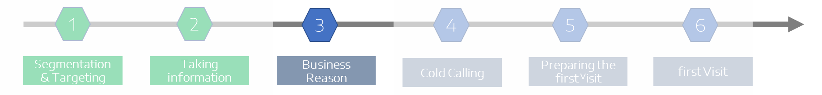

02 - B2B NEW BUSINESS CONQUEST IN 6 STEPS
Step 3 – Business reason
3
BUSINESS
REASON
Multi-mobilité
Click on the arrows to slide through the different screens

Slide 31
02 - B2B NEW BUSINESS CONQUEST IN 6 STEPS
Step 3 – Business reason
Why is it so important to have a good business reason / a pretext?
A good business reason is the key to justify a call (step #4)!
The business reason = a good reason to use on the phone to grab the interest of your prospect.
Be creative! Indeed:
  You sell good cars … so do your competitors
  You finance cars … so do your competitors
  You give discounts … so do your competitors
To make the difference you’ll have to point out:
  The added value of your brand, without discrediting the competition
  The added value of your dealership
  The kinds of service you can provide for business customers
  Original solutions that you can offer
  The quality of advice you can give
Multi-mobilité
Click on the arrows to slide through the different screens

Slide 32

02 - B2B NEW BUSINESS CONQUEST IN 6 STEPS
Step 3 – Business reason
Examples of good business reasons / pretextes
Introduce the low emission vehicle range
Call as a result of an information from the workshop
A cost-free analysis of the fleet in order to further optimise the fleet operating costs
Information on the recent changes in company car taxes
Information on financial solutions with tax advantages in order to pay less taxes
Consider the similarities between the car fleet management of your prospect and our mobility solutions
Invitation to join an event, like new car launch, Professional Days…
Free drive test of a new vehicle or model
Introduce the new mobility services
Multi-mobilité
A good business reason makes the difference to get an appointment
Click on the arrows to slide through the different screens

Slide 33
02 - B2B NEW BUSINESS CONQUEST IN 6 STEPS
Step 3 – Business reason - Do’s & Don’ts summary
According to what you saw in the previous screens, which of the following actions would you describe as "best practices"?
Find a specific or common interest of your target
Use a generic business reason
Assess the relevance of your business reason before calling
Use special sales conditions or discounts as a business reason
VALIDATE
Drag and drop the proposals below in the DO’S or DON’TS boxes. Then click on VALIDATE to confirm your answer

Slide 34
02 - B2B NEW BUSINESS CONQUEST IN 6 STEPS
Step 3 – Business reason - Do’s & Don’ts summary
According to what you saw in the previous screens, which of the following actions would you describe as "best practices"?
Find a specific or common interest of your target
Use a generic business reason
Assess the relevance of your business reason before calling
Use special sales conditions or discounts as a business reason
Sorry! Wrong answer
Good answer!
VALIDATE
Drag and drop the proposals below in the DO’S or DON’TS boxes. Then click on VALIDATE to confirm your answer

Slide 35
02 - B2B NEW BUSINESS CONQUEST IN 6 STEPS
Step 3 – Business reason - Do’s & Don’ts summary
According to what you saw in the previous screens, which of the following actions would you describe as "best practices"?
Please read the summary hereunder for more details. Then move forward.
Find a specific or common interest of your target
Use a generic business reason
Try to find a specific or common interest of your targets, e.g.: cost approach, eco-friendly image, …
Show interest in the problems your prospects are likely to encounter in their daily professional activity, e.g.: no fleet reporting, maintenance costs, no tax optimization, …
Assess the relevance of your business reason by listing the possible objections that your prospects may issue when making contact by phone. Example: electrification brings added costs.
Using the following elements as a business reason:
  General brand information
  Special sales conditions or discounts
  Denigrating the competition
Assess the relevance of your business reason before calling
Use special sales conditions or discounts as a business reason
Drag and drop the proposals below in the DO’S or DON’TS boxes. Then click on VALIDATE to confirm your answer

Slide 36
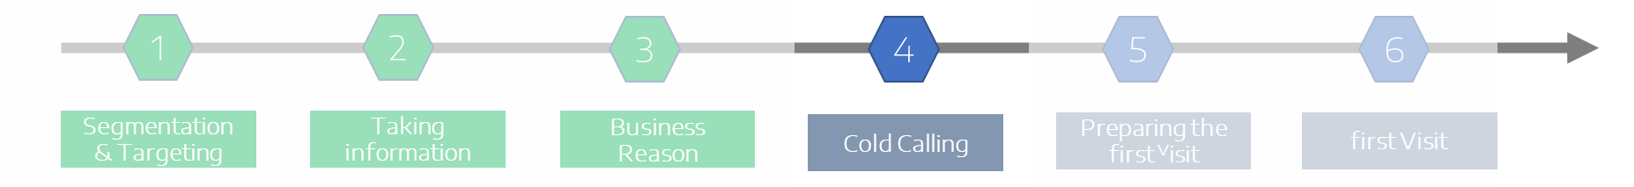

02 - B2B NEW BUSINESS CONQUEST IN 6 STEPS
Step 4 – Cold calling
4
COLD
CALLING
Multi-mobilité
Click on the arrows to slide through the different screens

Slide 37
02 - B2B NEW BUSINESS CONQUEST IN 6 STEPS
Step 4 – Cold calling
You found a good reason/pretext to contact your new business customer. It’s time to pick up your phone…
Your only objective = to get an appointment
Prepare a script
Prepare the answers to classic objections
Have your diary within reach
Make sure you’re in a quiet place
Multi-mobilité
Click on the arrows to slide through the different screens

Slide 38

02 - B2B NEW BUSINESS CONQUEST IN 6 STEPS
Step 4 – Cold calling
How to prepare the cold calling script?
A SCRIPT is a set of well-prepared talking points that are commonly used by telemarketers and inside sales reps on their first call to a new business customer
It must contain:
  An introductory sentence
  The reason of your call
  Answers to the classic objections to facilitate getting an appointment
    Not in the office, in a meeting
    Not interested
    Send e-mail/some documentation first
Find a sample of a cold calling script by clicking on this PDF ICON:
Multi-mobilité
Click on the arrows to slide through the different screens

Slide 39
02 - B2B NEW BUSINESS CONQUEST IN 6 STEPS
Step 4 – Cold calling - Do’s & Don’ts summary
According to what you saw in the previous screens, which of the following actions would you describe as "best practices"?
Stick to your script. No improvisation!
End the call suggesting a next action
Selling on the phone
Taking notes
Improvising your calls
VALIDATE
Drag and drop the proposals below in the DO’S or DON’TS boxes. Then click on VALIDATE to confirm your answer

Slide 40
02 - B2B NEW BUSINESS CONQUEST IN 6 STEPS
Step 4 – Cold calling - Do’s & Don’ts summary
According to what you saw in the previous screens, which of the following actions would you describe as "best practices"?
Stick to your script. No improvisation!
Selling on the phone
Taking notes
Improvising your calls
End the call suggesting a next action
Sorry! Wrong answer
Good answer!
VALIDATE
Drag and drop the proposals below in the DO’S or DON’TS boxes. Then click on VALIDATE to confirm your answer

Slide 41
02 - B2B NEW BUSINESS CONQUEST IN 6 STEPS
Step 4 – Cold calling - Do’s & Don’ts summary
According to what you saw in the previous screens, which of the following actions would you describe as "best practices"?
Please read the summary hereunder for more details. Then move forward.
Stick to your script. No improvisation!
Selling on the phone
Concentrate on your script, your business reason and the information you have on your new business customer (no improvisation!)
Introduce yourself briefly and quickly explain the reason for your call
Take note of the important elements of the conversation
End the call suggesting a next action
Improvising your calls (absence of a business reason or script, information on the prospect or the name of the contact person)
Selling on the phone
Being taken by surprise by the objections of my interlocutor
Embarrassing your interlocutor by asking questions they do not know to answer
Taking notes
Improvising your calls
End the call suggesting a next action
VALIDATE
Drag and drop the proposals below in the DO’S or DON’TS boxes. Then click on VALIDATE to confirm your answer

Slide 42
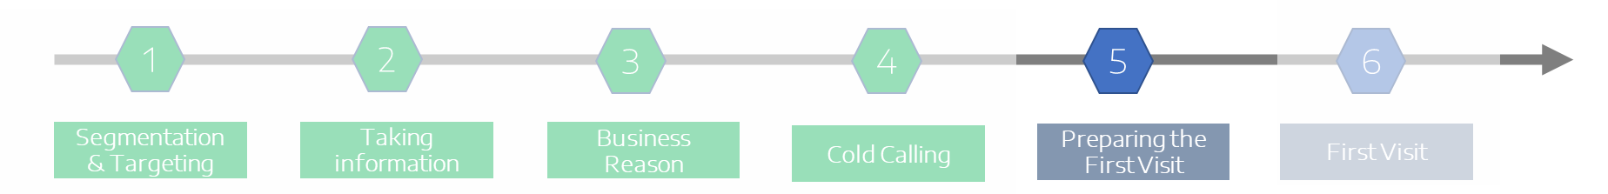

02 - B2B NEW BUSINESS CONQUEST IN 6 STEPS
Step 5 – Preparing the 1st visit
5
Multi-mobilité
PREPARING
THE 1st VISIT
Click on the arrows to slide through the different screens

Slide 43

02 - B2B NEW BUSINESS CONQUEST IN 6 STEPS
Step 5 – Preparing the 1st visit
How to prepare the first visit?
You won’t have 2 chances to make a good first impression…
Before leaving the dealership:
Read again the key information about the prospect (activity, contact person, size & composition of their car fleet, ...)
Be consistent with the pretext you used on the phone to obtain your appointment
Prepare some open questions to start or resume the sales conversation
Prepare answers to possible objections
Organise yourself in such a way you can visit your prospect with a vehicle that could draw his/her interest (New model, LEV, LCV… )
Multi-mobilité
Click on the arrows to slide through the different screens

Slide 44
02 - B2B NEW BUSINESS CONQUEST IN 6 STEPS
Step 5 – Preparing the 1st visit - Do’s & Don’ts summary
According to what you saw in the previous screens, which of the following actions would you describe as "best practices"?
Read your notes
Consider all first visits are the same
Take your promotional material
Prepare 3 open questions
Use the same general business reason for all your prospects
VALIDATE
Drag and drop the proposals below in the DO’S or DON’TS boxes. Then click on VALIDATE to confirm your answer

Slide 45
02 - B2B NEW BUSINESS CONQUEST IN 6 STEPS
Step 5 – Preparing the 1st visit - Do’s & Don’ts summary
According to what you saw in the previous screens, which of the following actions would you describe as "best practices"?
Read the notes you took during the cold call
Consider all first visits are the same
Prepare 3 open questions
Use the same general business reason for all your prospects
Take your promotional material
Sorry! Wrong answer
Good answer!
VALIDATE
Drag and drop the proposals below in the DO’S or DON’TS boxes. Then click on VALIDATE to confirm your answer

Slide 46
02 - B2B NEW BUSINESS CONQUEST IN 6 STEPS
Step 5 – Preparing the 1st visit - Do’s & Don’ts summary
According to what you saw in the previous screens, which of the following actions would you describe as "best practices"?
Please read the summary hereunder for more details. Then move forward.
Read the notes you took during the cold call
Consider all first visits are the same
Read the notes you took when you obtained the appointment
Prepare 3 open questions in writing (to start or resume the conversation)
Take your promotional material (Information on the brand and product range, brochure of the dealership, business cards…)
Thinking that all visits are the same: each customer is different!
Using a general business reason for every prospect
Prepare 3 open questions
Use the same general business reason for all your prospects
Take your promotional material
VALIDATE
Drag and drop the proposals below in the DO’S or DON’TS boxes. Then click on VALIDATE to confirm your answer

Slide 47
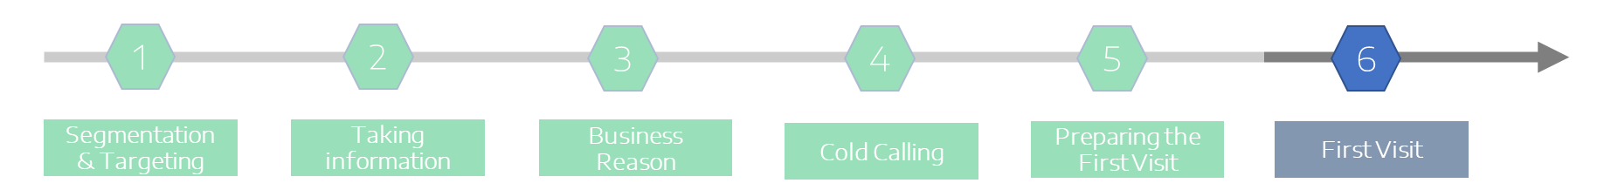
02 - B2B NEW BUSINESS CONQUEST IN 6 STEPS
Step 6 – The 1st visit
6
THE FIRST VISIT
Multi-mobilité
Click on the arrows to slide through the different screens

Slide 48
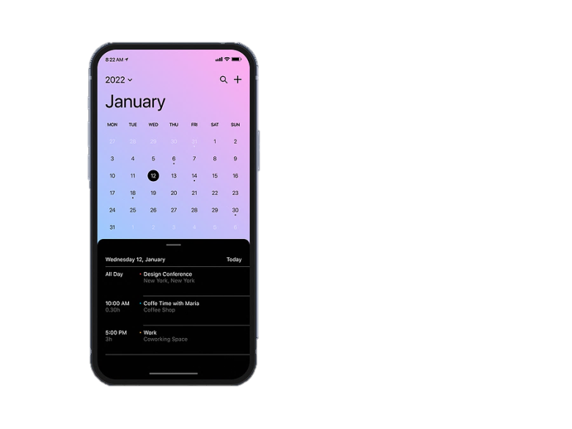
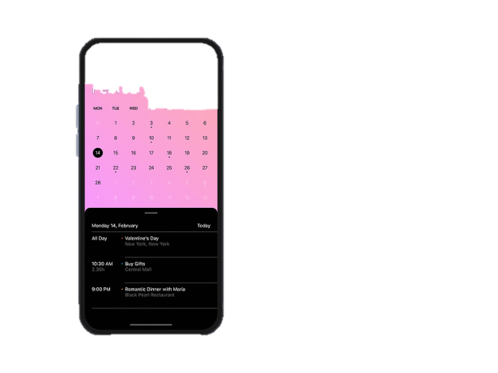
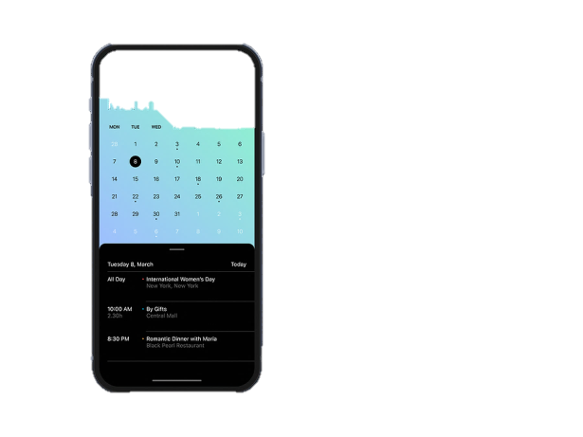
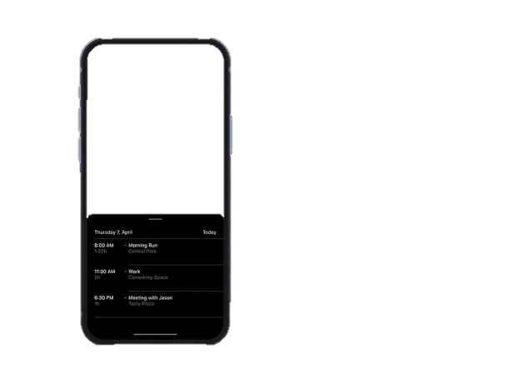
02 - B2B NEW BUSINESS CONQUEST IN 6 STEPS
Step 6 – The 1st visit
As the prospect accepted an unsolicited appointment by phone,
the first visit is a visit like no other...
TCO & Budget
Multi-mobilité
TCO & Budget
≠
1
st
visit
2
nd
th
3
4
rd
Click on the arrows to slide through the different screens

Slide 49
02 - B2B NEW BUSINESS CONQUEST IN 6 STEPS
Step 6 – The 1st visit
You are now facing your new business prospect
Your main objective =
Create interest in doing business with you: show your potential added-value for them
During a first visit, you must follow the agenda, point by point. Therefore, you must be prepared and act methodologically...
How can this be done in practice?
This is what we will see in the next chapter
Click on the arrows to slide through the different screens

Slide 50
Overview
01
Stakes of New Business Conquest
02
B2B New Business Conquest in 6 steps
03
Zoom on step #6: The First Visit
Conclusion
Learning Assessment

Slide 51
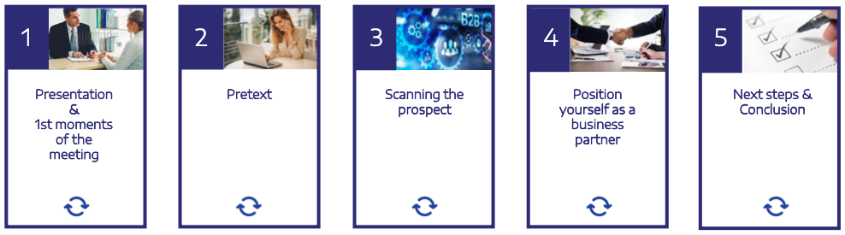
03 - ZOOM ON STEP #6: THE FIRST VISIT
Key points of the First Visit
How to conduct an efficient First Visit?
Here are the agenda items to focus on:
TCO & Budget
Presentation &
1st moments of the meeting
Pretext
Scanning the prospect
Position yourself as a business partner
Next steps
&
Conclusion
Flip over the cards

Slide 52

03 - ZOOM ON STEP #6: THE FIRST VISIT
Key points of the First Visit
How to conduct an efficient First Visit?
Here are the agenda items to focus on:
1
2
3
4
5
Say who you are & what you do in less than 1 minute
Identify the function & decision power of your speaking partner
Validate the timing & agenda of the meeting
Be always consistent with what you said on the phone
Do not disclose all your cards in order to add value in step 4
Ask open-ended questions in order to make the prospect talk about himself & collect useful information on:
  Your contact person
  The company
  His general needs
  His specific needs in terms of Mobility & Fleet Management
Position yourself as a reliable business partner ans propose concrete solutions to the expectations and/or problems of your prospect
Make the prospect want to do business with you
Reconfirm nad validate the main expectations mentioned during the meeting
Agree on the next steps
Schedule an appointment for the next meeting
Flip over the cards

Slide 53
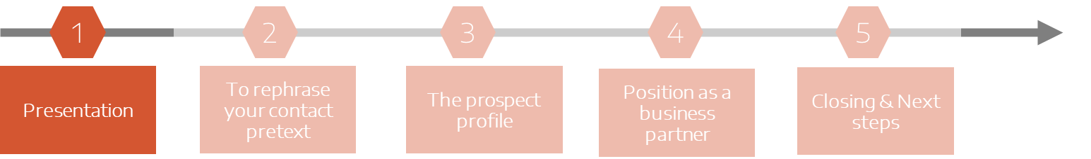

03 - ZOOM ON STEP #6: THE FIRST VISIT
Presentation & first moments of the meeting
1
Presentation
&
first moments of the meeting
Click on the arrows to slide through the different screens

Slide 54


03 - ZOOM ON STEP #6: THE FIRST VISIT
Presentation & first moments of the meeting
How to introduce yourself?
Be practically oriented: what did you or your dealership do for other customers?
Do not start explaining what your job title within your organisation is
No
Click on the arrows to slide through the different screens

Slide 55

03 - ZOOM ON STEP #6: THE FIRST VISIT
Presentation & first moments of the meeting
How to introduce yourself?
Be short. You have maximum 1 minute to introduce yourself:
Ice-breaking question / remark e.g.: commenting on something positive in their office; small talk about weather or traffic; thanking for time
Name and function
Name of dealership
BUT...
  If your speaking partner asks you to be more precise, give a short description of your dealership:
    Established for # years
    Location (nearby X)
    A staff of # people (sales and after sales)
    Almost # workshop interventions per day
    # satisfied B2B customers with our services…
Click on the arrows to slide through the different screens

Slide 56

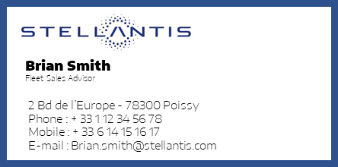

03 - ZOOM ON STEP #6: THE FIRST VISIT
Presentation & first moments of the meeting
How to introduce yourself?
Develop a personal professional greeting scenario. Examples of key phrases:
Thank you for receiving me / Nice to meet you / Pleased to meet you
Let me introduce myself. My name is… and I’m your…(position) at… (company)
The reason for my visit is…
As discussed on the phone, we both agreed to…
Do not forget to give your business card, from the beginning of the meeting
No place for improvisation!
You only get one chance to make a good first impression!
Click on the arrows to slide through the different screens

Slide 57
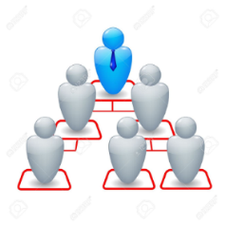

03 - ZOOM ON STEP #6: THE FIRST VISIT
Presentation & first moments of the meeting
Identify your contact person to adapt your speech
When dealing with a decision maker, it is important that you validate:
  Who he/she is
  What is his/her role and power in the decision-making process
Decision maker
When dealing with an intermediary, it is important that you validate her/his role in the decision-making process. It is especially important when the intermediary is in charge of the overall negotiation and when no direct contact to the decision maker is possible. This means to know:
Her/his task
The degree of influence (s)he has on the decision maker
When (s)he will be able to present the project or proposition to the decision maker
Intermediary
Click on the arrows to slide through the different screens

Slide 58

03 - ZOOM ON STEP #6: THE FIRST VISIT
Presentation & first moments of the meeting
Practical organisation
Once you have got to know the person you are talking to, and before you get to the point, don't forget to validate:
The timing available with the prospect in order to best manage the subjects that you absolutely must discuss with him/her
The agenda and objectives of the meeting
Click on the arrows to slide through the different screens

Slide 59
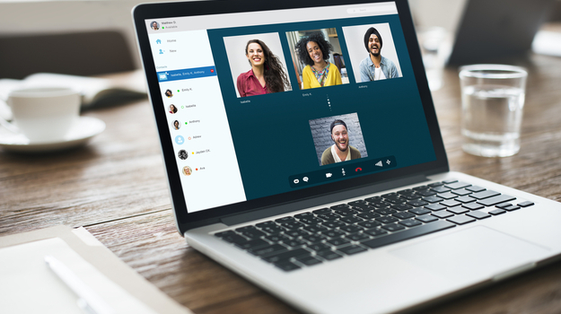
03 - ZOOM ON STEP #6: THE FIRST VISIT
Presentation & first moments of the meeting
Sometimes the first visit is held remotely. Here are the best practices for a digital presentation
Preparing your meeting is even more important when the first prospecting visit takes place at distance.
Indeed, the absence of direct contact, problems of concentration, technical issues and the use of a video-conferencing tool can greatly disrupt the progress of the meeting.
At distance, any approximation or error is amplified (perception of a long time, blanks, lack of interaction or structure, relevance and clarity of shared materials, etc.).
For your videoconference, pay attention to the following rules that are reminded in the carousel hereafter.
Click on the arrows to slide through the different screens

Slide 60
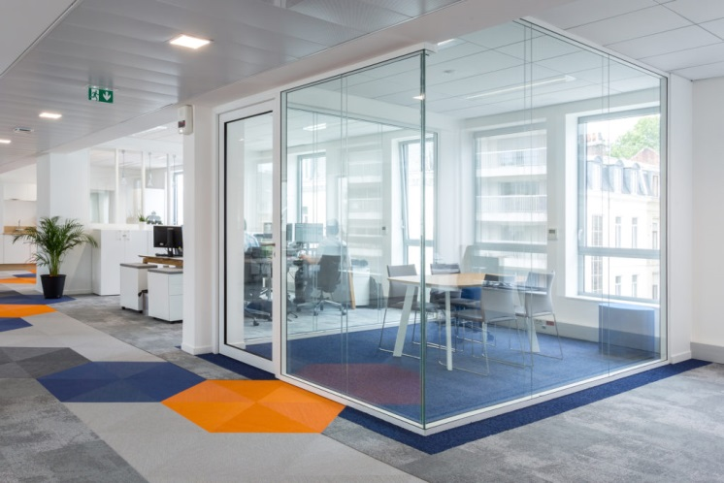


03 - ZOOM ON STEP #6: THE FIRST VISIT
Presentation & first moments of the meeting
Sometimes the first visit is held remotely. Here are the best practices for a digital presentation
Choose a secluded place so as not to be disturbed by a ringing phone, a customer coming in, a colleague calling out to you
Click on the arrows to slide through the different screens

Slide 61
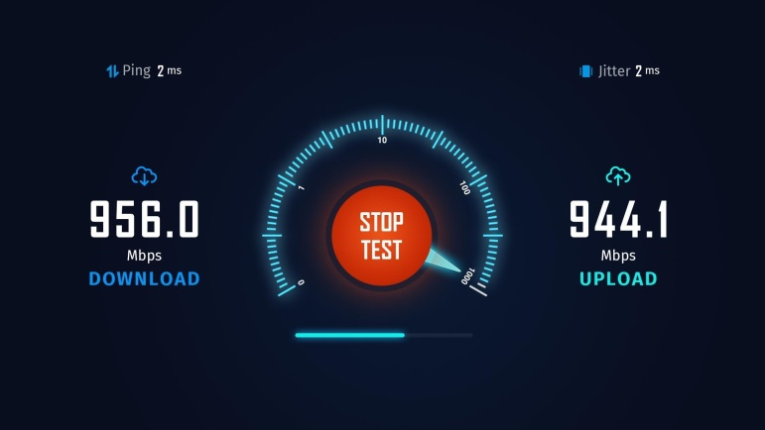

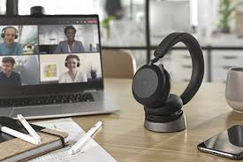
03 - ZOOM ON STEP #6: THE FIRST VISIT
Presentation & first moments of the meeting
Sometimes the first visit is held remotely. Here are the best practices for a digital presentation
Before starting your meeting, make sure your equipment is working properly
Also check the brightness of your working environment.
Click on the arrows to slide through the different screens

Slide 62
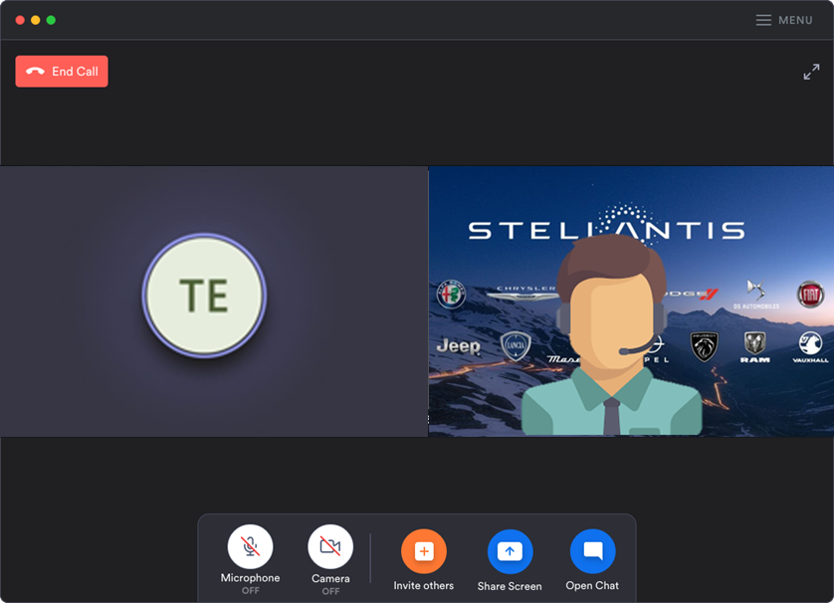
03 - ZOOM ON STEP #6: THE FIRST VISIT
Presentation & first moments of the meeting
Sometimes the first visit is held remotely. Here are the best practices for a digital presentation
When you are connected:
have your camera on, this will naturally encourage your correspondent to do the same and create a visual link with them
use a background of your organisation (dealership, brand or Stellantis)
Click on the arrows to slide through the different screens

Slide 63
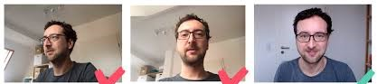

03 - ZOOM ON STEP #6: THE FIRST VISIT
Presentation & first moments of the meeting
Sometimes the first visit is held remotely. Here are the best practices for a digital presentation
Positioning facing the camera, not on the side.
Make sure your webcam is at the same height (or a little higher) as your eye level. If your camera is below your eyes, your look will be downwards, giving the impression your eyes are partly closed.
Click on the arrows to slide through the different screens

Slide 64
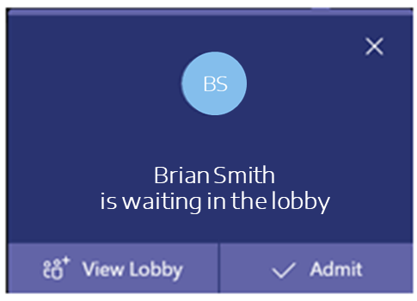
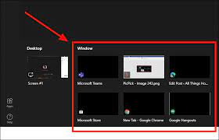
03 - ZOOM ON STEP #6: THE FIRST VISIT
Presentation & first moments of the meeting
Sometimes the first visit is held remotely. Here are the best practices for a digital presentation
Login to the session a few minutes before the scheduled time. Your prospect will be immediately informed of your presence.
Make sure the documents you are going to use are opened and ready to be shared.
Click on the arrows to slide through the different screens

Slide 65




03 - ZOOM ON STEP #6: THE FIRST VISIT
Presentation & first moments of the meeting
Sometimes the first visit is held remotely. Here are the best practices for a digital presentation
Ask the person you are talking to:
  if they can see and hear you well
  if they feel comfortable using digital video conferencing technology
Click on the arrows to slide through the different screens

Slide 66

03 - ZOOM ON STEP #6: THE FIRST VISIT
Presentation & first moments of the meeting
The best practices in digital presentation in a nutshell
Be prepared.
  Set up in a quiet, isolated place
  Operational and efficient digital equipment
  Mastered use of the digital tool
  Documents ready to be shared
Be punctual, dynamic and control your timing
  Login in advance
  Respect the agenda
  Interactivity and no downtime
Make sure your prospect feels comfortable with the technology used.
Click on the arrows to slide through the different screens

Slide 67
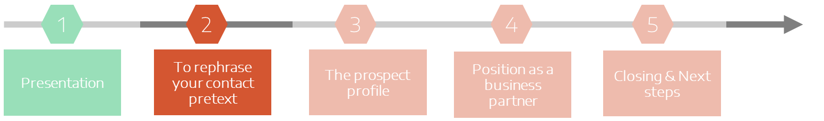

03 - ZOOM ON STEP #6: THE FIRST VISIT
To rephrase your contact pretext
2
To rephrase your contact pretext
Click on the arrows to slide through the different screens

Slide 68

03 - ZOOM ON STEP #6: THE FIRST VISIT
To rephrase your contact pretext
The prospect accepted an appointment within a clear framework (business reason, pretext)
  Be always consistent with what you said on the phone
  Start by asking open-ended questions in order to make the prospect talk about himself
  Do not disclose all your cards at this stage in order to add value in the second part of the interview
Click on the arrows to slide through the different screens

Slide 69
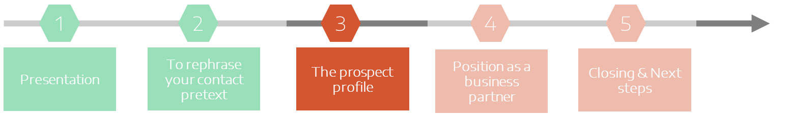

03 - ZOOM ON STEP #6: THE FIRST VISIT
The prospect profile
3
The prospect profile
Click on the arrows to slide through the different screens

Slide 70

03 - ZOOM ON STEP #6: THE FIRST VISIT
The prospect profile
To make an identification of the prospect
= ask questions that will help you:
  learn more about him/her, his/her company, products, market…
  make him/her talk about his/her general expectations, specific needs in terms of (green) mobility and fleet management and about his/her requirements towards the suppliers
  create a climate of confidence
  position yourself as a credible partner, giving envy to the prospect of doing business with you
Thanks to these questions, you’ll be able to complete your initial collection of data about your prospect
Click on the arrows to slide through the different screens

Slide 71

03 - ZOOM ON STEP #6: THE FIRST VISIT
The prospect profile
The topics to investigate
Example of interesting questions to ask:
  Details on the activity, the current business
  Is business going well?
  How long does the company exist?
  Number of the staff?
The company
Knowing the history and the activity of the company will make it easier to understand the decisions that have already been taken and those which will be considered in the future.
Click on the arrows to slide through the different screens

Slide 72


03 - ZOOM ON STEP #6: THE FIRST VISIT
The prospect profile
The topics to investigate
Example of interesting questions to ask:
  Size of the fleet
  Rules for the allocation of vehicles (existence of a Car Policy? If yes, ask to receive a copy!)
  Choice of brands and models (Are there any exclusions? If so, which and why?)
  Renewal policy (mileage, age of the vehicle, …)
  Acquisition mode(s)
  Running contracts?
  In the case of operational leasing, what are the services included in the contract?
  Are there vehicles to replace in a near future?
  What are the different professions within the company and what are their corresponding car categories?
Automotive needs
Ask general questions.
Do not start to sell at this stage
Click on the arrows to slide through the different screens

Slide 73

03 - ZOOM ON STEP #6: THE FIRST VISIT
The prospect profile
The topics to investigate
Example of interesting questions to ask:
  What is the environmental policy of your company and its impact on the choice of the vehicles?
  Are you satisfied with your current fleet management policy? Yes, no, why?
  What would you like to improve?
  Which cost optimization did you already consider? Do you have some end of year budget?
  What are your plans about the electrification of your fleet?
  Do you have targets for reducing the CO2 emissions of your fleet?
Fleet management
Click on the arrows to slide through the different screens

Slide 74

03 - ZOOM ON STEP #6: THE FIRST VISIT
The prospect profile
The topics to investigate
Example of interesting questions to ask:
  In general:
    With whom are you working currently? (Leasing company, Banking institution(s), Dealership(s))
    Since when?
    Reasons for the choice of this / these supplier(s)
  In particular:
    If you could change something about your current supplier, what would it be?
    What do you expect from a good car dealer (quality of service)?
Suppliers
Click on the arrows to slide through the different screens

Slide 75

03 - ZOOM ON STEP #6: THE FIRST VISIT
The prospect profile
Don’t forget to take notes and show it!
  You will keep control of the rhythm of the discussion
  You will show you interest
  You will record information
  You won’t forget any question to ask
Click on the arrows to slide through the different screens

Slide 76
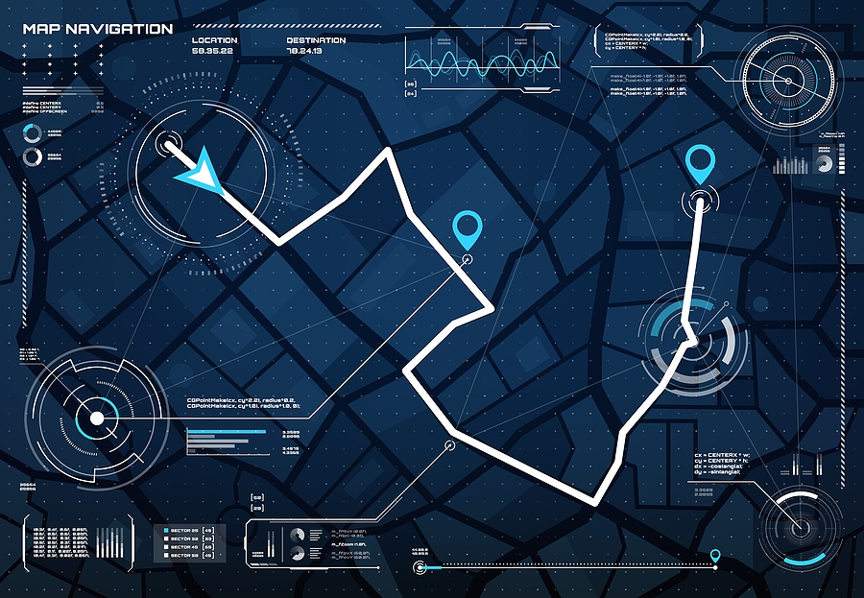
03 - ZOOM ON STEP #6: THE FIRST VISIT
The prospect profile
Whenever you meet a new business prospect, make sure you have a well-structured list of questions so that you forget nothing.
Remember that a new business prospect will choose you if (s)he is convinced that, thanks to your high level of expertise, you can help her/him achieve her/his goals.
The best way to show your added value, is asking the right questions.
Ask general questions to get information from your prospect and then continue with more precise questions if necessary.
Do not hog the time. The good distribution should be 30% speaking time for you and 70% for your prospect.
Click on the arrows to slide through the different screens

Slide 77
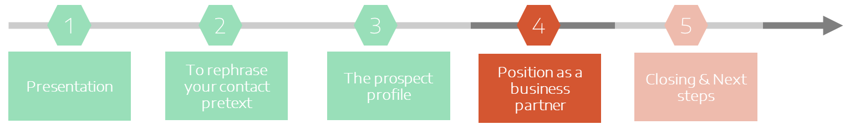

03 - ZOOM ON STEP #6: THE FIRST VISIT
Position as a business partner
4
Position yourself as a
business partner
Click on the arrows to slide through the different screens

Slide 78

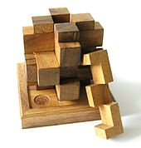
03 - ZOOM ON STEP #6: THE FIRST VISIT
Position as a business partner
Position yourself as a business partner, what does it mean?
Meet expectations
Solve problems
Prospect’s needs
Click on the arrows to slide through the different screens

Slide 79

03 - ZOOM ON STEP #6: THE FIRST VISIT
Position as a business partner
Position yourself as a business partner, what does it mean?
Proposing tangible solutions to the expectations and problems of your prospect
= The best way to show up your added value and to profile yourself as a unique partner
= Possibility of doing business with her/him
Click on the arrows to slide through the different screens

Slide 80

03 - ZOOM ON STEP #6: THE FIRST VISIT
Position as a business partner
Exploring the topics below will help you later transform them into a global offer solution
Vehicles
Financing
Fleet management
Car Policy
Fiscal & Accounting optimization
Click on the text boxes at the bottom of the screen

Slide 81

03 - ZOOM ON STEP #6: THE FIRST VISIT
Position as a business partner
Exploring the topics below will help you later transform them into a global offer solution
Some examples of requests related to the composition of the fleet:
  Mix of the fleet: e.g. 20% LEV/ZEV vehicles by end 2024
  Outside dimensions: max 3.5 m, …
  Loading capacity of light commercial vehicles. E.g.: 2 Euro pallets
  Driver motivation: introduce new models and brands (look, image)
Vehicles
Financing
Fleet management
Car Policy
Fiscal & Accounting optimization
Click on the text boxes at the bottom of the screen

Slide 82

03 - ZOOM ON STEP #6: THE FIRST VISIT
Position as a business partner
Exploring the topics below will help you later transform them into a global offer solution
Some examples of requests related to the financing mode(s):
Is operational leasing (full service contract) only for large fleets?
I want to buy the vehicles at the end of the contract. What financing mode would you recommend in this case?
I have some cash and I want to support a part of my investment: what financing mode do you recommend then?
Vehicles
Financing
Fleet management
Car Policy
Fiscal & Accounting optimization
Click on the text boxes at the bottom of the screen

Slide 83
03 - ZOOM ON STEP #6: THE FIRST VISIT
Position as a business partner
Exploring the topics below will help you later transform them into a global offer solution
Some examples of requests related to the Fleet management optimisation of the car fleet:
We are looking for an outsourcing model in order to focus on our core business
How to follow the evolution of our costs with a TCO approach?
How to organize the resale of our vehicles at the end of the contract?
We don't want to take any risks on our fleet (residual value, maintenance, ...)
Vehicles
Financing
Fleet management
Car Policy
Fiscal & Accounting optimization
Click on the text boxes at the bottom of the screen

Slide 84

03 - ZOOM ON STEP #6: THE FIRST VISIT
Position as a business partner
Exploring the topics below will help you later transform them into a global offer solution
Some examples of requests related to the internal company objectives:
We must implement a mobility plan for our staff.
Can you help us review/green up our car policy?
We want to carry out an electro-compatibility study of our staff.
How to install and manage our charging infrastructure?
We must reduce the total costs of our fleet with 5%. How?
Vehicles
Financing
Fleet management
Car Policy
Fiscal & Accounting optimization
Click on the text boxes at the bottom of the screen

Slide 85

03 - ZOOM ON STEP #6: THE FIRST VISIT
Position as a business partner
Exploring the topics below will help you later transform them into a global offer solution
Some examples of requests related to the fiscal optimization:
To pay less VAT or other taxes
Wanting to make a profit on the resale of a vehicle
How to “green” the fleet to receive fiscal benefits?
Some examples of requests related to the accounting optimization:
To choose an acquisition mode allowing:
  to depreciate the vehicles,
  to pay less taxes,
  to improve the solvency to the banker,
  to relieve the balance sheet
Vehicles
Financing
Fleet management
Car Policy
Fiscal & Accounting optimization
Click on the text boxes at the bottom of the screen

Slide 86
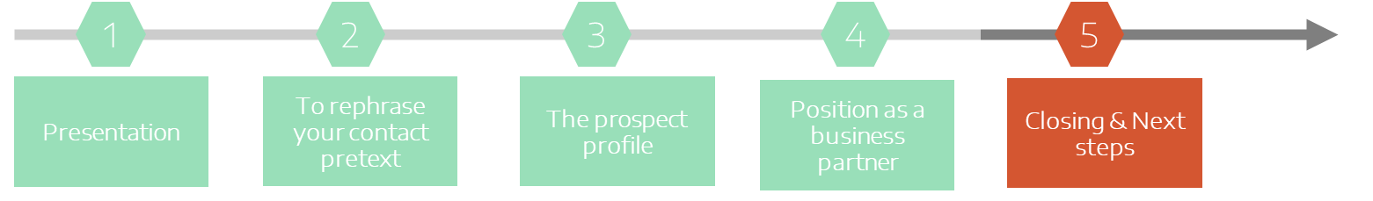

03 - ZOOM ON STEP #6: THE FIRST VISIT
Closing & Next steps
5
Closing & Next steps
You have reached the end of your first visit...
But before leaving your prospect, pay attention to your conclusion

Slide 87


03 - ZOOM ON STEP #6: THE FIRST VISIT
Closing & Next steps
Reconfirm and validate the expectations/problems your new business prospect mentioned during the meeting.
Use the following elements to propose future action-oriented solutions:
VEHICLES
FLEET MANAGEMENT
OPTIMISATION
ELECTRIFICATION OF THE FLEET
Flip over the cards

Slide 88

03 - ZOOM ON STEP #6: THE FIRST VISIT
Closing & Next steps
Reconfirm and validate the expectations/problems your new business prospect mentioned during the meeting.
Use the following elements to propose future action-oriented solutions:
Send documentation
Suggest a test drive/car disposal
Make a quotation
Explain in detail the specific B2B services offered by the dealership
Speak about the advantages of the financial solutions offered by the captive leasing company
Propose to carry out an electro-compatibility study of the staff
Make a report on the possibilities of potential savings thanks to the introduction of LEV/ZEV in the fleet
Advise on the drafting / green up / implementation of a Car Policy
Agree with the prospect on next steps
Make sure your prospect is satisfied with the result of the meeting
Schedule an appointment with the prospect for the next meeting
Flip over the cards

Slide 89

03 - ZOOM ON STEP #6: THE FIRST VISIT
The first visit in a nutshell- Do’s & Don’ts summary
Closing & Next steps
Avoid going into detail so as not to waste time
Suggest the content and ask for the timing
Talk more about product than customer pain
Ask open questions and let them talk
Close the meeting by informing them of all next steps
VALIDATE
Drag and drop the proposals below in the DO’S or DON’TS boxes. Then click on VALIDATE to confirm your answer

Slide 90
03 - ZOOM ON STEP #6: THE FIRST VISIT
The first visit in a nutshell- Do’s & Don’ts summary
Closing & Next steps
Suggest the content and ask for the timing
Talk more about product than customer pain
Ask open questions and let them talk
Avoid going into detail so as not to waste time
Close the meeting by informing them of all next steps
Sorry! Wrong answer
Good answer!
VALIDATE
Drag and drop the proposals below in the DO’S or DON’TS boxes. Then click on VALIDATE to confirm your answer

Slide 91
03 - ZOOM ON STEP #6: THE FIRST VISIT
The first visit in a nutshell- Do’s & Don’ts summary
Closing & Next steps
Please read the summary hereunder for more details. Then move forward.
Suggest the content and ask for the timing
Talk more about product than customer pain
Reconfirm the business reason for your visit
Suggest the content and ask for the timing
Ask open questions and let them talk
Take notes and reconfirm all important issues at the end of the meeting
Close the meeting by informing them of all next steps
Ask to see the vehicles (if possible)
Digital meeting: check connection, webcam and mike. Have your documents ready on your desktop.
Talking too much about “product” and not enough about “customer pain points and issues”,
Not digging for answers and objections
Concluding the meeting without defining a next step
Forgetting to make a visit report, to plan the next steps, to send requested quotations or documentation
Digital meeting: noisy place, lack of background
Ask open questions and let them talk
Avoid going into detail so as not to waste time
Close the meeting by informing them of all next steps
VALIDATE
Drag and drop the proposals below in the DO’S or DON’TS boxes. Then click on VALIDATE to confirm your answer

Slide 92

03 - ZOOM ON STEP #6: THE FIRST VISIT
First Visit - What you should remember
It is your task to discover the needs/problems of the prospect and position yourself as a future partner and business solutions provider
A first visit will almost never lead to a sale
Each new business prospect has specific needs. Identify these needs and propose possible solutions for each of them
Never leave a prospect without having defined the next steps of your new business approach (set an appointment in your agenda and make the minutes of your visit)
YOU NEVER GET A SECOND CHANCE TO MAKE A GOOD FIRST IMPRESSION
Click on the exclamation mark

Slide 93
Overview
01
Stakes of New Business Conquest
02
B2B New Business Conquest in 6 steps
03
Zoom on step #6: The First Visit
Conclusion
Learning Assessment

Slide 94
CONCLUSION
Wrap up exercise
B2B New Business Conquest, a step-by-step approach composed of 6 main stages
Have in mind the key information on your prospect before visiting them for the first time
Use a strong pretext to get an appointment
Document on your prospect as much as possible before making contact
Select your priority target according to their potential
Work out a pretext based upon the collected information
Be focused on your prospect’s needs and worries and don’t try to sell too quickly
1
2
3
4
5
6
Segmentation & Targeting
Taking Information
Business Reason
Cold Calling
Preparing the First Visit
First Visit
VALIDATE
Drag and drop each content box under the corresponding Business Conquest stage. Then click on VALIDATE

Slide 95
CONCLUSION
Wrap up exercise
B2B New Business Conquest, a step-by-step approach composed of 6 main stages
1
2
3
4
5
6
Segmentation & Targeting
Taking Information
Business Reason
Cold Calling
Preparing the First Visit
First Visit
Select your priority target according to their potential
Document on your prospect as much as possible before making contact
Work out a pretext based upon the collected information
Use a strong pretext to get an appointment
Have in mind the key information on your prospect before visiting them for the first time
Be focused on your prospect’s needs and worries and don’t try to sell too quickly
Sorry! Wrong answer
Good answer!
VALIDATE
Drag and drop each content box under the corresponding Business Conquest stage. Then click on VALIDATE

Slide 96

CONCLUSION
Wrap up exercise
B2B New Business Conquest, a step-by-step approach composed of 6 main stages
Have in mind the key information on your prospect before visiting them for the first time
Use a strong pretext to get an appointment
2
1
Document on your prospect as much as possible before making contact
Select your priority target according to their potential
Work out a pretext based upon the collected information
Be focused on your prospect’s needs and worries and don’t try to sell too quickly
3
4
5
6
Please take a few moments to analyse the correct solution.
Segmentation & Targeting
Taking Information
Business Reason
Cold Calling
Preparing the First Visit
First Visit
Select your priority target according to their potential
Document on your prospect as much as possible before making contact
Work out a pretext based upon the collected information
Use a strong pretext to get an appointment
Have in mind the key information on your prospect before visiting them for the first time
Be focused on your prospect’s needs and worries and don’t try to sell too quickly
1
2
3
4
5
6
Segmentation & Targeting
Taking Information
Business Reason
Cold Calling
Preparing the First Visit
First Visit
Select your priority target according to their potential
Document on your prospect as much as possible before making contact
Work out a pretext based upon the collected information
Use a strong pretext to get an appointment
Have in mind the key information on your prospect before visiting them for the first time
Be focused on your prospect’s needs and worries and don’t try to sell too quickly
Success Factor
Being focused on the objectives of each specific step is the key to success!
VALIDATE
Drag and drop each content box under the corresponding Business Conquest stage. Then click on VALIDATE

Slide 97
Overview
01
Stakes of New Business Conquest
02
B2B New Business Conquest in 6 steps
03
Zoom on step #6: The First Visit
Conclusion
Learning Assessment

Slide 98
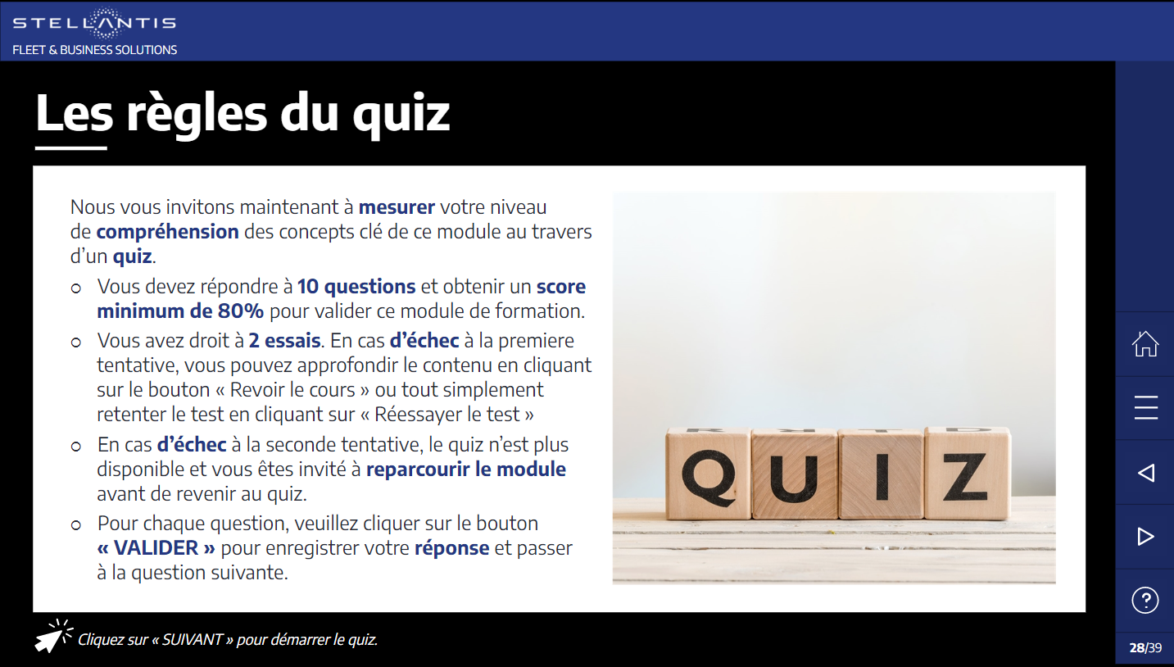
Learning Assessment
Quiz rules
We now invite you to measure your level of understanding of the key concepts of this module through a quiz.
  There are 10 questions to answer and you must obtain a minimum score of 80% to validate this training module.
  2 attempts are allowed. f you fail the first attempt, you can go deeper into the content by clicking on the "review the course" button or simply retake the test by clicking on “Take the test again".
  If you fail the second attempt, the quiz is no longer available and you are invited to go through the module again before returning to the quiz.
  For each question, please click on the “SUBMIT" button to save your answer and move on to the next question.
Click on "NEXT" to start the quiz

Slide 99
Quiz
SET OF 11 GENERAL QUESTIONS
Random throw of 5 questions in the "general questions set"
+
Random throw of 5 questions in the "first visit questions set"

Slide 100
Quiz
Good answer!
Wrong answer
Click on “CONTINUE” and move forward.
Sorry!
Wrong answer
The correct answer is:
xxx
Click on “CONTINUE” and move forward.
CONTINUE

Slide 101
Quiz
Q1
What is the correct chronological order to follow in your B2B prospecting activity?
Inquiry, telephone call, preparing a business reason, targeting, preparation for the visit, the first visit
Preparing a business reason, targeting, phone call, inquiry, preparation for the visit, the first visit
Phone call, preparation for the visit, preparing a business reason, targeting, inquiry, the first visit
Targeting, inquiry, preparing the business reason, phone call, preparation for the visit, the first visit

Slide 102
Quiz
Among the proposals listed below, which must be done in the first place during your new business conquest activity?
Finding a good business reason for a phone call
Visiting all the companies within my catchment area and drop a brochure with my contact information at the front desk
Target companies out of my qualified database on which I will focus my new business conquest activity
Take the list of lost customers and start calling them in alphabetical order
Q2

Slide 103
Quiz
Q3
Spot the odd one out. Which of the proposals listed below is not a good practice of segmentation and targeting?
Identification of a group of priority prospects (the one that offers the greatest potential)
Plan my prospecting activity in my diary according a realistic schedule
Segmentation before targeting
Targeting before segmentation

Slide 104
Quiz
Q4
What do you need to have in front of you when cold calling?
Your PC
The list of the “to do’s” for the rest of the day
A script and your diary
The brochure of the newest model

Slide 105
Quiz
Q5
Spot the odd one out. When I prepare a first visit to a B2B lead:
I arrange a test drive and a long-term hire quotation on the latest model of my vehicle range
I reread the notes taken during the cold call. (information collected; used business reason, …)
I prepare 3 open-ended questions in writing (to start or boost the conversation)
I take my promotional material (business catalogue, dealership brochure, business cards, ...)

Slide 106
Quiz
Q6
Spot the odd one out. When qualifying a lead, I make an inquiry on
Date of the next renewal or the next acquisition
Name and function of the contact person
Size and composition of the fleet
Decision-making circuit

Slide 107
Quiz
Q7
Why is it necessary to identify your contact person from the first appointment?
To know which questions to ask them
To be informed on their role in the decision-making process and to adapt your speaking to their expectations
To know their industry knowledge within the automotive sector
To find out if I need to announce the discount from the start

Slide 108
Quiz
Q8
What is your objective of a first new business conquest telephone call?
Presenting the product range
Explaining the influence of tax on the total cost of a vehicle
Making an appointment
Explaining the services offered by the captive leaser

Slide 109
Quiz
Q9
Among the proposals listed below, which is not a good business reason to call?
Information on the recent changes in company car tax
Presentation of the current trade conditions. (discounts)
Study and analysis of the fleet in order to further optimise the fleet costs
Explanation of the financing solutions with tax advantages allowing to reduce the taxable base

Slide 110
Quiz
Q10
Spot the odd one out. What are the characteristics of a good business reason of a new business cold call?
A subject to which your contact person will not be able to find concrete objections
Raise a problem that your contact person would be likely to encounter as part of their fleet management
Identify a specific or common interest of your priority targets
Trigger a quick purchase through a commercially interesting but temporary process

Slide 111
Quiz
SET OF « ZOOM » QUESTIONS ON first VISIT
To be mixed with previous set of questions

Slide 112
Quiz
Q11
What is the best way to introduce yourself to your contact person on a first visit
a) I give him or her my business card so that the client has all the useful information about me, and then I go straight to the point. Professional customers have no time to lose.
b) I take my time to explain in detail who I am, what my job is, what my dealership is about, what are the benefits of working with us and I provide him/her with comprehensive information about car models. A professional customer wants to have all information available from the start.
c) I ask the customer to introduce himself and his/her company. A successful sale is only possible if the customer is in charge of the conversation.
d) I briefly introduce myself, the dealership and what I can do for business customers. I keep in mind I only have one chance to make a good first impression.

Slide 113
Quiz
Q12
You are making a first visit. The assistant of your new business prospect informs you that he was asked to receive you instead of his boss. What do you do?
a) You thank him for having received you but tell him that you prefer to speak directly to the decision-maker
b) You thank him for having received you, introduce yourself, inform him of the purpose of your visit, collect relevant information and try to find out what is his role in the decision-making process.
c) You inform him of the purpose of your visit, give him some documentation and ask for another appointment with the decision-maker.
d) You consider this person as the decision-maker.

Slide 114
Quiz
Q13
What are your objectives during the first visit?
Selling a car.
Suggesting a test drive of one of the new models.
Discovering the customer’s needs and getting them excited about doing business with you.
Presenting the commercial fleet conditions.

Slide 115
Quiz
Q14
From the list below, what is the most important thing you should do at the end of your first visit?
a) Thank the customer for having you
b) Reformulate the prospect's needs.
c) Define the next steps together with a date for the next action.
d) Present your business card and the brochure of your concession.

Slide 116
Quiz
You must prepare your first visit. Which statement do you agree with?
a) It is better not to prepare. You just have to listen to what the customer has to say.
b) Before the meeting, I must inform myself about the discounts and sales conditions that I can apply.
c) A first visit requires preparation and training: for example, I need to know how to “introduce myself” in less than a minute. It is also important to gather a minimum of information about the customer
d) Yes, I should try to find out if there is any competition.
Q15

Slide 117
Quiz
Q16
How do you discover the customer's needs and get them in the mood to do business with you?
a) Ask your contact questions in a natural and informal way during the conversation. It is important that the customer speaks.
b) Ask a minimum of questions. Too many questions can irritate the customer. By the way, there is a lot of information available on the internet.
c) That is not necessary. All customers are the same: they are just looking for the best sales conditions.
d) It is important to ask the right questions in a structured way. That is the only way to know who he/she is, what is his/her company and what are his/her needs and current suppliers. Do not hesitate to take notes.

Slide 118
Quiz
Q17
Which items do you have to check before starting your online meeting?
Your position in front of the camera and the brightness of the picture
Your webcam and mike
Your documents ready and opened
All of the above

Slide 119
Quiz
Q18
In order to have an efficient visual contact with your prospect during a video conference, what can you do?
Sit very close to the camera
Avoid any noise interference
Choose a nice background theme
Put the webcam in front of you

Slide 120
Quiz
Report
Click on
the X at the top right
of the page
to close
the course
You have completed this course.
Your quiz score is XXX%
If your score is 80% or higher, congratulations! Your module is validated.
You master the key concepts related to the B2B New Business Conquest.
We invite you to close this page using the "EXIT" button and consult the next module.
EXIT
If your score is less than 80%, your training course is not validated.
We invite you to go through the module again and redo the quiz to deepen your knowledge of the key concepts related to the B2B New Business Conquest.
REVIEW THE COURSE
TAKE THE TEST AGAIN!

