Slide 1
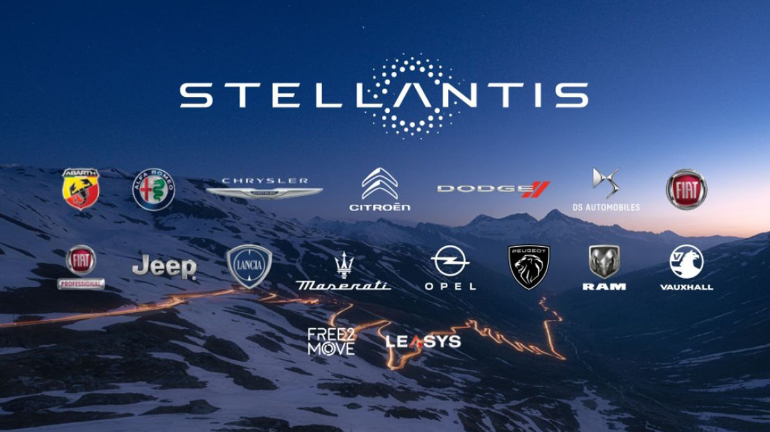
Welcome to this training module
The basics of B2B customer retention
START

Slide 2
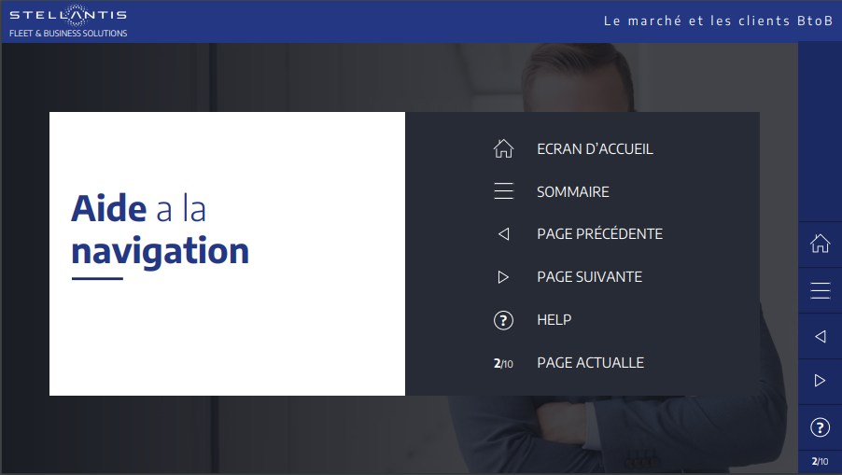
Help
WELCOME
Browsing help
OVERVIEW
PREVIOUS PAGE
NEXT PAGE
HELP
CURRENT PAGE

Slide 3
OBJECTIVES
By the end of this module, you will have learned about:
the central role of the global offer in the B2B retention process
contact opportunities and retention tools
the relevance of adapting and developing retention marketing activities

Slide 4







Overview
01
The stakes of B2B retention
02
The global offer at the heart of the retention process
03
The marketing tools for B2B retention
04
End of contract and renewal
05
Implementing your retention strategy
Conclusion
Learning assessment

Slide 5
In context
01 – THE CHALLENGES OF B2B RETENTION
What do you think of the statement below?
Check the statement you prefer, then click on SUBMIT to confirm your answer.
Following up your existing customers is a more efficient strategy than winning new customers.
I agree with this statement
I don't agree with this statement
SUBMIT

Slide 6
In context
01 – THE CHALLENGES OF B2B RETENTION
What do you think of the statement below?
Check the statement you prefer, then click on SUBMIT to confirm your answer.
X
Une politique de suivi de vos clients existants est plus efficace à mettre en œuvre et à suivre qu’une politique de conquête de nouveaux clients ?
Even though retention and prospecting new customers are both important, don't forget that, on average, winning a new customer is six times more expensive in terms of margin and time than a rigorous and methodical follow-up of your existing customer portfolio.
A good balance between both activities is therefore essential to sustain and develop your business.
Je suis d’accord avec cette affirmation
Je ne suis pas d’accord avec cette affirmation
It is always more efficient and cost-effective to maintain your portfolio of existing customers than to win new customers
VALIDER
NEXT

Slide 7
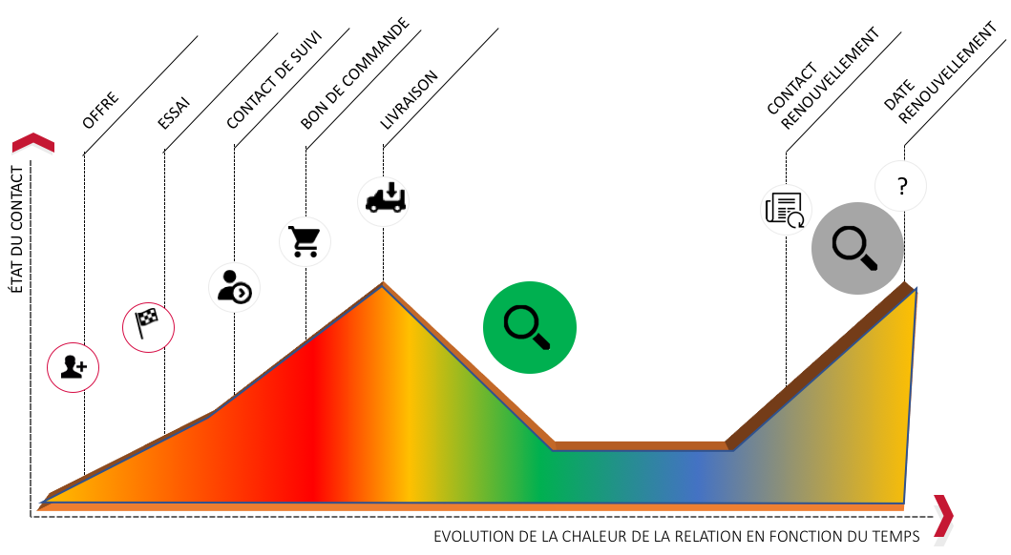
Customer relation journey through sales cycle
01 – THE CHALLENGES OF B2B RETENTION
Why is customer proximity vital throughout the sales cycle?
FOLLOW-UP CONTACT
RENEWAL
CONTACT
RENEWAL
DATE
TEST DRIVE
PURCHASE ORDER
OFFER
DELIVERY
CONTACT STATUS
Multi-mobilité
TCO & Budget
Click on the magnifying glasses, the green one first
CHANGES IN WARMTH OF RELATIONS OVER TIME

Slide 8
Customer relation journey through sales cycle
01 – THE CHALLENGES OF B2B RETENTION
Why is proximity to the customer vital throughout the sales cycle?
FOLLOW-UP CONTACT
RENEWAL
CONTACT
RENEWAL
DATE
TEST DRIVE
PURCHASE ORDER
OFFER
DELIVERY
CONTACT STATUS
Multi-mobilité
TCO & Budget
Without a structured, systematic customer follow-up, customer relation proximity decreases very quickly after delivery of the vehicle.
Click on the magnifying glasses, the green one first
CHANGES IN WARMTH OF RELATIONS OVER TIME

Slide 9
Customer relation journey through sales cycle
01 – THE CHALLENGES OF B2B RETENTION
Why is proximity to the customer vital throughout the sales cycle?
FOLLOW-UP CONTACT
RENEWAL
CONTACT
RENEWAL
DATE
TEST DRIVE
PURCHASE ORDER
OFFER
DELIVERY
CONTACT STATUS
Once the sale is made, too many customers are “forgotten” and are only contacted again when it comes to renewing their vehicle. The risk, for you, is that the customer might have been contacted and won over by a competitor who is more active than you.
Multi-mobilité
TCO & Budget
Click on the magnifying glasses, the green one first
CHANGES IN WARMTH OF RELATIONS OVER TIME

Slide 10
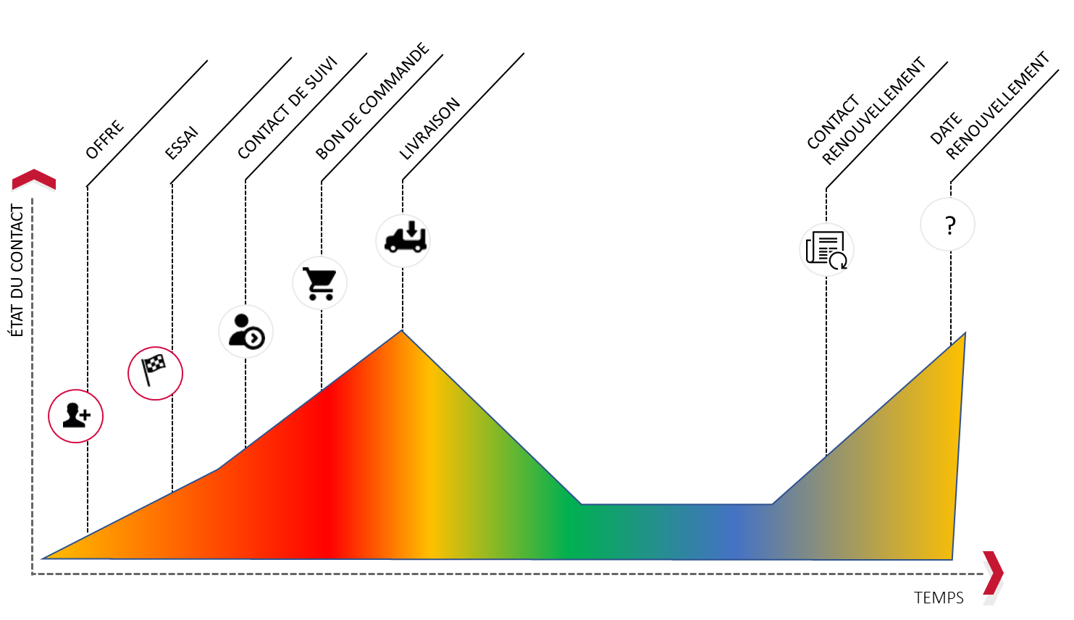
Success factors
01 – THE CHALLENGES OF B2B RETENTION
Staying in contact with your customers: a key factor in your retention strategy.
Planning how to follow up the vehicle delivery enables you to maintain a warm relationship with your B2B customers.
This increases your chances of keeping these customers loyal in the long term.
FOLLOW-UP CONTACT
RENEWAL
CONTACT
RENEWAL
DATE
TEST DRIVE
PURCHASE ORDER
OFFER
DELIVERY
CONTACT STATUS
Multi-mobilité
TCO & Budget
TIME

Slide 11

Success factors
01 – THE CHALLENGES OF B2B RETENTION
Satisfied customers = Loyal customers
How does global selling structure to the retention process?
What tools do you have and what opportunities should be grasped to follow up customers effectively?
We’ll be looking at that in the rest of this module…
Multi-mobilité
TCO & Budget

Slide 12
Overview
01
The stakes of B2B retention
02
The global offer at the heart of the retention process
03
The marketing tools for B2B retention
04
End of contract and renewal
05
Implementing your retention strategy
Conclusion
Learning assessment

Slide 13




What is the global offer?
02 – THE GLOBAL OFFER AT THE HEART OF THE RETENTION PROCESS
The global offer is a combination of various elements. Based on your experience, put each theme in the most suitable category (Vehicle(s) – Financing – Services – Your advice).
Themes:
Vehicle(s)
Financing
Services
Your advice
Leasing offer from captive bank
Vehicle conversions
LEV and Business ranges
Tax advice
TCO & Budget
Multi-mobilité
TCO & Budget
Multi-mobilité
Charging solutions
Move the themes from the left column to the most suitable element of the global offer. Then submit your answers.
SUBMIT

Slide 14
What is the global offer?
02 – THE GLOBAL OFFER AT THE HEART OF THE RETENTION PROCESS
The global offer is a combination of various elements. Based on your experience, put each theme in the most suitable category (Vehicle(s) – Financing – Services – Your advice).
Themes:
Vehicle(s)
Financing
Services
Your advice
groupe
Transformations
gammes LEV et
Vehicle conversions
Leasing offer from captive bank
Charging solutions
Tax advice
Guidance fiscale
TCO & Budget
Multi-mobilité
TCO & Budget
LEV and Business ranges
Solutions de recharge
Text feedback
That's the right answer! Click on “NEXT” to continue the training session.
Oh no! That’s not the right answer. Click on “NEXT” to see the correct answer.
NEXT

Slide 15


What is the global offer?
02 – THE GLOBAL OFFER AT THE HEART OF THE RETENTION PROCESS
The global offer plays a central role in the process of B2B customer retention.
It’s an essential lever to hold the customer captive, by offering them an overall mobility solution consisting of:
Click on the arrows
Vehicle(s)
Accessories
Conversions
Focus on LEV and Business ranges

Slide 16
What is the global offer?
02 – THE GLOBAL OFFER AT THE HEART OF THE RETENTION PROCESS
The global offer plays a central role in the process of B2B customer retention.
It’s an essential lever to hold the customer captive, by offering them an overall mobility solution consisting of:
Click on the arrows
Vehicle(s)
Financing
+
Multi-mobilité
Multi-mobilité
Accessories
Conversions
Focus on LEV and Business ranges
Leasing offer from captive lease company
Captive bank proposal

Slide 17
What is the global offer?
02 – THE GLOBAL OFFER AT THE HEART OF THE RETENTION PROCESS
The global offer plays a central role in the process of B2B customer retention.
It’s an essential lever to hold the customer captive, by offering them an overall mobility solution consisting of:
Click on the arrows
Vehicle(s)
Financing
Services
+
+
Multi-mobilité
Multi-mobilité
Accessories
Conversions
Focus on LEV and Business ranges
Leasing offer from captive lease company
Captive bank proposal
Maintenance
Vehicle services
Management services
Mobility services
Charging solutions

Slide 18
What is the global offer?
02 – THE GLOBAL OFFER AT THE HEART OF THE RETENTION PROCESS
The global offer plays a central role in the process of B2B customer retention.
It’s an essential lever to hold the customer captive, by offering them an overall mobility solution consisting of:
Click on the arrows
Vehicle(s)
Financing
Services
Your advice
+
+
+
TCO & Budget
Multi-mobilité
TCO & Budget
Multi-mobilité
Accessories
Conversions
Focus on LEV and Business ranges
Leasing offer from captive lease company
Captive bank proposal
Maintenance
Vehicle services
Management services
Mobility services
Charging solutions
Assistance in the choice of financing
Tax advice
Mobility advice

Slide 19
What is the global offer?
02 – THE GLOBAL OFFER AT THE HEART OF THE RETENTION PROCESS
The global offer plays a central role in the process of B2B customer retention.
It’s an essential lever to hold the customer captive, by offering them an overall mobility solution consisting of:
Click on the arrows
Vehicle(s)
Financing
Services
Your advice
Takeaways
+
+
+
Each element of the global offer is an opportunity to maintain the customer relation until they renew their vehicle
TCO & Budget
Multi-mobilité
TCO & Budget
Multi-mobilité
Accessories
Conversions
Focus on LEV and Business ranges
Leasing offer from captive lease company
Captive bank proposal
Maintenance
Vehicle services
Management services
Mobility services
Charging solutions
Assistance in the choice of financing
Tax advice
Mobility advice

Slide 20
Overview
01
The stakes of B2B retention
02
The global offer at the heart of the retention process
03
The marketing tools for B2B retention
04
End of contract and renewal
05
Implementing your retention strategy
Conclusion
Learning assessment

Slide 21



National marketing campaigns
03 – THE MARKETING TOOLS FOR B2B RETENTION
National marketing campaigns are campaigns designed and offered by the Brand to its network, or directly to the end customer.
  In the network, key B2B moments are organised each year, with specific offers for PCs, LCVs, EVs and mobility solutions. These moments are opportunities to get closer to and in touch with your B2B customers.
  Various mailings, in sync with national campaigns, create contact opportunities with your business customers.
YOUR ACTION

Slide 22

National marketing campaigns
03 – THE MARKETING TOOLS FOR B2B RETENTION
National marketing campaigns are campaigns designed and offered by the Brand to its network, or directly to the end customer.
  In the network, key B2B moments are organised each year, with specific offers for PCs, LCVs, EVs and mobility solutions. These moments are opportunities to get closer to and in touch with your B2B customers.
  Various mailings, in sync with national campaigns, create contact opportunities with your business customers.
X
  Use or adapt these key moments which are contact opportunities with your customers.
YOUR ACTION

Slide 23



National marketing campaigns
03 – THE MARKETING TOOLS FOR B2B RETENTION
National
Local
Personal
Roll out national campaigns locally.
Mailing to B2B customers
Product launches
Business and/or Electric events
Turn over the cards

Slide 24
National marketing campaigns
03 – THE MARKETING TOOLS FOR B2B RETENTION
National
Local
Personal
Roll out national campaigns locally.
You need to:
Check and adjust your targeting
Track your targets
Monitor your ongoing B2B business, using B2B mailings
You need to:
Use the materials and communications means provided by the Brand to communicate about your event on a local level (web advertising, radio, press, customer targeting and invitations).
Turn over the cards

Slide 25



Local marketing campaigns
03 – THE MARKETING TOOLS FOR B2B RETENTION
National
Local
Personal
In addition to rolling out national campaigns locally, you can also organise specific events at your outlet.
Special B2B events
Themed info sessions
Turn over the cards
TIP

Slide 26
Local marketing campaigns
03 – THE MARKETING TOOLS FOR B2B RETENTION
National
Local
Personal
In addition to rolling out national campaigns locally, you can also organise specific events at your outlet.
Meetings with vehicle body repairers
Aftersales days
Trade events
Attending trade fairs and local events
Breakfast or afterwork get-togethers on current topics, led by a specialist, providing specific information (e.g. tax advantages of LEVs, charging solutions, etc.) and networking
Linked to a product launch
Turn over the cards
TIP

Slide 27

Local marketing campaigns
03 – THE MARKETING TOOLS FOR B2B RETENTION
<<<<<<<
National
Local
Personal
As well as rolling out national campaigns locally, you can also organise specific events at your outlet.
Meetings with vehicle body repairers
Aftersales days
Trade events
Attending trade fairs and local events
Breakfast or afterwork get-togethers on current topics, led by a specialist, providing specific information (e.g. tax advantages of LEVs, charging solutions, etc.) and networking
Linked to a product launch
X
Suggest these activities to your manager. Be proactive when recommending this kind of activity.
TIP

Slide 28


Personal marketing campaigns
03 – THE MARKETING TOOLS FOR B2B RETENTION
National
Local
Personal
The activities you carry out personally.
Be proactive
Be present online
Turn over the cards

Slide 29
Personal marketing campaigns
03 – THE MARKETING TOOLS FOR B2B RETENTION
National
Local
Personal
The activities you carry out personally.
Take part in customer events by organising test drives
Provide information about new developments in Low Emission Vehicles, fleets, tax incentives, etc.
Via social media (updated LinkedIn profile, regular postings, sharing what's happening at your outlet)
Monitor customer reviews on various sites and answer their questions
Via your outlet website (to be updated weekly)
Via mailings
Turn over the cards

Slide 30
Overview
01
The stakes of B2B retention
02
The global offer at the heart of the retention process
03
The marketing tools for B2B retention
04
End of contract and renewal
05
Implementing your retention strategy
Conclusion
Learning assessment

Slide 31


What's at stake at the end of the contract
04 – END OF CONTRACT AND RENEWAL
End of contract: a moment of truth in the customer journey
This is when you can measure how effective your customer retention activities have been, and if they end up into vehicle renewal within your Brand, together with financing and services.
YOUR ACTION

Slide 32

What's at stake at the end of the contract
04 – END OF CONTRACT AND RENEWAL
End of contract: a moment of truth in the customer journey
This is when you can measure how effective your customer retention activities have been, and if they end up into vehicle renewal within your Brand, together with financing and services.
  For customers on credit / financial lease / operational lease, check and keep up to date:
    Your Customer Relationship Management (CRM) tool
    Your contract management apps.
  Get in touch with your B2B customers on average 6 months before their contract is due to end. Schedule calendar alerts.
    Organise pre-handover appointments (maintenance included in the contract, tyres and/or bodywork). Pay attention to operational lease customers: they are highly sensitive to re-invoicing of refurbishment costs. You need to have informed them of how these fees are set when they choose a financing scheme.
    Powerful digital tools are available to help you with this task.
X
YOUR ACTION

Slide 33




Tools and services
04 – END OF CONTRACT AND RENEWAL
Management tool
The contract management tool has three features:
Turn over the cards
Takeaways
Portfolio management
Animation
Reporting

Slide 34

Tools and services
04 – END OF CONTRACT AND RENEWAL
Management tool
The contract management tool has three features:
Turn over the cards
Portfolio management
To do:
update your customer records
search on different criteria, including the end dates of credit, financial lease and operational lease contracts
Benefits for you:
up-to-date and efficient customer records
Portfolio management
Animation
Reporting

Slide 35
Tools and services
04 – END OF CONTRACT AND RENEWAL
Management tool
The contract management tool has three features:
Turn over the cards
Animation
To do:
Follow up and analyse the results of every transaction
Benefits for you:
Learn lessons and optimise the process
Animation
Animation
Reporting

Slide 36
Tools and services
04 – END OF CONTRACT AND RENEWAL
Management tool
The contract management tool has three features:
Turn over the cards
Reporting
To do:
Follow up and process pending records (processing date pending), to follow up your portfolio
Benefits for you:
Gather information for the fleet meetings
Create useful contacts
Reporting
Animation
Reporting

Slide 37
Tools and services
04 – END OF CONTRACT AND RENEWAL
Management tool
The contract management tool has three features:
Takeaways
Turn over the cards
Your management tool helps you to:
be proactive
anticipate your customers’ needs
generate contact opportunities with the customer to guarantee their mobility, via early renewal management
take into account delivery lead times, LCV conversions, installation of charging points, etc.
Portfolio management
Facilitation
Reporting

Slide 38

Tools and services
04 – END OF CONTRACT AND RENEWAL
PAM
ProActive Management of operational lease contracts
Click on the “+” buttons
+
What is PAM?
+
Benefits

Slide 39
Tools and services
04 – END OF CONTRACT AND RENEWAL
PAM
ProActive Management of long-term hire contracts
Click on the “+” buttons
-
What is PAM?
PAM is a solution offered by the captive lease company, to encourage B2B customer retention by identifying any mileage deviations based on real-time vehicle tracking.
Customers can then be offered an amendment to their contract, which will adjust the rent and prevent any unpleasant financial surprises when they return the vehicle.
Upon request, the PAM team can contact your customers to offer them a dynamic study of their fleet.

Slide 40
Tools and services
04 – END OF CONTRACT AND RENEWAL
PAM
ProActive Management of long-term hire contracts
Click on the “+” buttons
-
Benefits
By limiting mileage deviations, you can increase customer satisfaction.
The PAM team will inform you that an amendment is sent to your customer, providing you with a pretext to contact the customer and to give them your advice.
An amendment is an opportunity to update the residual value.
Optimised contract management ensures customers are never subjected to “major” readjustments and prevents unpleasant surprises at the end of the contract.

Slide 41
Overview
01
The stakes of B2B retention
02
The global offer at the heart of the retention process
03
The marketing tools for B2B retention
04
End of contract and renewal
05
Implementing your retention strategy
Conclusion
Learning assessment

Slide 42

Organise to take your retention actions
05 – IMPLEMENTING YOUR RETENTION STRATEGY
Click on each button
Objective
Approach
Your actions

Slide 43


Organise to take your retention actions
05 – IMPLEMENTING YOUR RETENTION STRATEGY
Click on each button
Objective
Develop a personalised retention strategy, adjusted to the circumstances, the potential and the specific requirements of each customer:
  Adjust the frequency of contact and fleet meetings to fleet size.
  Select the most relevant means of communication (visits, e-mails, advertising, outlet newsletters, etc.).
  Invite your customers to events organised at your dealership (product launches, trade days, meetings with body shop repairers, aftersales days, etc.).
  Take part in local events (trade fairs, exhibitions, sporting events, vehicle displays in shops).
  Encourage and present new models to short-term rental companies, to your customers and to all sales influencers.
Approach
Your actions
Set up an annual contact plan for each customer and regularly check whether you are achieving your objectives.

Slide 44

Organise to take your retention actions
05 – IMPLEMENTING YOUR RETENTION STRATEGY
Click on each button
Objective
Analyse your customer portfolio according to the:
  customer size: market share for each make, fleet size.
  fleet status for each customer: growth, stagnation or decline; electrification level.
  methods of acquisition.
  sales potential: with or without short- and/or medium-term prospects (3 months / 12 months), renewals / additional orders.
  mentioned and non-mentioned needs requiring a solution: LEV engines and/or mobility.
Approach
Your actions

Slide 45

Organise to take your retention actions
05 – IMPLEMENTING YOUR RETENTION STRATEGY
Click on each button
Objective
Be methodical and proactive when taking and following up your actions:
  Use the monitoring tools and analysis tools provided by the Brand, the captive bank and/or lease company.
  Systematically plan your action and retention alerts in your calendar or CRM, bearing in mind national campaigns set up by Head Office.
  Keep up to date with customer news and update the customer database (new contact person, change in fleet composition, aftersales contact, etc.).
Approach
Your actions
Now let’s look at these retention actions in detail, from vehicle delivery to renewal.

Slide 46

What retention actions should be taken?
05 – IMPLEMENTING YOUR RETENTION STRATEGY
Which of the actions listed below do you consider as effective in a good retention policy?
Drag and drop the statements into the box on the right, then click on SUBMIT to confirm your answer.
My retention actions
Contact the customer at the end of their contract
Set up a fleet meeting
Send out a sales brochure
Make a delivery follow-up call
Send a personal invitation to a dealership event
Contact a new prospect
SUBMIT

Slide 47
What retention actions should be taken?
05 – IMPLEMENTING YOUR RETENTION STRATEGY
Which of the actions listed below do you consider as effective in a good retention policy?
Drag and drop the statements into the box on the right, then click on SUBMIT to confirm your answer.
My retention actions
Contact the customer at the end of their contract
Set up a fleet meeting
Send a personal invitation to a dealership event
Send out a sales brochure
Make a delivery follow-up call
Contact a new prospect
Feedback
Well done! That’s the right answer.
We’ll be looking at all this in further detail on the next few screens.
Oh no! That’s not the right answer.
The effective retention actions are:
Set up a fleet meeting
Make a delivery follow-up call
Send a personal invitation to a dealership event
We’ll be looking at all this in further detail
on the next few screens.
SUBMIT

Slide 48









What retention actions should be taken?
05 – IMPLEMENTING YOUR RETENTION STRATEGY
VEHICLE ANNIVERSARY DATE
OUTLET NEWS
DELIVERY FOLLOW-UP
AFTERSALES CONTACT
RENEWAL YEAR
FLEET MEETING
Click on the icon for each contact opportunity for further details

Slide 49


What retention actions should be taken?
05 – IMPLEMENTING YOUR RETENTION STRATEGY
VEHICLE ANNIVERSARY DATE
X
AFTERSALES CONTACT
OUTLET NEWS
REPLACEMENT YEAR
DELIVERY FOLLOW-UP
Delivery follow-up contact
FLEET INVENTORY
Call the customer (driver) a few days after delivery to confirm that the vehicle handover has gone well.
Send a feedback form and an e-mail to congratulate and thank the customer for their trust in your outlet. Take this opportunity to tell the customer that you will be contacting them regularly to make sure everything is going well with the contract.
Click the icon for each contact opportunity for further details

Slide 50
What retention actions should be taken?
05 – IMPLEMENTING YOUR RETENTION STRATEGY
VEHICLE ANNIVERSARY DATE
OUTLET NEWS
REPLACEMENT YEAR
DELIVERY FOLLOW-UP
AFTERSALES CONTACT
X
FLEET INVENTORY
“Vehicle anniversary date” contact
Call the customer on the vehicle anniversary date to:
    ensure they remain satisfied with their vehicle and have not encountered any issues since the last time you were in touch
    check that the current vehicle mileage matches the figures stated at the beginning of the contract (where applicable) and suggest an amendment if necessary
    ask if there have been any changes in the customer's current situation (changes at the company, in its financial situation, fleet status, environmental strategy for the fleet, etc.)
Click the icon for each contact opportunity for further details

Slide 51
What retention actions should be taken?
05 – IMPLEMENTING YOUR RETENTION STRATEGY
VEHICLE ANNIVERSARY DATE
OUTLET NEWS
REPLACEMENT YEAR
DELIVERY FOLLOW-UP
AFTERSALES CONTACT
X
FLEET INVENTORY
Aftersales contact
Keep up to date with your customer’s aftersales visits, by checking the schedule and keeping in regular touch with the receptionists or workshop manager.
Contact the customer after their first visit to the workshop, after maintenance works, and repair or body work.
Breakdowns, repairs or accidents: consider these events as unique opportunities to establish a strong relationship with your customer.
The kind of issue doesn't matter, it's how you help them find a solution!
Click the icon for each contact opportunity for further details

Slide 52
What retention actions should be taken?
05 – IMPLEMENTING YOUR RETENTION STRATEGY
VEHICLE ANNIVERSARY DATE
OUTLET NEWS
REPLACEMENT YEAR
DELIVERY FOLLOW-UP
AFTERSALES CONTACT
X
FLEET INVENTORY
Fleet meeting
`
BEFORE
DURING
Click on “BEFORE”
Visit your most important customers regularly for a full understanding of their situation (keep the relationship close).
Prioritise the frequency of visits and plan them according to your retention strategy.
Remember that most of all, your customers want to do business with people, not with companies!
Click the icon for each contact opportunity for further details

Slide 53
What retention actions should be taken?
05 – IMPLEMENTING YOUR RETENTION STRATEGY
X
VEHICLE ANNIVERSARY DATE
OUTLET NEWS
REPLACEMENT YEAR
DELIVERY FOLLOW-UP
AFTERSALES CONTACT
Fleet meeting
`
BEFORE
DURING
FLEET INVENTORY
Click on“DURING”
BEFORE the customer appointment:
Identify the key information from available databases:
  Your customer records
  The lease company database (operational lease contracts)
  The financing contracts database
  The prospects database
Make your analysis based on:
Contract end dates (for vehicle termination within 6 months)
Vehicles with high CO₂ emissions for their category (early renewal)
Significant mileage deviations compared to the mileage stated in the contract (renegotiation or early termination of contract)
Aftersales history of fleet vehicles (check for and anticipate any possible dissatisfaction)
Aftersales history of fleet vehicles (check for and anticipate any possible dissatisfaction)
Click the icon for each contact opportunity for further details

Slide 54
What retention actions should be taken?
05 – IMPLEMENTING YOUR RETENTION STRATEGY
X
VEHICLE ANNIVERSARY DATE
OUTLET NEWS
REPLACEMENT YEAR
DELIVERY FOLLOW-UP
AFTERSALES CONTACT
Fleet meeting
`
BEFORE
DURING
FLEET INVENTORY
DURING the customer appointment:
Check key company information: company financial situation, fleet status, future developments, mid-term strategy planning, etc.
Run through the fleet and identify vehicles that require action: upcoming renewals.
Take stock of their vehicle selection criteria.
Discuss their environmental ambitions.
Make a joint decision on the actions to take and the next steps.
Sample questions to ask:
Since the last time we spoke, have there been any major changes at your company, which affect your fleet?
What feedback have you received from users on the vehicles provided and the services offered by our outlet?
Have there been any changes in your vehicle selection criteria (TCO, impact on the environment, image, fleet electrification, etc.)?
Click the icon for each contact opportunity for further details

Slide 55
What retention actions should be taken?
05 – IMPLEMENTING YOUR RETENTION STRATEGY
VEHICLE ANNIVERSARY DATE
OUTLET NEWS
REPLACEMENT YEAR
DELIVERY FOLLOW-UP
AFTERSALES CONTACT
X
FLEET INVENTORY
Outlet News
Product launches, business and aftersales events, meetings with car body repairers, destocking, etc. are opportunities to spend time with your customers and forge links with them:
  Personalised invitations to your main customers to attend these events
  Pro days: targeting of invitations according to the topic covered, vehicles specifically converted for the trade in particular (catering, construction, etc.)
  Digital communications: through social media, by sharing Brand news.
Click the icon for each contact opportunity for further details

Slide 56
What retention actions should be taken?
05 – IMPLEMENTING YOUR RETENTION STRATEGY
VEHICLE ANNIVERSARY DATE
OUTLET NEWS
REPLACEMENT YEAR
DELIVERY FOLLOW-UP
AFTERSALES CONTACT
FLEET INVENTORY
X
Renewal year
Always get back in touch with your customers 6 months before their contract is due to expire.
Click the icon for each contact opportunity for further details

Slide 57
Overview
01
The stakes of B2B retention
02
The global offer at the heart of the retention process
03
The marketing tools for B2B retention
04
End of contract and renewal
05
Implementing your retention strategy
Conclusion
Learning assessment

Slide 58

Takeaways
06 – CONCLUSION
In B2B, you are selling more than a product or service, you sell a global mobility solution, for which you will establish a long-term relationship
A methodical analysis of your customer portfolio helps you focus your efforts on your priorities
Take advantage of every opportunity to keep in touch with the customer (new model, business day, news, fleet meeting, electrification, operational lease contract amendment, etc.)
At each fleet meeting, never forget the importance of the needs analysis and of the customer database update (list of items to be dealt with + calendar alert)
Note and take advantage of all details provided by the customer
Include every information item in a report in the customer database.

Slide 59
Overview
01
The stakes of B2B retention
02
The global offer at the heart of the retention process
03
The marketing tools for B2B retention
04
End of contract and renewal
05
Implementing your retention strategy
Conclusion
Learning assessment

Slide 60

Quiz
It’s now time to measure to what extent you understand the key concepts in this module, via a quiz.
You’ll need to answer 10 questions and obtain a minimum score of 80% to pass this training module.
You have two goes. If you don't pass the first time, you can go back through the content by clicking on the “Review the course” button, or just have another go at the test by clicking on “Take the test again”.
If you don't pass the second time, the quiz will no longer be available and you’ll have to go back over the module before returning to the quiz.
After each question, click on the “SUBMIT” button to save your answer and move to the next question.
Click on “NEXT” to start the quiz.

Slide 61
Question
Regarding B2B customer retention, which of these statements do you agree with?
It's more important to win new customers than to maintain existing ones.
It's always easier to win new customers than to maintain your existing portfolio.
It's always easier to maintain your existing customer portfolio than to win new customers.
It costs more to maintain your customer portfolio than to win new customers.
Feedback text
That’s the right answer. Click on “NEXT” to continue the quiz.
Oh no! That’s not the right answer.
The correct answer is:
It's always easier to maintain your existing customer portfolio than to win new customers.
Click on “NEXT” to continue the quiz.
SUBMIT

Slide 62
Question
In the sales cycle, when does the “proximity of the customer relationship” decrease the fastest?
When the offer is made.
When getting in touch about renewal.
When signing the purchase order.
After vehicle delivery.
Feedback text
That’s the right answer. Click on “NEXT” to continue the quiz.
Oh no! That’s not the right answer.
The correct answer is:
After vehicle delivery.
Click on “NEXT” to continue the quiz.
SUBMIT

Slide 63
Question
Why is it risky to only contact a customer when it's time to renew their vehicle?
There's no risk, your customer is loyal and wouldn’t want to be disturbed.
There's no risk, on the contrary, they would have had the possibility to study the market.
There’s a risk that your customer might have got in touch with another salesperson at the dealership.
There’s a risk that your customer may have been contacted by a competitor and left without you noticing.
Feedback text
That’s the right answer. Click on “NEXT” to continue the quiz.
Oh no! That’s not the right answer.
The correct answer is:
There’s a risk that your customer may have been contacted by a competitor and left without you noticing.
Click on “NEXT” to continue the quiz.
SUBMIT

Slide 64
Question
In your opinion, what is the difference between prospecting and retention?
There’s no difference as these words are synonyms.
Prospecting does not exist in the automotive industry, as the customer travels to the dealership.
Prospecting and retention are both methodical, planned activities However, prospecting relates to new customers and retention to existing ones.
The vehicle quality creates loyalty to the brand, not the salesperson’s actions.
Feedback text
That’s the right answer. Click on “NEXT” to continue the quiz.
Oh no! That’s not the right answer.
The correct answer is:
Prospecting and retention are both methodical, planned activities. However, prospecting relates to new customers and retention to existing ones.
Click on “NEXT” to continue the quiz.
SUBMIT

Slide 65
Question
What is the purpose of the “global offer” lever for retention, which makes it possible to hold the customer captive?
To offer for the vehicle(s) + financing + service(s) + advice.
To propose the entire range of the Brand’s vehicles.
To suggest an electric mobility solution.
To make a multi-mobility offer.
Feedback text
That’s the right answer. Click on “NEXT” to continue the quiz.
Oh no! That’s not the right answer.
The correct answer is:
To offer for the vehicle(s) + financing + service(s) + advice all together.
Click on “NEXT” to continue the quiz.
SUBMIT

Slide 66
Question
After delivery, which two actions should be taken?
(there is more than one correct answer)
Call the customer (driver) a few days after delivery to confirm that the vehicle handover has gone well.
Send a promotional offer for the renewal of another vehicle.
Send a feedback form.
Send a request to join your customer's LinkedIn network.
Feedback text
That’s the right answer. Click on “NEXT” to continue the quiz.
Oh no! That’s not the right answer.
The correct answers are:
Call the customer (driver) a few days after delivery to confirm that the vehicle handover has gone well
Send a feedback form.
Click on “NEXT” to continue the quiz.
SUBMIT

Slide 67
Question
Breakdowns, repairs and accidents: how should these events be managed?
Although regrettable, these events must be managed by aftersales. The sales advisor must focus exclusively on selling.
These events are always damaging and inevitably have a negative impact on sales.
These events are good opportunities to establish a strong relationship with the customer and for retention. The customer must be made aware that it will always be possible to find a solution.
These events are rare within the Brand and the customer needs to know that they'd be unlucky for something like that to happen.
Feedback text
That’s the right answer. Click on “NEXT” to continue the quiz.
Oh no! That’s not the right answer.
The correct answer is:
These events are good opportunities to establish a strong relationship with the customer and for retention. The customer must be made aware that it will always be possible to find a solution.
Click on “NEXT” to continue the quiz.
SUBMIT

Slide 68
Question
Of the moments of truth listed below, which one should you pay extra attention to for customers with a operational lease contract?
Vehicle delivery.
Delivery follow-up.
Fleet meeting.
End of contract.
Feedback text
That’s the right answer. Click on “NEXT” to continue the quiz.
Oh no! That’s not the right answer.
The correct answer is:
End of contract.
Click on “NEXT” to continue the quiz.
SUBMIT

Slide 69
Question
What features does your “management tool” app include?
(there is more than one correct answer)
Portfolio management.
Invoicing.
Animation.
Reporting.
Feedback text
That’s the right answer. Click on “NEXT” to continue the quiz.
Oh no! That’s not the right answer.
The correct answers are:
Portfolio management.
Animation.
Reporting.
Click on “NEXT” to continue the quiz.
SUBMIT

Slide 70
Question
What is the “PAM” service offer?
The PAM (“Personal Assistance Manager”) offer is an assistance service that covers the car AND its driver throughout the contract.
The PAM (“ProActive Maintenance”) offer is a connected tool informing you about the maintenance tasks to be carried out.
The PAM (“Personal Actions of Marketing”) consists of your online marketing activity.
Based on real-time vehicle data, the PAM (‘ProActive Management’) offer identifies any mileage deviation from the contract.
Feedback text
That’s the right answer. Click on “NEXT” to continue the quiz.
Oh no! That’s not the right answer.
The correct answer is:
Based on real-time vehicle data, the PAM (‘ProActive Management’) identifies any mileage deviation from the contract.
Click on “NEXT” to continue the quiz.
SUBMIT

Slide 71
Question
How can national marketing campaigns be of great help to you?
They let customers make a purchase online.
They offer a “pretext”, an opportunity to contact your customers.
They offer savings on the dealership’s advertising costs.
They give the opportunity to communicate directly on promotions.
Feedback text
That’s the right answer. Click on “NEXT” to continue the quiz.
Oh no! That’s not the right answer.
The correct answer is:
They offer a “pretext”, an opportunity to contact your customers.
Click on “NEXT” to continue the quiz.
SUBMIT

Slide 72
Question
Identify two good ways to be active online with your customers
(there is more than one correct answer)
Via social media.
By responding to reviews customers leave on your websites.
By replying to customer e-mails.
By answering the phone after no more than four rings.
Feedback text
That’s the right answer. Click on “NEXT” to continue the quiz.
Oh no! That’s not the right answer.
The correct answers are:
Via social media.
By responding to reviews customers leave on your websites.
Click on “NEXT” to continue the quiz.
SUBMIT

Slide 73

Results
You've come to the end of this training session.
Your score for the quiz is xx%.
If your score is 80% or higher, well done! You've completed the module. You fully understand the key concepts of retention. Please close this page by clicking on the “CLOSE” button, then you can move on to the next module.
If you’ve scored less than 80%, you haven't completed the module. Please go back over the module and have another go at the quiz, to learn more about the key concepts of retention.
CLOSE
REVIEW THE COURSE
TAKE THE TEST AGAIN!

