Slide 1
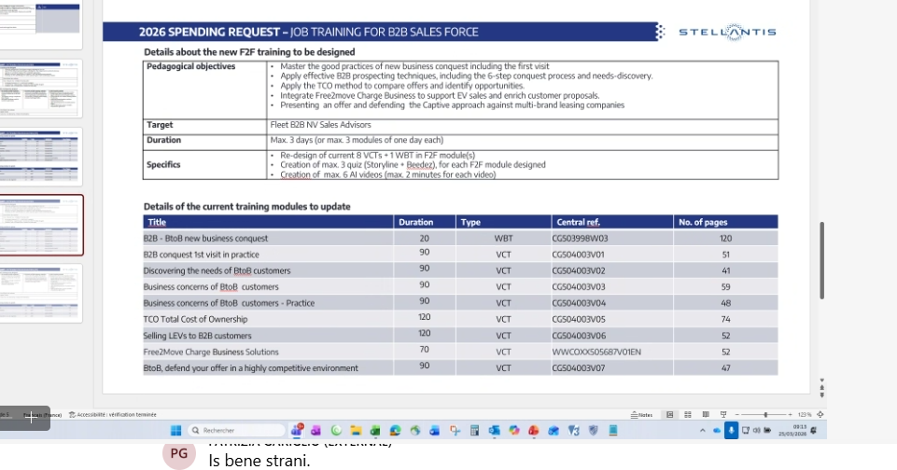
B2B Trainings-update
https://shiftup.sharepoint.com/sites/FLEETB2B/Shared%20Documents/Forms/AllItems.aspx?id=%2Fsites%2FFLEETB2B%2FShared%20Documents%2FB2B%20trainings%2FB2B%20Trainings%2Dupdate&p=true&ct=1774435480510&or=Teams%2DHL&ga=1

Slide 2
