Slide 1
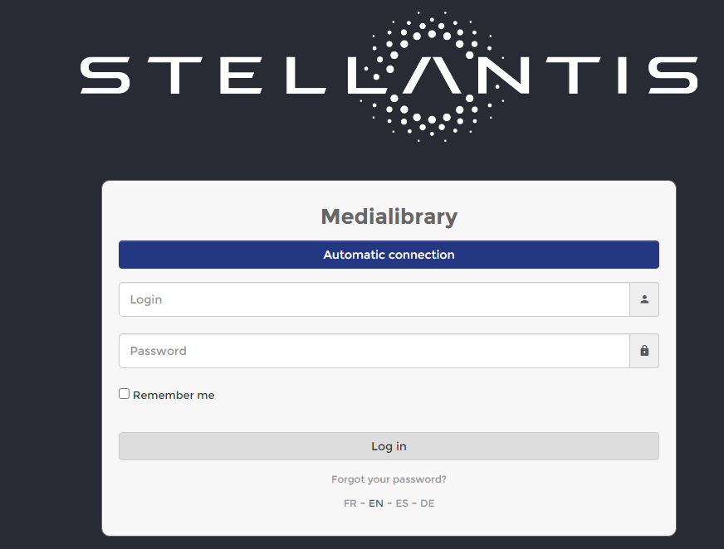
ACCESSO DAMS
https://admin1-medialibrary.stellantis.com
Id e pw
koine@koine.it
LunaVal%
PatVale85!
FR

Slide 2
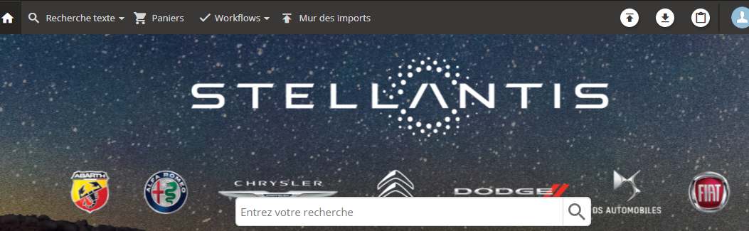
X caricare pacchetti
Mur des imports

Slide 3
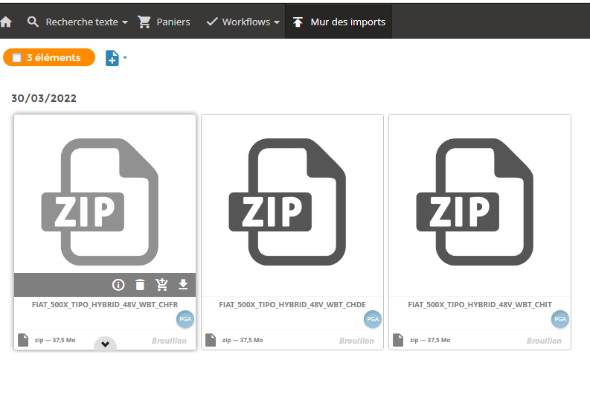
Mur des imports – fiche e-learning - OTHERS
CLICCA QUI PER IMPORTARNE ALTRI

Slide 4
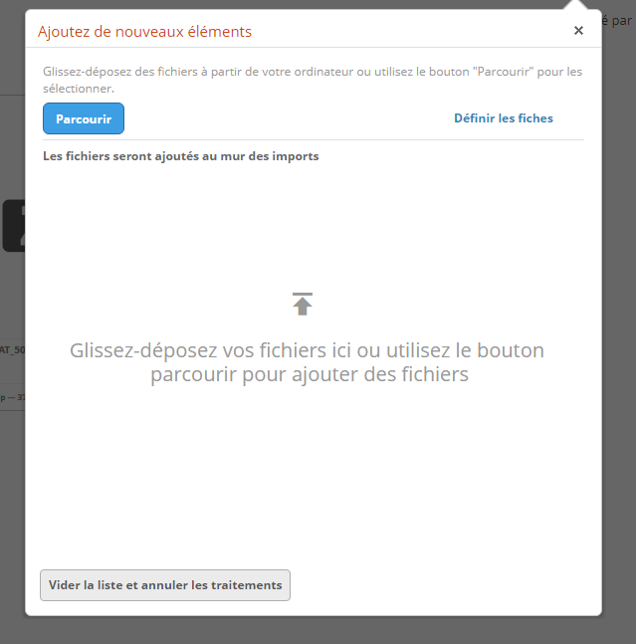
Trascinare qui i file

Slide 5
Mur des imports
CLICCA due volte su ogni zip per inoltrare a LMS

Slide 6
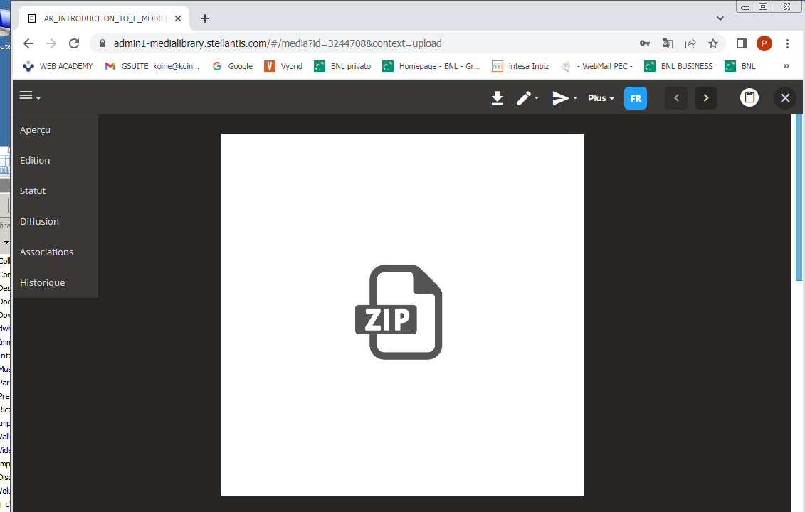
Clicca su diffusion

Slide 7
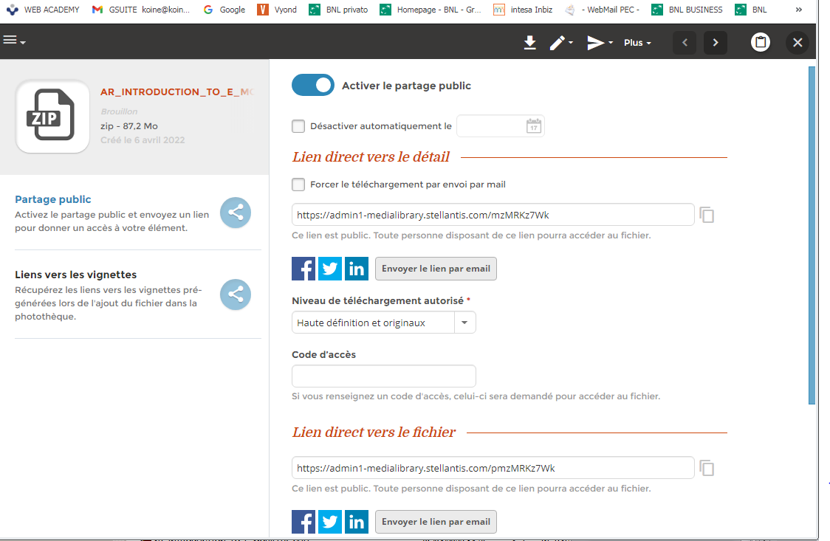
Attiva la diffusione
Copia questo link
Per inviarne altri torna indietro e ripeti con gli altri

Slide 8
messaggio a LIS
mylearningbusinesscenter@trainingsupportcare.com
Da: koine@koine.it [mailto:koine@koine.it] A: mylearningbusinesscenter@trainingsupportcare.com Cc: Maurizio Cecco <maurizio.cecco@astara.com> Oggetto: WBT Alfa Romeo Tonale MY26 Part 1 SCORM packs
Code course global: CPAR506212W01
You can download the files from the following links:
CHCPAR506212ITW25_SCORM.zip
https://admin1-medialibrary.stellantis.com/pm3DCjTaWp
CHCPAR506212ITW25_SOURCE_FILES.zip
https://admin1-medialibrary.stellantis.com/pmN7KQH7SQ
CHCPAR506212DEW25_SCORM.zip
https://admin1-medialibrary.stellantis.com/pm0Znap7Uq
CHCPAR506212DEW25_SOURCE_FILES.zip
https://admin1-medialibrary.stellantis.com/pmcxPYz9E9
CHCPAR506212FRW25_SCORM.zip
https://admin1-medialibrary.stellantis.com/pmt9l1q6lU
CHCPAR506212FRW25_SOURCE_FILES.zip
https://admin1-medialibrary.stellantis.com/pmBHXMs41S
I send you the sales data also.
We wait for the message to perform the quality test.
Best regards
Patrizia Gariglio
Koinè snc
Tel ++39 011 3971099
Mob. 335 6896974

Slide 9
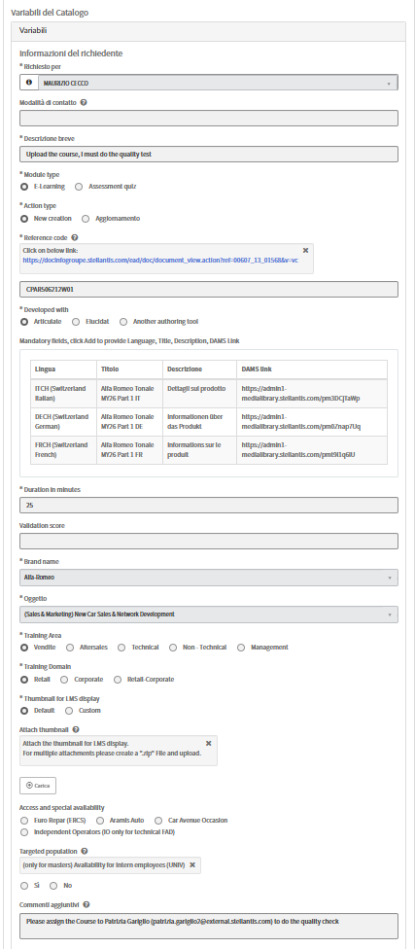
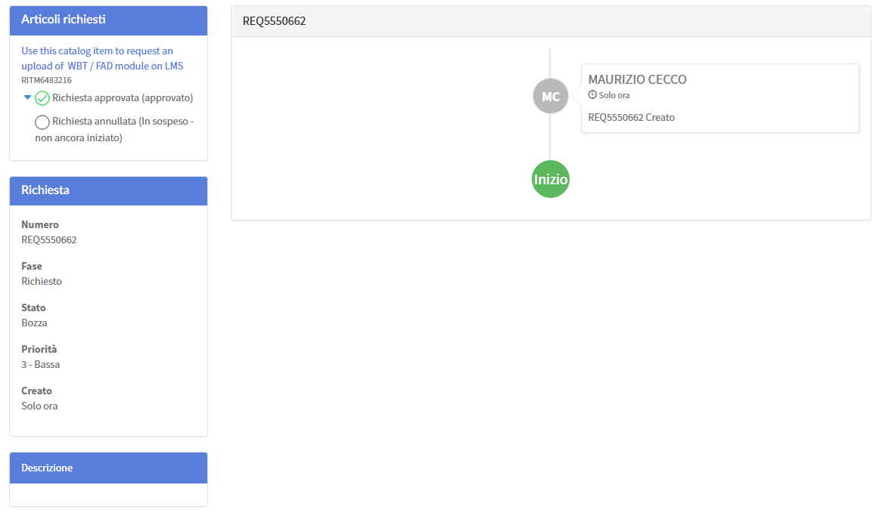
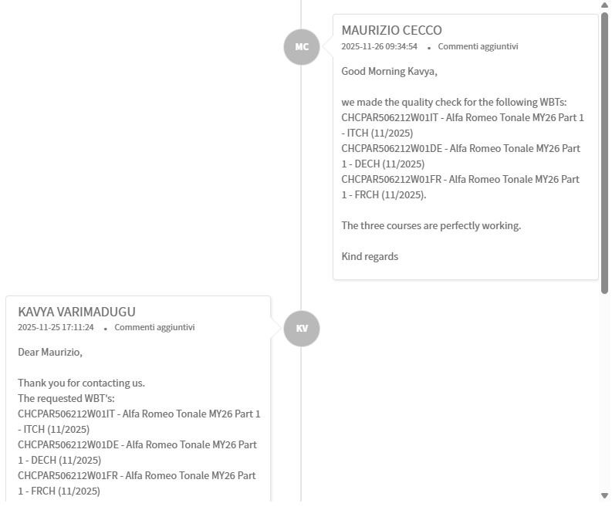
TICKET CREATO
Inoltra mail finale di DriveIT a Cecco

Slide 10
messaggio a LIS
mylearningbusinesscenter@trainingsupportcare.com
Da: koine@koine.it [mailto:koine@koine.it] A: mylearningbusinesscenter@trainingsupportcare.com Cc: Maurizio Cecco <maurizio.cecco@astara.com> Oggetto: WBT Fiat Grande Panda MHEV SCORM packs
Code course global: CPFI505697M04
You can download the files from the following links:
CHCPFI505697M04IT25_SCORM.zip
https://admin1-medialibrary.stellantis.com/pmsXhkVhxy
CHCPFI505697M04IT25_SOURCE_FILES.zip
https://admin1-medialibrary.stellantis.com/pm6Hegh1r6
CHCPFI505697M04DE25_SCORM.zip
https://admin1-medialibrary.stellantis.com/pmQeNbW6Dg
CHCPFI505697M04DE25_SOURCE_FILES.zip
https://admin1-medialibrary.stellantis.com/pm5wWnaPjg
CHCPFI505697M04FR25_SCORM.zip
https://admin1-medialibrary.stellantis.com/pmMahf57bQ
CHCPFI505697M04FR25_SOURCE_FILES.zip
https://admin1-medialibrary.stellantis.com/pmIwHSSa59
I send you the sales data also.
We wait for the message to perform the quality test.
Best regards
Patrizia Gariglio
Koinè snc
Tel ++39 011 3971099
Mob. 335 6896974

Slide 11
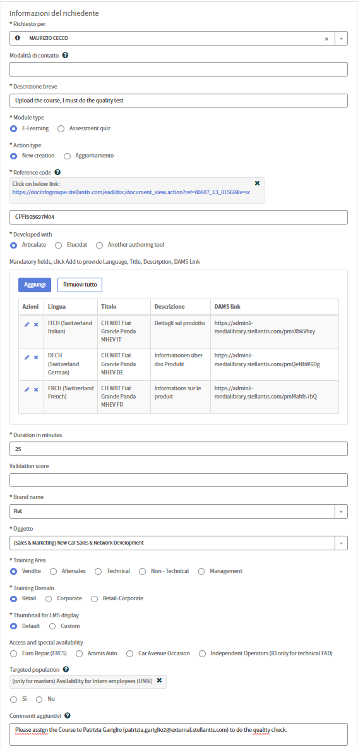
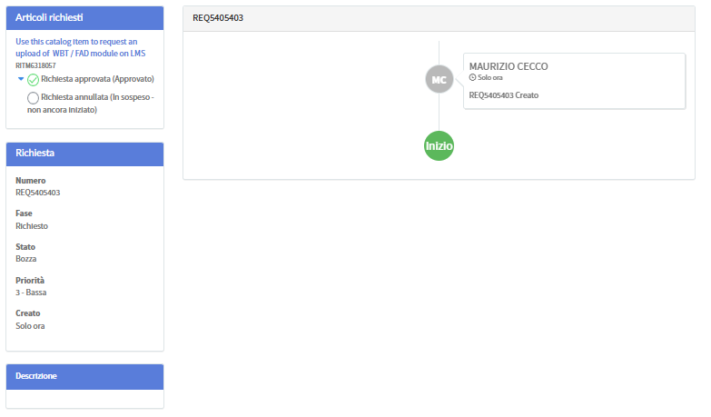
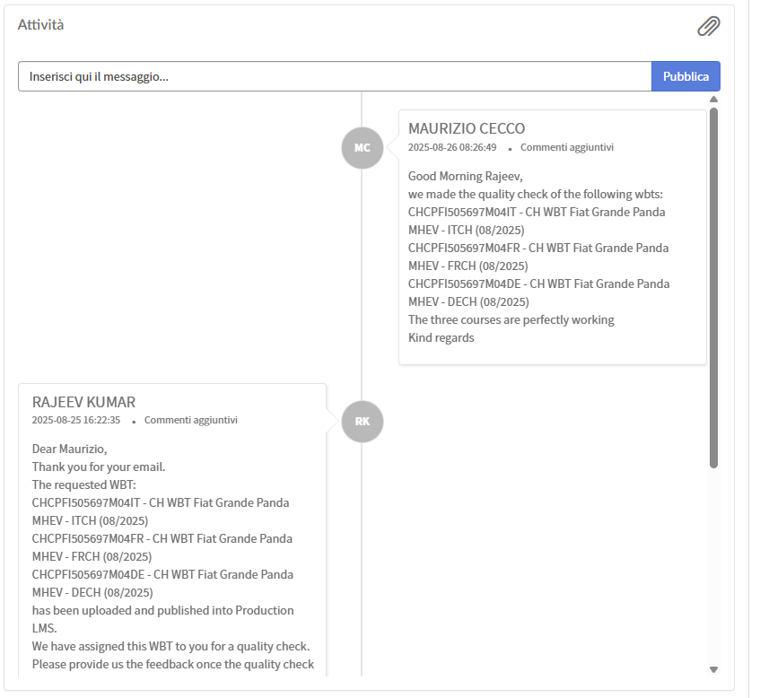
TICKET CREATO
Inoltra mail finale di DriveIT a Cecco

Slide 12
messaggio a LIS
mylearningbusinesscenter@trainingsupportcare.com
Da: koine@koine.it [mailto:koine@koine.it] A: mylearningbusinesscenter@trainingsupportcare.com Cc: Maurizio Cecco <maurizio.cecco@astara.com> Oggetto: Jeep New Compass Part 2 SWITZERLAND SCORM packs
Code course global: CPJE505993W02
You can download the files from the following links:
CHCPJE505993W02IT25_SCORM.zip
https://admin1-medialibrary.stellantis.com/pmrVYQm5xl
CHCPJE505993W02IT25_SOURCE_FILES.zip
https://admin1-medialibrary.stellantis.com/pm28IJ93wS
CHCPJE505993W02DE25_SCORM.zip
https://admin1-medialibrary.stellantis.com/pmOjYo45UR
CHCPJE505993W02DE25_SOURCE_FILES.zip
https://admin1-medialibrary.stellantis.com/pmwHBNPD7b
CHCPJE505993W02FR25_SCORM.zip
https://admin1-medialibrary.stellantis.com/pm4ebyZBPq
CHCPJE505993W02FR25_SOURCE_FILES.zip
https://admin1-medialibrary.stellantis.com/pmTNahb2iX
I send you the sales data also.
We wait for the message to perform the quality test.
Best regards
Patrizia Gariglio
Koinè snc
Tel ++39 011 3971099
Mob. 335 6896974

Slide 13
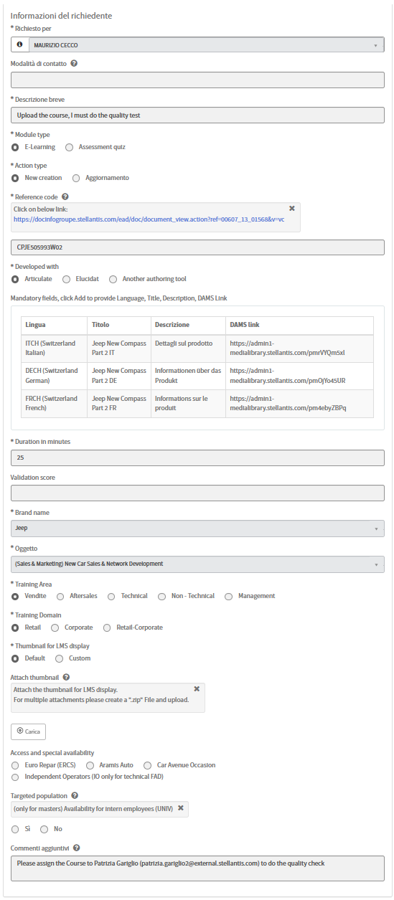
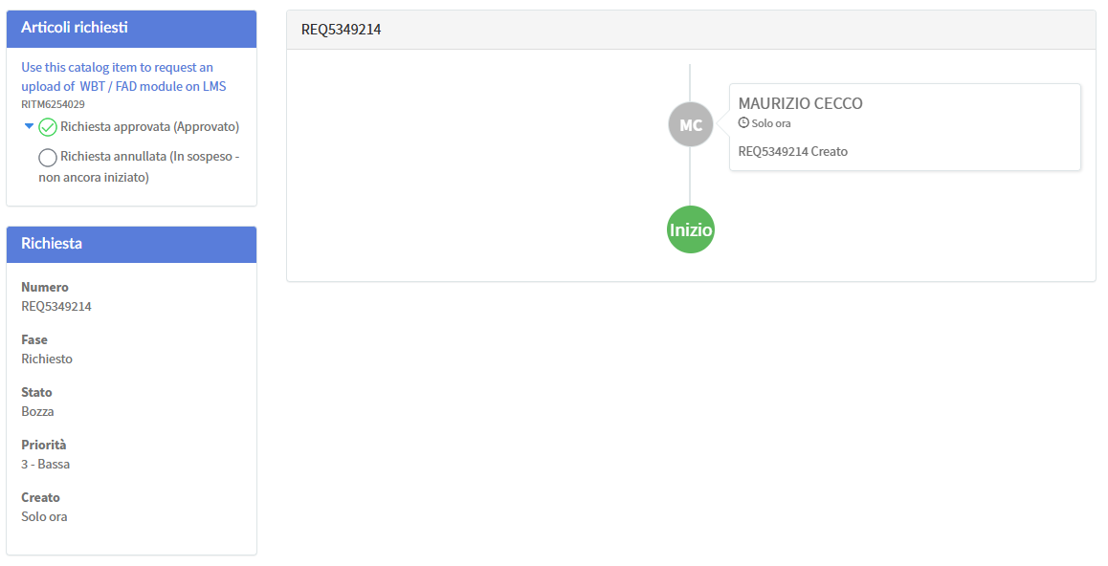
TICKET CREATO
Inoltra mail finale di DriveIT a Cecco

Slide 14
messaggio a LIS
mylearningbusinesscenter@trainingsupportcare.com
Da: koine@koine.it [mailto:koine@koine.it] A: mylearningbusinesscenter@trainingsupportcare.com Cc: Maurizio Cecco <maurizio.cecco@astara.com> Oggetto: Jeep Compass MY25 Mod.1 SWITZERLAND SCORM packs
Code course global: CPJE505993W01
You can download the files from the following links:
CHCPJE505993W01IT25_SCORM.zip
https://admin1-medialibrary.stellantis.com/pmJ0cYR8WZ
CHCPJE505993W01IT25_SOURCE_FILES.zip
https://admin1-medialibrary.stellantis.com/pmZ1OIj3EF
CHCPJE505993W01DE25_SCORM.zip
https://admin1-medialibrary.stellantis.com/pmci2Gf6Mj
CHCPJE505993W01DE25_SOURCE_FILES.zip
https://admin1-medialibrary.stellantis.com/pmDlPUNalq
CHCPJE505993W01FR25_SCORM.zip
https://admin1-medialibrary.stellantis.com/pmbSlDF8R4
CHCPJE505993W01FR25_SOURCE_FILES.zip
https://admin1-medialibrary.stellantis.com/pm15sLd4y9
I send you the sales data also.
We wait for the message to perform the quality test.
Best regards
Patrizia Gariglio
Koinè snc
Tel ++39 011 3971099
Mob. 335 6896974

Slide 15
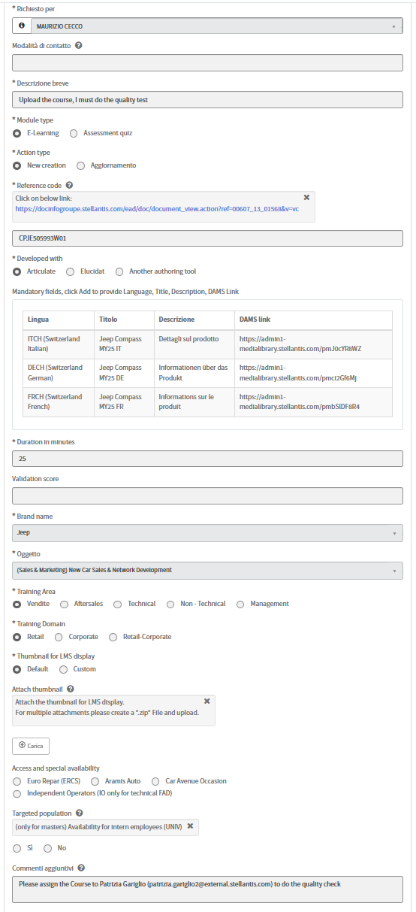
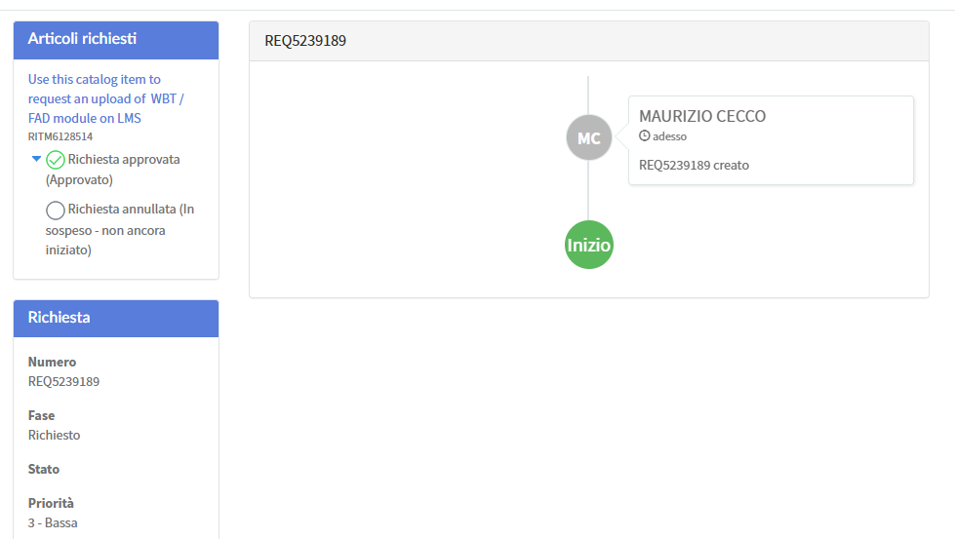
TICKET CREATO
Inoltra mail finale di DriveIT a Cecco

Slide 16
messaggio a LIS
mylearningbusinesscenter@trainingsupportcare.com
Da: koine@koine.it [mailto:koine@koine.it] A: mylearningbusinesscenter@trainingsupportcare.com Cc: Maurizio Cecco <maurizio.cecco@astara.com> Oggetto: Alfa Romeo Junior IBRIDA Q4 SWITZERLAND SCORM packs
Code course global: WWCPAR505623W05
You can download the files from the following links:
CHCPAR505623W01IT25_SCORM.zip
https://admin1-medialibrary.stellantis.com/pmC866w3hr
CHCPAR505623W01IT25_SOURCE_FILES.zip
https://admin1-medialibrary.stellantis.com/pm41JPG9zr
CHCPAR505623W01DE25_SCORM_2.zip
https://admin1-medialibrary.stellantis.com/pmqNMoO8Qg
https://admin1-medialibrary.stellantis.com/pmkfofg6ZM
CHCPAR505623W01DE25_SOURCE_FILES_2.zip
https://admin1-medialibrary.stellantis.com/pmCIDZd9yD
https://admin1-medialibrary.stellantis.com/pmW0vMe98B
CHCPAR505623W01FR25_SCORM.zip
https://admin1-medialibrary.stellantis.com/pmwO8mQ91o
CHCPAR505623W01FR25_SOURCE_FILES.zip
https://admin1-medialibrary.stellantis.com/pmMFCKa7iM
I send you the sales data also.
We wait for the message to perform the quality test.
Best regards
Patrizia Gariglio
Koinè snc
Tel ++39 011 3971099
Mob. 335 6896974

Slide 17
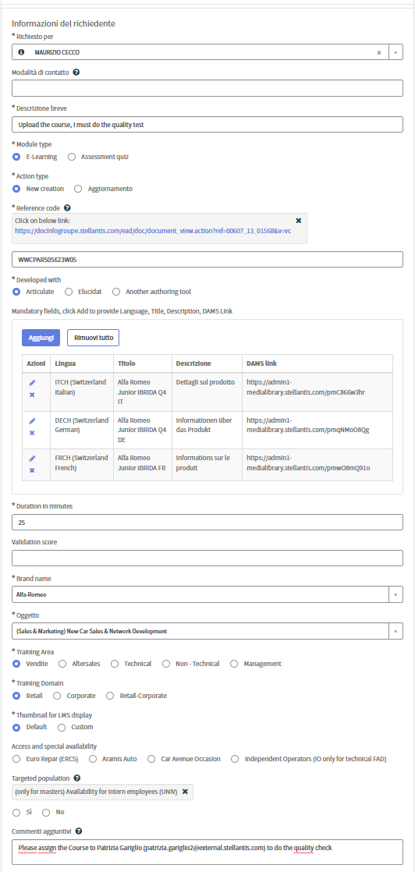
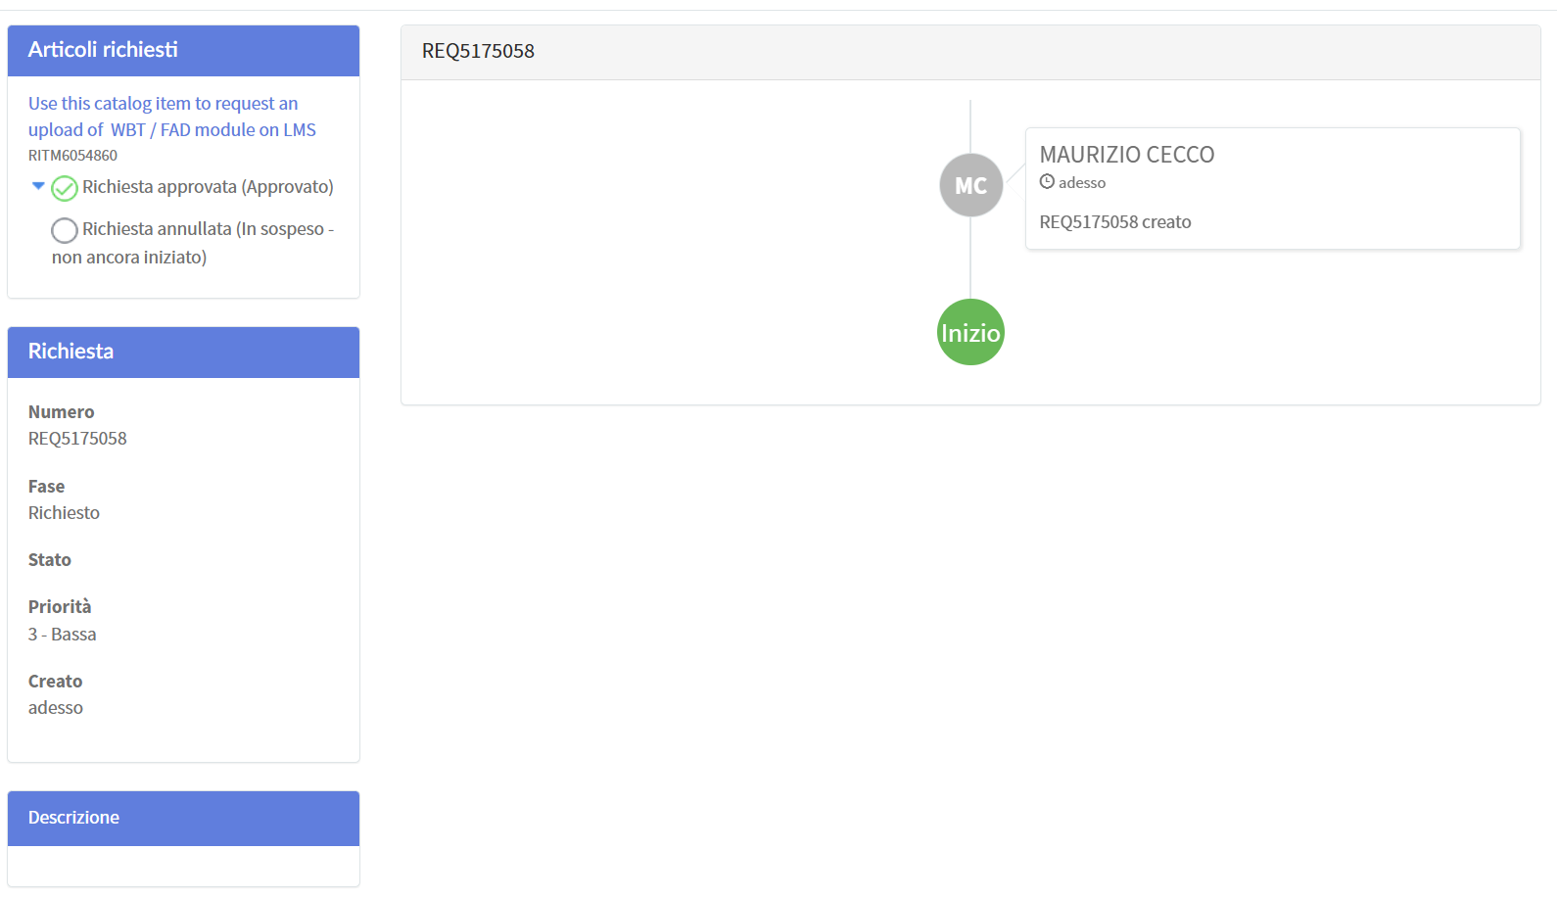
TICKET CREATO
Inoltra mail finale di DriveIT a Cecco*
*RICORDARSI DI COMUNICARGLI NUOVA PASSWORD DRIVEIT (Ranshofen2025bb!)

Slide 18
messaggio a LIS
mylearningbusinesscenter@trainingsupportcare.com
Da: koine@koine.it [mailto:koine@koine.it] A: mylearningbusinesscenter@trainingsupportcare.com Cc: Maurizio Cecco <maurizio.cecco@astara.com> Oggetto: Abarth 695 75th Anniversary SWITZERLAND SCORM packs
Code course global: CPAB503583W01
You can download the files from the following links:
CHCPAB503583W01DE24_SCORM.zip
https://admin1-medialibrary.stellantis.com/pmA8lS349h
CHCPAB503583W01DE24_SOURCE_FILES.zip
https://admin1-medialibrary.stellantis.com/pmdZ7fn31K
CHCPAB503583W01FR24_SCORM.zip
https://admin1-medialibrary.stellantis.com/pmYYXSo39N
CHCPAB503583W01FR24_SOURCE_FILES.zip
https://admin1-medialibrary.stellantis.com/pm7n54I2sE
CHCPAB503583W01IT24_SCORM.zip
https://admin1-medialibrary.stellantis.com/pmexV2S7v9
CHCPAB503583W01IT24_SOURCE_FILES.zip
https://admin1-medialibrary.stellantis.com/pmgQx0si6N
I send you the sales data also.
We wait for the message to perform the quality test.
Best regards
Patrizia Gariglio
Koinè snc
Tel ++39 011 3971099
Mob. 335 6896974

Slide 19
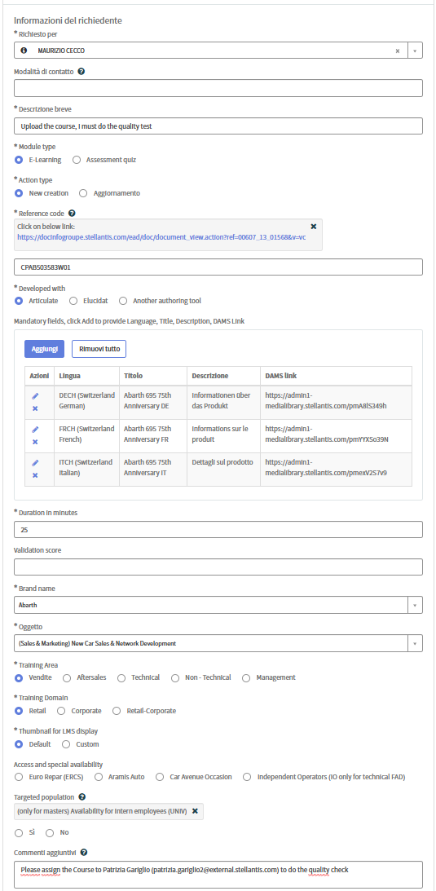
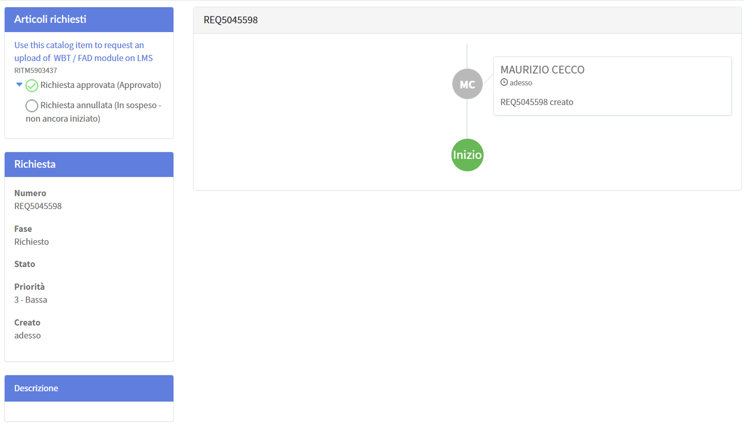
TICKET CREATO
Inoltra mail finale di DriveIT a Cecco*
*RICORDARSI DI COMUNICARGLI NUOVA PASSWORD DRIVEIT

Slide 20
messaggio a LIS
mylearningbusinesscenter@trainingsupportcare.com
Da: koine@koine.it [mailto:koine@koine.it] A: mylearningbusinesscenter@trainingsupportcare.com Cc: Maurizio Cecco <maurizio.cecco@astara.com> Oggetto: Abarth 600e SWITZERLAND SCORM packs
Code course global: CPAB505563W01
You can download the files from the following links:
CHCPAB505563W01DE24_SCORM.zip
https://admin1-medialibrary.stellantis.com/pmSvu9aJN4
CHCPAB505563W01DE24_SOURCE_FILES.zip
https://admin1-medialibrary.stellantis.com/pmJMG6M8os
CHCPAB505563W01FR24_SCORM.zip
https://admin1-medialibrary.stellantis.com/pmekpXT1py
CHCPAB505563W01FR24_SOURCE_FILES.zip
https://admin1-medialibrary.stellantis.com/pmFc63O3nu
CHCPAB505563W01IT24_SCORM.zip
https://admin1-medialibrary.stellantis.com/pmu70z3Mop
CHCPAB505563W01IT24_SOURCE_FILES.zip
https://admin1-medialibrary.stellantis.com/pm6L4a4REO
I send you the sales data also.
We wait for the message to perform the quality test.
Best regards
Patrizia Gariglio
Koinè snc
Tel ++39 011 3971099
Mob. 335 6896974

Slide 21
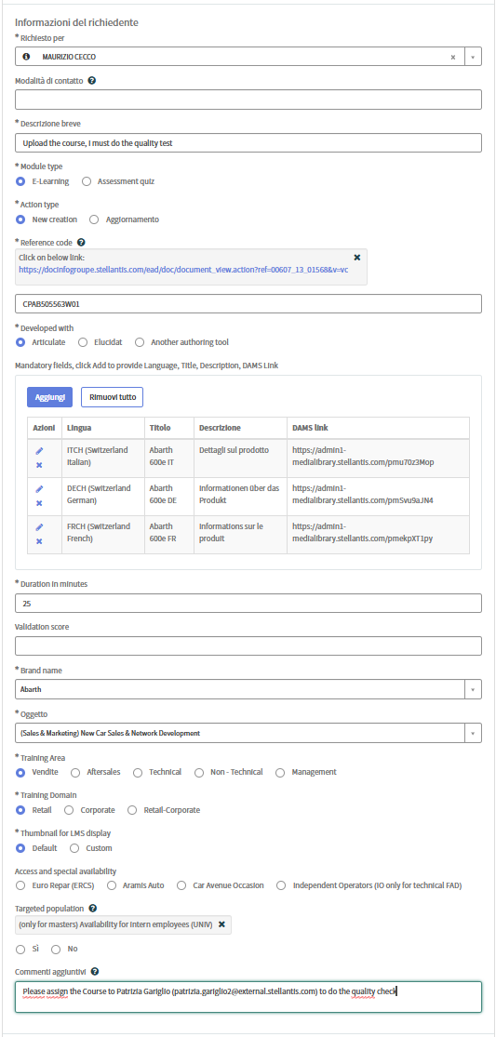

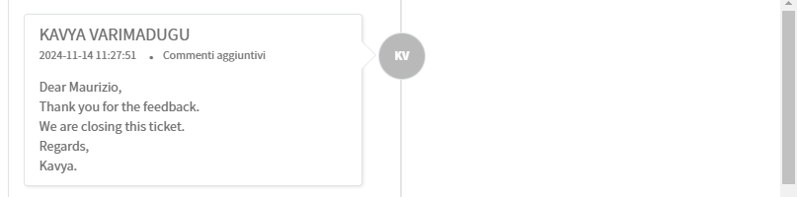
TICKET CREATO
TICKET CHIUSO
Inoltra mail finale di DriveIT a Cecco

Slide 22
messaggio a LIS
mylearningbusinesscenter@trainingsupportcare.com
Da: koine@koine.it [mailto:koine@koine.it] A: mylearningbusinesscenter@trainingsupportcare.com Cc: Maurizio Cecco <maurizio.cecco@astara.com> Oggetto: Fiat 500 1957 Collection
SWITZERLAND SCORM packs
Code course global : CPFI505551W01
You can download the files from the following links:
CHCPFI505551W01DE24_SCORM.zip
https://admin1-medialibrary.stellantis.com/pmOFdPL8zY
CHCPFI505551W01DE24_SOURCE_FILES.zip
https://admin1-medialibrary.stellantis.com/pmRjIInaVL
CHCPFI505551W01FR24_SCORM.zip
https://admin1-medialibrary.stellantis.com/pmIHO8uaUe
CHCPFI505551W01FR24_SOURCE_FILES.zip
https://admin1-medialibrary.stellantis.com/pmQkoFcach
CHCPFI505551W01IT24_SCORM.zip
https://admin1-medialibrary.stellantis.com/pmXJfGNapy
CHCPFI505551W01IT24_SOURCE_FILES.zip
https://admin1-medialibrary.stellantis.com/pmPS7mi7Tn
I send you the sales data also.
We wait for the message to perform the quality test.
Best regards
Patrizia Gariglio
Koinè snc
Tel ++39 011 3971099
Mob. 335 6896974

Slide 23
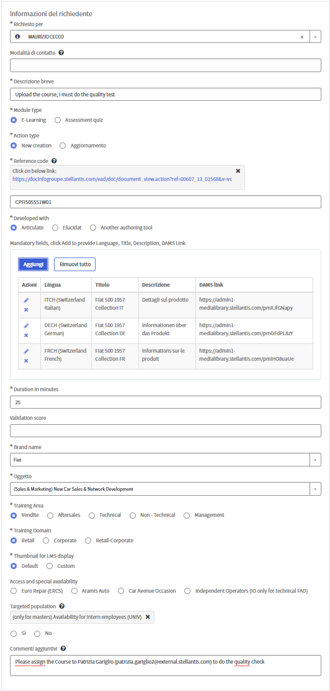

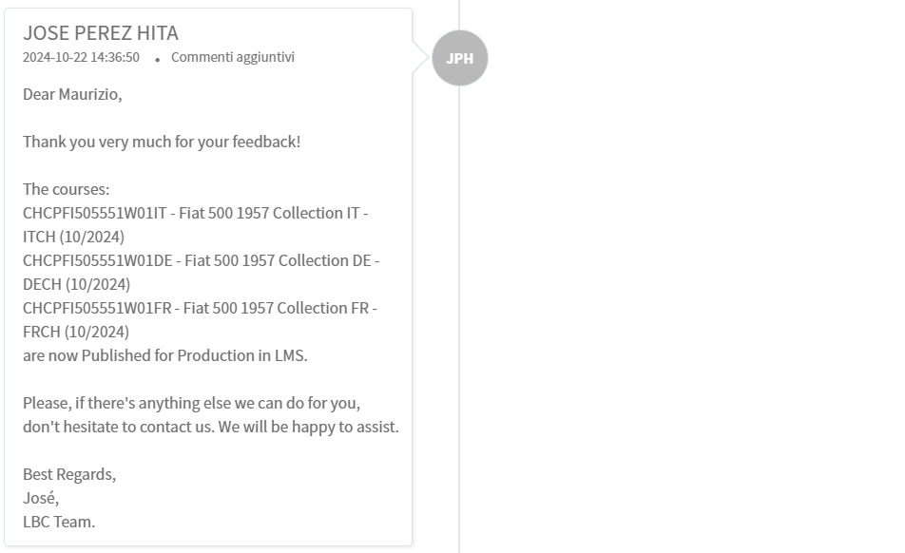
TICKET CREATO
TICKET CHIUSO
Inoltra mail finale di DriveIT a Cecco

Slide 24
messaggio a LIS
mylearningbusinesscenter@trainingsupportcare.com
Da: koine@koine.it [mailto:koine@koine.it] A: mylearningbusinesscenter@trainingsupportcare.com Cc: Maurizio Cecco <maurizio.cecco@astara.com> Oggetto: Fiat Panda MY25 SWITZERLAND SCORM packs
Code course global : CPFI505552W01
You can download the files from the following links:
CHCPFI505552W01DE24_SCORM.zip
https://admin1-medialibrary.stellantis.com/pmbsmJ69aX
CHCPFI505552W01DE24_SOURCE_FILES.zip
https://admin1-medialibrary.stellantis.com/pmt6TVq4fV
CHCPFI505552W01FR24_SCORM.zip
https://admin1-medialibrary.stellantis.com/pmFAf5a200
CHCPFI505552W01FR24_SOURCE_FILES.zip
https://admin1-medialibrary.stellantis.com/pmc0WPF3gl
CHCPFI505552W01IT24_SCORM.zip
https://admin1-medialibrary.stellantis.com/pmtWWoi75S
CHCPFI505552W01IT24_SOURCE_FILES.zip
https://admin1-medialibrary.stellantis.com/pmvz3y141a
I send you the sales data also.
We wait for the message to perform the quality test.
Best regards
Patrizia Gariglio
Koinè snc
Tel ++39 011 3971099
Mob. 335 6896974

Slide 25
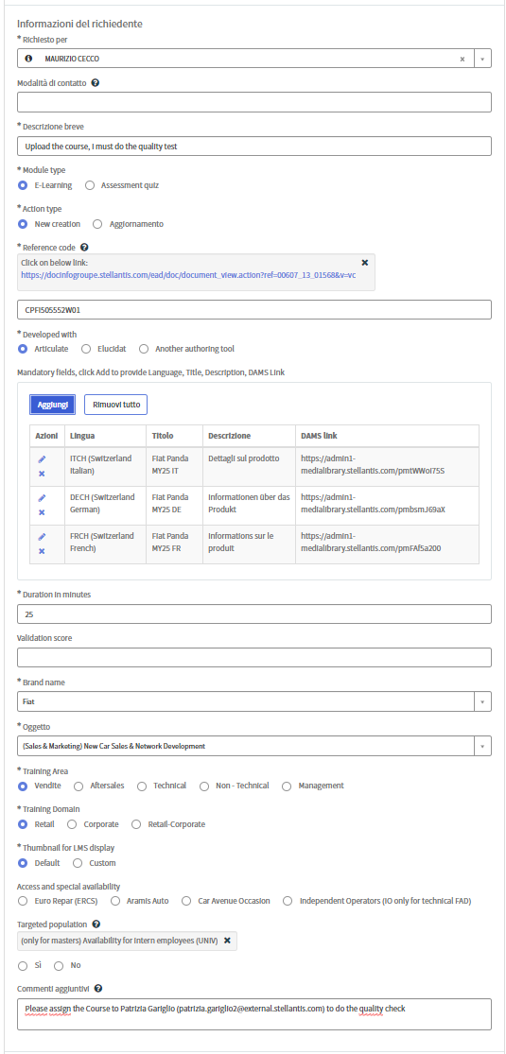

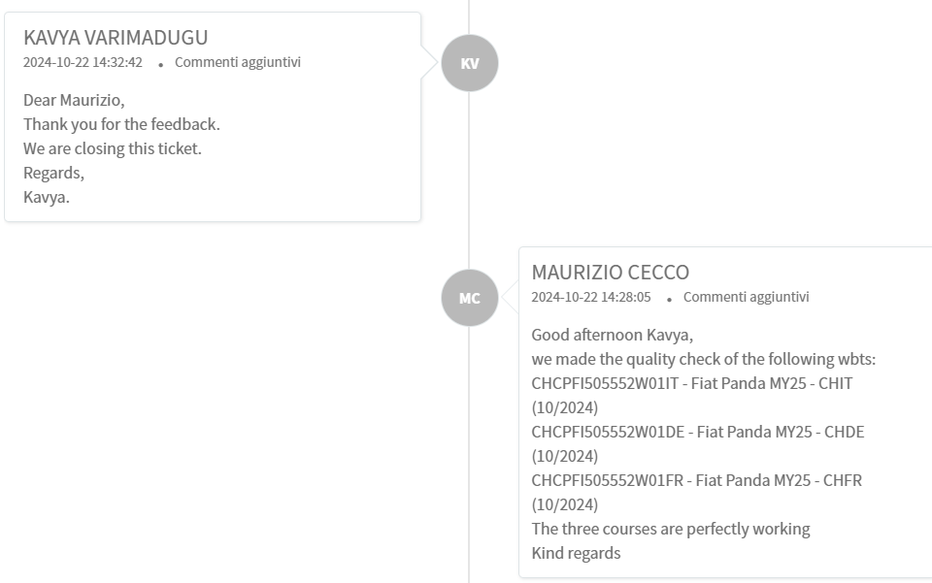
TICKET CREATO
TICKET CHIUSO
Inoltra mail finale di DriveIT a Cecco

Slide 26
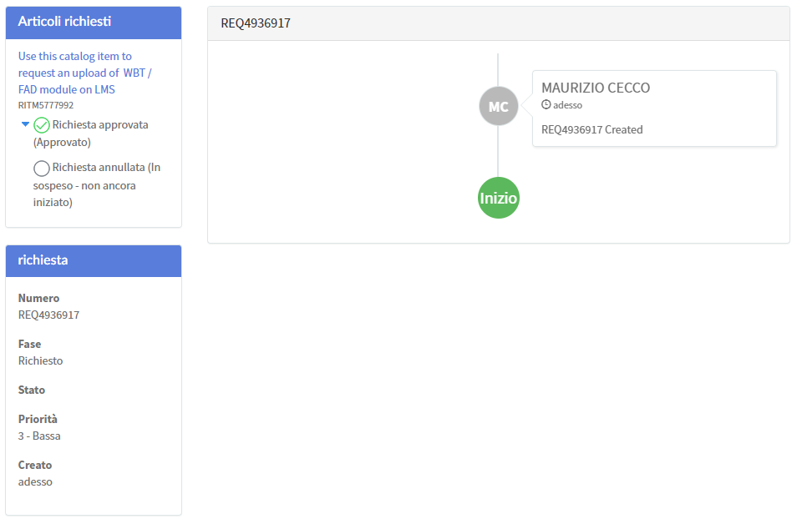
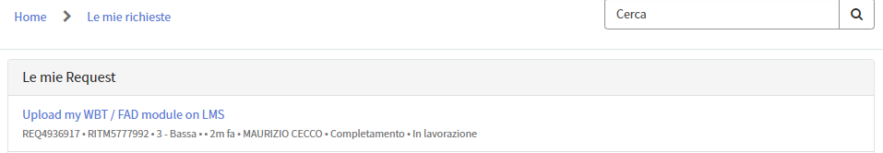
messaggio a LIS
mylearningbusinesscenter@trainingsupportcare.com
Da: koine@koine.it [mailto:koine@koine.it] A: mylearningbusinesscenter@trainingsupportcare.com Cc: Maurizio Cecco <maurizio.cecco@astara.com> Oggetto: WBTGRANDE PANDA SWITZERLAND SCORM packs
You can download the files from the following links:
CHCPFI505697W01DE24_SCORM.zip
https://admin1-medialibrary.stellantis.com/pmPqhQc9dt
CHCPFI505697W01DE24_SOURCE_FILES.zip
https://admin1-medialibrary.stellantis.com/pmixlum546
CHCPFI505697W01FR24_SCORM.zip
https://admin1-medialibrary.stellantis.com/pmTR9T14aT
CHCPFI505697W01FR24_SOURCE_FILES.zip
https://admin1-medialibrary.stellantis.com/pmhGQdT40P
CHCPFI505697W01IT24_SCORM.zip
https://admin1-medialibrary.stellantis.com/pmWGOb95la
CHCPFI505697W01IT24_SOURCE_FILES.zip
https://admin1-medialibrary.stellantis.com/pmYJ4fv906
I send you the sales data also.
We wait for the message to perform the quality test.
Best regards
Patrizia Gariglio
Koinè snc
Tel ++39 011 3971099
Mob. 335 6896974

Slide 27
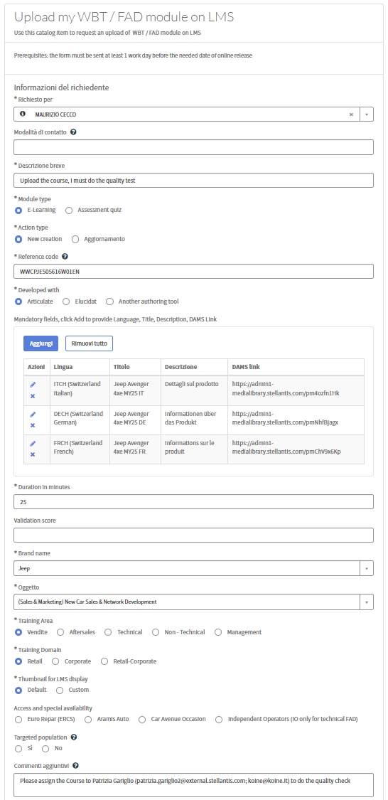
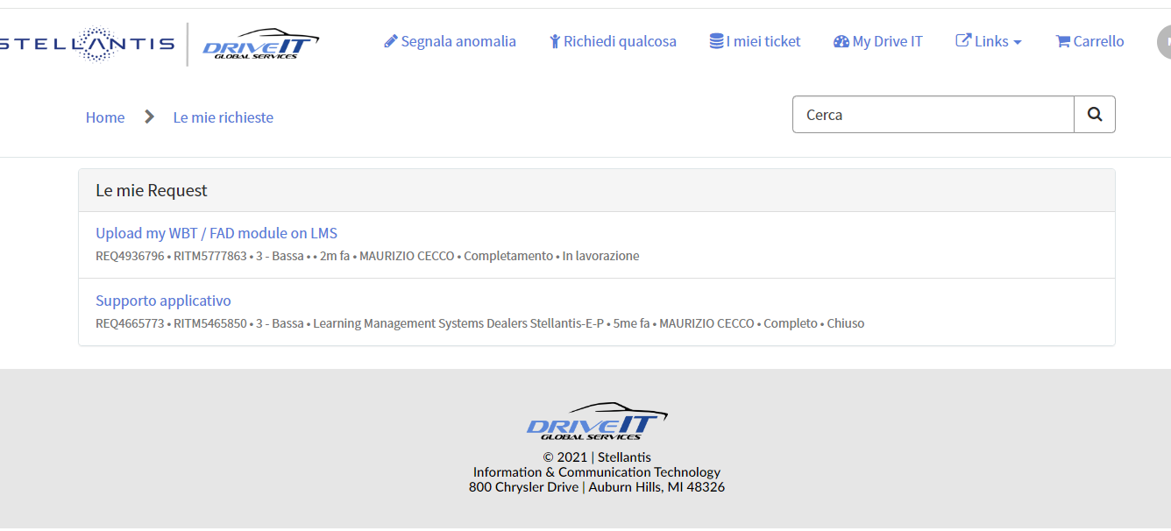
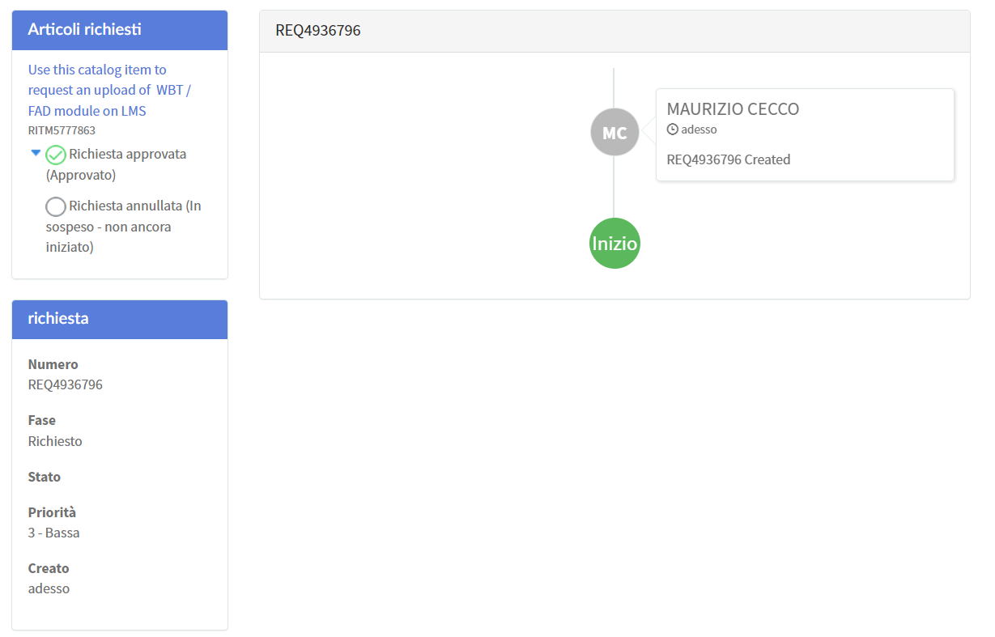
messaggio a LIS
mylearningbusinesscenter@trainingsupportcare.com
Da: koine@koine.it [mailto:koine@koine.it] A: mylearningbusinesscenter@trainingsupportcare.com Cc: Maurizio Cecco <maurizio.cecco@astara.com> Oggetto: WBT Jeep Avenger 4xe MY25 SWITZERLAND SCORM packs
Good morning
On behalf of Maurizio Cecco I ask you to upload the Jeep Avenger 4xe MY25 SWITZERLAND course in 3 languages (Italian, German and French).
You can download the files from the following links:
CHCPJE505616W01DE24_SCORM.zip
https://admin1-medialibrary.stellantis.com/pmNhfBjagx
CHCPJE505616W01DE24_SOURCE_FILES.zip
https://admin1-medialibrary.stellantis.com/pmGIunV3RD
CHCPJE505616W01FR24_SCORM.zip
https://admin1-medialibrary.stellantis.com/pmChV9x6Kp
CHCPJE505616W01FR24_SOURCE_FILES.zip
https://admin1-medialibrary.stellantis.com/pmaqsYYF7a
CHCPJE505616W01IT24_SCORM.zip
https://admin1-medialibrary.stellantis.com/pm4ozfn1Hk
CHCPJE505616W01IT24_SOURCE_FILES.zip
https://admin1-medialibrary.stellantis.com/pmHMPiR45X
I send you the sales data also.
We wait for the message to perform the quality test.
Best regards
Patrizia Gariglio
Koinè snc
Tel ++39 011 3971099
Mob. 335 6896974

Slide 28
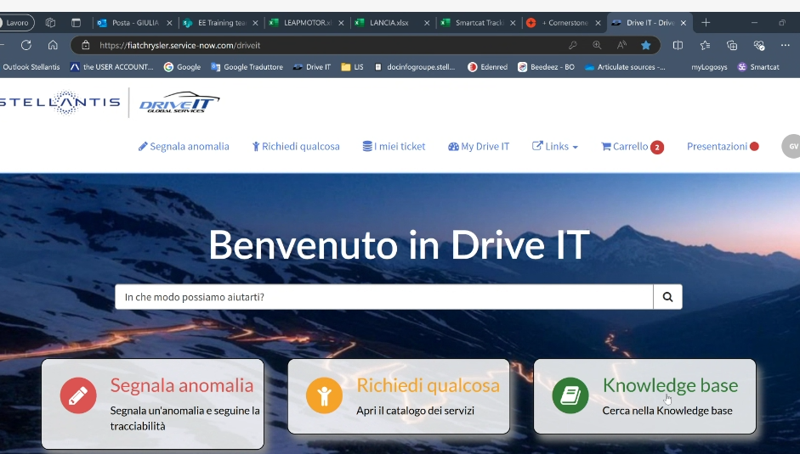
Drive-IT
https://fiatchrysler.service-now.com/driveit
User/domain Fiatauto\SF08856
Password Estate2025%Sole

Slide 29
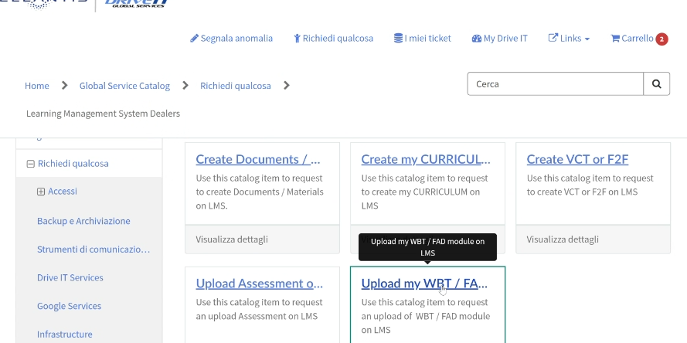

Slide 30
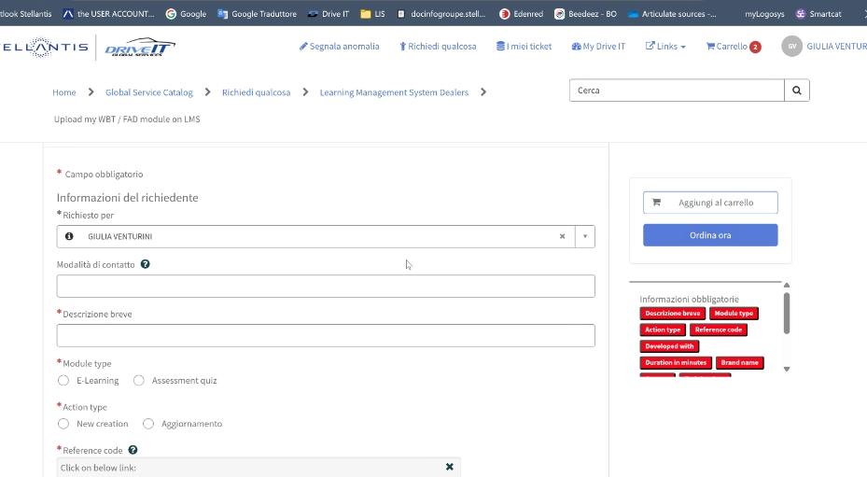
Upload the course, I must do the quality test
oppure

Slide 31
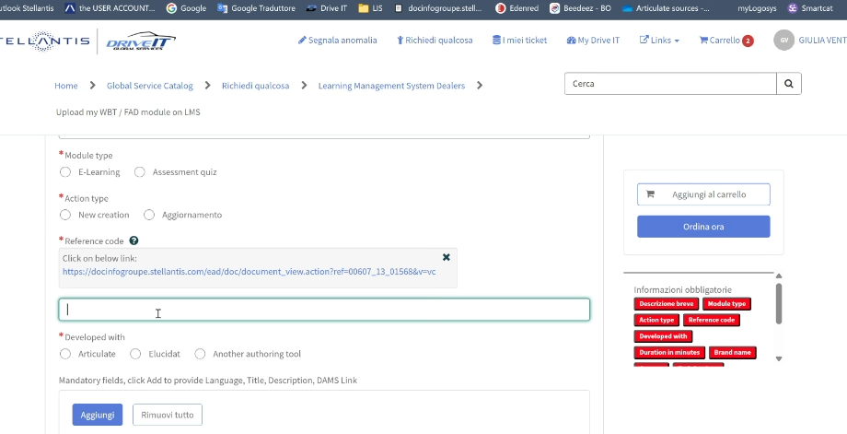
SOLO CODICE CORSO GENERALE en
X

Slide 32
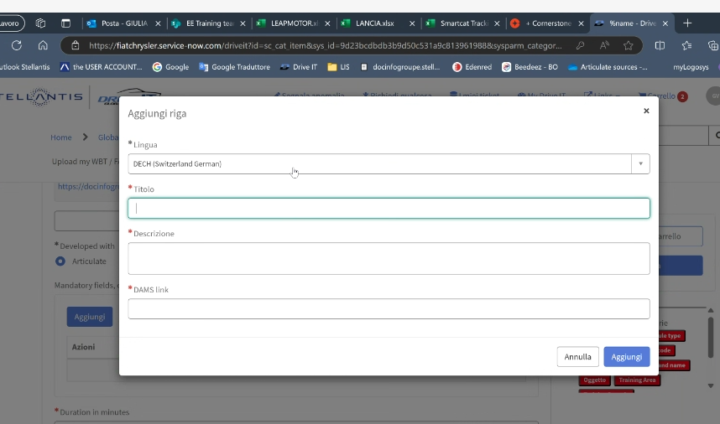
TITOLO IN LINGUa
descrizione IN LINGUa
Link di dams

Slide 33
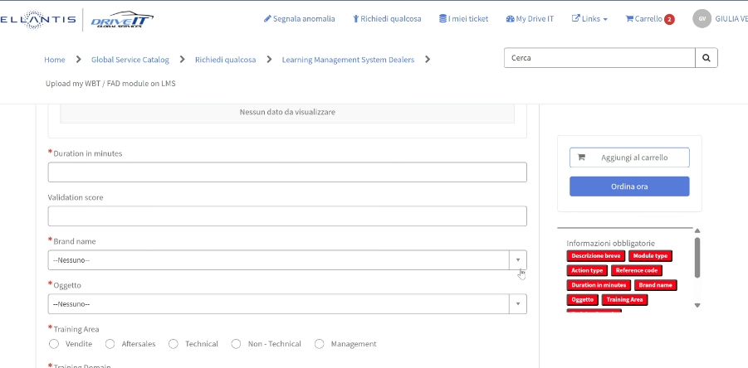
Se multibrand inserire stellantis multibrand

Slide 34
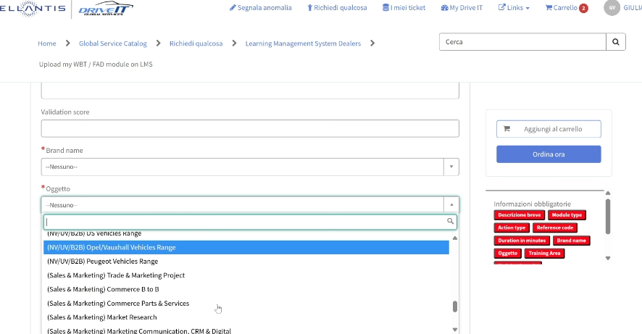
Concordare con CH

Slide 35
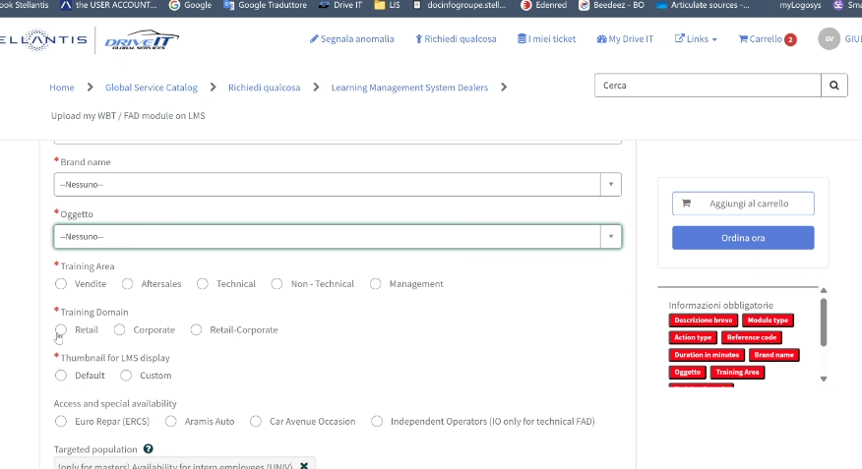
Mettere default

Slide 36
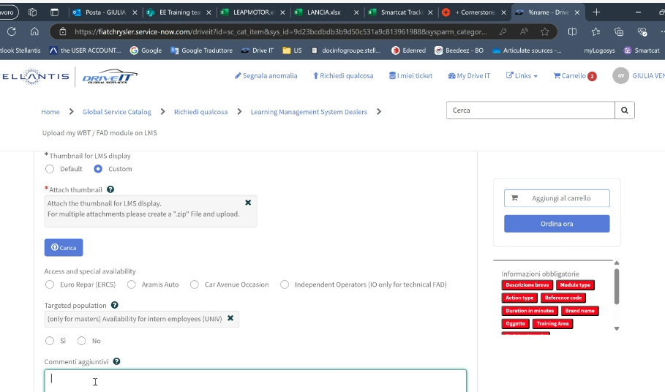
Scrivere
Please assign the Course to Patrizia Gariglio (patrizia.gariglio2@external.stellantis.com) to do the quality check

Slide 37
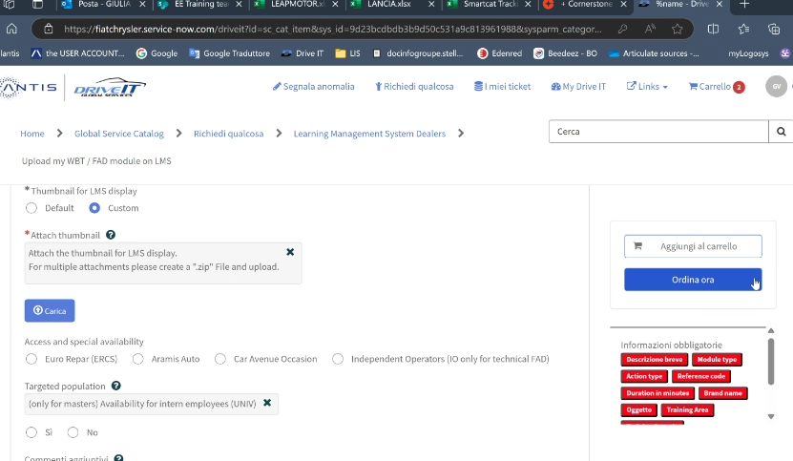
Aggiungi al carrello - Non Ordina ora
Poi clicca Azioni

Slide 38
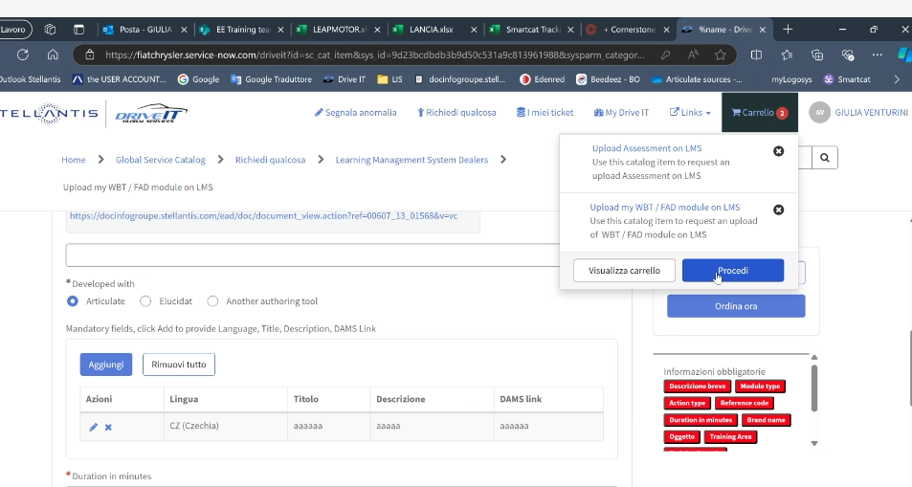
In Carrello
Procedi

Slide 39
ESEMPIO PER CH form compilato

Slide 40
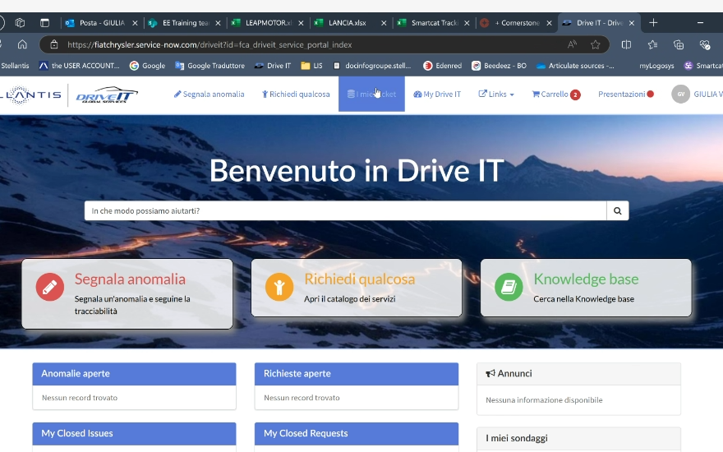
X Vedere a che punto è la richiesta
Clicca su My ticket

Slide 41
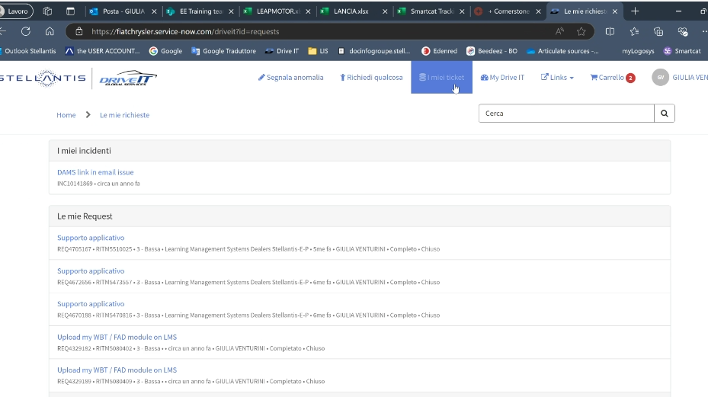
Vedi su My ticket

Slide 42
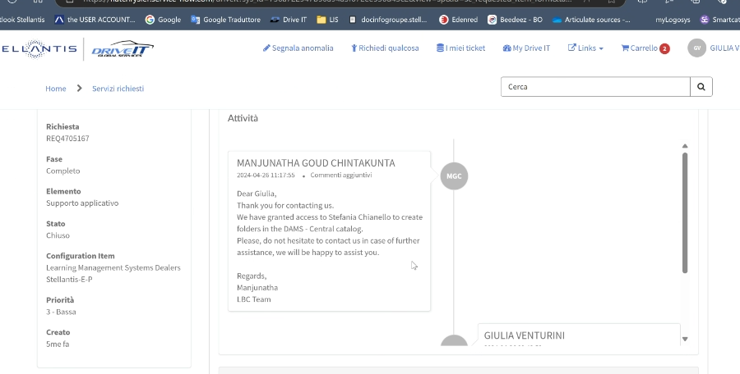
Qui compare lo status del ticket

Slide 43
messaggio finale
-----Messaggio originale----- Da: koine@koine.it [mailto:koine@koine.it] Inviato: mercoledì 6 aprile 2022 14:16 A: 'FGA Ticket System' Cc: Maurizio Cecco Oggetto: R: [#525851] Fiat 500 Tipo Hybrid - SWITZERLAND
The courses have been checked and are properly working. They can be uploaded in Production. I send the platform images.
The training manager involved for receiving the course codes is Maurizio Cecco (maurizio.cecco@astara.com)
Patrizia Gariglio
Koinè snc
Tel ++39 011 3971099
Mob. 335 6896974

