Slide 1
NEW ALFA ROMEO TONALE
Ready for new business opportunities?

Slide 2



Welcome!
Alfa Romeo Tonale welcomes you to this WBT, aimed to update you about the upcoming news which will let you work even more profitably with this successful model.
By the way, please note our WBT will be divided into 2 parts, the Style news part being published later on, with official pictures availability.
Come on, let’s start!
Course duration 40’
Final test 10 questions
Passing score 80%

Slide 3



Table of contents
01. INTRODUCTION
An appealing profit pool
A very peculiar customer
The 4 Tonale pillars
Led by Quality
02. What's new
Track increase
Exterior dimensions
Powertrain line-up
Rotary shifter
03. Range evolution
The new Tonale Range… in a nutshell
More market coverage, more business opportunities
Trims, one by one
Launch Edition
04. Conclusion

Slide 4
INTROdUCTION

Slide 5
AN APPEALING PROFIT POOL
01 | Introduction
1.5 Mio uts worldwide
With a stable trend of about 1.5 million units in the last few years (13% of the worldwide premium market): C-SUV is the first segment in Europe for volumes and represents a very appealing profit pool, isn’t it?
From its very first appearance Tonale had all it takes to play a primary role and stand out from the crowd in this scenario; today it has been further improved… are you ready, too?

Slide 6




A VERY PECULIAR CUSTOMER
01 | Introduction
We well know the "standard" C-SUV Premium customer… the Tonale customer has some specificities it’s well worth to know.
AVERAGE
Mettiamo che reference è NCBS FY2024 EU5
MALE
FEMALE
W PARTNER
SINGLE
Click the icon to know more.

Slide 7

A VERY PECULIAR CUSTOMER
01 | Introduction
We well know the "standard" C-SUV Premium customer… the Tonale customer has some specificities it’s well worth to know.
AVERAGE
TONALE
Mettiamo che reference è NCBS FY2024 EU5 (fonte)
MALE
FEMALE
MALE
FEMALE
W PARTNER
SINGLE
W PARTNER
SINGLE
While the "status" of Tonale customer is more or less the same of the standard one, please note we have 10% more male customers (89% vs 79%)... good opportunities to conquer a wider female audience!

Slide 8
A VERY PECULIAR CUSTOMER
01 | Introduction
We well know the "standard" C-SUV Premium customer… the Tonale customer has some specificities it’s well worth to know.
AVERAGE
REASON FOR PURCHASE
Mettiamo che reference è NCBS FY2024 EU5
1. MODEL / MAKE LOYALTY
30%
2. EXTERIOR STYLING / APPEARANCE
24%
3. BRAND REPUTATION
16%
Click the icon to know more.

Slide 9
A VERY PECULIAR CUSTOMER
01 | Introduction
We well know the "standard" C-SUV Premium customer… the Tonale customer has some specificities it’s well worth to know.
AVERAGE
TONALE
REASON FOR PURCHASE
REASON FOR PURCHASE
Mettiamo che reference è NCBS FY2024 EU5
30%
1. EXTERIOR STYLING / APPEARANCE
42%
1. MODEL / MAKE LOYALTY
2. EXTERIOR STYLING / APPEARANCE
24%
2. MODEL / MAKE LOYALTY
26%
3. BRAND REPUTATION
16%
3. BRAND REPUTATION
17%
Note that style is not a primary reason for purchasing a C-SUV premium. As a result, the offer in the C-SUV is wide but boring, made of cars to go from point A to B without emotion.
Tonale stands out, since its very unique sporty style assumes a primary role as a reason for purchasing!

Slide 10
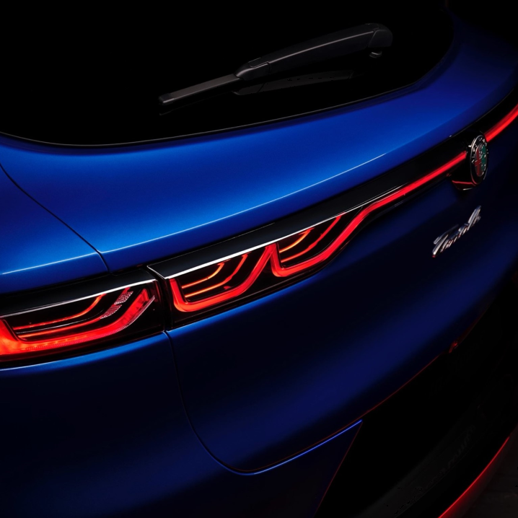
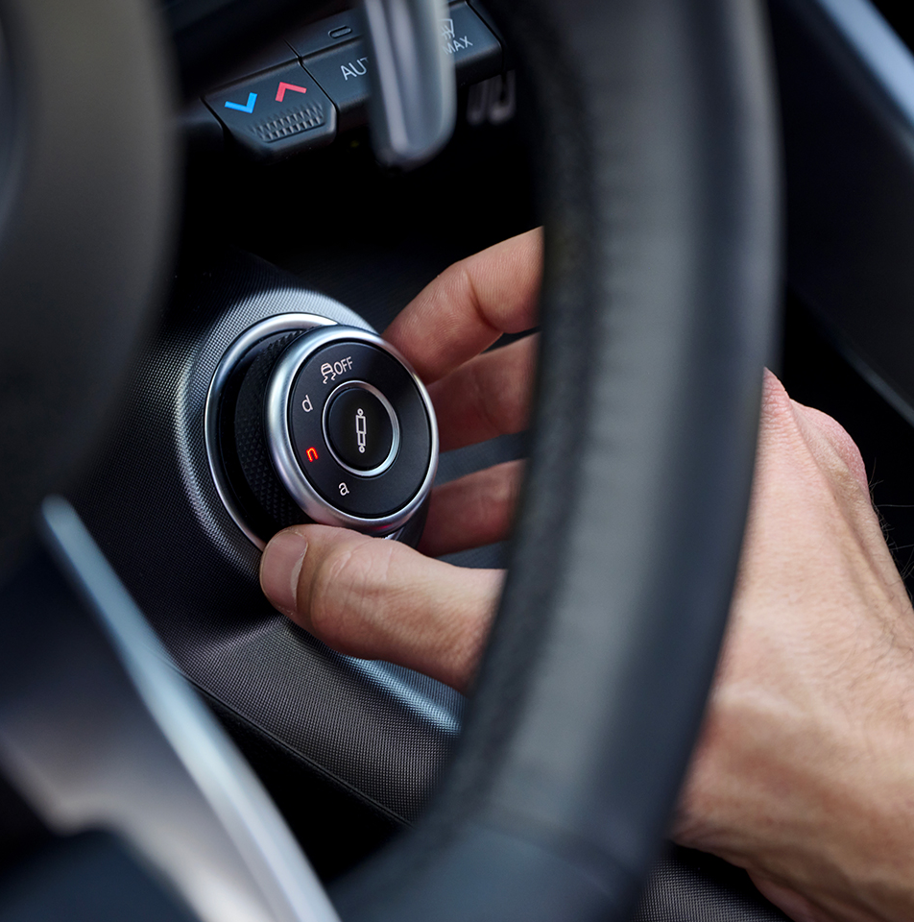
The 4 Tonale pillars
01 | Introduction
Tonale project lays on 4 main pillars and it’s well worth a quick recap about them, also with the aim to anticipate the main New Tonale novelties.
DESIGN
DRIVING DYNAMICS
ENHANCED SOFTWARE EXPERIENCE
PREMIUMNESS & QUALITY
Click on each pillar to discover some more.

Slide 11
The 4 Tonale pillars
01 | Introduction
Tonale project lays on 4 main pillars and it’s well worth a quick recap about them, also with the aim to anticipate the main New Tonale novelties.
Even more character and sportiness for a vehicle already rich in historical references and inspirations… Wait for WBT Part 2 and “touch with your hand” !
True Alfa Romeo DNA, translated into emotion at first drive. Dedicated mechanical solutions create the recipe that an Alfista would expect.
Cutting edge technology, latest generation infotainment & connectivity, best in class safety (5 stars EuroNCAP) & ADAS.
Harman Kardon 14-speakers premium Hi-Fi, ventilated front seats, semi-autonomous parking…these are some of the premium features you can find on Tonale.
Even more character and sportiness on a design that is already a strength for the Tonale… Wait for WBT Part 2 and “touch with your hand” !
DESIGN
DRIVING DYNAMICS
ENHANCED SOFTWARE EXPERIENCE
PREMIUMNESS & QUALITY
Notes:
CARD - SCOPRIRE UNA PER VOLTA LE FIGURE IN ANIMAZIONE

Slide 12

A genuine, made in Italy, 100% Alfa Romeo!
01 | Introduction
Talking about driving dynamics, it’s well worth underlining Tonale unique driving experience is the result of a 100% Alfa Romeo DNA:
Indeed, Tonale features many Alfa Romeo-dedicated mechanical elements.
Specific…
Front & rear independent McPherson suspension with dedicated geometry and Alfa Romeo sporty tuning
Frequency Selective Damping (FSD) shock absorber / Dual Stage Valve (DSV) electronic suspension
Direct steering response calibration, similar to Giulia and Stelvio
Dedicated engine lineup (1.6 Diesel, 1.5 Ibrida, 1.3 Ibrida Plug-In)
Brembo performance brakes
Brake by wire technology, derived from Giulia and Stelvio
Q4 All Wheel Drive system
…

Slide 13
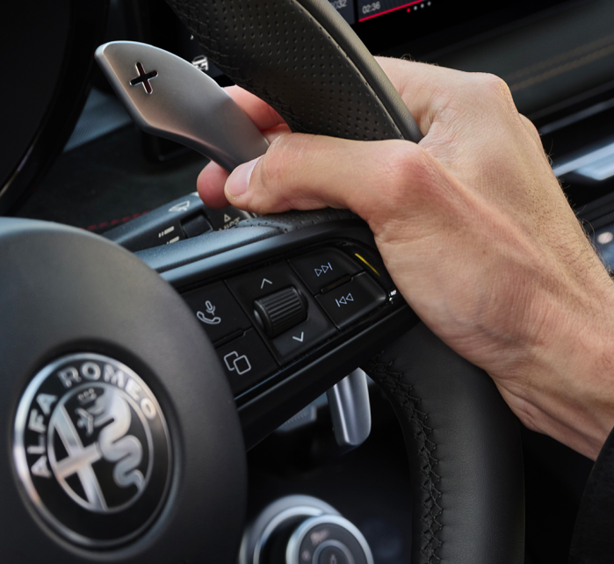
01 | Introduction
Led by Quality
Quality is fundamental for a premium brand. The Alfa Romeo Tonale was managed in a continuous improvement approach since its launch, always keep increasing the customer satisfaction and customer experience with the model.
The input? The voice of customers and salesmen!
As an example, some of the many product actions introduced:
Wireless charger with A/C ventilation at the end of 2023.
ADAS blindness new calibration at the end of 2023
Radio reactivity improvement at the beginning of 2024
Steering wheel buttons new configuration in the summer 2024.
That’s why New Tonale is going to offer the best, both on on quality and features.

Slide 14
What’s new
Time to deep dive the news Tonale offers…

Slide 15
02 | What’s new
Track increase
“At Alfa Romeo they have people who know how to make gloves for flies”. (Enzo Ferrari)
The mechanical elements are key to improve an Alfa Romeo.
Matching the new design, to further enhance the bold stance of the New Tonale, the wheel track was increased by 8 mm by modifying the ET of the new 19" and 20" wheels (4 mm by side).
This translates in:
Improved Look: as a result, the wheels are in an outer position, aligned to the wheel arches, giving the new Tonale a more muscular appearance
Improved roadholding & driving dynamics
Ah… please note: no change on the 17” and 18” wheels!
+8 mm (4 mm by side)

Slide 16


Exterior dimensions
02 | What’s new
Mettere indicazione/legenda che la vettura in rosso è la New Tonale mentre quella in bianco è la versione precedente
It’s well worth underlining New Tonale has "the right size": not too long, not too short, to catch the heart of the C-SUV segment.
Nevertheless, the interior space and trunk sport a generous volume.
New Tonale keeps its general dimensions, with just 2 exceptions:
Today, indeed…
It’s shorter (-6 mm) as for both overall length and front overhang
It has a wider track (+8 mm) (as already seen, only for 19” and 20” wheels)
NEW TONALE
Dimensions
Click the button to see overall dimensions.
Notes:
Animazione compare img bianca vecchia e poi la rossa con scritto NEW TONALE

Slide 17
Exterior dimensions
Length [mm]
4,522 (-6)
Front overhang [mm]
945 (-6)
Height [mm]
1,601
Rear overhang [mm]
941
Width - no mirrors [mm]
1,841
Front track [mm]
1589 (+8) / 1581*
Width – with mirrors folded [mm]
1,937
Rear track [mm]
1588 (+8) / 1580*
Width - with mirrors [mm]
2,082
Trunk [liters]
Diesel/Ibrida 500 – 1.550 Plugin 385 - 1.430
Wheelbase [mm]
2,636
*with 17" and 18" wheels

Slide 18
Powertrain line-up
02 | What’s new
The new Tonale confirms its complete choice of powertrains, giving each customer the chance to get "their right engine".
Moreover, listening customers’ input, the 1.5 Ibrida features a power (combined) and performance improvement.
The new technical regulation (GTR21*, mandatory from Euro 7) sets clear indications to indicate combined power between internal combustion engine and electric motor.
Let’s deep dive the updated engine range.
1.6 TURBO DIESEL 130 hp
1.5 IBRIDA 175 hp
1.3 IBRIDA PLUG-IN Q4 270 hp
No change with respect to the previous Euro 6E homologation
Improved declared power thanks to the combined value (+14hp)
Improved 0-100 km/h value (-0.3 s)
Modifications to the aftertreatment for Euro 6E Bis compliance
Effect on combined power and declared CO₂ (no impact on the customer perceived fuel consumption)
What’s new?
Mission
High mileage version
Perfect balance between performance & efficiency
Maximum performance & efficiency
Click on each powertrain to see the details.
Notes:
Animare : una per una

Slide 19




Powertrain line-up – 1.6 Turbo Diesel 130 hp
Architecture
Drive type FWD
Fuel type Diesel
Number of cylinders 4
Engine features
Cubic capacity (cm³) 1.598 / 1.6
Max power [HP/kW] 130/96 at 3750 rpm
Max torque [Nm] 320 at 1500 rpm
Gearbox
Gearbox Type DDCT
Number of forward gears 6
138-144
Indicate come nota che sono valori di CO2 pre-omologazione, non vedo la nota da nessuna parte…c’è solo l’asterisco
Performance & CO₂
Top Speed [kph] 195
0 - 100 km/h [s] 10,9
CO₂ combined* [g/km] 139 - 144

Slide 20
Powertrain line-up – 1.5 Ibrida 175 hp
Architecture
Drive type FWD
Fuel type Gasoline
Electrification type Hybrid 48V
Number of cylinders 4
Engine features
Cubic capacity (cm³) 1.469 / 1.5
Max power combined [HP/kW] 174/128 at 5750 rpm
Max power ICE [HP/kW] 160 / 118 at 5750 rpm
Max torque ICE [Nm] 240 at 1500 rpm
Max power E-motor [HP/kW] 20/15
Max torque E-motor [Nm] 55
Gearbox
Gearbox Type DDCT
Number of forward gears 7
Performance & CO₂
Top Speed [kph] 212
0 - 100 km/h [s] 8,5
CO₂ combined* [g/km] 128 - 132
CO2: 128-133
Indicate come nota che sono valori di CO2 pre-omologazione, non vedo la nota da nessuna parte…c’è solo l’asterisco

Slide 21
Powertrain line-up - 1.3 IBRIDA PLUG-IN Q4 270 hp
Architecture
Drive type eAWD
Fuel type Gasoline
Electrification type Plug-In Hybrid
Number of cylinders 4
Engine features
Cubic capacity (cm³) 1.332 / 1.3
Max power combined [HP/kW] 268/197 at 5750 rpm
Max power ICE [HP/kW] 150 / 110 at 5750 rpm
Max torque ICE [Nm] 270 at 1800 rpm
Max power E-motor [HP/kW] 128/94
Max torque E-motor [Nm] 250
Gearbox
Gearbox Type AT
Number of forward gears 6
Performance & CO₂
Top Speed [kph] 195
0 - 100 km/h [s] 6,6
CO₂ combined* [g/km] 79-85
EV range WLTP combined [km] 58 - 62
CO2: 77-83
EV Range: 58 – 61
Indicate come nota che sono valori di CO2 ed EV range pre-omologazione, non vedo la nota da nessuna parte…c’è solo l’asterisco

Slide 22
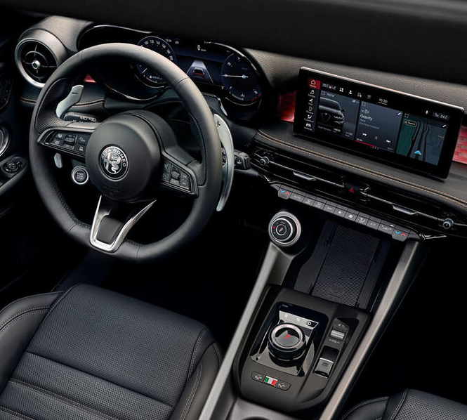

02 | What’s new
ROTARY SHIFTER
Even though already introduced in 2025, the new rotary shifter deserves a closer look, since it allows for a fresher and more technological look of the interior.
Technically speaking, it allows manual shifting when the paddle shifters (OPT) are equipped:
AUTOMATIC
TEMPORARY MANUAL
PERMANENT MANUAL
MODE ACTIVATION
Click the button to see how shifting modes are activated.

Slide 23
THREE SHIFTINg MODES
AUTOMATIC
Put the rotary in “D” position, the shifting is fully managed in automatic mode and the “D” icon appears on the cluster display.
TEMPORARY MANUAL
Use the + or – paddle shifter to change the gear and stay in temporary manual. On the cluster is indicated D + the gear engaged.
After a certain time in which the driver doesn’t change the gear, the vehicle automatically returns in automatic mode.
Perchè non mettiamo le immagini?
PERMANENT MANUAL
Press the + paddle shifter for 2 seconds. On the cluster the indication is M plus the number of the gear currently engaged.
Press again the + paddle shifter for 2 seconds to go back in automatic mode.
Attesa info brand

Slide 24
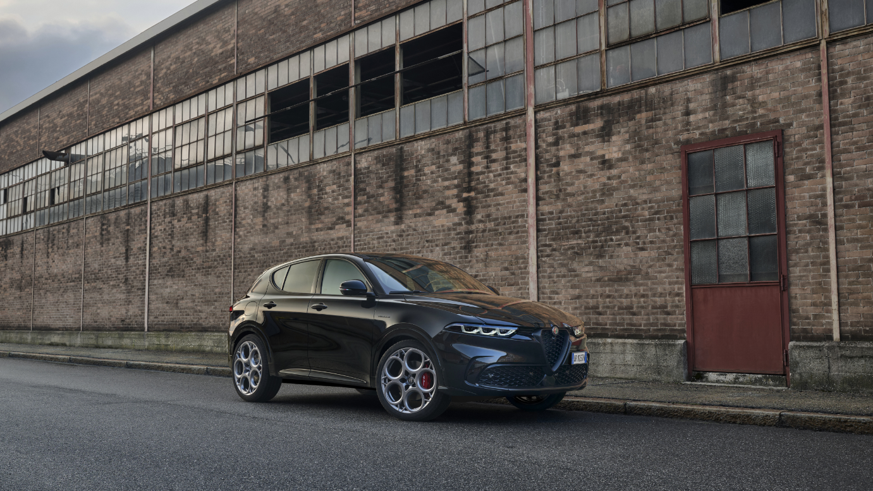
Range evolution
A big piece of news about Tonale is about Lineup… let’s see!

Slide 25
The new Tonale Range… in a nutshell
03 | Range evolution
As stated before about quality, the new Tonale takes inspiration from customers’ (and salesmen’s) inputs, asking for more customization and greater choice.
Let’s have a look at a glance.
MORE TRIMS
+2
(4 versions vs 2)
MORE
COLORS
+ 3 all metallic
+ black roof option
MORE INTERIOR
COLORS
+ red leather
+ black /white
Alcantara
Colors
Click the button to see an overview on the new colors.

Slide 26
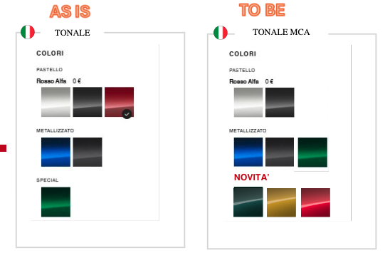
colors
colors
As is
To be
Tonale
New Tonale
Solid
Solid
Metallic
Metallic
Mettiamo “NEW” METALLIC
Metallic
Mettiamo il bollino “NEW” sui colori sopra

Slide 27
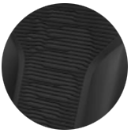
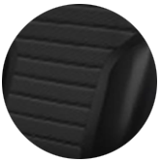

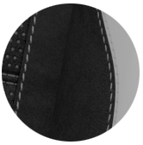
SEATS colors
As is
To be
Tonale
New Tonale
Black cloth & Scuba leatherette ‘’Biscione"
Black leather
Black cloth & Scuba leatherette ‘’Biscione"
Black leather
NEW
NEW
Red leather
Alcantara with ICE backing and ICE inserts

Slide 28
More market coverage, more business opportunities
03 | Range evolution
To answer the need of a wider market coverage, New Tonale’s range adds 2 trims.
Also in this case, the approach is to have the tailored offer for each customer.
Current range
New range
Veloce
Veloce
Ti
Sprint
Sprint
Tonale
Click on each label to see some details.
Notes:
Animazione: alla vecchia gamma ‘25 si aggiungono I due nuovi trim entrando da destra

Slide 29
More market coverage, more business opportunities
03 | Range evolution
To answer the need of a wider market coverage, New Tonale’s range adds 2 trims.
Also in this case, the approach is to have the tailored offer for each customer.
Current range
New range
Reasons why
Veloce
Veloce
Hero version
No content changes vs MY 25 version
To reinforce the upper range between Veloce and Sprint
Iconic name
Ti
Sprint
Sprint
Improved style and perceived quality
More affordable entry price (but NOT a NAKED version)
Aligned to competitors’ range
Tonale
Notes:
Animazione: alla vecchia gamma ‘25 si aggiungono I due nuovi trim entrando da destra

Slide 30
NEW RANGE: Trims, one by one
03 | Range evolution
After a general view on range evolution, it’s time for a closer look to each trim, from the lower one to the upper one. Let’s see.
Veloce
Ti
Sprint
Tonale
Click on each trim to see some details.
Notes:
Nota per sviluppo: pagina PIVOT le etichette dei trim si attivano in ordine, partendo da Tonale a salire

Slide 31
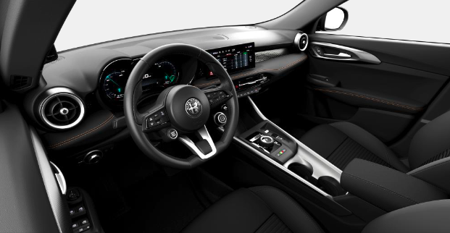
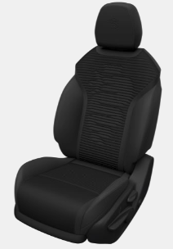
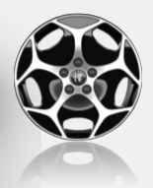
Tonale TRIM
Key concept: Tonale trim is NOT a naked one!
Ideal to attract customer hesitating Tonale with other generalist brands. It has been conceived to offer a more affordable entry price extending the market coverage, but without giving up any key equipment.
Anzichè generalist mettiamo “mainstream”
17” Aero Wheels
Black cloth & Scuba leatherette seats with ‘’Biscione’’ on the back
Full contents
Since Tonale is the basic trim, it’s well worth to list ALL the contents, being the upper trims been built by addition.
Click on the button to see to Tonale trim.

Slide 32




Tonale full contents
Exterior
Grained body kit
Full LED front and rear lights with 3+3 signature
17” Aero wheels
Privacy glass (PHEV)
Comfort & technology
12,3” full TFT instrument cluster
10,25’’ Alfa Connect infotainment touch
Alfa Connected Services
Wireless Apple Car Play / Android Auto
Dual zone automatic A/C with AQS
Keyless Entry & Go
Puddle lights & courtesy lights on exterior door handles on the front doors
Electrical-folding side mirrors
Electrochromic interior mirror
interior
Black cloth & Scuba leatherette seats with ‘’Biscione’’ on the back
Biscotto accent stitching on dashboard and door panels
Leather steering wheel
Front central armrest
60/40 rear seats with central armrest and ski pass
Black ceiling
6-way adjustable front seats
2-way electric lumbar adjust on driver seat
Available options
Techno Pack
Sunroof
18”, 19”, 20” wheels
Winter pack (LHD only)
Safety
Intelligent Adaptive Cruise Control
Auto High Beam
Front & rear parking sensors
Rear back-up camera
Autonomous Emergency Braking with vulnerable road users
Lane keeping system
Drowsy Driver
Da aggiungere agli opt:
Paddle shifters

Slide 33
NEW RANGE: Trims, one by one
03 | Range evolution
To answer the need of a wider market coverage, New Tonale’s range adds 2 trims.
Also in this case, the approach is to have the tailored offer for each customer.
Veloce
Ti
Sprint
Tonale
Click on each trim to see some details.
Notes:
Nota per sviluppo: pagina PIVOT le etichette dei trim si attivano in ordine, partendo da Tonale a salire

Slide 34
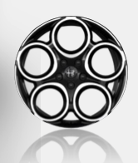
Sprint trim
Key concept: improved style and perceived quality.
An affordable upselling vs Tonale with improved style and functionality: this version features radio with navigation & 18” wheels.
18” Wheels
Black cloth & Scuba leatherette seats with ‘’Biscione’’ on the back
Tonale trim, PLUS…
Click on the button to see what has been added to Tonale trim to create Sprint.

Slide 35
Sprint contents (tonale trim plus..)
Exterior
Glossy black body kit
Privacy glass (new)
18” wheels
Comfort & technology
10,25’’ Alfa Connect infotainment touch with Navigation system
interior
Aluminum pedals
Aluminum door sills (new)
Multi-color ambient light (new)
Available options
Techno Pack
Sunroof
19”, 20” wheels
Winter pack (LHD only)
Da aggiungere agli opt:
Paddle shifters

Slide 36
NEW RANGE: Trims, one by one
03 | Range evolution
To answer the need of a wider market coverage, New Tonale’s range adds 2 trims.
Also in this case, the approach is to have the tailored offer for each customer.
Veloce
Ti
Sprint
Tonale
Click on each trim to see some details.
Notes:
Nota per sviluppo: pagina PIVOT le etichette dei trim si attivano in ordine, partendo da Tonale a salire

Slide 37
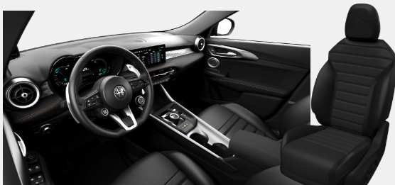
Ti TRIM
Key concept: the premium version with an iconic name is back!
Ti version upgrades the premiumness of the interior with full leather electrically adjustable, heated and ventilated seats.
18” Wheels
Red or Black leather seats
Sprint, PLUS…
Click on the button to see what has been added to Sprint trim to create Ti.

Slide 38
Ti contents (SPRINT trim plus..)
Exterior
Glossy black side windows surround (DLO)
Ti badge on fender
Available options
Techno Pack
Sunroof
19”, 20” wheels
Harman Kardon Hi-Fi & memories on driver seat
interior
Paddle shifters
Red or black leather seats
8-way electrically adjustable front seats
4-way electric lumbar adjust on front seats
Heated and ventilated front seats
Heated steering wheel and nozzles

Slide 39
NEW RANGE: Trims, one by one
03 | Range evolution
To answer the need of a wider market coverage, New Tonale’s range adds 2 trims.
Also in this case, the approach is to have the tailored offer for each customer.
Veloce
Ti
Sprint
Tonale
Click on each trim to see some details.
Notes:
Nota per sviluppo: pagina PIVOT le etichette dei trim si attivano in ordine, partendo da Tonale a salire

Slide 40

Veloce TRIM
Key concept: the upper positioning for those who want ALL: style & technical features.
This version features 19” wheels, Brembo brakes and electronic suspension.
IMAGE
PRENDERE IMMAGINE DEL CERCHIO OFFUSCATO DA Istruction letter
Red or black interior
19” Wheels
Red or Black leather seats
Ti, PLUS…
Click on the button to see what has been added to Ti trim to create Sport.

Slide 41
VELOCE contents (ti trim plus..)
Exterior
19” wheels
Veloce badge on fenders
Full LED Matrix front lights
Red Brembo brake calipers
Dual chrome exhaust pipes (PHEV)
Available options
Techno Pack
Sunroof
20” wheels
Harman Kardon Hi-Fi & memories on driver seat
Da aggiungere agli esterni:
Tonale black rear logo
Comfort & technology
DSV (Dual Stage Valve) electronic suspension

Slide 42
Sport Veloce - LAUNCH EDITION range positioning
03 | Range evolution
Let’s have a look at Sport Veloce positioning within the range: it’s a “top of the range”, as we can clearly see.
Veloce
Sport Veloce
Ti
Sprint
Tonale
Notes:
Animazione: Sport Veloce entra dopo e si colloca al suo posto entrando da destra

Slide 43
Sport veloce - Launch Edition
03 | Range evolution
Key concept: a Launch Edition, affordable but with top of the range style and unique premium interior.
Beside the “regular” range, we have a special version: exterior and interior top equipment with dedicated color & trim, available in all colors, also with black roof option.
characterizations
Exterior
Black caliper with white Alfa Romeo lettering
Badge on fender
20” 2-tone wheels diamond cut
Glossy black body kit with silver accent
Tonale black rear logo
Interior
Alcantara seats with bright backing and ice inserts
Alcantara IP fascia (LHD only)
Unique ambient light design
Bright accent stitchings on door panels, dashboard, steering wheel and armrest
Sprint, PLUS…
Click on the button to see what has been added to Sprint trim to create the Launch Edition.
Notes:
Nota per sviluppo: pagina PIVOT le etichette dei trim si attivano in ordine, partendo da Tonale a salire

Slide 44
Sport veloce - Launch Edition contents (SPRINT trim plus..)
Exterior
20” wheels
Glossy black body kit with lateral and rear silver inserts - specific
Sport Speciale badge on fenders - specific
Black Brembo brake calipers - specific
Dual chrome exhaust pipes (PHEV)
Black Tonale rear logo - specific
Available options
Techno Pack
Sunroof
Matrix headlamps
DSV electronic suspension
Harman Kardon Hi-Fi & memories on driver seat
Togliere specific da Tonale Black rear logo, ora c’è anche su Veloce
Interior
Alcantara seats with ICE backing and ICE inserts specific
Alcantara-wrapped central dashboard fascia (LHD only) with ICE contrasting stitching - specific
ICE contrasting stitching on steering wheel, door panels and center armrest - specific
Multi-color ambient light with new graphics - specific
Paddle shifters
8-way electrically adjustable front seats
4-way electric lumbar adjust on front seats
Heated front seats
Heated steering wheel and nozzles

Slide 45
Conclusion/1
In a very appealing profit pool – the C-SUV is the most important segment in Europe - New Tonale has a strong and distinctive design to stand out from the crowd and to play a primary role.
The main product pillars are confirmed: Design, Driving Experience, Technology and Premiumness.
Tonale is the C-SUV with emotional style and driving pleasure, matching the 100% Alfa Romeo DNA with the comfort and roominess typical of an SUV.

Slide 46
Conclusion/2
Before recapping the product novelties, let’s remember Alfa Romeo applies a continuous improvement policy right listening to its customers: hence, New Tonale is bound to be an exceptional quality product:
New design with bold stance and even more character (stay tuned for WBT part 2…)
New wheels
More customization: more exterior colors (+3 metallic paints, +black roof option), more interior options (red leather, black & white Alcantara)
Improved mechanics: track increase (+ 8 mm on 19” and 20”) & complete engine line-up updated to Euro 6E Bis homologation (1.6 TURBO DIESEL 130 hp, 1.5 IBRIDA 175 hp, 1.3 IBRIDA PLUG-IN Q4 270 hp): the right engine for each customer!
Perfect size: 4,52m (- 6mm), not too big, not too small, with large roominess and a big 500L trunk volume
New range: Tonale, Sprint, Ti and Veloce. Aside the exclusive Sport Speciale with a perfect match of exterior style and affordable positioning
Well, all the best, with Alfa Romeo New Tonale!

Slide 47
TEST OUT

Slide 48

Instructions for taking the test
Final Quiz: 10 Questions
AIM This test is designed to assess how much of the course content you have learnt.
RULES
You will pass the test if you correctly answer at least 80% of the questions (8 out of 10).
When you exit the course, if you still haven’t reached the pass mark of 80%, you can take the test again.
HOW TO DO THE TEST You can change your choice as many times as you like until you click on "Confirm".
You need to answer before you can move on to the next question. At the end of the test, a report will show you your score.

Slide 49
Question 1
We said C-SUV segment represent a very appealing profit pool.
Can you remember how many units per year we’re talking about?
1.5 million units
25 million units
15,000 units
Specificare sempre che è un dato di vendita globale
CONFIRM

Slide 50
Question 2
Let’s recap some of the Alfa Romeo DNA elements.
Choose the right cluster.
Front & rear independent suspension, FSD suspension/DSV suspension, Brembo brakes.
Koni suspension, FSD suspension/DSV suspension, Drum brakes.
Front & rear independent suspension, Pirelli tyres, Bosch brakes.
CONFIRM

Slide 51
Question 3
Talking about track increase.
Choose the right statement.
New Tonale increases track by 4mm on each side on 19” and 20”.
New Tonale increases track by 4mm on each side on all versions.
New Tonale increases track by 8mm on each side on 18” and 19”.
CONFIRM

Slide 52
Question 4
Talking about overall dimensions.
Choose the right statement.
New Tonale decreases overall length by 6mm on front overhang.
New Tonale decreases overall length by 12mm on rear overhang.
New Tonale decreases overall length by 6mm on both front and rear overhang.
CONFIRM

Slide 53
Question 5
Talking about range.
Choose the right statement: what changes vs previous Tonale version?
New Tonale today offers 8 vs. 6 colors, 4 vs. 2 versions and 4 vs. 2 interior trims.
New Tonale today offers the same number of colors, 4 vs. 2 versions and 4 vs. 2 interior trims.
New Tonale today offers 8 vs. 6 colors, the same number of versions and interior trims.
CONFIRM

Slide 54
Question 6
Talking about range.
Which one is the statement which best fit to Tonale trim?
NOT a naked one!
Improved style and perceived quality.
An iconic name is back!
The upper positioning for those who want ALL.
Rinforzerei dicendo che è interessante per Conquista clienti mainstream
CONFIRM

Slide 55
Question 7
Talking about range.
Which one is the statement which best fit to Sprint trim?
NOT a naked one!
Improved style and perceived quality.
An iconic name is back!
The upper positioning for those who want ALL.
CONFIRM

Slide 56
Question 8
Talking about range.
Which one is the statement which best fit to Ti trim?
NOT a naked one!
Improved style and perceived quality.
An iconic name is back!
The upper positioning for those who want ALL.
CONFIRM

Slide 57
Question 9
Talking about range.
Which one is the statement which best fit to Veloce trim?
NOT a naked one!
Improved style and perceived quality.
An iconic name is back!
The upper positioning for those who want ALL.
CONFIRM

Slide 58
Question 10
Talking about range.
Which one is the statement which best fit to Sport Veloce (Launch Edition) trim?
It’s derived from Sprint, features dedicated color & trim and 20” wheels.
It’s derived from Veloce, features dedicated color & trim and 19” wheels.
It’s derived from Ti, features dedicated color & trim and 21” wheels.
Non mettiamo il trim di derivazione, teniamola sul fatto che hai il meglio dello stile e degli interni ad un posizionamento Prezzo “inclusive”/molto appealing
CONFIRM

