Slide 1

FIAT GRANDE PANDA ICE
1.2 Pure Tech gasoline 100cv with 6-speed MT

Slide 2





Sfondo e colori da usare per la grafica
FARE CLIC PER MODIFICARE LO STILE DEL TITOLO DELLO SCHEMA
FARE CLIC PER MODIFICARE LO STILE DEL TITOLO DELLO SCHEMA
FARE CLIC PER MODIFICARE LO STILE DEL TITOLO DELLO SCHEMA
FARE CLIC PER MODIFICARE LO STILE DEL TITOLO DELLO SCHEMA
FARE CLIC PER MODIFICARE LO STILE DEL TITOLO DELLO SCHEMA

Slide 3
HEADER / ID OF THE CAPSULES
Fiat Grande Panda 1.2 Pure Tech gasoline 100cv
WWCPFI505697B09EN
Fiat Grande Panda is now available powered with the 1.2 gasoline engine 100cv
Mandatory

Slide 4
HEADER / ID OF THE CAPSULES
FIAT
TBD il Gruppo di distribuzione
PRODUCT: SAL1 + SAL2 + SAL3 + SAL4 + SAL5
PRODUCT: New Vehicles Sales Advisor; New Vehicles Sales manager; B2B Specialist
ENG
/ subtrack
Fiat / Range

Slide 5
INTRODUCTION
PANDA WORLD GOES PURE GASOLINE
EXPLORE FIAT GRANDE PANDA 1.2 GASOLINE
POWERTRAIN
EXTERIOR
INTERIOR
GAMMA
CUSTOMER BENEFITS
TEST OUT

Slide 6


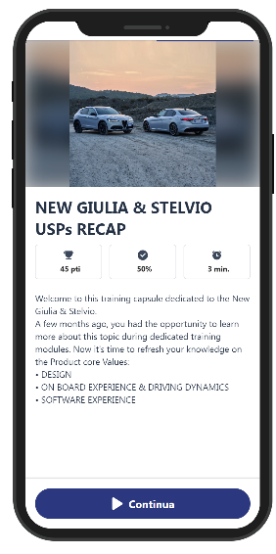
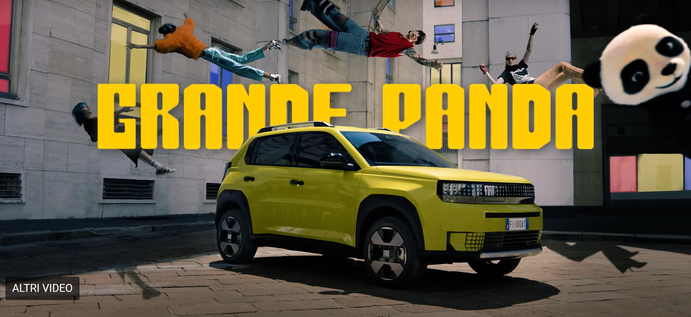



Card
INTRODUCTION
Welcome to this pill about Fiat Granda Panda product novelty.
Before moving on with news, let’s recap a bit why Fiat Grande Panda is PANDASTIC
We learned how Fiat Grande Panda world is based on the following 3 pillars
Image
Text1
Iconicity
Ingenuity
Text2
Inclusivity
Continue

Slide 7



Card
PANDA WORLD GOES PURE GASOLINE
POWERTRAIN
Image
Let’s get a closer look about what’s going on the successful Fiat Grande Panda world !
The current line-up based on
100% pure electric
Hybrid
it’s now getting bigger thanks to the new gasoline engine.
This is
Text1
Text2
NOTA DI LAVORO
Il badge della versione benzina non esiste.
Posteriormente la vettura non avrà né badge né sticker.
Ecco quindi che per indentificare il nuovo motore benzina, ho messo una generica scritta GASOLINE
Continue

Slide 8
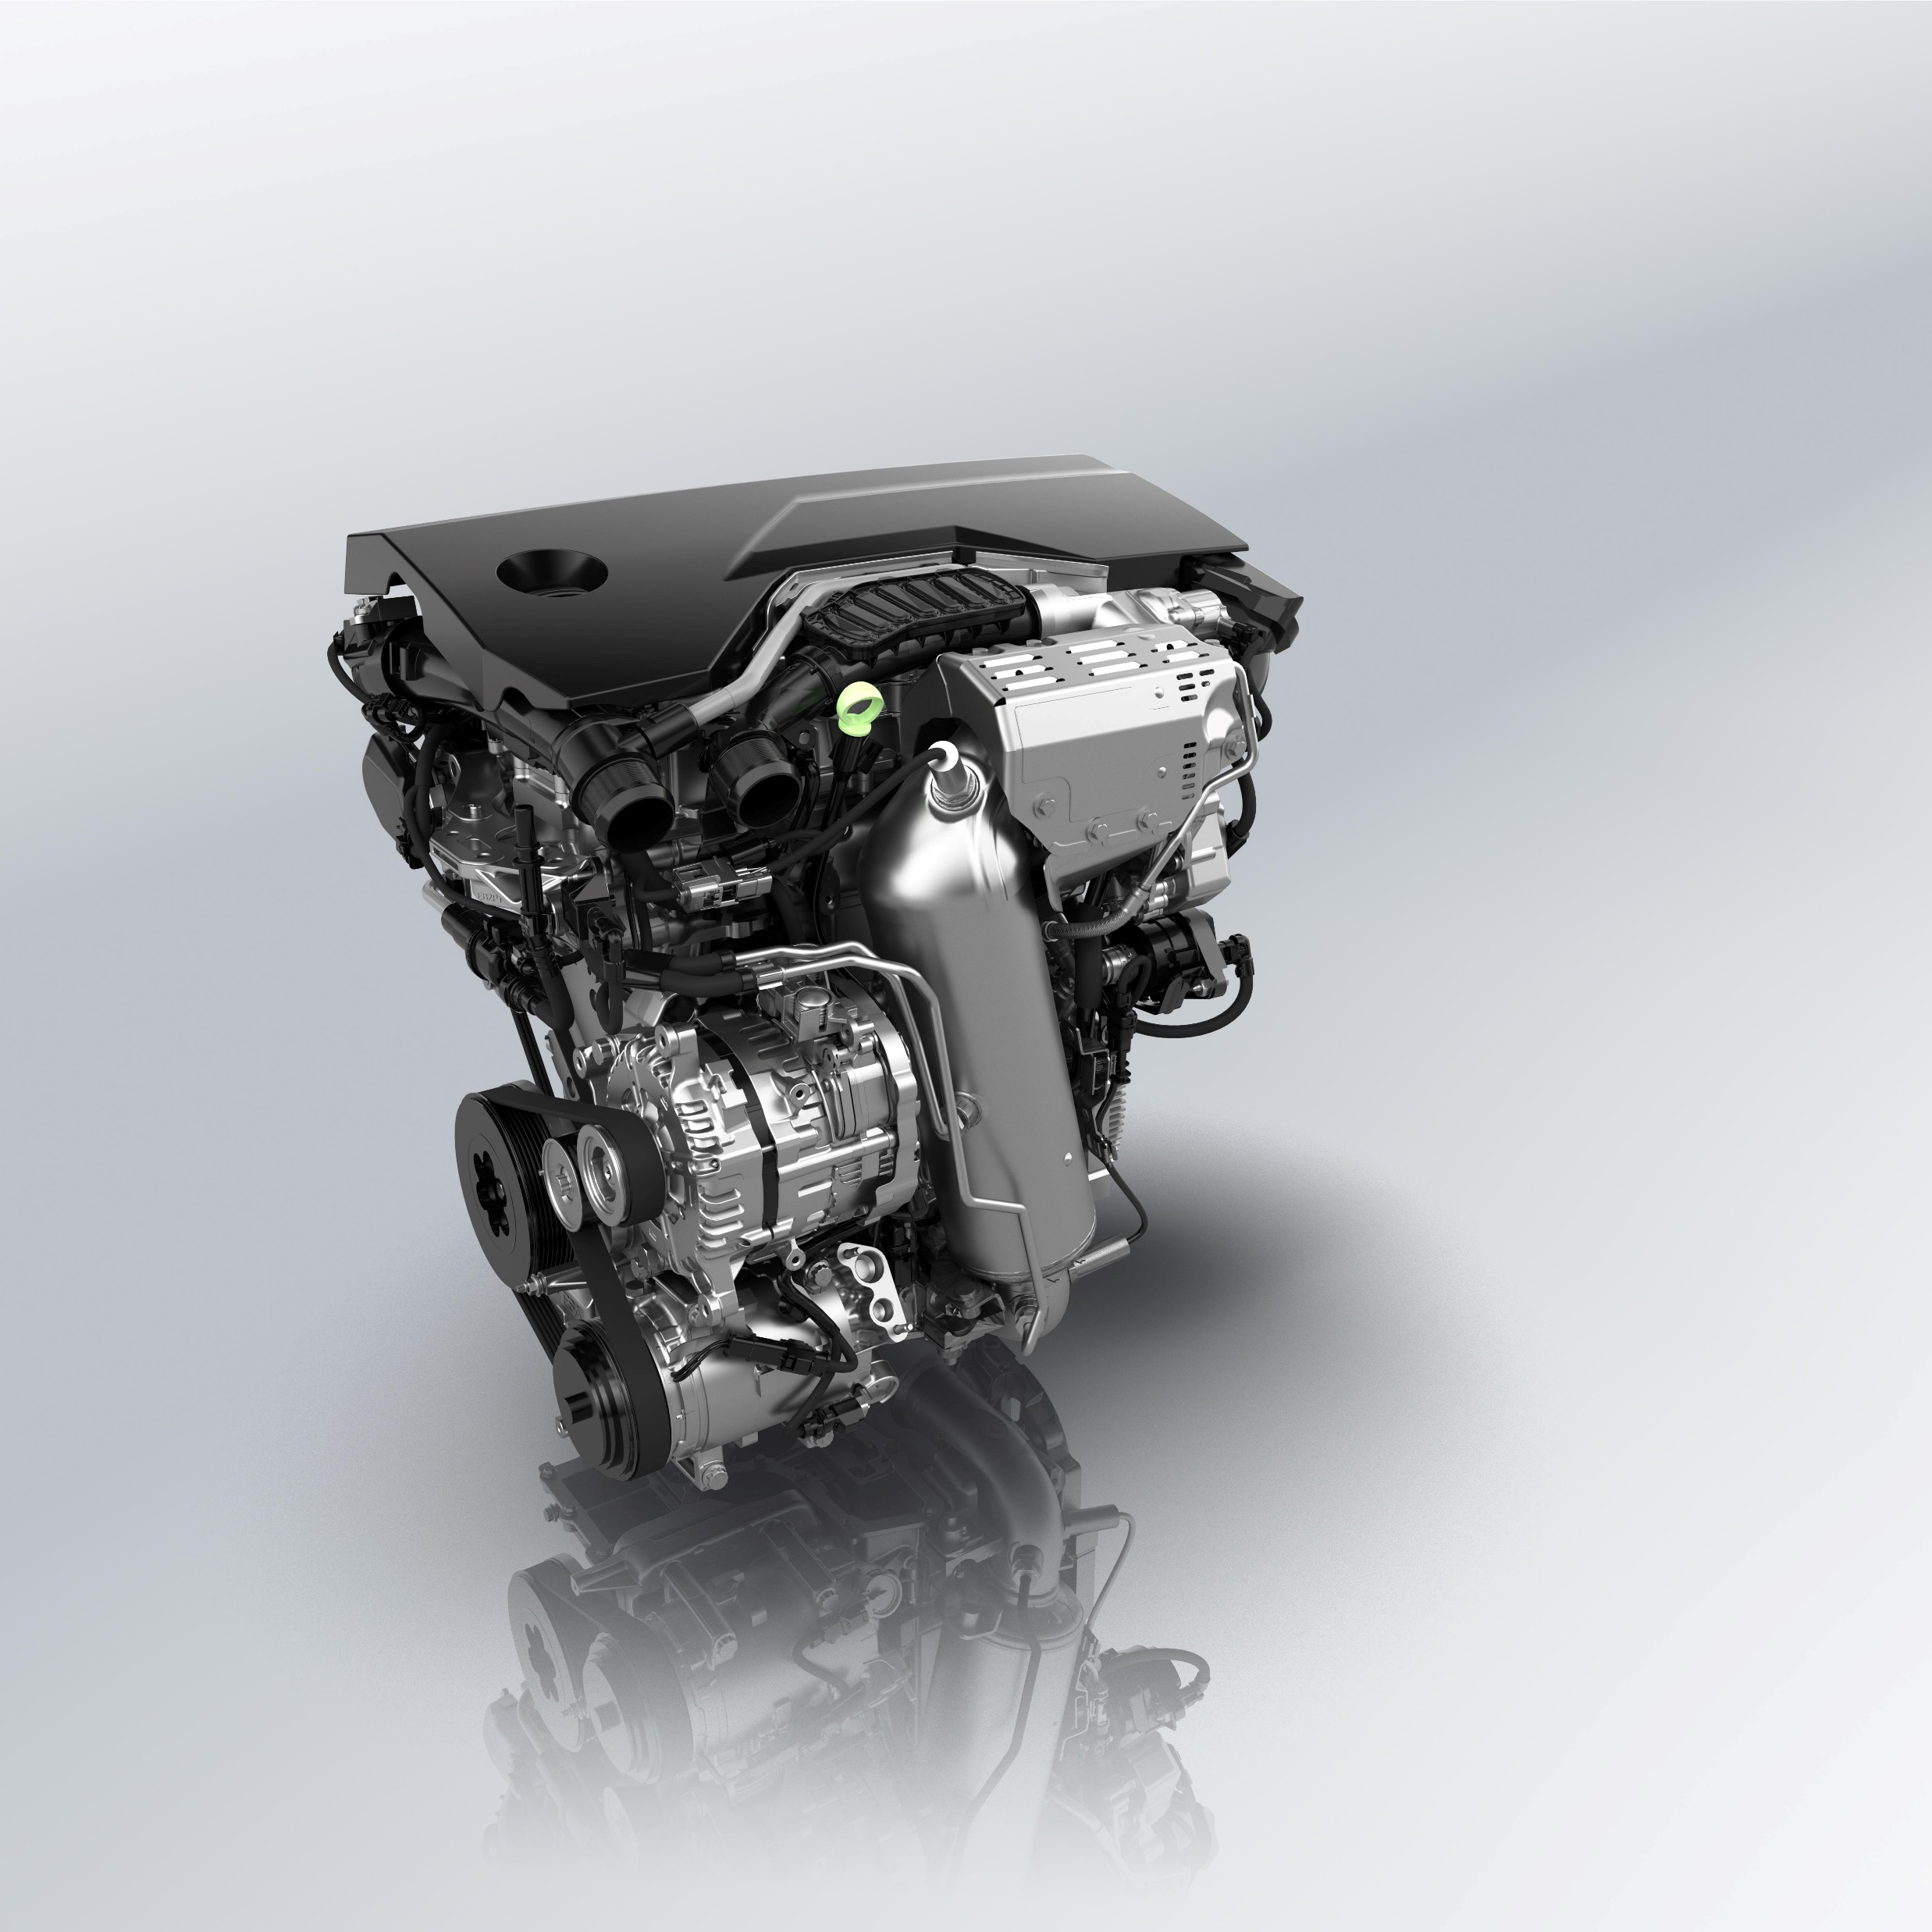
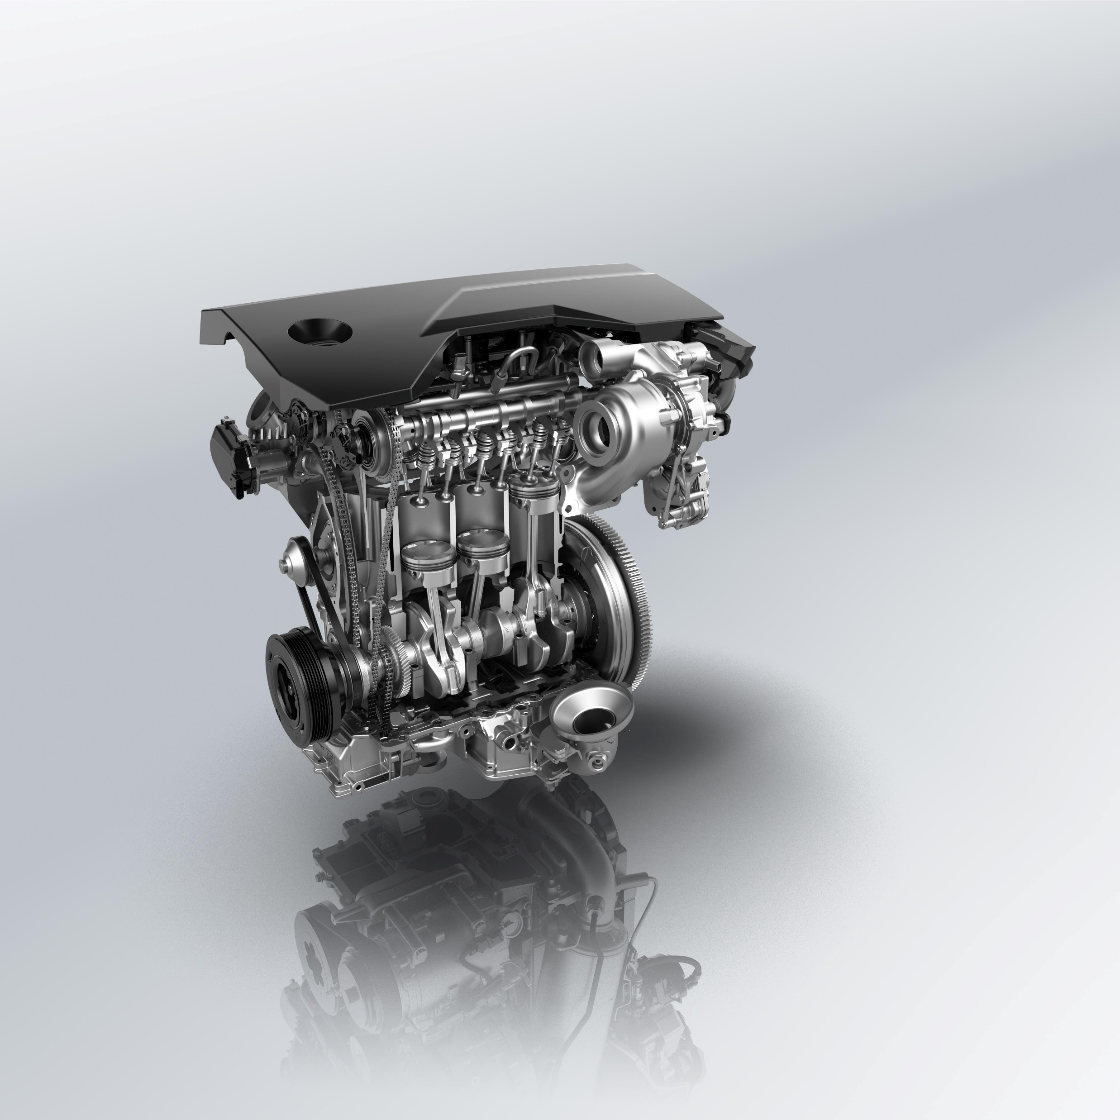
Card
PANDA WORLD GOES PURE GASOLINE
POWERTRAIN
Fiat Grande Panda is now available with the new engine
1.2 Pure Tech gasoline 100cv with 6-speed manual transmission.
This smooth-running 3-cylinder engine delivers both lively performance and driving experience.
Image
Text1
Text2
Continue
NOTA DI LAVORO: immagini ‘giganti’ disponibili più avanti nella presentazione

Slide 9

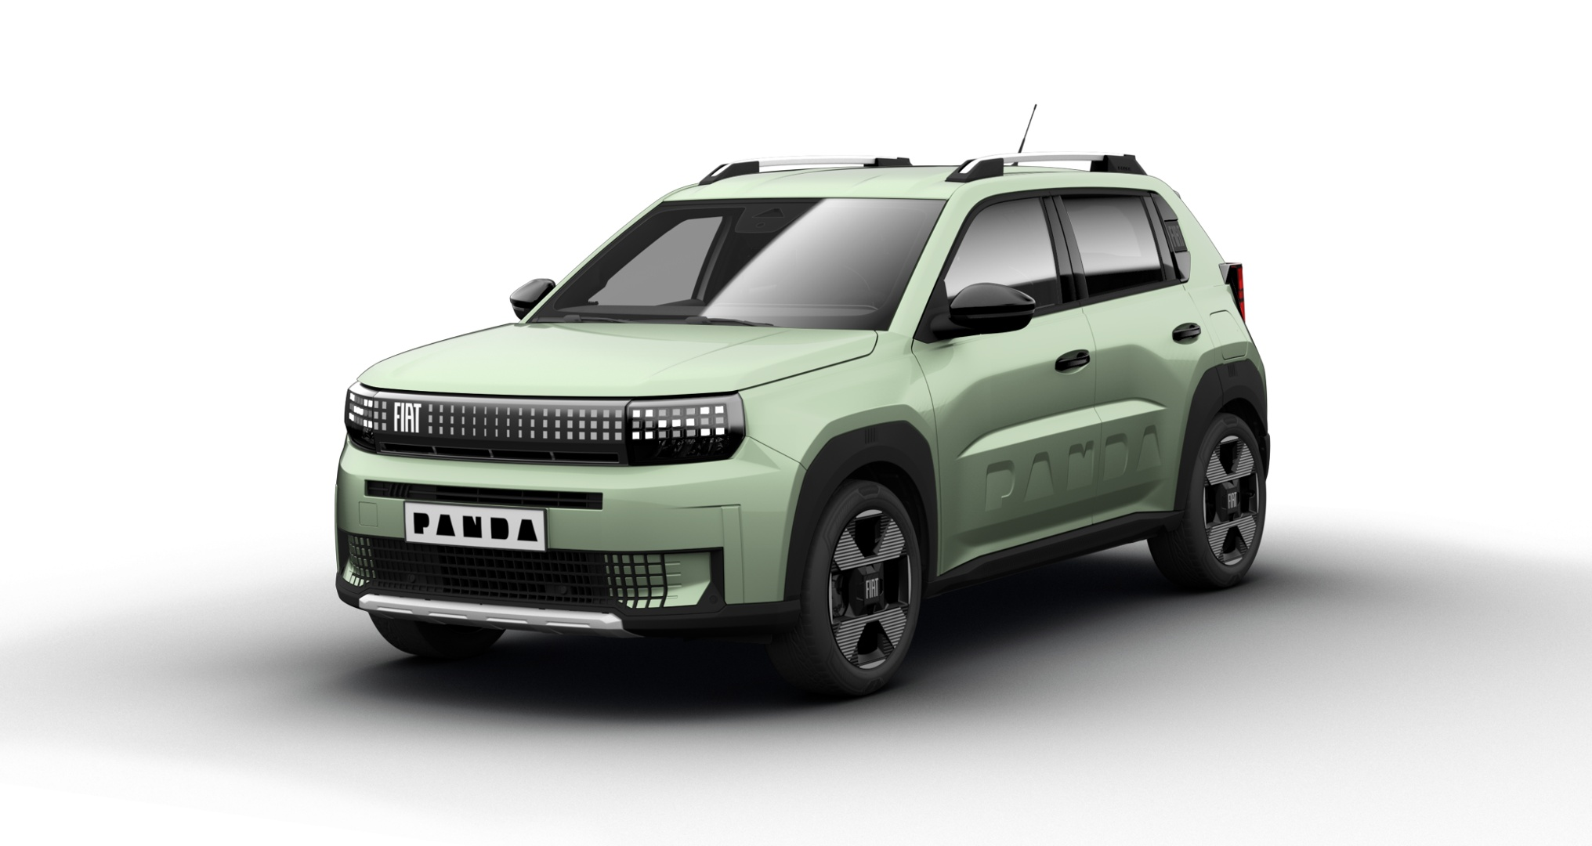


Card
DISCOVERING FIAT GRANDE PANDA GASOLINE
EXTERIOR
The easiest way to learn more about Fiat Grande Panda GASOLINE engine is having a comparison with the HYBRID engine
Image
Let’s start from the EXTERIOR
Text1
Some external color range (7 colors) of Hybrid
Text2
… but with some different features vs Hybrid…
FACCIAMO FLIP CARD
Continue

Slide 10
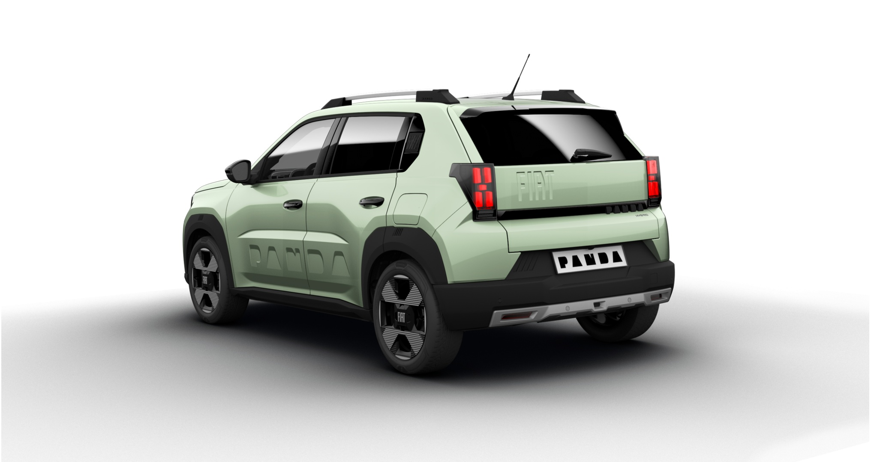
Card
DISCOVERING FIAT GRANDE PANDA GASOLINE
EXTERIOR
Image
Rear brakes: drum (*)
Text1
No sticker on the back
Text2
(*) Front brakes are always ‘disc’
Continue
NOTA DI LAVORO: immagini ‘giganti’ disponibili più avanti nella presentazione

Slide 11



Card
DISCOVERING FIAT GRANDE PANDA GASOLINE
INTERIOR
Let now let’s explore the INTERIOR
Image
Some commercial offer (3 trims) of Hybrid
Text1
Text2
… but with some different features vs Hybrid…
FACCIAMO FLIP CARD
Continue
NOTA DI LAVORO: immagini ‘giganti’ disponibili più avanti nella presentazione

Slide 12
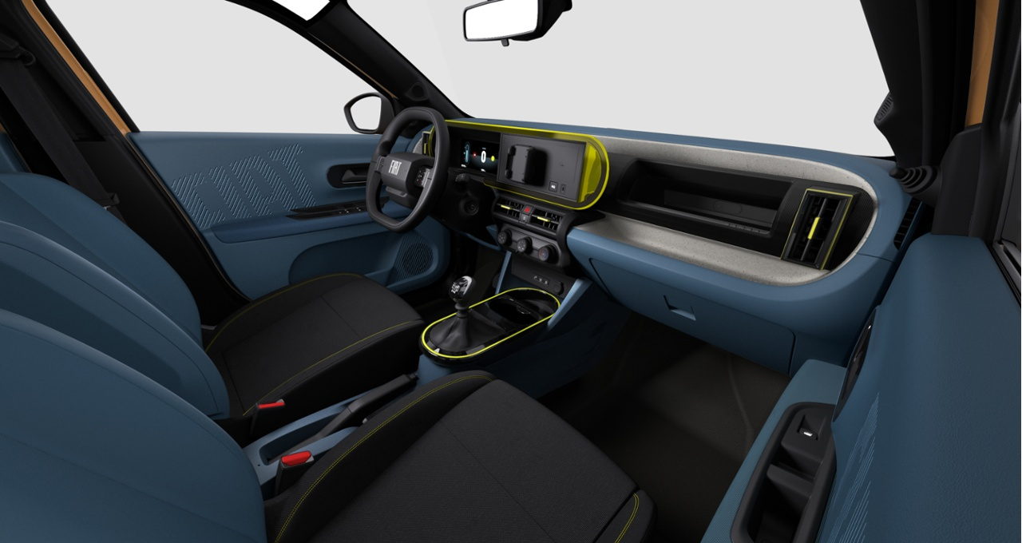
Card
DISCOVERING FIAT GRANDE PANDA GASOLINE
INTERIOR
It’s easy and simple to image where the main difference are.
It’s getting in the car where you can find such main different features:
parking brake lever (manual)
6 gears lever + reverse (manual)
Start&Stop with deactivation switch
1
Image
2
3
Text1
3
2
Text2
1
Due to this interior layout, central armrest and wireless charger are no longer available
Continue
NOTA DI LAVORO: immagini ‘giganti’ disponibili più avanti nella presentazione

Slide 13
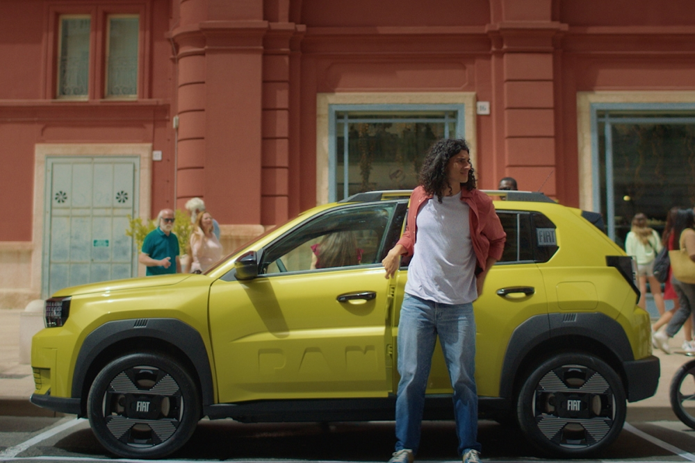
Card
CUSTOMER BENEFITS
NOTES
Introducing the 1.2 gasoline engine in Fiat Grande Panda line-up we are now available to enlarge and including a wider group of customers.
What the customer gets
affordable entry price
engaging driving with a 6-speed gearbox
easy handling, ideal for city driving
At the same time, we keep on going to offer:
good interior space in a compact footprint
stylish and urban SUV design
Fiat brand with rich legacy and practical DNA
Image
Text1
Text2
We are always
PANDASTIC
Continue
NOTA DI LAVORO: Pandastic da fare con la grafica di Pandastic

Slide 14
Card
CUSTOMER BENEFITS
OBJECTION HANDLING
Just to be confident how to manage potential customer doubts, let’s have a look how to handling customer objection
Q: Why no automatic gearbox?
A: For many customers, this engine is the base-point spot. It’s more affordable than automatic and never the less, 6-speed manual keeps things fun and frugal.
Q: Isn’t it underpowered?
A: For its size and weight, it’s perfectly matched. Ideal for city and mixed driving. The engine and gearbox are tuned for responsiveness where it matters most – low to mid-range torque.
Q: Is this an easy-going technology solution?
A: Not every customer wants complexity. This is a simple, efficient choice for short trips and low-cost ownership.
Q: Am I going to be satisfied with these engine performances?
A: This solution is ideal for city driving, with peppy response and optimized gearing for daily use.
Image
Text1
Text2
Continue

Slide 15
Card
CUSTOMER BENEFITS
NOTES
⚖️ Module 3: Potential Weaknesses & How to Address Them
Weakness | Reframe / Sales Strategy
Not turbocharged | "Prioritizes simplicity, reliability, and low cost over unnecessary complexity."
Manual gearbox only | "Perfect for drivers who love control and engagement. Plus, it helps lower the price and running costs."
No hybrid assistance | "Not every customer wants complexity. This is a simple, efficient choice for short trips and low-cost ownership."
Modest performance | "Ideal for city driving, with peppy response and optimized gearing for daily use."
Image
Text1
Text2
Continue

Slide 16
Card
KEY POINT TO REMEMBER
Image
TBD
Text1
Text2
Continue

Slide 17
Card
TEST OUT
Image
TBD
Text1
Text2
Continue

Slide 18
IMAGES BACKUP

Slide 19
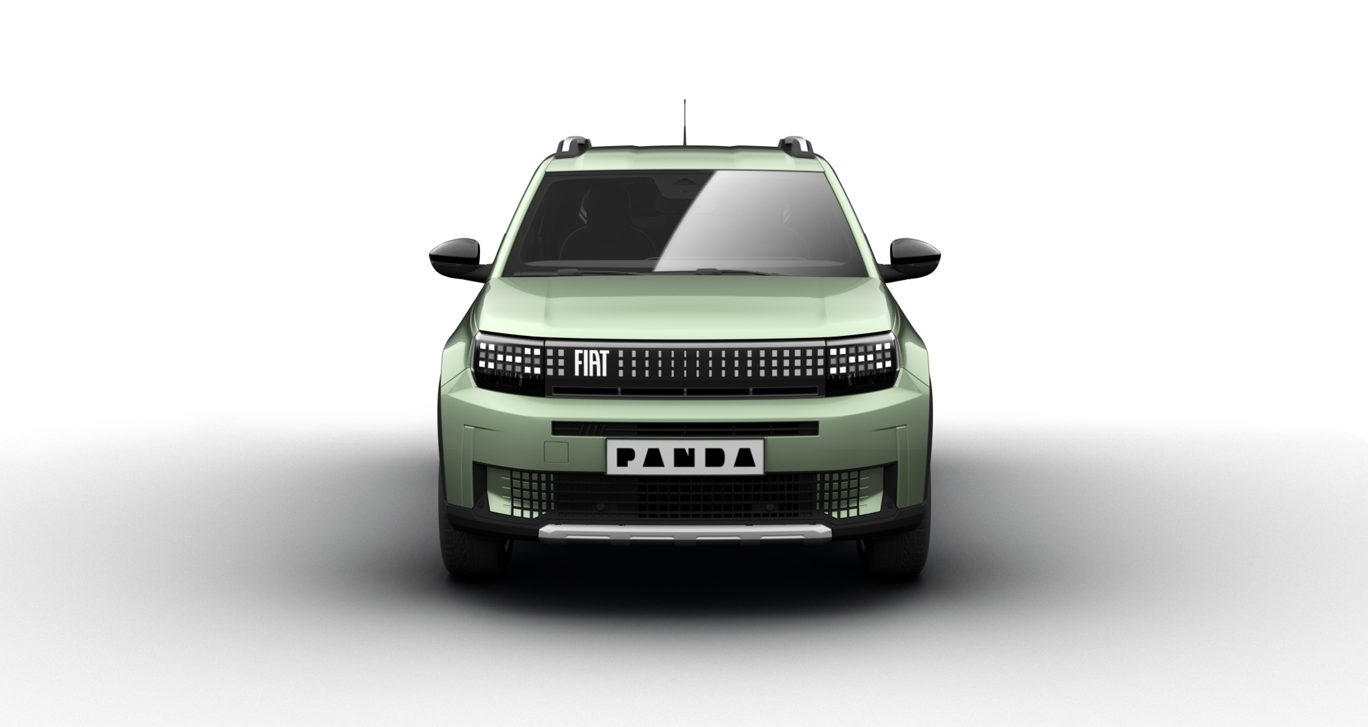
Colore esterno Azzurro Acqua (metallizzato)
Origine Fiat Grande Panda Hybrid (cmq disponibile su tutti i trim)
E’ il colore di Comunicazione scelto per la Fiat Grande Panda ICE (qui in allestimento LA PRIMA)

Slide 20
Colore esterno Azzurro Acqua (metallizzato)
Origine Fiat Grande Panda Hybrid (cmq disponibile su tutti i trim)
E’ il colore di Comunicazione scelto per la Fiat Grande Panda ICE (qui in allestimento LA PRIMA)

Slide 21
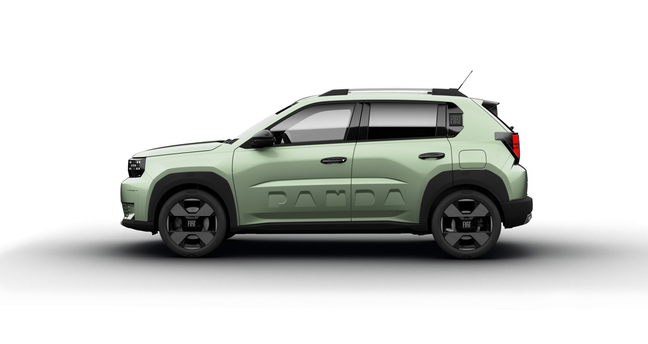
Colore esterno Azzurro Acqua (metallizzato)
Origine Fiat Grande Panda Hybrid (cmq disponibile su tutti i trim)
E’ il colore di Comunicazione scelto per la Fiat Grande Panda ICE (qui in allestimento LA PRIMA)

Slide 22
Colore esterno Azzurro Acqua (metallizzato)
Origine Fiat Grande Panda Hybrid (cmq disponibile su tutti i trim)
E’ il colore di Comunicazione scelto per la Fiat Grande Panda ICE (qui in allestimento LA PRIMA)
ATTENZIONE:
Cancellare badge Hybrid
Non altro badge da inserire

Slide 23

Motore 1.2 PureTech turbo benzina da 100 CV
Vista frontale

Slide 24

Motore 1.2 PureTech turbo benzina da 100 CV
Vista frontale sezionata

Slide 25
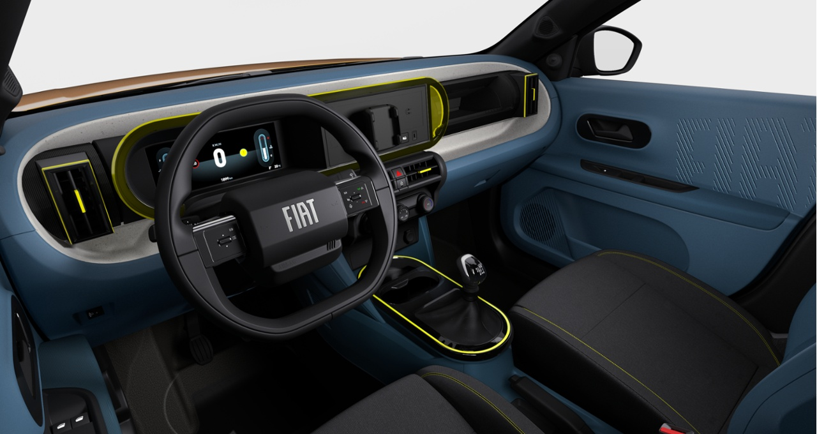
Interno tessuto «Blu Signature»
Origine Fiat Grande Panda Hybrid (trim LA PRIMA)
23/07/25: preview by Lorenzo D’Arpa tramite Teams
Rimango in attesa della immagine in alta risoluzione

Slide 26
Interno tessuto «Blu Signature»
Origine Fiat Grande Panda Hybrid (trim LA PRIMA)
23/07/25: preview by Lorenzo D’Arpa tramite Teams
Rimango in attesa della immagine in alta risoluzione

Slide 27
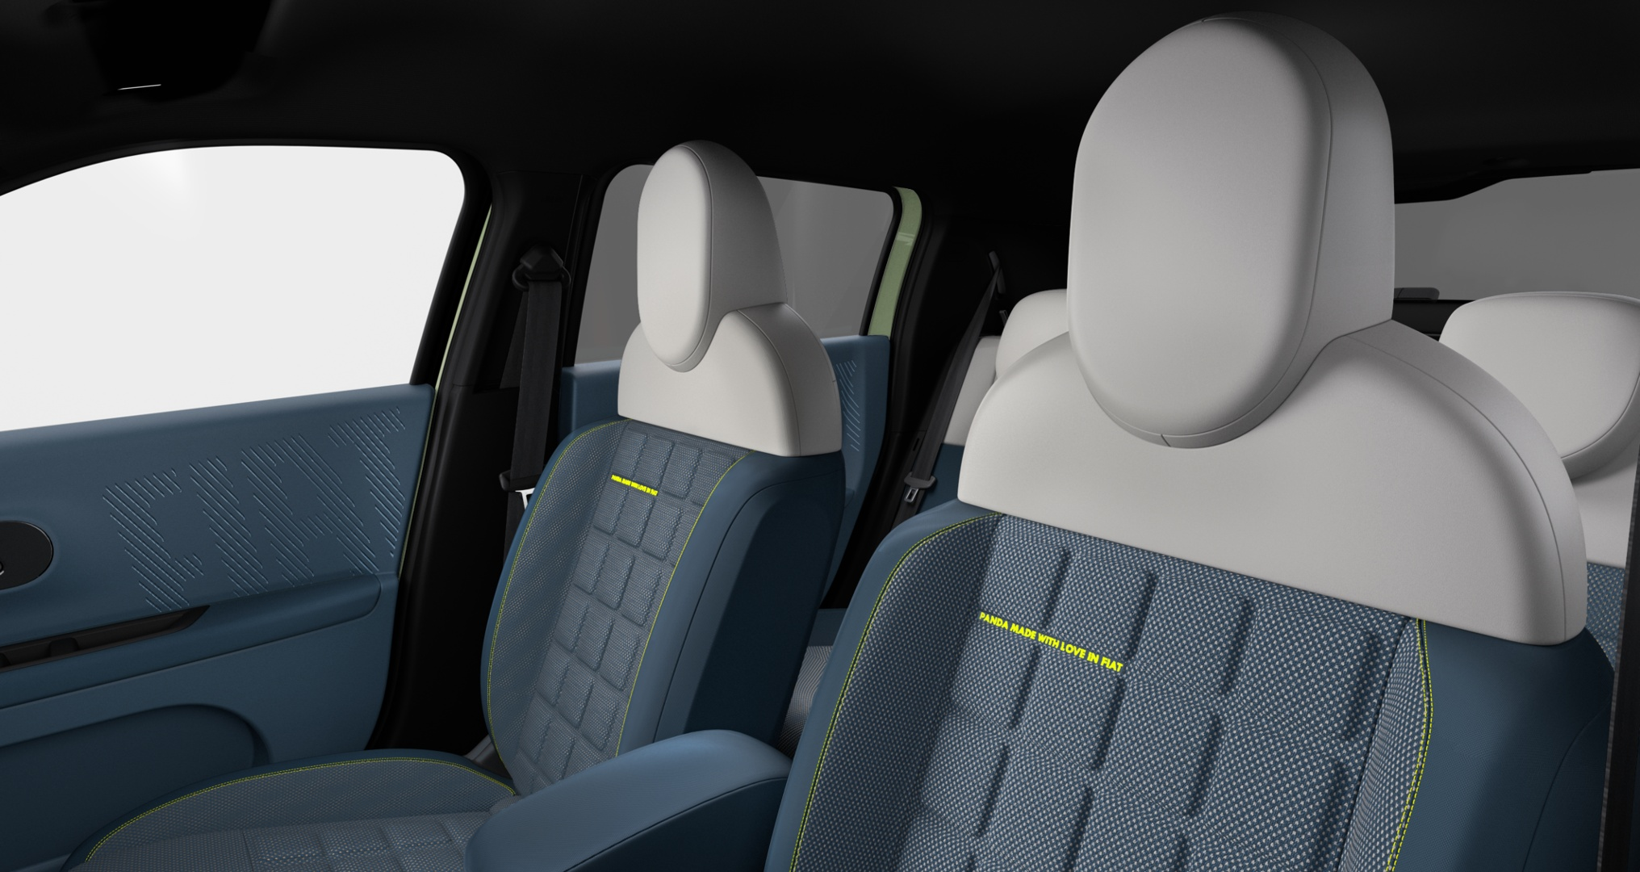
Interno tessuto «Blu Signature»
Origine Fiat Grande Panda Hybrid (trim LA PRIMA)

