Slide 1
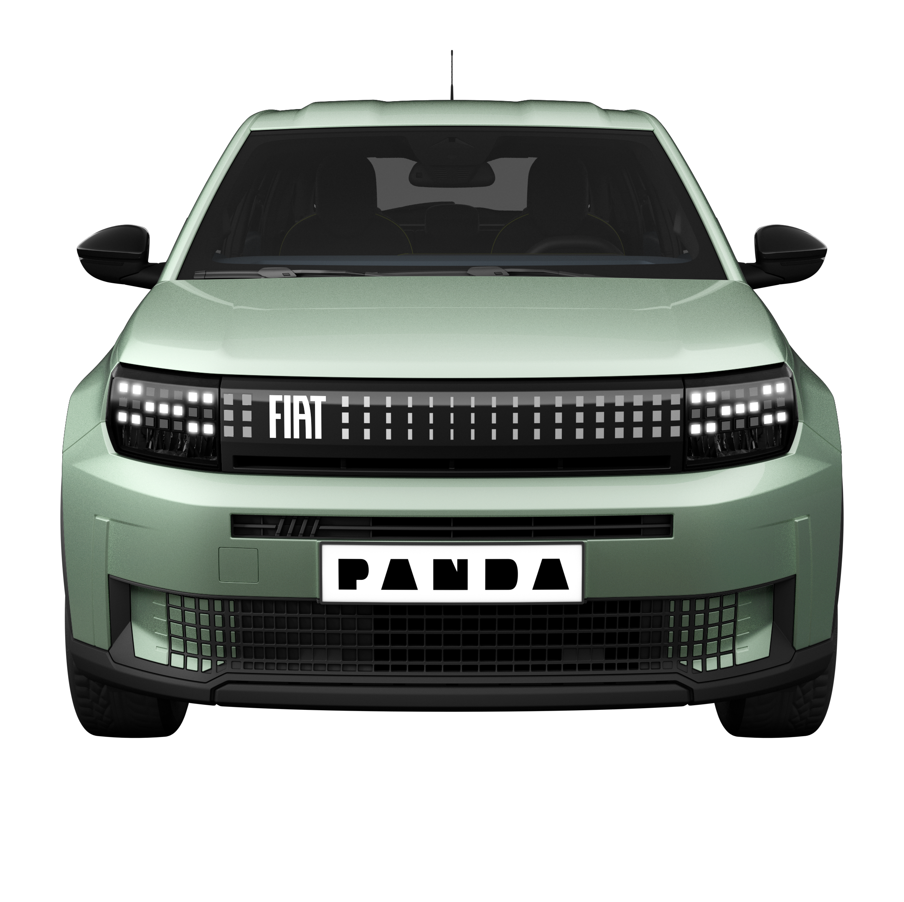
HEADER / ID OF THE CAPSULES
Fiat Grande Panda 1.2 gasoline 100 HP
WWCPFI505697B09EN
Fiat Grande Panda is now available powered with the 1.2 gasoline engine 100 HP
MANDATORY

Slide 2
HEADER / ID OF THE CAPSULES
FIAT
PRODUCT: SAL1 + SAL2 + SAL3 + SAL4 + SAL5
ENG
/ subtrack
Fiat / Grande Panda

Slide 3

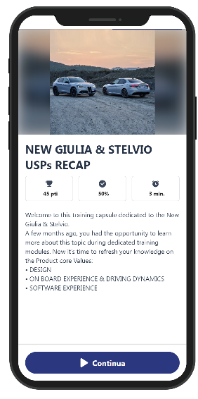
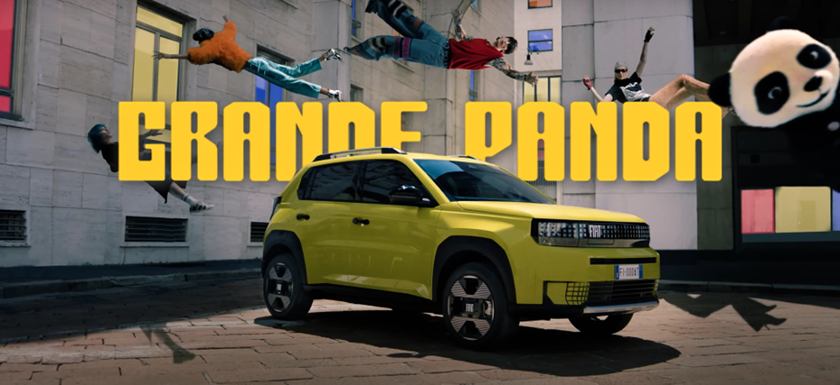

COVER Card
Index
GRANDE PANDA ICE
WELCOME Card
Panda world goes pure gasoline (1/2)
Panda world goes pure gasoline (2/2)
Quiz before topic
Notion cover
GRANDE PANDA ICE: Exterior overview (1/2)
GRANDE PANDA ICE: Exterior overview (2/2)
Quiz before topic
Notion cover
GRANDE PANDA ICE: Interior overview (1/2)
GRANDE PANDA ICE: Interior overview (2/2)
Quiz before topic
Notion cover
Customer Benefit
Objection handling (1/2)
Objection handling (2/2)
Key concepts to remember
GRANDE PANDA ICE
With the New Grande Panda ICE, Fiat updates its city car icon.
Let’s go and discover all its features.
Image
Text1
Text2
Continue

Slide 4


WELCOME Card
Index
GRANDE PANDA ICE
WELCOME Card
Panda world goes pure gasoline (1/2)
Panda world goes pure gasoline (2/2)
Quiz before topic
Notion cover
GRANDE PANDA ICE: Exterior overview (1/2)
GRANDE PANDA ICE: Exterior overview (2/2)
Quiz before topic
Notion cover
GRANDE PANDA ICE: Interior overview (1/2)
GRANDE PANDA ICE: Interior overview (2/2)
Quiz before topic
Notion cover
Customer Benefit
Objection handling (1/2)
Objection handling (2/2)
Key concepts to remember
GRANDE PANDA ICE
Welcome to this pill about Fiat Granda Panda product novelty.
Before moving on with news, let’s recap a bit why Fiat Grande Panda is PANDASTIC
We learned how Fiat Grande Panda world is based on the following 3 pillars:
Iconicity
Ingenuity
Inclusivity
Image
Text1
Text2
Continue

Slide 5
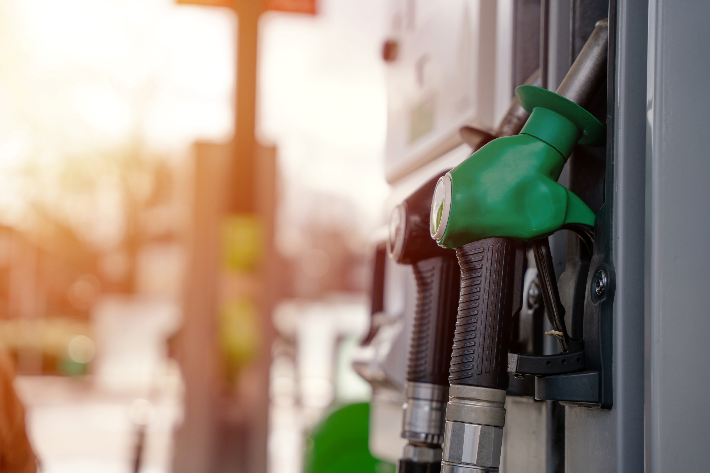
Card
Index
GRANDE PANDA ICE
WELCOME Card
Panda world goes pure gasoline (1/2)
Panda world goes pure gasoline (2/2)
Quiz before topic
Notion cover
GRANDE PANDA ICE: Exterior overview (1/2)
GRANDE PANDA ICE: Exterior overview (2/2)
Quiz before topic
Notion cover
GRANDE PANDA ICE: Interior overview (1/2)
GRANDE PANDA ICE: Interior overview (2/2)
Quiz before topic
Notion cover
Customer Benefit
Objection handling (1/2)
Objection handling (2/2)
Key concepts to remember
Panda world goes pure gasoline (1/2)
Let’s get a closer look about what’s going on the successful Fiat Grande Panda world!
The current line-up based on:
100% pure electric
Hybrid
It’s now getting bigger thanks to the new gasoline engine.
Image
Text1
Text2
Continue

Slide 6
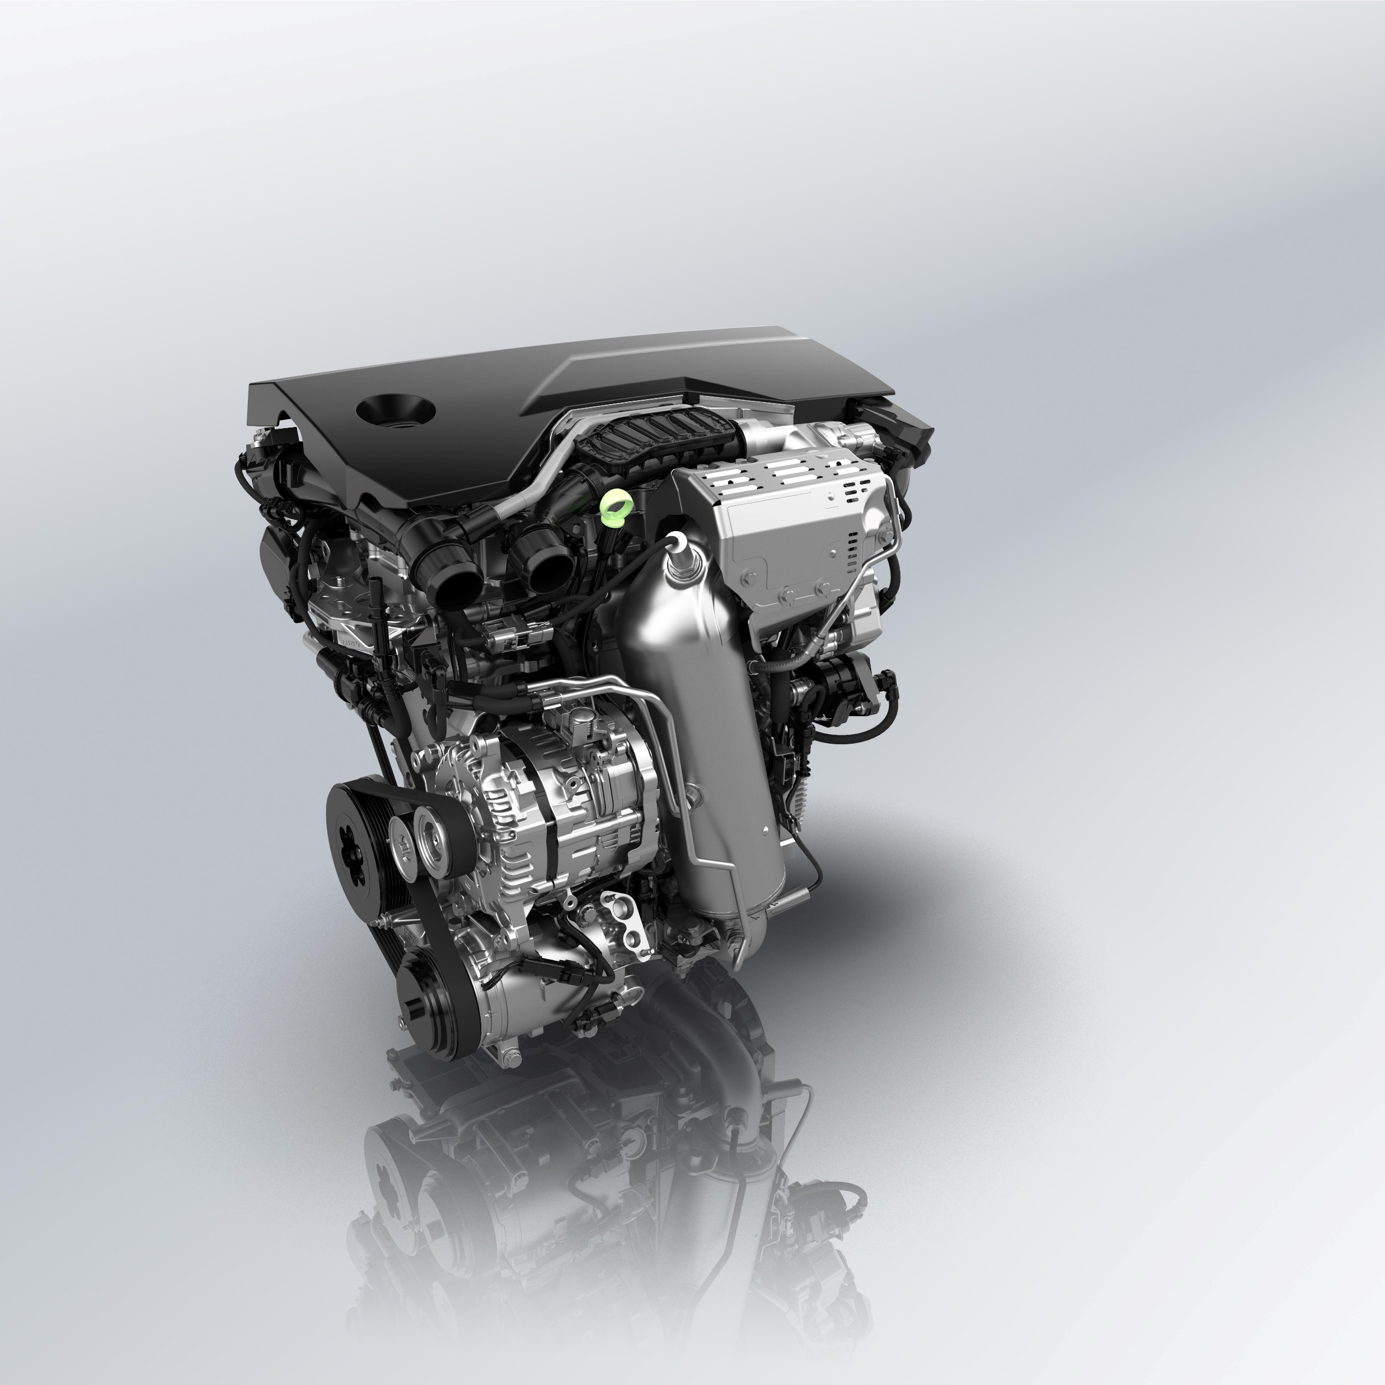
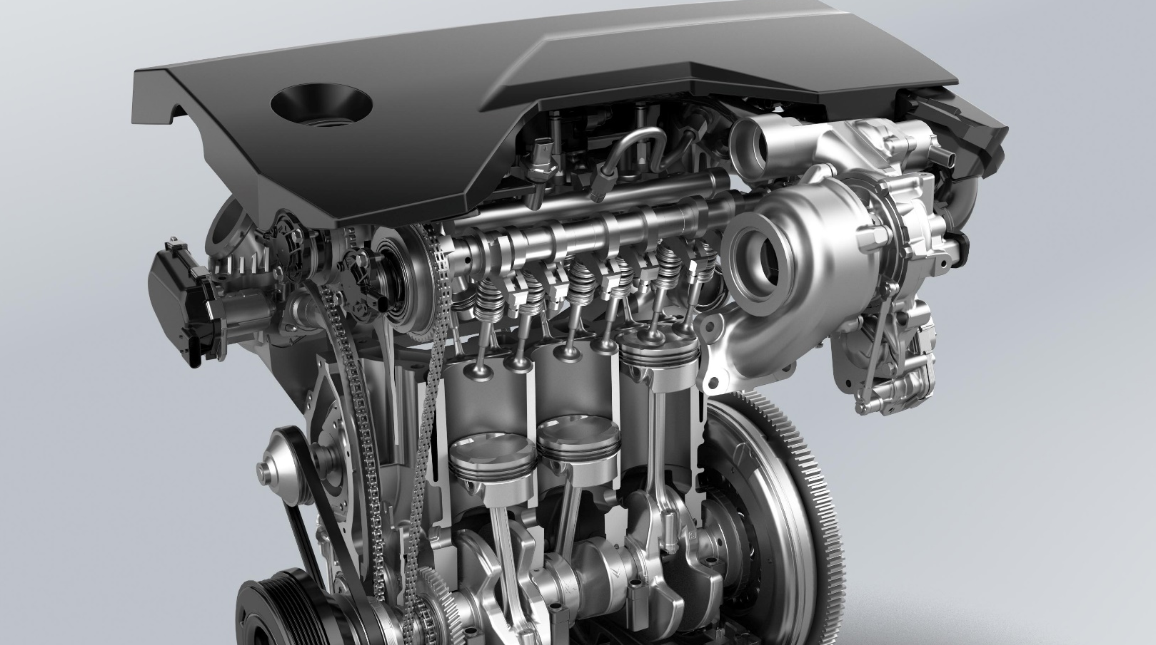
Card
Index
GRANDE PANDA ICE
WELCOME Card
Panda world goes pure gasoline (1/2)
Panda world goes pure gasoline (2/2)
Quiz before topic
Notion cover
GRANDE PANDA ICE: Exterior overview (1/2)
GRANDE PANDA ICE: Exterior overview (2/2)
Quiz before topic
Notion cover
GRANDE PANDA ICE: Interior overview (1/2)
GRANDE PANDA ICE: Interior overview (2/2)
Quiz before topic
Notion cover
Customer Benefit
Objection handling (1/2)
Objection handling (2/2)
Key concepts to remember
Panda world goes pure gasoline (2/2)
Fiat Grande Panda is now available with the new engine
1.2 gasoline 100HP with 6-speed manual transmission.
This smooth-running 3-cylinder engine delivers both lively performance and driving experience.
Image
Text1
Text2
Detail on the 3 cylinders
This is the 1.2 engine
Continue

Slide 7
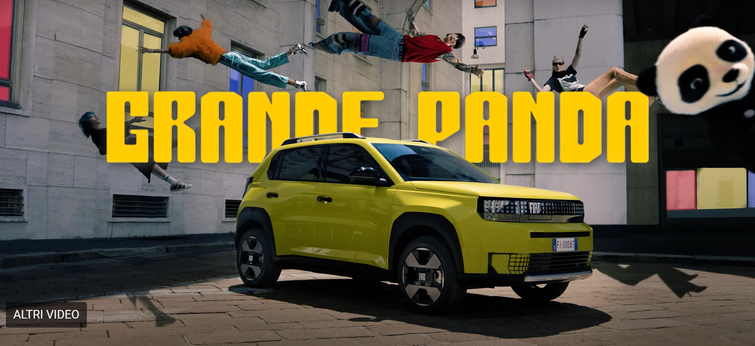
Quiz BEFORE topic
Index
GRANDE PANDA ICE
WELCOME Card
Panda world goes pure gasoline (1/2)
Panda world goes pure gasoline (2/2)
Quiz before topic
Notion cover
GRANDE PANDA ICE: Exterior overview (1/2)
GRANDE PANDA ICE: Exterior overview (2/2)
Quiz before topic
Notion cover
GRANDE PANDA ICE: Interior overview (1/2)
GRANDE PANDA ICE: Interior overview (2/2)
Quiz before topic
Notion cover
Customer Benefit
Objection handling (1/2)
Objection handling (2/2)
Key concepts to remember
Fiat Grande Panda is now available with a new powertrain
Image
1.4 Pure Tech gasoline 100HP with 8-speed automatic transmission
1.2 Pure Tech gasoline 100HP with 6-automatic transmission
1.2 gasoline 100HP with 6-speed manual transmission
Text1
Text2
Continue

Slide 8
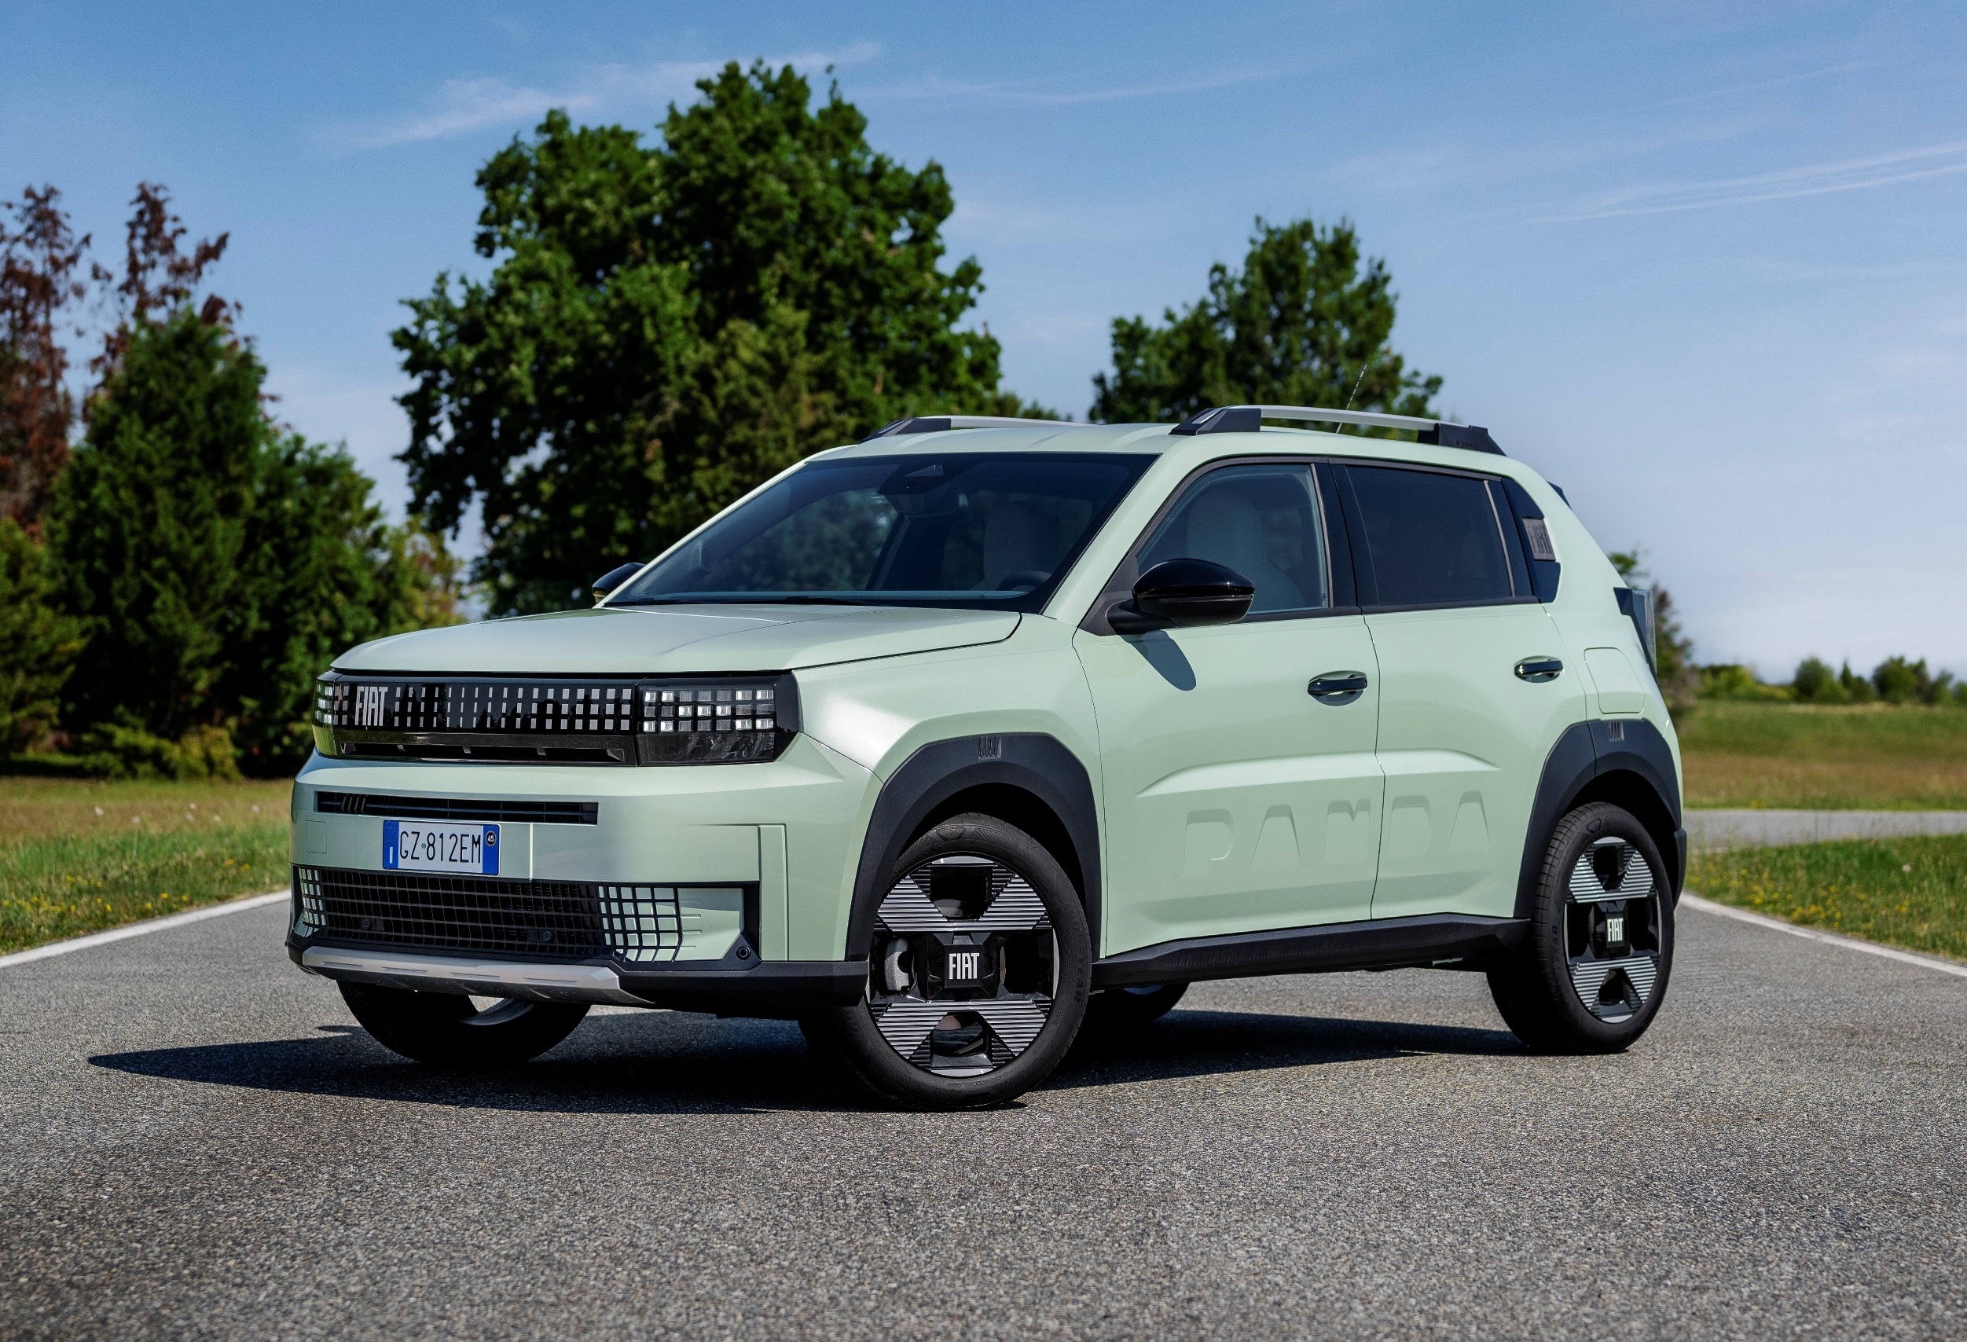
COVER Card
Index
GRANDE PANDA ICE
WELCOME Card
Panda world goes pure gasoline (1/2)
Panda world goes pure gasoline (2/2)
Quiz before topic
Notion cover
GRANDE PANDA ICE: Exterior overview (1/2)
GRANDE PANDA ICE: Exterior overview (2/2)
Quiz before topic
Notion cover
GRANDE PANDA ICE: Interior overview (1/2)
GRANDE PANDA ICE: Interior overview (2/2)
Quiz before topic
Notion cover
Customer Benefit
Objection handling (1/2)
Objection handling (2/2)
Key concepts to remember
GRANDE PANDA ICE:
Exterior overview
Image
Let’s now discover the exterior of the new Grande Panda ICE.
Text1
Text2
Continue

Slide 9
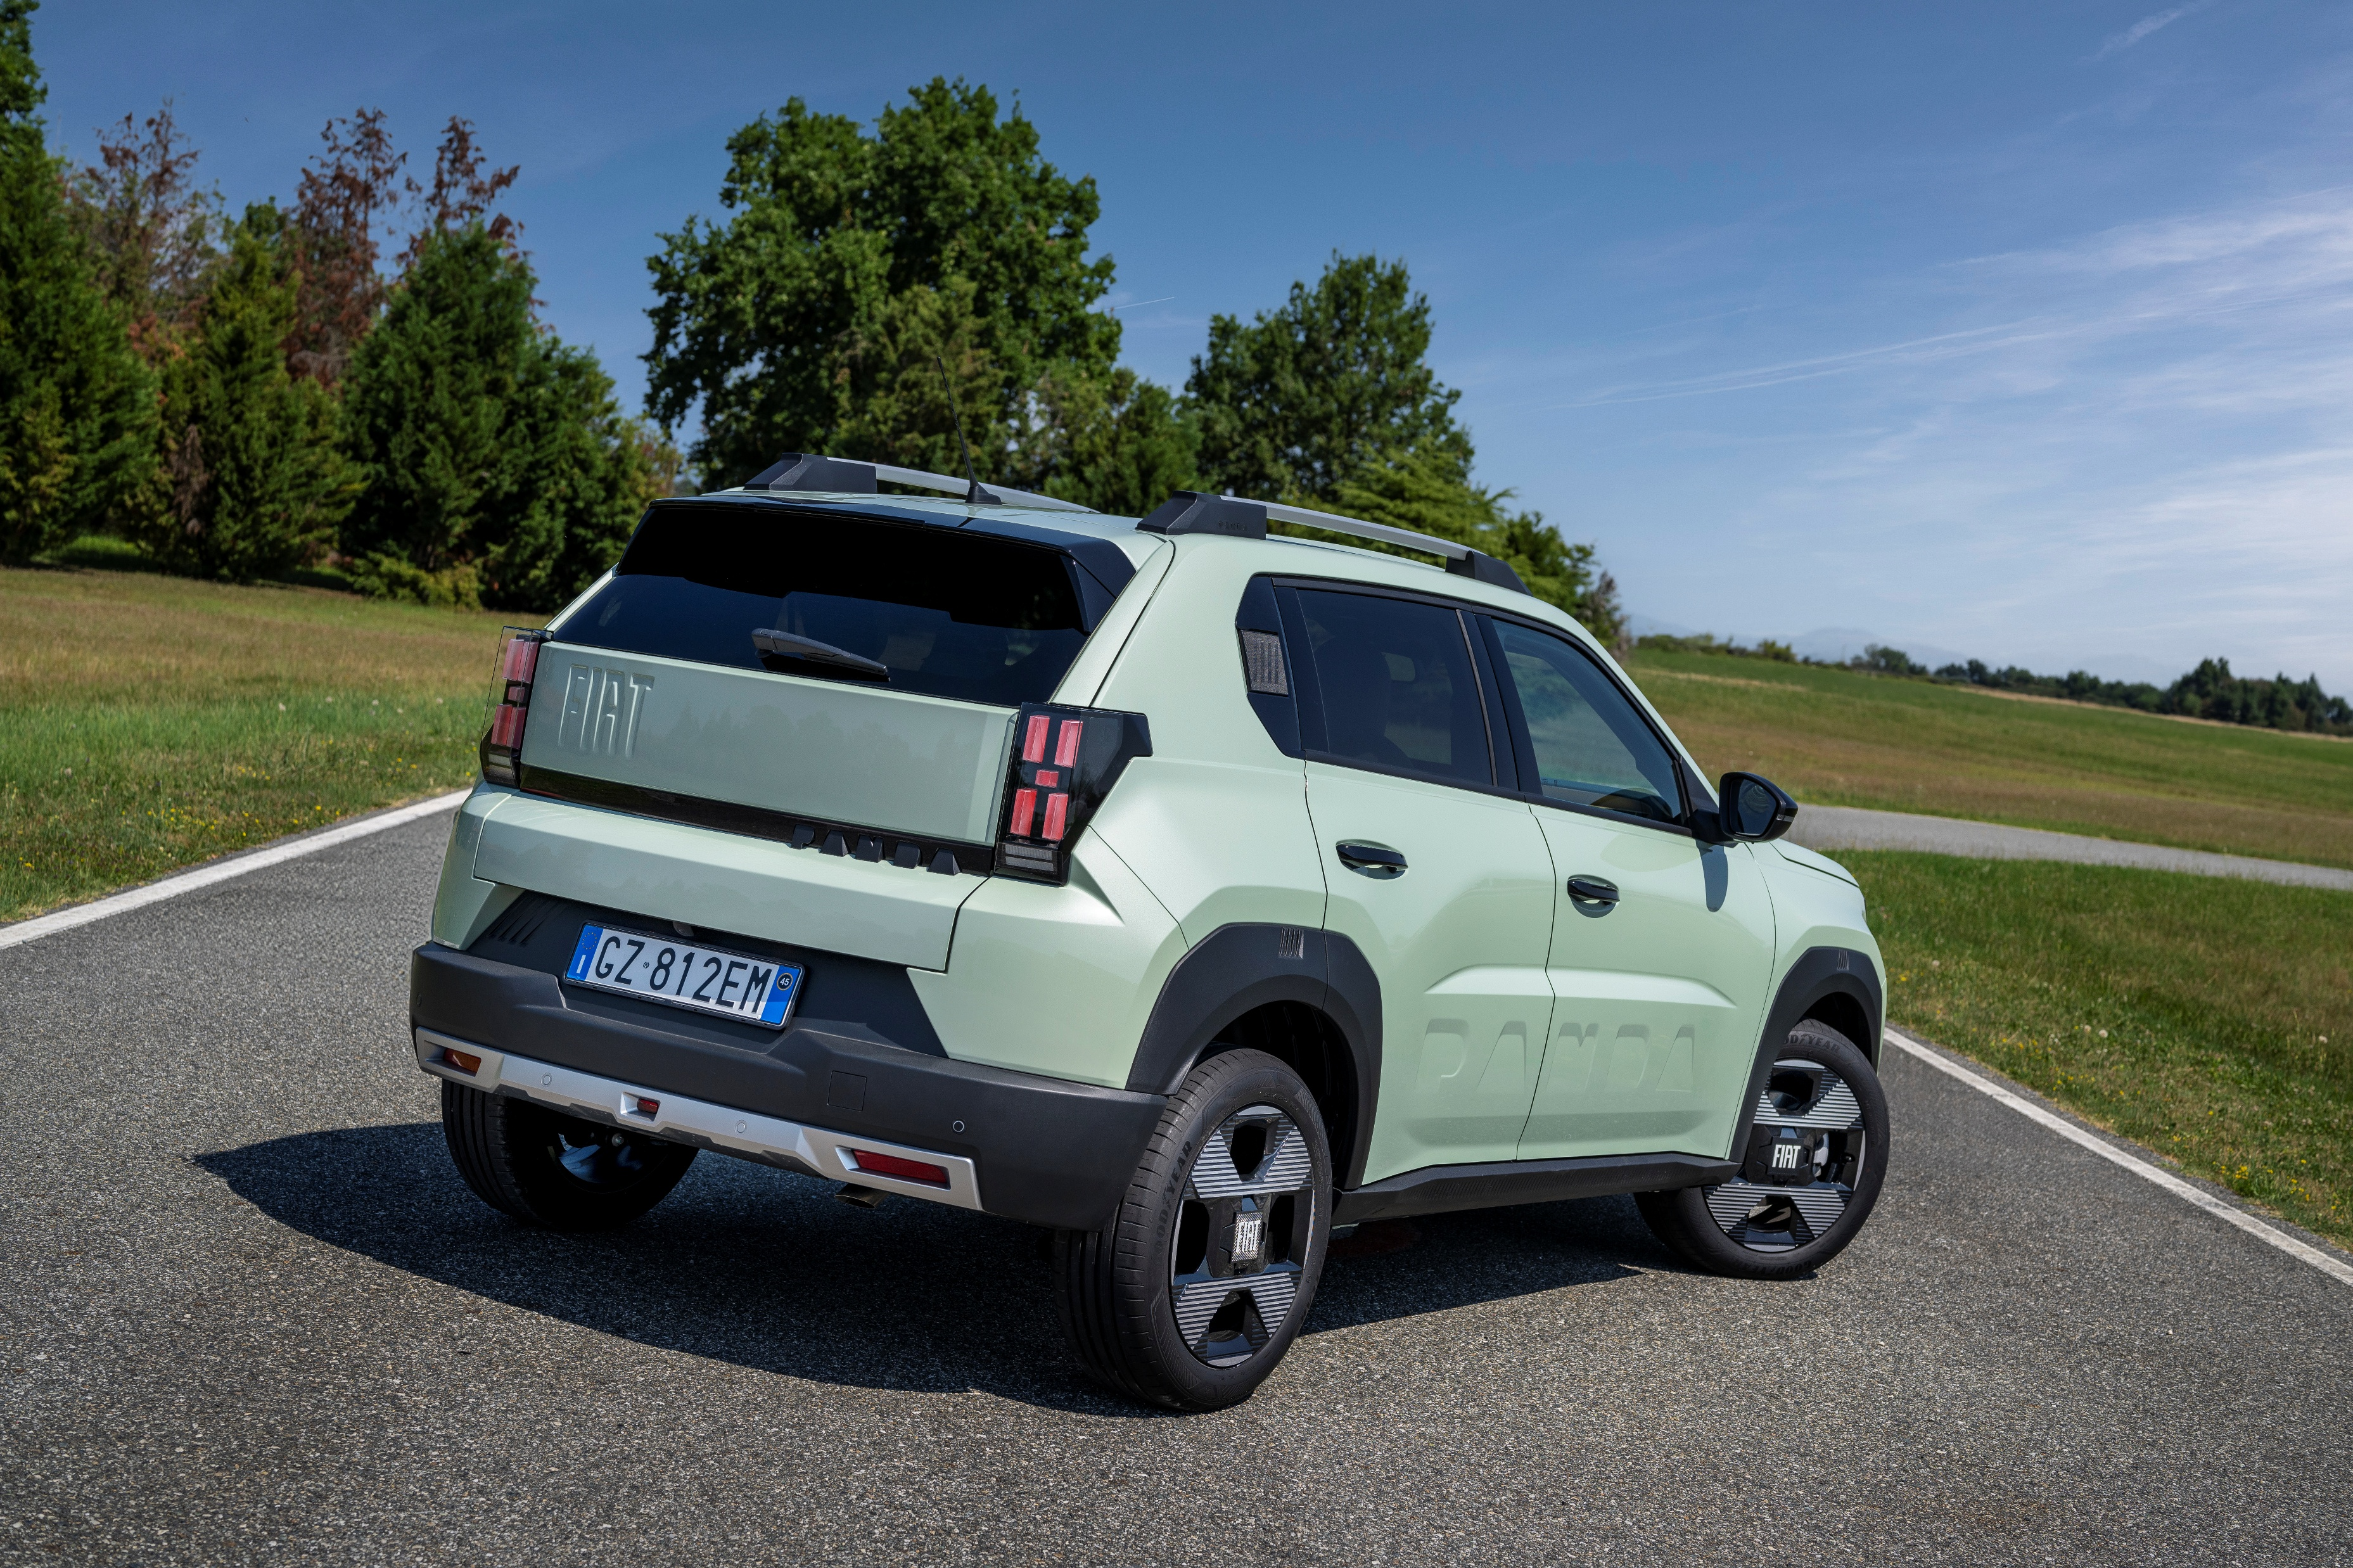


Card
Index
GRANDE PANDA ICE
WELCOME Card
Panda world goes pure gasoline (1/2)
Panda world goes pure gasoline (2/2)
Quiz before topic
Notion cover
GRANDE PANDA ICE: Exterior overview (1/2)
GRANDE PANDA ICE: Exterior overview (2/2)
Quiz before topic
Notion cover
GRANDE PANDA ICE: Interior overview (1/2)
GRANDE PANDA ICE: Interior overview (2/2)
Quiz before topic
Notion cover
Customer Benefit
Objection handling (1/2)
Objection handling (2/2)
Key concepts to remember
GRANDE PANDA ICE:
Exterior overview (1/2)
The easiest way to learn more about Fiat Grande Panda GASOLINE engine is having a comparison with the HYBRID engine, highlighting differences.
Let’s start from the EXTERIOR
Same External color palette (7 colors) of Hybrid
but with a different feature.
The (RED) badge is applied on the B-pillars when you choose the red paint.
Image
Text1
Text2
Continue

Slide 10
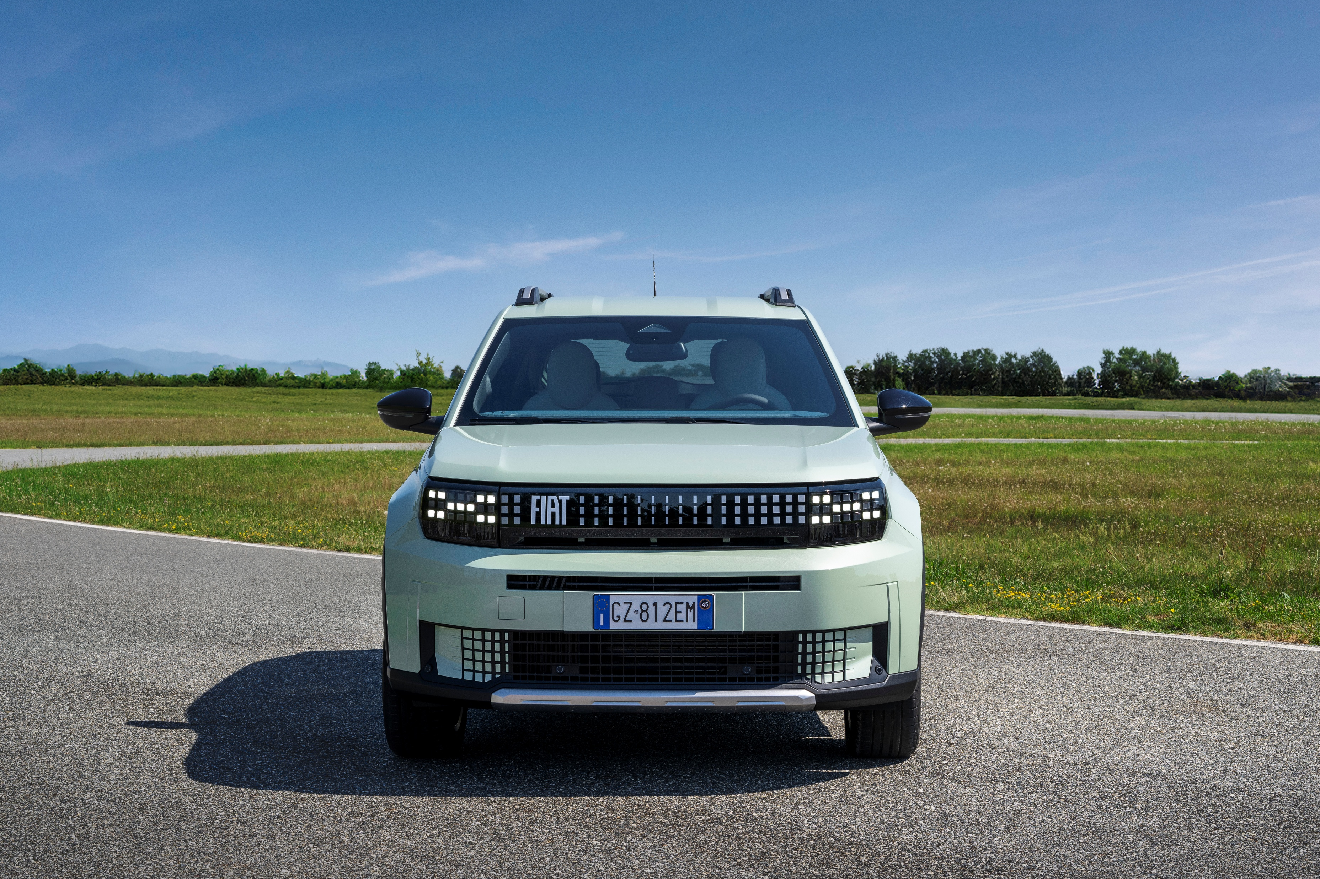

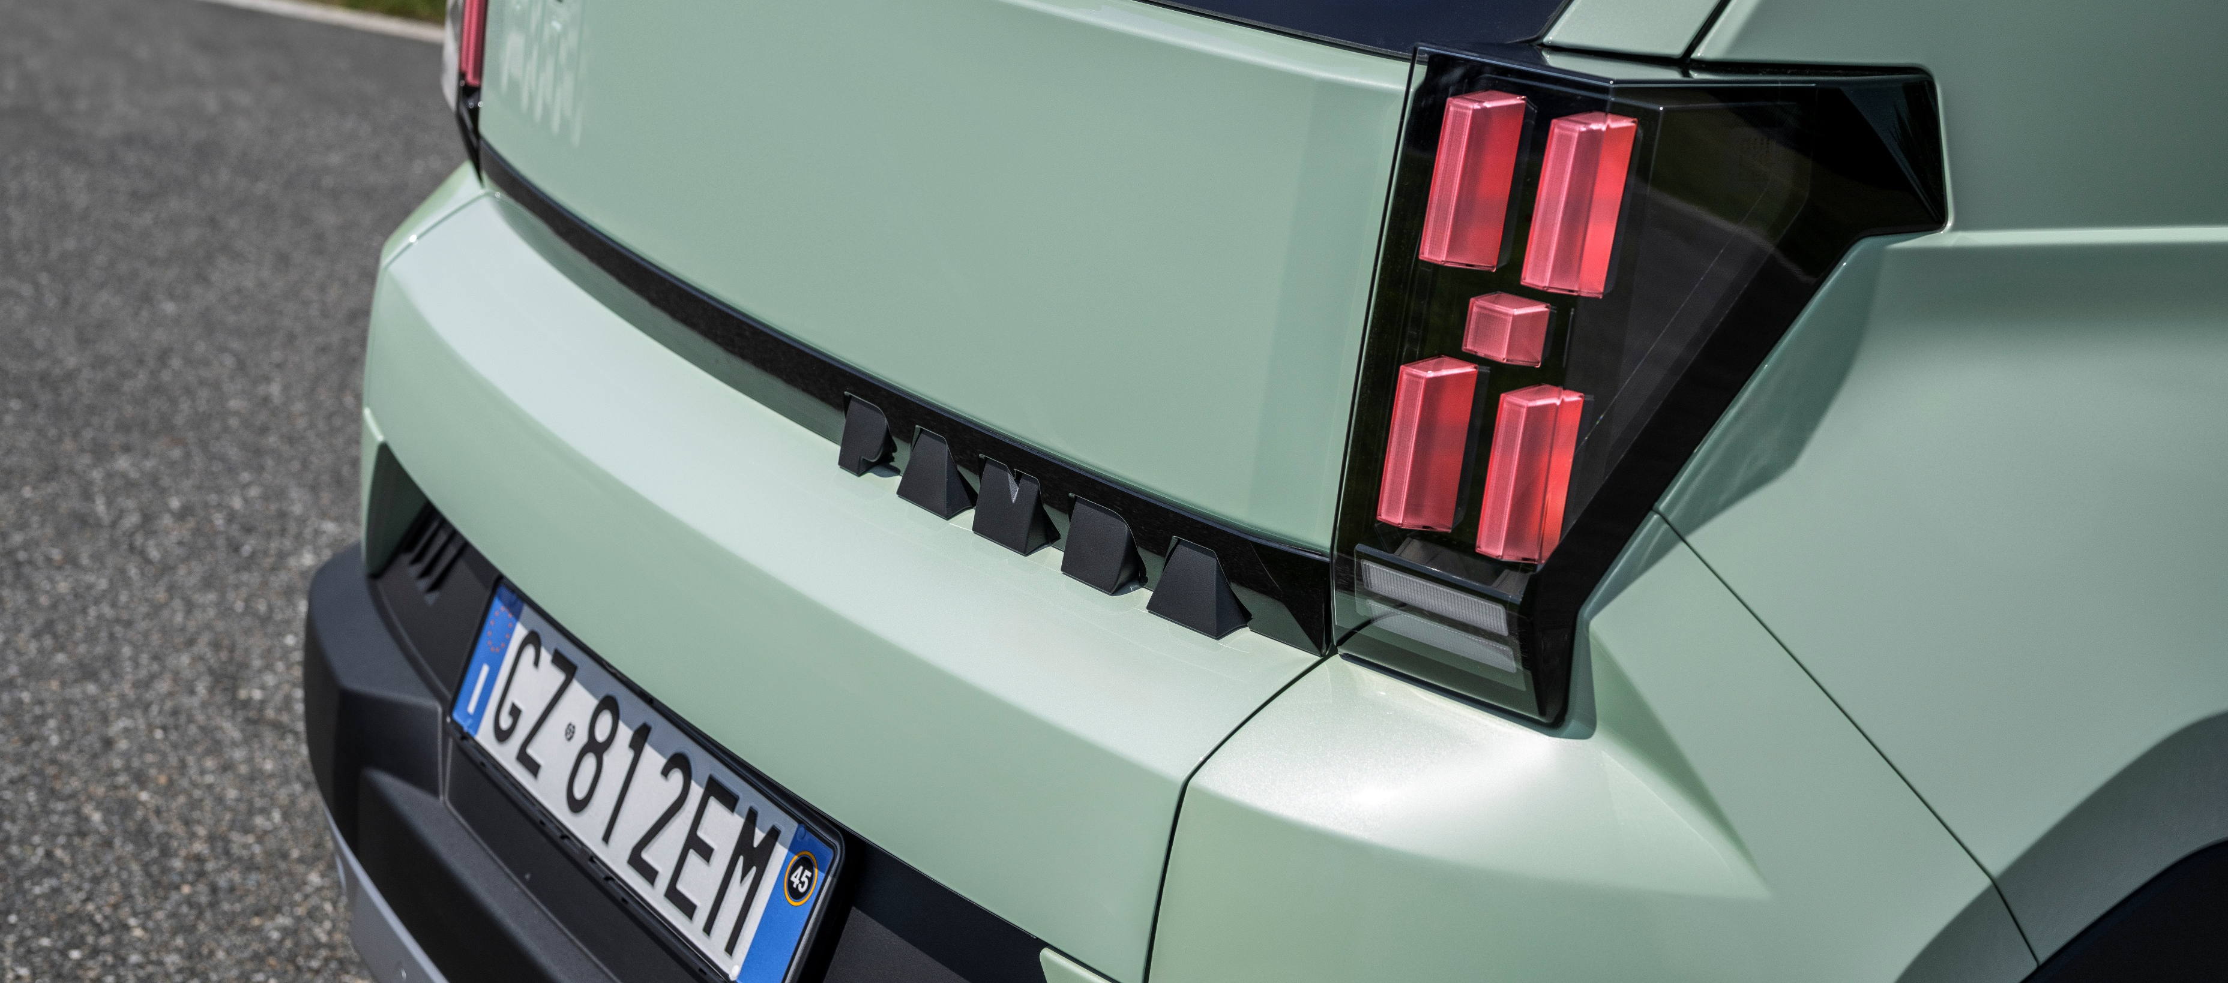
Card
Index
GRANDE PANDA ICE:
Exterior overview (2/2)
GRANDE PANDA ICE
WELCOME Card
Panda world goes pure gasoline (1/2)
Panda world goes pure gasoline (2/2)
Quiz before topic
Notion cover
GRANDE PANDA ICE: Exterior overview (1/2)
GRANDE PANDA ICE: Exterior overview (2/2)
Quiz before topic
Notion cover
GRANDE PANDA ICE: Interior overview (1/2)
GRANDE PANDA ICE: Interior overview (2/2)
Quiz before topic
Notion cover
Customer Benefit
Objection handling (1/2)
Objection handling (2/2)
Key concepts to remember
Let's discover the exterior differences compared to
the Hybrid version.
Rear brakes: drum (*)
Image
Text1
No sticker on the back
Text2
(*) Front brakes are always ‘disc’
Continue

Slide 11
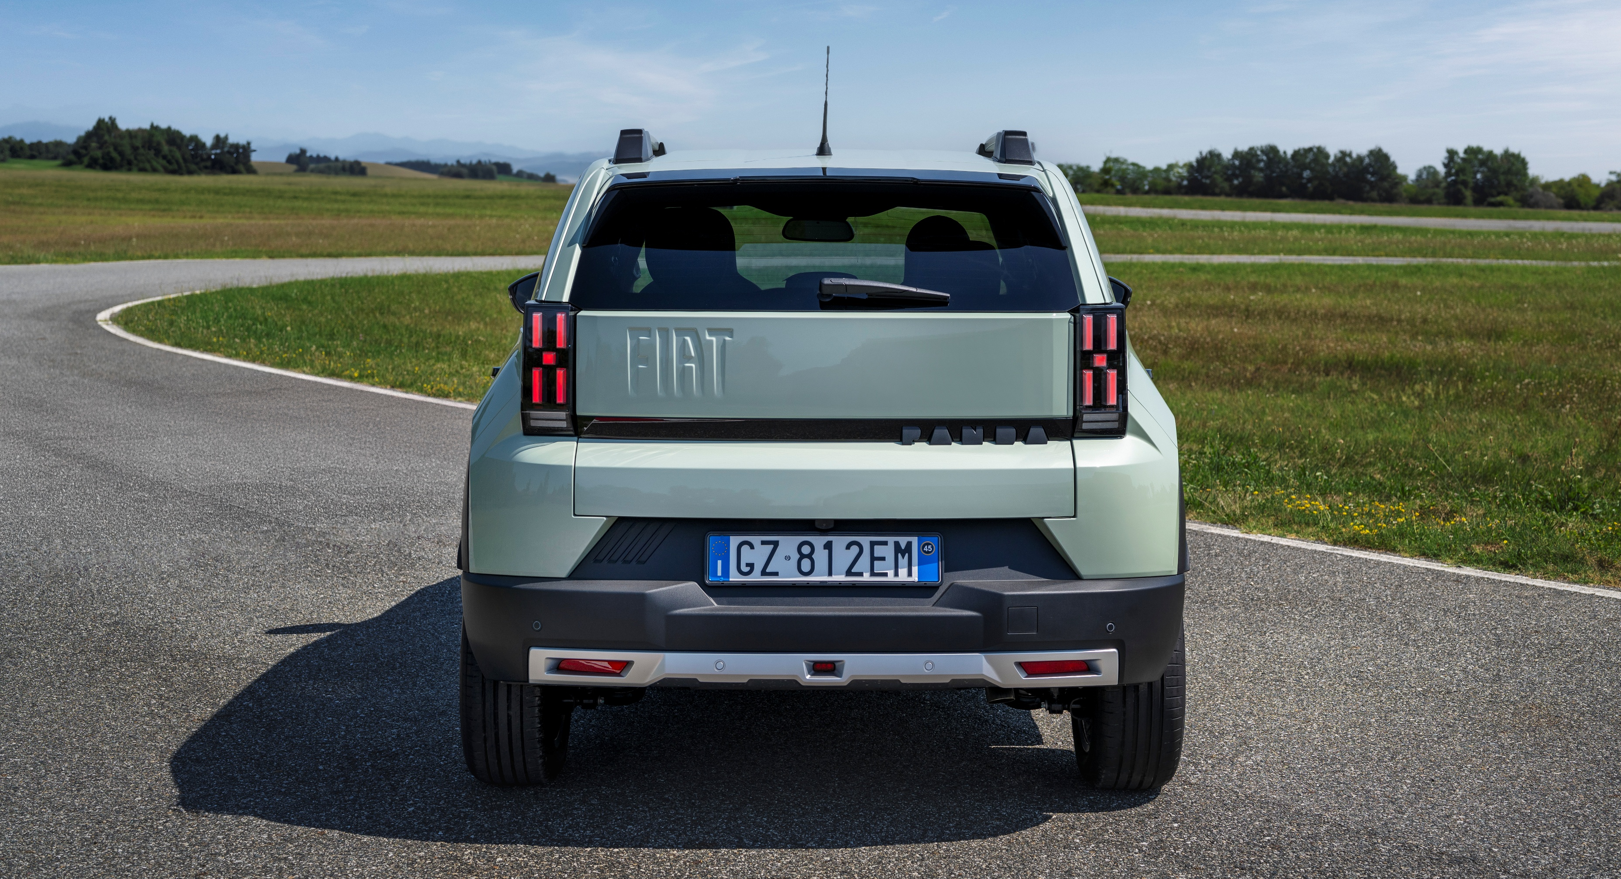
Quiz BEFORE topic
Index
GRANDE PANDA ICE
WELCOME Card
Panda world goes pure gasoline (1/2)
Panda world goes pure gasoline (2/2)
Quiz before topic
Notion cover
GRANDE PANDA ICE: Exterior overview (1/2)
GRANDE PANDA ICE: Exterior overview (2/2)
Quiz before topic
Notion cover
GRANDE PANDA ICE: Interior overview (1/2)
GRANDE PANDA ICE: Interior overview (2/2)
Quiz before topic
Notion cover
Customer Benefit
Objection handling (1/2)
Objection handling (2/2)
Key concepts to remember
Fiat Grande Panda is now available with different engine solution: what about the label on the rear side?
Image
“E” on the BEV, no label on “Hybrid” and no label for the gasoline
“E” on the BEV, “Hybrid” on “Hybrid” and “1.2” for the gasoline
“E” on the BEV, “Hybrid” on Hybrid and no label for the gasoline
Text1
Text2
Continue

Slide 12
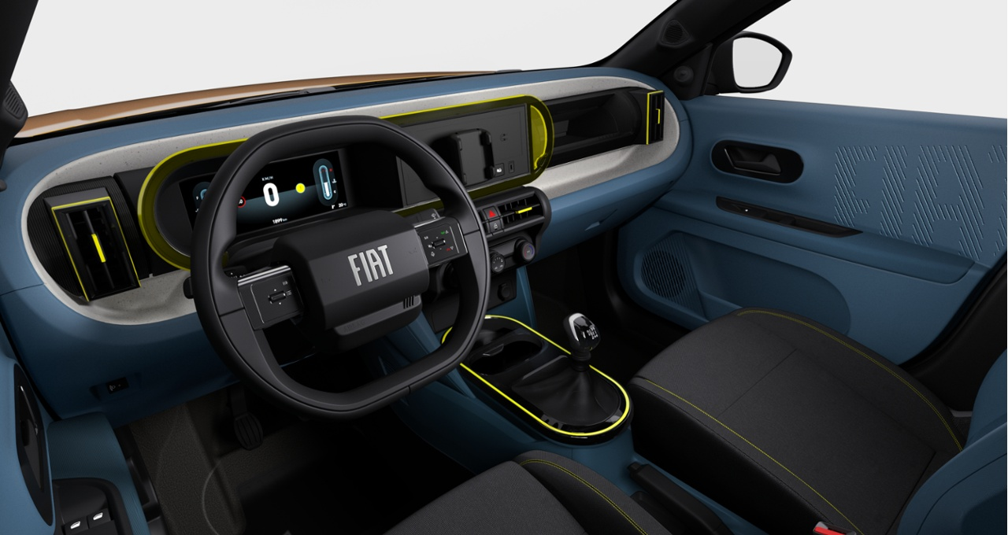
COVER Card
Index
GRANDE PANDA ICE
WELCOME Card
Panda world goes pure gasoline (1/2)
Panda world goes pure gasoline (2/2)
Quiz before topic
Notion cover
GRANDE PANDA ICE: Exterior overview (1/2)
GRANDE PANDA ICE: Exterior overview (2/2)
Quiz before topic
Notion cover
GRANDE PANDA ICE: Interior overview (1/2)
GRANDE PANDA ICE: Interior overview (2/2)
Quiz before topic
Notion cover
Customer Benefit
Objection handling (1/2)
Objection handling (2/2)
Key concepts to remember
GRANDE PANDA ICE:
Interior overview
Let now let’s explore the interior
Image
Text1
Text2
Continue

Slide 13



Card
Index
GRANDE PANDA ICE
WELCOME Card
Panda world goes pure gasoline (1/2)
Panda world goes pure gasoline (2/2)
Quiz before topic
Notion cover
GRANDE PANDA ICE: Exterior overview (1/2)
GRANDE PANDA ICE: Exterior overview (2/2)
Quiz before topic
Notion cover
GRANDE PANDA ICE: Interior overview (1/2)
GRANDE PANDA ICE: Interior overview (2/2)
Quiz before topic
Notion cover
Customer Benefit
Objection handling (1/2)
Objection handling (2/2)
Key concepts to remember
GRANDE PANDA ICE:
Interior overview (1/2)
The same commercial offer (3 trims) compared to Hybrid
Image
Text1
Text2
… but with some different features.
Continue

Slide 14
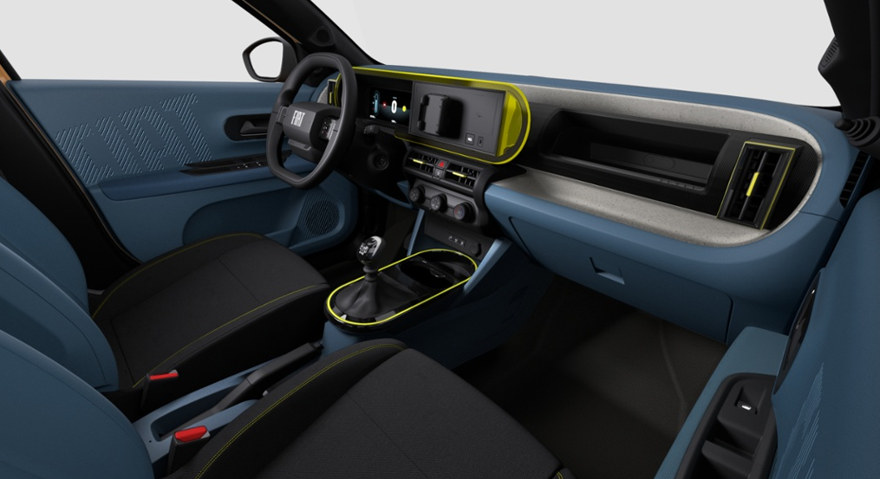
Card
Index
GRANDE PANDA ICE:
Interior overview (2/2)
GRANDE PANDA ICE
WELCOME Card
Panda world goes pure gasoline (1/2)
Panda world goes pure gasoline (2/2)
Quiz before topic
Notion cover
GRANDE PANDA ICE: Exterior overview (1/2)
GRANDE PANDA ICE: Exterior overview (2/2)
Quiz before topic
Notion cover
GRANDE PANDA ICE: Interior overview (1/2)
GRANDE PANDA ICE: Interior overview (2/2)
Quiz before topic
Notion cover
Customer Benefit
Objection handling (1/2)
Objection handling (2/2)
Key concepts to remember
It’s easy and simple to image where the main difference are.
It’s getting in the car where you can find such main different features:
Parking brake lever (manual)
6 gears lever + reverse (manual)
Start&Stop with deactivation switch
Image
Text1
3
2
Text2
1
Due to this interior layout, central armrest and wireless charger are no longer available.
Continue

Slide 15
Quiz BEFORE topic
Index
GRANDE PANDA ICE
WELCOME Card
Panda world goes pure gasoline (1/2)
Panda world goes pure gasoline (2/2)
Quiz before topic
Notion cover
GRANDE PANDA ICE: Exterior overview (1/2)
GRANDE PANDA ICE: Exterior overview (2/2)
Quiz before topic
Notion cover
GRANDE PANDA ICE: Interior overview (1/2)
GRANDE PANDA ICE: Interior overview (2/2)
Quiz before topic
Notion cover
Customer Benefit
Objection handling (1/2)
Objection handling (2/2)
Key concepts to remember
Talking about Interiors, the “Gasoline” engine take back a features that was not available on “Hybrid”
Image
“Head-up-display” available as optional
“Turbo” button for an extra gasoline power boost
Parking manual brake lever, 6 gears lever + reverse and Start&Stop with deactivation switch
Text1
Text2
Continue

Slide 16
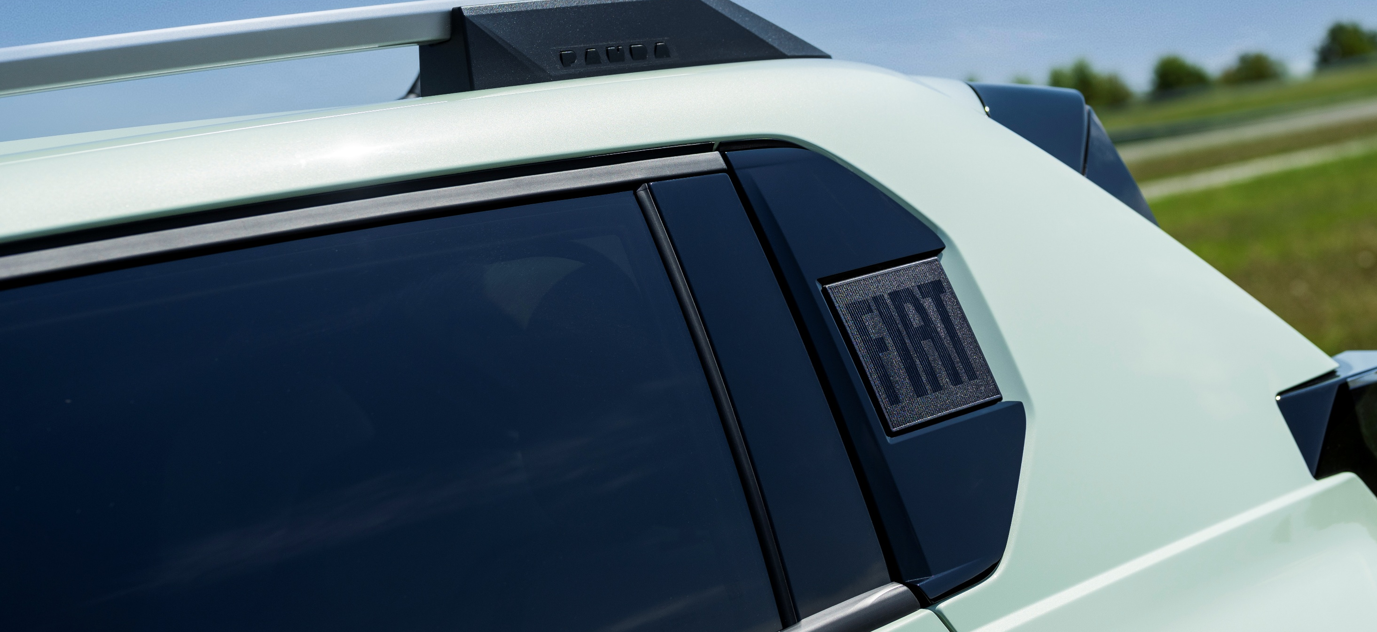
COVER Card
Index
GRANDE PANDA ICE
WELCOME Card
Panda world goes pure gasoline (1/2)
Panda world goes pure gasoline (2/2)
Quiz before topic
Notion cover
GRANDE PANDA ICE: Exterior overview (1/2)
GRANDE PANDA ICE: Exterior overview (2/2)
Quiz before topic
Notion cover
GRANDE PANDA ICE: Interior overview (1/2)
GRANDE PANDA ICE: Interior overview (2/2)
Quiz before topic
Notion cover
Customer Benefit
Objection handling (1/2)
Objection handling (2/2)
Key concepts to remember
CUSTOMER BENEFIT
Customer benefits are at the heart of
every design choice.
Image
Text1
Text2
Continue

Slide 17
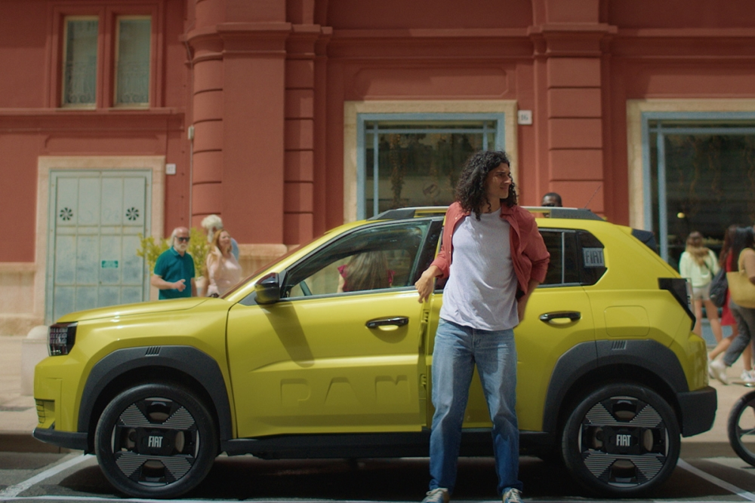
Card
Index
GRANDE PANDA ICE
WELCOME Card
Panda world goes pure gasoline (1/2)
Panda world goes pure gasoline (2/2)
Quiz before topic
Notion cover
GRANDE PANDA ICE: Exterior overview (1/2)
GRANDE PANDA ICE: Exterior overview (2/2)
Quiz before topic
Notion cover
GRANDE PANDA ICE: Interior overview (1/2)
GRANDE PANDA ICE: Interior overview (2/2)
Quiz before topic
Notion cover
Customer Benefit
Objection handling (1/2)
Objection handling (2/2)
Key concepts to remember
Customer Benefit
Introducing the 1.2 gasoline engine in Fiat Grande Panda line-up we are now available to enlarge and including a wider group of customers.
🚀 What the Customer gets
affordable entry price
engaging driving with a 6-speed gearbox
easy handling, ideal for city driving
🔥 At the same time, we keep on going to offer:
good interior space in a compact footprint
stylish and SUV inspired design
Fiat brand with rich legacy and practical DNA
Image
Text1
Text2
Continue

Slide 18
Card
Index
GRANDE PANDA ICE
WELCOME Card
Panda world goes pure gasoline (1/2)
Panda world goes pure gasoline (2/2)
Quiz before topic
Notion cover
GRANDE PANDA ICE: Exterior overview (1/2)
GRANDE PANDA ICE: Exterior overview (2/2)
Quiz before topic
Notion cover
GRANDE PANDA ICE: Interior overview (1/2)
GRANDE PANDA ICE: Interior overview (2/2)
Quiz before topic
Notion cover
Customer Benefit
Objection handling (1/2)
Objection handling (2/2)
Key concepts to remember
Objection handling (1/2)
Just to be confident how to manage potential customer doubts, let’s have a look how to handling customer objection
Q: Why no automatic gearbox?
A: For many customers, this engine is the base-point spot. It’s more affordable than automatic and never the less, 6-speed manual keeps things fun and frugal.
Q: Isn’t it underpowered?
A: For its size and weight, it’s perfectly matched. Ideal for city and mixed driving. The engine and gearbox are tuned for responsiveness where it matters most – low to mid-range torque.
Image
Text1
Text2
Continue

Slide 19
Card
Index
GRANDE PANDA ICE
WELCOME Card
Panda world goes pure gasoline (1/2)
Panda world goes pure gasoline (2/2)
Quiz before topic
Notion cover
GRANDE PANDA ICE: Exterior overview (1/2)
GRANDE PANDA ICE: Exterior overview (2/2)
Quiz before topic
Notion cover
GRANDE PANDA ICE: Interior overview (1/2)
GRANDE PANDA ICE: Interior overview (2/2)
Quiz before topic
Notion cover
Customer Benefit
Objection handling (1/2)
Objection handling (2/2)
Key concepts to remember
Objection handling (2/2)
Q: Is this an easy-going technology solution?
A: Not every customer wants the most up-to-date technology. This is a simple, efficient choice for short trips and low-cost ownership.
Q: Am I going to be satisfied with these engine performances?
A: This solution is ideal for city driving, with peppy response and optimized gearing for daily use.
Image
Text1
Text2
Continue

Slide 20
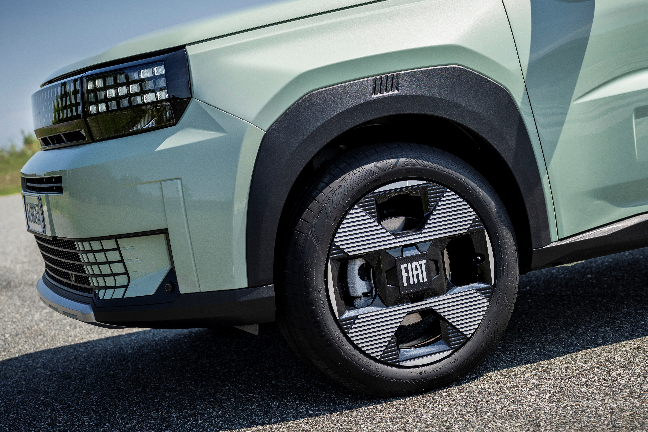
COVER Card
Index
GRANDE PANDA ICE
WELCOME Card
Panda world goes pure gasoline (1/2)
Panda world goes pure gasoline (2/2)
Quiz before topic
Notion cover
GRANDE PANDA ICE: Exterior overview (1/2)
GRANDE PANDA ICE: Exterior overview (2/2)
Quiz before topic
Notion cover
GRANDE PANDA ICE: Interior overview (1/2)
GRANDE PANDA ICE: Interior overview (2/2)
Quiz before topic
Notion cover
Customer Benefit
Objection handling (1/2)
Objection handling (2/2)
Key concepts to remember
KEY POINTS TO REMEMBER
Fiat Grande Panda 1.2 gasoline enlarge the engine type offer to be closer to the customer, to increase the commercial success already ‘on-the-air’
Considering the Hybrid version as a reference, main new features in summary are the following:
gasoline engine with 6-speed manual gearbox
parking manual brake lever
6 gears lever + reverse
Start&Stop with deactivation switch
In terms of Exterior keep in mind:
same 7 colors palette
rear brakes are now drums type
there is no rear sticker
In terms of Interior, due to new layout:
same 3 trims: Icon, Pop and La Prima
central armrest is no longer available
wireless charger is no longer available
Image
Text1
Text2
Continue

