Slide 1
HEADER / ID OF THE CAPSULES
Fiat Grande Panda 1.2 Pure Tech benzina 100cv
WWCPFI505697B09IT
Fiat Grande Panda è ora disponibile con il motore benzina 1.2 da 100cv
Mandatory

Slide 2
HEADER / ID OF THE CAPSULES
FIAT
PRODUCT
ITA
/ subtrack
Fiat / Range

Slide 3
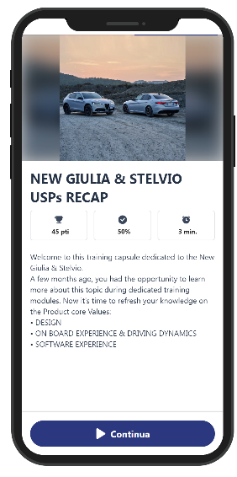
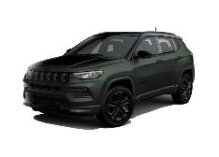

COVER Card
Contents
COMPASS MY25
- Compass evolution
- The new Range
- The North Star (1/4)
- The North Star (2/4)
- The North Star (3/4)
- The North Star (4/4)
- Trim level equipments
- Focus on wheels
- Paint news
- Range evolutions (1/3)
- Range evolutions (2/3)
- Range evolutions (3/3)
- New Pack strategy (1/2)
- New Pack strategy (2/2)
Conclusion
- Quiz before topic
- Quiz before topic
- Quiz before topic
- Key points to remember (1/2)
- Key points to remember (2/2)
COMPASS MY25
With the MY25 Jeep Compass updates itself to continue to be the modern interpretation of the Jeep SUV.
Let's go and find out the details.
Foto TBD
Image
Text1
Text2
Continue

Slide 4







Scratch the card
Card
Contents
COMPASS MY25
- Compass evolution
- The new Range
- The North Star (1/4)
- The North Star (2/4)
- The North Star (3/4)
- The North Star (4/4)
- Trim level equipments
- Focus on wheels
- Paint news
- Range evolutions (1/3)
- Range evolutions (2/3)
- Range evolutions (3/3)
- New Pack strategy (1/2)
- New Pack strategy (2/2)
Conclusion
- Quiz before topic
- Quiz before topic
- Quiz before topic
- Key points to remember (1/2)
- Key points to remember (2/2)
THE NEW RANGE
The Compass range changes for an even more simple and lean line-up, passing from 4 to 3 trims:
- Altitude and Summit trims confirmed
- Overland and Trailhawk are closed
and the new and unprecedented NORTH STAR trim is introduced.
Image
Text1
MY24
MY25
TRAILHAWK
SUMMIT
SUMMIT
NORTH STAR
OVERLAND
ALTITUDE
ALTITUDE
MHEV
PHEV
Continue

Slide 5

Quiz BEFORE topic
Contents
COMPASS MY25
- Compass evolution
- The new Range
- The North Star (1/4)
- The North Star (2/4)
- The North Star (3/4)
- The North Star (4/4)
- Trim level equipments
- Focus on wheels
- Paint news
- Range evolutions (1/3)
- Range evolutions (2/3)
- Range evolutions (3/3)
- New Pack strategy (1/2)
- New Pack strategy (2/2)
Conclusion
- Quiz before topic
- Quiz before topic
- Quiz before topic
- Key points to remember (1/2)
- Key points to remember (2/2)
Which are the 3 pillars that inspired the North Star new Trim?
Image
History, Fashion and Jeepness
Style, Off Road and Capability
Style, Robustness and Jeepness
text

Slide 6
NOTE OPERATIVE
è una apertura ordini anticipata SOLO per il Mercato Italia (inizio Settembre ‘25)
essendo un anticipo SOLO per Mercato Italia, testo della capsule in italiano
l’omologazione ancora non disponibile, ipotesi +20 gr/CO₂ vs Hybrid
ricerca foto by email alla Semeria + rendering a Lapecorella
codice DAMS già definito (disponibile in 1° pagina)
DESCRIZIONE
Fiat Grande Panda prosegue nel suo successo ed amplia la sua gamma, diventando ora disponibile con una nuova motorizzazione a benzina e cambio manuale (*)
L’offerta si arricchisce del motore 1.2 PureTech turbo benzina da 100 CV con cambio manuale a 6 marce.
Questo motore a 3 cilindri (**) dalla fluida erogazione di potenza è in grado di offrire prestazioni vivaci e una guida brillante, confermandosi un motore versatile e moderno.
(*) accontentando quei clienti che «… e qui bisogna sentire il tone-of-voice della Press»
(**) con distribuzione a cinghia in bagno d’olio: questo punto è molto delicato da comunicare

