Slide 1
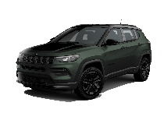

HEADER / ID OF THE CAPSULES
Jeep Compass MY25
WWCPJE505760B01EN
With the MY25 Compass updates its commercial offer and range. Let's discover the new Compass MY25 together

Slide 2
HEADER / ID OF THE CAPSULES
Jeep
New Vehicles Sales Advisor; New Vehicles Sales manager; B2B Specialist
EN
/ subtrack
Jeep/ Compass

Slide 3
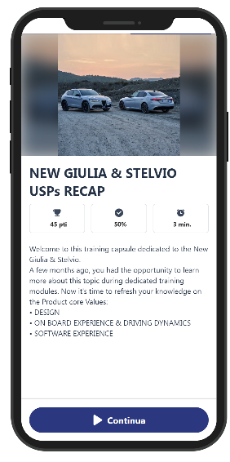
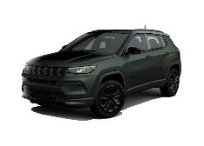

COVER Card
Contents
COMPASS MY25
- Compass evolution
- The new Range
- The North Star (1/4)
- The North Star (2/4)
- The North Star (3/4)
- The North Star (4/4)
- Trim level equipments
- Focus on wheels
- Paint news
- Range evolutions (1/3)
- Range evolutions (2/3)
- Range evolutions (3/3)
- New Pack strategy (1/2)
- New Pack strategy (2/2)
Conclusion
- Quiz before topic
- Quiz before topic
- Quiz before topic
- Key points to remember (1/2)
- Key points to remember (2/2)
COMPASS MY25
With the MY25 Jeep Compass updates itself to continue to be the modern interpretation of the Jeep SUV.
Let's go and find out the details.
Foto TBD
Image
Text1
Text2
Continue

Slide 4
WELCOME Card
Contents
COMPASS MY25
- Compass evolution
- The new Range
- The North Star (1/4)
- The North Star (2/4)
- The North Star (3/4)
- The North Star (4/4)
- Trim level equipments
- Focus on wheels
- Paint news
- Range evolutions (1/3)
- Range evolutions (2/3)
- Range evolutions (3/3)
- New Pack strategy (1/2)
- New Pack strategy (2/2)
Conclusion
- Quiz before topic
- Quiz before topic
- Quiz before topic
- Key points to remember (1/2)
- Key points to remember (2/2)
COMPASS EVOLUTION
The MY25 news can be summarized as follows:
- New Range
- New Buzz Model Version: NORTH STAR
- Trim level Equipment review
- Paints news
- Range evolution
- New pack Strategy
Image
Text1
Text2
Continue

Slide 5







Scratch the card
Card
Contents
COMPASS MY25
- Compass evolution
- The new Range
- The North Star (1/4)
- The North Star (2/4)
- The North Star (3/4)
- The North Star (4/4)
- Trim level equipments
- Focus on wheels
- Paint news
- Range evolutions (1/3)
- Range evolutions (2/3)
- Range evolutions (3/3)
- New Pack strategy (1/2)
- New Pack strategy (2/2)
Conclusion
- Quiz before topic
- Quiz before topic
- Quiz before topic
- Key points to remember (1/2)
- Key points to remember (2/2)
THE NEW RANGE
The Compass range changes for an even more simple and lean line-up, passing from 4 to 3 trims:
- Altitude and Summit trims confirmed
- Overland and Trailhawk are closed
and the new and unprecedented NORTH STAR trim is introduced.
Image
Text1
MY24
MY25
TRAILHAWK
SUMMIT
SUMMIT
NORTH STAR
OVERLAND
ALTITUDE
ALTITUDE
MHEV
PHEV
Continue

Slide 6
Card
Contents
COMPASS MY25
- Compass evolution
- The new Range
- The North Star (1/4)
- The North Star (2/4)
- The North Star (3/4)
- The North Star (4/4)
- Trim level equipments
- Focus on wheels
- Paint news
- Range evolutions (1/3)
- Range evolutions (2/3)
- Range evolutions (3/3)
- New Pack strategy (1/2)
- New Pack strategy (2/2)
Conclusion
- Quiz before topic
- Quiz before topic
- Quiz before topic
- Key points to remember (1/2)
- Key points to remember (2/2)
THE NORTH STAR (1/4)
The NORTH STAR trim celebrates the 1Million unit sold in Europe by Compass & Renegade together.
This unique and exclusive trim leverage on the 3 pillars that have built the success of these models:
- STYLE
- ROBUSTNESS
- JEEPNESS
Let’s know the details.
Image
Text1
Text2
Continue

Slide 7

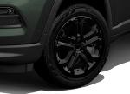
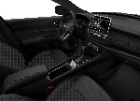
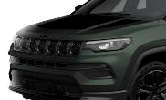
Card
Contents
COMPASS MY25
- Compass evolution
- The new Range
- The North Star (1/4)
- The North Star (2/4)
- The North Star (3/4)
- The North Star (4/4)
- Trim level equipments
- Focus on wheels
- Paint news
- Range evolutions (1/3)
- Range evolutions (2/3)
- Range evolutions (3/3)
- New Pack strategy (1/2)
- New Pack strategy (2/2)
Conclusion
- Quiz before topic
- Quiz before topic
- Quiz before topic
- Key points to remember (1/2)
- Key points to remember (2/2)
THE NORTH STAR (2/4)
STYLE elements:
- New exclusive colour TECHNOGREEN
- Dedicated exterior and interior finishing
- Dedicated hood decal
Image
Text1
Text2
Continue

Slide 8

Card
Contents
COMPASS MY25
- Compass evolution
- The new Range
- The North Star (1/4)
- The North Star (2/4)
- The North Star (3/4)
- The North Star (4/4)
- Trim level equipments
- Focus on wheels
- Paint news
- Range evolutions (1/3)
- Range evolutions (2/3)
- Range evolutions (3/3)
- New Pack strategy (1/2)
- New Pack strategy (2/2)
Conclusion
- Quiz before topic
- Quiz before topic
- Quiz before topic
- Key points to remember (1/2)
- Key points to remember (2/2)
THE NORTH STAR (3/4)
ROBUSTNESS elements:
- New High Resistance seats material
Image
Text1
Text2
Continue

Slide 9
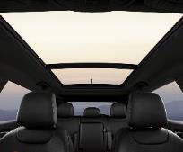
Card
Contents
COMPASS MY25
- Compass evolution
- The new Range
- The North Star (1/4)
- The North Star (2/4)
- The North Star (3/4)
- The North Star (4/4)
- Trim level equipments
- Focus on wheels
- Paint news
- Range evolutions (1/3)
- Range evolutions (2/3)
- Range evolutions (3/3)
- New Pack strategy (1/2)
- New Pack strategy (2/2)
Conclusion
- Quiz before topic
- Quiz before topic
- Quiz before topic
- Key points to remember (1/2)
- Key points to remember (2/2)
THE NORTH STAR (4/4)
JEEPNESS elements:
- Standard Open Air experience thanks to the Dual pane sunroof, which allows a unique and typically Jeep travel experience
In short, a unique mix of elements that allow NORTH STAR to best represent the authenticity of Jeep
Foto Compass North Star
Image
Text1
Text2
Continue

Slide 10
Card
Contents
COMPASS MY25
- Compass evolution
- The new Range
- The North Star (1/4)
- The North Star (2/4)
- The North Star (3/4)
- The North Star (4/4)
- Trim level equipments
- Focus on wheels
- Paint news
- Range evolutions (1/3)
- Range evolutions (2/3)
- Range evolutions (3/3)
- New Pack strategy (1/2)
- New Pack strategy (2/2)
Conclusion
- Quiz before topic
- Quiz before topic
- Quiz before topic
- Key points to remember (1/2)
- Key points to remember (2/2)
TRIM LEVEL EQUIPMENTS
Let's now do a quick review of the MY25 range to see in more detail the complete equipment of NORTH STAR but also to highlight the new equipment introduced on Altitude and Summit.
Image
Text1
Δ vs MY24:
+ Metallic paint
- Two tone paint
(opt)
Altitude +:
•Roof rails
•LED fog lamps
•Dedicated hood decal
•Black logos/dedicated badges
•High resistance seats material
•Privacy glasses
•Two-tone black roof
•Technogreen metallic paint
•Dual-pane sunroof
•18’’ black wheels
•Front/rear parking sensors
•Parallel and perpendicular Park Assist
SUMMIT
Δ vs MY24:
+ Metallic paint
- 18’’ Alloy wheels
(opt)
- Electrochromic rear view mirror
NORTH STAR
Text2
ALTITUDE
Continue

Slide 11




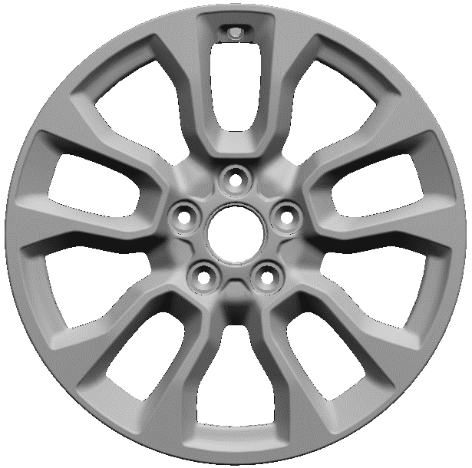

Card
Contents
COMPASS MY25
- Compass evolution
- The new Range
- The North Star (1/4)
- The North Star (2/4)
- The North Star (3/4)
- The North Star (4/4)
- Trim level equipments
- Focus on wheels
- Paint news
- Range evolutions (1/3)
- Range evolutions (2/3)
- Range evolutions (3/3)
- New Pack strategy (1/2)
- New Pack strategy (2/2)
Conclusion
- Quiz before topic
- Quiz before topic
- Quiz before topic
- Key points to remember (1/2)
- Key points to remember (2/2)
FOCUS ON WHEELS
And we continue by making a focus on the alloy wheel offer, highlighting the MY25 variations on the various trims:
Image
19’’
Text1
18’’
Altitude
North Star
Text2
17’’
Altitude
Altitude M+S
Altitude M+S
Continue

Slide 12



Card
Contents
COMPASS MY25
- Compass evolution
- The new Range
- The North Star (1/4)
- The North Star (2/4)
- The North Star (3/4)
- The North Star (4/4)
- Trim level equipments
- Focus on wheels
- Paint news
- Range evolutions (1/3)
- Range evolutions (2/3)
- Range evolutions (3/3)
- New Pack strategy (1/2)
- New Pack strategy (2/2)
Conclusion
- Quiz before topic
- Quiz before topic
- Quiz before topic
- Key points to remember (1/2)
- Key points to remember (2/2)
PAINTS NEWS
MY25 also introduces important news on the color offering grid:
TECHNO GREEN with Black Roof
New paint for free on North Star
Image
Text1
BLUE SHADE
New paint for free on Altitude and Summit
Text2
Continue

Slide 13
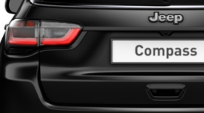
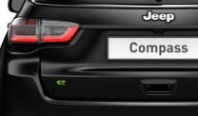

Card
Contents
COMPASS MY25
- Compass evolution
- The new Range
- The North Star (1/4)
- The North Star (2/4)
- The North Star (3/4)
- The North Star (4/4)
- Trim level equipments
- Focus on wheels
- Paint news
- Range evolutions (1/3)
- Range evolutions (2/3)
- Range evolutions (3/3)
- New Pack strategy (1/2)
- New Pack strategy (2/2)
Conclusion
- Quiz before topic
- Quiz before topic
- Quiz before topic
- Key points to remember (1/2)
- Key points to remember (2/2)
RANGE EVOLUTION (1/3)
… and to complete the product news a look on the changes introduced on the logos/ badges that equip the different versions:
Image
1
WHAT
WHY
e-hybrid badge elimination on all trim level
No Conventional engines available in the range:
e-Hybrid is the standard engine e does not need of specific badge
Text1
WAS
BECOMES
Text2
Continue

Slide 14
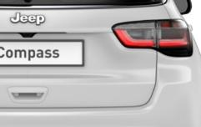
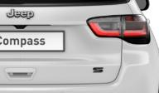

Card
Contents
COMPASS MY25
- Compass evolution
- The new Range
- The North Star (1/4)
- The North Star (2/4)
- The North Star (3/4)
- The North Star (4/4)
- Trim level equipments
- Focus on wheels
- Paint news
- Range evolutions (1/3)
- Range evolutions (2/3)
- Range evolutions (3/3)
- New Pack strategy (1/2)
- New Pack strategy (2/2)
Conclusion
- Quiz before topic
- Quiz before topic
- Quiz before topic
- Key points to remember (1/2)
- Key points to remember (2/2)
RANGE EVOLUTION (2/3)
2
WHAT
WHY
S badge removed from the Summit trim
Align the ‘’Summit’’ configuration among all models
Image
Text1
WAS
BECOMES
Text2
Continue

Slide 15
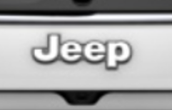


Card
Contents
COMPASS MY25
- Compass evolution
- The new Range
- The North Star (1/4)
- The North Star (2/4)
- The North Star (3/4)
- The North Star (4/4)
- Trim level equipments
- Focus on wheels
- Paint news
- Range evolutions (1/3)
- Range evolutions (2/3)
- Range evolutions (3/3)
- New Pack strategy (1/2)
- New Pack strategy (2/2)
Conclusion
- Quiz before topic
- Quiz before topic
- Quiz before topic
- Key points to remember (1/2)
- Key points to remember (2/2)
RANGE EVOLUTION (3/3)
3
WHAT
WHY
Drop of black badges
Altitude and Summit equipped with silver badges.
Only North Star remains with black badges for a further differentiation of the version.
Image
Text1
WAS
BECOMES
Text2
Continue

Slide 16

Card
Contents
COMPASS MY25
- Compass evolution
- The new Range
- The North Star (1/4)
- The North Star (2/4)
- The North Star (3/4)
- The North Star (4/4)
- Trim level equipments
- Focus on wheels
- Paint news
- Range evolutions (1/3)
- Range evolutions (2/3)
- Range evolutions (3/3)
- New Pack strategy (1/2)
- New Pack strategy (2/2)
Conclusion
- Quiz before topic
- Quiz before topic
- Quiz before topic
- Key points to remember (1/2)
- Key points to remember (2/2)
NEW PACK STRATEGY (1/2)
We can now complete the MY25 news with a close look on the new Pack Strategy finalized to make the Compass offer simple and lean.
In summary:
- 4 Packs available only, identical for all versions
- 3 stand alone opt only:
- Sunroof
- NAV (Altitude only)
- Premium Audio Alpine (North Star only)
Let's discover the names and contents of the 4 Packs:
Image
Text1
Contents
1
SAFETY PACK LIGHT
Front/Rear parking sensors
Park assist
Text2
2
SAFETY PACK FULL
360° camera
Blind spot monitoring
Exterior mirrors courtesy lamps
Continue

Slide 17
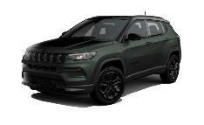


Card
Contents
COMPASS MY25
- Compass evolution
- The new Range
- The North Star (1/4)
- The North Star (2/4)
- The North Star (3/4)
- The North Star (4/4)
- Trim level equipments
- Focus on wheels
- Paint news
- Range evolutions (1/3)
- Range evolutions (2/3)
- Range evolutions (3/3)
- New Pack strategy (1/2)
- New Pack strategy (2/2)
Conclusion
- Quiz before topic
- Quiz before topic
- Quiz before topic
- Key points to remember (1/2)
- Key points to remember (2/2)
NEW PACK STRATEGY (2/2)
Contents
Image
3
WINTER PACK
Heated seats
Heated steering wheel
All weather floor mats
Windshield de-icer
Steering wheel w/leather wrap
Text1
4
PREMIUM PACK
Navigation
Traffic Sign Information
Handsfree power liftgate
L2 Autonomous drive
Wireless charger
Text2
Continue

Slide 18
COVER Card
Contents
COMPASS MY25
- Compass evolution
- The new Range
- The North Star (1/4)
- The North Star (2/4)
- The North Star (3/4)
- The North Star (4/4)
- Trim level equipments
- Focus on wheels
- Paint news
- Range evolutions (1/3)
- Range evolutions (2/3)
- Range evolutions (3/3)
- New Pack strategy (1/2)
- New Pack strategy (2/2)
Conclusion
- Quiz before topic
- Quiz before topic
- Quiz before topic
- Key points to remember (1/2)
- Key points to remember (2/2)
CONCLUSION
What is important to remember about the Jeep Compass MY25?
Let’s recap with some questions
Image
Text1
Text2
Continue

Slide 19
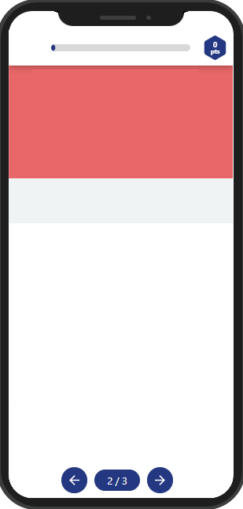
Quiz BEFORE topic
Contents
COMPASS MY25
- Compass evolution
- The new Range
- The North Star (1/4)
- The North Star (2/4)
- The North Star (3/4)
- The North Star (4/4)
- Trim level equipments
- Focus on wheels
- Paint news
- Range evolutions (1/3)
- Range evolutions (2/3)
- Range evolutions (3/3)
- New Pack strategy (1/2)
- New Pack strategy (2/2)
Conclusion
- Quiz before topic
- Quiz before topic
- Quiz before topic
- Key points to remember (1/2)
- Key points to remember (2/2)
Which are the 3 pillars that inspired the North Star new Trim?
Image
History, Fashion and Jeepness
Style, Off Road and Capability
Style, Robustness and Jeepness
text

Slide 20
Quiz BEFORE topic
Contents
COMPASS MY25
- Compass evolution
- The new Range
- The North Star (1/4)
- The North Star (2/4)
- The North Star (3/4)
- The North Star (4/4)
- Trim level equipments
- Focus on wheels
- Paint news
- Range evolutions (1/3)
- Range evolutions (2/3)
- Range evolutions (3/3)
- New Pack strategy (1/2)
- New Pack strategy (2/2)
Conclusion
- Quiz before topic
- Quiz before topic
- Quiz before topic
- Key points to remember (1/2)
- Key points to remember (2/2)
The new North Star trim is characterized, among other things, by:
Image
The new dashboard leather covered and full black body colour
The new 7 slot front grille in Techno Green 3D effect
The new body colour Techno Green and dedicated exterior and interior finishing
text

Slide 21
Quiz BEFORE topic
Contents
COMPASS MY25
- Compass evolution
- The new Range
- The North Star (1/4)
- The North Star (2/4)
- The North Star (3/4)
- The North Star (4/4)
- Trim level equipments
- Focus on wheels
- Paint news
- Range evolutions (1/3)
- Range evolutions (2/3)
- Range evolutions (3/3)
- New Pack strategy (1/2)
- New Pack strategy (2/2)
Conclusion
- Quiz before topic
- Quiz before topic
- Quiz before topic
- Key points to remember (1/2)
- Key points to remember (2/2)
The new Pack strategy is characterized by:
Image
No packs available, the new range is characterized by trim levels fully equipped
3 packs available on top to the normal opt list
4 packs available and 3 only stand alone opt
text

Slide 22
Card
Contents
COMPASS MY25
- Compass evolution
- The new Range
- The North Star (1/4)
- The North Star (2/4)
- The North Star (3/4)
- The North Star (4/4)
- Trim level equipments
- Focus on wheels
- Paint news
- Range evolutions (1/3)
- Range evolutions (2/3)
- Range evolutions (3/3)
- New Pack strategy (1/2)
- New Pack strategy (2/2)
Conclusion
- Quiz before topic
- Quiz before topic
- Quiz before topic
- Key points to remember (1/2)
- Key points to remember (2/2)
KEY POINTS TO REMEMBER (1/2)
Jeep Compass MY25 is renewed to continue to be the market leader in its segment. The new features in summary are the following:
- New range with 3 Trims (instead of 4) one of which is completely new, the North Star
- North Star new trim characterized by:
- New and exclusive body colour Techno Green
- Dedicated exterior and interior finishing
- Dedicated hood decal
- New high resistance seats material
- Standard Dual pane Sunroof
Image
Text1
Text2
Continue

Slide 23
Card
Contents
COMPASS MY25
- Compass evolution
- The new Range
- The North Star (1/4)
- The North Star (2/4)
- The North Star (3/4)
- The North Star (4/4)
- Trim level equipments
- Focus on wheels
- Paint news
- Range evolutions (1/3)
- Range evolutions (2/3)
- Range evolutions (3/3)
- New Pack strategy (1/2)
- New Pack strategy (2/2)
Conclusion
- Quiz before topic
- Quiz before topic
- Quiz before topic
- Key points to remember (1/2)
- Key points to remember (2/2)
KEY POINTS TO REMEMBER (2/2)
- New trim levels equipment
- New Alloy wheels offer with dedicated new 18’’ design specific for North Star
- Range evolution with new Badge Strategy aimed to:
- Range harmonization
- further differentiation for the North Star
- New pack strategy characterized by:
- 4 Packs available only, identical for all versions
- 3 stand alone opt only:
- Sunroof
- NAV (Altitude only)
- Premium Audio Alpine (North Star only)
Image
Text1
Text2
Continue

