Slide 1





K9 Salesmen
Knowledge Check up
background music
ENTER THE COURSE
Notes:
Course cover, background music to be played consistently within the course. A sound on/off button will be displayed on the player.
https://audiojungle.net/item/epic-uplifting-countdown/3331039
https://audiojungle.net/item/magical/11363054

Slide 2










Welcome to your new learning experience
aboard a K9 vehicle.
2
2

Slide 3

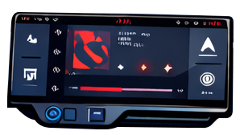

K9 Salesmen Knowledge Check up
Use your mouse to explore the driver’s compartment and discover what it hides… than click on the DASHBOARD
3
3

Slide 4

K9 Salesmen Knowledge Check up
DASHBOARD
4
4

Slide 5
Single animated slide.
Hi! I’m your K9 vehicle.
Yes, I’m talking to you.
Ready to embark on our journey?
YES, TELL ME MORE!
NOT REALLY… BUT GO ON
Select the answer to continue.
5
Notes:
https://audiojungle.net/item/retro-classic-90s-video-game-start-sound-19/59951841

Slide 6
Single animated slide.
I’ve got some surprises in store for you.
First of all, the key is hidden somewhere in the driver’s compartment.
Until you find it, the ignition won’t work and you won’t be able to go anywhere.
OH NO! AM I STUCK HERE?
WAIT, ISN’T THIS A TRAINING COURSE?
Select the answer to continue.
6

Slide 7
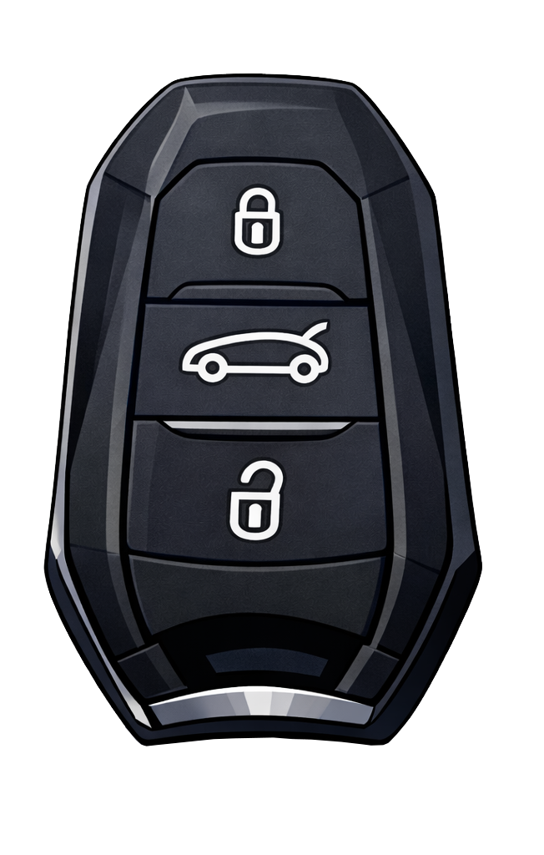
Single animated slide.
Think of it as a treasure hunt: I will be your guide, and the compartment will be your map. By solving a series of challenges, you will practice your knowledge of the K9 vehicle and get ready to provide
the best service to our customers.
The final prize?
You guessed it… the key!
UNDERSTOOD
7
Notes:
After clicking on the navigator, learners land on this slide which is the course main dashboard. It contains the following elements:
A central section with text and buttons. This is where the learner will interact with the course and the questions/instructions will be shown.
NOTES:
The text written in capital letters will appears inside the buttons. When buttons are clicked, the learner either sees the next chunk of text or is directed to the next slide.
In this case, learners can click on either button but the flow of the conversation won’t change.
In the first message that appears on the screen, it would be great to have the learner’s name appear next to «Hi…». It can be done in most cases by extracting the name from the LMS.
A counter (0/13) showing the number of answers given.
A countdown (from 1 hours to 0), which starts the moment the learner clicks on Let’s start on the next slide.
A phone icon, which the learner can click when they need help on a topic (max. twice in the course)
A diary icon, showing the learner’s contacts
A small icon of a steering wheel, which leads back to the homepage (slide 2)
Two badges (now inactive, will turn green when active): a grind, that the learner obtains when completing all technical questions, and a handshake, obtained after completing all customer-focused questions.

Slide 8

Before we begin,
take a moment to check out the dashboard.
CONTINUE
8

Slide 9
K9 Salesmen Knowledge Check up
01/13
01:00:00
Return to the main screen
Course Title
Question counter
Ask a friend for help (it becomes green when someone is available)
Check your contact list
Keep an eye on the time.
If you don’t solve all the challenges within one hour, you’ll need to start again to get your key.
Menu
the blue color indicates the section you are currently viewing and helps you stay oriented throughout the course.
Use the Next and Back buttons to move between pages.
LET’S START
Page number
9

Slide 10
01/13
01:00:00
Let’s fire up the engines with a quick question on the K9 range.
What is the main advantage of the new K9 BEV generation?
Range increased by 50 km compared to the previous version
Full recharge in less than 10 minutes
Engine with power over 200 kW
CONFIRM
Select the correct answer and press Confirm.
10

Slide 11
K9 Salesmen Knowledge Check up
01/13
01:00:00
How do you do it?
Correct!
The new generation of K9 offers a 50km autonomy increase of its BEV powertrain compared to the current version.
GOOD TO KNOW, LET’S KEEP GOING!
11
11

Slide 12
K9 Salesmen Knowledge Check up
01/13
01:00:00
How do you do it?
Not really…
You haven’t covered any ground with this answer.
TRY AGAIN
12

Slide 13
01/13
01:00:00
Single animated slide.
In this course, you will also need to prove your ability to turn technical features into benefits for your customer.
Let’s do some practice based
on the previous question.
PUT ME TO THE TEST
13

Slide 14
02/13
01:00:00
Single animated slide.
How does the extra 50km autonomy add value for our customers
in typical day-to-day situations?
Drag the boxes to the correct position.
In case this happens…
…the K9 offers you the following:
A last-minute delivery is added at the end of the route.
Greater flexibility in route planning
Traffic, detours or delays extend the planned journey.
Reduced operational stress and fewer unexpected stops
The driver needs to complete a longer shift without recharging.
More deliveries completed per working day
14

Slide 15

02/13
01:00:00
Single animated slide.
How does the extra 50km autonomy add value for our customers
in typical day-to-day situations?
Drag the boxes to the correct position.
In case this happens…
…the K9 offers you the following:
A last-minute delivery is added at the end of the route.
Greater flexibility in route planning
Traffic, detours or delays extend the planned journey.
Reduced operational stress and fewer unexpected stops
WELL DONE,
LET’S CONTINUE
The driver needs to complete a longer shift without recharging.
More deliveries completed per working day
15

Slide 16


K9 Salesmen Knowledge Check up
You have unlocked a new section.
Do you notice anything different?
Use your mouse to explore…
STORAGE COMPARTMENT
16

Slide 17

Great news!
You have found the K9 Quick guide!
It will be useful to review your knowledge of the K9 technical features.
GOOD TO KNOW
17
Notes:
clue-found

Slide 18
But wait…
Some pages have been accidentally torn out
and the book needs to be put back together.
OPEN THE BOOK
18

Slide 19
03/13
01:00:00
4
The manual’s chapters have been all messed up.
Safety, Comfort & Driving Support Regulation
Each corresponds to one of the four product pillars of the K9 range.
5
1
Telematics Solution
Style and Brand Differentiation
6
2
AI-Powered Driving Control
Human-Machine Interface
3
To put the book back together
Drag the correct pillars in the empty slots.
Multienergy Powertrain BEV Gen2
Bespoke colour range, ECOLED headlamps, interior features focused on ergonomics and design, and distinctive brand markers
19
CONFIRM
Notes:
Drag and drop interaction
Instructions appear in the left-hand page.
Learners need to drag the correct 4 pillars in the empty spaces of the page (e.g. Style and Brand Differentiation). They appear in small labels as scrap pieces of papers scattered around the book.
When they drag an item in the correct spot, a feedback pop-up appears providing a short explanation of the pillar. Two options are wrong.
At the end, TURN THE PAGE button appears on screen and leads to the next slide. Question counter goes up by 1.

Slide 20
03/13
01:00:00
4
The manual’s chapters have been all messed up.
Safety, Comfort & Driving Support Regulation
Expanded ADAS range to meet the highest safety requirements
Each corresponds to one of the four product pillars of the K9 range.
5
1
Telematics Solution
Style and Brand Differentiation
This is not one of the 4 pillars…
Bespoke colour range, ECOLED headlamps, interior features focused on ergonomics and design, and distinctive brand markers
6
2
AI-Powered Driving Control
Human-Machine Interface
This is not one of the 4 pillars…
Infotainment system designed for smartphone interaction, with multi-windows, widgets and shortcuts. On-board security with advanced voice commands
3
To put the book back together
Drag the correct pillars in the empty slots.
Multienergy Powertrain BEV Gen2
A full range of ICE and BEV powertrains
Bespoke colour range, ECOLED headlamps, interior features focused on ergonomics and design, and distinctive brand markers
20
CONFIRM
Notes:
Drag and drop interaction
Instructions appear in the left-hand page.
Learners need to drag the correct 4 pillars in the empty spaces of the page (e.g. Style and Brand Differentiation). They appear in small labels as scrap pieces of papers scattered around the book.
When they drag an item in the correct spot, a feedback pop-up appears providing a short explanation of the pillar. Two options are wrong.
At the end, TURN THE PAGE button appears on screen and leads to the next slide. Question counter goes up by 1.

Slide 21
K9 Salesmen Knowledge Check up
03/13
01:00:00
Correct!
How do you do it?
Well done, you have recognized the four key areas of innovation of the K9 range.
CAN I GO NOW?
21

Slide 22
K9 Salesmen Knowledge Check up
03/13
01:00:00
How do you do it?
Not yet!
Before meeting our customers, you will need to show that your technical knowledge is sound enough to answer all their questions.
I’M READY!
22

Slide 23
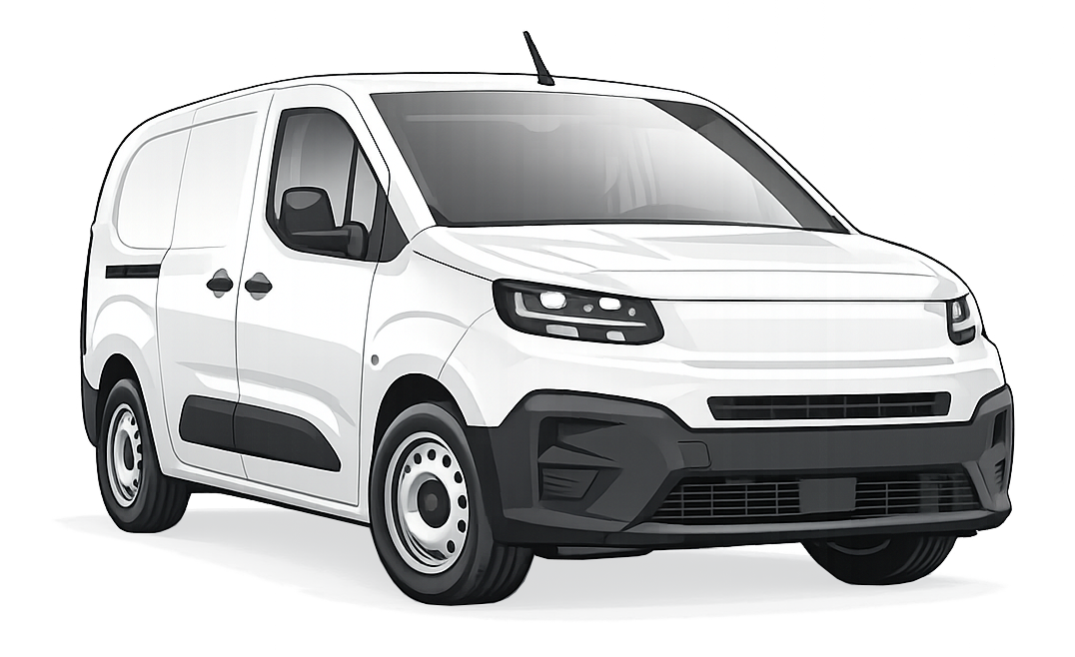
04/13
01:00:00
How much
do you know about K9?
Let’s review some of the basics…
What is the maximum volume on K9?
Select the correct answer and press Confirm.
3.54 m³
3.9 m³
4.4 m³
CONFIRM
23
Notes:
Multiple choice quiz on the left-hand page, feedback message on the right-hand page.
Question counter goes up by 1.

Slide 24

K9 Salesmen Knowledge Check up
04/13
01:00:00
Correct!
How do you do it?
Stellantis K9 C Van offers a maximum of 4.4 m³ of cargo volume and a load capacity of up to 1000 kg.
The ideal customer for K9 are those who need a compact, mid-range vehicle to make deliveries in urban environments.
TURN THE PAGE
24

Slide 25
K9 Salesmen Knowledge Check up
04/13
01:00:00
How do you do it?
Wrong turn.
This answer doesn’t help you make progress.
TRY AGAIN
25

Slide 26
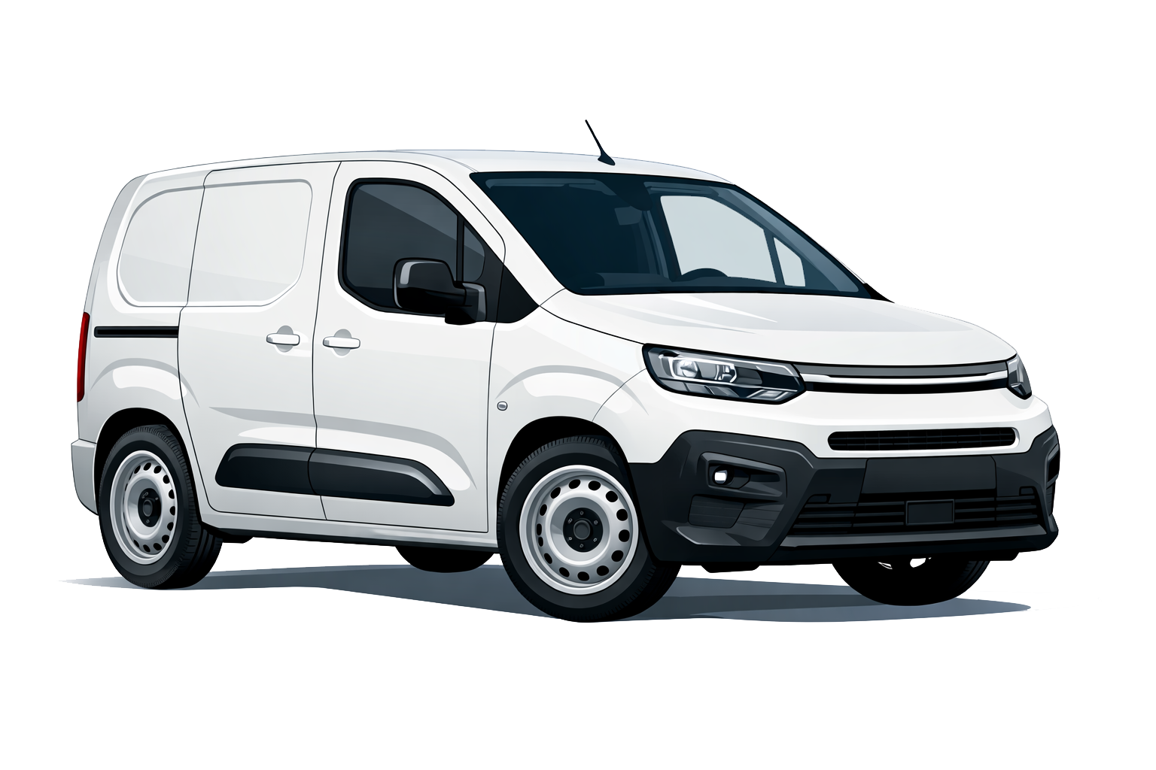
05/13
01:00:00
How much
do you know about K9?
Keep an eye on the battery
of your BEV, which is at 20%. How long will it take to charge it to 80%?
Select the correct answer and press Confirm.
30 minutes
28 minutes
25 minutes
CONFIRM
26
Notes:
This is a standard multiple-choice quiz with feedback. An icon showing a low battery charge appears on the screen.
When the correct answer is given, the question counters increases by 1.

Slide 27
K9 Salesmen Knowledge Check up
05/13
01:00:00
Correct!
How do you do it?
25 minutes is the time it takes for the BEV version
of K9 to go from 20% to 80%.
25 minutes is also the time needed to recharge the vehicle to drive an extra 100 km.
CONTINUE
27

Slide 28
K9 Salesmen Knowledge Check up
05/13
01:00:00
How do you do it?
Not really…
You are still at a standstill with this answer.
TRY AGAIN
28

Slide 29


K9 Salesmen Knowledge Check up
You have unlocked a new section.
Do you notice anything different?
Use your mouse to explore…
REAR VIEW MIRROR
29

Slide 30
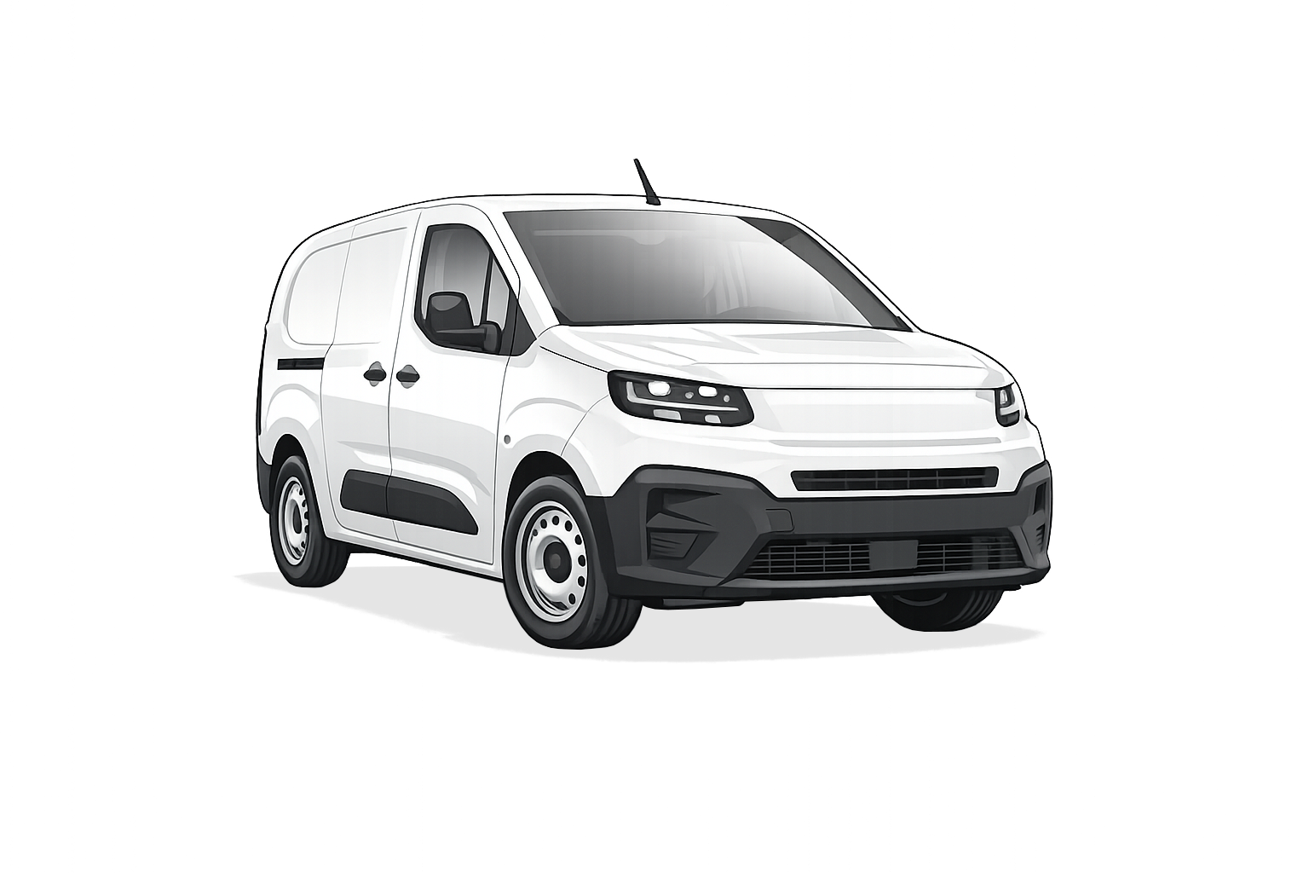
K9 Salesmen Knowledge Check up
06/13
01:00:00
Which element of the K9 improves visibility during manoeuvres?
Dynamic Surround View
Front parking sensors
Select the correct answer and press Confirm.
Manual enlarged mirrors
CONFIRM
30

Slide 31
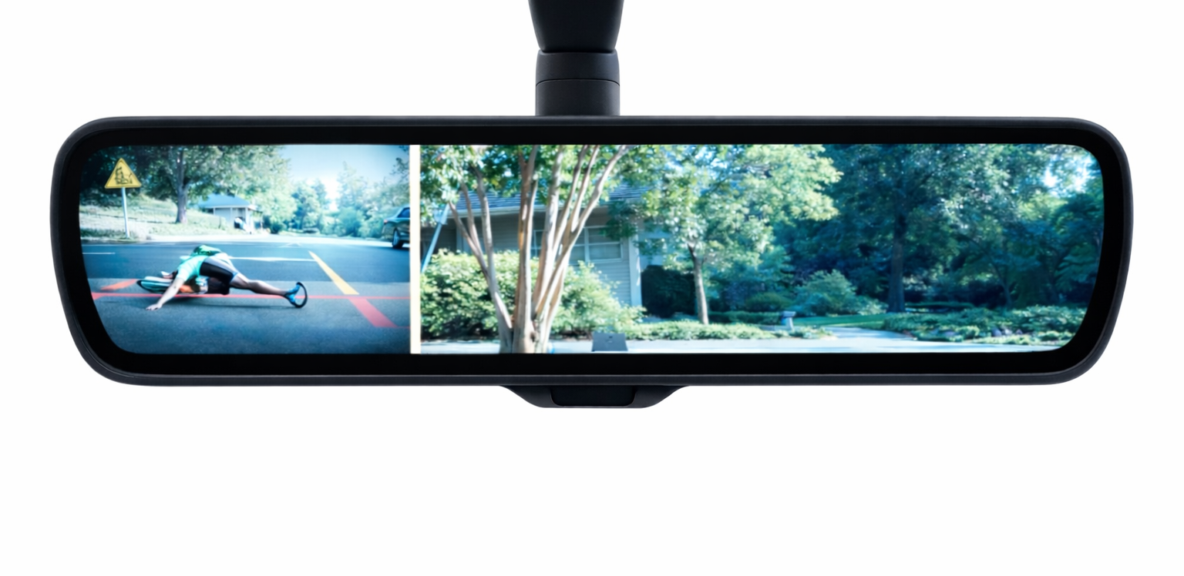
K9 Salesmen Knowledge Check up
06/13
01:00:00
Correct!
How do you do it?
The Dynamic Surround View function displays images on the rear view mirror coming from 2 cameras:
Under side right mirror (SD)
Above the rear doors (HD)
It provides rear view while driving and side view on the blind-area right side.
KEEP GOING
31

Slide 32
K9 Salesmen Knowledge Check up
06/13
01:00:00
How do you do it?
Not really…
This answer won’t make you go any further.
TRY AGAIN
32

Slide 33

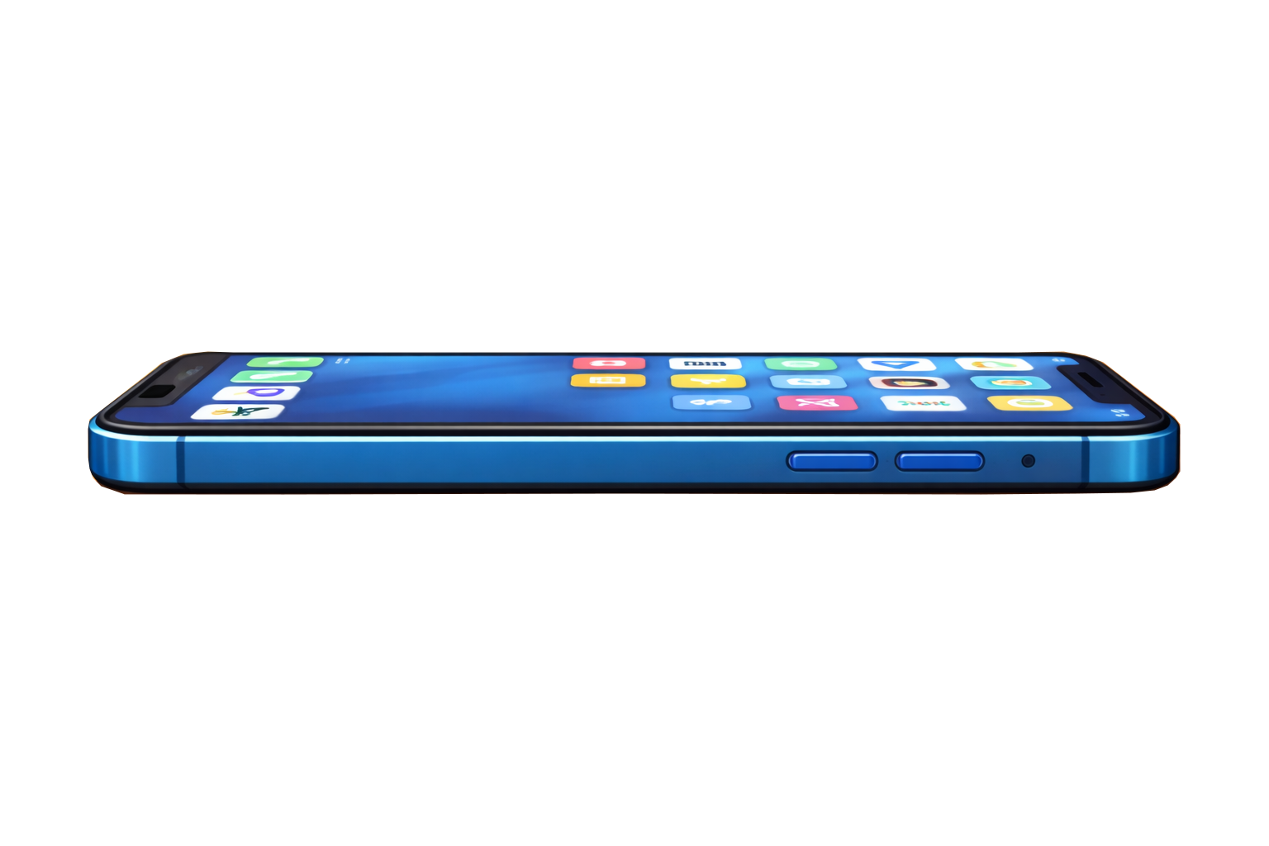
K9 Salesmen Knowledge Check up
You have unlocked a new section.
Do you notice anything different?
Use your mouse to explore…
SMARTPHONE
33
Notes:
The smartphone has now been unlocked:
When hovering the mouse, learners see the «open lock» icon next to it. When clicking on it, learners are directed to the next slide.

Slide 34


K9 Salesmen Knowledge Check up
06/13
01:00:00
You have completed your technical check-up.
You’re nearly ready to go, and would like to charge your smartphone.
10%
34

Slide 35

07/13
01:00:00
How do you do it?
Explore the environment
and select the 2 correct answers
Connect charging cable to dedicated USB Port
Use the Bluetooth connection
Wireless charger
35
Notes:
Labeled image. The page contains a stylized image of the smartphone and the K9 infotainment system with 3 hotspots, placed on:
A bluetooth icon on the dashboard screen
A smartphone holder
A USB port.
The learner needs to answer the question by clicking on the correct spot (the USB port) and pressing Confirm.
When each hotspot is clicked, a small text box opens describing what it corresponds to, and showing two buttons: CONFIRM or GO BACK.
When learners select the correct answer, a pop-up feedback shows the dedicated USB port image and provides additional information. Question counter goes up by 1.
If they pick the wrong answer, they open the corresponding pop-up feedback. They return to the image where the hotspot will be marked in red, and will need to try again

Slide 36
K9 Salesmen Knowledge Check up
07/13
01:00:00
Correct!
How do you do it?
With the Smartphone Station, standard on all versions of K9, the smartphone battery is recharged by connecting the cable to the dedicated USB port. As optional is also available the wireless charger
With Smartphone Station:
Accommodate the phone in the compartment, pair it with the Bluetooth connection to allow data exchange, and use the dedicated App to interact, also through your voice.
KEEP GOING
36
36

Slide 37
K9 Salesmen Knowledge Check up
07/13
01:00:00
How do you do it?
Not really…
This answer won’t make you go any further.
TRY AGAIN
37
37

Slide 38
07/13
01:00:00
Well done, you have completed
the technical section!
You’ve come a long way, but you’ve got still some ground to cover to prove you’re ready to meet our customers.
CONTINUE
38
Notes:
Text and graphic slide.
The question counter is updated, the countdown keeps running, the badge corresponding to the technical section (the grind icon) has turned green.

Slide 39

07/13
01:00:00
As you prepare for meeting your customers, you will need a roadmap to correctly analyze their needs and identify their usage habits.
WHERE CAN I FIND IT?
39
Notes:
Drag and drop interaction.
The dashboard screen shows the text in the box. To advance from one paragraph to the next, learners need to click on the buttons.
After clicking LET’S TRY, the map shows on screen with the 3 numbered steps and 3 empty droppable areas next to them. Under the map, 3 text labels appear in random order and need to be dragged on the corresponding droppable areas: MISSION, CAPABILITIES, USAGE. When each item is dropped correctly, a feedback pop-up appears, providing more information about how to carry out the needs analysis (including some sample questions and focal points taken from the SOS).
When the third pop-up feedback is closed, learners advance to the next slide.
OPTIONAL: Learners can click on the phone icon, which will flash, and get a hint from a friend (see next slide).
Map image taken from: https://www.shutterstock.com/it/image-vector/vector-generic-city-map-navigator-screen-2712122447?trackingId=62844254-c22c-48de-8f6d-2289d5e3bd43&listId=searchResults

Slide 40
07/13
01:00:00
To get to your destination, you will need to focus on three key areas.
Can you place them in the correct order?
LET’S TRY!
40
Notes:
Drag and drop interaction.
The dashboard screen shows the text in the box. To advance from one paragraph to the next, learners need to click on the buttons.
After clicking LET’S TRY, the map shows on screen with the 3 numbered steps and 3 empty droppable areas next to them. Under the map, 3 text labels appear in random order and need to be dragged on the corresponding droppable areas: MISSION, CAPABILITIES, USAGE. When each item is dropped correctly, a feedback pop-up appears, providing more information about how to carry out the needs analysis (including some sample questions and focal points taken from the SOS).
When the third pop-up feedback is closed, learners advance to the next slide.
OPTIONAL: Learners can click on the phone icon, which will flash, and get a hint from a friend (see next slide).
Map image taken from: https://www.shutterstock.com/it/image-vector/vector-generic-city-map-navigator-screen-2712122447?trackingId=62844254-c22c-48de-8f6d-2289d5e3bd43&listId=searchResults

Slide 41
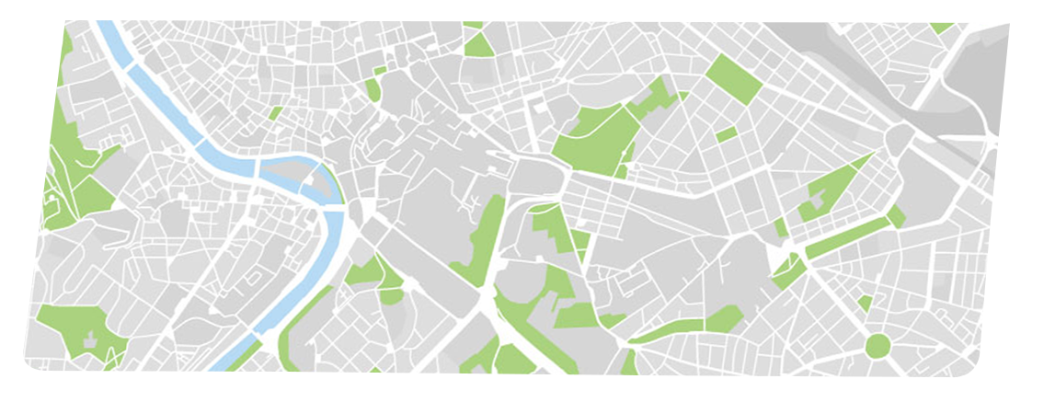
3 tentavivi se sbaglia torna indietro
08/13
01:00:00
The phone
is ringing.
The user clicks on the green icon.
Drag the three labels in the correct space. If you need help, you can call a friend.
3
1
MISSION
2
CAPABILITIES
USAGE
41

Slide 42




K9 Salesmen Knowledge Check up
08/13
01:00:00
The phone call.
Hey Mike, I’m a bit lost…
Why don’t you start from the basics?
Try to get to know the customer’s type and needs…
Okay…
Then, you could move to the vehicle’s specific requirements, and finally how they plan to use it.
CONTINUE
42
I think I got it! Thanks, Mike.
42
Notes:
Text and graphic slide. The speech bubbles represent an exchange between the driver and a friend, and appear in sequence from top to bottom. When the Continue button is pressed, learners return to the previous slide.

Slide 43
08/13
01:00:00
Drag the three labels in the correct space. If you need help, you can call a friend.
3
1
MISSION
2
CAPABILITIES
USAGE
43
Notes:
Drag and drop interaction.
The dashboard screen shows the text in the box. To advance from one paragraph to the next, learners need to click on the buttons.
After clicking LET’S TRY, the map shows on screen with the 3 numbered steps and 3 empty droppable areas next to them. Under the map, 3 text labels appear in random order and need to be dragged on the corresponding droppable areas: MISSION, CAPABILITIES, USAGE. When each item is dropped correctly, a feedback pop-up appears, providing more information about how to carry out the needs analysis (including some sample questions and focal points taken from the SOS).
When the third pop-up feedback is closed, learners advance to the next slide.
OPTIONAL: Learners can click on the phone icon, which will flash, and get a hint from a friend (see next slide).
Map image taken from: https://www.shutterstock.com/it/image-vector/vector-generic-city-map-navigator-screen-2712122447?trackingId=62844254-c22c-48de-8f6d-2289d5e3bd43&listId=searchResults

Slide 44

K9 Salesmen Knowledge Check up
08/13
01:00:00
Mission
How do you do it?
Sample questions:
Focal points:
Goods delivery
Food/Temperature controlled
Construction
People mover/Collective transport
Recreational
Special equipment (converted)
Craftsmen/Utilities
Merchant
What type of Customer are you helping (Individual or Business)?
What type of vehicle is he looking for?
How many vehicles?
CONTINUE
44
44

Slide 45
08/13
01:00:00
Drag the three labels in the correct space. If you need help, you can call a friend.
3
1
MISSION
2
CAPABILITIES
USAGE
45

Slide 46
K9 Salesmen Knowledge Check up
08/13
01:00:00
Capabilities
How do you do it?
Sample questions:
Focal points:
Max volume capacity (m³)
Average payload (Kg)
Max payload (Kg)
Towing capacity
Max number of passengers
What type of products do you carry?
Which load/volume do you need?
CONTINUE
46
46

Slide 47
08/13
01:00:00
Drag the three labels in the correct space. If you need help, you can call a friend.
3
USAGE
1
MISSION
2
CAPABILITIES
47

Slide 48
K9 Salesmen Knowledge Check up
08/13
01:00:00
Usage
How do you do it?
Sample questions:
Focal points:
Average km/day + daily journey variability
(Are longer trips possible vs standard trip?)
Working days/week
Working weeks/year
Average usage (% urban X extra-urban)
Special needs (if required)
Which type of roads do you cover more often?
How many Km per day?
CONTINUE
48
48

Slide 49




08/13
01:00:00
By investigating the three main areas, you will be able make a selection of 5 vehicles
(one which will always be a BEV)
to present to your customer,
as in this example.
174
versions
GOOD DELIVERY
Only Panel Van
60
versions
1100 kg payload
11-12 m³
3 seats
12
versions
50-100 km/day
50% Urban
I UNDERSTAND
Max 5 versions
49

Slide 50
08/13
01:00:00
When you are ready,
click on the icon to check your customers’ details.
50

Slide 51




08/13
01:00:00
Take a look at your calendar.
You are meeting FOUR CUSTOMERS today.
MR BLACK
MR MUSTARD
MR BROWN
MR WHITE
Click on the IMAGES to read their profiles and find out what their needs analysis reveals.
51

Slide 52


08/13
01:00:00
1
MISSION
Wine distributor serving restaurants and retailers in hilly areas, needing a reliable vehicle for daily deliveries of bottled wine.
2
CAPABILITIES
Minimum payload: 1,100 kg
Load volume: 7 m³
Enhanced traction and controlled descents for safe transport of fragile loads
3
USAGE
MR BLACK
Daily mileage: 90–130 km
Regular stops and steep downhill sections
52

Slide 53

08/13
01:00:00
1
MISSION
Tech-savvy professional managing a small service business, looking for a modern vehicle that supports connectivity, navigation and digital tools during daily operations.
2
CAPABILITIES
Load volume: 5–6 m³
Payload: 900–1,000 kg
3
USAGE
MR MUSTARD
Daily mileage: 60–100 km
Mainly urban routes
Frequent use of navigation, apps and hands-free communication while driving
53

Slide 54

08/13
01:00:00
1
MISSION
Customer evaluating a fleet of 10 commercial vehicles for medium-intensity daily operations.
2
CAPABILITIES
Payload: 1,000–1,200 kg
Load volume: 6–8 m³
3
USAGE
Daily mileage: 100–180 km
Mixed routes (urban + extra-urban)
Some vehicles operating on fixed routes suitable for BEV, others requiring ICE for longer range or flexibility
MR BROWN
54

Slide 55

08/13
01:00:00
1
MISSION
Small business owner replacing a damaged vehicle after an accident, looking for a vehicle with strong, reliable safety features as standard.
2
CAPABILITIES
Payload: ~900–1,100 kg
Load volume: ~6–7 m³
Additional driver assistance systems
3
USAGE
MR WHITE
Daily mileage: 70–120 km
Mainly urban driving
High exposure to traffic, frequent stops and interactions with other vehicles
55

Slide 56
08/13
01:00:00
MR BLACK
MR MUSTARD
MR BROWN
MR WHITE
It’s time to test your knowledge and see if you would be able
to help your customers by suggesting the correct features.
Click on the button to continue.
To return to this slide and review the profiles, click on the diary button.
LET’S GO
56

Slide 57
09/13
01:00:00
Mr Black works in hilly areas and would like to know how the K9 handles steep descents.
Which option would you highlight?
Grip Control with Hill Assist Descent available in the Worksite Pack
Standard Cruise Control
Eco mode to reduce speed
Click on the Mr Black image to view the customer profile again.
Select the correct answer and press Confirm.
CONFIRM
57
Notes:
This is a standard multiple-choice quiz with feedback. When the correct answer is given, the question counters increases by 1.

Slide 58
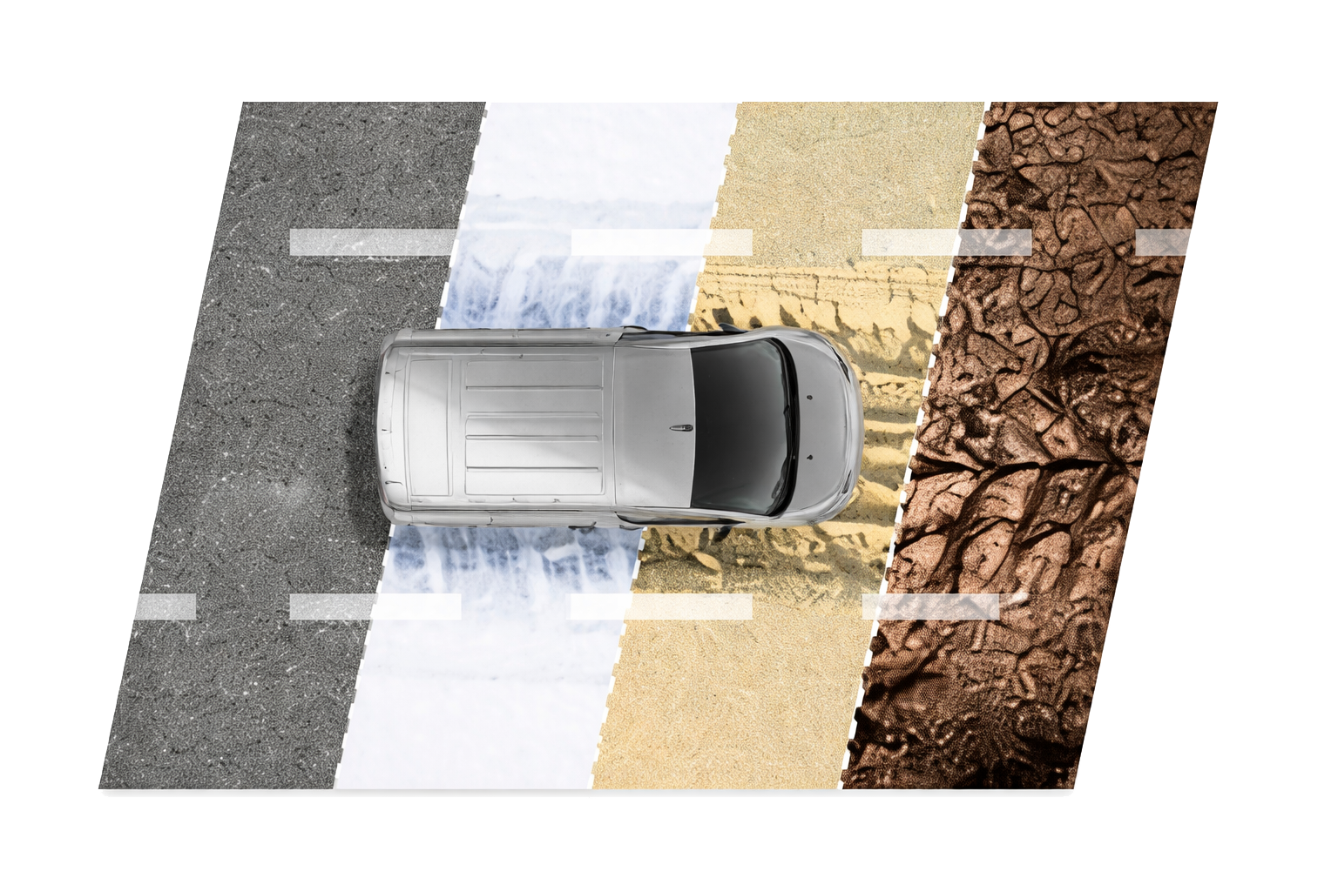
K9 Salesmen Knowledge Check up
09/13
01:00:00
Correct!
How do you do it?
Advanced Grip Control, available with the Worksite Pack, combines ESP with ASR, Grip control, and Hill Assist Descent Control.
It optimizes the traction of the vehicle and is controlled by a dedicated button.
Deliveries take place in hilly areas, with steep downhill sections and frequent stops.
The daily mileage is 90–130 km, so consistent safety and comfort are essential throughout the working day.
CONTINUE
58
58

Slide 59
K9 Salesmen Knowledge Check up
09/13
01:00:00
How do you do it?
Not really…
This answer won’t make you go any further.
TRY AGAIN
59
59

Slide 60
10/13
01:00:00
Mr Mustard seems to have a strong interest in technology.
Which argument could you use to convince him?
Infotainment with 10” HD screen and tablet-like interface
Basic audio system with 2 speakers
No smartphone integration
Click on the Mr Mustard image to view the customer profile again.
Select the correct answer and press Confirm.
CONFIRM
60
Notes:
This is a standard multiple-choice quiz with feedback. When the correct answer is given, the question counters increases by 1.

Slide 61
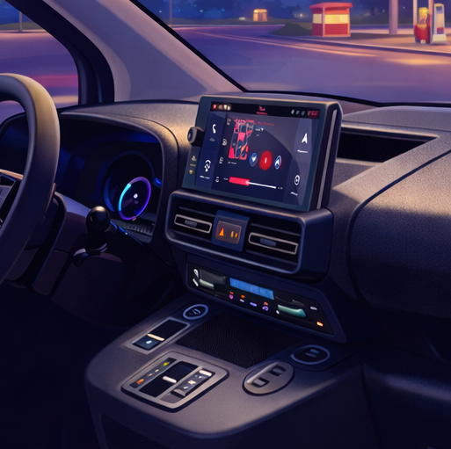
K9 Salesmen Knowledge Check up
10/13
01:00:00
Correct!
How do you do it?
For a tech-savvy professional who mainly works in the city and frequently uses navigation and apps, this system is essential.
The infotainment system with 10” HD screen and tablet-like interface was born from the idea of offering LCV users the best interaction of their smartphones.
Totally customizable with just a few gestures, it offers multi-windows, widgets and shortcuts with the responsiveness of a modern tablet.
CONTINUE
61
61

Slide 62
K9 Salesmen Knowledge Check up
10/13
01:00:00
How do you do it?
Not really…
This answer won’t make you go any further.
TRY AGAIN
62
62

Slide 63
11/13
01:00:00
Mr Brown has expressed an interest in learning about the choice of powertrains for his fleet.
Which options do you present him with?
Available in ICE and BEV versions
Only electric
Only diesel
Click on the Mr Brown image to view the customer profile again.
Select the correct answer and press Confirm.
CONFIRM
63
Notes:
This is a standard multiple-choice quiz with feedback. When the correct answer is given, the question counters increases by 1.

Slide 64
K9 Salesmen Knowledge Check up
11/13
01:00:00
Correct!
How do you do it?
 | LCV
 | Petrol | Diesel | BEV
140 HP
130 HP
110 HP
100 HP
As our customer is evaluating to buy /replace various commercial vehicles we can propose him a complete range of ICE and BEV powered powertrains, suitable for every need.
E
A
M
M
M
CONTINUE
64
64

Slide 65
K9 Salesmen Knowledge Check up
11/13
01:00:00
How do you do it?
Not really…
This answer won’t make you go any further.
TRY AGAIN
65
65

Slide 66
12/13
01:00:00
Mr White needs a new LCV since his previous one was damaged in an accident. He asks about the active safety features of the K9.
How would you describe the vehicle’s ADAS equipment?
Standard ADAS on all versions, including AEBS (Advanced Emergency Braking System) to reduce collision risk
Adaptive Cruise Control
Active safety systems such as Lane Keep Assist are available only on top versions
Click on the Mr White image to view the customer profile again.
Select the correct answer and press Confirm.
CONFIRM
66
Notes:
This is a standard multiple-choice quiz with feedback. When the correct answer is given, the question counters increases by 1.

Slide 67
K9 Salesmen Knowledge Check up
The phone is ringing.
The user clicks on the green icon.
Hey Mike, I’m not sure about the ADAS available on the K9…
Well, it’s easy.
EU Regulations define the new and highest safety requirements. Our vehicles ensure the highest standards by offering a our full ADAS package as standard across the whole range.
Got it! Thanks.
CONTINUE
67
67
Notes:
Text and graphic slide. The speech bubbles represent an exchange between the driver and a friend, and appear in sequence from top to bottom. When the Continue button is pressed, learners return to the previous slide.

Slide 68
K9 Salesmen Knowledge Check up
Correct!
How do you do it?
All Stellantis vehicles have a comprehensive ADAS package as standard in all versions, including AEBS, a key feature to reduce collision risk especially in urban driving.
Mr White is looking for real safety, business continuity, and protection of his investment with no additional cost.
CONTINUE
68
68

Slide 69
K9 Salesmen Knowledge Check up
How do you do it?
Not really…
This answer won’t make you go any further.
TRY AGAIN
69
69

Slide 70
Congratulations!
You have proved your ability in understanding your customers’ needs!
You are almost ready to go.
CONTINUE
70
Notes:
Text and graphic slide.
The question counter is updated, the countdown keeps running, the badge corresponding to the needs analysis section (the handshake icon) has turned green.

Slide 71


K9 Salesmen Knowledge Check up
Before finding the key, there is one more thing you need to do.
Use your mouse to explore…
STEERING WHEEL
71

Slide 72
13/13
01:00:00
Which K9 configuration includes paddles for regenerative braking selection?
Only on BEV
On BEV and ICE Diesel with AT as an optional
Only on ICE with AT
Select the correct answer and press Confirm.
CONFIRM

Slide 73
K9 Salesmen Knowledge Check up
11/05
01:00:00
Correct!
How do you do it?
Regenerative braking paddles are available on BEV
Paddles optimize efficiency by adjusting the regenerative braking intensity according to driving conditions.
Their benefits are particularly significant for those who drive in the city.
CONTINUE
73
73

Slide 74
K9 Salesmen Knowledge Check up
11/05
01:00:00
How do you do it?
Not really…
This answer won’t make you go any further.
TRY AGAIN
74
74

Slide 75


K9 Salesmen Knowledge Check up
Congratulations!
By solving all the challenges, you have demonstrated your technical expertise
and ability to identify your customers’ needs.
Find the last element and get ready for the journey!
75

Slide 76
You have found the key!
It was in the door pocket all the time… You can now turn on the vehicle and go.
Drag the key over the ignition area
76

Slide 77
77

