Slide 1
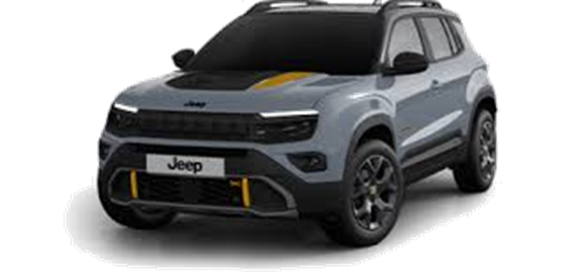

HEADER / ID OF THE CAPSULES
Jeep® Avenger MY26 & new Safety Warnings
WWCPJE506194B01EN
Jeep® Avenger MY26 is arriving! Let’s discover the novelties both on Product and Safety sides.

Slide 2
HEADER / ID OF THE CAPSULES
Jeep
Product
EN
/ subtrack
Jeep/ Avenger

Slide 3

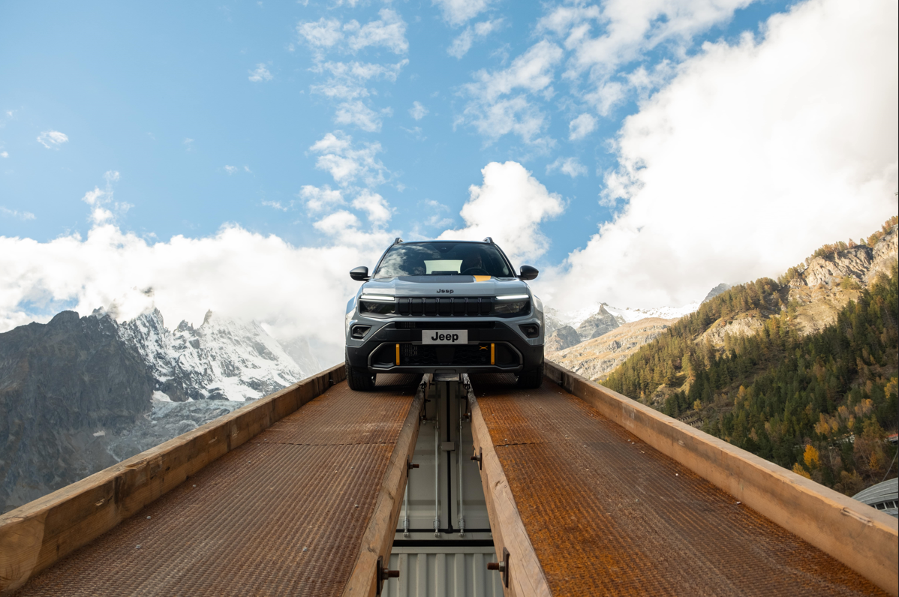

COVER Card
INTRODUCTION
Since its launch in 2023, Avenger has achieved unprecedented success confirmed by the achievement of the "Car of the Year" and more than 200,000 customer orders.
As we know, its success is based on 3 pillars:
Design to function
Capability
Technology
They fully represent the spirit of Avenger.
Image
Text1
Launched in 2023, Avenger won "Car of the Year" achievement with 200,000 orders, driven by design, capability, and technology.
Text2
Continue

Slide 4

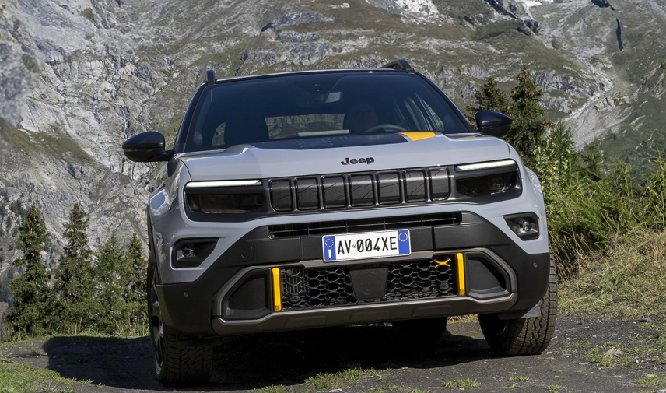
Quiz before topic
When talking about Design, what «Design to work» mean?
Image
More dynamic lines for an aesthetic that catches people's attention
Taut lines typical of SUVs primarily oriented towards off-road use
Functional design oriented to the 360° body protection
text

Slide 5
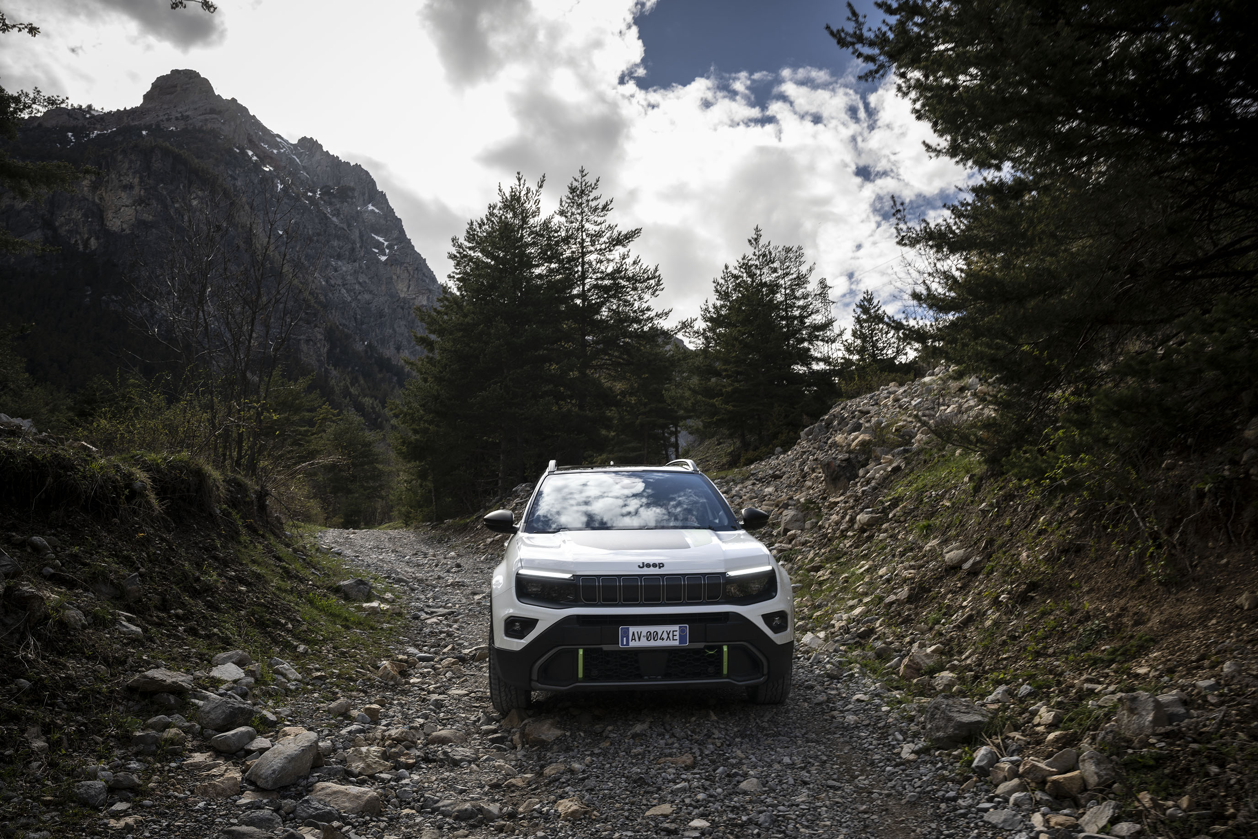
Quiz before topic
Speaking of Capability, what is the secret of unparalleled traction and off-road performance of JEEP® Avenger 4xe?
Image
The carbon driveshaft combined with the off road tyres specifically developed for Avenger 4xe
The carbon driveshaft with limited slip differential
The integration of the all-wheel drive system with the 48V Hybrid technology, Jeep® provides electrified and seamless performance in different driving conditions.
text
Jeep® combines AWD and 48V hybrid tech for seamless, electrified driving in all conditions.

Slide 6
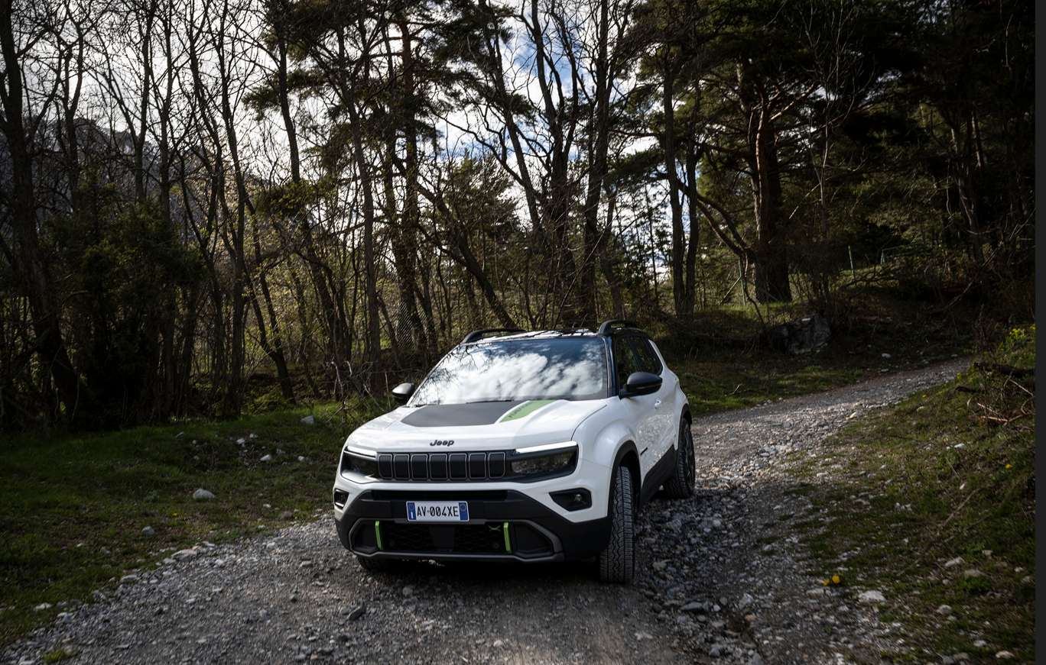
Quiz before topic
Speaking of Technology, how does "power looping" work?
Image
Front thermal engine provides traction to the front wheels. Front electric motor works act as a generator and supplies power to the rear electric one which provides traction to rear wheels
Front thermal engine provides traction to the rear wheels. Rear electric motor provides traction to front wheels
Front thermal engine works as a generator and supplies energy to the rear electric one that provides traction to rear wheels
Front thermal engine works as a generator and supplies energy to the rear e-motor, which drives the rear wheels.
Front thermal engine provides traction to the front wheels. Front electric motor acts as generator and powers the rear electric one providing traction to rear wheels
text

Slide 7
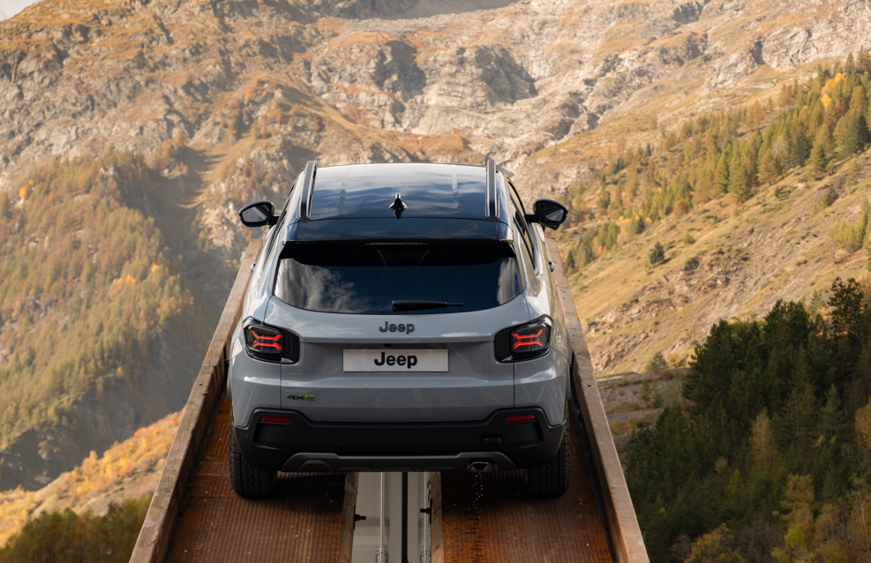
Card
AVENGER MY26: CONTINUITY WITH MY25
This year too, Jeep Avenger is being renewed but it does so in full continuity with the MY 25, keeping unchanged:
range structure
trim levels
pack strategy
According to markets derogation rules the Petrol Manual transmission will be closed for orders in two phases: July ‘25 or October ‘25
MY 26 will maintain the model series “2” as MY 25
The MY 26 version instead introduces novelties concerning Product.
Let’s discover the details.
Image
Text1
Text2
Continue

Slide 8
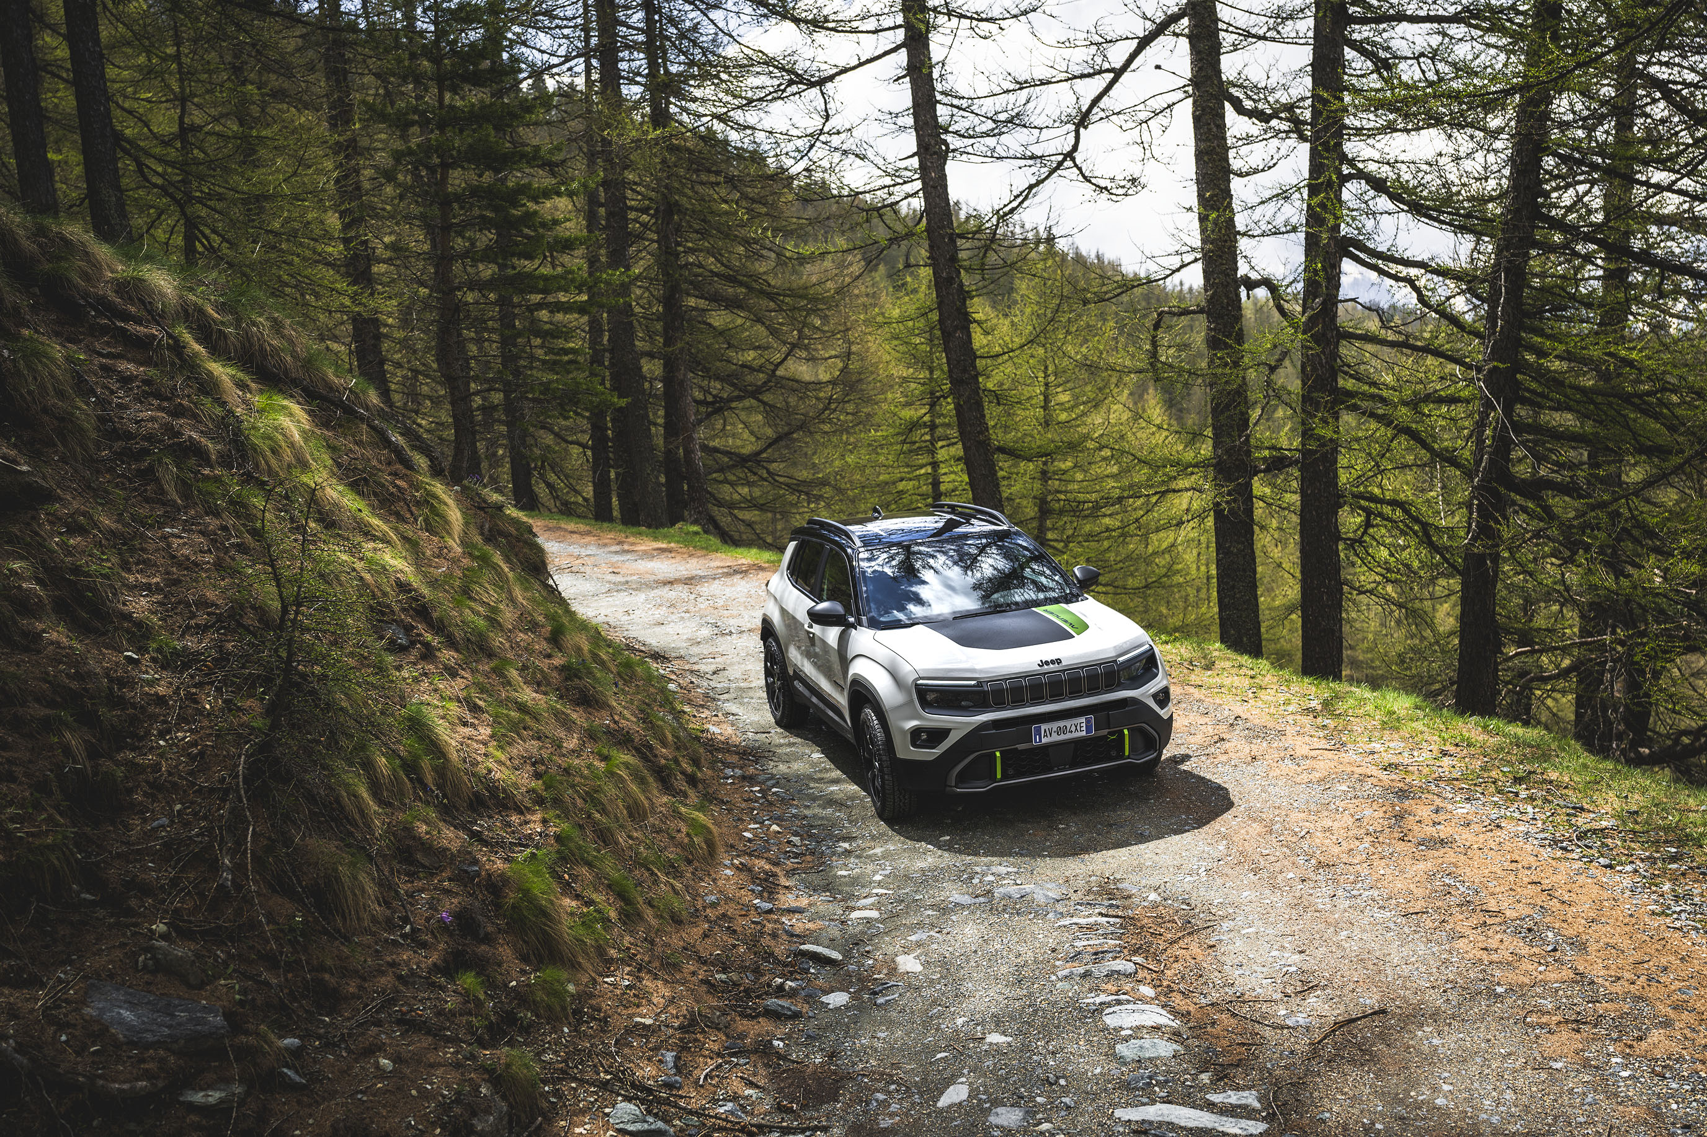
Card
AVENGER MY 26: ENGINES RANGE
The second MY 26 novelty concerns the engine range update and compliance with emission regulation.
In details:
Engines range: the 100 HP 1.2 ICE manual transmission engine is being discontinued. The engine's runout phase occurs as follows:
  - end October: closing orders
  - end December: stop production
  2) Emission compliance: the e-Hybrid 1.2 110 HP engine complies with Euro 6 E Bis homologation
Image
Text1
Text2
Continue

Slide 9
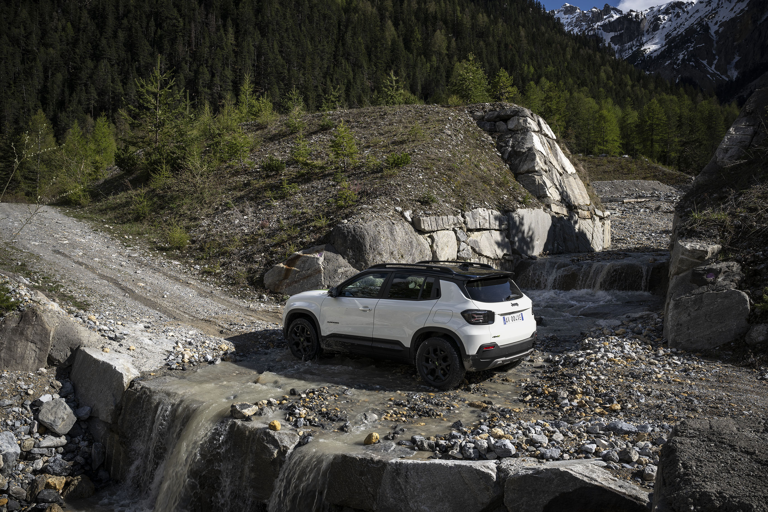
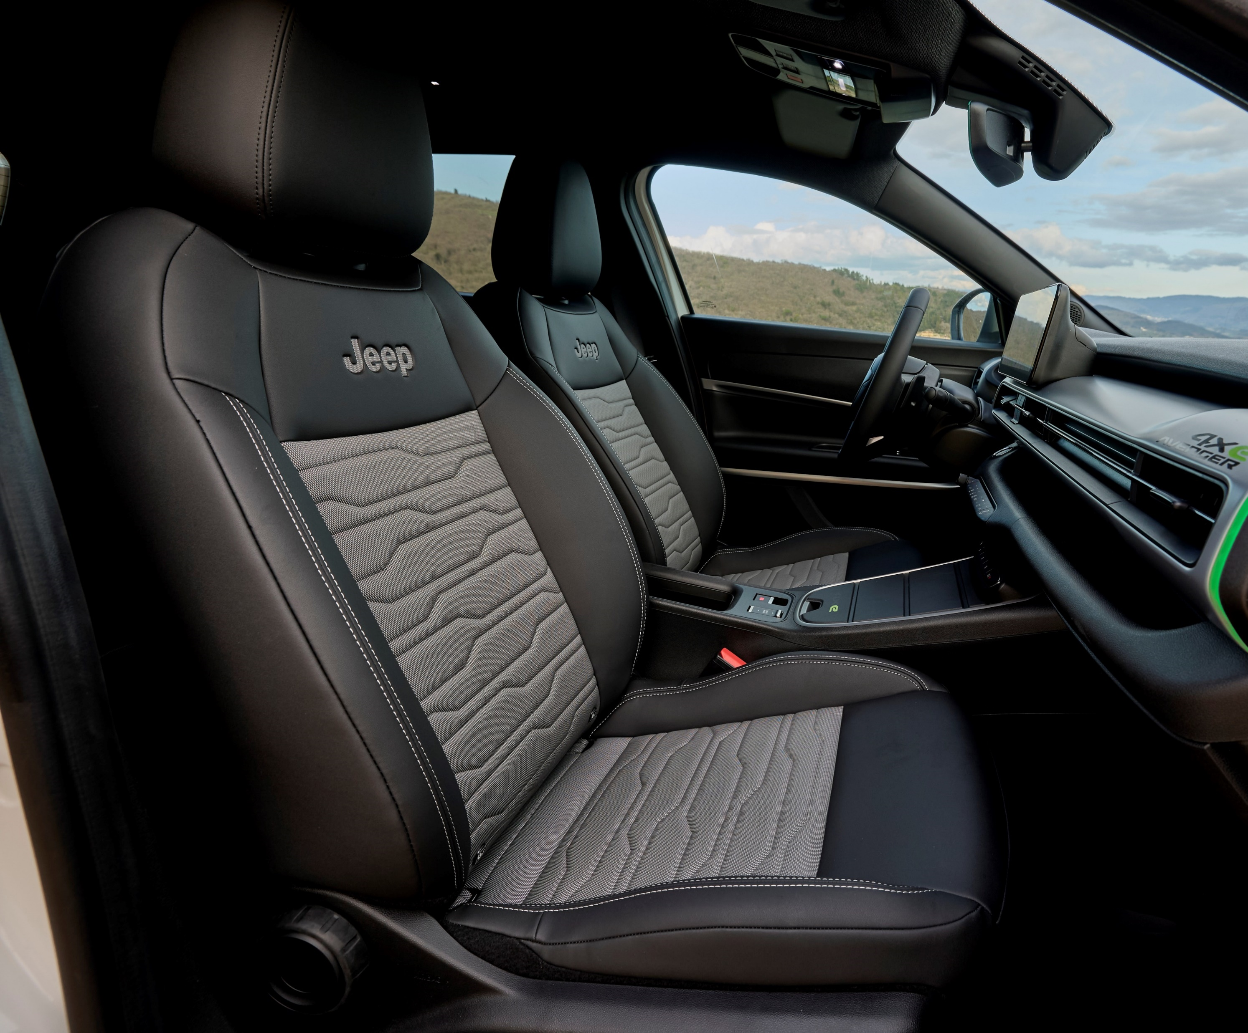
Card
AVENGER MY 26: PRODUCT CHANGES (1/4)
Product updates refer to:
Black Headliner
What: All Avenger versions will have the black headliner, actually dedicated to 4xe
When: from October
Image
Text1
Text2
Continue

Slide 10
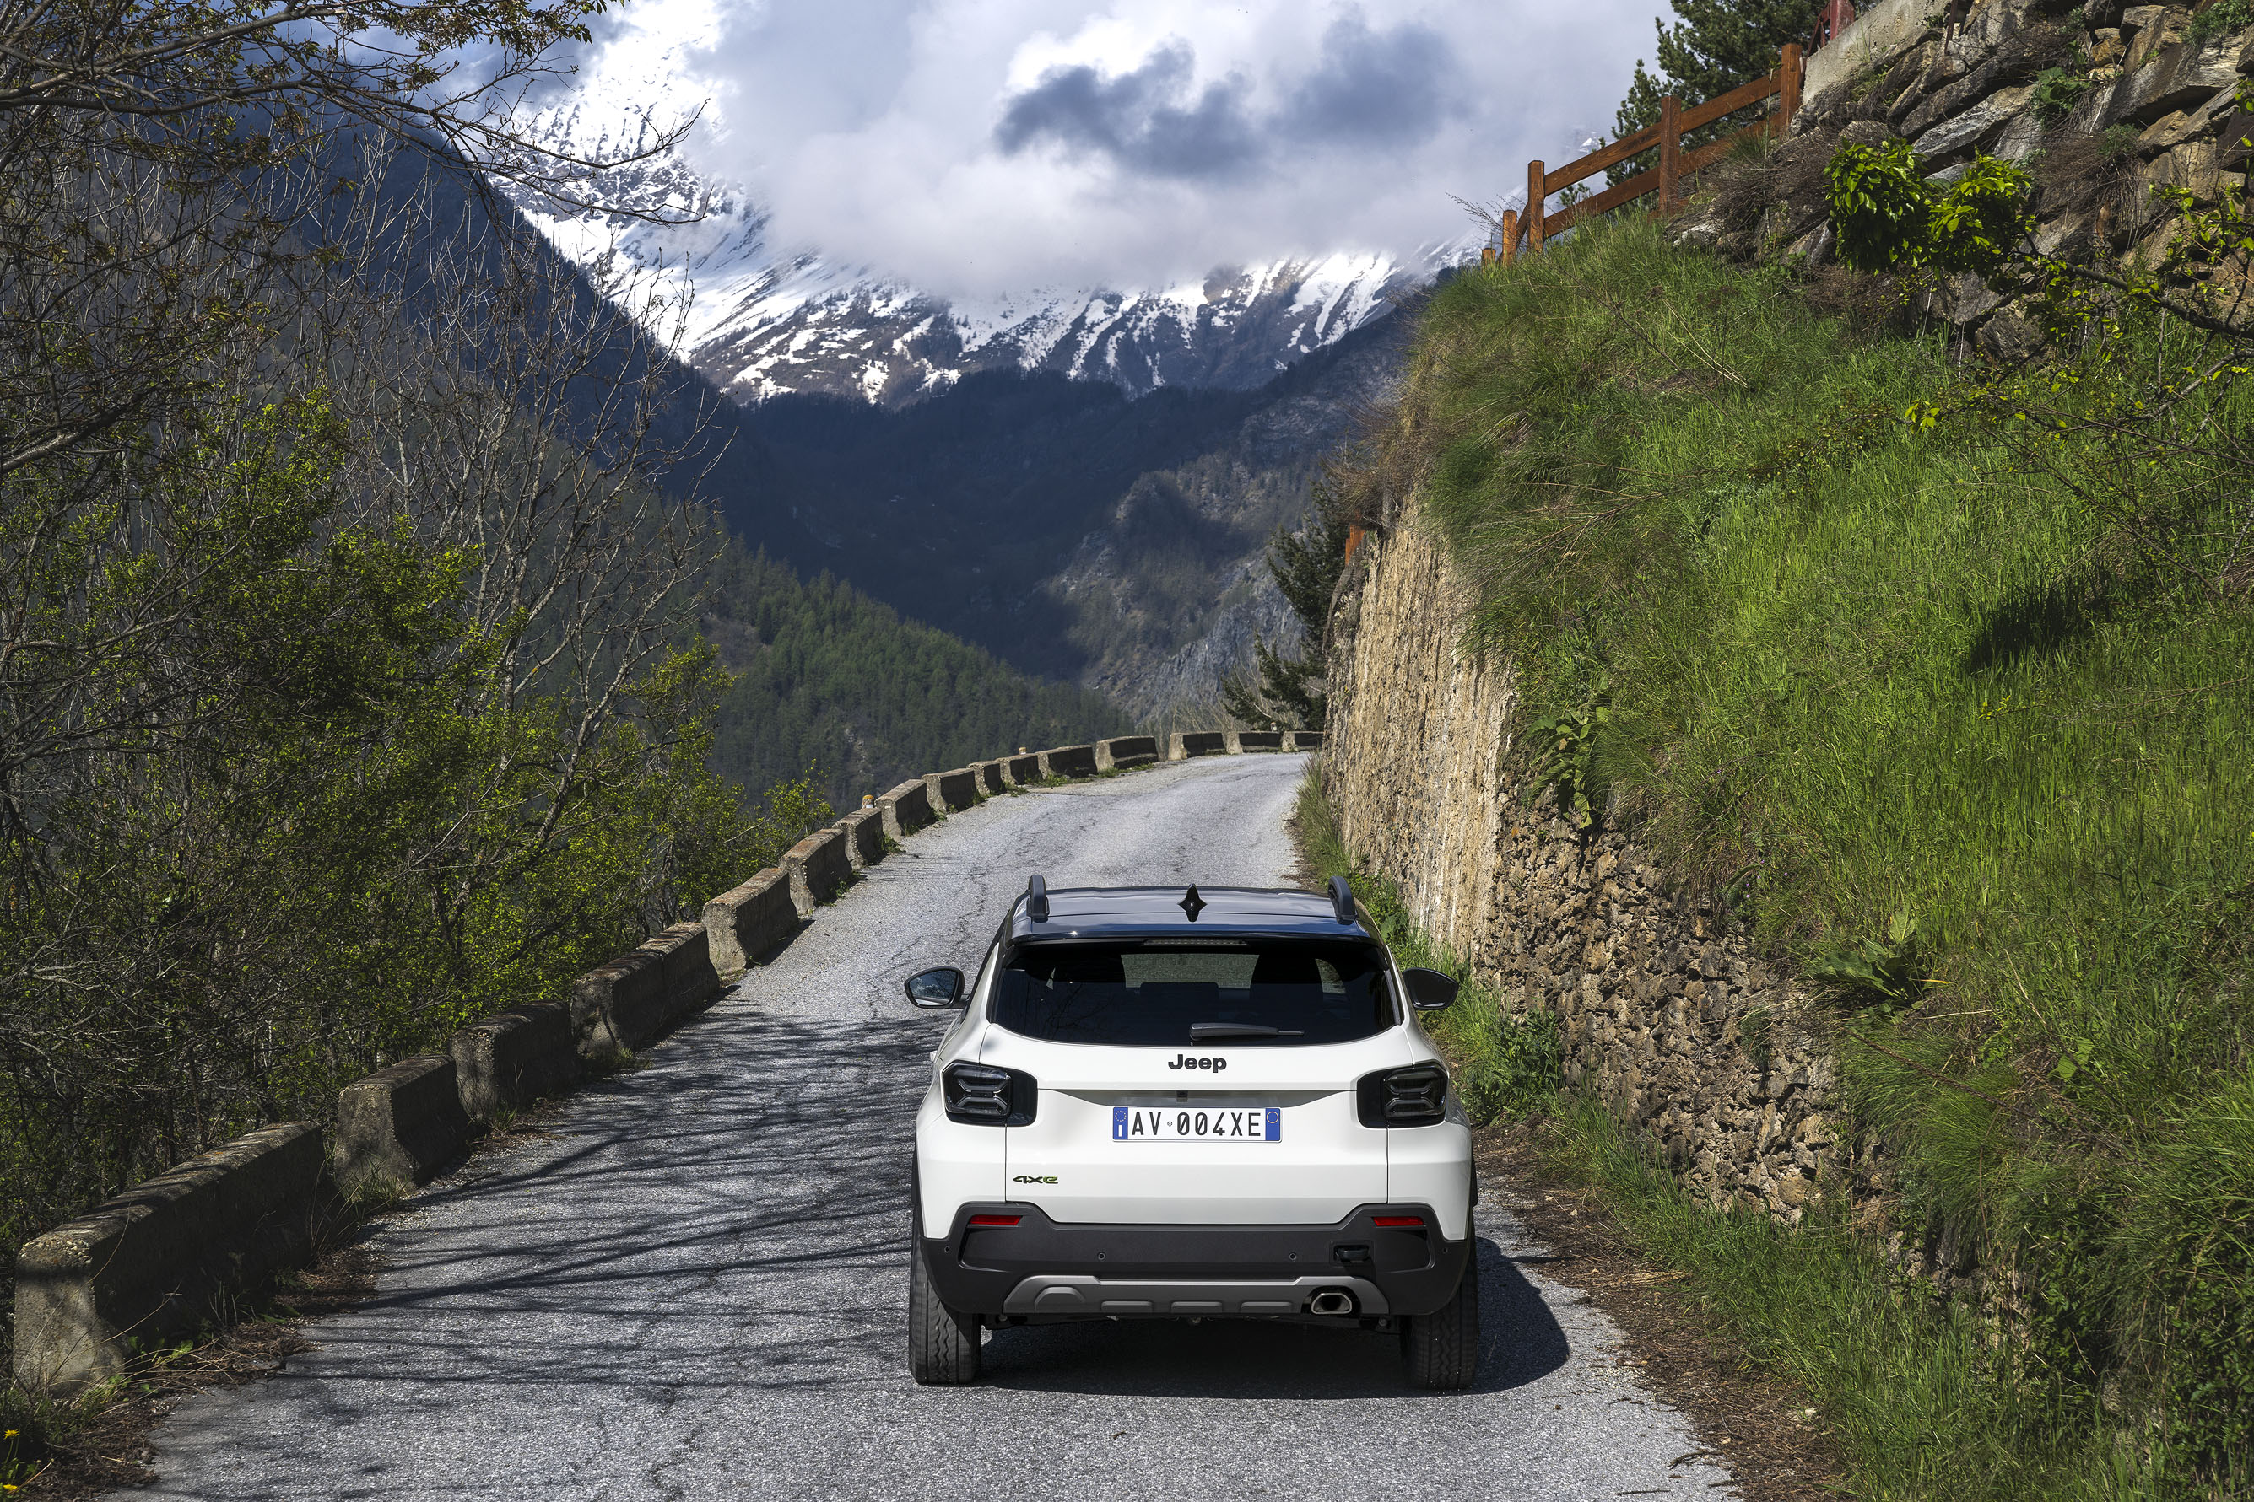
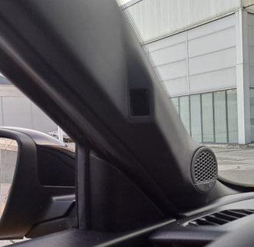
Card
AVENGER MY 26: PRODUCT CHANGES (2/4)
DAA Camera
What: Introduction of the Driver Attention Assist Camera available as standard
When: from October BEV, Q1 ‘26 e-Hybrid/4xe
Image
Text1
Text2
Continue

Slide 11
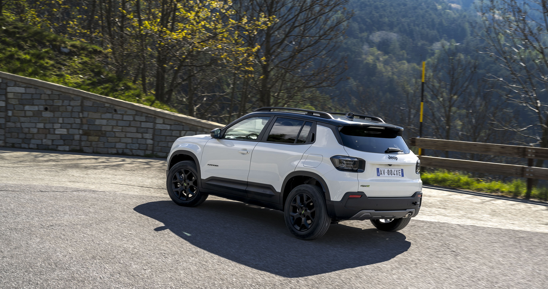
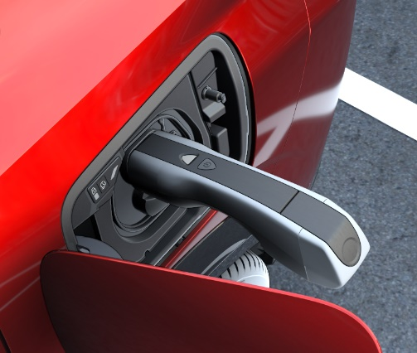
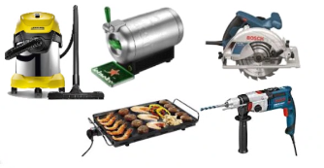
Card
AVENGER MY 26: PRODUCT CHANGES (3/4)
Latest product changes which impact the BEV version only:
Vehicle to Load availability (V2L)
What:
V2L allows electric vehicles to supply power from its battery to external electrical devices and appliances
V2L provides power of up to 3.6 kW AC (16A) and energy is supplied through specific adapter.
Adapter is sold through F2Move and Dealers/Aftersales
When: from October
Image
Text1
Text2
Continue

Slide 12
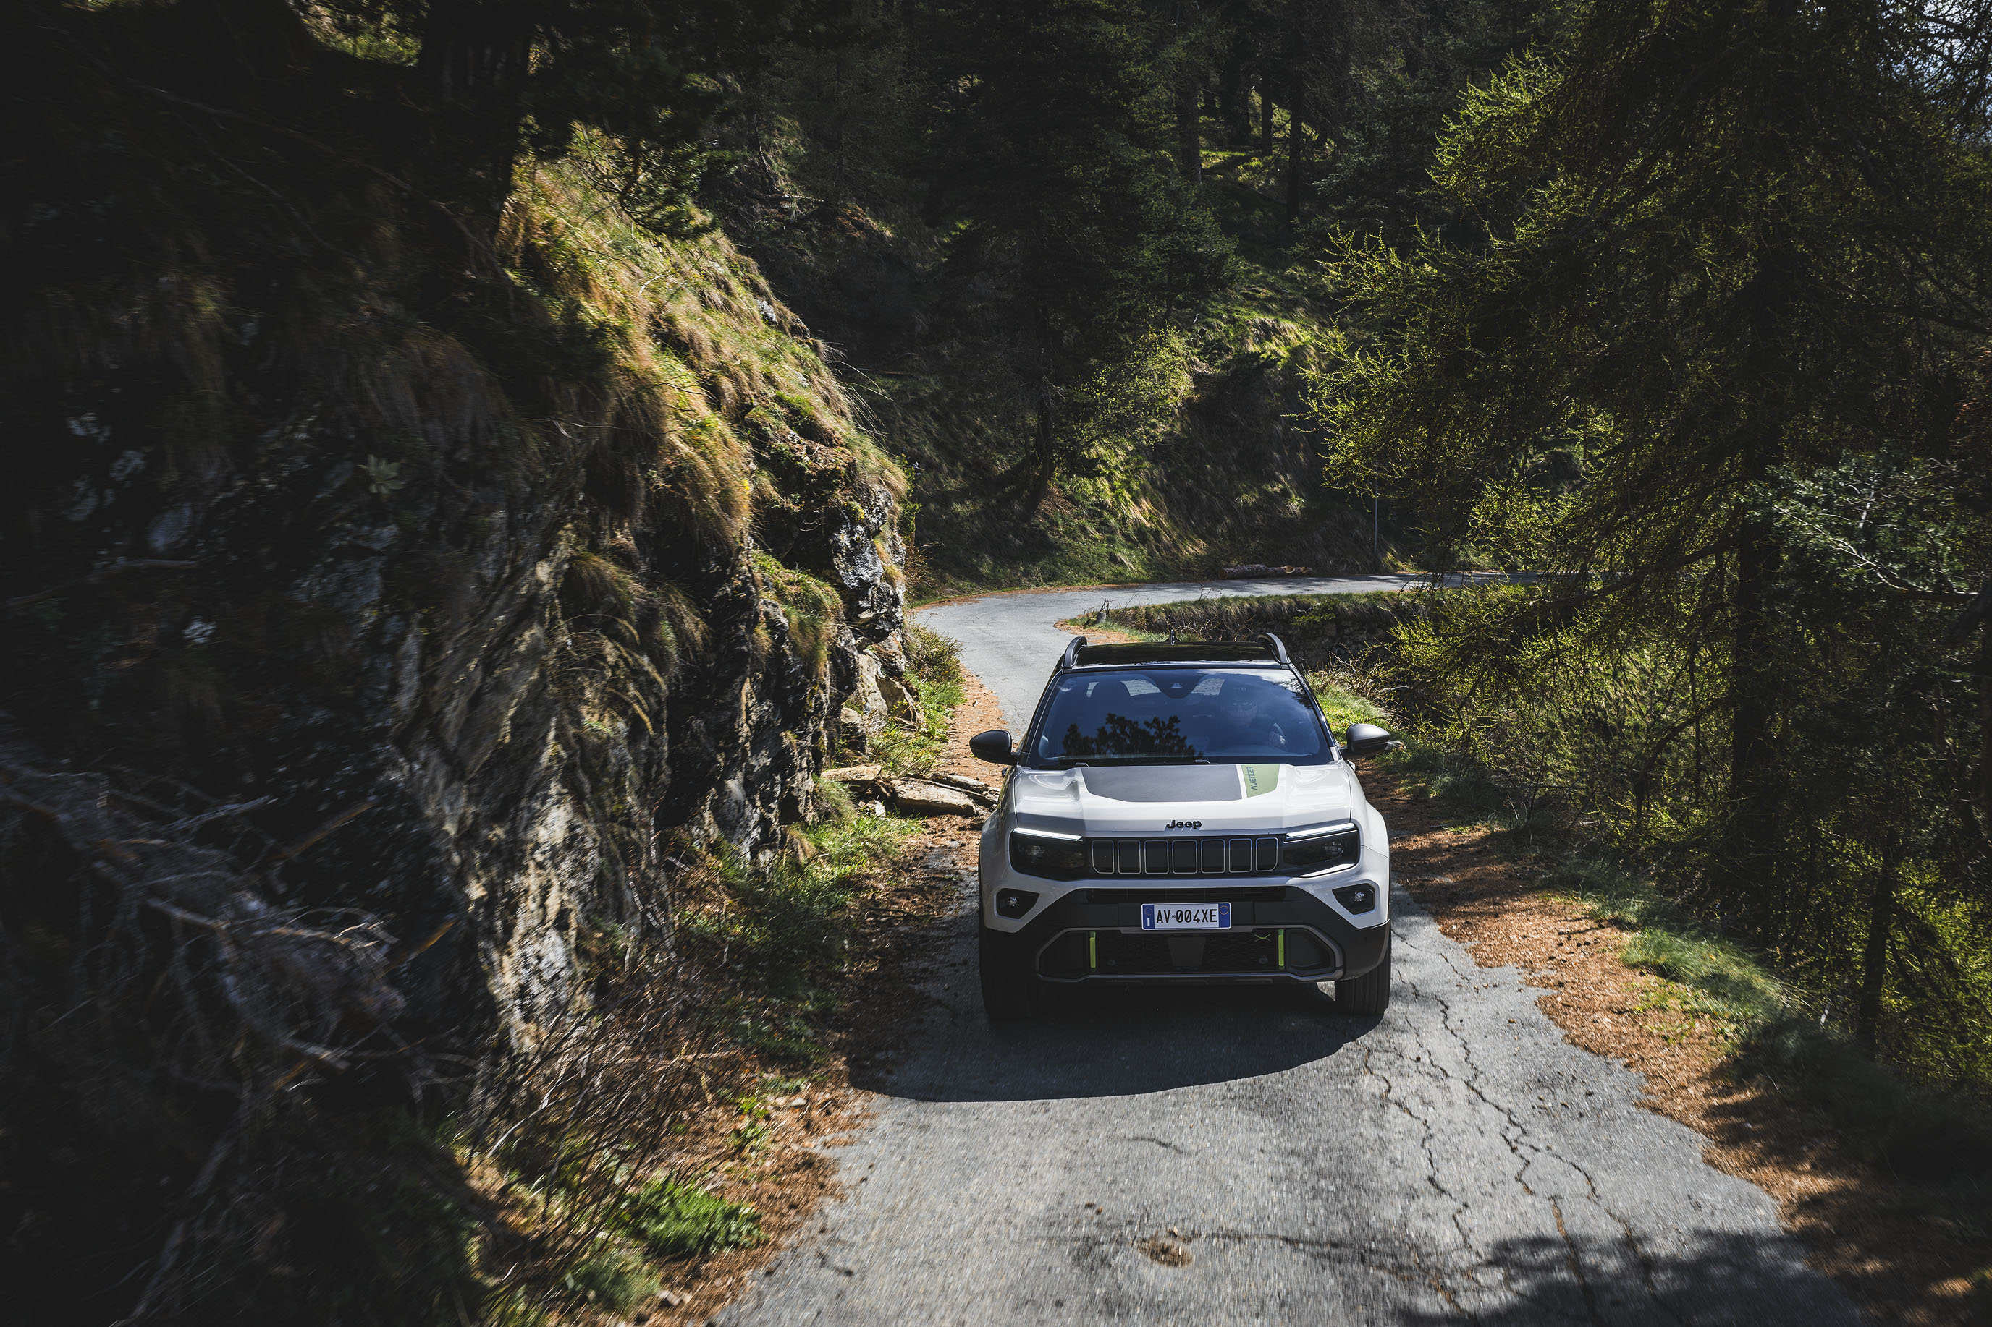
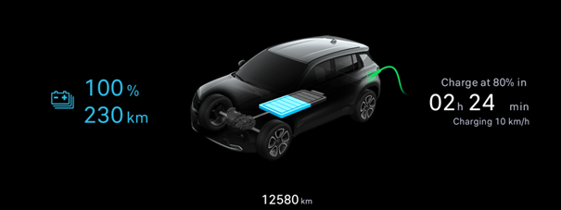
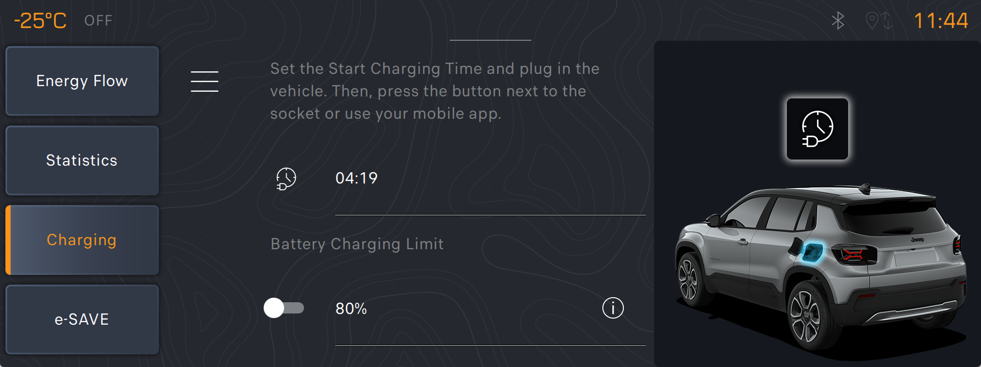
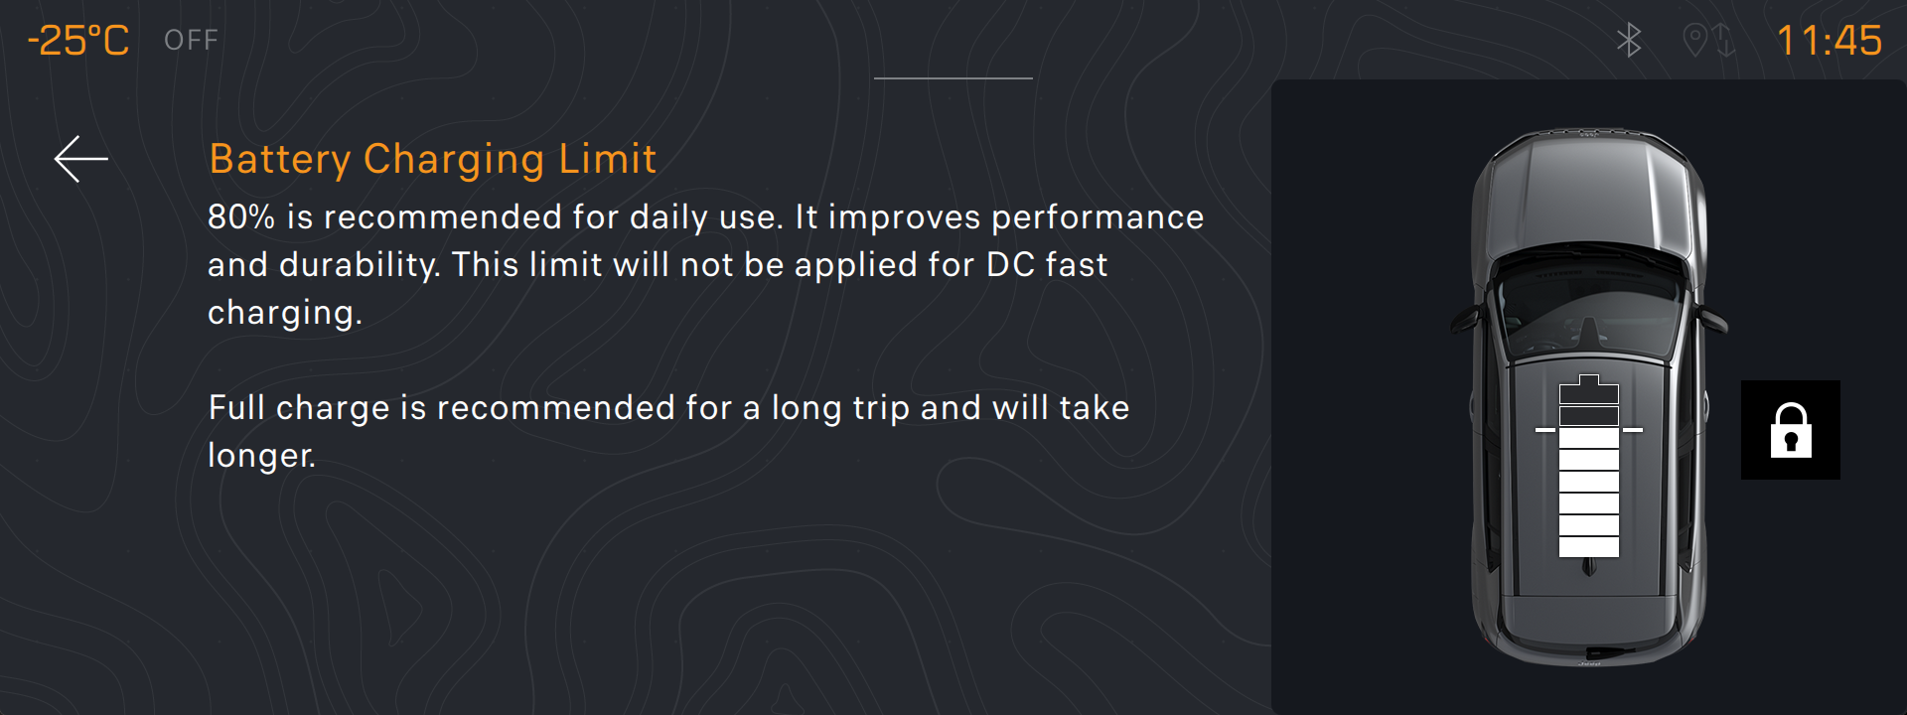
Card
AVENGER MY 26: PRODUCT CHANGES (4/4)
Latest product changes which impact the BEV version only:
80% Charge Limit Warning
What:
This function allows customer to optimize charging speed and battery life by limiting the charge percentage to 80%.
Below are screenshots highlighting the warnings on:
Radio and Cluster display
Mobile App
When: from October
Image
Text1
Text2
Continue

Slide 13
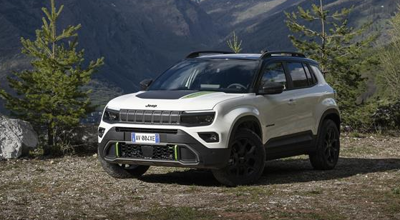
COVER Card
CONCLUSION
What is important to remember about this capsules dedicated to the Jeep® Avenger MY 26?
Image
Text1
Text2
Continue

Slide 14
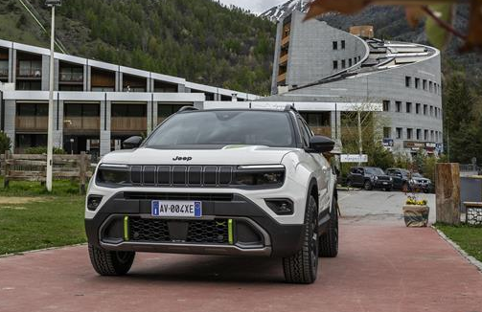
Card
KEY POINTS TO REMEMBER (1/2)
1) Two years after its official launch, the Jeep Avenger has surpassed 200,000 orders. It is the best-selling model in its class in Italy, while it ranks among the top ten in Europe.
2) With the MY 26 version Avenger is renewed in continuity with the MY 25 one, keeping unchanged:
range structure
trim levels
pack strategy
Image
Text1
Text2
Continue

Slide 15
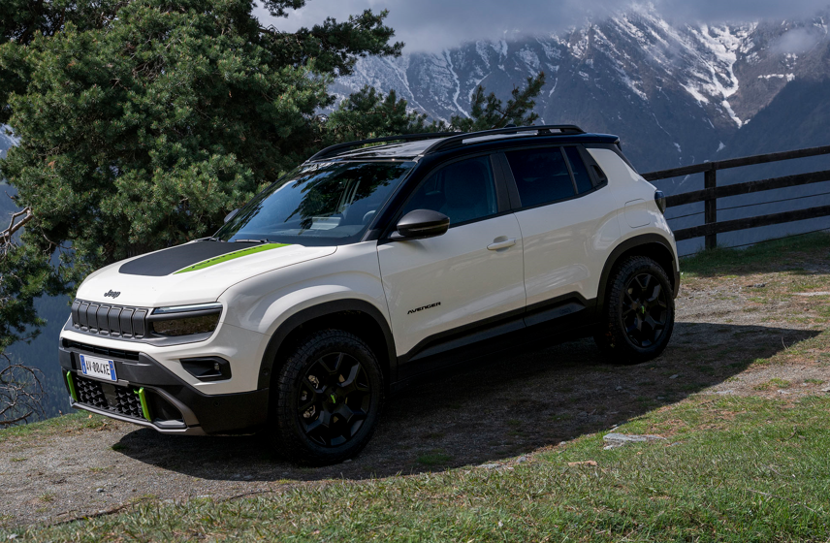
Card
KEY POINTS TO REMEMBER (2/2)
3) MY 26 introduce novelties concerning Product and Engines Range
4) Engines range update applies to:
the 1.2 ICE 100HP manual transmission engine will no longer be available
the e-Hybrid 1.2 110 HP engine complies with Euro 6 E Bis homologation
5) Product updates refer to:
Black headliner for all the versions
Introduction of the DAA Camera
Availability of the Vehicle to Load (V2L)
Introduction of the 80% Charge Limit Warning
Great sales with the new Jeep® Avenger MY 26!
Image
Text1
Text2
Continue

