Slide 1
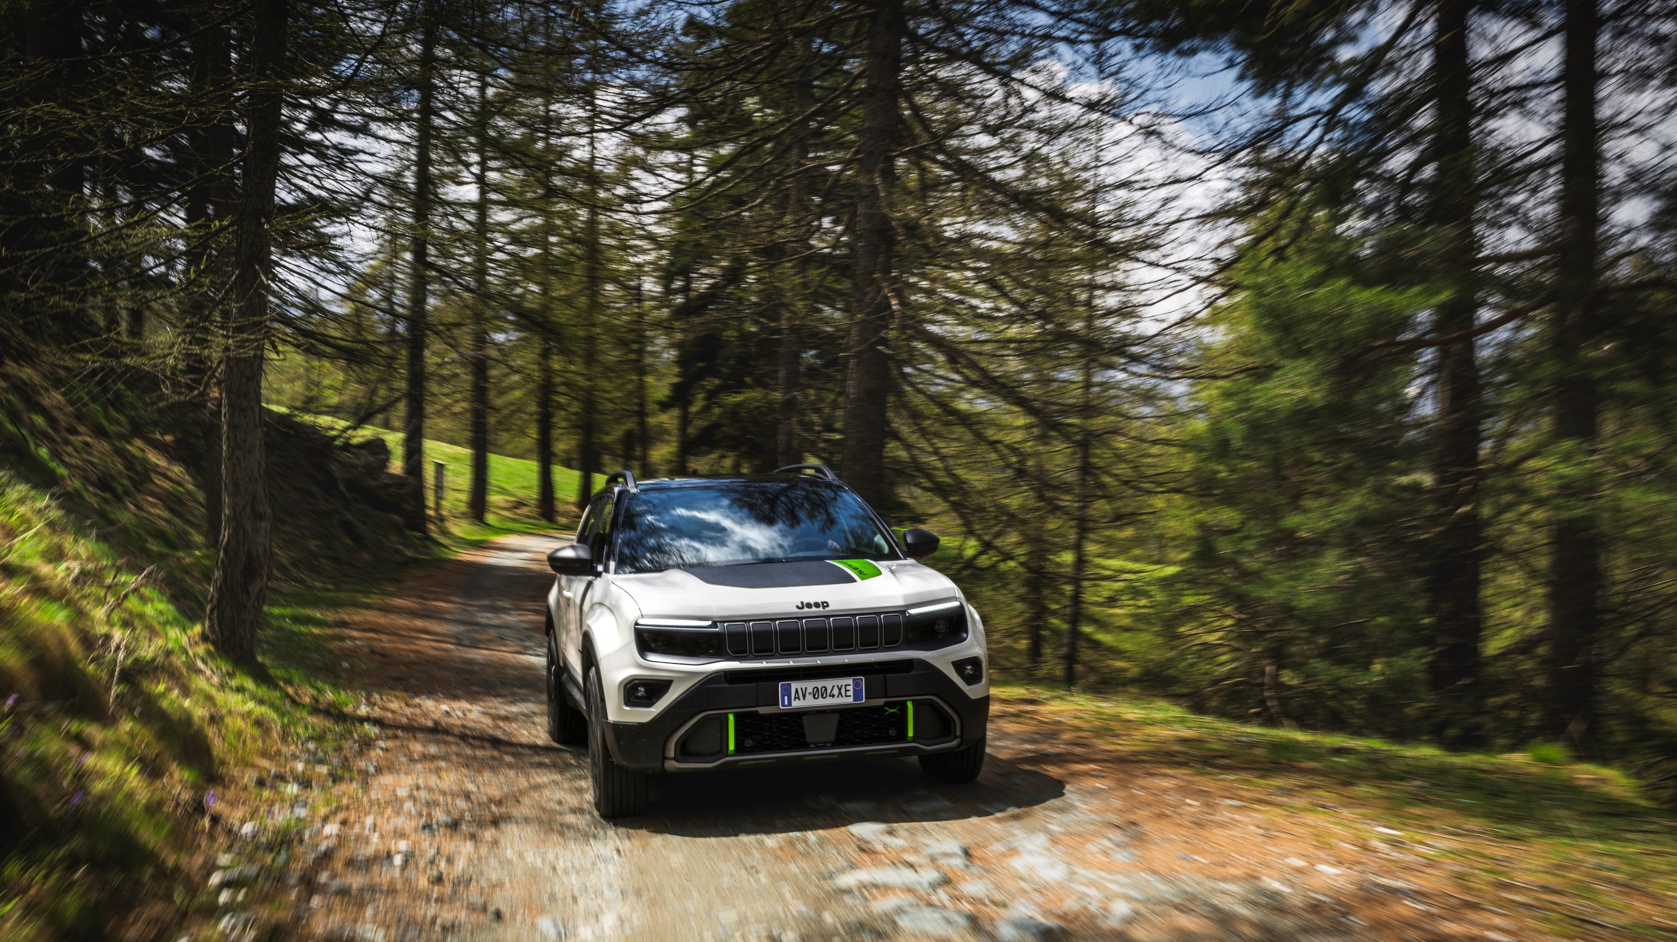


MY26
& new Safety Warnings

Slide 2
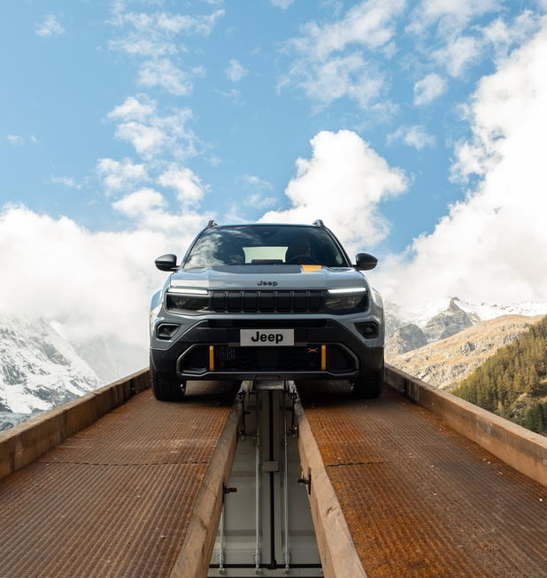
INTRODUCTION
Launched in 2023, Avenger won "Car of the Year" achievement with 200,000 orders, driven by design, capability, and technology.

Slide 3
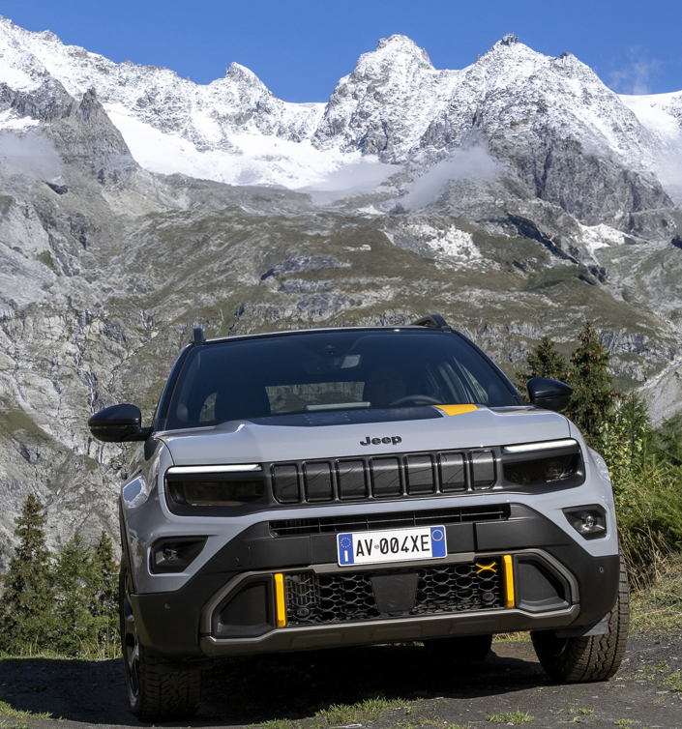
When talking about Design, what «Design to work» mean?
More dynamic lines for an aesthetic that catches people's attention
Taut lines typical of SUVs primarily oriented towards off-road use
Functional design oriented to the 360° body protection

Slide 4
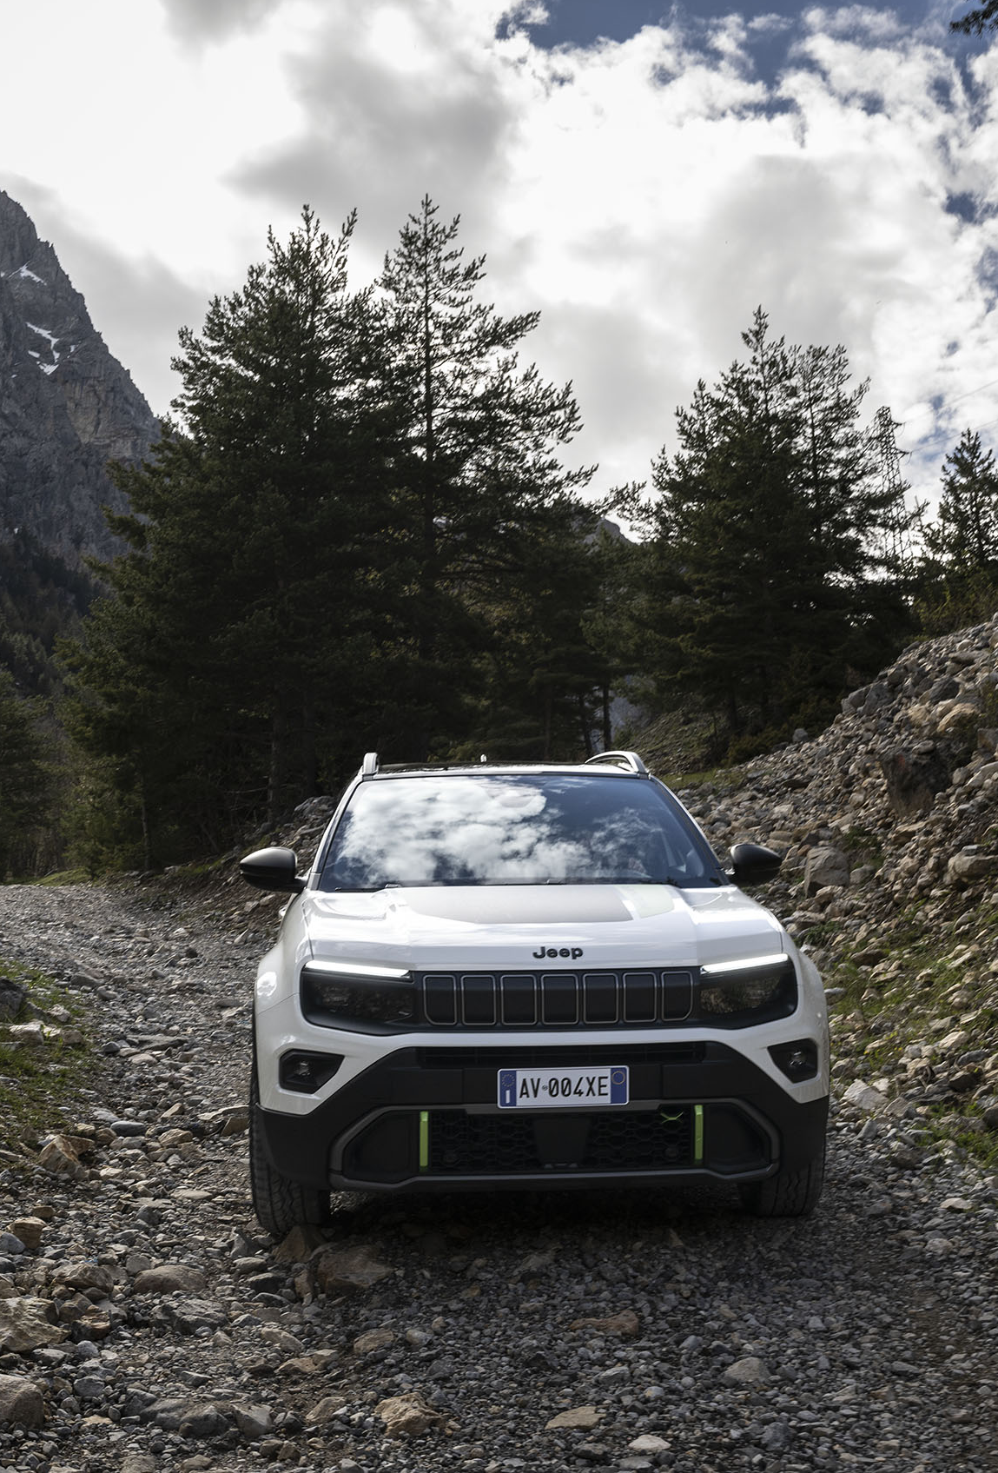
Speaking of Capability, what is the secret of unparalleled traction and off-road performance of JEEP® Avenger 4xe?
The carbon driveshaft combined with the off road tyres specifically developed for Avenger 4xe
The carbon driveshaft with limited slip differential
Jeep® combines AWD and 48V hybrid tech for seamless, electrified driving in all conditions.

Slide 5
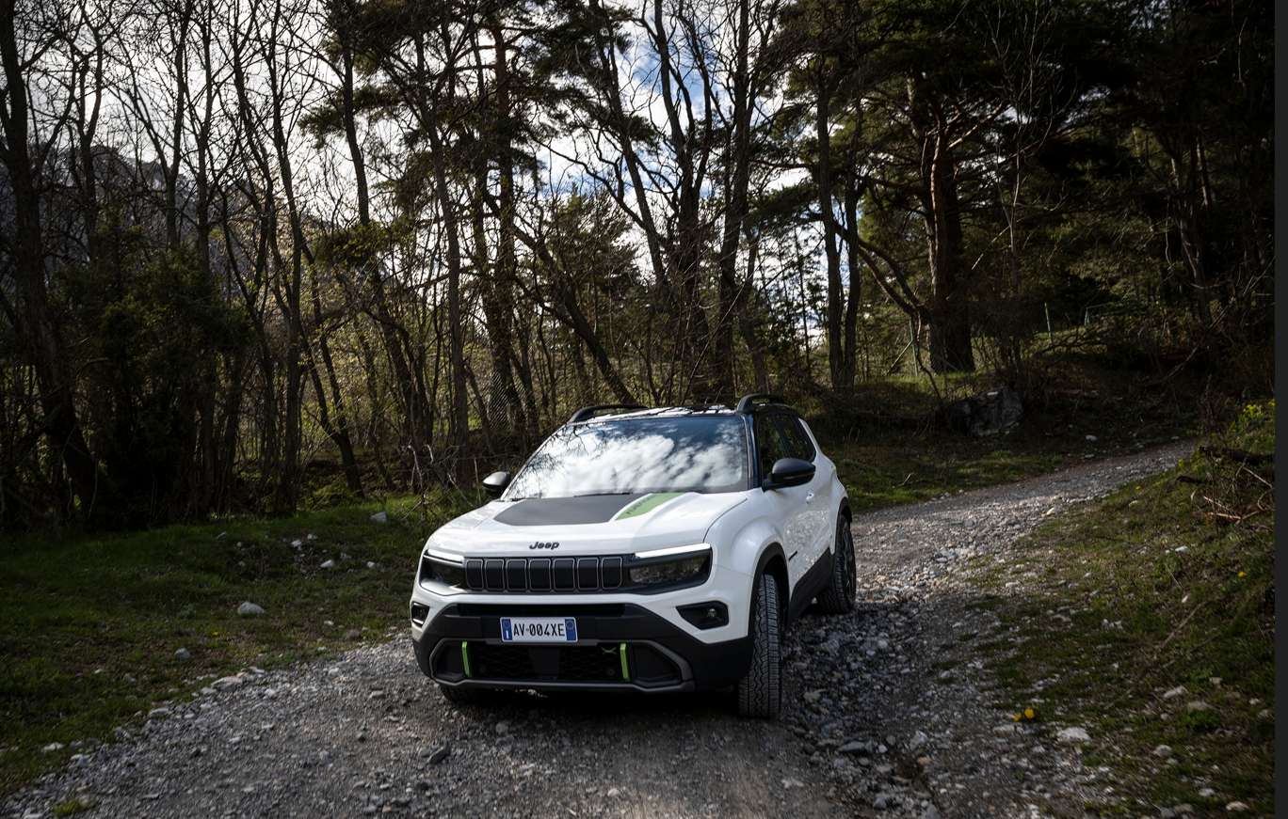
Speaking of Technology, how does "power looping" work?
Front thermal engine provides traction to the front wheels. Front electric motor acts as generator and powers the rear electric one providing traction to rear wheels
Front thermal engine provides traction to the rear wheels. Rear electric motor provides traction to front wheels
Front thermal engine works as a generator and supplies energy to the rear e-motor, which drives the rear wheels.

Slide 6
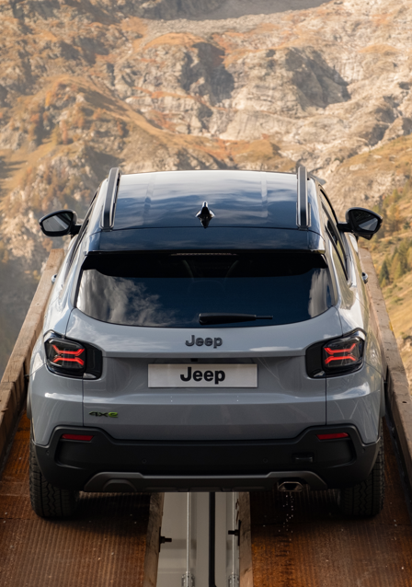
AVENGER MY26: CONTINUITY WITH MY25
This year too, Jeep® Avenger is being renewed but it does so in full continuity with the MY 25, keeping unchanged:
range structure
trim levels
pack strategy
According to markets derogation rules the Petrol Manual transmission will be closed for orders in two phases: July ‘25 or October ‘25
MY 26 will maintain the model series “2” as MY 25
The MY 26 version instead introduces novelties concerning Product.
Let’s discover the details.

Slide 7
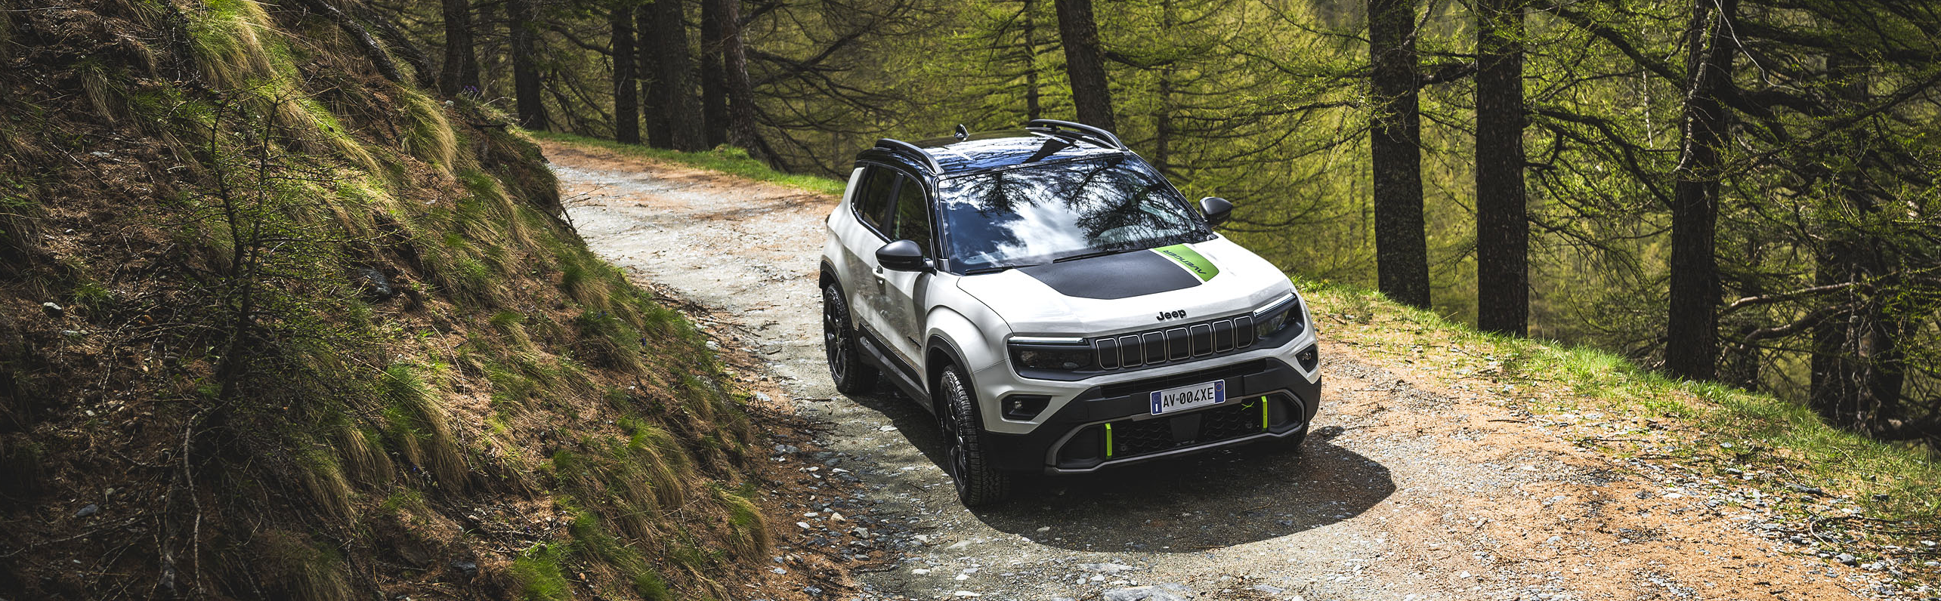
AVENGER MY 26: ENGINES RANGE
The second MY 26 novelty concerns the engine range update and compliance with emission regulation.
In details:
Engines range: the 100 HP 1.2 ICE manual transmission engine is being discontinued. The engine's runout phase occurs as follows:
end October: closing orders
end December: stop production
Emission compliance: the e-Hybrid 1.2 110 HP engine complies with Euro 6 E Bis homologation

Slide 8
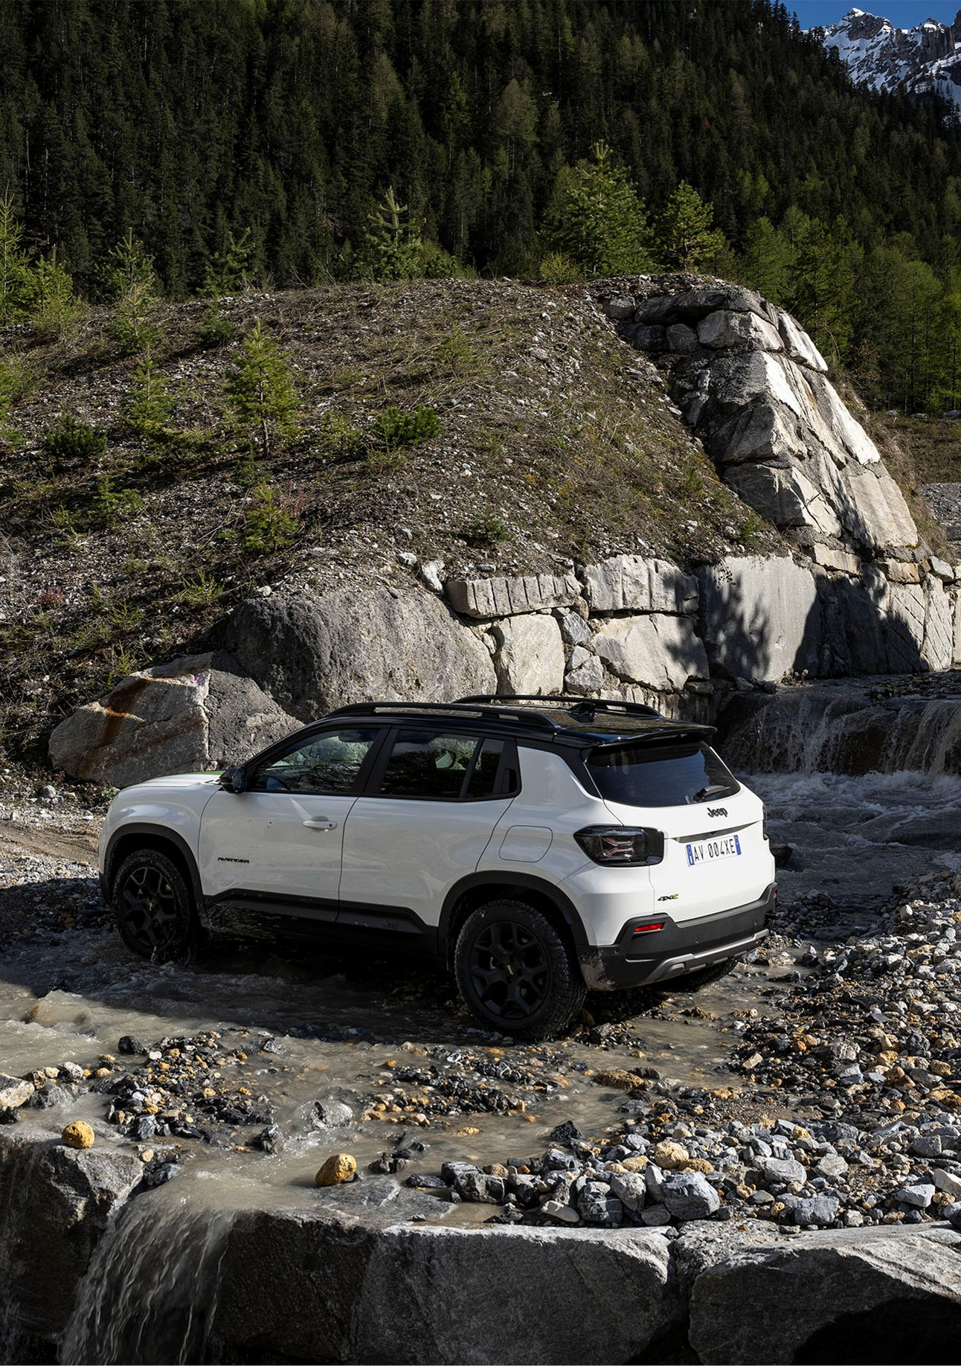
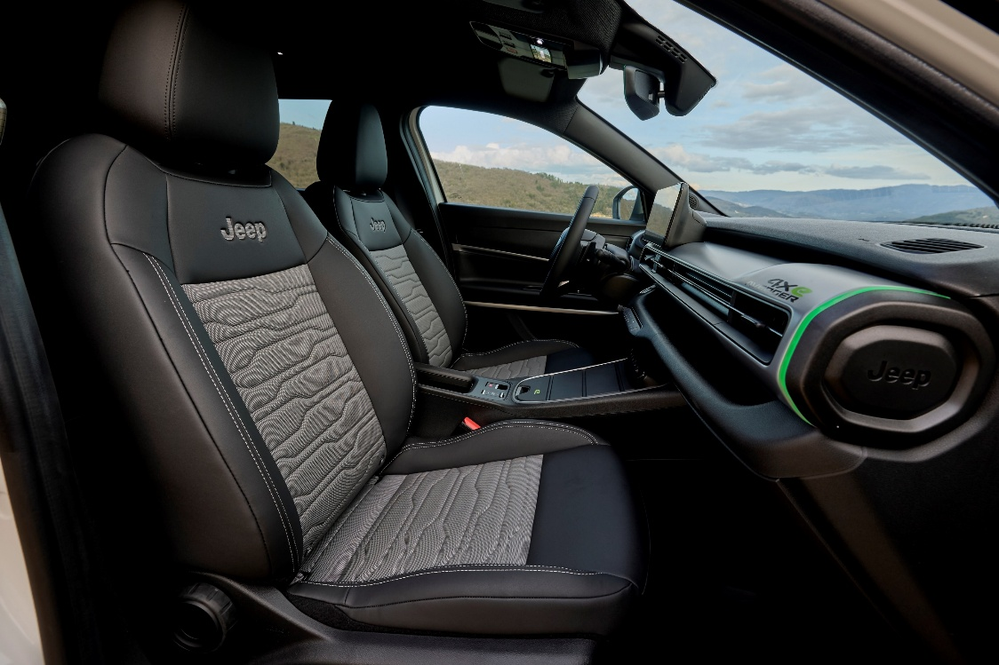
AVENGER MY 26: PRODUCT CHANGES (1/4)
Product updates refer to:
Black Headliner
What: All Avenger versions will have the black headliner, actually dedicated to 4xe
When: from October

Slide 9
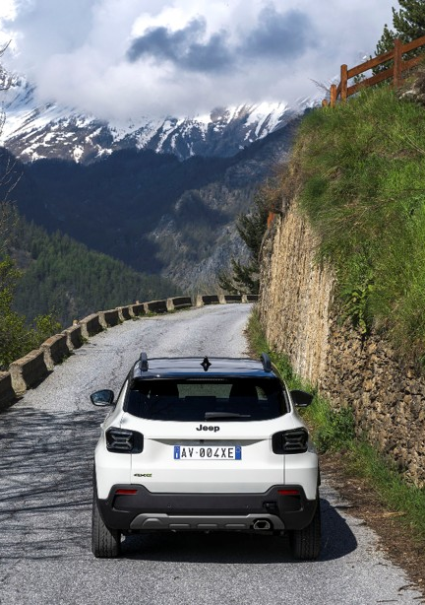
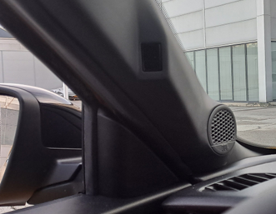
AVENGER MY 26: PRODUCT CHANGES (2/4)
DAA Camera
What: Introduction of the Driver Attention Assist Camera available as standard
When: from October BEV, Q1 ‘26 e-Hybrid/4xe

Slide 10
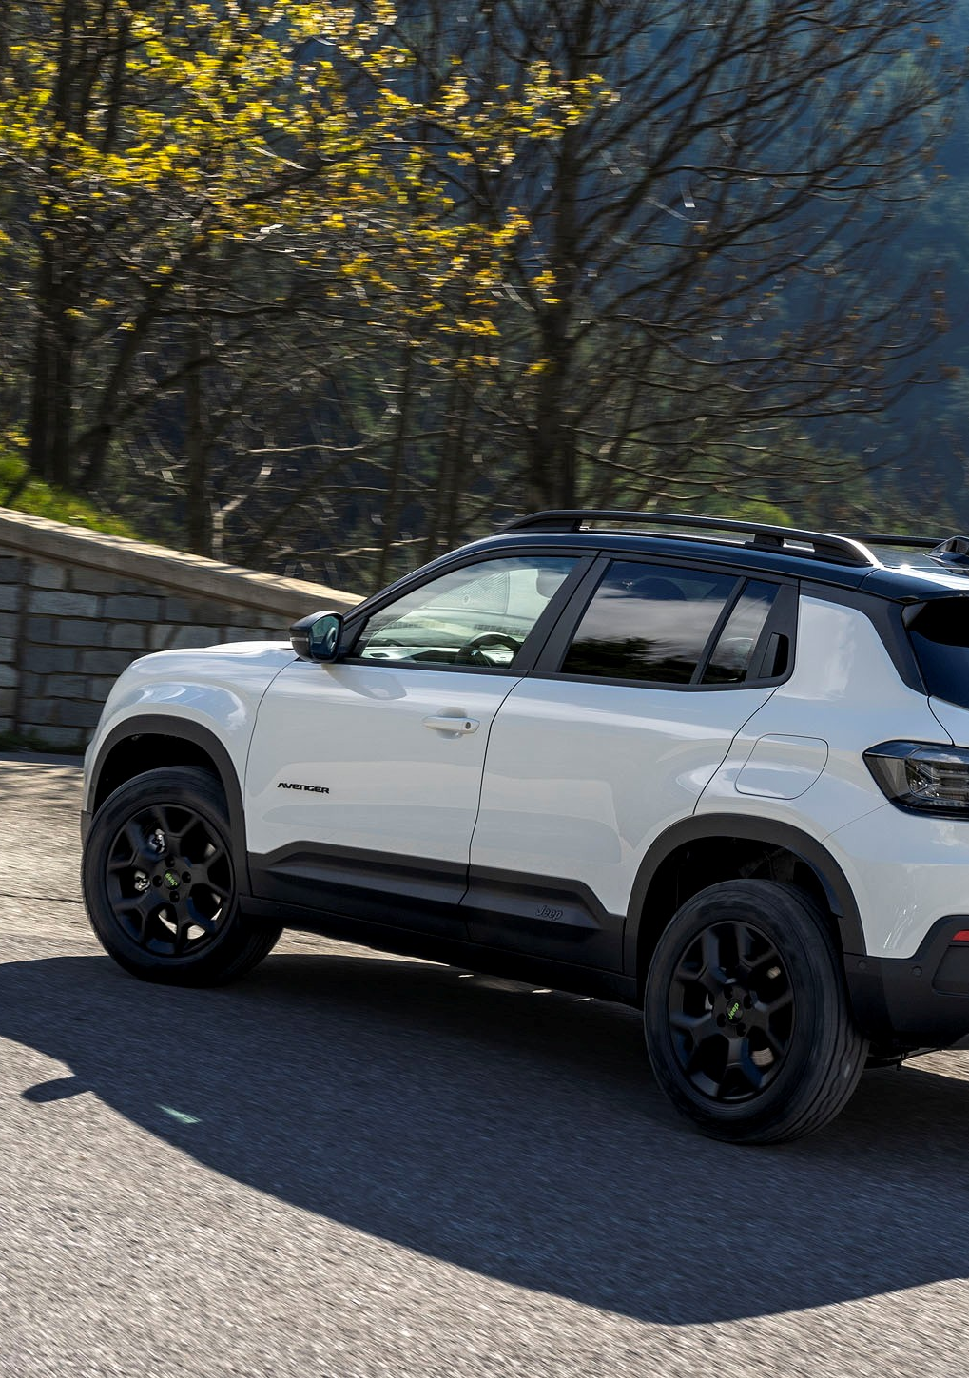
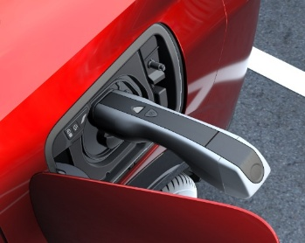
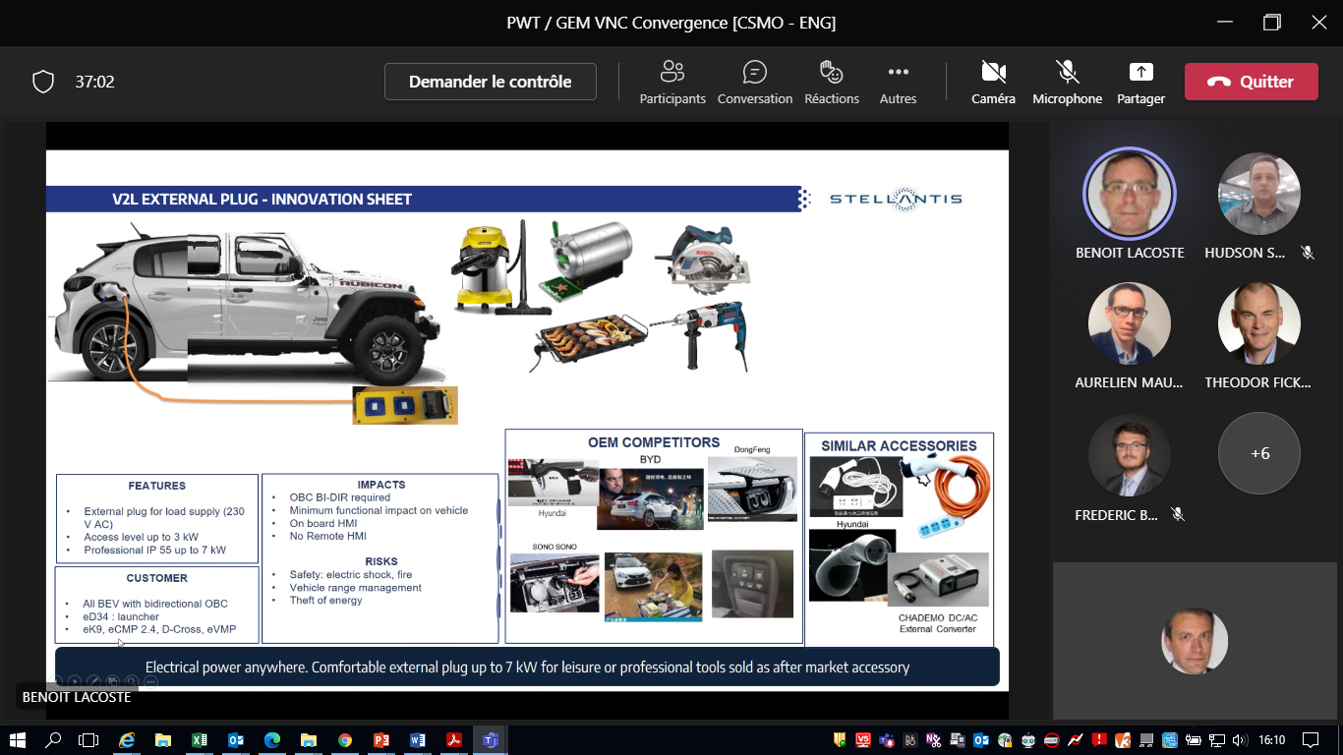
AVENGER MY 26: PRODUCT CHANGES (3/4)
Latest product changes which impact the BEV version only:
Vehicle to Load availability (V2L)
What:
V2L allows electric vehicles to supply power from its battery to external electrical devices and appliances
V2L provides power of up to 3.6 kW AC (16A) and energy is supplied through specific adapter.
Adapter is sold through F2Move and Dealers/Aftersales
When: from October

Slide 11
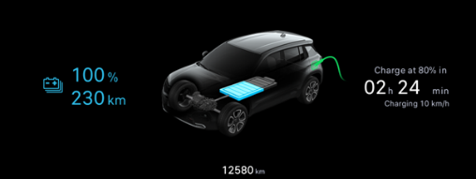
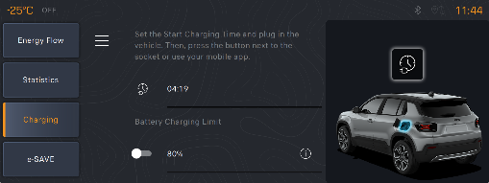
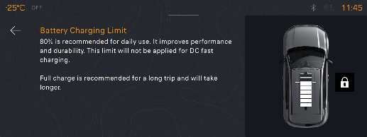
AVENGER MY 26: PRODUCT CHANGES (4/4)
Latest product changes which impact the BEV version only: 80% Charge Limit Warning
What:
This function allows customer to optimize charging speed and battery life by limiting the charge percentage to 80%.
Below are screenshots highlighting the warnings on:
Radio and Cluster display
Mobile App
When: from October

Slide 12
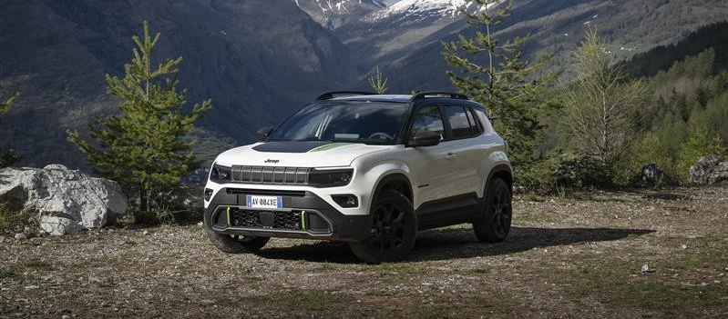
CONCLUSION
What is important to remember about this capsules dedicated to the Jeep® Avenger MY 26?

Slide 13
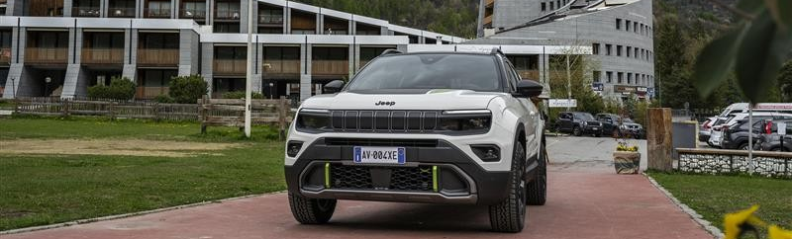
KEY POINTS TO REMEMBER (1/2)
Two years after its official launch, the Jeep® Avenger has surpassed 200,000 orders. It is the best-selling model in its class in Italy, while it ranks among the top ten in Europe.
With the MY 26 version Avenger is renewed in continuity with the MY 25 one, keeping unchanged:
range structure
trim levels
pack strategy

Slide 14
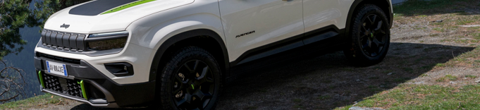
KEY POINTS TO REMEMBER (2/2)
MY 26 introduce novelties concerning Product and Engines Range
Engines range update applies to:
the 1.2 ICE 100HP manual transmission engine will no longer be available
the e-Hybrid 1.2 110 HP engine complies with Euro 6 E Bis homologation
Product updates refer to:
Black headliner for all the versions
Introduction of the DAA Camera
Availability of the Vehicle to Load (V2L)
Introduction of the 80% Charge Limit Warning
Great sales with the new Jeep® Avenger MY 26!

