Slide 1
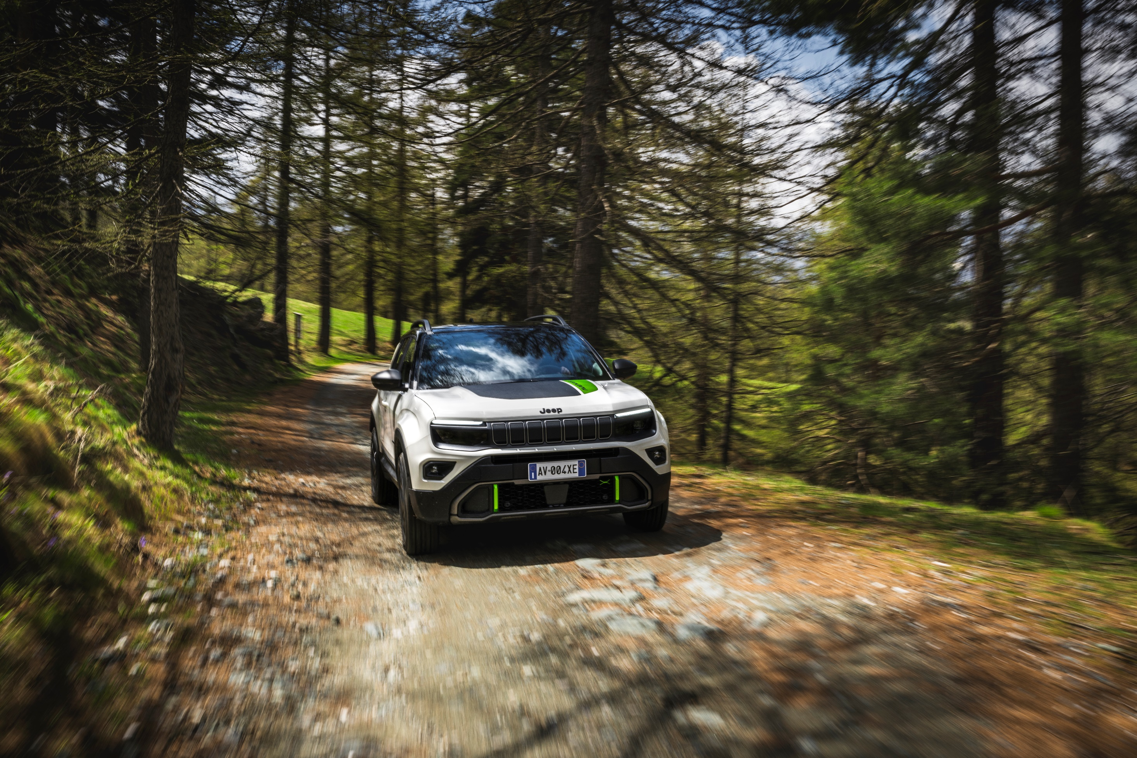


4xe

Slide 2
AVENGER 4xe
Jeep® proudly presents the Avenger 4xe to a renowned crowd of European journalists, bringing more fun, more freedom and more Avenger to the world.

Slide 3
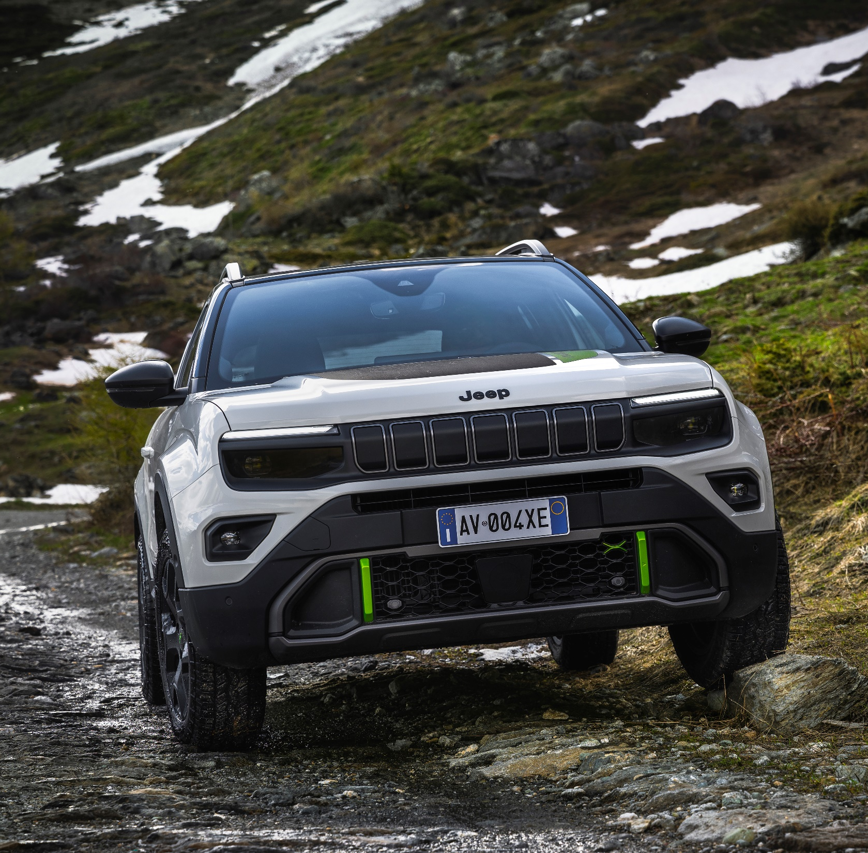
AVENGER 4xe Unveils
After the presentation of the Powertrain technology, the Jeep® Brand unveils the all new Avenger 4xe celebrating its rich heritage of exploration and groundbreaking design.

Slide 4
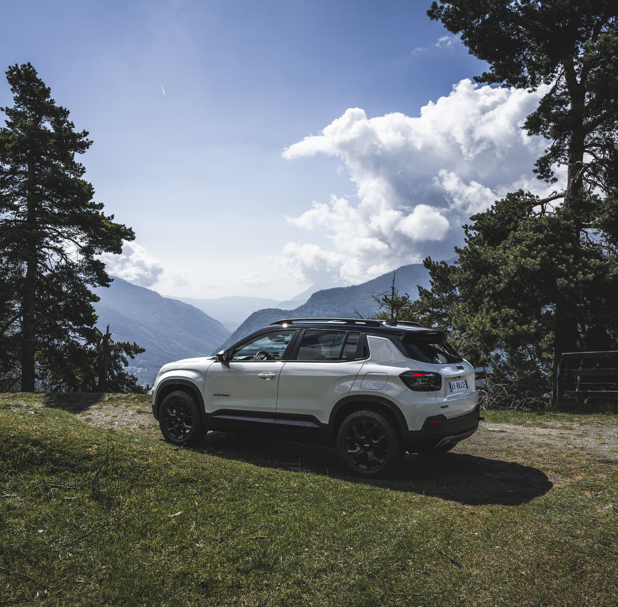
AVENGER 4xe Unveils
The Jeep Avenger 4xe signifies the response to the evolving demands of customers.
After the launch of the Petrol Manual Transmission, Full Electric Version and the recently e-Hybrid, the Avenger completes the line up with the 4xe All Wheel Drive Version.

Slide 5

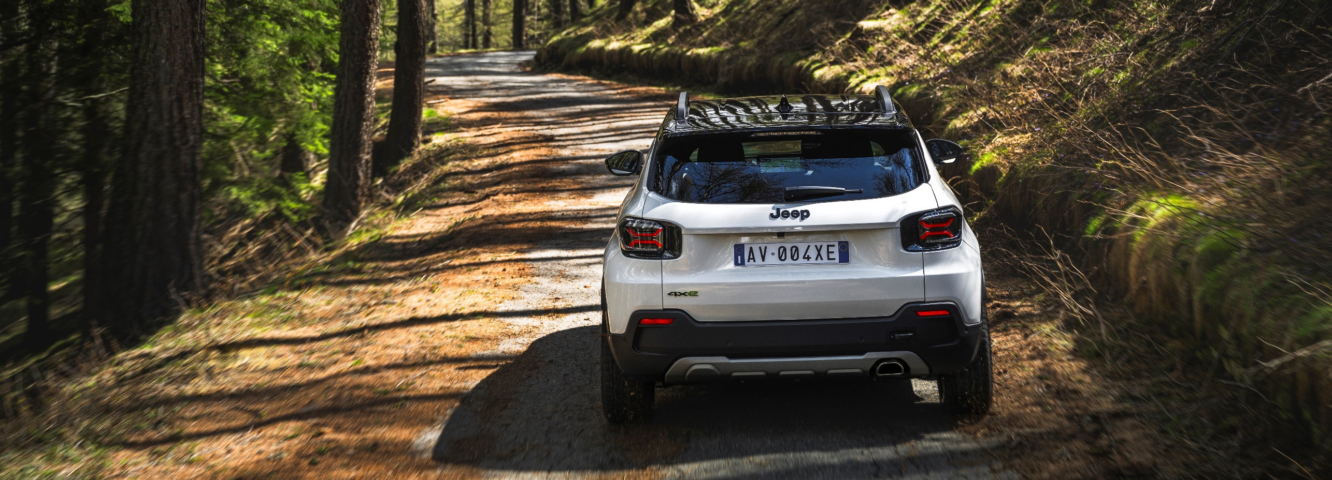
ONE OF THE BIGGEST STORIES OF JEEP
Eric Laforge – Head of Jeep Brand in Enlarged Europe has commented : “Avenger is one of the biggest success stories of Jeep in Europe with 80.000 orders from final customers of which almost 30% full electric. Thanks to this success, Avenger 4xe will be the new benchmark in the “B- SUV” segment, offering exclusive design, all-round capability, top performance, and the full expression of the Jeep brand’s values”.

Slide 6
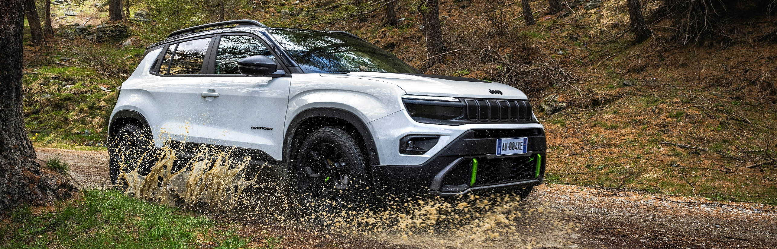
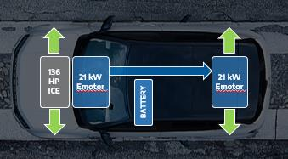
MORE FUN (1/3)
What is the secret of this all round capability?
The 4xe Avenger powertrain lies a dynamic 48V hybrid system, featuring a 1.2-liter turbo engine 136 HP, augmented by dual 21 kW electric motors positioned both at the front and rear of the vehicle and paired with an automatic 6-speed dual-clutch transmission.
136
HP
ICE
21 Kw
Emotor
21 Kw
Emotor
BATTERY

Slide 7
MORE FUN (2/3)
And as a result the Avenger 4xe performances are excellent:
Max speed 194 Km/h (+10 km/h compared to the e-hybrid model)
0-100 km/h: 9,5 sec
and sets a new benchmark in the Avenger hybrid line-up, offering the highest power and torque output, with 36 HP and 25 Nm more than the e-Hybrid FWD version.

Slide 8
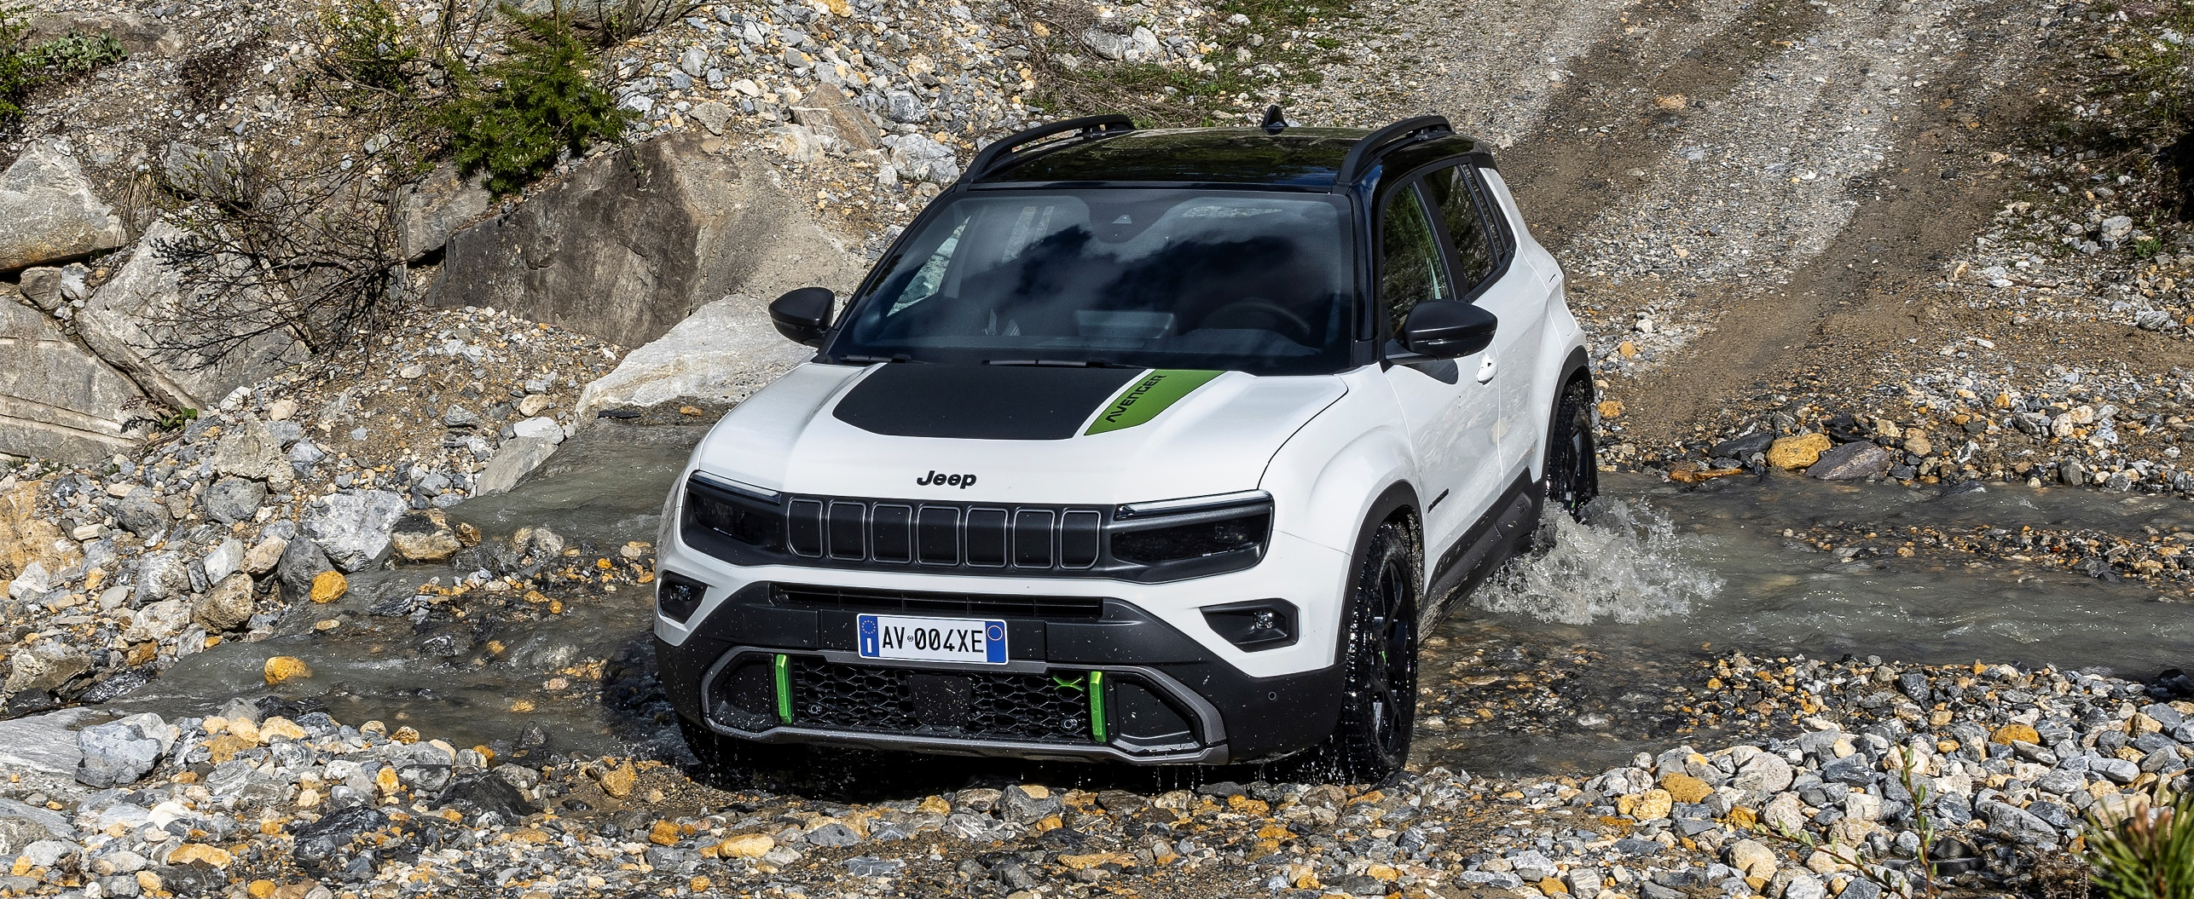
MORE FUN (3/3)
On top to that also an important improvement on Off Road characteristics:
+ 10 mm increase in ground clearance
Water fording up to 400 mm

Slide 9
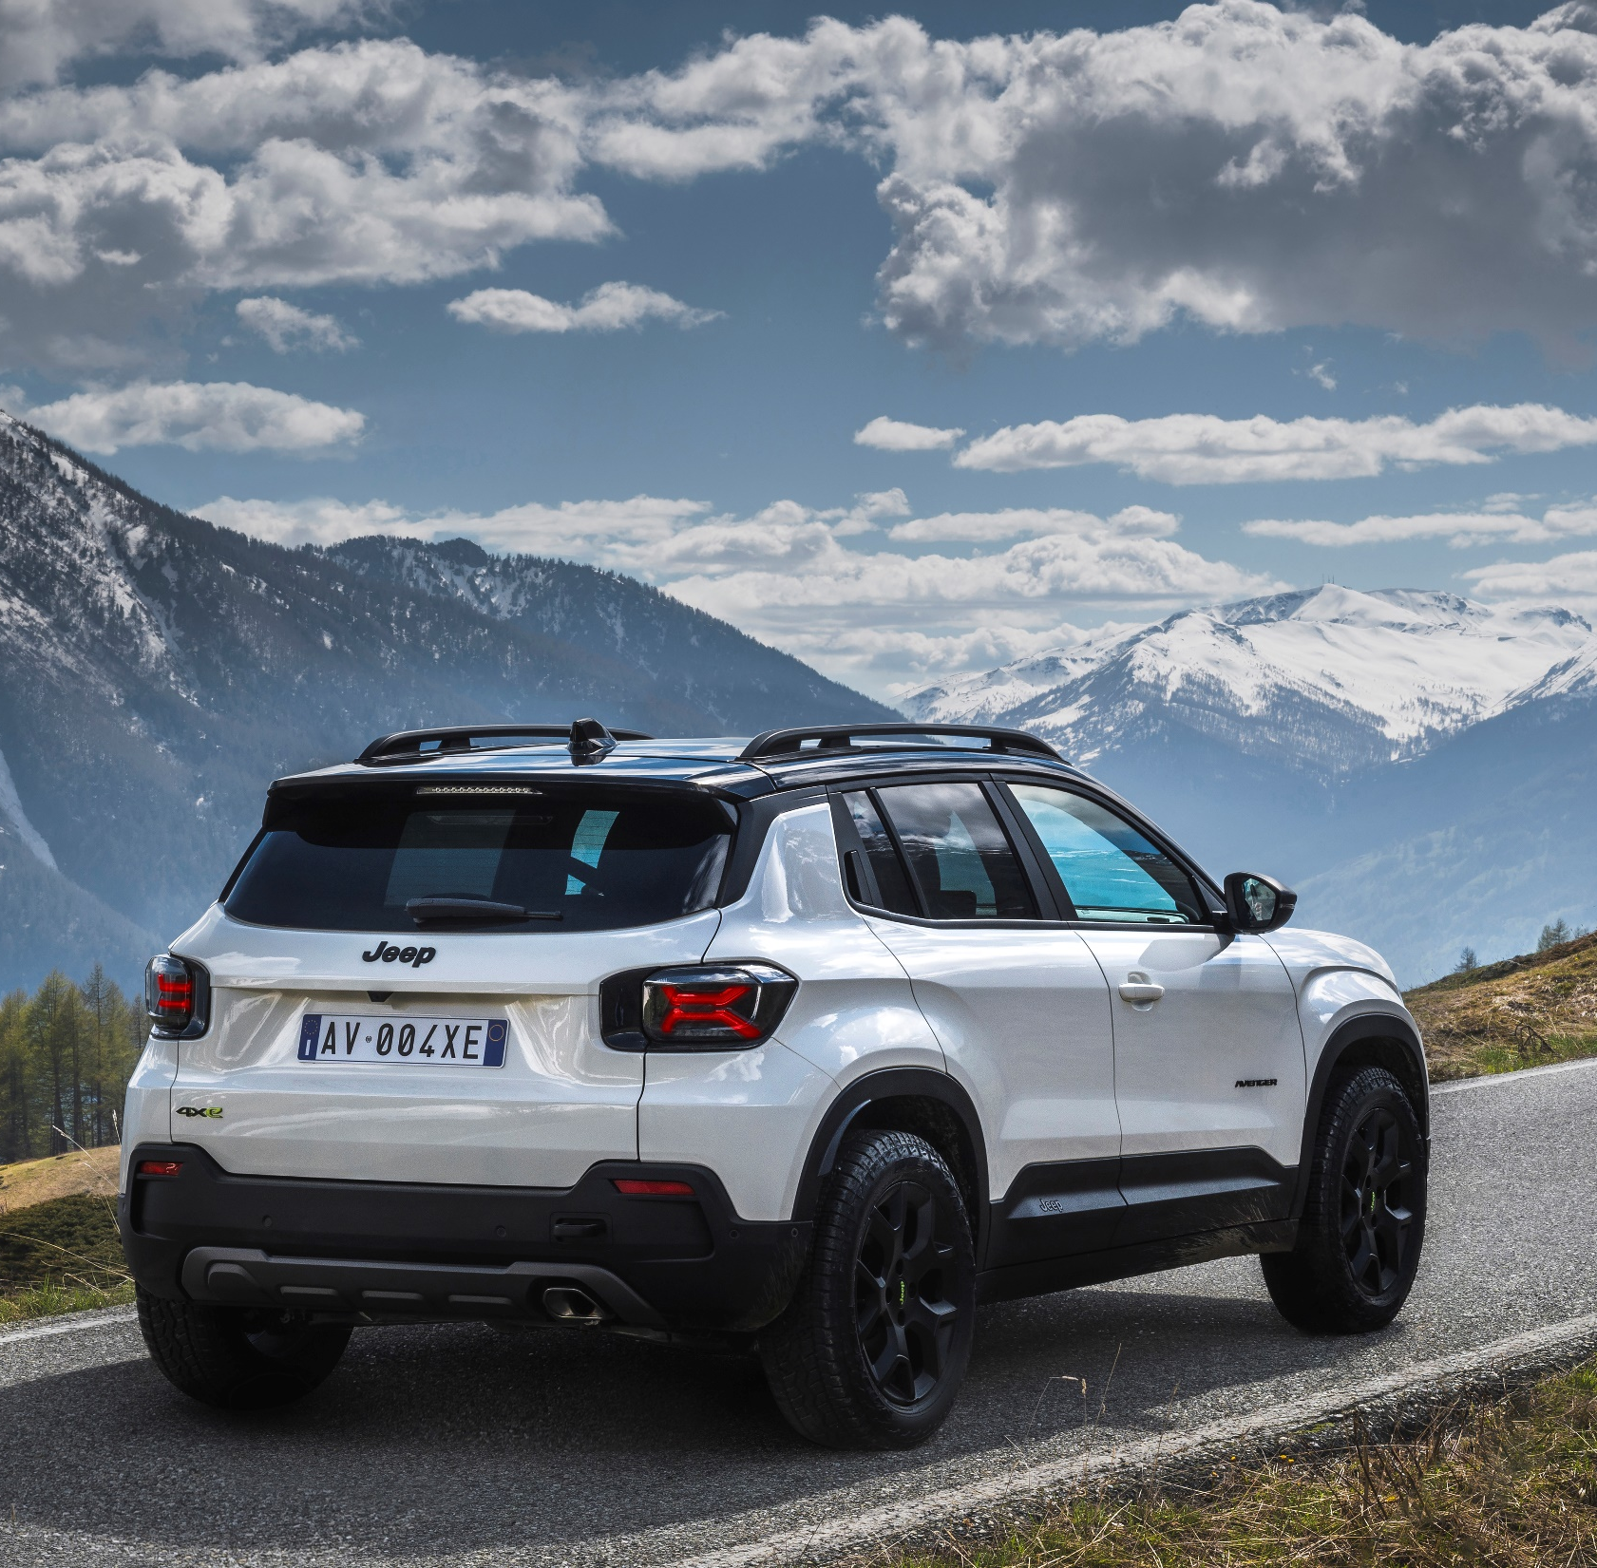
MORE FREEDOM (1/2)
Jeep® Avenger 4xe is equipped with a smart all-wheel-drive system which, depending on the drive modes, allows:
At low speeds (between – 30 and +30 km/h): traction on all four wheels is permanent, with a 50:50 split
At medium speeds (30 to 90 km/h): the rear axle drive activates only upon demand
At high speeds (above 90 km/h): forward drive becomes permanent, and the rear e-motor disengages from the axle to minimize fuel consumption.

Slide 10
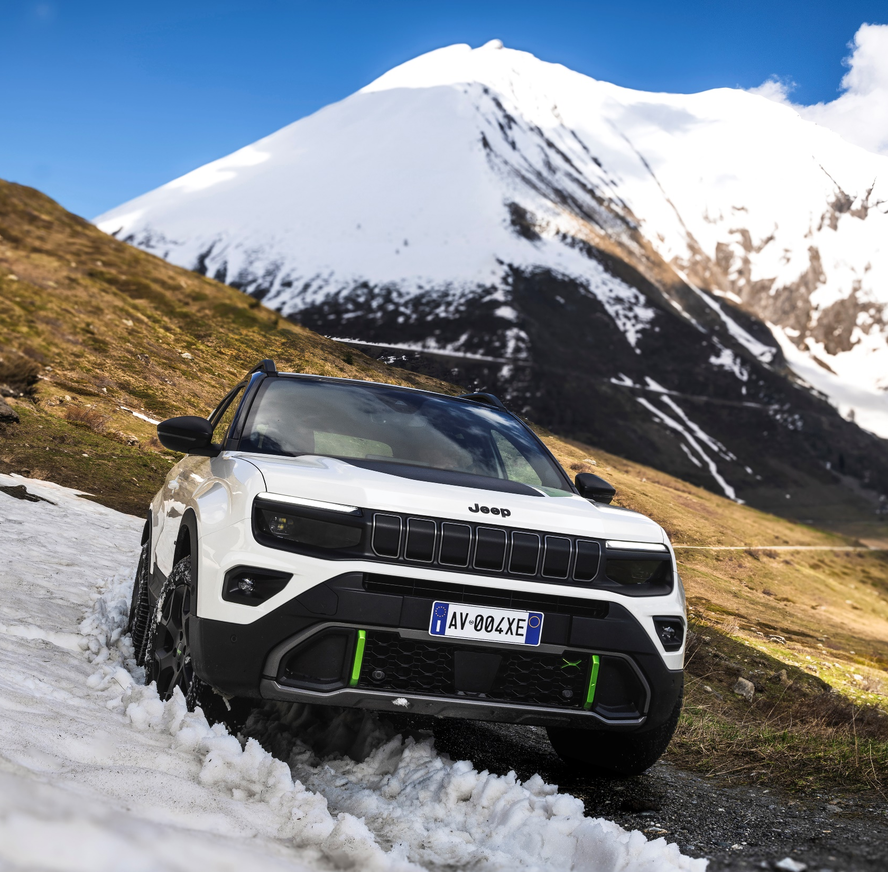
MORE FREEDOM (2/2)
On top, the Avenger 4xe is equipped with an innovative Multilink rear suspension scheme. This feature, typically found on bigger vehicles enhances articulation on the rear axle, resulting in increased comfort on rough roads.

Slide 11
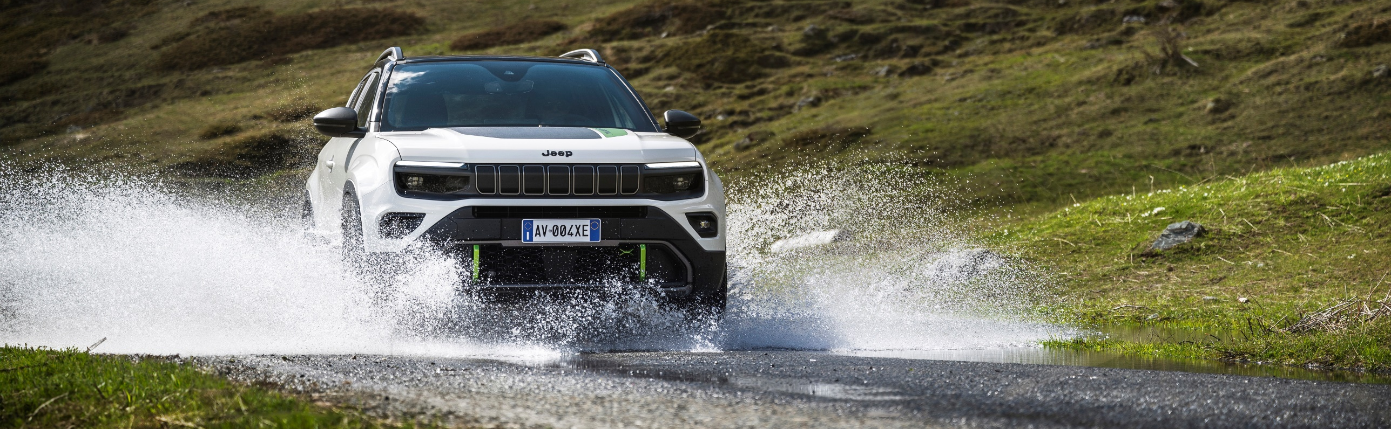
MORE AVENGER (1/2)
The Jeep Avenger 4xe spirit emerges also from many exterior and interior elements specifically designed for it.
Let’s start with the Exterior details:
New front and rear bumpers made in mold-in-color material with anti-scratch finishing
Redesigned fog lights positioned slightly higher to enhance night visibility
Rear tow-hook
Standard roof bars to enhance load capacity
Standard M+S tyres

Slide 12
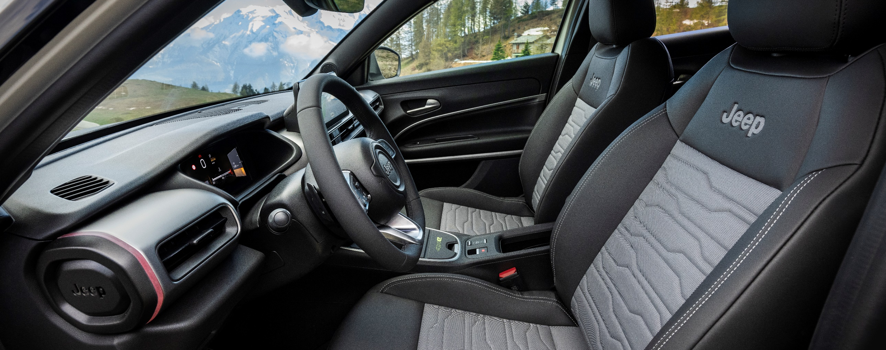
MORE AVENGER (2/2)
And stepping inside here too important innovations concern the seat materials that for Avenger 4xe are:
completely washable
two times more resistant than conventional ones
perfect for adventurers who embrace the great outdoors

Slide 13
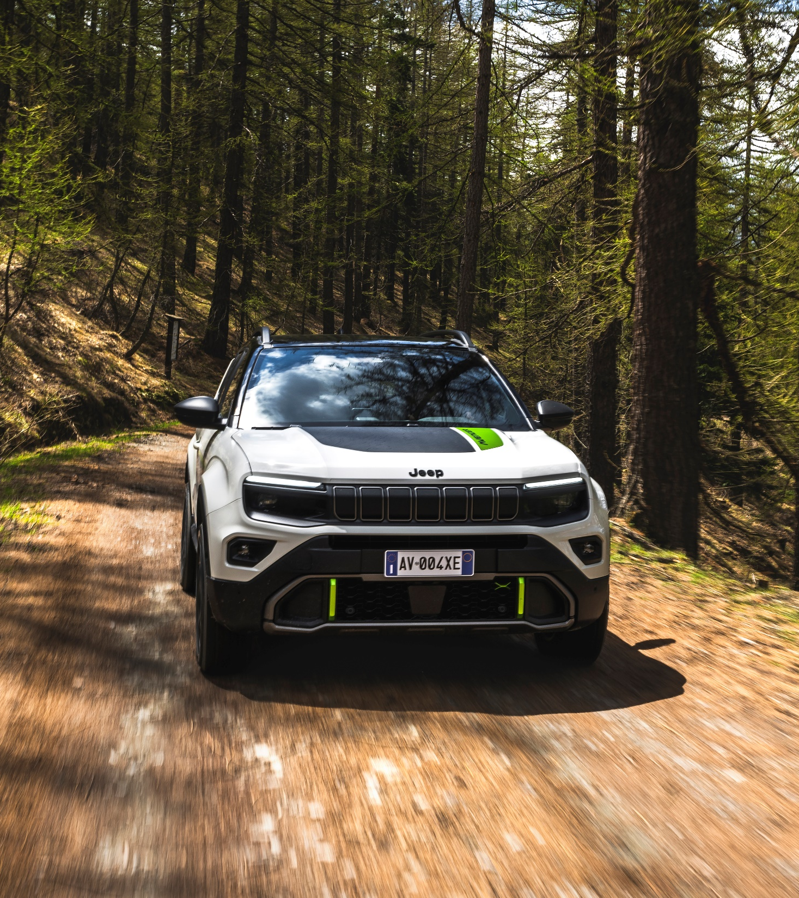
Before closing, some questions to check if everything is clear.
On Avenger 4xe, are speed and ground clearance…
the same of the Avenger e-Hybrid version?
different due to type-approval reasons?
both improved vs e-Hybrid: 194 km/h (+10 km/h) and 210 mm (+10 mm)?

Slide 14

Is the Avenger 4xe powertrain composed by…
a 136 HP (100 kW) thermal engine with one electric motor of 21 Kw?
a 136 HP (100 kW) electric motor with one thermal engine of 21 kW?
a 136 HP (100 kW) thermal engine with two electric motors of 21 kW each?

Slide 15
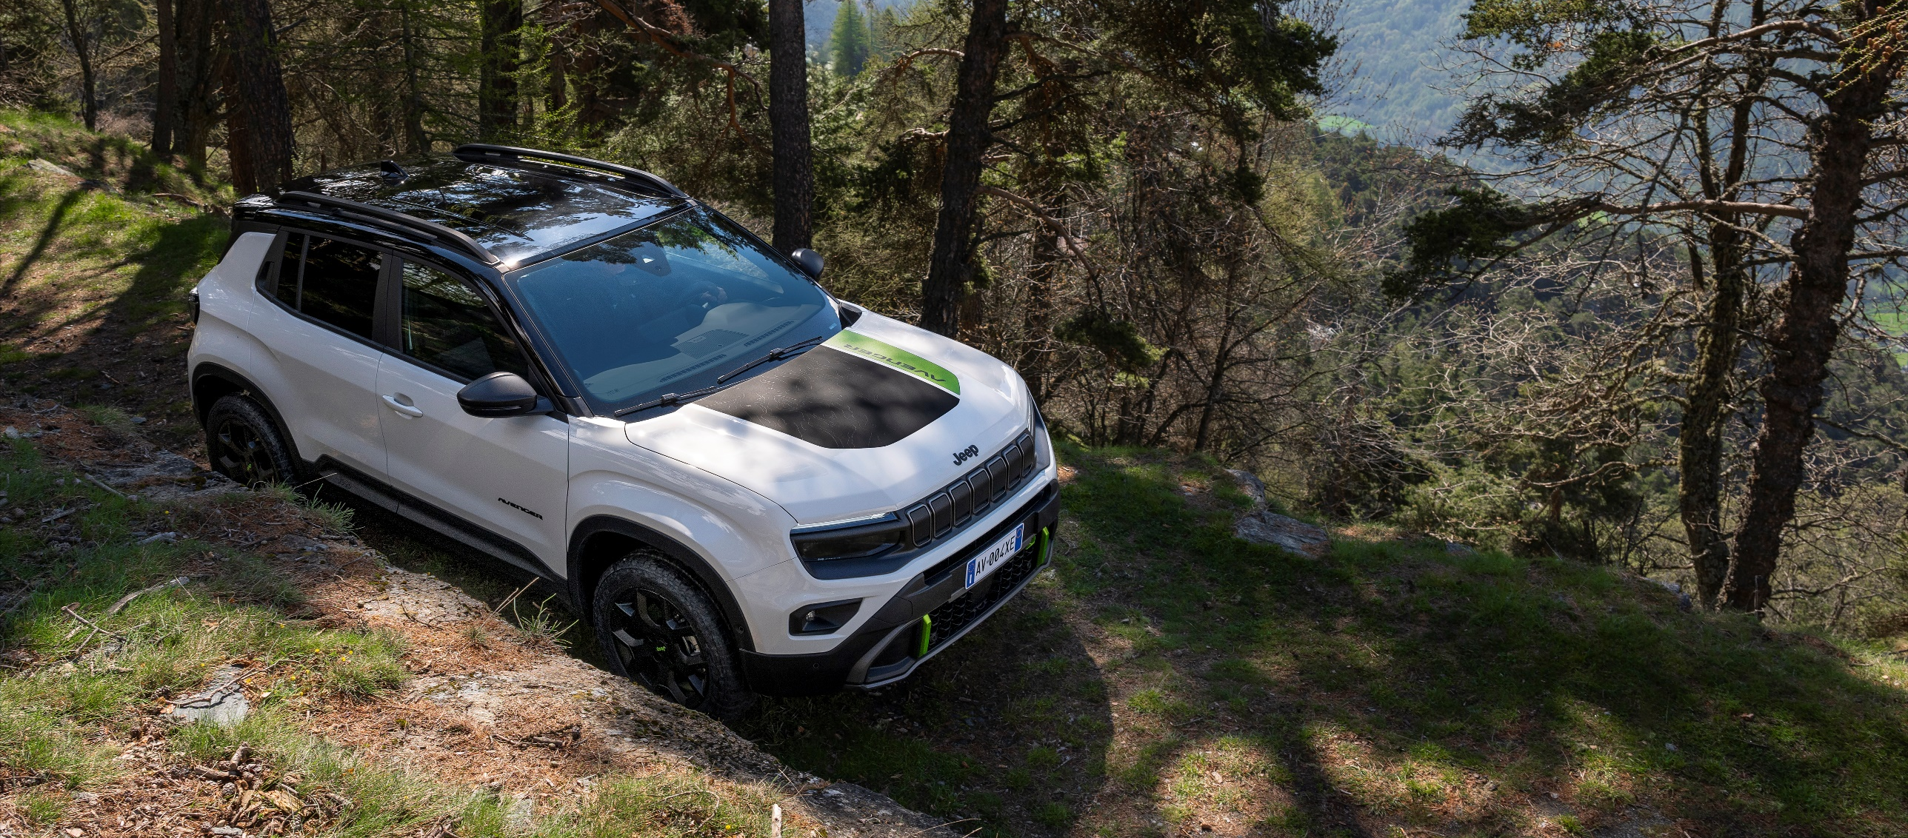
CONCLUSION
What is important to remember from this capsules dedicated to the Reveal of the new Jeep Avenger 4xe?

Slide 16
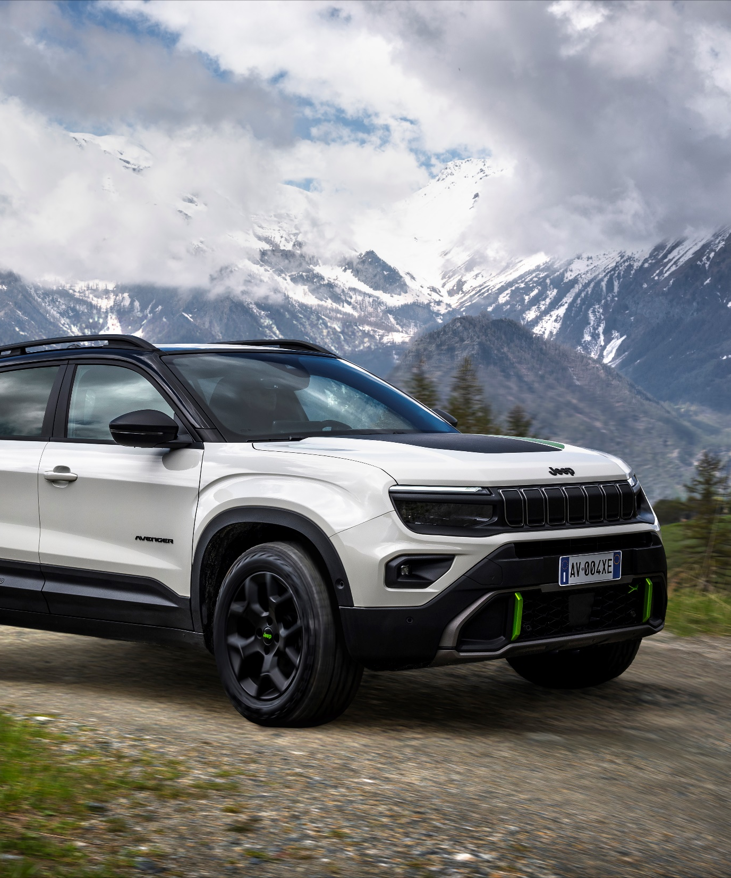
KEY POINTS TO REMEMBER (1/3)
For the first time, Jeep® introduces the innovative 48V hybrid technology with the new Avenger 4xe.
The Product uniqueness vs the e-Hybrid version are many, here below a recap:
SPECIFIC COMPONENTS:
48V HYBRID
136 HP ICE engine + two 21 kW electric motors (front & rear)
+10MM GROUND CLEAREANCE
M+S TYRES
DEDICATED MULTI-LINK REAR SUSPENSION

Slide 17
KEY POINTS TO REMEMBER (2/3)
SPECIFIC EXTERIORS:
NEW FRONT & REAR BUMPERS
FOGLIGHTS DESIGN
ROOF RAILS
REAR TOW HOOK
SPECIFIC INTERIORS:
NEW seats with washable & durable materials

Slide 18

KEY POINTS TO REMEMBER (3/3)
Before closing, remember a last important info regarding the TIMING for the launch of the model:
The Jeep® Avenger 4xe’s orders will be opened by the end of 2024.
In the meanwhile, there will be many customers who will come to the dealership asking for the Avenger 4xe. For this phase the guidelines are as follows:
Keep focus on Avenger FWD line-up;
Convert possible interested customer to Avenger FWD leveraging on product USP & best-in-class capabilities.
For those customers fully oriented on a 4x4 with urgent timing constraint → Convert them to Renegade 4xe.

