Slide 1


Jeep® Renegade 2025 Range Update
WWCPJE505759M01EN
The Renegade 2025 changes its commercial offer and range. Let's discover the Renegade 2025 Range Update together.

Slide 2
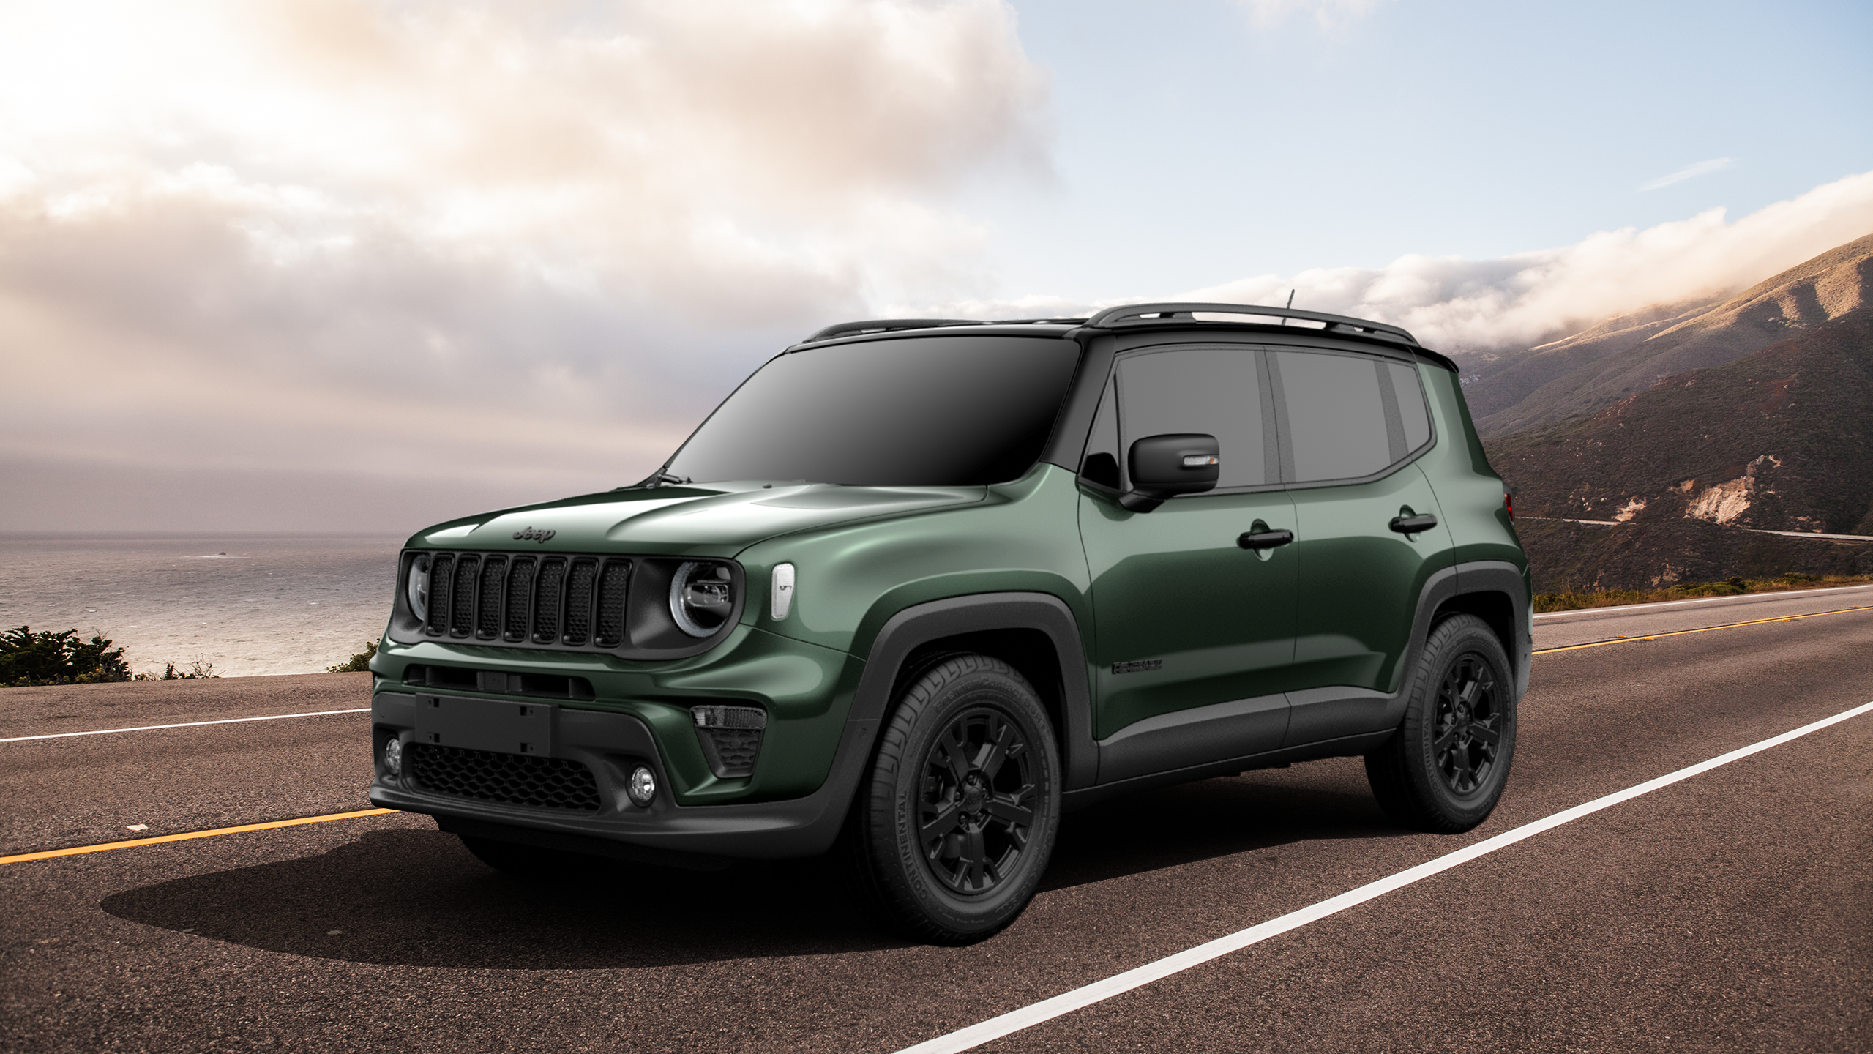

RENEGADE 2025 Range Update

Slide 3
RENEGADE 2025 RANGE UPDATE
Timeless style faithful to the Jeep brand origins: this is Renegade to maintain its market leadership.
Let's go and find out the details.

Slide 4
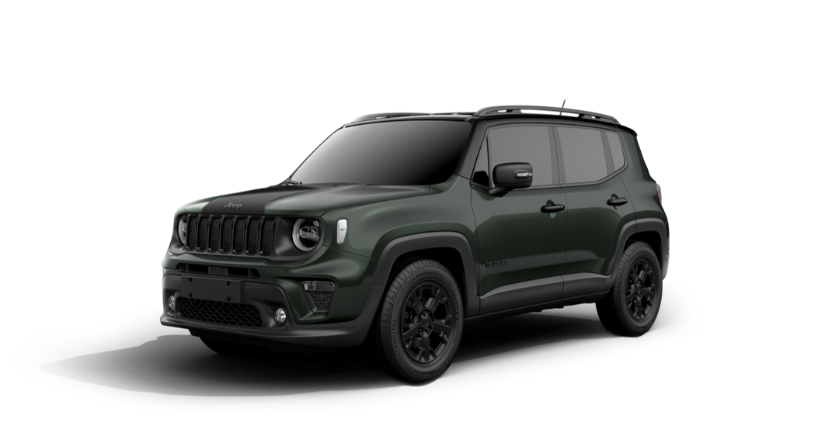
RENEGADE EVOLUTION
The Renegade 2025 Range Update novelties can be summarized as follows:
Range novelties
New buzz model: NORTH STAR
Trim level equipment review
New bicolor paint
Bi – color new roof cut design

Slide 5
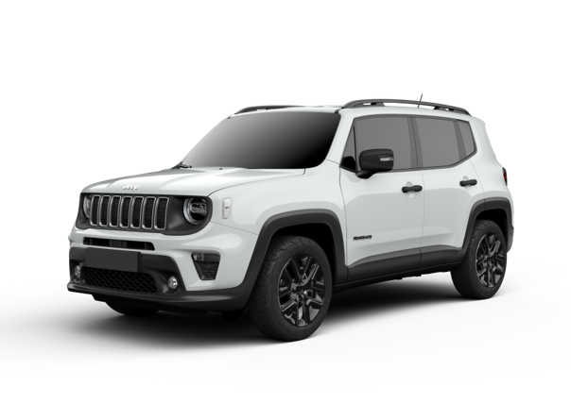
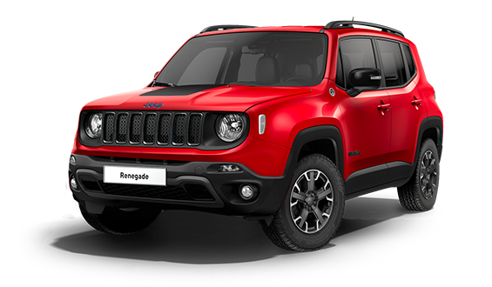


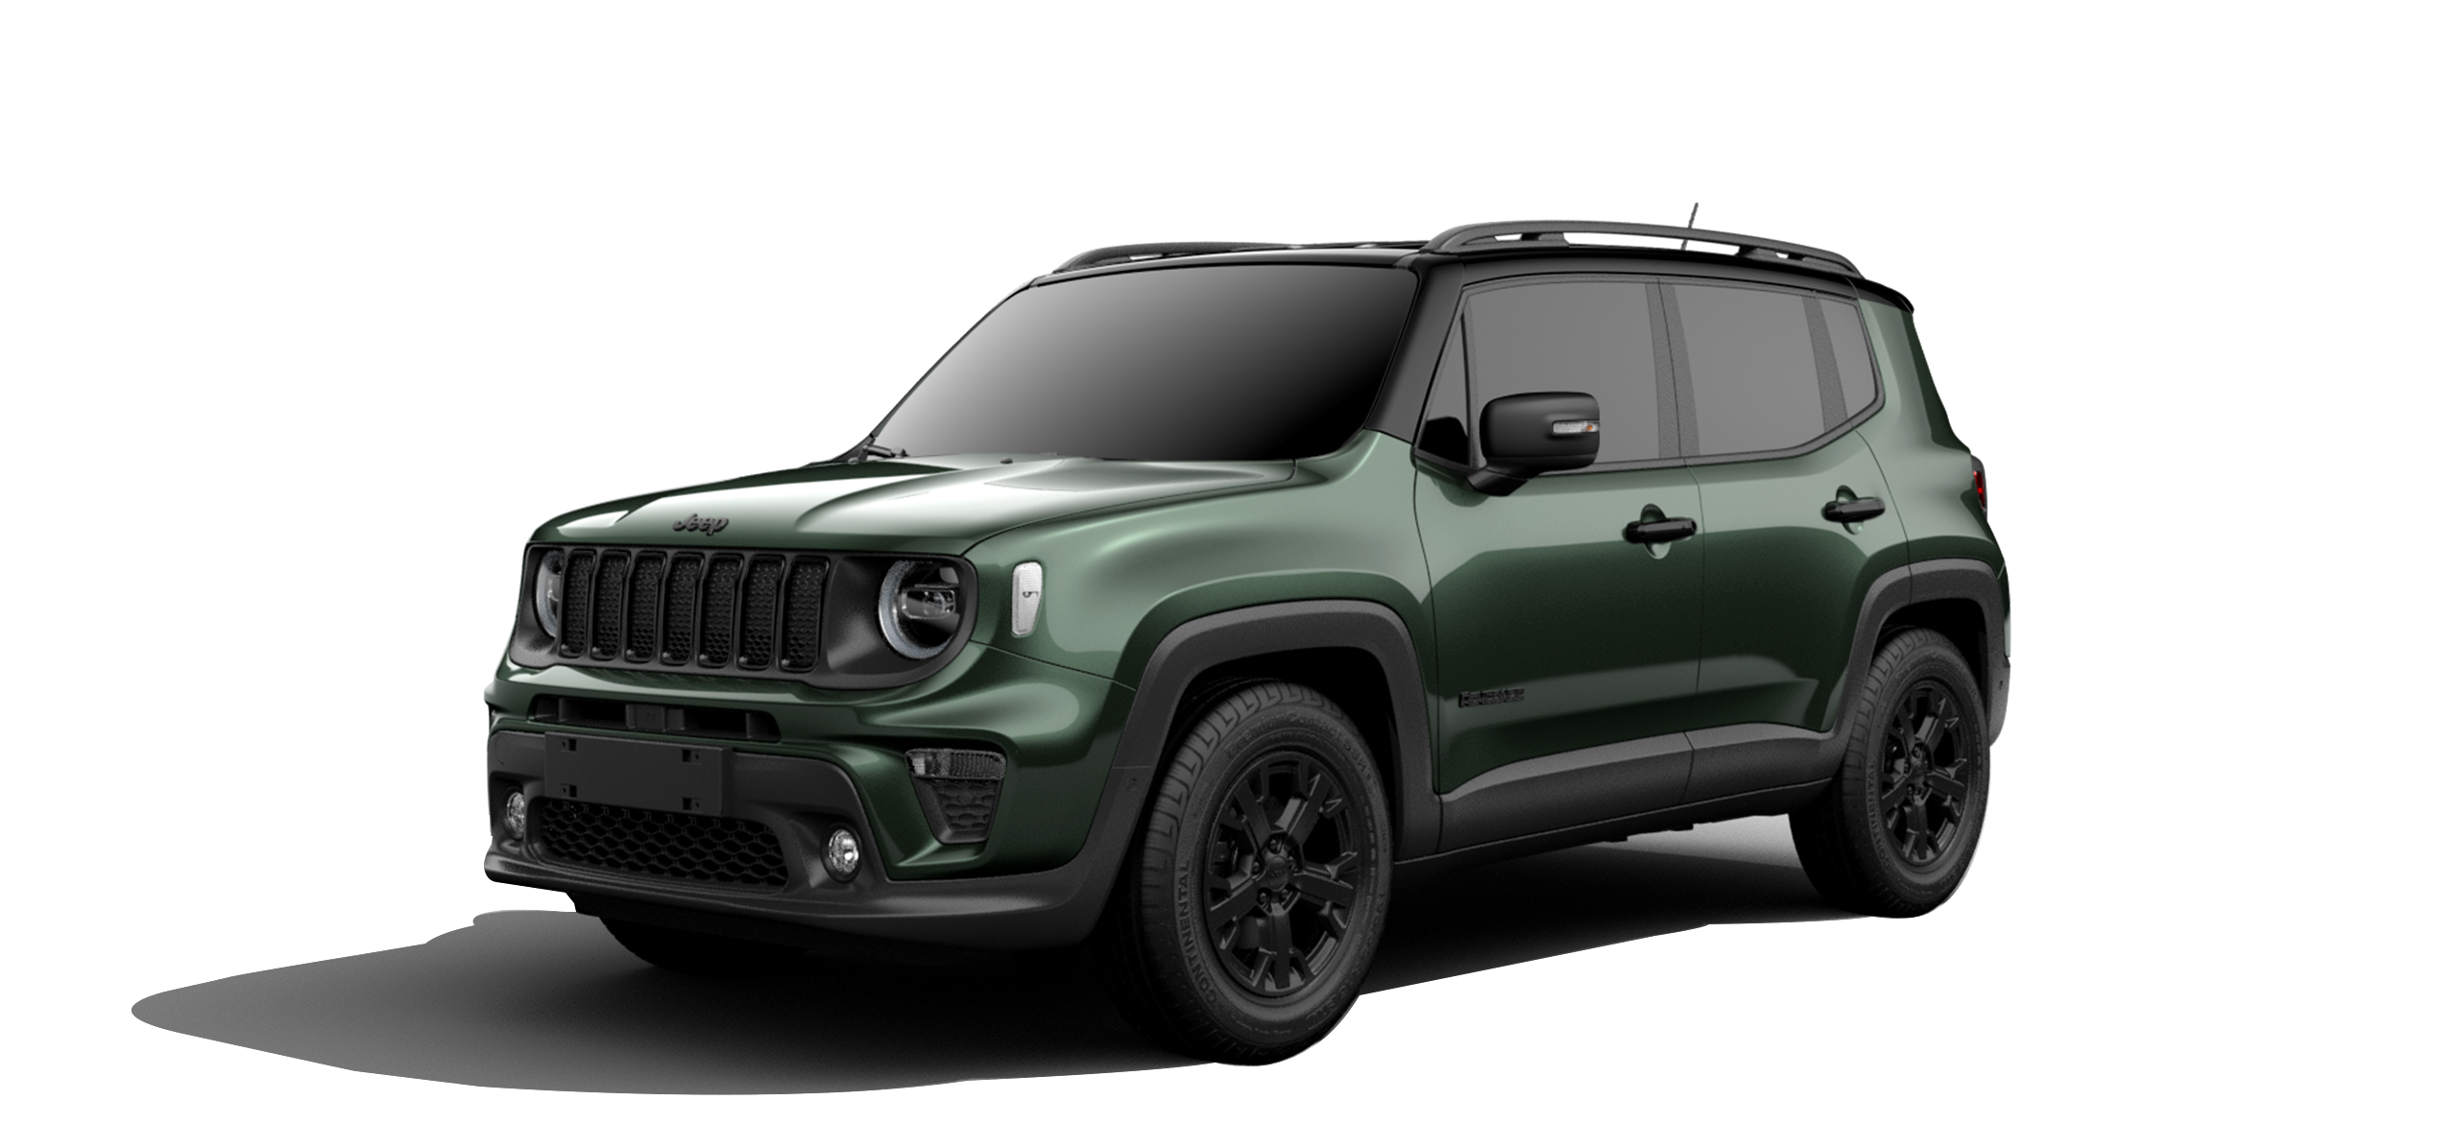
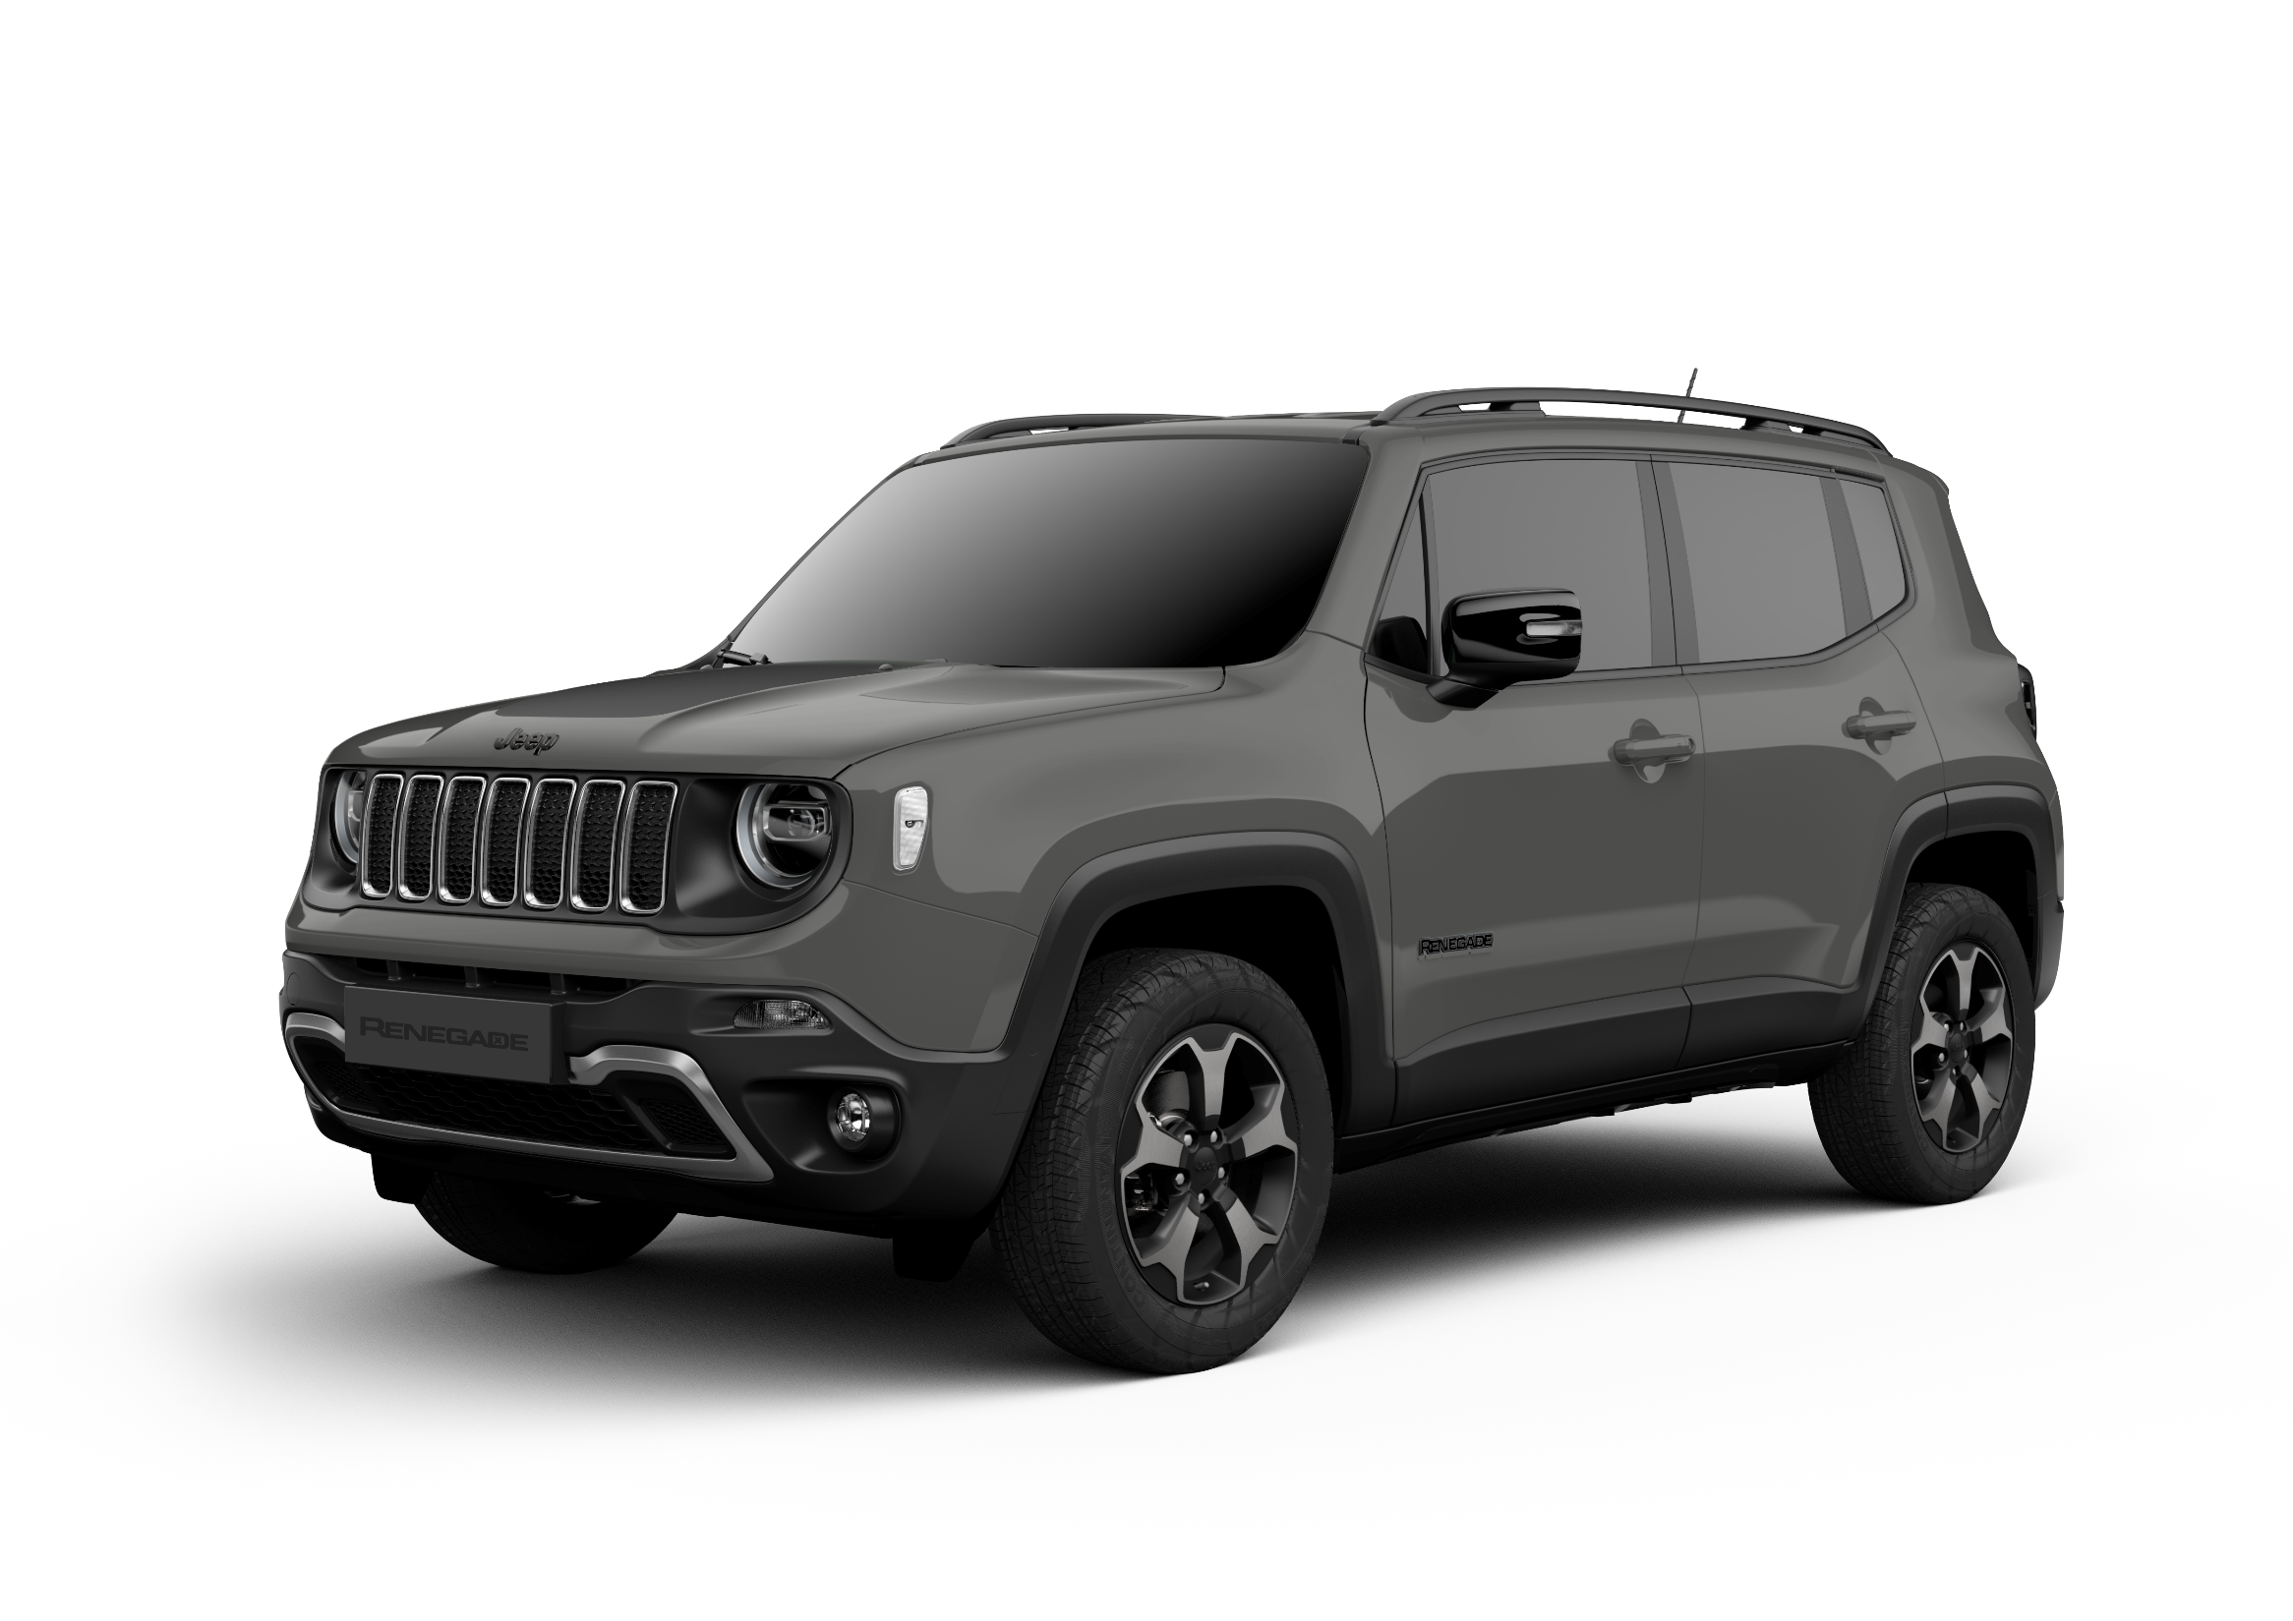
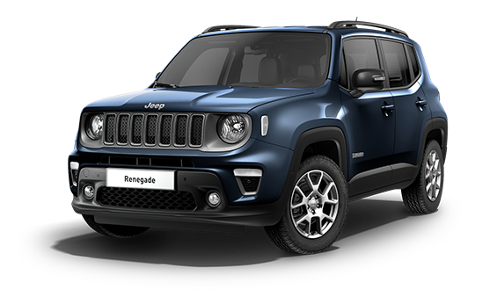
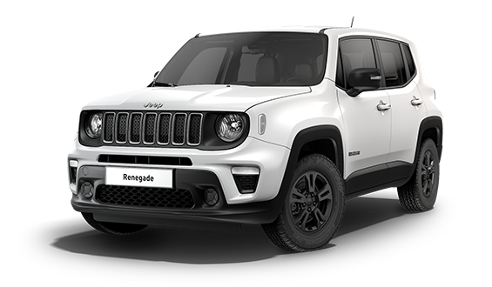
THE NEW RANGE
The Renegade range changes for an even more simple and lean line-up, moving from 5 to 4 trims:
Renegade, Altitude and Summit trims confirmed
Overland and Trailhawk are closed and a new fresh look with the NORTH STAR trim is introduced.
The NORTH STAR is the only trim available in PHEV and E-hybrid versions.
MY24
Renegade 2025 Range Update
240HP
E-hybrid
190HP
SUMMIT
TRAILHAWK
SUMMIT
E-hybrid
UPDATE
240HP
240HP
NORTH STAR
OVERLAND
E-hybrid
190HP
ALTITUDE
ALTITUDE
E-hybrid
RENEGADE
MHEV
PHEV
RENEGADE

Slide 6
THE NORTH STAR (1/4)
The NORTH STAR trim celebrates the 1Million unit sold in Europe by Compass & Renegade.
This unique and exclusive trim leverage on the 3 pillars that have built the success of these models:
STYLE
ROBUSTNESS
JEEPNESS
Let’s know the details.

Slide 7
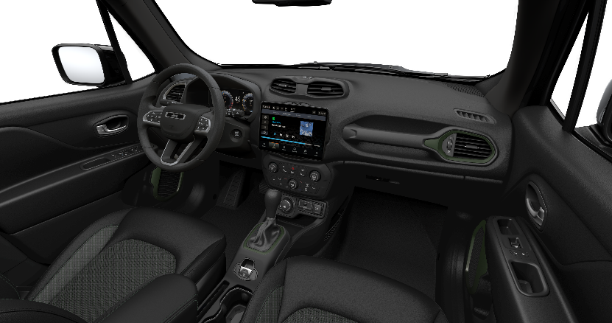

THE NORTH STAR (2/4)
STYLE elements:
New exclusive color TECHNOGREEN with bi-color New roof cut design
Dedicated exterior and interior finishing
Dedicated hood decal and Badge* *Image to be confirmed

Slide 8
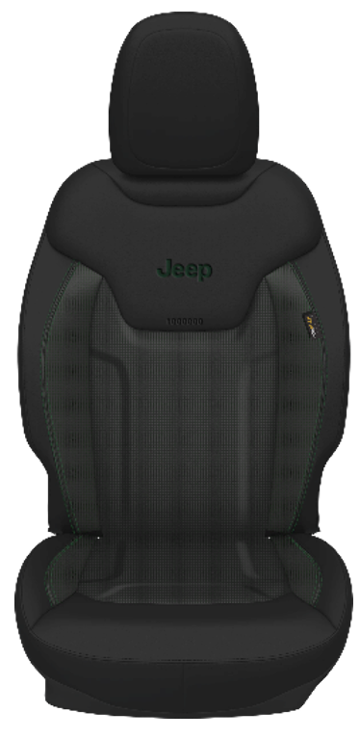

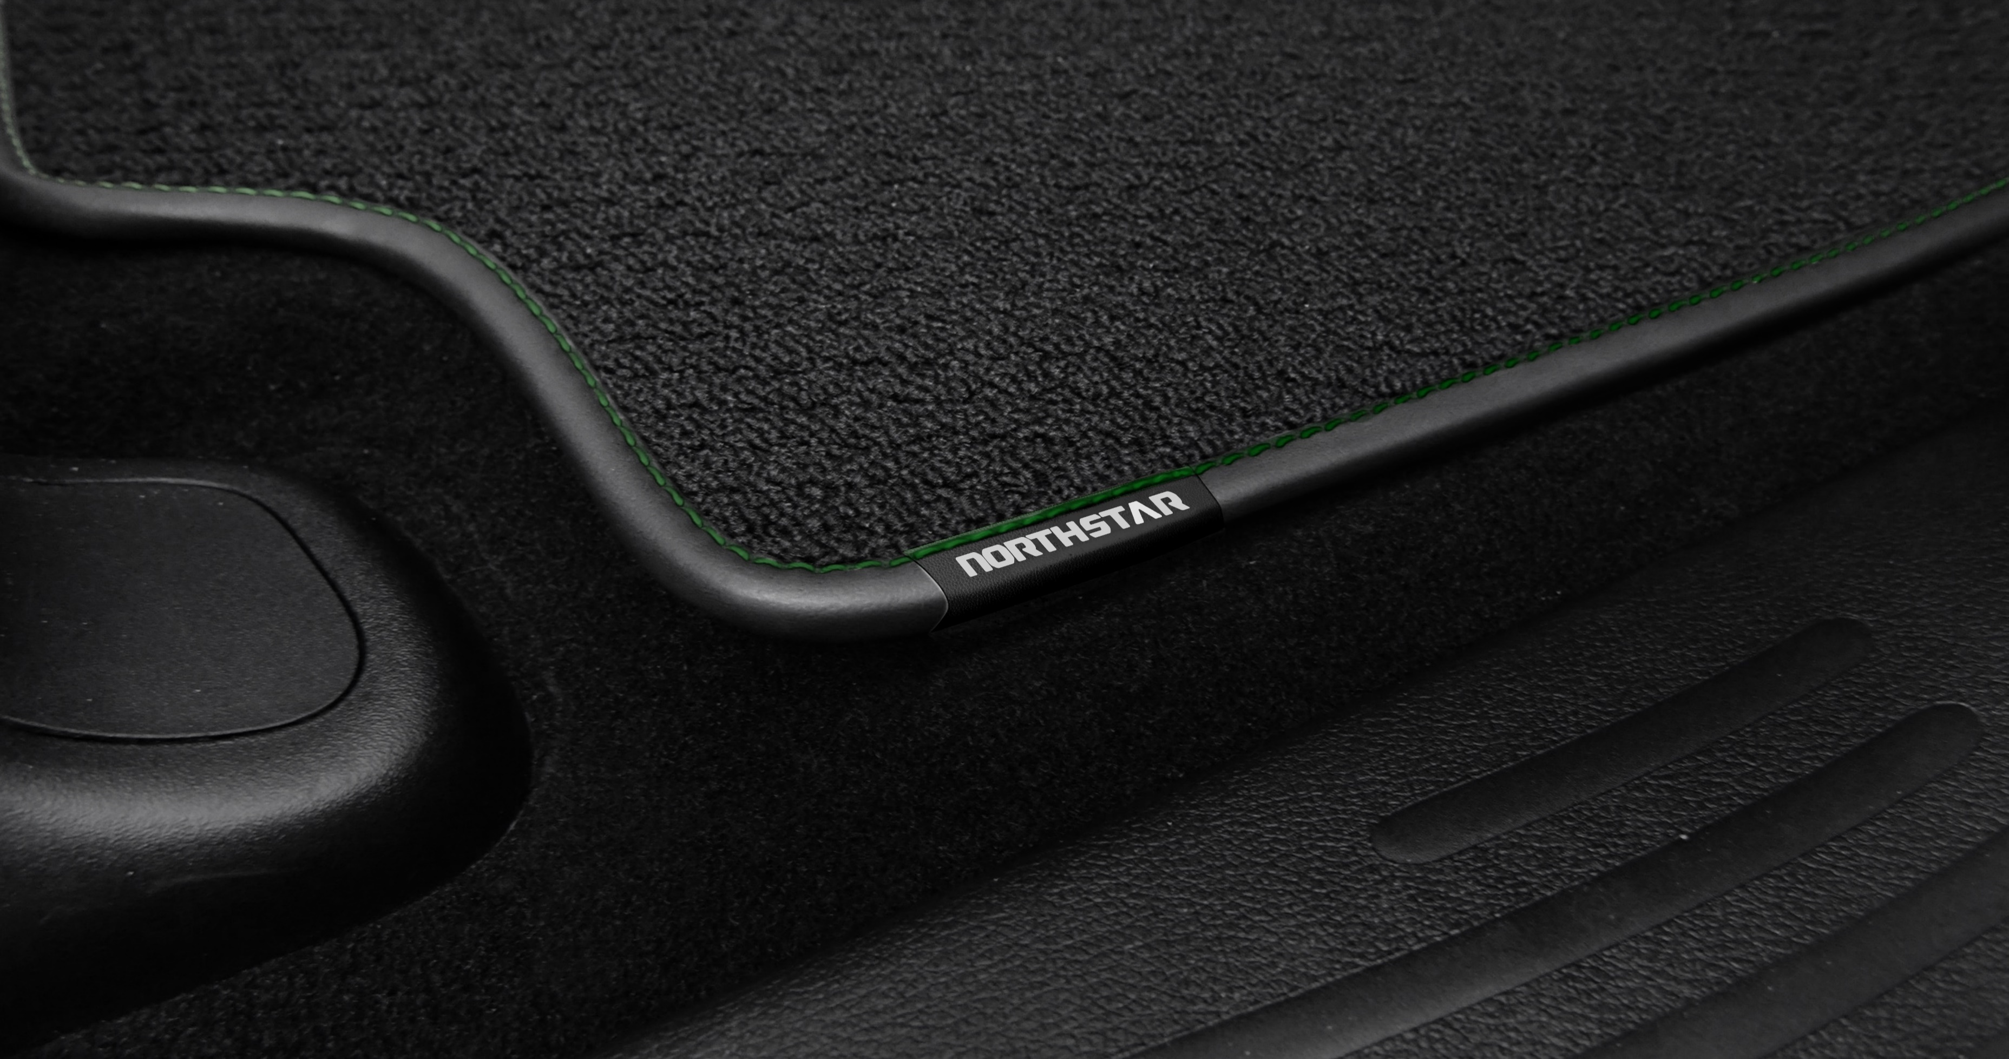
THE NORTH STAR (3/4)
ROBUSTNESS elements:
New High Resistance seats material
Specific floor mat

Slide 9
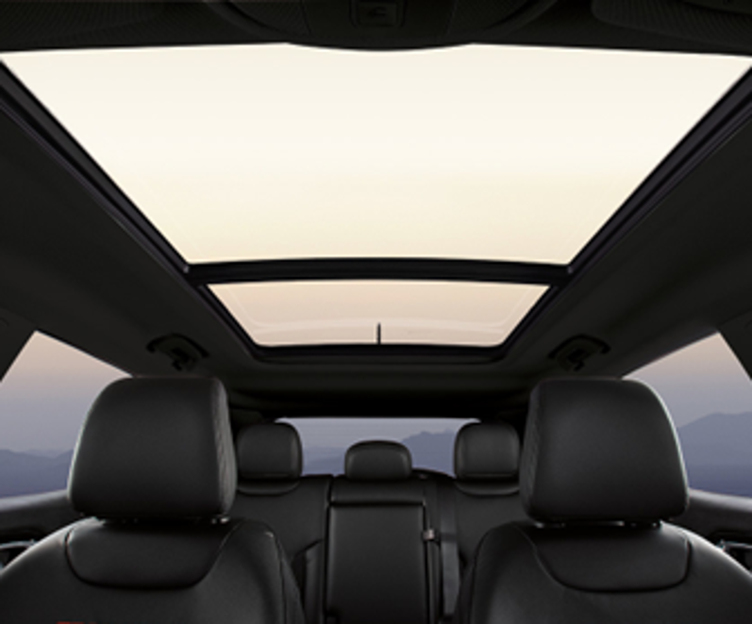
THE NORTH STAR (4/4)
JEEPNESS elements:
Standard Open Air experience thanks
to the Dual pane sunroof, which allows
a unique and typically Jeep® travel experience
In short, a unique mix of elements that allow NORTH STAR to best represent the authenticity of Jeep®

Slide 10
TRIM LEVEL EQUIPMENTS
Let’s now do a quick review of the Renegade range to see in more detail the complete equipment of THE NORTH STAR but also to highlight the new equipment introduced on Renegade, Altitude and Summit.
Δ vs MY24:
Two tone roof (opt)
E-hybrid Badge
Nav
Δ vs Altitude:
+ Metakrome front rings and skid plate
EXTERIOR:
17” Black alloy wheels with summer tire
Dual-pane panoramic sunroof
Dedicated hood decal
Dedicated badge
Two tone roof with new roof cut design
Privacy glasses
INTERIOR:
Dedicated high resistance seats material
Dedicated floor mats
Dedicated air vents bezel
Parking sensors/Park assist
COMFORT:
Mode 3 charging cable (specific for PHEV)
E-hybrid
SUMMIT
E-hybrid
240HP
Δ vs MY24:
NAV VS MY24
E-hybrid Badge
Metakrome front rings and skid plateVS MY24
Δ vs Renegade:
+ 2° Row USB
NORTH STAR
E-hybrid
ALTITUDE
Δ vs MY24:
2° Row USB
Metakrome front rings and skid plate
E-hybrid Badge
E-hybrid
RENEGADE

Slide 11

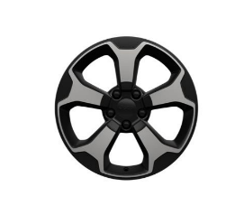


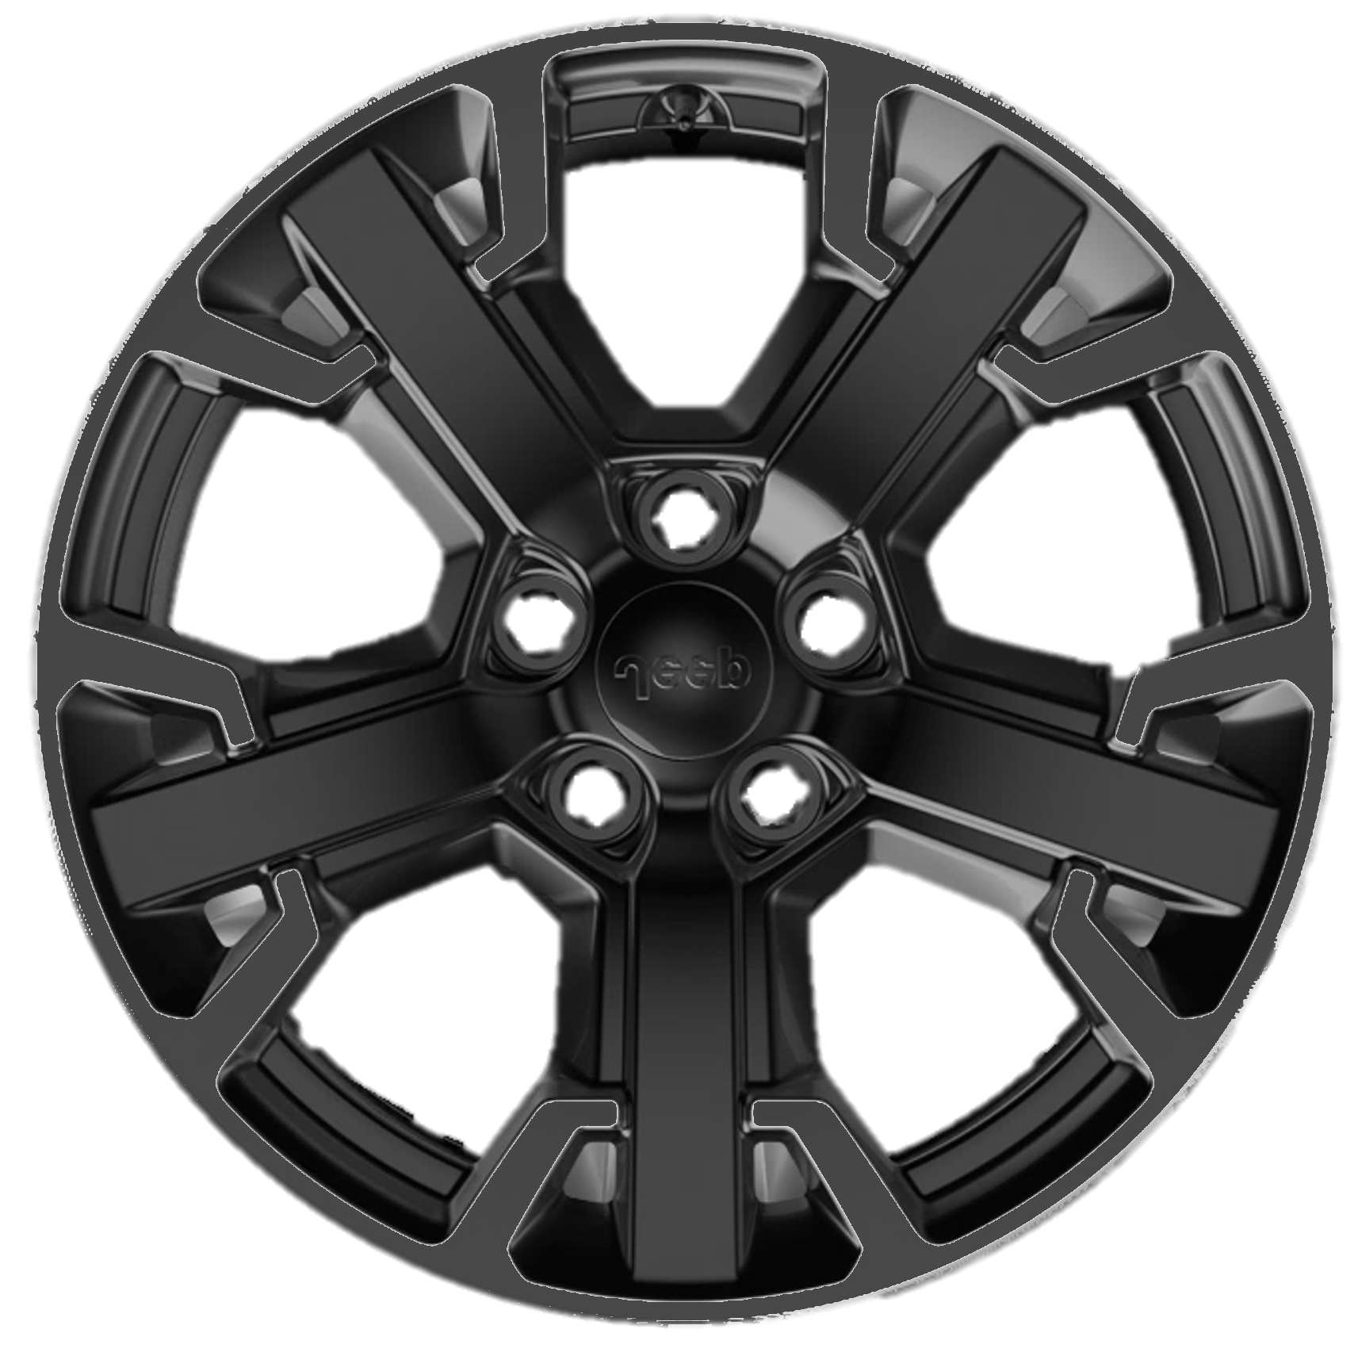
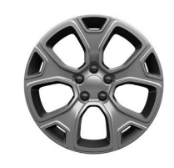

FOCUS ON WHEELS
16’’
And we continue by making a focus on the alloy wheel offer, highlighting the Renegade 2025 Range Update variations on the various trims:
Renegade
17’’
Altitude
Summer/M+S
Altitude
Summer/ M+S
North Star
MHEV/PHEV
18’’
Altitude
Summit

Slide 12
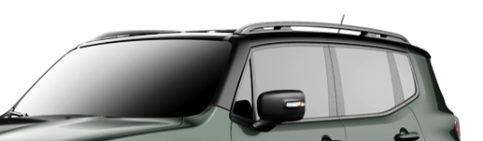
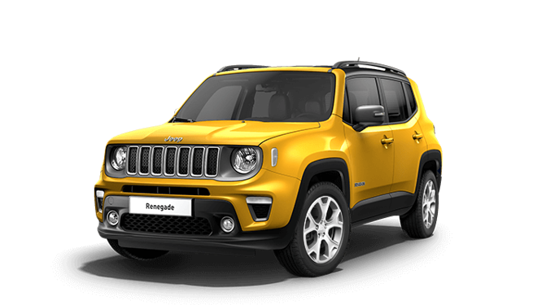
NEW BI-COLOR PAINT
Renegade 2025 Range Update also introduces important news on the color offering grid:
NEW BLACK ROOF CUT DESIGN
Available on all the Trims
TECHNO GREEN with Black Roof
New paint for free on North Star
SOLAR YELLOW
New paint for free on Renegade and Summit

Slide 13
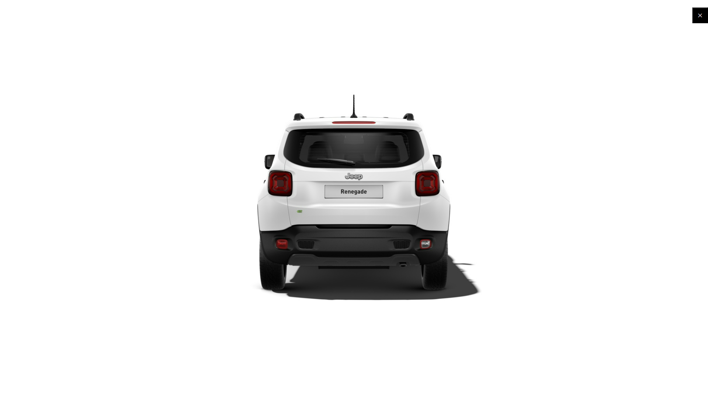
RANGE EVOLUTION (1/3)
… and to complete the product news a look on the changes introduced on the badges/finishing that equip the different versions:
WHAT
e-hybrid badge
elimination on all trim level
WHY
No Conventional engines available in the range: e-Hybrid is the standard engine e does not need of specific badge
WAS
BECOMES

Slide 14
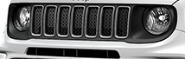
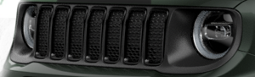
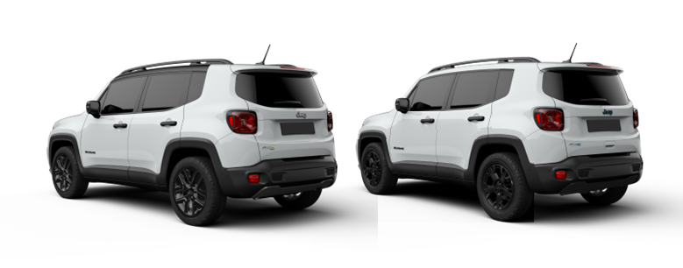
RANGE EVOLUTION (2/3)
WHAT
Front Grid Rings & Rear Skid plate:
from Metakrome silver glossy to Glossy Black on Renegade and Altitude
WHY
Differentiate the range of Onroad version, keeping the high trim Summit more distinctive with painted version rings and skid plate.
WAS
BECOMES

Slide 15
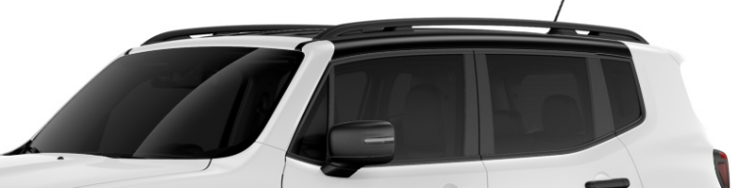
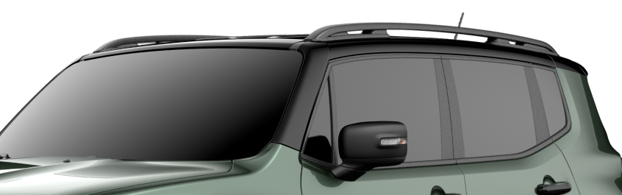
RANGE EVOLUTION (3/3)
WHAT
All range bi-color with new cut roof
WHY
To integrate the Jeep Renegade’s dynamic silhouette with rugged sophistication.
WAS
BECOMES

Slide 16
NEW PACK STRATEGY (1/3)
We can now complete the Renegade news with a close look on the Pack Strategy finalized to make the Renegade offer simple and lean.
In summary:
4 Packs available only, identical for all versions
a few only stand alone opt to complete the offer, as for example:
Sunroof
NAV
Height adjustment

Slide 17
NEW PACK STRATEGY (2/3)
Let’s discover the names and contents of the 4 Packs:
Contents
01
TECH PACK
(Altitude / Standard on Summit)
Blind spot detection
Passive entry/Keyless Go
F/R parking sensors
Park assist
Adaptive Cruise Control
02
TECH PACK NORTH STAR
(North Star)
Blind spot detection
Passive entry/Keyless Go
Adaptive Cruise Control

Slide 18


NEW PACK STRATEGY (3/3)
Let’s discover the names and contents of the 4 Packs:
Contents
03
WINTER PACK
(Renegade, Altitude, North Star, Standard on Summit)
Heated seats
Heated steering wheel
Windshield de-icer
Steering wheel w/leather wrap
04
COMFORT PACK
(Summit)
Winter Pack
Leather seats
Power seats

Slide 19
CONCLUSION
What is important to remember about the Jeep® Renegade 2025 Range Update?

Slide 20
KEY POINTS TO REMEMBER (1/2)
Renegade 2025 Range Update is renewed to continue to be the market leader in its segment. The new features in summary are the following:
New range with 4 Trims (instead of 5) one of which is completely new, the NORTH STAR
NORTH STAR new trim characterized by:
New and exclusive body bi-color with new cut black roof
Dedicated exterior and interior finishing
Dedicated hood decal and specific badge
New high resistance seats material
Dedicated floor mat
Standard Dual pane Sunroof

Slide 21
KEY POINTS TO REMEMBER (2/2)
New trim levels equipment
17'' Alloy wheels specific for NORTH STAR
Range evolution with changes on the badges/finishing that equip the different versions
Pack strategy characterized by:
4 Packs available only, identical for all versions
a few only stand alone opt to complete the offer, as for example:
Sunroof
NAV
Height adjustment

