Slide 1
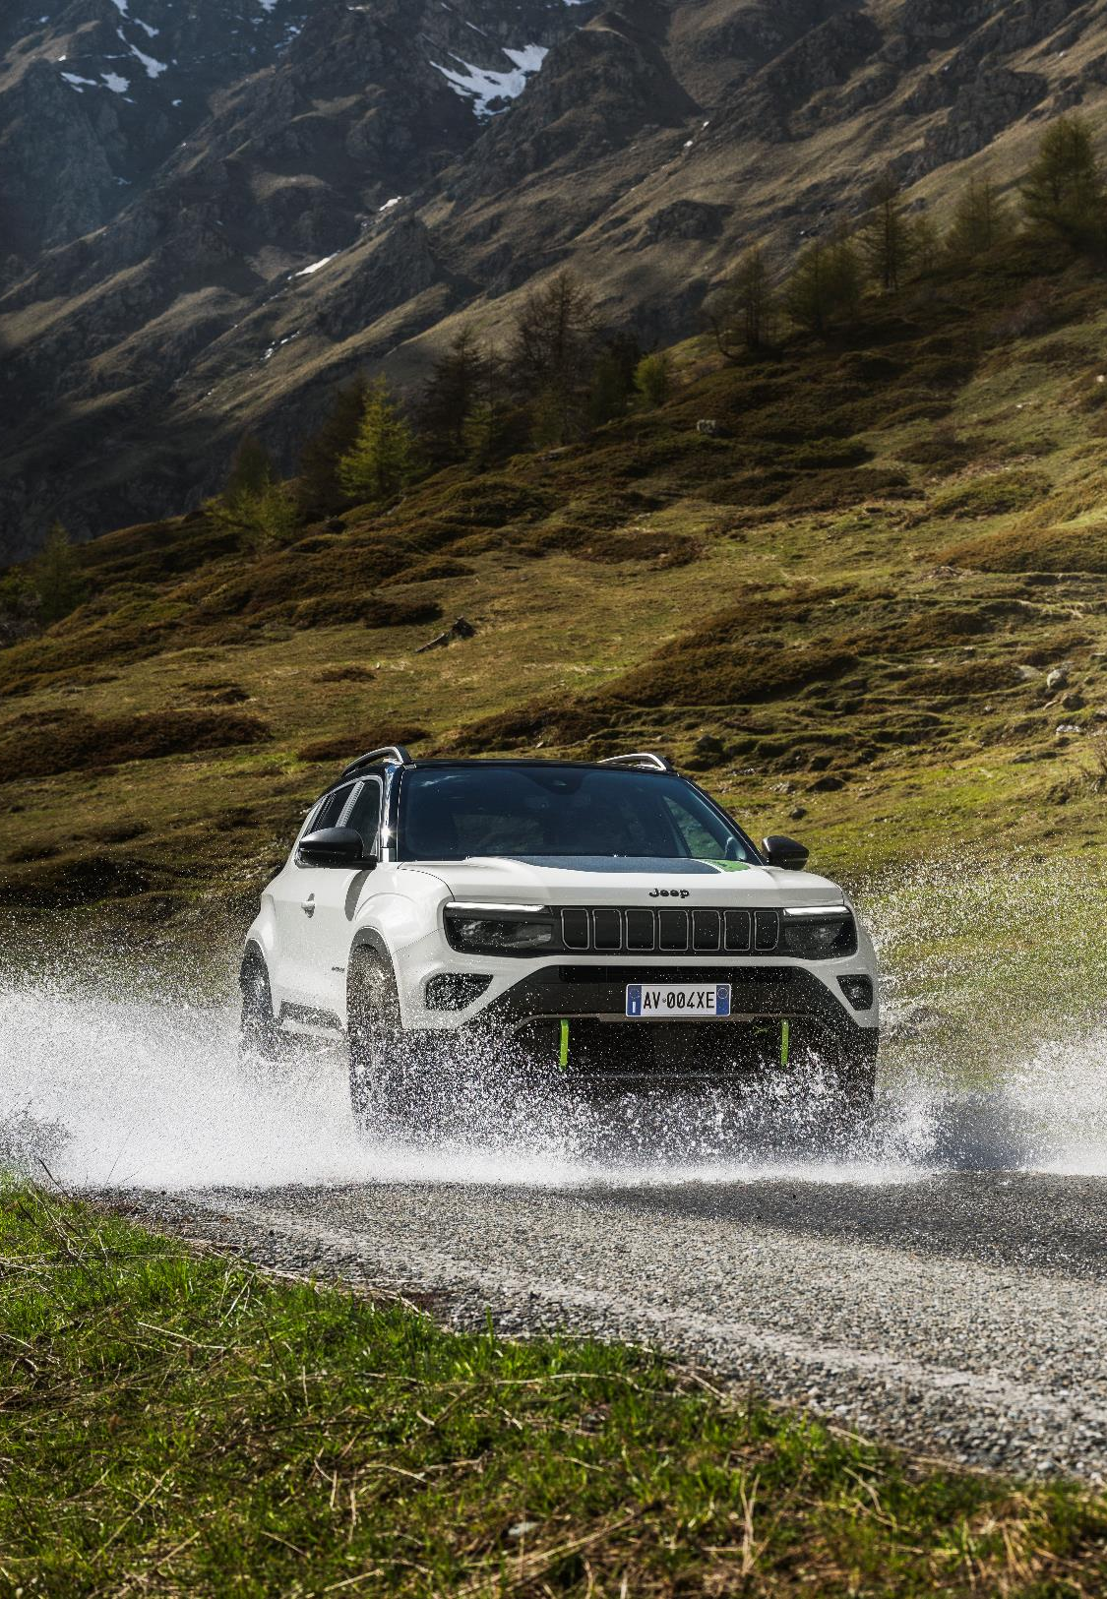

4xe & MY25

Slide 2
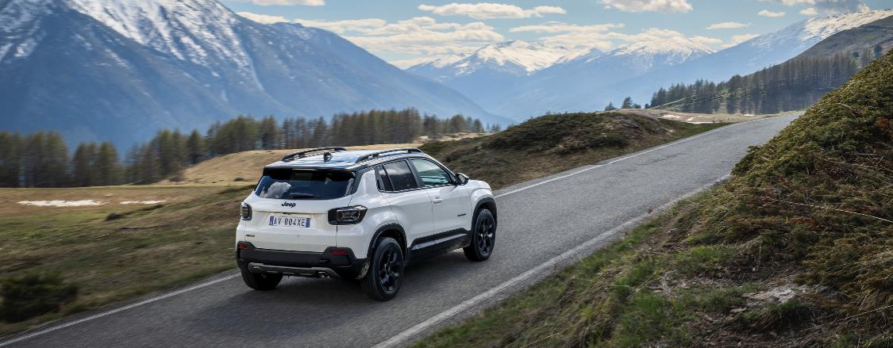

SUMMARY
01 | INTRODUCTION
02 | THE JEEP® AVENGER 4xe CUSTOMER
03 | NEW JEEP® AVENGER 4xe – IMPROVED TECHNOLOGY
04 | DEDICATED DESIGN TO FUNCTION
05 | THE NORTH FACE LAUNCH EDITION (TNF)
06 | NEW JEEP® AVENGER 4xe VS COMPETITORS
07 | JEEP® AVENGER MY25
08 | TECHNOLOGY INNOVATION

Slide 3
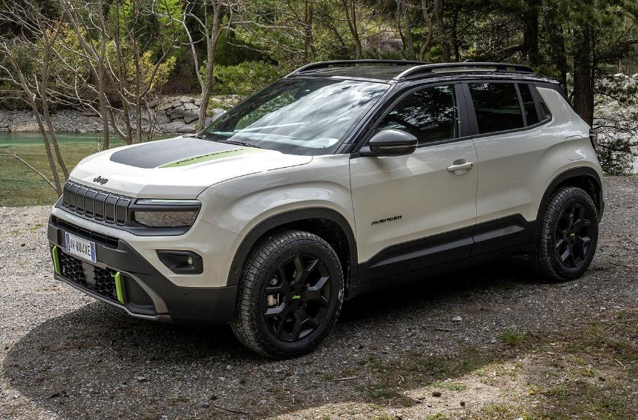

01 | NEW JEEP® AVENGER 4xe & MY25 - INTRODUCTION
welcome
WELCOME TO THIS ON LINE TRAINING SESSION DEDICATED TO NEW JEEP® AVENGER 4xe & MY25!
At the end of the session, you’ll have a detailed overview about Jeep® Avenger 4xe that brings together Avenger’s distinctive looks, compactness and versatility coupled Jeep® brand’s All-Wheel-Drive system performances.

Slide 4

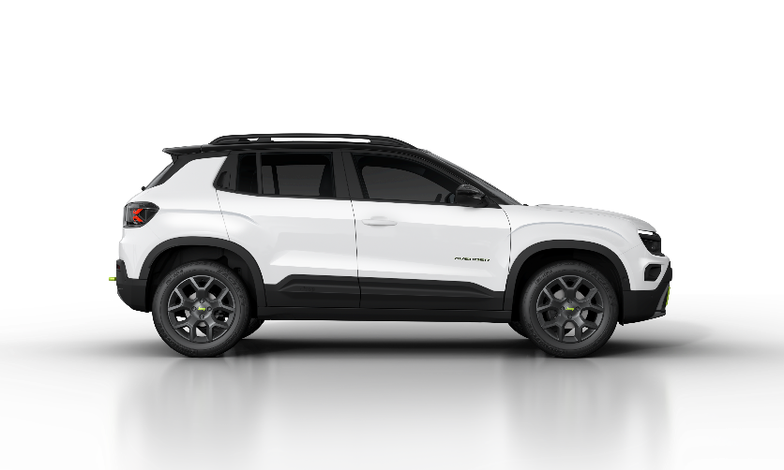
02 | THE JEEP® AVENGER 4xe CUSTOMER
4X4 OVERVIEW
44%
4x4 WEIGHT
B/C-SUV SEGMENT
31%
vs
28%
27%
26%
22%
18%
16%
15%
14%
14%
15%
2018
2019
2020
2021
2022
2023
4x4 is part of Jeep® DNA with a high value recognized by the Market
Avenger 4xe is more than a powertrain

Slide 5
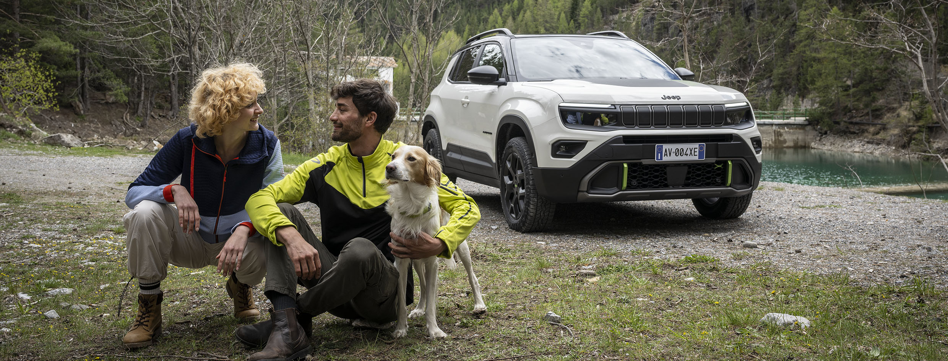
02 | THE JEEP® AVENGER 4xe CUSTOMER
JEEP® AVENGER 4xe – cUSTOMERS PROFILE
JEEP® AVENGER 4xe PERMITS TO ATTRACT MANY DIFFERENT CUSTOMER CLUSTERS!
Who they are?
“Open air” enthusiasts and those who love and practice sports
Past 4x4 owners who wouldn’t give up additional traction and safety provided by all-wheel-drive
Urban Customers who need a compact car during working week but love weekend outdoor escapades
People who are not “into offroad” but want to stand out from the crowd!
Fleets and professionals who need a car capable to cope with extreme conditions

Slide 6





03 | NEW JEEP® AVENGER 4xe & MY25 - IMPROVED TECHNOLOGY
PERFORMANCES EVALUATION
How is Avenger 4xe powertrain made up?
48V hybrid system
1.2 L turbo engine 136 HP
Two 21 kW electric motors:
one on the front axle integrated into the 6-speed dual-clutch automatic transmission
the second on the rear axle
MAX POWER THERMAL ENGINE
100 kW (136Hp)
MAX POWER ELECTRIC ENGINES
21+21 kW
MAX TORQUE
230 Nm
MAX TORQUE FRONT ELECTRIC ENGINE
55 Nm
MAX TORQUE REAR ELECTRIC ENGINE
88 Nm
MAX SPEED
194 km/h
0-100 ACCELERATION
9.5 s
WLTP CO₂ COMBINED
124-126 g/km*
WLTP FUEL
CONSUMPTIONS COMBINED
5.6-5.7 l/100km*
*Pre-homologation data

Slide 7
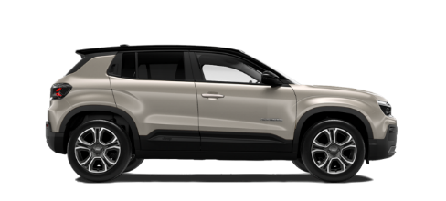
03 | NEW JEEP® AVENGER 4xe & MY25 - IMPROVED TECHNOLOGY
CAPABILITY PERFORMANCES EVALUATION
Jeep® Avenger 4xe - a concrete step forward versus the excellence in performances!
4x2
OFFROAD ANGLES
Approach/Brakeover/Departure
20°/20°/34°
GROUND CLEAREANCE mm
200
WATER FORDING mm
230
DRIVEN WHEELS
FRONT
SELEC-TERRAIN
SPECIFIC TRACTION CONTROL

Slide 8
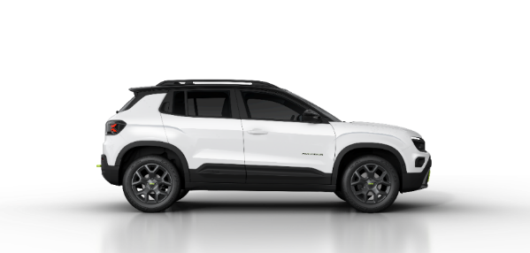
03 | NEW JEEP® AVENGER 4xe & MY25 - IMPROVED TECHNOLOGY
CAPABILITY PERFORMANCES EVALUATION
Jeep® Avenger 4xe – a concrete step forward versus the excellence in performances!
4xe
OFFROAD ANGLES
Approach/Brakeover/Departure
22°/21°/35°
GROUND CLEAREANCE mm
210
WATER FORDING mm
400
DRIVEN WHEELS
AWD always available
(power looping technology)
SELEC-TERRAIN
SPECIFIC TRACTION CONTROL +
AWD MANAGEMENT (LOCK < 30km/h)

Slide 9
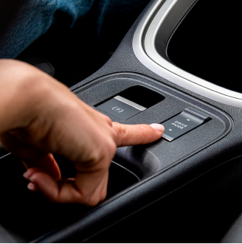

03 | NEW JEEP® AVENGER 4xe & MY25 - IMPROVED TECHNOLOGY
CAPABILITY – selec terrain
JEEP® AVENGER 4xe is supplied with a specific SELEC-TERRAIN: how it works?
4 different driving modes
AUTO
FWD dominant
EV drive at low speed
AWD on demand from unclutch 0-90 km/h
SAND/MUD*
Smart AWD
permanent AWD up to 30 km/h with 50:50 torque repartition
30-90 km/h AWD on demand
Above 90 km/h permanent FWD
ASR/ESP in SAND/MUD
SNOW*
Smart AWD
permanent AWD up to 30 km/h with 50:50 torque repartition
30-90 km/h AWD on demand
Above 90 km/h permanent FWD.
ASR/ESP in SNOW
SPORT**
AWD up to 40 km/h
energy supplied to rear motor both from battery and front electric motor for maximum boost
Above 40 km/h permanent FWD
Specific gas pedal response and gearbox map & steering feedback
BENEFITS?
Selec-Terrain guarantees to JEEP® AVENGER 4xe the most effective performances according to driving conditions
*Rear electric motor always linked to wheels up to 90km/h
**Rear electric motor always linked to wheels up to 40km/h

Slide 10

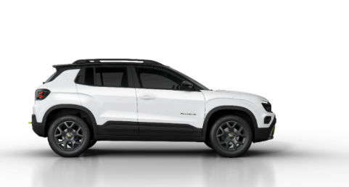
03 | NEW JEEP® AVENGER 4xe & MY25 - IMPROVED TECHNOLOGY
CAPABILITY – selec terrain
JEEP® AVENGER 4xe Selec-Terrain drive mode differences - 4x2 versus 4xe
4x2
4xe
4xe differences
Auto mode automatically adapt to drive needs with AWD on demand: reducing consumption and allowing electric drive at low speed in FWD condition and activating the AWD when needed.
ECO
NORMAL
AUTO
AWD management up to 40km/h, energy supplied to rear motor both from battery and front electric motor for maximum boost. Above 40kph permanent FWD.
SPORT
SAND
ESP and ASR calibration merged for the two drive modes, AWD lock up to 30km/h, 30-90km/h AWD on demand.
MUD
SAND / MUD
SNOW
AWD lock up to 30km/h, 30-90km/h AWD on demand.

Slide 11
03 | NEW JEEP® AVENGER 4xe & MY25 - IMPROVED TECHNOLOGY
CAPABILITY – ADDITIONAL INFO
Jeep® Avenger 4xe's 48V Hybrid system allows to drive in 100% electric mode at low speeds when AWD isn’t active.
No transmission shaft! Traction on the rear wheels is entrusted to electric.
System guarantees 4x4 availability despite the level of charge of the battery thanks to Power Looping Technology.

Slide 12
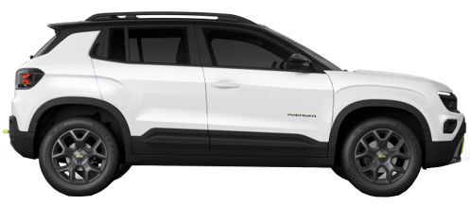
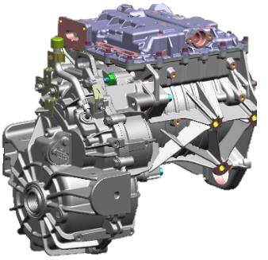
03 | NEW JEEP® AVENGER 4xe & MY25 - IMPROVED TECHNOLOGY
CAPABILITY – SLOPES PERFORMANCES
Avenger 4xe promises to overcome slopes on challenging terrain!
Look at performances:
40% - gravel
up to 20% - front axle total grip absence
Engine torque: 88Nm
Reducer ratio: 22.7:1
Torque at rear wheels: 1900Nm
WHAT IS THE REASON WHY?
Jeep® Avenger 4xe is equipped with a reducer coupled to the rear eMotor capable of ensuring 1900 Nm torque at rear wheels multipying 88Nm of the electric motor by 22.7 ratio!
Inverter
eMotor 48 V
(21 kW))
Reducer

Slide 13
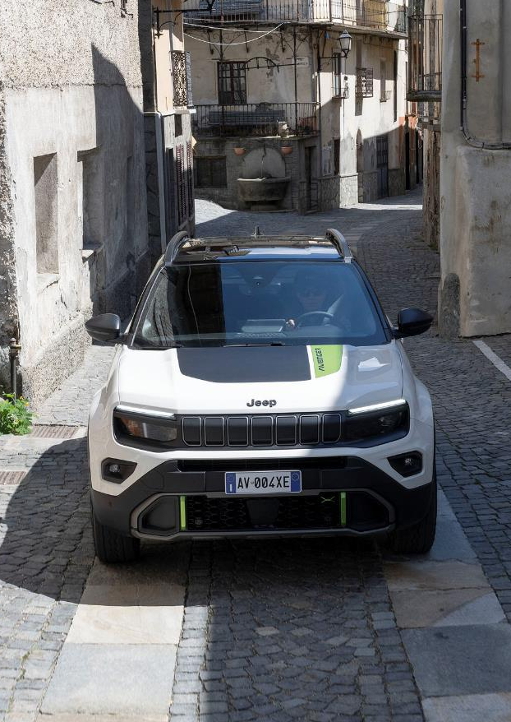
04 | NEW JEEP® AVENGER 4xe & MY25 - DEDICATED DESIGN TO FUNCTION
DEDICATED DESIGN TO FUNCTION
Jeep® Avenger 4xe design prioritized vehicle's protection.
This includes redesigned fog lights positioned slightly higher and outward.
Roof rails are adding new cargo functionality.
Rear tow hook is always useful to help/been helped by a friend offroad!

Slide 14
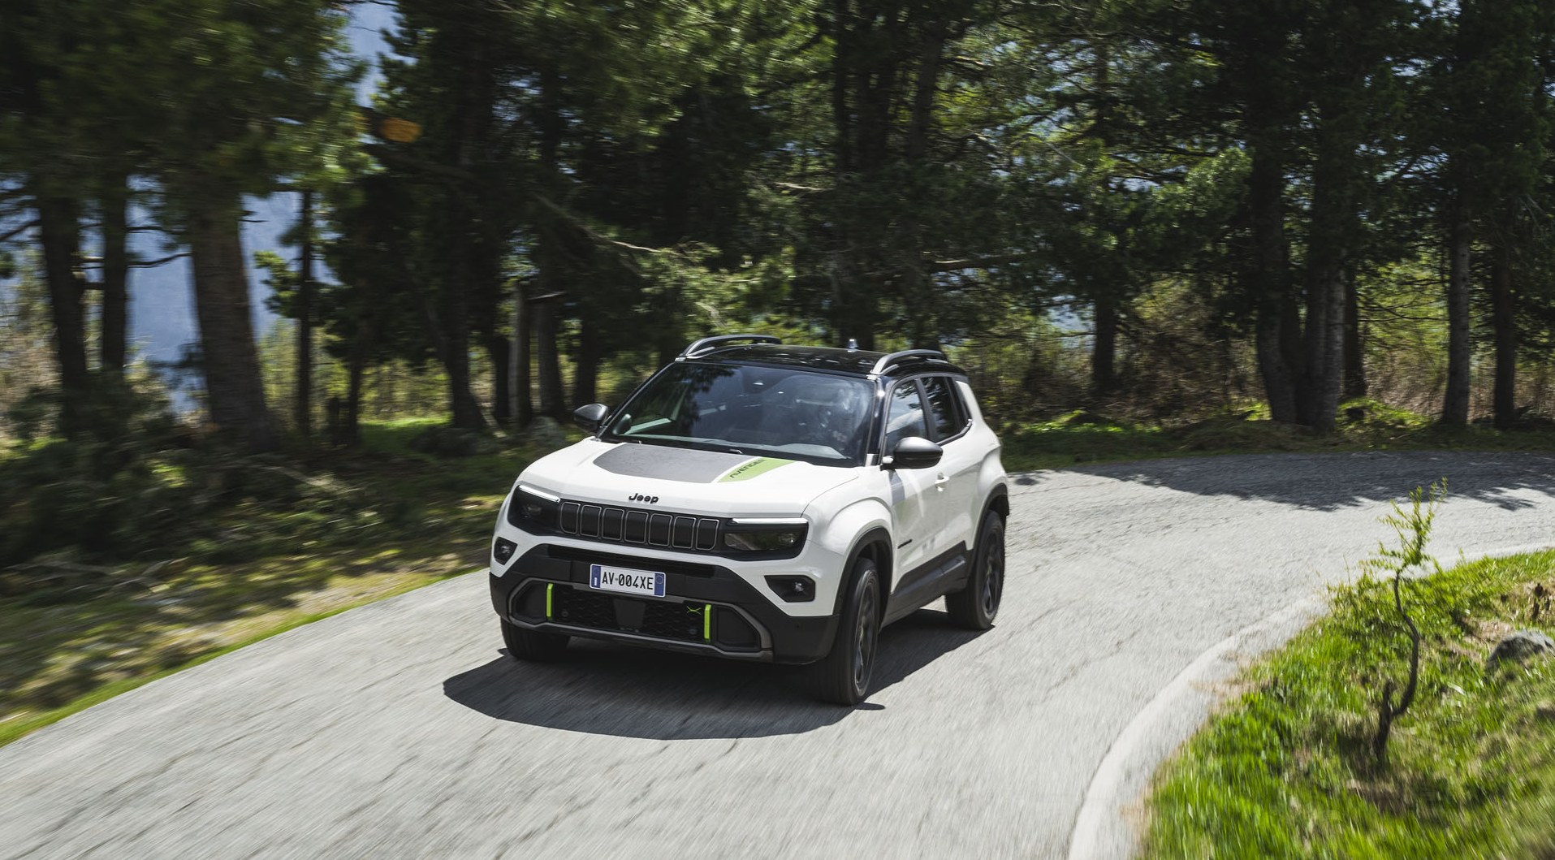
04 | NEW JEEP® AVENGER 4xe & MY25 - DEDICATED DESIGN TO FUNCTION
DEDICATED DESIGN TO FUNCTION
Front and rear bumpers are made in mold-in-color material with anti-scratch finishing and protecting number plate from impact.
Front lower grill and the radar are protected by robust bumpered ensuring durability in rugged environments.
Jeep® Avenger 4xe also features hood sticker (opt).
It’s made of matt color to prevent unpleasant sun reflections while driving.

Slide 15

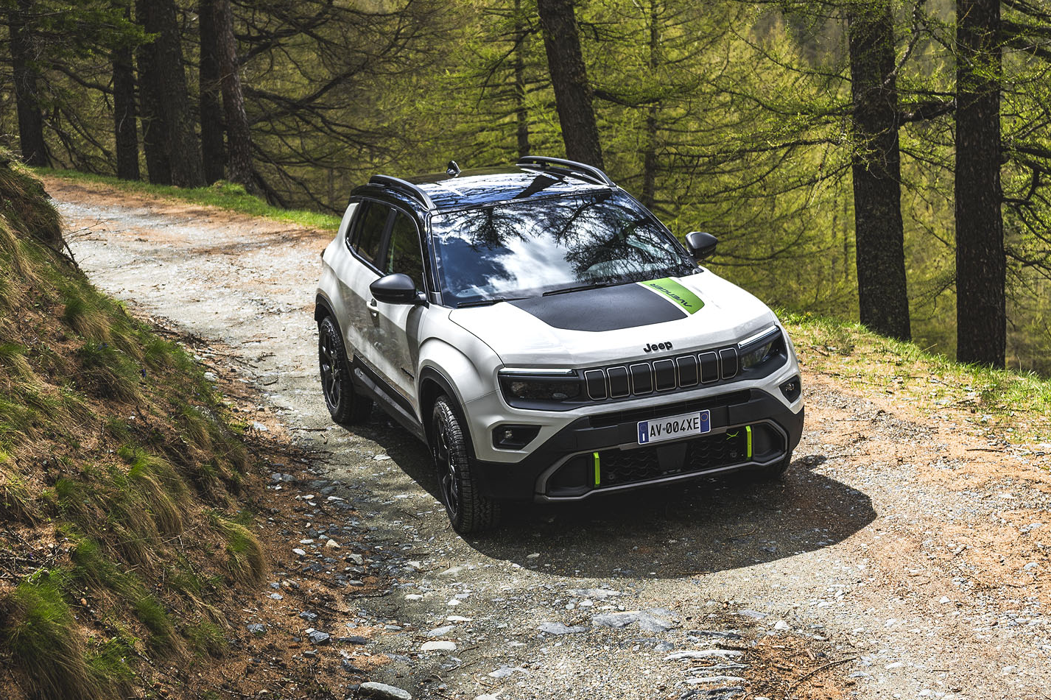
04 | NEW JEEP® AVENGER 4xe & MY25 - DEDICATED DESIGN TO FUNCTION
AVENGER 4xe – UNIQUENESS
NEW FRONT & REAR BUMPERS
FOGLIGHTS DESIGN
ROOF RAILS
REAR TOW HOOK
17" BLACK ALLOY WHEELS WITH M+S TYRES
SPECIFIC
EXTERIOR

Slide 16
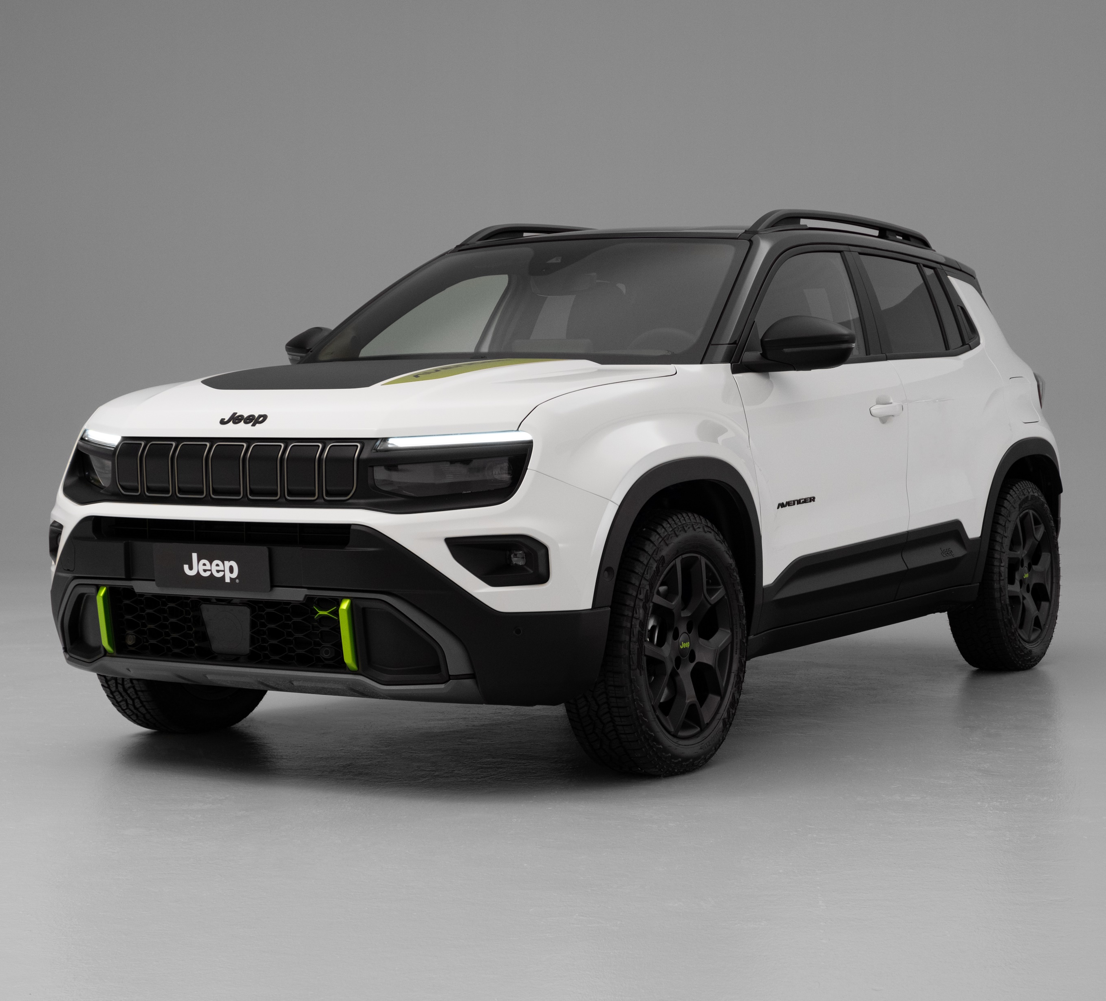
04 | NEW JEEP® AVENGER 4xe & MY25 - DEDICATED DESIGN TO FUNCTION
AVENGER 4xe
Specific components - Exterior
HOOD STICKER
MOPAR ACCESSORY
ROOF RAILS
GRILLE CARRIER
MOULD-IN COLOUR MATERIAL
SPECIFIC FOGLIGHTS DESIGN
NEW FRONT BUMPERS ANTI SCRATCH
MOULD-IN COLOUR MATERIAL
BUMPER GREEN ACCENT
MOPAR ACCESSORY

Slide 17
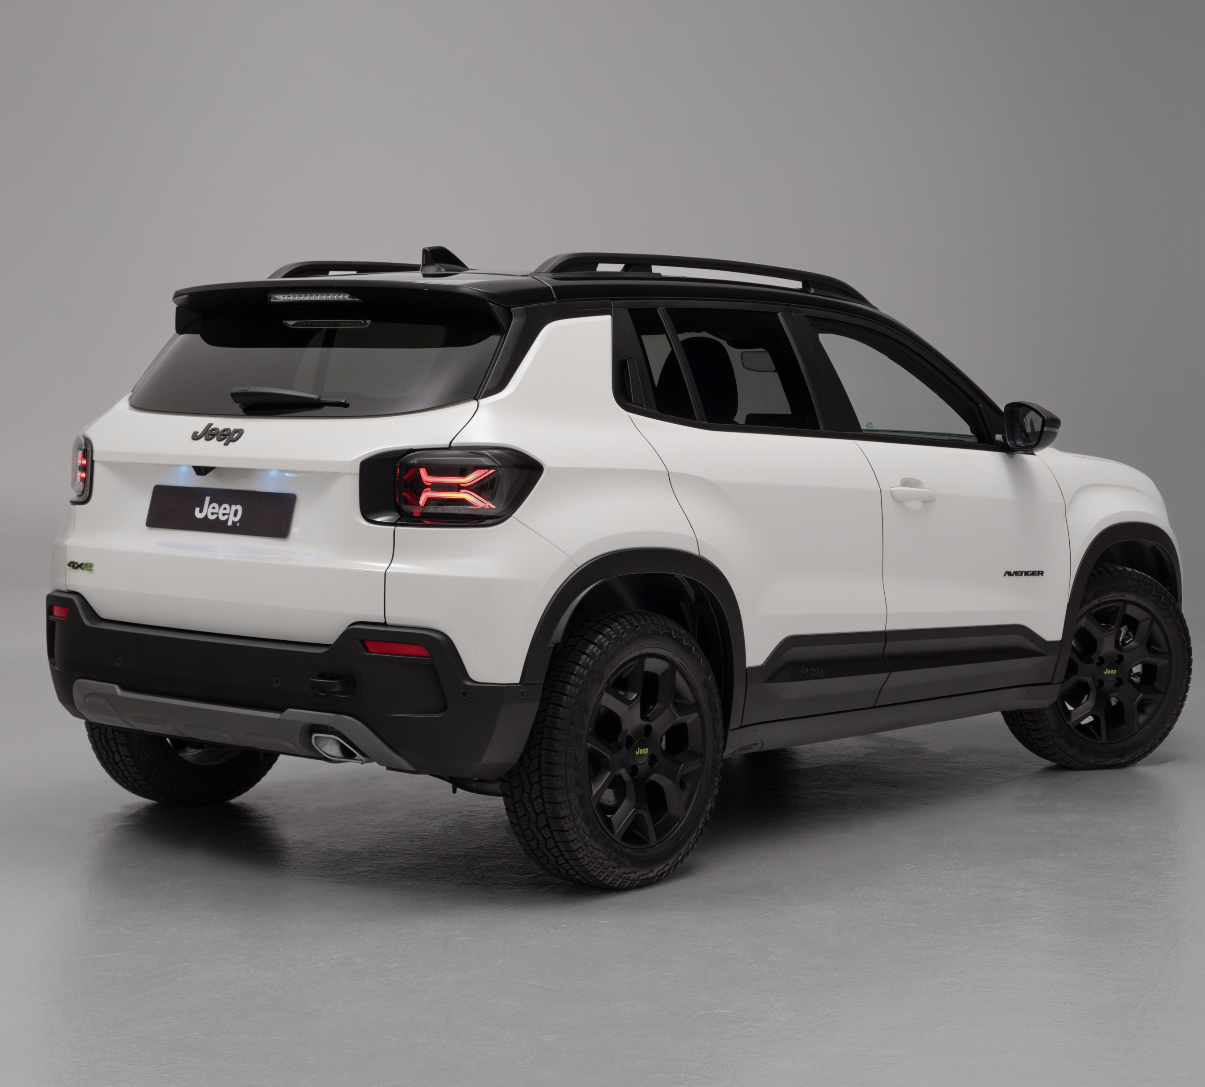
04 | NEW JEEP® AVENGER 4xe & MY25 - DEDICATED DESIGN TO FUNCTION
AVENGER 4xe
Specific components - Exterior
BLACK LOGOS
DEDICATED REAR BUMPER
17’’ BLACK ALLOY WHEELS WITH M+S TYRES (All Terrain tyres available as option)
REAR TOW HOOK

Slide 18
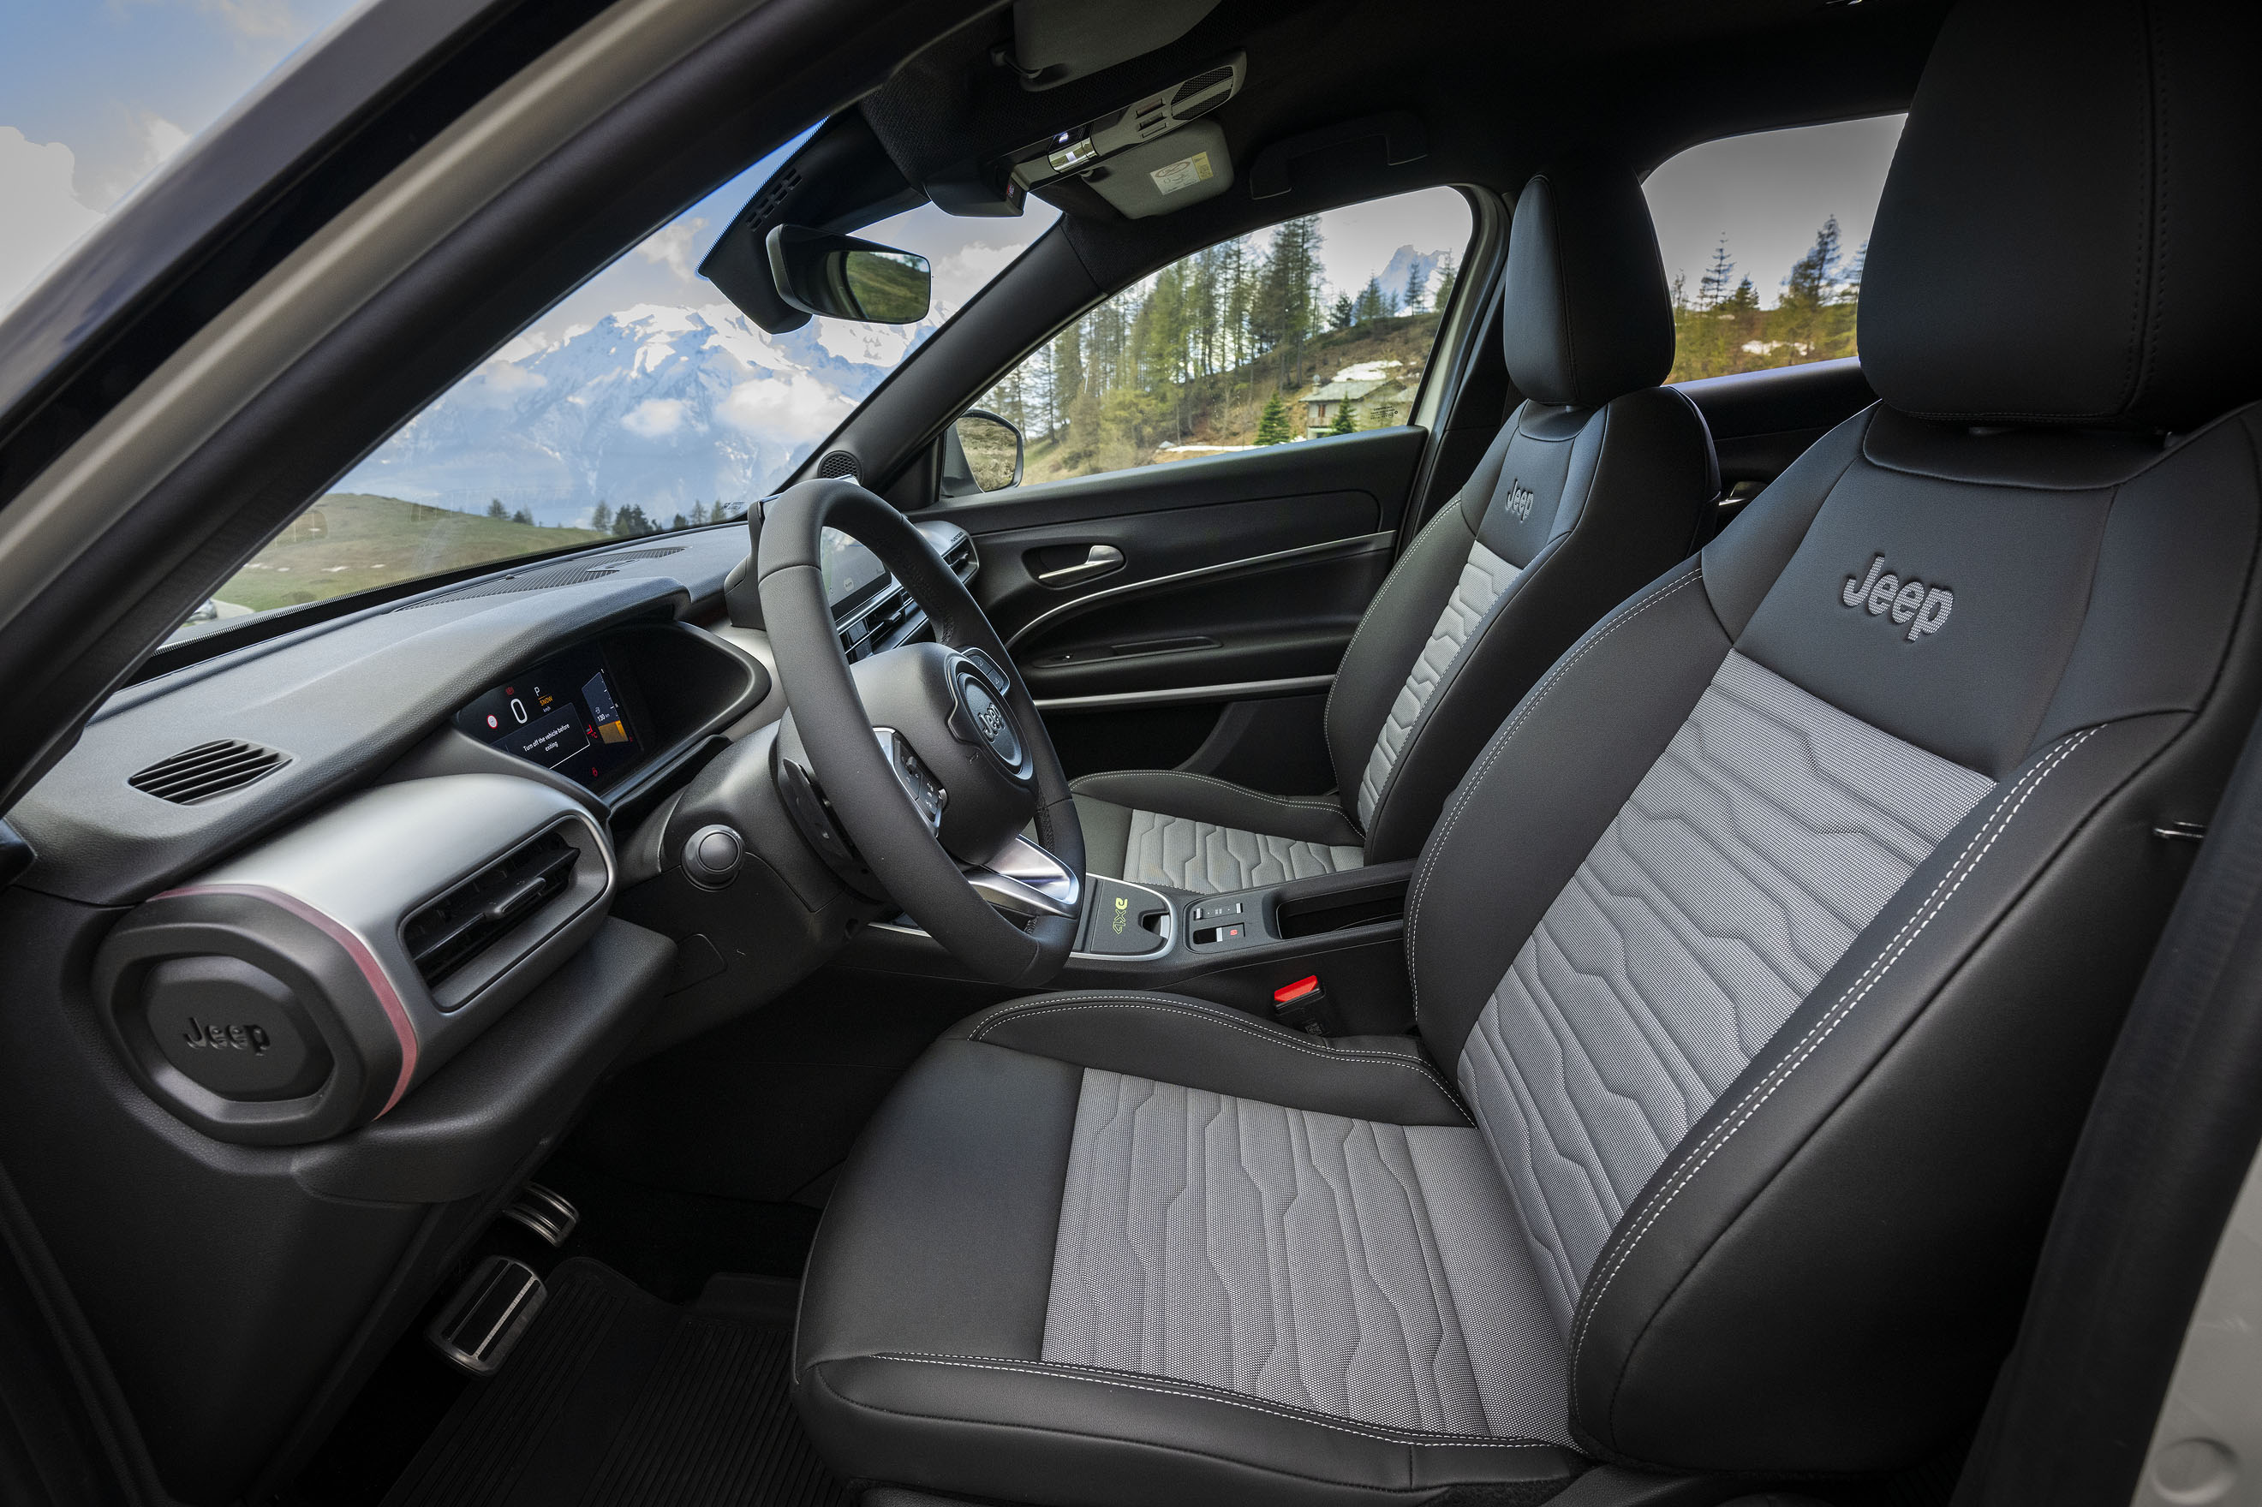
04 | NEW JEEP® AVENGER 4xe & MY25 - DEDICATED DESIGN TO FUNCTION
AVENGER 4xe – UNIQUENESS
NEW SEATS WITH INNOVATIVE WASHABLE MATERIALS TWICE MORE DURABLE THAN A CONVENTIONAL FABRIC
SPECIFIC
INTERIOR

Slide 19
04 | NEW JEEP® AVENGER 4xe & MY25 - DEDICATED DESIGN TO FUNCTION
AVENGER 4xe
Specific components - Interior
BLACK HEADLINER
NEW SEATS WITH WASHABLE & DURABLE MATERIALS

Slide 20
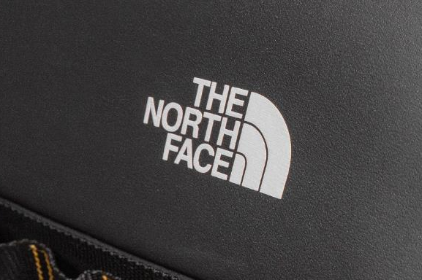
05 | NEW JEEP® AVENGER 4xe & MY25 - THE NORTH FACE LAUNCH EDITION
Avenger 4xe THE NORTH FACE – REASON WHY
Jeep® SUVs are unique tools to experience the outdoors and they have always been able to satisfy Customer needs thanks products able to provide a sense of freedom, comfort and safety even in the most extreme situations.
Jeep® shares with The North Face® strong values like the empowerment to explore and the outdoor life in nature.
Jeep® and The North Face® meet together in a strong message:
EXPLORE TOGETHER, EXPLORE TO GET THERE

Slide 21
05 | NEW JEEP® AVENGER 4xe & MY25 - THE NORTH FACE LAUNCH EDITION
Avenger 4xe THE NORTH FACE – REASON WHY
The partnership between Jeep® and The North Face® is based on many pillars & common points:
2 American brands in expansion in Europe
Both brands focus on Outdoor and exploration - empower to explore - live the nature and have fun
Both iconic products: Jeep® Willys / TNF Dome tent
Entry point for exploration = Avenger 4xe will be the entry point of Jeep® 4x4 line-up
Both brands
have a strong community
offer sustainable products
design is driven by functionality: right material in the right place, durable performing materials performance and extra functionality obtained by ultra-storage systems

Slide 22
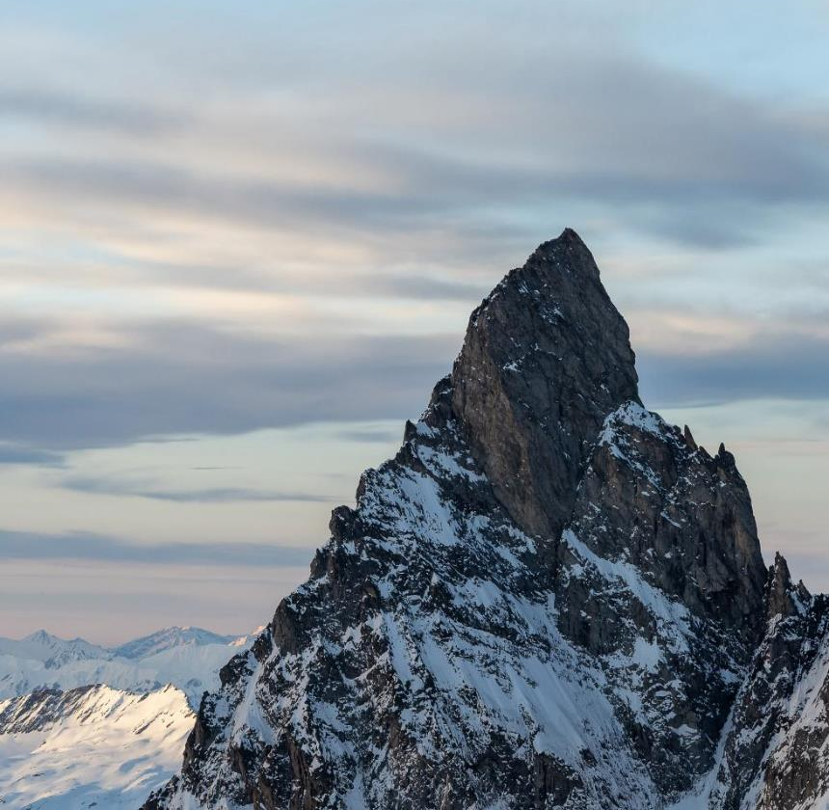

05 | NEW JEEP® AVENGER 4xe & MY25 - THE NORTH FACE LAUNCH EDITION
Avenger 4xe THE NORTH FACE – REASON WHY
With these premises, the Jeep® Avenger 4xe "The North Face" Launch Edition was born.
Only 4806 units will be produced, a value that refers to the new official height of Mont Blanc is the highest mountain in Europe and the symbol of the pinnacle of the two brands.
This version will feature a series of specific exterior and interior aesthetic details that will make it truly unique.

Slide 23
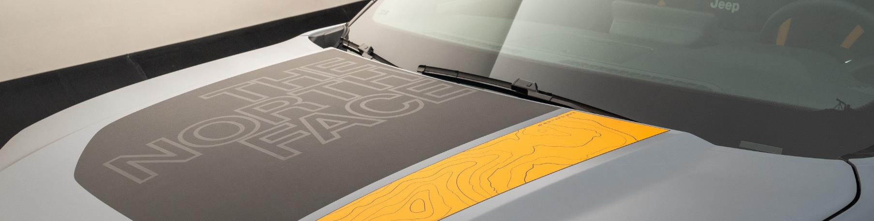
05 | NEW JEEP® AVENGER 4xe & MY25 - THE NORTH FACE LAUNCH EDITION
AVENGER 4xe The North Face - UNIQUENESS
FRONT BUMPER WITH SUMMIT GOLD TOUCHES
DEDICATED ANTI-REFLECTION HOOD STICKER "THE NORTH FACE"
NEW 7 SLOTS DESIGN WITH TOPOGRAPHIC LINES
SUMMIT GOLD DOOR LOGO WITH TOPOGRAPHIC LINES
SPECIFIC
EXTERIOR

Slide 24
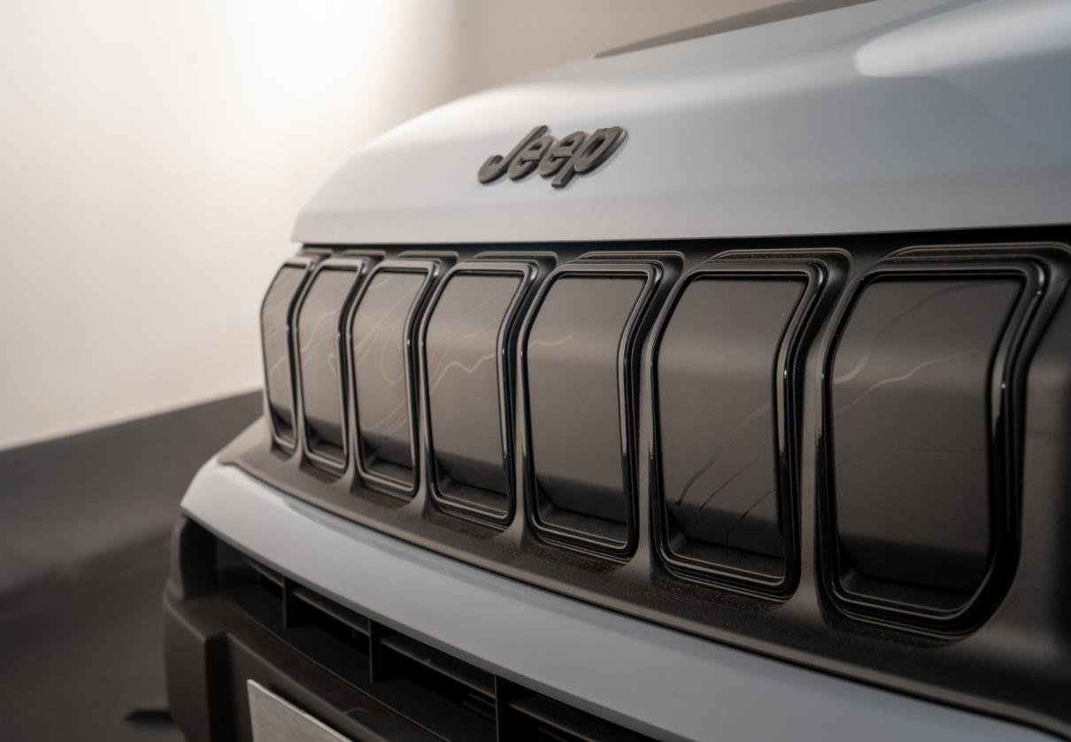

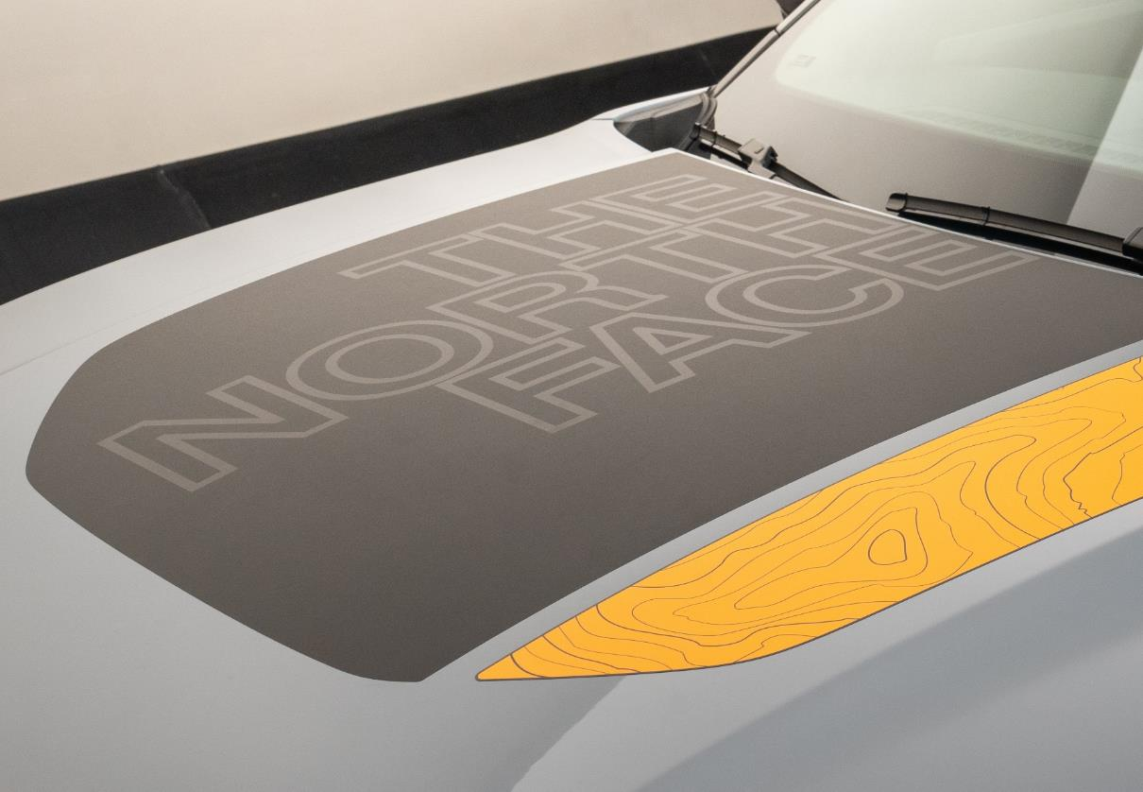
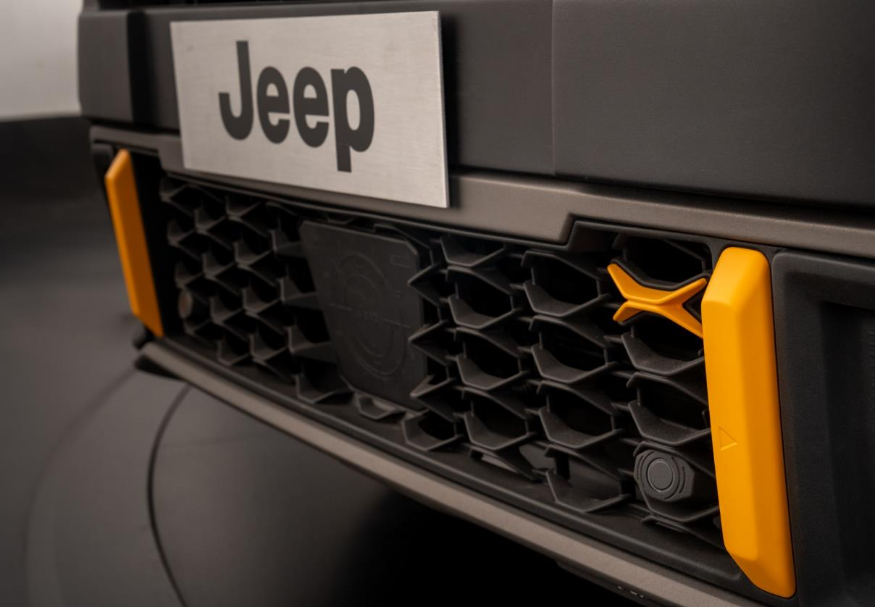
05 | NEW JEEP® AVENGER 4xe & MY25 - THE NORTH FACE LAUNCH EDITION
AVENGER 4xe The North Face
Specific components - Exterior
TNF SPECIFIC
SEVEN SLOTS WITH CONTOUR LINES & GLOSSY BLACK RINGS
TNF SPECIFIC
HOOD STICKER IN SUMMIT GOLD
TNF SPECIFIC
IN SUMMIT GOLD

Slide 25
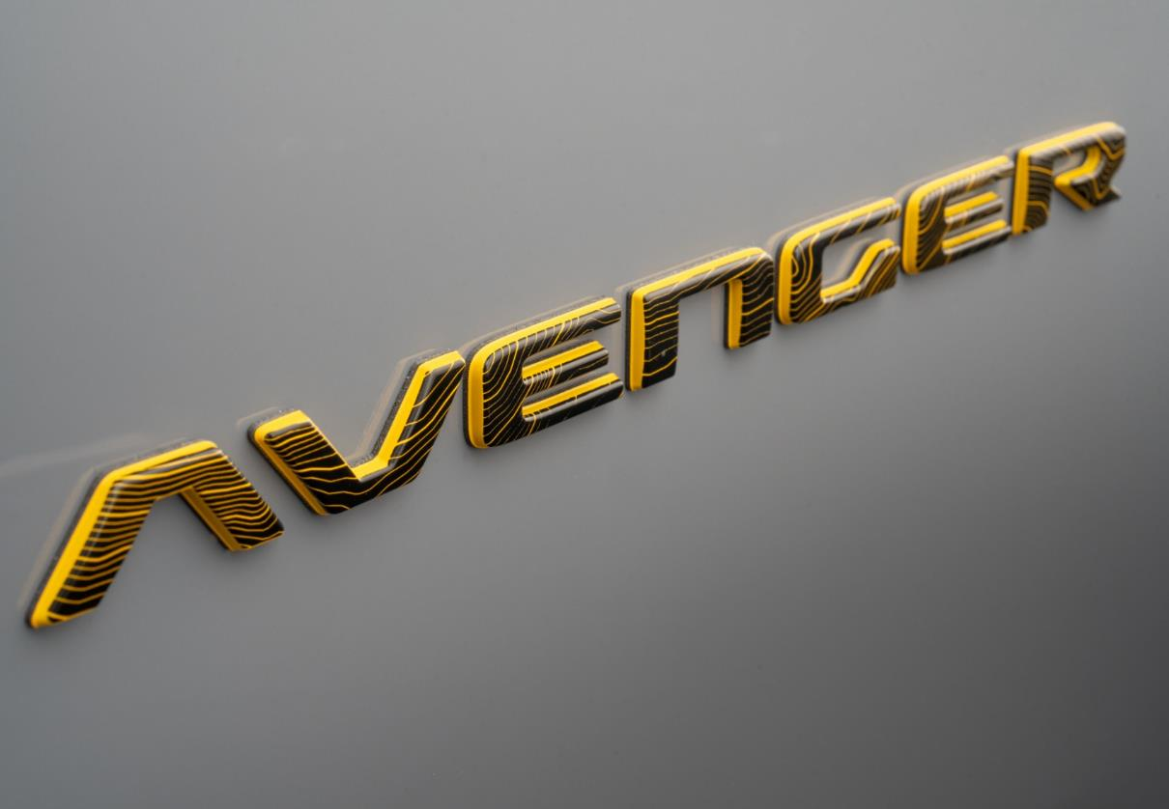

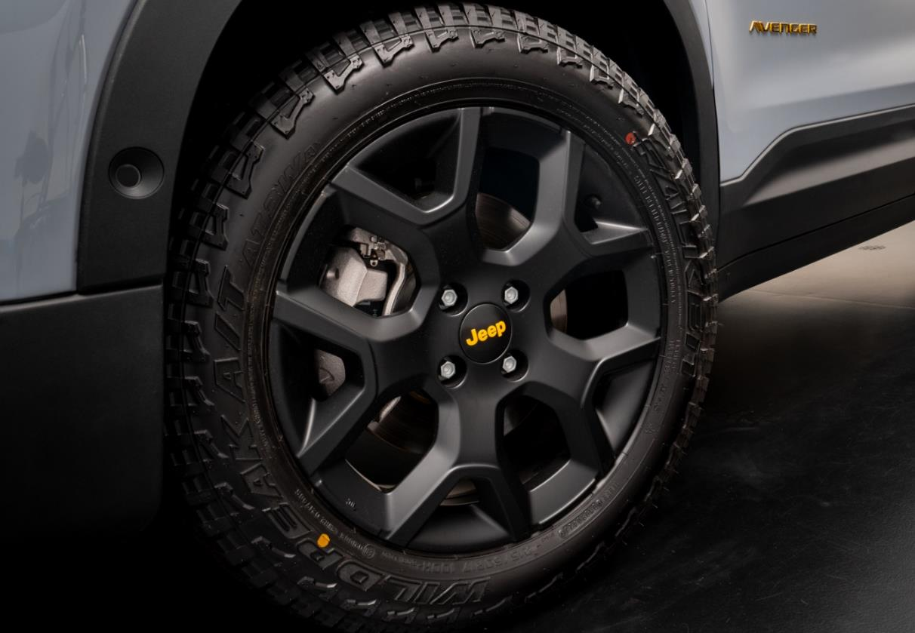
05 | NEW JEEP® AVENGER 4xe & MY25 - THE NORTH FACE LAUNCH EDITION
AVENGER 4xe The North Face
Specific components - Exterior
TNF SPECIFIC
AVENGER LOGO WITH SUMMIT GOLD CONTOURS
TNF SPECIFIC
SUMMIT GOLD WHEELCAP

Slide 26
05 | NEW JEEP® AVENGER 4xe & MY25 - THE NORTH FACE LAUNCH EDITION
AVENGER 4xe The North Face
- UNIQUENESS
New seats made with washable & durable materials, Summit Gold finishing
In the front: TNF jacket profile
In the back: TNF logo, TNF backpacks extra cargo system and hooks
SPECIFIC
INTERIOR
New dashboard with topographic lines & Mont Blanc profile and "one of 4.806" logo
Innovative rubber mats with Alps relief
Padcover with TNF logo
Rear seats recall the vision that climbers had when they climbed the mountain in the fog and only saw the North Face logo and the backpack straps.

Slide 27
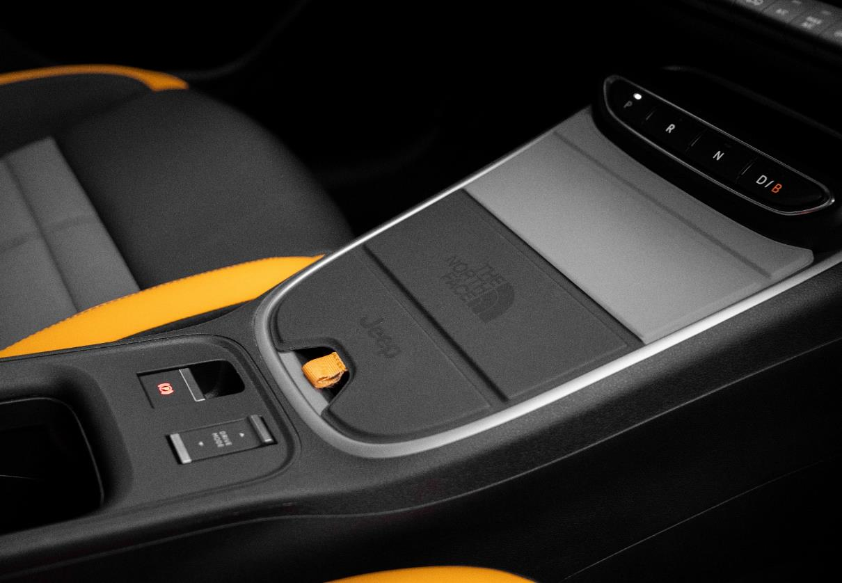
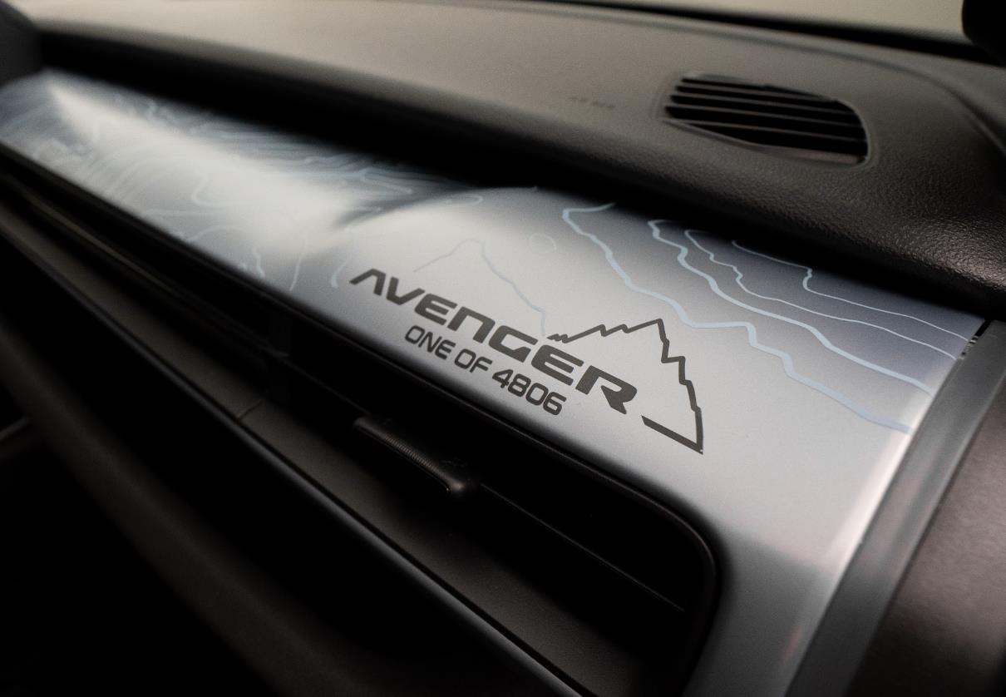

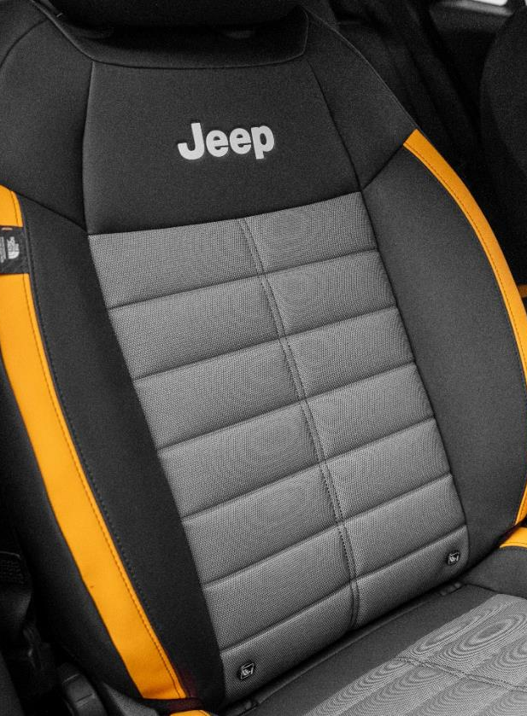
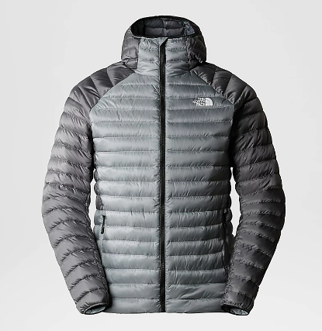
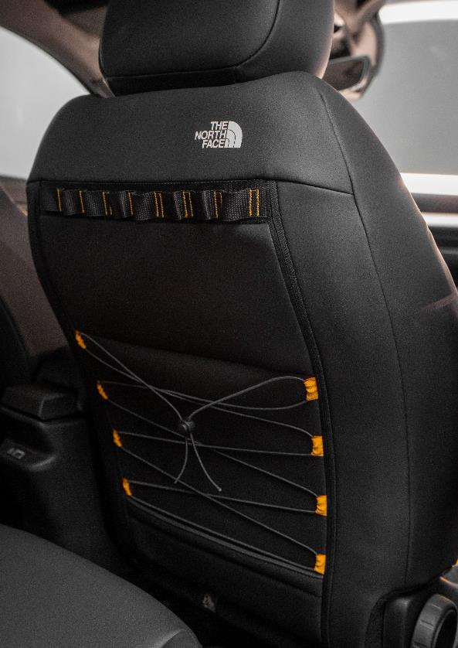
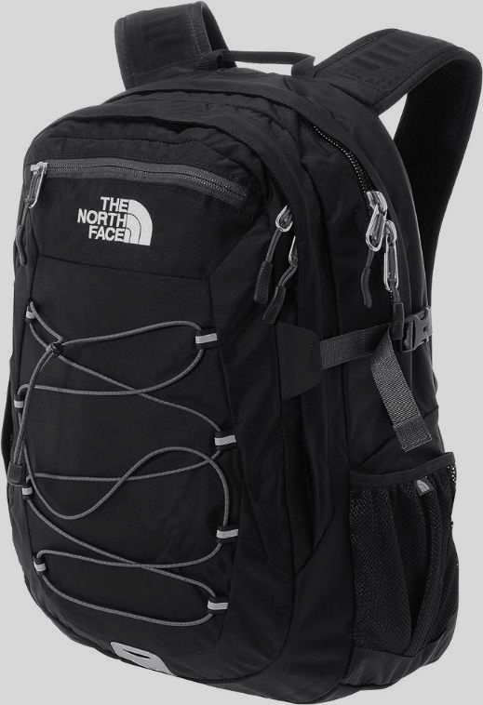
05 | NEW JEEP® AVENGER 4xe & MY25 - THE NORTH FACE LAUNCH EDITION
AVENGER 4xe The North Face
Specific components - Interior
TNF SPECIFIC
PADCOVER AND BEZELS
TNF SPECIFIC
Contour line+mont blanc logo
TNF SPECIFIC
RUBBER MATS
TNF SPECIFIC
NEW SEATS WITH WASHABLE & DURABLE MATERIALS
TNF SPECIFIC
MATERIAL, LOGO AND BACK REFINEMENT WITH TNF HOOK

Slide 28

05 | NEW JEEP® AVENGER 4xe & MY25 - THE NORTH FACE LAUNCH EDITION
AVENGER 4xe The North Face
- UNIQUENESS
THE NORTH FACE EXPLORATION KIT
SPECIFIC
EQUIPMENTS

Slide 29
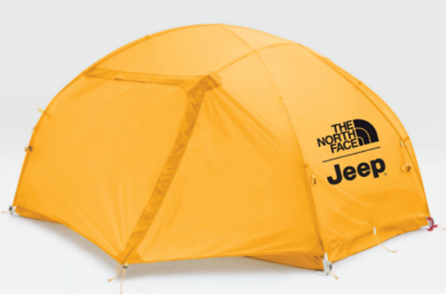
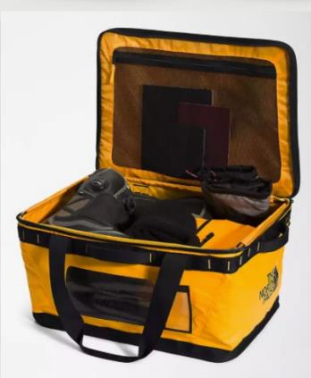
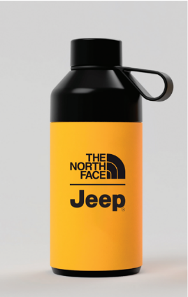
05 | NEW JEEP® AVENGER 4xe & MY25 - THE NORTH FACE LAUNCH EDITION
THE NORTH FACE EXPLORATION KIT
Dedicated to those Customers who perfectly embody the spirit of both brands…
Tent
Duffle bag
Water bottle
With both Jeep® & The North Face logos
The products of the Exploration Kit will be covered by The North Face warranty. Further details will follow in a dedicated communication.

Slide 30

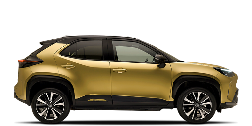
06 | NEW JEEP® AVENGER 4xe VS COMPETITORS
Avenger 4xe Competitors - Capabilities
Product reference
Yaris cross AWD
170
20
19
35
5.3
52
(~550)

Slide 31

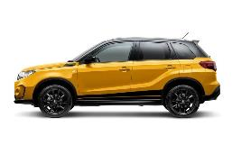
06 | NEW JEEP® AVENGER 4xe VS COMPETITORS
Avenger 4xe Competitors - Capabilities
4xe speciAlist
VITARA allgrip
175
18
18
28
-
-

Slide 32

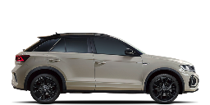
06 | NEW JEEP® AVENGER 4xe VS COMPETITORS
Avenger 4xe Competitors - Capabilities
Brand to kill
T-roc 4motion
161
16
13
18
-
-

Slide 33
06 | NEW JEEP® AVENGER 4xe VS COMPETITORS
Avenger 4xe Competitors - Performances
Product reference
Yaris cross AWD
4.18/1.77/1.60
HEV
AUTOMATIC
116/130
120
170
11.8/11.3
108

Slide 34
06 | NEW JEEP® AVENGER 4xe VS COMPETITORS
Avenger 4xe Competitors - Performances
4xe speciAlist
VITARA allgrip
4.19/1.78/1.60
MHEV/HEV
MANUAL/AUTOMATIC
129/114
235/138
190/180
10.2
128-126

Slide 35
06 | NEW JEEP® AVENGER 4xe VS COMPETITORS
Avenger 4xe Competitors - Performances
Brand to kill
T-roc 4motion
4.24/1.82/1.56
DIESEL
AUTOMATIC
150
360
200
8.5
144

Slide 36
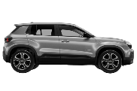
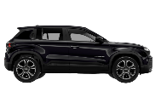
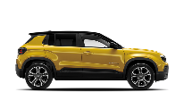
07 | JEEP® AVENGER MY25
AVENGER LINE-UP EVOLUTION
MY24
PETROL
E-HYBRID
BEV
SUMMIT
ALTITUDE
LONGITUDE
SUMMIT
SUMMIT
ALTITUDE
ALTITUDE
LONGITUDE
LONGITUDE

Slide 37
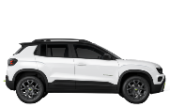
07 | JEEP® AVENGER MY25
AVENGER LINE-UP EVOLUTION
MY25
NEW
PETROL
E-HYBRID
BEV
SUMMIT (PACK)
ALTITUDE
LONGITUDE
TNF
OVERLAND (PK)
SUMMIT (PACK)
UPLAND
SUMMIT (PACK)
ALTITUDE
ALTITUDE
LONGITUDE
LONGITUDE

Slide 38
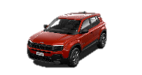
07 | JEEP® AVENGER MY25
MY25 LINE-UP
Longitude
EXTERIOR
16'' alloy wheels
Full LED headlamps reflector
Body color door handles
Grey skid plates
INTERIOR
Black Grained dashboard & fabric seats
Urethane steering wheel
6-way manual driver seat
4-way manual passenger seat
Front armrest
Heated & power adjustable side mirrors
FEATURES
10.25” radio screen
7’’ full digital cluster
Cruise Control
Autonomous Emergency Braking
Traffic Sign Recognition
Lane Keep Assist
Driver Attention Assist
Hill Descent Control
Selec-Terrain
Rear parking sensors
Electric parking brake
Telematic Box & Connected services
Wiring preparation for towing (Petrol/e-Hybrid)
Keyless start
Auto A/C mono zone
Keyless Go
Mode 3 charging cable
REMOVED CONTENTS vs MY24
Keyless entry
Handsfree liftgate
Mandatory delta content vs ICE for electric platform constraints
Additional contents vs MY24

Slide 39
07 | JEEP® AVENGER MY25
MY25 LINE-UP
Altitude (Longitude+)
EXTERIOR
17'' alloy wheels
Silver skid plates
Led foglamps
INTERIOR
Cloth/vinyl premium seats
Silver dashboard & interior inserts (NO ICE)
Height adjustable cargo floor
Synt. Leather steering wheel
FEATURES
Adaptive Cruise Control (ACC)
10.25’’ Full Digital Cluster
180° rear camera with “drone view”
Automatic high beam
Keyless start
Auto dimming mirror
Summit (Altitude+)
EXTERIOR
18'' alloy wheels
Full LED front & rear
INTERIOR
Multi-color Ambient Light*
Electrochromic “frameless” rear-view mirror
FEATURES
Adaptive cruise control (ACC)
10.25’’ Full Digital Cluster
Wireless charger
Blind spot
360° parking sensors
Power foldable mirrors
L2 Autonomous Driving (e-Hybrid/BEV)
Compartments Mopar Rubber Mats
Mopar PadCover (e-Hybrid/BEV)
REMOVED CONTENTS vs MY24
Keyless entry
Handsfree liftgate
Additional contents vs MY24

Slide 40

07 | JEEP® AVENGER MY25
MY25 LINE-UP 4xe
4xe Upland
EXTERIOR
17‘’ black alloy wheels
M+S tyres
New front & rear bumpers
Full LED headlamps reflector
Body color door handles
Silver skid plates
Led foglamps
Rear tow hook
Roof Rails
INTERIOR
Silver dashboard
Dedicated fabric washable & durable seats
Synt leather steering wheel
6-way manual driver seat
4-way manual passenger seat
Front armrest
Heated & power adjustable side mirrors
Height adjustable cargo floor
FEATURES
10.25” radio screen
10.25’’ full digital cluster
Auto A/C mono zone
Adaptive Cruise control
Autonomous Emergency Braking
Traffic Sign Recognition
Lane Keep Assist
Driver Attention Assist
Hill Descent Control
Selec-Terrain
Electric parking brake
Telematic Box & Connected Services
Wiring preparation for towing
180° rear camera with “drone view”
Automatic high beam
Keyless start
Auto dimming mirror
Additional contents vs Altitude

Slide 41
07 | JEEP® AVENGER MY25
MY25 LINE-UP 4xe
4xe Overland In addition vs Upland
EXTERIOR
Full LED front headlamps projector
Rear LED lights
Privacy glass
INTERIOR
Interior multi color ambient light
Velour floor mats
FEATURES
360° parking sensors
L2 assisted driving
Wireless charger
Foldable mirrors with puddle lights
Blind Spot Monitor
Frameless auto dimming mirror
Compartments Mopar Rubber Mats
Mopar PadCover
4xe The North Face In addition vs Overland
EXTERIOR
17‘’ black alloy wheels with gold accents
Anti-reflection hood sticker with The North Face logo
Jeep® 7 slots with topographic lines and glossy black rings
Summit gold plate protection insert
INTERIOR
Dedicated seats (washable & durable) with Summit gold profile, The North Face logo and extra cargo system
Dedicated dashboard with topographic lines & Mont Blanc profile
Dedicated rubber floor mats with mountains profile
Dedicated pad cover with The North Face logo
Interior multi color ambient light
FEATURES
Navigation system
Heated windshield
Heated front seats
Passive entry
Handfree power liftgate

Slide 42

07 | JEEP® AVENGER MY25
PACK STRATEGY
LONGITUDE
INFOTAINMENT & CONVENIENCE
Navigation System
Traffic Sign Information
10.25” digital cluster
ACC – Adaptive Cruise Control
Techno leather steering wheel
LED fog lamps
2nd row charging USB type C
Height adjustable cargo floor
WINTER PACK
Heated windshield
Heated seats
ALTITUDE & SUMMIT
INFOTAINMENT & CONVENIENCE
Navigation System
Traffic Sign Information
JBL Premium Audio (Petrol/e-Hybrid)
Passive entry
Hands free Power liftgate
Mopar storage compartments rubber mats
Mopar PadCover (Bev/e-Hybrid)
WINTER PACK
Heated windshield
Heated seats
LEATHER PACK
Leather seats
Driver electric regulation
Driver massage function
Heated Windshield
Heated seats
UPLAND & OVERLAND
INFOTAINMENT & CONVENIENCE
Navigation System
Traffic sign information
Passive entry
Hands free Power liftgate
Mopar storage compartments rubber mats
Mopar PadCover (Bev/e-Hybrid)
WINTER PACK
Heated windshield
Heated seats
LEATHER PACK
Leather seats
Driver electric regulation
Driver massage function
Heated windshield
Heated seats

Slide 43
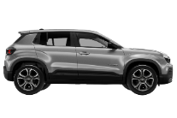
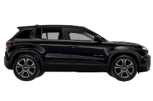
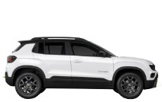



07 | JEEP® AVENGER MY25
MY25 LINE-UP 4xe
4xe UPLAND & OVERLAND and
THE NORTH FACE
ALTITUDE & SUMMIT
LONGITUDE
HEAT PUMP
(only on BEV)
FIX & GO KIT
M+S
TIRES
Not available on Summit
OPEN AIR
SUNROOF
Without roof rails on 4xe

Slide 44
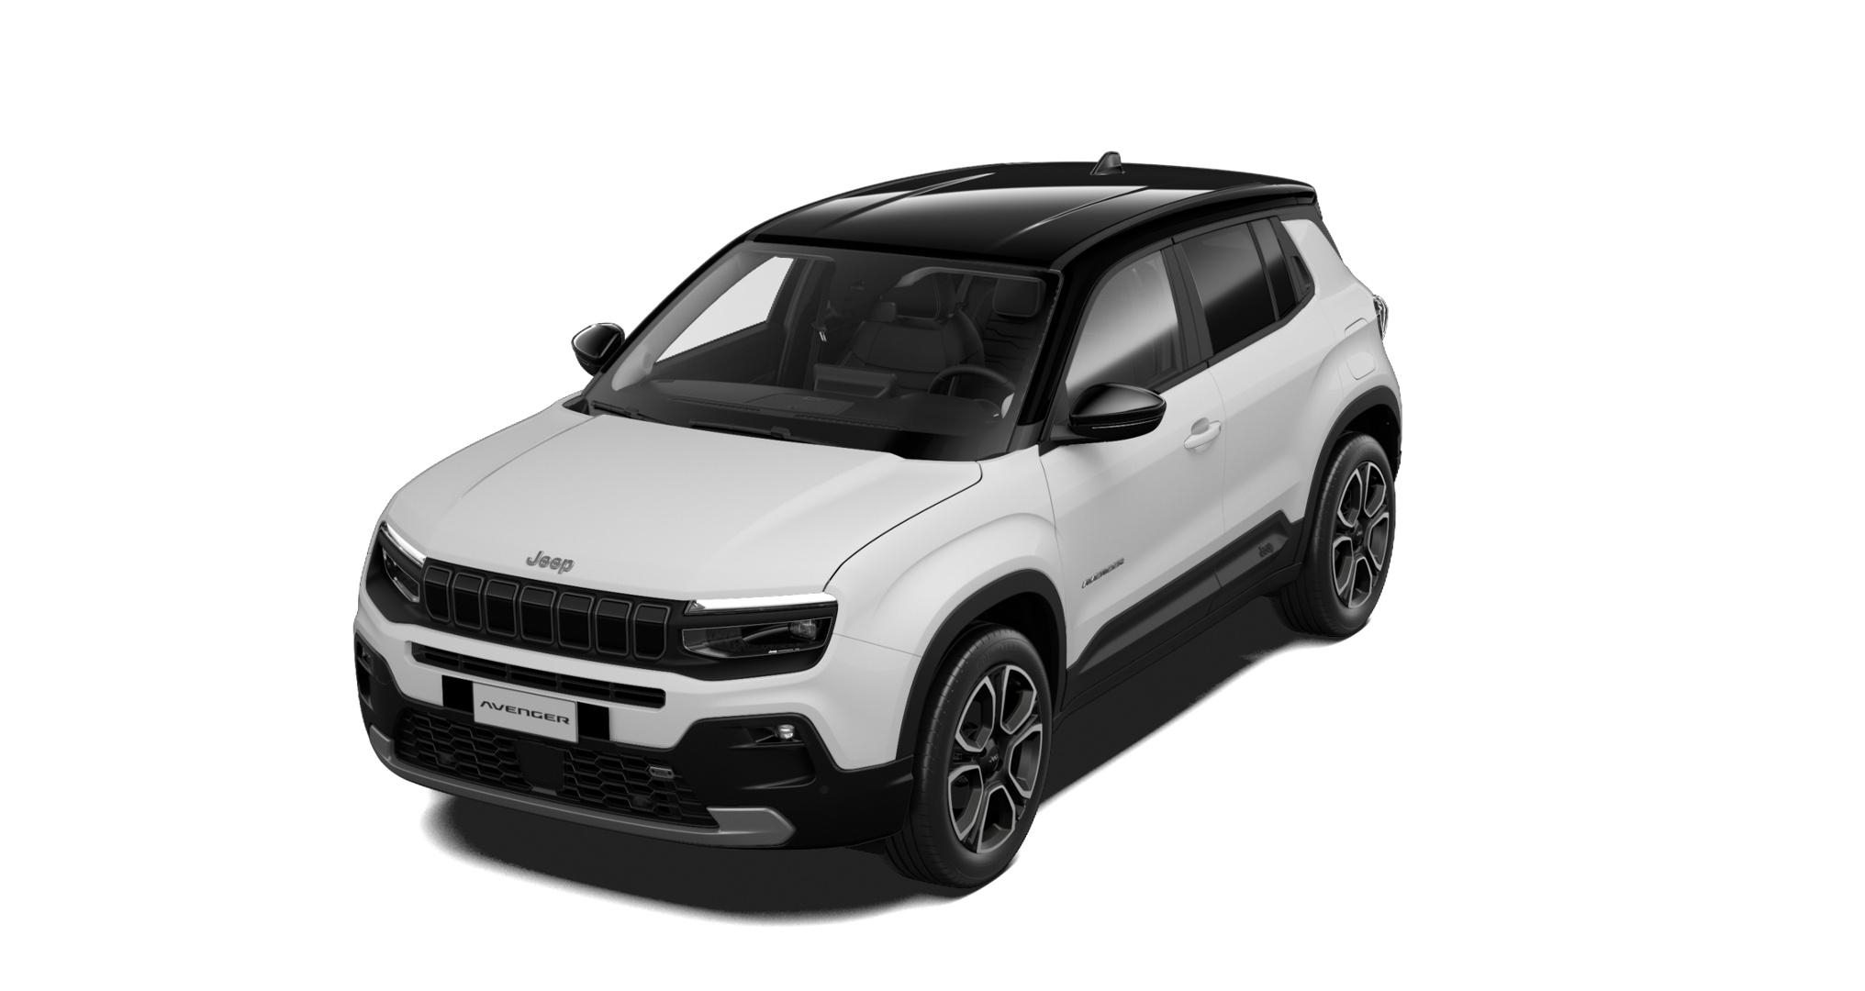

07 | JEEP® AVENGER MY25
COLOR PALETTE
Thanks to a wide offer that includes 4 solid and 3 metallic colours, in addition to BICOLOR version, Jeep® Avenger MY25 color palette allows to the Customer to choose the preferred aesthetic solution. The new Concrete color is dedicated to The North Face launch.
SOLID
Free
New!
Snow*
Volcano
Ruby*
Concrete*
METALLIC
Sun*
Stone*
Granite*
*Available also BICOLOR with Volcano Roof

Slide 45
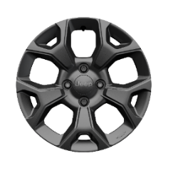
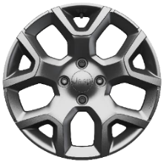
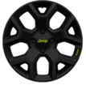
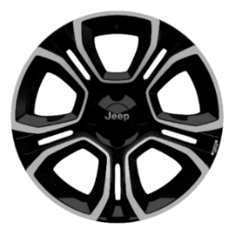


07 | JEEP® AVENGER MY25
WHEELS RANGE
16" ALLOY - PAINTED
BENEFITS?
16", 17" or 18" inches, Customer will always find the most effective solution to his/her needs
Grey gloss
Standard on LONGITUDE
17" ALLOY - PAINTED
SILVER Gloss
Standard on ALTITUDE
Standard on 4xe
18" ALLOY – DIAMOND CUT
2-tone matt black w/diamond cut
2-tone GLOSS black w/Blue touches
Standard on SUMMIT / Opt on ALTITUDE
Accessory by

Slide 46





07 | JEEP® AVENGER MY25
Jeep® Avenger My25 range simplification is completed by the following product updates:
YELLOW DAHSBOARD & SEATS OPTIONS REMOVAL
JEEP® LOGO LOWER GRILLE UPDATE
BADGE REMOVAL (ONLY e HYBRID)

Slide 47


08 | TECHNOLOGY INNOVATION
CONNECTED SERVICES – THE OFFER
These services are available from the moment of vehicle delivery to the Customer and have a duration:
CONNECT
ONE
Lifetime for SOS Call 10 years for other services
These services are offered on a free trial basis with the car for a limited time. It is the Customer's decision whether to renew them or not. Trial period duration is:
CONNECT
PLUS
6 months for Jeep® Avenger

Slide 48

08 | TECHNOLOGY INNOVATION
CONNECTED SERVICES – CHAT GPT
A GREAT NOVELTY!
Welcome to the future!
ChatGPT is the high-tech evolution of Natural Voice Recognition to go further in your requests addressed to your vehicle, thanks to generative artificial intelligence.
Use natural language and ask complex questions, to get advices or explanations all along your trip.
ChatGPT will always have a proposal to facilitate your trip and offer you an exciting experience, while keeping your hands on the steering wheel and your eyes on the road.

Slide 49

THANK YOU FOR THE ATTENTION

