Slide 1
1
VOCE FUORI CAMPO mentre scorrono immagini di una concessionaria LPMI
After reviewing the technology and features that distinguish our B10 REEV, we need to take another fundamental step: understanding how to best make them available to our customers.
VOCE FUORI CAMPO mentre scorrono immagini di una concessionaria LPMI ed entrano in campo con 1 venditore e cliente che si avvicinano e parlano vicino ad una B10.
It may seem easy, but it's not: we need to be prepared, especially to explain to our customers that the B10 offers not only technology but also driving modes, the so-called Energy Modes, to optimize performance and on-board comfort in every situation... in the city or on the highway... everywhere!
A good knowledge of Energy Modes - and how they influence vehicle’s behavior - is key to provide the Customer with the right information to exploit B10 REEV’s full potentiality.
You need to be clear and effective in your explanations, ensuring that the customer:
understands its importance
is clear about its path to infotainment
is clear that each mode is associated with a specific mission

Slide 2
2
VOCE FUORI CAMPO mentre l’inquadratura si focalizza sul venditore con la sua faccia che capisce che ci si sta rivolgendo a lui
In a nutshell: your role is the key
For this reason, first make sure you have all the necessary knowledge on the subject... and not only that: be sure to test drive the B10 REEV on the road, with an extended test drive where you can test all the modes in different scenarios and driving conditions.
IF YOU DON'T TRY IT FIRST, YOU WILL NOT HAVE THE CLARITY AND SENSITIVITY TO PROPERLY TRANSFER INFORMATION TO OUR CUSTOMERS.

Slide 3
3
VOCE FUORI CAMPO mentre l’inquadratura si focalizza sul venditore con la sua faccia che capisce che ci si sta rivolgendo a lui
Very good, now you understood that you are the link to transfer the knowledge, and the emotion as well, to your customer.
Do you feel so skilled to challenge yourself?
Build your Leap and charge the Battery…
L
E
A
P
Level
Energy
Assisted
Path

Slide 4
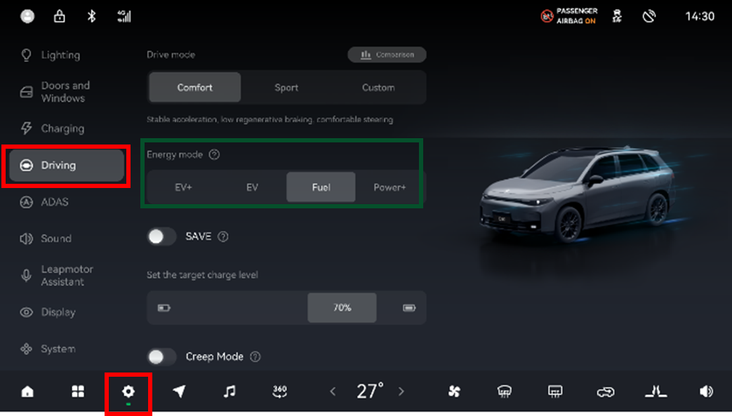
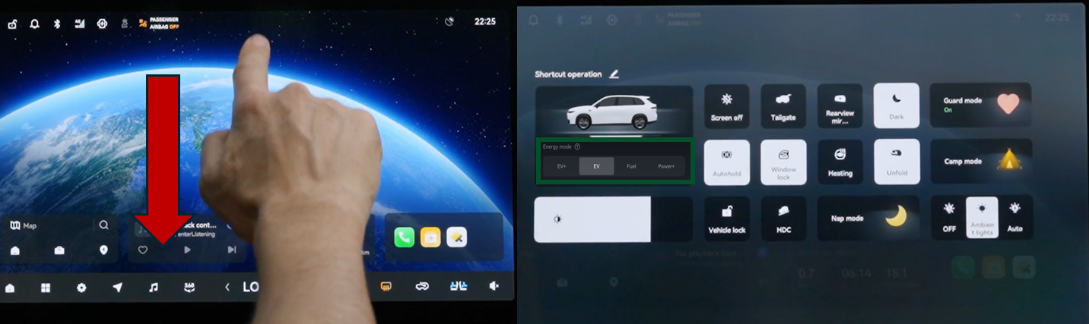
P
4
Path
Question 1
You have tested the car, so at this point you should know how-to engage a specific Energy Mode…
Select the correct sentences (more correct answers)…
From the Infotainment: Home page → Settings → Driving
Trough the dedicated “Rotary selector” on the tunnel
From the cluster navigating through the left control commands on the steering wheel
From the Infotainment using the “Quick action” menu
Debrief: video con mano su Infotainment che fa Vedere il percorso

Slide 5

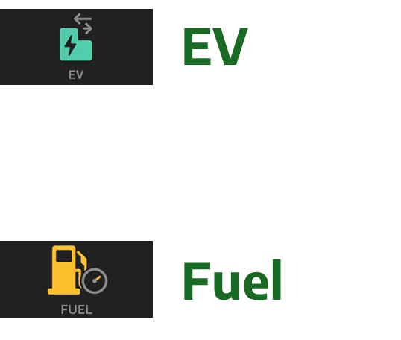
5
Question 2
Which are the 2 energy modes that we suggest for the best part of driving situations ?
Select the correct sentences (more correct answers)…
EV+
EV
Fuel
Power+
Debrief: REEV technology offers four adaptive Energy Modes to tailor energy management and vehicle's behaviour to driver's needs. When it comes to everyday driving 2 modes can be suggested to the customer for common operation
EV Mode Which allows to combine Electric Driving pleasure with energy and cost efficiency, day by day
Fuel Mode Which enables smooth driving in case of limited access to charging station
The other 2 modes are instead used to manage specific needs/situations that may happen while driving
We will talk about it in a few minutes
A
Assisted

Slide 6
E
6
Question 3
Why is it important to never let the battery drop below 15% charge?
Select the correct sentence…
Because the driving condition could worsen and become noisy and uncomfortable
because there would be only a few kilometers of autonomy left with the risk of being left on the road
because the driving torque would be given by the ICE engine instead of the electric one with a consequent increase in consumption
Debrief: Leapmotor B10 REEV should not be driven in such a way. The SOC should never drop below 15% since in this case the power output is limited and the ICE will start working at max load to compensate, so it will be noisy and uncomfortable.
Energy

Slide 7

L
7
Question 4
At what SOC levels are warnings given to recommend charging the battery?
Select the correct sentence…
19%, 14% e 9%
15%, 10, e 5%
10%, 5% e 2%
Debrief: Like on any EV car, performance are influenced by the Battery State of Charge (SoC) and other environmental conditions.
The Leapmotor REEV technology warns the customer, in 3 steps, starting from 19% of SOC, as displayed below:
Level
LOW 19% SoC: Power output limited. Charge soon.
VERY LOW 14% SoC: Power output highly restricted. Charge now.
EXTREMELY LOW 9% SoC: severe power output limit! Charge immediately.

Slide 8
Se il partecipante ha risposto correttamente a tutte le domande viene fuori questa frase:
8
Congratulations, you've passed all the questions, your battery level is optimal, and you're ready for a review of using Energy modes.
Se invece ne ha sbagliata una o più quest’altra:
Too bad you didn't manage to fully charge the battery! You need to keep working to fully master REEV technology.
To that end, what do you think to meet with our customer and train them on how to best advise them on using Energy Modes?

Slide 9

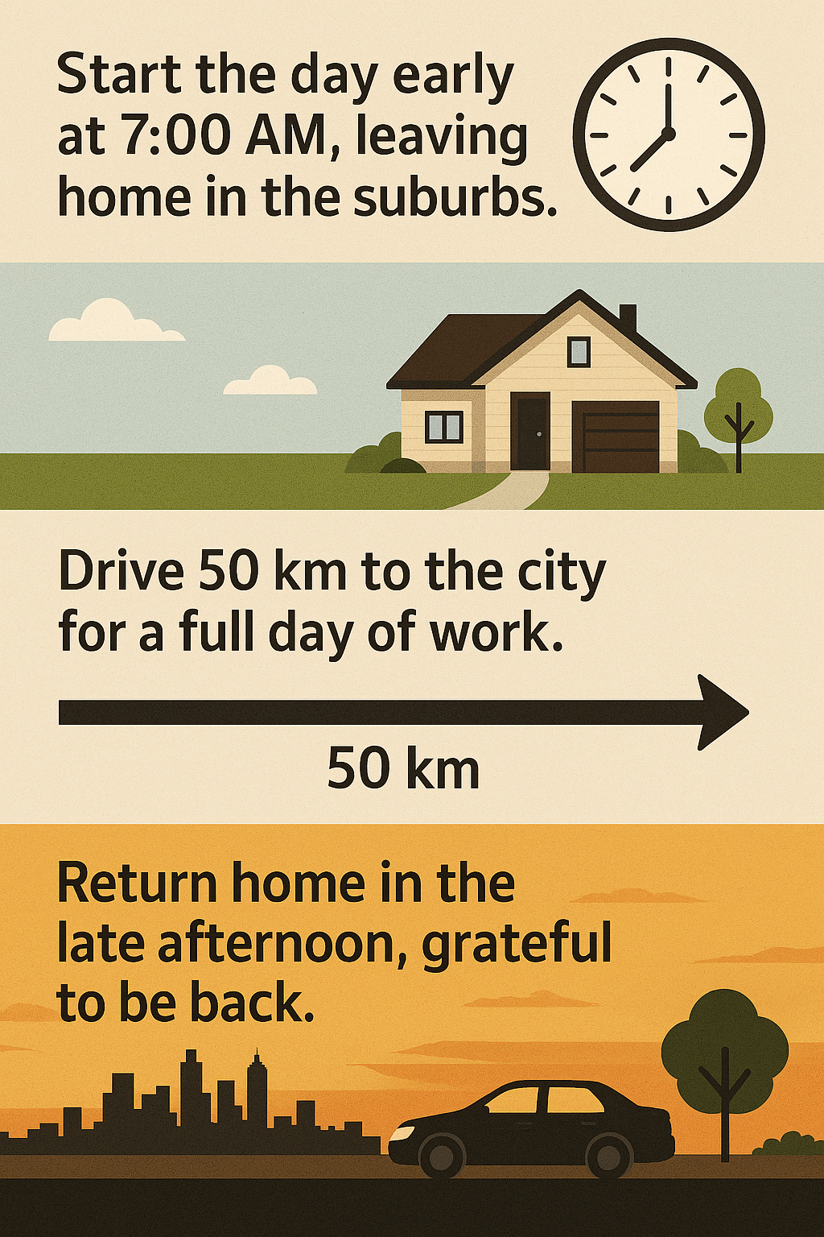


Select the Energy Mode that best suits this daily routine
9
Scenario 1 – Intro Video
Video che descrive il profile cliente e la sua giornata tra Lavoro, famiglia e impegni vari
Daily routine
From the suburbs to the town…and back
Combining work and family is a challenge for a modern parent!
Kick off the morning at 7:00, heading out from the quiet outskirts
Cover 40-60 kilometers to reach the bustling city for a full day’s grind.
Finally, in the late afternoon, children pick up from school, 1 hour gym and then finally back home

Slide 10
Tips
How it works:
Full EV Driving with ICE start supporting only when needed
(SOC below 25%)
10
Scenario 1 - Summary
SK di sintesi:
The best mode for this mission is EV, which prioritizes electric driving.
The vehicle will prioritize pure Electric Power Drive, and automatically start the ICE generator only when the battery is below 25%.
This is the Mode recommended for DAILY COMMUTE, which allows to combine the Electric Driving pleasure with low operating cost.
Daily routine
From the suburbs to the town…and back

Slide 11



11
Select the Energy Mode that best suits this daily routine
Scenario 2 - Intro Video
Video che descrive il profile cliente e la sua giornata tra Lavoro, famiglia e impegni vari
Remote range
Working Journey with limited charging stops
Being a sales representative is a satisfying job, but the daily mileage is high.
Early quick breakfast and then off to the highway to reach the first customer
and many times, after the highway, a long stretch of country roads… choosing the right car is essential

Slide 12
Tips
How it works:
It uses the ICE generator proactively
12
Select the Energy Mode that best suits this daily routine
Scenario 2 - Summary
SK di sintesi:
The best mode for this mission is Fuel, which prioritizes Fuel driving.
The vehicle works in full EV Driving till the battery charge is above 80%; when below starts to generate electricity.
This mode enables smooth driving on long distance highways or in mountain roads in case of limited access to charging station or to limit the number and the time of stops. Customer Benefits:
No range anxiety
Long distance flexibility
No time loss for charging stops
With B10 REEV long distance trips are not a problem with 970 km of range.
Remote range
Working Journey with limited charging stops

Slide 13



11
Select the Energy Mode that best suits this daily routine
Scenario 3 - Intro Video
Video che descrive il profile cliente e la sua giornata tra Lavoro, famiglia e impegni vari
Extended EV Driving
Last miles EV when needeed
One of those marathon days… Career, family life & daily tasks, no finish line in sight!
Only 30% charge left… but the finish line is near! but before I get home I have to pass through a ZTM, where I can only travel in Full EV
...and my relaxing Yoga class is right in the city center... but getting there isn't always so relaxing!

Slide 14
Tips
How it works:
Switch to EV+ mode will allow to maximize the use of battery energy for the longest possible EV drive experience
11
Select the Energy Mode that best suits this daily routine
Scenario 3 - Summary
SK di sintesi:
The best mode for this mission is EV+, which allows for an almost full use of the battery
This mode lets you drive longer on electric power - for example for the last few remaining kms before destination - by using the battery as much as possible. By switching to EV + mode, ICE generator will start under 9% instead of under 25% with EV mode.
At the destination, however, it is important to ensure that battery recharging is possible; otherwise, it could negatively affect the vehicle's performance.
Extended EV Driving
Last miles EV when needeed

Slide 15



11
Select the Energy Mode that best suits this daily routine
Scenario 4 - Intro Video
Video che descrive il profile cliente e la sua giornata tra Lavoro, famiglia e impegni vari
It's finally time for a weekend in the mountains! It's lovely to be here, but getting there is always difficult due to the particularly steep and often snowy road.
Challenging driving conditions
At times when power becomes essential
The weekend in mountain is lovely but getting there is always difficult due to the particularly steep and often snowy road.
The kids are already in the car and I haven't had time to recharge the battery... never mind, I'll try to do it when I get to my beloved cabin.

Slide 16
Tips
How it works:
The ICE engine is always running, prioritizing the vehicle's propulsion needs
Maximum power output of the ICE Generator
11
Select the Energy Mode that best suits this daily routine
Scenario 4 - Summary
SK di sintesi:
The best mode for this mission is Power+, where the priority is to maintain the performance in specific condition:
Low Battery Level
Very cold start conditions
Demanding power situations
the ICE Engine will run continuously to generate electricity at full capacity
This Mode ensures ENOUGH POWER even at low battery levels (SOC below 15%)
Challenging driving conditions
At times when power becomes essential

