Slide 1
CAPSULES CREATION & processes MyLearning App
June 2023 – V1

Slide 2
CAPSULES CREATION & processes - MyLearning App
1/ What is MyLearning App
2/ Global process of capsules creation – Agency/PM/LBC
3/ Capsule Creation Story Board Template
4/ Capsule set-up recommendations
5/ Do’s & Don’ts

Slide 3
1. WHAT IS MyLEARNING APP?
Development for training content in MyLearning App

Slide 4
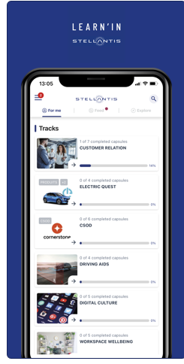
1. What is My Learning App?
WHAT IS MyLearning APP?
It is an application available on mobile and desktop for micro-learning solution (Beedeez).
Different capsules will be available to your country
Link to the LMS One-offs or long campaigns of capsules
Mandatory / optional
Reporting
WHAT IS A CAPSULE?
A piece of content There are different types of content:
Impactful, entertaining and interactive knowledge – 3 to 5 min
Knowledge Assessment – up to 30 min
Reference Material (Handover, sales memento, videos…)
WHAT IS A CAMPAIGN?
A campaign is a set of several capsules of a common subject, complement to each other, with potentially ranked in a logical order, valid for a certain period of time
Notes:
Mobile, bespoke, dynamic, short & crispy : New learning approach!

Slide 5
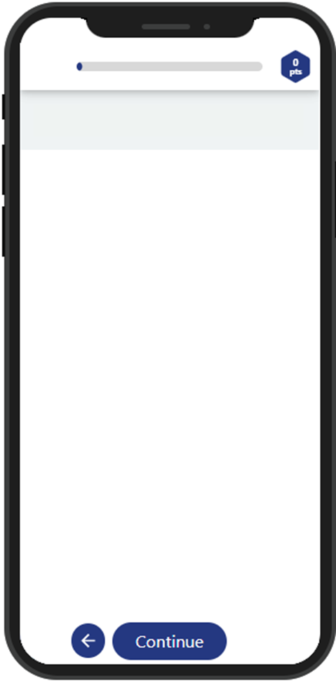
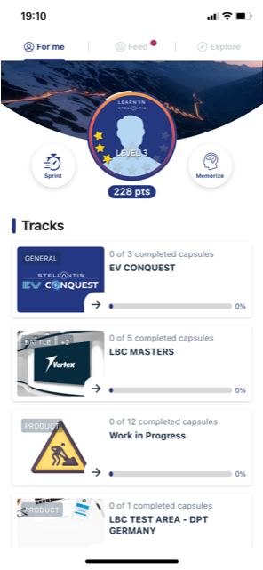
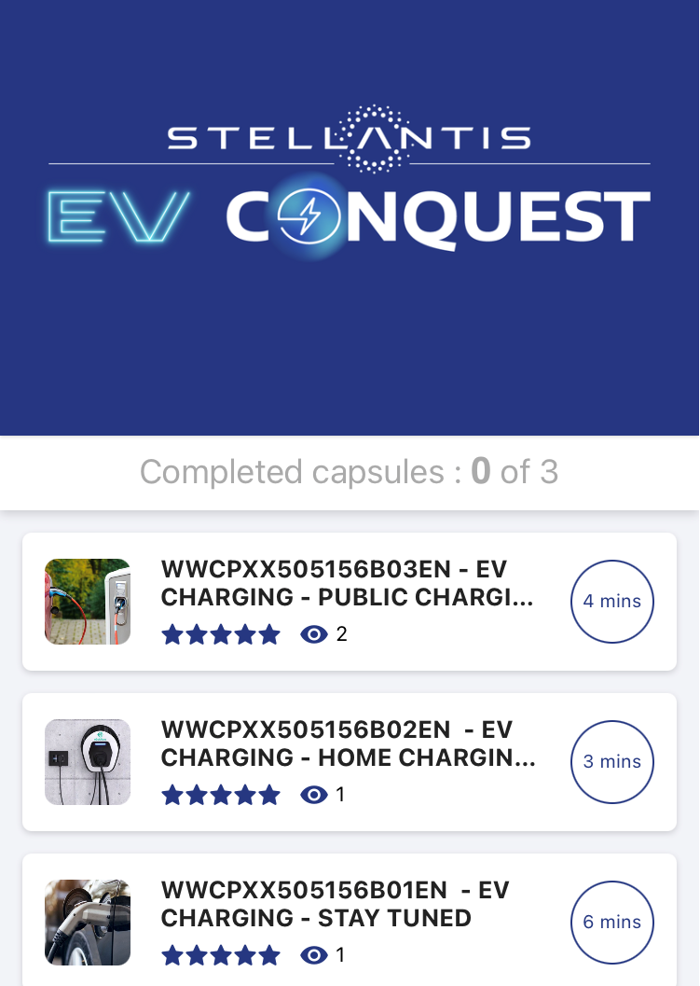
1. What is My Learning App?
WHAT IS A TRACK?
A track is a section.
Sub-tracks can exist under the main tracks.
Tracks could be:
- Brand/product (Peugeot, Fiat, Opel,….)
- Transverse topic (EV Conquest, Services connected,…)
- Sales job (Operating Standard, customer relationship,…)

Slide 6
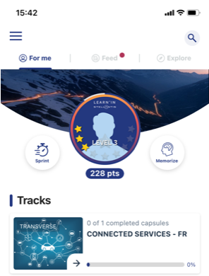
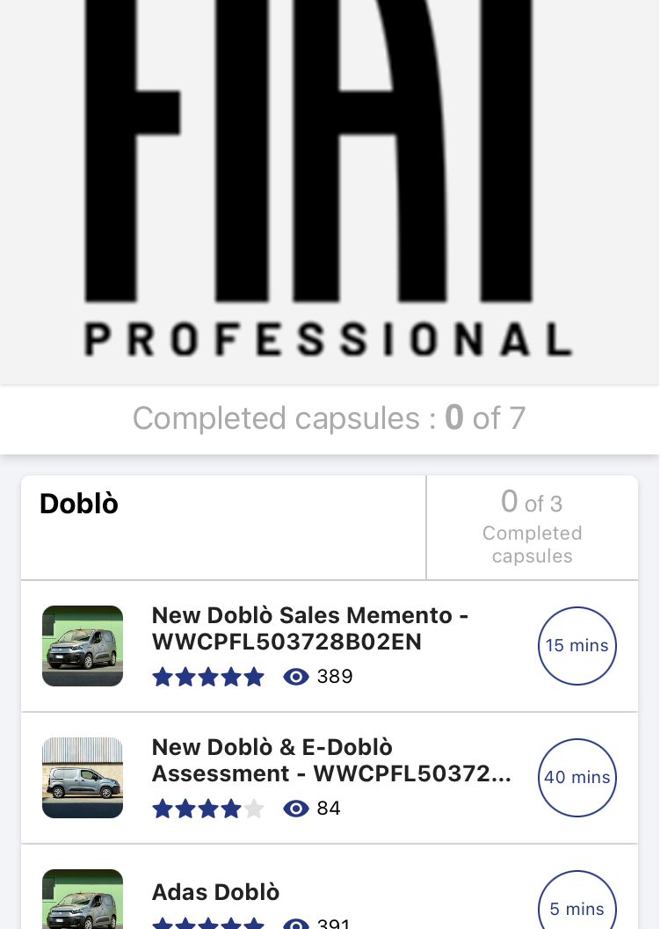

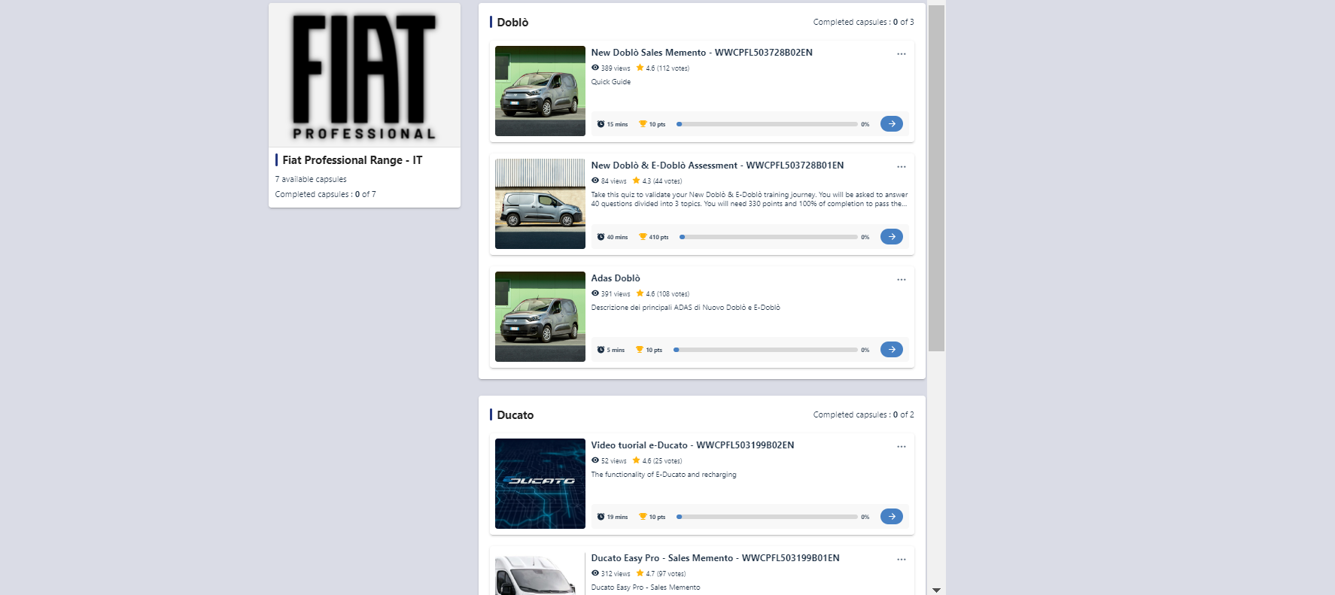
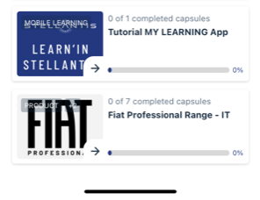
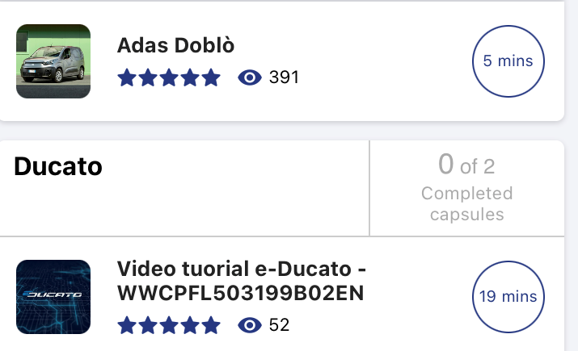
1. What is My Learning App?

Slide 7
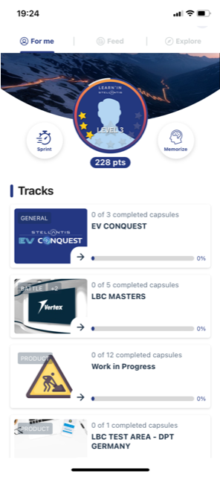
1. What is My Learning App?
LEARN AS YOU WANT!
SPRINT
Give the app how much free time you have….5 min, 7 min…
My Learning App will propose you the capsules with the right duration
MEMORIZE
Give the app how much free time you have….5 min, 7 min…
My Learning App will propose the adequate number of questions on capsules you have already done

Slide 8
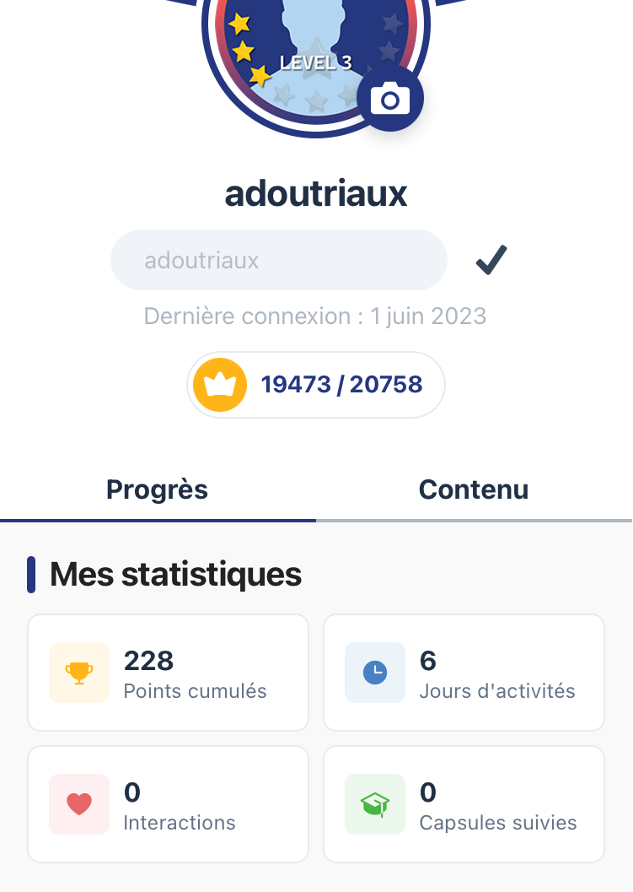
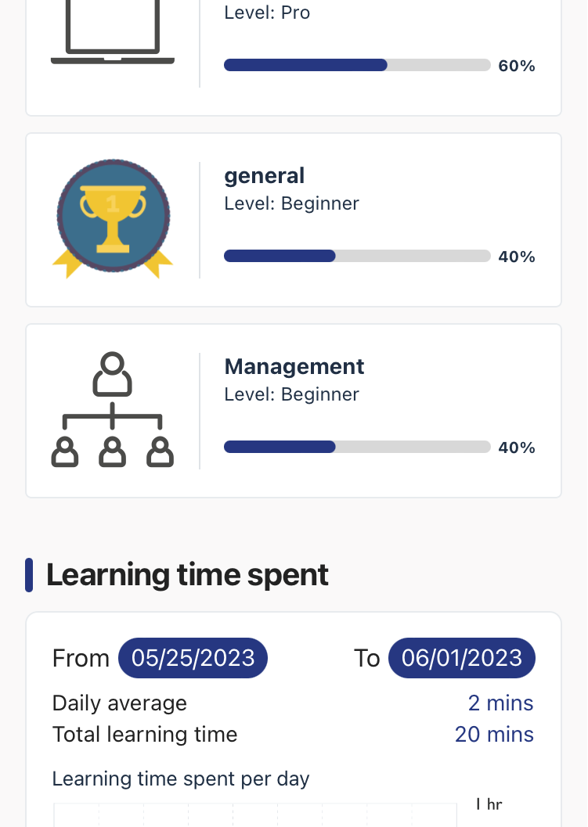
1. What is My Learning App?
MEASURE YOUR PROGRESS!
Activities summary per profile
Statistics on capsules done
Time spent on learning

Slide 9
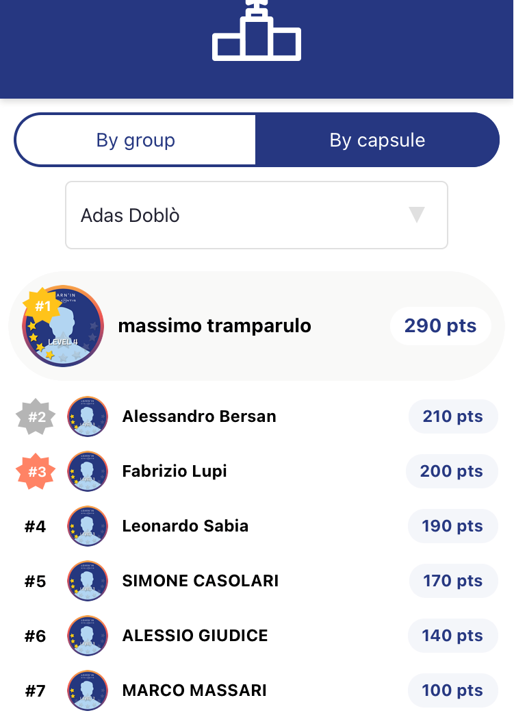
1. What is My Learning App?
LEARN BY PLAYING!
For each capsules done, points are given.
Leaderboards are available to check your ranking!
Notes:
Additional functionnalities to come. Not used at first

Slide 10
2. GLOBAL PROCESS OF CAPSULES CREATION

Slide 11
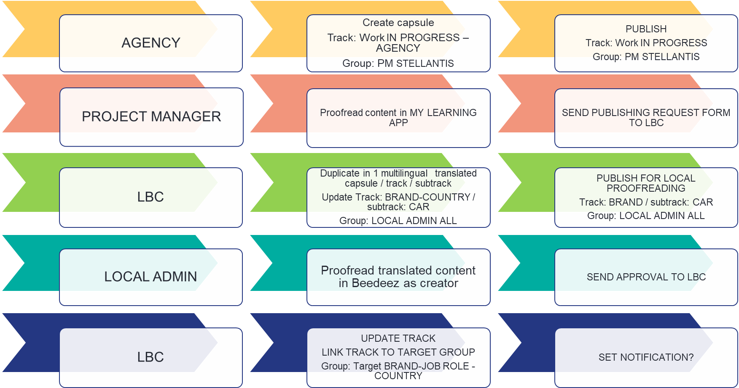

Slide 12
From agency onboarding to LBC publication
DETAIL PROCESS AGENCY/PM/LBC
PM requests Agency access on Beedeez Back Office of live system
LBC creates user authorization and check creations settings & track
Agency gets an automatic emails from Beedeez
Agency uses the Storyboard for proposing an overview
Agency fills the Storyboard with details text / images
PM validates the Storyboard
Agency creates the caps into Beedeez Back Office
PM gives final validations into Beedeez / back & forth
PM to send request to Drive IT to LBC for publishing using form
PM to add the Storyboard into the DAMS in folder XXXXX
LBC starts the publication process to each market
After markets proofreading, LBC publishes.

Slide 13
3. CAPSULES CREATION SB TEMPLATE
Development for training content in MyLearning App

Slide 14
STORYBOARD CAPSULES
Header (ID of the capsules)
Detailed story board - example
Detailed potential interactive screen template for story board
Recommendation for assessment

Slide 15
STORYBOARD CAPSULES
Header (ID of the capsules)
Detailed story board - example
Detailed potential interactive screen template for story board
Recommendation for assessment

Slide 16
HEADER / ID OF THE CAPSULES

Slide 17
HEADER / ID OF THE CAPSULES
PM Stellantis
EN
Work In Progress - AGENCY NAME
(e.g. Work In Progress Vertex)

Slide 18
STORYBOARD CAPSULES
Header (ID of the capsules)
Detailed story board - example
Detailed potential interactive screen template for story board
Recommendation for assessment

Slide 19
STORY BOARD EXAMple
Connected Services campaign
Capsule 1: WWCOXX505158B01EN What is Connectivity in Automotive

Slide 20
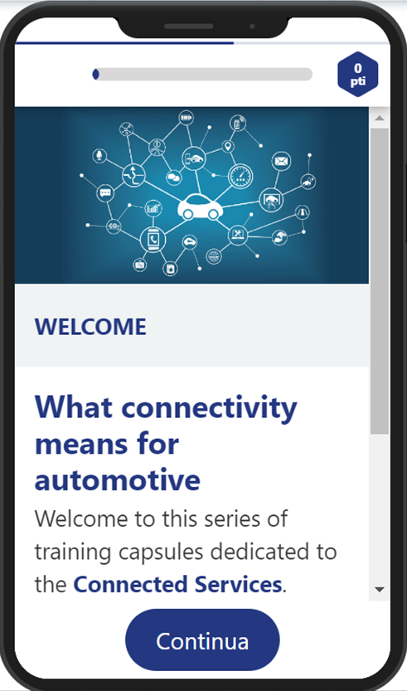

MyLearning App campaign: Connected Services, June 2023
Index
Text, Video/Images, Audio, Multimedia contents
Visual Layout
WELCOME
Card
WHAT ARE CONNECTED SERVICES
Quizz
Card
Card
TOUCHPOINTS
Card
Quizz
Image
WELCOME
Text1
What connectivity means for automotive
Welcome to this series of training capsules dedicated to the Connected Services.
Some time ago we had the opportunity to learn about this topic in a dedicated web training. Now its time to refresh the main topics to stay focused!
Text2

Slide 21
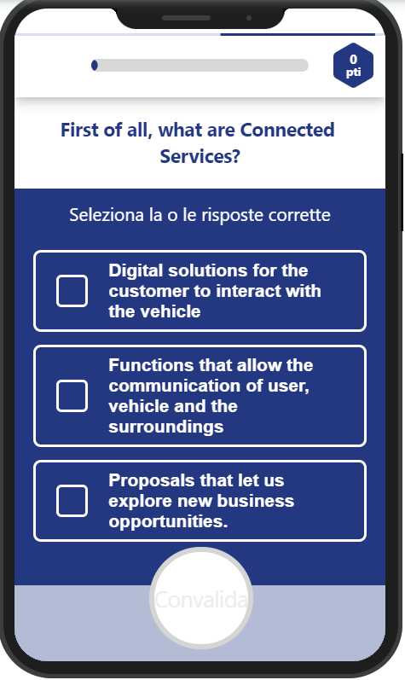
MyLearning App campaign: Connected Services, June 2023
Index
Text, Video/Images, Audio, Multimedia contents
Visual Layout
WELCOME
Card
WHAT ARE CONNECTED SERVICES
Quizz (multiple answers)
Card
Card
TOUCHPOINTS
Card
Quizz
First of all, what are Connected Services?
Question
Digital solutions for the customer to interact with the vehicle √
Functions that allow the communication of user, vehicle and the surroundings √
Proposals that let us explore new business opportunities. √
Multiple
answers

Slide 22

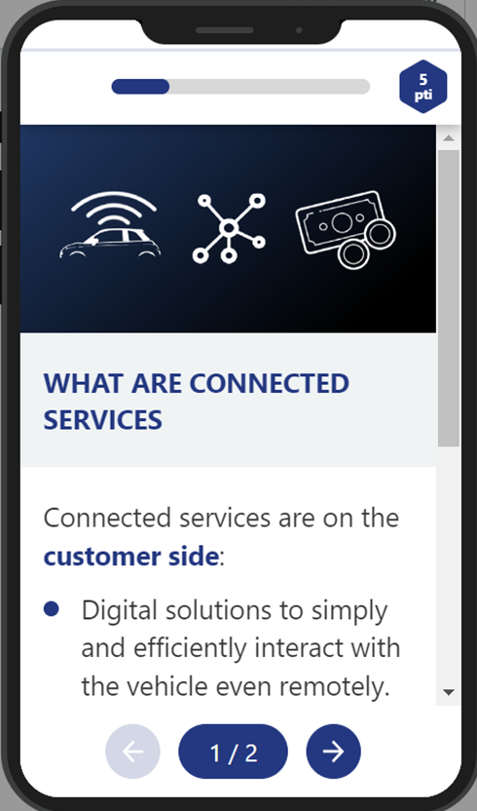
MyLearning App campaign: Connected Services, June 2023
Index
Text, Video/Images, Audio, Multimedia contents
Visual Layout
WELCOME
Card
WHAT ARE CONNECTED SERVICES
Quizz
Card
Card
TOUCHPOINTS
Card
Quizz
Image
WHAT ARE CONNECTED SERVICES
Text1
Connected services are on the customer side:
Digital solutions to simply and efficiently interact with the vehicle even remotely.
Functions that expand the communication between user, vehicle and the surrounding environment.
On brand and dealer side they are also:
Proposals that explore new and interesting business opportunities adding new elements to the value chain.
1 / 2
Text2

Slide 23

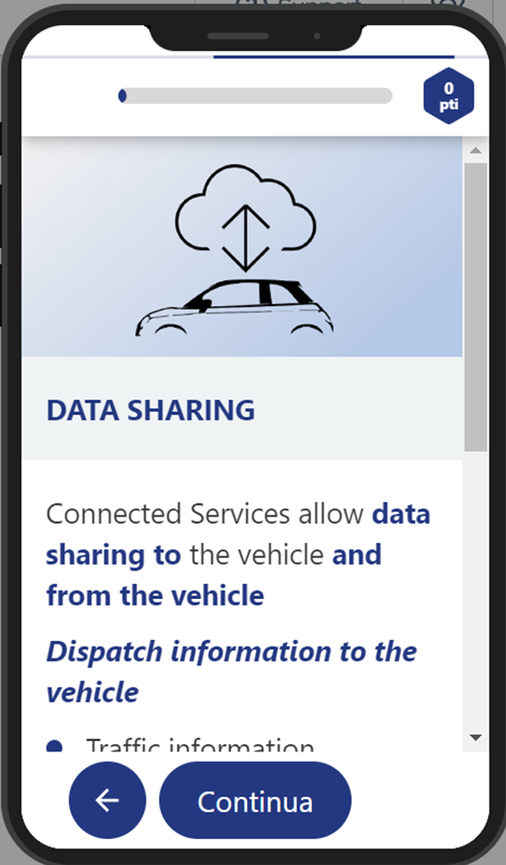
MyLearning App campaign: Connected Services, June 2023
Index
Text, Video/Images, Audio, Multimedia contents
Visual Layout
WELCOME
Card
WHAT ARE CONNECTED SERVICES
Quizz
Card
Card
TOUCHPOINTS
Card
Quizz
Image
DATA SHARING
Text1
Connected Services allow data sharing to the vehicle and from the vehicle
Dispatch information to the vehicle
Traffic information
Weather
Parkings
…more
Dispatch information from the vehicle
Vehicle location
Consumption, mileage
Mechanical condition of the vehicle
…more
Text2

Slide 24

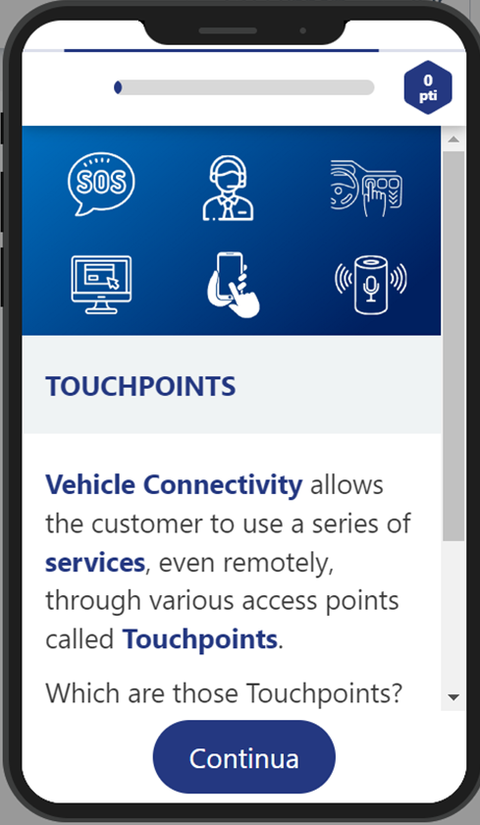
MyLearning App campaign: Connected Services, June 2023
Index
Text, Video/Images, Audio, Multimedia contents
Visual Layout
WELCOME
Card
WHAT ARE CONNECTED SERVICES
Quizz
Card
Card
TOUCHPOINTS
Card
Quizz
Image
TOUCHPOINTS
Text1
Vehicle Connectivity allows the customer to use a series of services, even remotely, through various access points called Touchpoints.
Which are those Touchpoints?
Help us to catalogue them between:
On-Vehicle touchpoints
Remote touchpoints
Text2

Slide 25
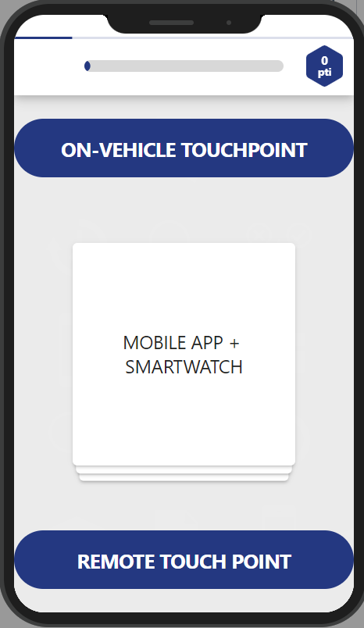
MyLearning App campaign: Connected Services, June 2023
Index
Text, Video/Images, Audio, Multimedia contents
Visual Layout
WELCOME
Card
WHAT ARE CONNECTED SERVICES
Quizz
Card
Card
TOUCHPOINTS
Card
Quizz (swipe cards)
ON-VEHICLE TOUCHPOINTS
Choice 1
SOS button
ASSIST button
INFOTAINMENT DISPLAY
WEB PORTAL
MOBILE APP + SMARTWATCH
VOICE ASSISTANT (f.i. Alexa)
Cards
REMOTE TOUCHPOINTS
Choice 2

Slide 26
STORYBOARD CAPSULES
Header (ID of the capsules)
Detailed story board - example
Detailed potential interactive screen template for story board
Recommendation for assessment

Slide 47
STORYBOARD CAPSULES
Header (ID of the capsules)
Detailed story board - example
Detailed potential interactive screen template for story board
Recommendation for assessment

Slide 48
FOR ASSESSMENT
STORY BOARD CAPSULES / ASSESSMENT
The Story Board of the Assessment should be done on EXCEL FILE with:
- Questions
- Potential answers
- Correct answer
- Correct Answer explanations (if required)
1 NOTION should include 10 questions not more.
1 swipe card should be not be used twice or more in 1 notion - TBC

Slide 49
4. CAPSULES SET-UP RECOMMENDATIONS

Slide 50
IMPLEMENTATION OF master CAPSULES
Capsules creation
(Agency)
Validation
(PM)
Publishing (LBC)
Recommendations I
Recommendations II
Recommendations III

Slide 51
I - RECOMMENDATIONS WHEN CREATING A CAPSULE
TRACK DEDICATED PER AGENCY
Each agency will produce capsules under a specific track, named per agency in the Live platform.
Track = AGENCY – Name
Example: AGENCY - Vertex
All PM will have access to all agency tracks.
MANAGEMENT OF MEDIA (VIDEO, PDF, PICTURE)
VIDEO / PDF
Use of Existing video with text/voice over already translated by countries. This is the preferred solution for deployment reason. Local video / local pdf will be up-loaded by local country admin.
Use of None existing video
Recommended to use video and image without text nor voice
If case of new video with text/voice, the same process as for WBT will be used for deployment. Be careful, timelines may be long for some countries, normal process -2 weeks of profreading- could be too short and has to be anticapted.
PICTURE
All images should not content any text.
WORK IN PROGRESS

Slide 52
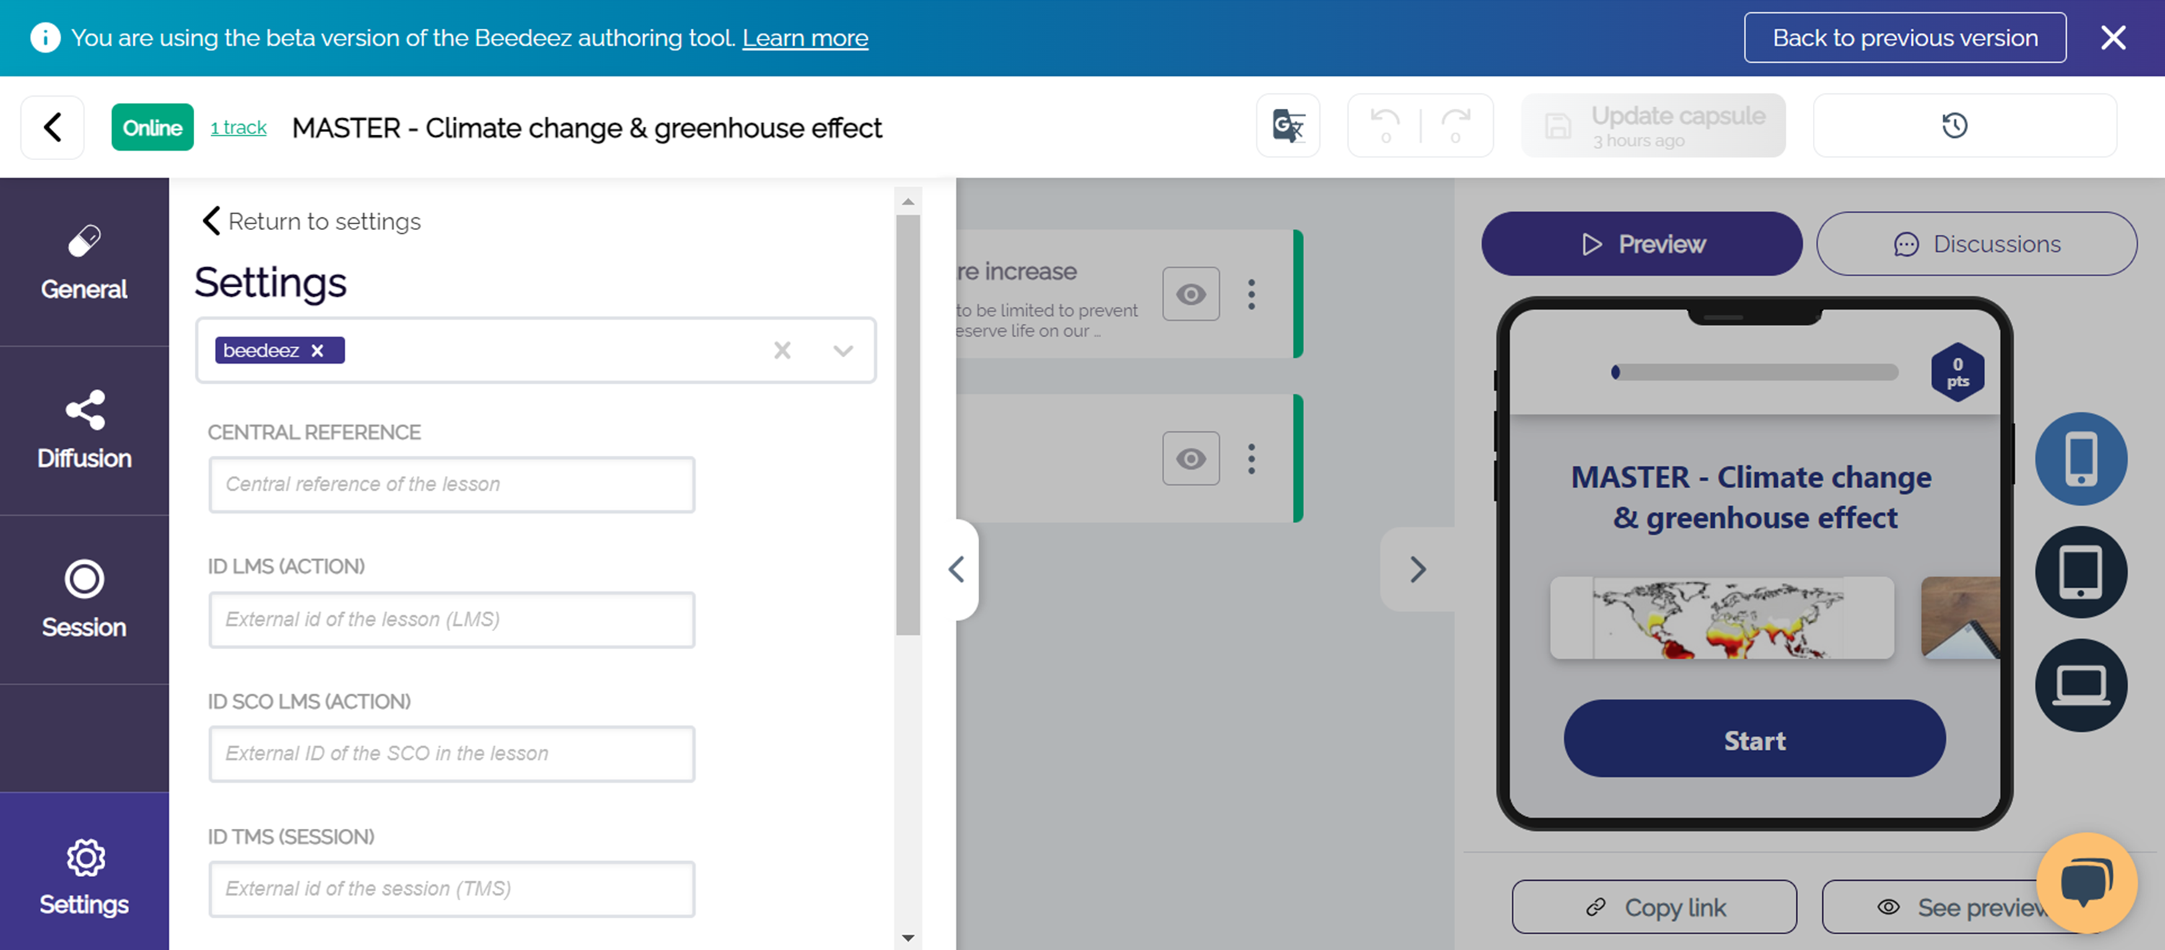
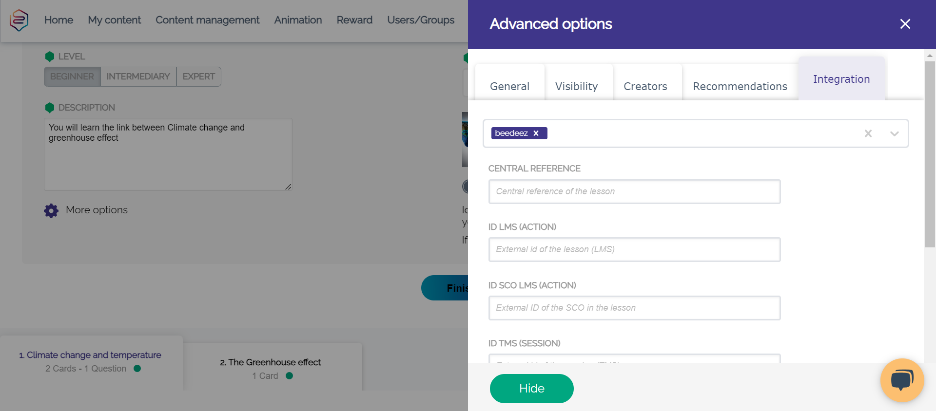
I - RECOMMENDATIONS WHEN CREATING A CAPSULE
WORK IN PROGRESS
TITLE OF THE CAPSULES
Usage of central reference requested:
Example: « Conversion - Safe Loading - WWCPXX503652B01EN”
- to be included in the title – at the end
- To be include in the field: Settings / More Option / Integration / Field Central Reference
/

Slide 53
I - RECOMMENDATIONS WHEN CREATING A CAPSULE
PASSING RATE
For knowledge capsules, the pass rate should be set to 20%
For assessment, the usual pass rate should be set – 80% or 90% depending on brand

Slide 54
I - RECOMMENDATIONS WHEN CREATING A CAPSULE
WORK IN PROGRESS
SPECIFIC SETTINGS PER CAPSULES
ALWAYS
- Set the Availability: “Always visible and accessible”
NEVER
- Request a Qrcode
- Set an rank of view between capsules. This should not be done at that stage but at the publishing stage by the LBC

Slide 55
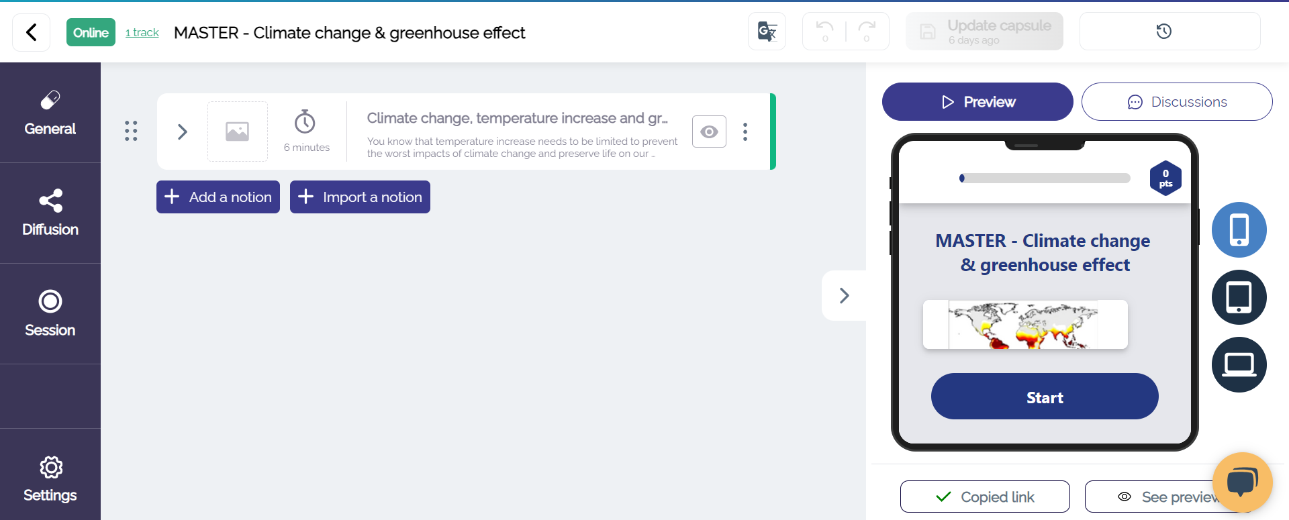
II - RECOMMENDATIONS FOR VALIDATION / PROOFREADING
PREVIEW LINK
Create a “Preview link” for review
A link can be generated by the agency. The preview link opens up in the given language of the browser
WORK IN PROGRESS
Copy link in a browser

Slide 56
III - RECOMMENDATIONS AT THE PUBLIHING LEVEL (AFTER PROoFREADING)
Order between capsules
If a capsule needs to be done before an other one, the information has to be provided in the Request for Publication form done by the PM.
The information will be entered by LBC when published.
Management of « Mandatory » capsules
Put the capsules in high visibility mode, via the Setting / « Promote mode »
Not really « Mandatory » option
SB in DAMS
When the content is final, PM should add the story Board of the capsule in the DAMS as below:
- Within the product folder, with a specific subfolder « MyLearning App »
- Within the Transverse folder (Connected Services, EV,…) with a specific subfolder « MyLearning App »
WORK IN PROGRESS

Slide 57
5. Do’s and Don’ts
Development for training content in MyLearning App

Slide 58
Introduction – MY learning app
online learning platform that focuses on providing interactive and engaging learning experiences
offers a range of tools and features to create and deliver educational content in the form of interactive capsules.
These capsules are designed to enhance learner engagement and knowledge retention.

Slide 59
Structure of capsule
A capsule in MyLearning App typically consists of multimedia-rich content, including text, images, videos, quizzes, interactive exercises, and other interactive elements. It aims to present information in a structured and interactive format, enhancing learner engagement and knowledge retention.
Capsules are often designed to be bite-sized, allowing learners to consume and digest the content within a relatively short time frame. It offers a modular approach to learning, enabling learners to progress through the content in a sequential and organized manner.
However, capsules generally include an
introduction,
various sections or modules covering different aspects of the topic,
interactive elements to reinforce learning, and a
conclusion or summary.
"Notions" refers to the concept of knowledge or specific topics that are covered within a capsule. Notions represent the individual learning points or pieces of information that learners will encounter and engage with as they progress through the content.

Slide 60
Including a quiz at the beginning of a learning unit
Activation of prior knowledge
Assessment of existing knowledge
Focus on relevant content
Motivation and engagement

Slide 61
Including a quiz after the content in a learning unit
Reinforcement of key points
Immediate feedback
Active engagement
Time-efficient assessment

Slide 62
Do’s
Do's for creating bite-sized learning units:
Do focus on one specific learning objective or topic per capsule. Keep in mind the typical attention span of your target audience. While it can vary, shorter capsules are generally more effective in holding learners' attention.
Do break down complex concepts into smaller, understandable chunks for better engagement.
Do keep the content concise and to the point. Ensure that the capsule covers the necessary content to achieve the desired learning objectives. Focus on delivering key information and concepts effectively without overwhelming the learners.
Do use clear and concise language: Keep your language simple, concise, and easy to understand. Avoid using jargon or complex terminology that might confuse learners. Use plain language that is accessible to a wide range of learners. It is also important to get the best quality of translation via the App.

Slide 63
DO’s
Do use a conversational tone: Adopt a friendly and conversational tone in your communication. This helps to create a relaxed and engaging learning environment. Avoid being overly formal or too academic, as it can create a barrier between you and the learners. Address the learners directly: Use pronouns like "you" to address the learners directly, creating a sense of personal connection. Use inclusive language and consider the diversity of your audience. This helps to engage learners and make the content more relatable.
Do consider cultural differences: When creating learning units for different languages and cultures, consider cultural nuances to ensure that the content is appropriate and respectful.
Do use visual aids, such as images or diagrams, to enhance understanding; avoid using text in images/videos (they will not be translated automatically time-consuming)
Do incorporate interactive elements, such as quizzes (before or/and after content), to promote engagement and active learning.
Do use a consistent and clear structure for each unit.

Slide 64
Don’ts
Don'ts for creating bite-sized learning units:
Don't try to cover too much information in a single unit.
Don't overload the units with unnecessary details or tangents.
Don't make the units too short or lacking in meaningful content.
Don't rely solely on text; include multimedia elements for better engagement.
Don't assume prior knowledge; provide necessary background information or prerequisites.
Don't make the units overly fragmented or disconnected from each other.
Don't forget to include opportunities for feedback and assessment and answer explanations.

Slide 65
Pedagogical principles
Active learning: Provide learners with opportunities to actively participate in the learning process rather than just passively receiving information. In myLearning App, this can be done through interactive quizzes.
Active learning promotes engagement and cognitive processing of the learning content.
Relevance: Ensure that the learning content is relevant and meaningful to the learners. Show them how the content applies to their daily lives, work, or interests.
When learners recognize the relevance, they are more motivated and find more enjoyment in learning.
Challenge: Offer learners appropriate challenges that match their level of competence. Striking a balance between ease and challenge ensures an optimal learning experience.
Tasks that are too easy can lead to boredom, while overly difficult tasks can result in frustration.

Slide 66
ADVANTAGES
DISADVANTAGES
Flexible Learning
Focused Learning
Cognitive Processing
Time-Saving
Review and Recapitulation
Limited Depth
Contextualization
Dependency on Quality

