Slide 1


PLEASE NOTE THAT ALL THE INFORMATION INCLUDED INTO THIS PRESENTATION ARE STRICTLY CONFIDENTIAL AND UNDER EMBARGO UNTIL FURTHER INFORMATION IS PROVIDED AND CAN’T BE RELEASED OUTSIDE THE COMPANY

Slide 2
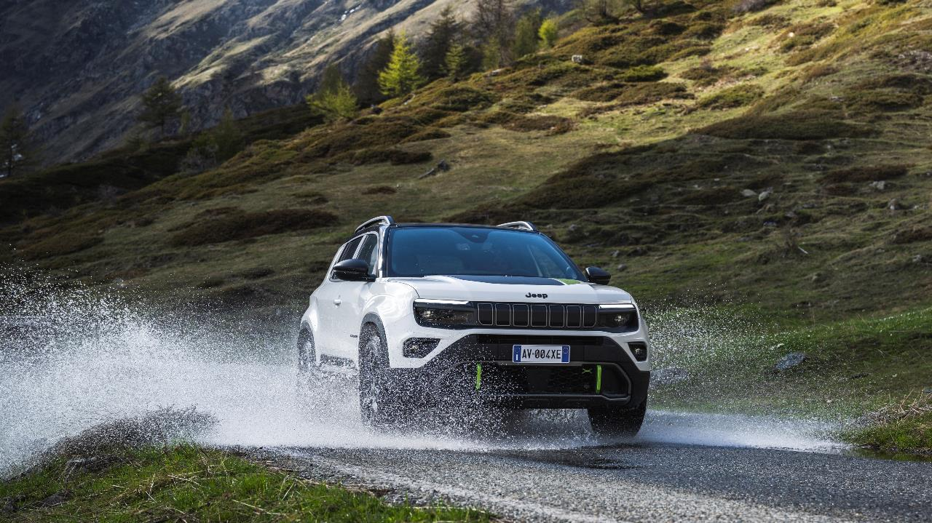

AVENGER MY25
TIMELINE AND NEW INTRODUCTIONS
4XE
DEEP DIVE
MY25 EVOLUTION AND 4XE RANGE
COST OPTIMIZATIONS
NEW FEATURES
PRICING
BRAND CONTENT
GUIDELINES

Slide 3
AVENGER MY25
TIMELINE AND NEW INTRODUCTIONS
4XE
DEEP DIVE
MY25 EVOLUTION AND 4XE RANGE
COST OPTIMIZATIONS
NEW FEATURES
PRICING
BRAND CONTENT
GUIDELINES

Slide 4
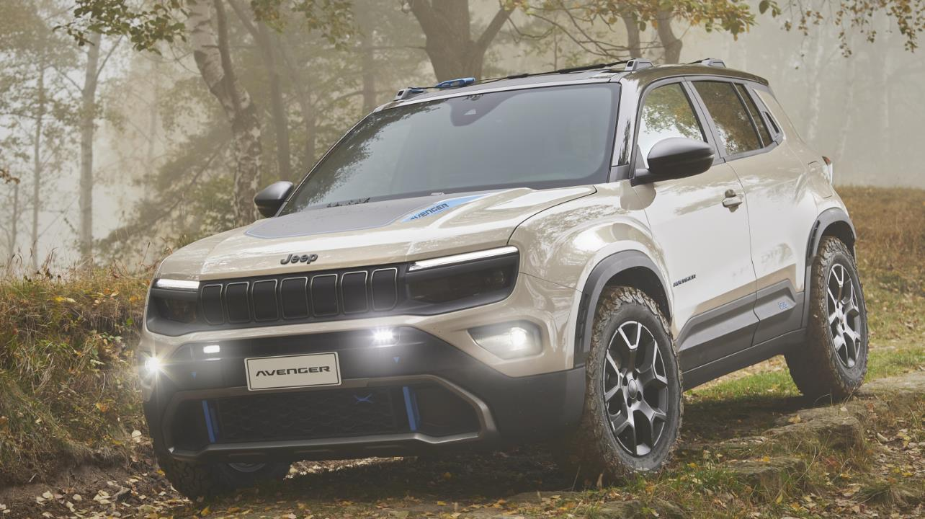



AVENGER MY25 – TIMELINE
2024
2025
Jun
Jul
Ago
Set
Oct
Nov
Dec
Jan
Feb
Mar
Apr
May
CO2 post
LRM
SOPM
FWD
SOP
I
LRM
OK TO SHIP
CO2 pre
CO2 post
SOPM
SOP
I
TNF
+
Full range
27/1
10/2
10/3
Instr. Letter
Orders open
Set up
I
Pricing, Web, Car Config, Prod Cat

Slide 5




AVENGER MY25 – NEW INTRODUCTIONS
AVENGER 4XE
FWD RANGE RE-SHUFFLE
CHAT GPT VOICE ASSISTANT
AUTOMATIC PARKING

Slide 6
AVENGER MY25
TIMELINE AND NEW INTRODUCTIONS
4XE
DEEP DIVE
MY25 EVOLUTION AND 4XE RANGE
COST OPTIMIZATIONS
NEW FEATURES
PRICING
BRAND CONTENT
GUIDELINES

Slide 7




AVENGER 4xe – UNIQUENESS
NEW FRONT & REAR BUMPERS
FOGLIGHTS DESIGN
ROOF RAILS
REAR TOW HOOK
SPECIFIC
EXTERIORS
NEW seats
with washable &
durable materials
SPECIFIC
interiors
48V HYBRID
136hp ice engine + two 21kw electric motors (front & rear)
+10MM GROUND CLEAREANCE
M+S TYRES
DEDICATED MULTI-LINK REAR SUSPENSION
SPECIFIC
COMPONENTS

Slide 8
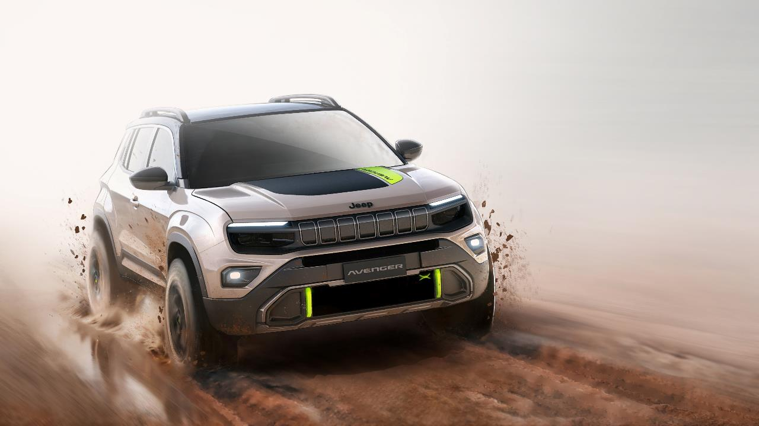

AVENGER 4xe The North Face – UNIQUENESS
NEW NEW FRONT & REAR BUMPERS WITH SUMMIT GOLD TOUCHES
DEDICATED THE NORTH FACE ANTI-REFLECTIOn HOOD STICKER
NEW 7 slots DESIGN with topographic lines
SPECIFIC
EXTERIORS
NEW seats with washable & durable materials, SUMMIT GOLD FINISHING, The north face logo & extra cargo system
New dashboard with topographic lines & Mont Blanc profile
SPECIFIC RUBBER MATS & PADCOVER WITH TNF logo
SPECIFIC
interiors
SPECIFIC
EQUIPMENTS
THE NORTH FACE WELCOME KIT

Slide 9
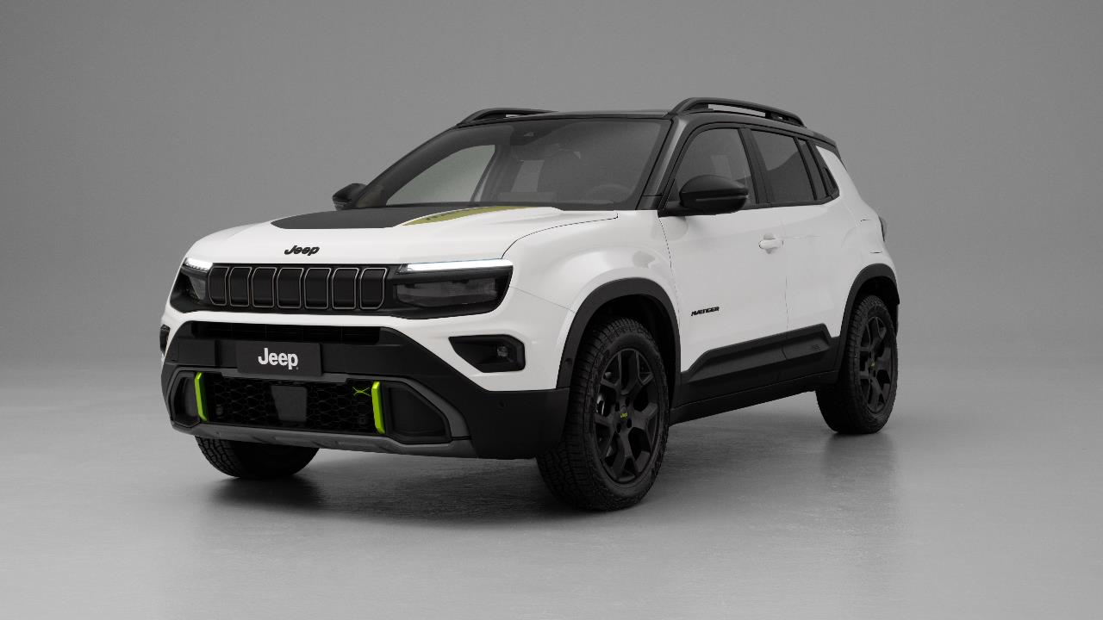
AVENGER 4xe – 4XE & TNF specific components
ROOF RAILS
TNF SPECIFIC
In summit gold
TNF SPECIFIC with contour lines & glossy black rings
SPECIFIC FOGLIGHTS DESIGN
NEW FRONT BUMPERS anti scratch
mould-in colour material
TNF SPECIFIC
In summit gold

Slide 10
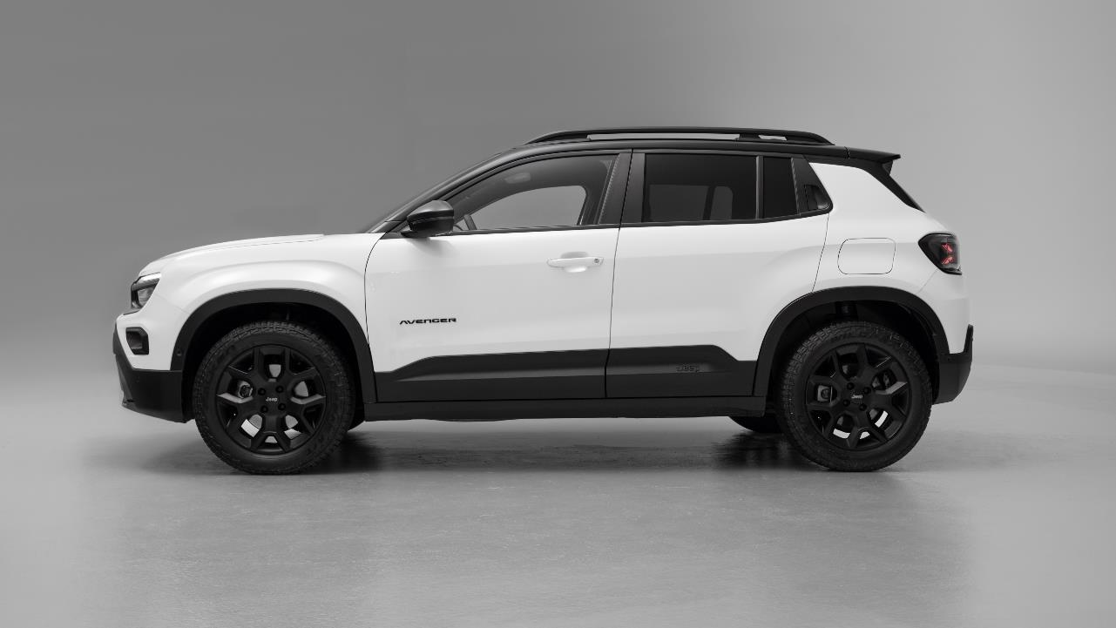
AVENGER 4xe – 4XE & TNF specific components
TNF SPECIFIC
WiTH summit gold Contours
TNF SPECIFIC
summit gold wheelcap
17’’ Black alloy wheels with m+s tyres

Slide 11
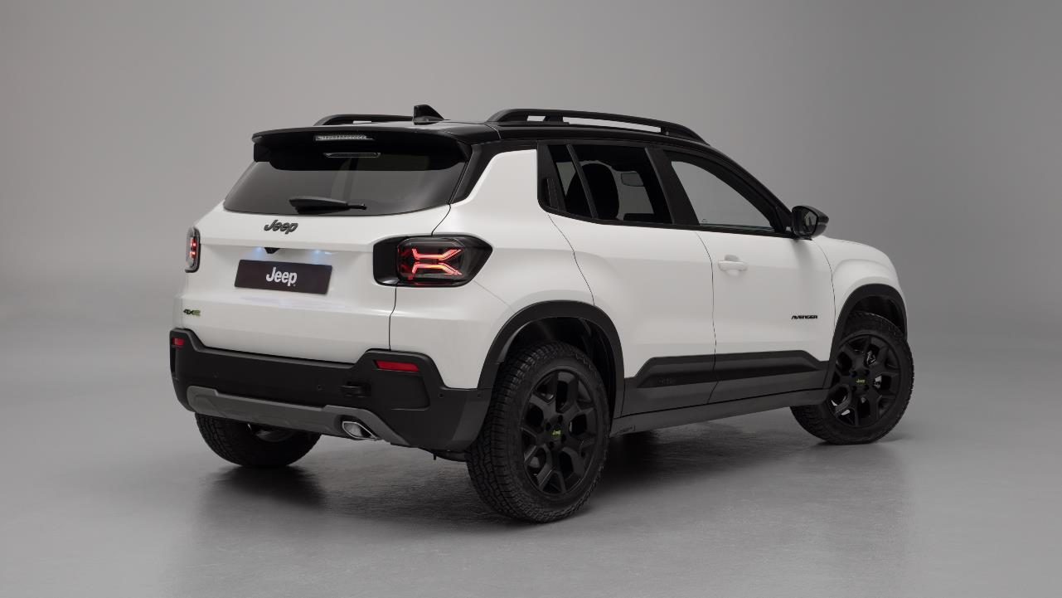
AVENGER 4xe – 4XE & TNF specific components
REAR TOW HOOK

Slide 12
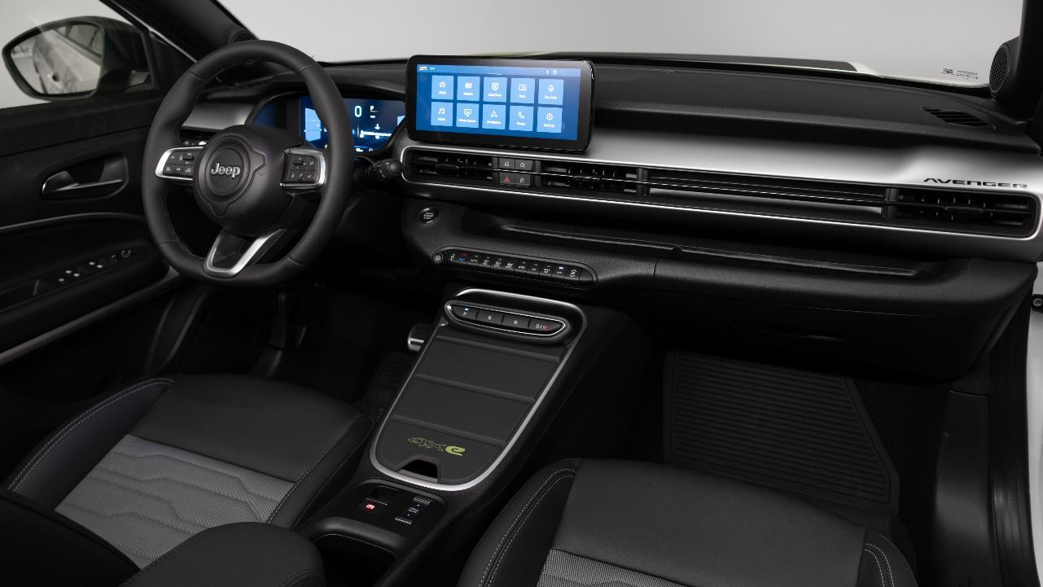
AVENGER 4xe – 4XE & TNF specific components
TNF SPECIFIC
Contour line+mont blanc logo
TNF SPECIFIC
RUBBER MATS
TNF SPECIFIC
padcover
TNF SPECIFIC
bezels
NEW seats
with washable &
durable materials
TNF SPECIFIC
Material , logo and back refinement with tnf hook

Slide 13
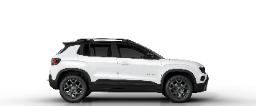
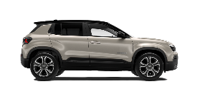
AVENGER 4xe – CAPABILITY
B-SUV BEST
IN CLASS
4x2
4xe
OFFROAD ANGLES
Approach/Brakeover/Departure
20°/20°/34°
22°/21°/35°
Ground cleareance
200
210
mm
WATER FORDING
230
400
mm
DRIVEN WHEELS
FRONT
AWD always available
(power looping technology)
Selec-tErrain
SPECIFIC TRACTION CONTROL
SPECIFIC TRACTION CONTROL
+
AWD MANAGEMENT (LOCK < 30km/h)

Slide 14
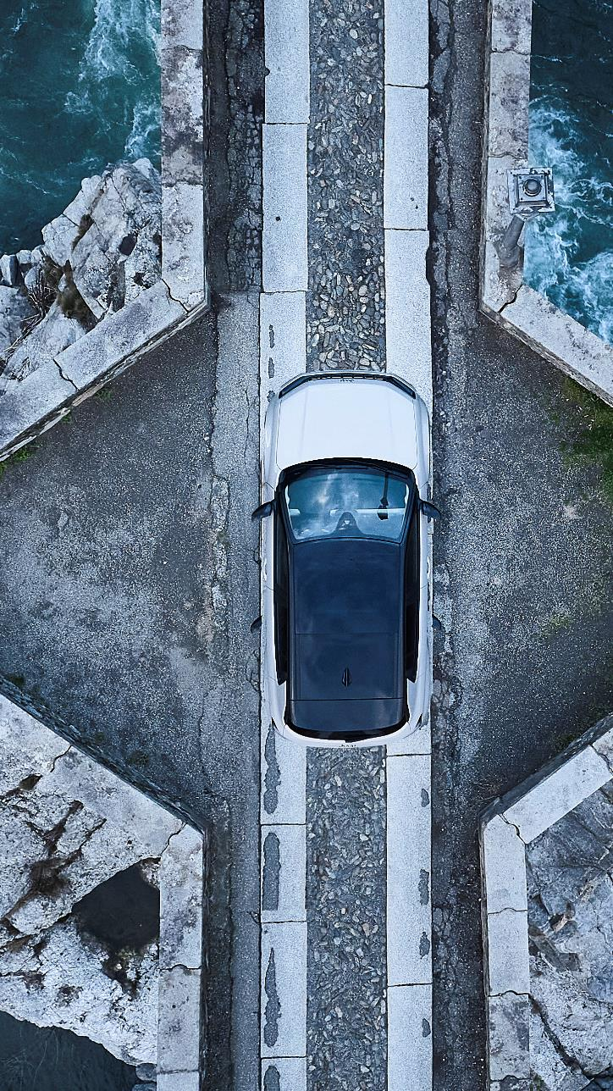
AVENGER 4xe – CAPABILITY
SELEC-TERRAIN
4 drive modes:
AUTO: FWD dominant, EV drive at low speed, AWD on demand from unclutch 0-90kph.
SAND/MUD: smartAWD, permanent AWD up to 30kph with 50:50 torque repartition, 30-90kph AWD on demand. Above 90kph permanent FWD.
ASR/ESP in SAND/MUD SNOW: smartAWD, permanent AWD up to 30kph with 50:50 torque repartition, 30-90kph AWD on demand.
Above 90kph permanent FWD.
ASR/ESP in SNOW
SPORT: AWD up to 40kph, energy supplied to rear motor both from battery and front electric motor for maximum boost. Above 40kph permanent FWD.
Specific gas pedal response and gearbox map
POWER LOOPING TECHNOLOGY
THERMAL ENGINE GIVE TRACTION TO FRONT WHEELS
ELECTRIC REAR ENGINE GIVE TRACTION TO REAR WHEELS
136 HP ICE
21 kW Emotor
21 kW Emotor
BATTERY
ELECTRIC FRONT ENGINE
(INTEGRATED IN THE DUAL CLUTCH TRANSMISSION)
AS GENERATOR TO SUPPLY ENERGY TO REAR ENGINE
4x4 ALWAYS AVAILABLE
Repartition up to 50:50

Slide 15
AVENGER 4xe – PERFORMANCES
e-Hybrid
4xe
MAX POWER THERMAL ENGINE
74 kW (100Hp)
100 kW (136Hp)
MAX POWER ELECTRIC ENGINE
21 kW
21+21 kW
MAX TORQUE
205 Nm
230 Nm
MAX SPEED
184 km/h
194 km/h
0-100 ACCELERATION
10.4 s
9.5 s
WLTP CO2 COMBINED
111-114 g/km
TBC
WLTP FUEL
CONSUMPTIONS COMBINED
4.9-5.1 l/100km
TBC

Slide 16
AVENGER MY25
TIMELINE AND NEW INTRODUCTIONS
4XE
DEEP DIVE
MY25 EVOLUTION AND
4XE RANGE
COST OPTIMIZATIONS
NEW FEATURES
PRICING
BRAND CONTENT
GUIDELINES

Slide 17




AVENGER LINE-UP EVOLUTION
MY24
MY25
NEW
Petrol
e-Hybrid
Bev
Petrol
e-Hybrid
Bev
SUMMIT
SUMMIT (PACK)
ALTITUDE
ALTITUDE
LONGITUDE
LONGITUDE
TNF
OVERLAND (PK)
SUMMIT
SUMMIT (PACK)
UPLAND
SUMMIT
ALTITUDE
SUMMIT (PACK)
ALTITUDE
ALTITUDE
LONGITUDE
ALTITUDE
LONGITUDE
LONGITUDE
LONGITUDE
Notes:
Avenger trim 3% BEV, 1% ICE

Slide 18

AVENGER LINE-UP EVOLUTION
Managed through special series with Summit/Overland Pack
619.2
420.2
Petrol
e-Hybrid
Bev
Longitude
M25
M2K
M2E
Altitude
P25
P2K
P2E
Summit
P25 SXXX
P2K SXXX
P2E SXXX
Upland
S4L
Overland
S4L SXXX
TNF
U4L

Slide 19
Summit/Overland creation
619.2
420.2
Petrol
e-Hybrid
Bev
Summit
P25
+
BW0/BXM
(LHD/RHD)
P2K
+
BVS/BXL
(LHD/RHD)
P2E
+
BW1/BXN
(LHD/RHD)
Overland
S4L
+
BVT/BXK
(LHD/RHD)

Slide 20






MY25 LINE-UP
Longitude
Altitude
(Longitude+)
Summit
(Altitude+)
EXTERIOR
16'' alloy wheels
Full LED headlamps reflector
Body color door handles
Grey skid plates
INTERIOR
Black Grained dashboard & Fabric seats
Urethane steering wheel
6-way manual driver seat
4-way manual passenger seat
Front armrest
Heated & power adjustable side mirrors
FEATURES
10.25” radio screen
7’’ full digital cluster
Cruise control
Autonomous Emergency Braking
Traffic Sign Recognition
Lane Keep Assist
Driver Attention Assist
Hill descent control
Selec-Terrain
Rear parking sensors
Electric parking brake
Height adjustable cargo floor
Telematic Box & Connected services
Wiring preparation for towing (Petrol/e-Hybrid)
Auto A/C mono zone
Keyless Go
Mode 3 charging cable
EXTERIOR
17'' alloy wheels
Silver skid plates
Led foglamps
INTERIOR
Cloth/vinyl premium seats
Silver dashboard & interior inserts (NO ICE)
Height adjustable cargo floor
Synt. Leather steering wheel
FEATURES
Adaptive cruise control (ACC)
10.25’’ Full Digital Cluster
180° rear camera with “drone view”
Automatic high beam
Keyless start
Auto dimming mirror
EXTERIOR
18'' alloy wheels
Full LED front & rear
INTERIOR
Multi-colour Ambient Light*
Electrochromic “frameless” rear-view mirror
FEATURES
Keyless entry & engine start
Wireless charger
Blind spot
180° rear camera with “drone view”
360° parking sensors
Automatic high beam
Power Foldable Mirrors
Handsfree liftgate
L2 Autonomous Driving (e-Hybrid/BEV)
JBL Premium Audio (Petrol/e-Hybrid)
Automatic Parking
REMOVED CONTENTS vs MY24
Keyless entry
Handsfree liftgate
Mandatory delta content vs ICE for electric platform constraints
Additional contents vs MY24
OPT
MY24→MY25
3 → 2
6 → 3
5 → 3

Slide 21
MY25 LINE-UP 4xe
4xe Upland
4xe Overland
In addition vs Upland
4xe Launch Edition
In addition vs Overland
EXTERIOR
17‘’ black alloy wheels
M+S tyres
New front & rear bumpers
Full LED headlamps reflector
Body color door handles
Silver skid plates
Led Foglamps
Rear tow hook
Roof Rails
INTERIOR
Silver dashboard
Dedicated fabric washable & durable seats
Synt leather steering wheel
6-way manual driver seat
4-way manual passenger seat
Front armrest
Heated & power adjustable side mirrors
Height adjustable cargo floor
FEATURES
10.25” radio screen
10.25’’ full digital cluster
Auto A/C mono zone
Adaptive Cruise control
Autonomous Emergency Braking
Traffic Sign Recognition
Lane Keep Assist
Driver Attention Assist
Hill descent control
Selec-Terrain
Electric parking brake
Telematic Box & Connected services
Wiring preparation for towing
180° rear camera with “drone view”
Automatic high beam
Keyless start
Auto dimming mirror
EXTERIOR
Full LED front headlamps projector
Rear LED lights
Privacy glass
INTERIOR
Interior multi colour ambient light
Velour floor mats
FEATURES
360° parking sensors
L2 assisted driving
Wireless charger
Foldable mirrors with puddle lights
Blind spot monitor
Frameless auto dimming mirror
EXTERIOR
17‘’ black alloy wheels with gold accents
Anti-reflection hood sticker with The North Face logo
Jeep 7 slots with topographic lines and glossy black rings
Summit gold plate protection insert
INTERIOR
Dedicated seats (washable & durable) with Summit gold profile, The North Face logo and extra cargo system
Dedicated dashboard with topographic lines & Mont Blanc profile
Dedicated rubber floor mats with mountains profile
Dedicated Pad Cover with The North Face logo
Interior multi colour ambient light
FEATURES
Navigation system
Heated windshield
Heated front seats
Passive entry
Handfree power liftgate
Additional contents vs Altitude

Slide 22


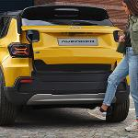



PACK STRATEGY
INFOTAINMENT & CONVENIENCE (BVQ)
Navigation System
Traffic sign nformation
10.25” digital cluster
ACC – adaptive cruise control
Techno leather steering wheel
LED fog lamps
2nd row charging usb type C
Height adjustable cargo floor
WINTER PACK (6R7)
Heated Windshield
Heated seats
LONGITUDE
INFOTAINMENT & CONVENIENCE (BVR)
Navigation System
Traffic sign information
Passive entry
Hands free Power liftgate
Mopar storage compartments rubber mats
Mopar PadCover (Bev/e-Hybrid)
WINTER PACK (6R7)
Heated Windshield
Heated seats
LEATHER PACK (445 m/h 6R7)
Leather seats
Driver electric regulation
Driver massage function
ALTITUDE
&
SUMMIT
INFOTAINMENT & CONVENIENCE (BVR)
Navigation System
Traffic sign information
Passive entry
Hands free Power liftgate
Mopar storage compartments rubber mats
Mopar PadCover (Bev/e-Hybrid)
WINTER PACK (6R7)
Heated Windshield
Heated seats
LEATHER PACK (445 m/h 6R7)
Leather seats
Driver electric regulation
Driver massage function
UPLAND
&
OVERLAND

Slide 23



STAND ALONE OPTIONS
HEAT PUMP
(BBV)
FIX & GO KIT
(499)
M+S
TIRES
(WAE)
Not available on Summit
LONGITUDE
OPEN AIR
SUNROOF
(400)
ALTITUDE
&
SUMMIT
UPLAND
&
OVERLAND

Slide 24

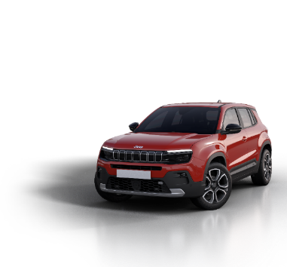
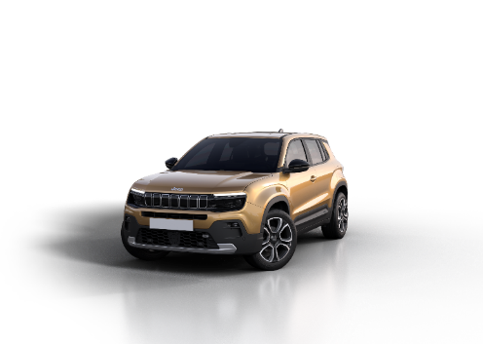
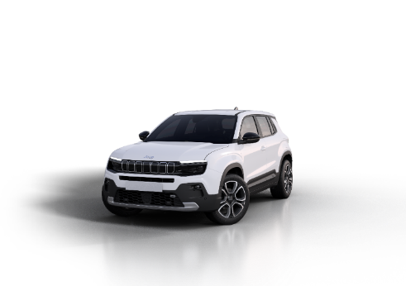
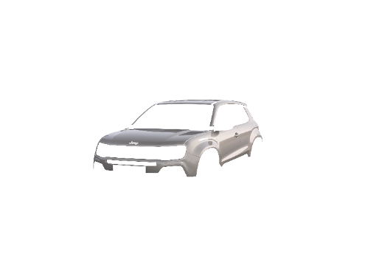
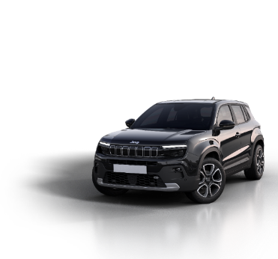
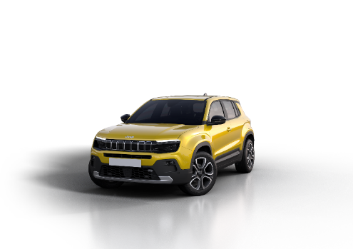
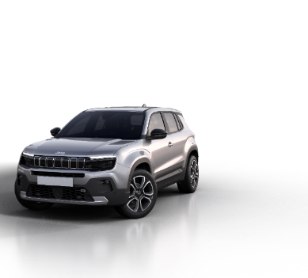
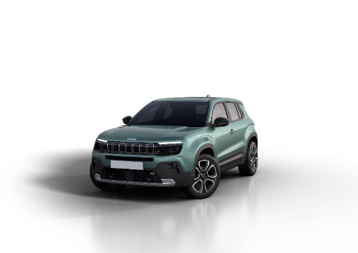
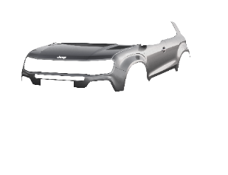

COLOR PALETTE
*Available also BICOLOR with Volcano Roof
SOLID
NEW!
Free
Ruby*
Snow*
Volcano
Ruby*
Concrete*
METALLIC
Sun*
Granite*
Stone*
Lake*

Slide 25
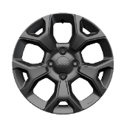
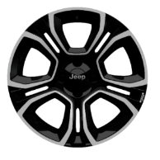
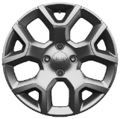
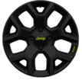
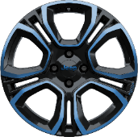


WHEELS RANGE
16” ALLOY - PAINTED
17” ALLOY - PAINTED
18” ALLOY – DIAMOND CUT
Grey gloss
SILVER Gloss
2-tone matt black w/diamond cut
Standard on LONGITUDE
Standard on ALTITUDE
Standard on SUMMIT / Opt on ALTITUDE
2-tone GLOSS black w/Blue touches
Tires details
Standard on 4xe
Accessory by Mopar
TYPE | SUMMER
DIMENSION | 215/65 R16
SPEED INDEX | H
LOAD INDEX | 98
SNOW CHAINS | YES
TYPE | SUMMER | M+S 4 season
DIMENSION | 215/60 R17 | 215/60 R17
SPEED INDEX | H | V
LOAD INDEX | 96 | 100
SNOW CHAINS | YES | YES
TYPE | SUMMER
DIMENSION | 215/55 R18
SPEED INDEX | V
LOAD INDEX | 99
SNOW CHAINS | NO

Slide 26
AVENGER MY25
TIMELINE AND NEW INTRODUCTIONS
4XE
DEEP DIVE
MY25 EVOLUTION AND 4XE RANGE
OPTIMIZATIONS ACTIONS
NEW FEATURES
PRICING
BRAND CONTENT
GUIDELINES

Slide 27
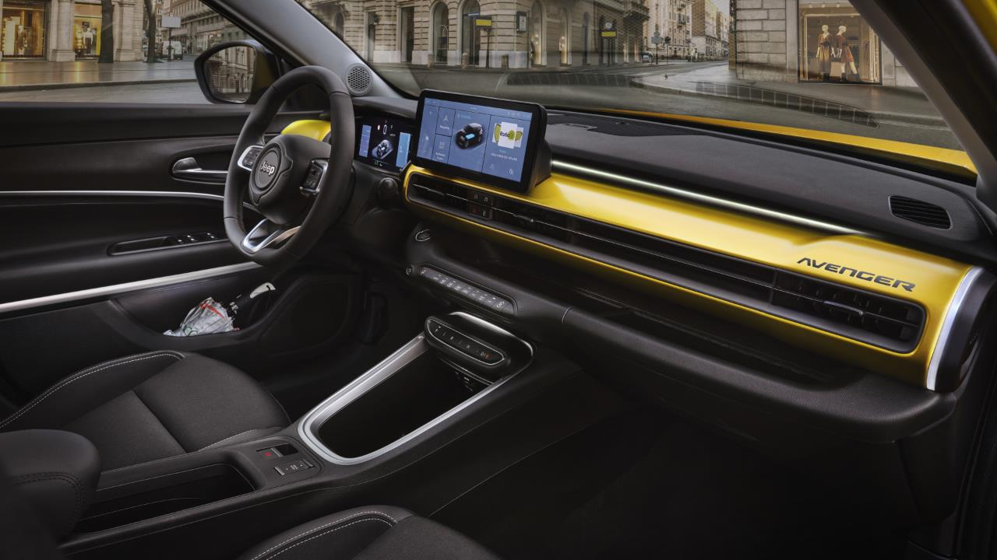
COMPLEXITY REDUCTION
YELLOW DAHSBOARD
OPTION REMOVAL

Slide 28
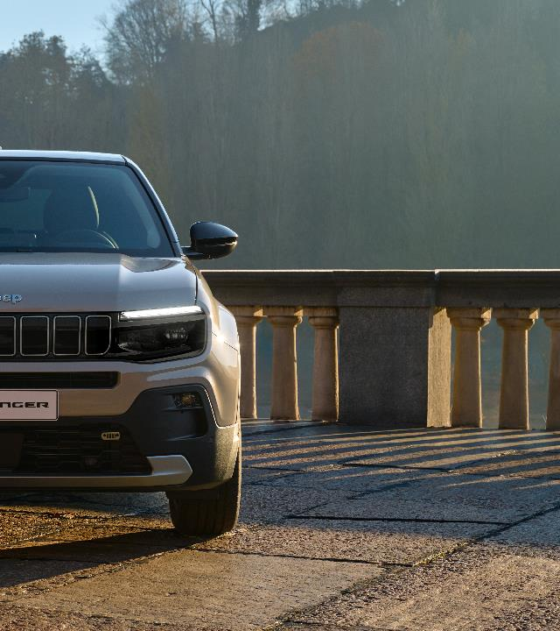
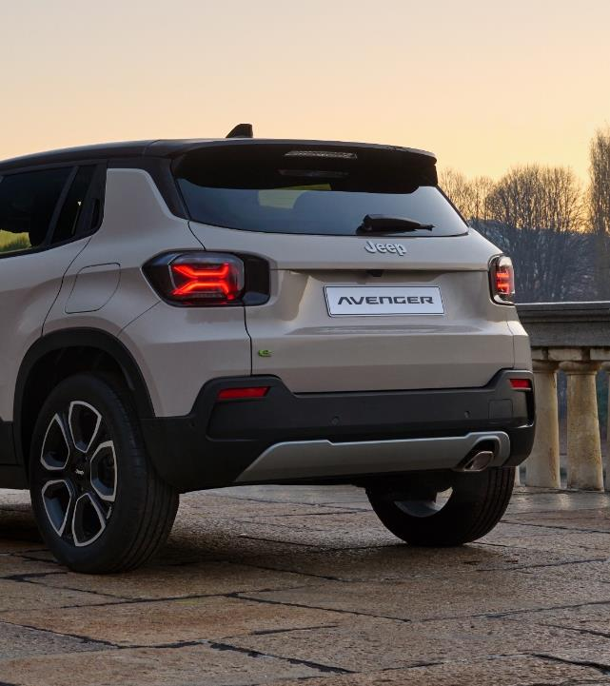
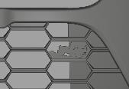

COST OPTIMIZATION ACTIONS
Jeep logo lower grille replaced by black easter egg
BADGE REMOVAL
(from e-Hybrid only)

Slide 29
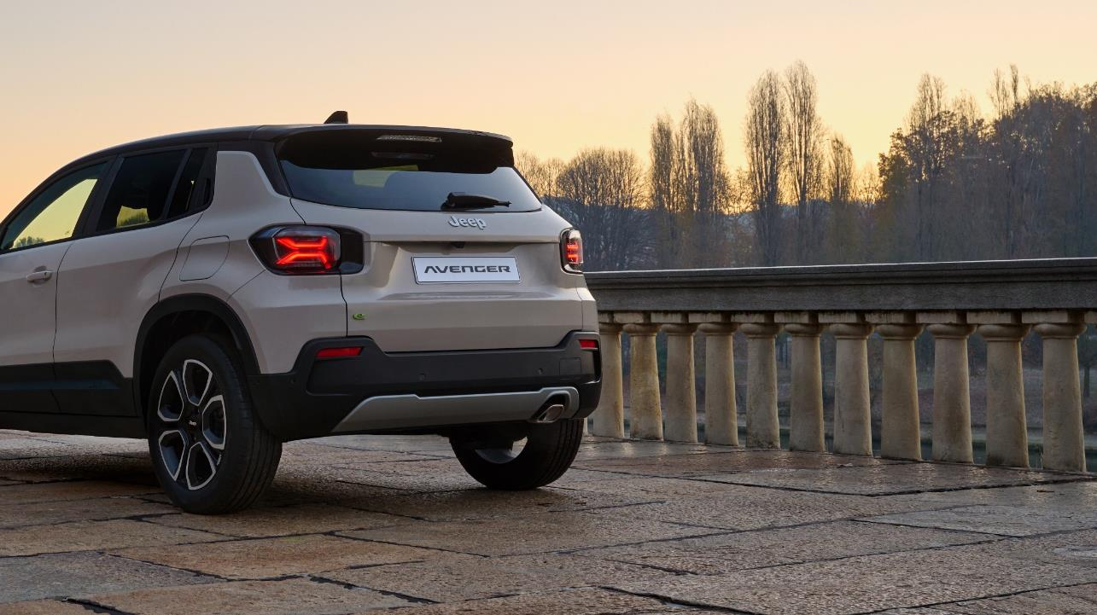


COST OPTIMIZATION ACTIONS
ISOFIX ZIP REMOVAL
CHARGING CABLE LENGTH (from 6→5 m)

