Slide 1
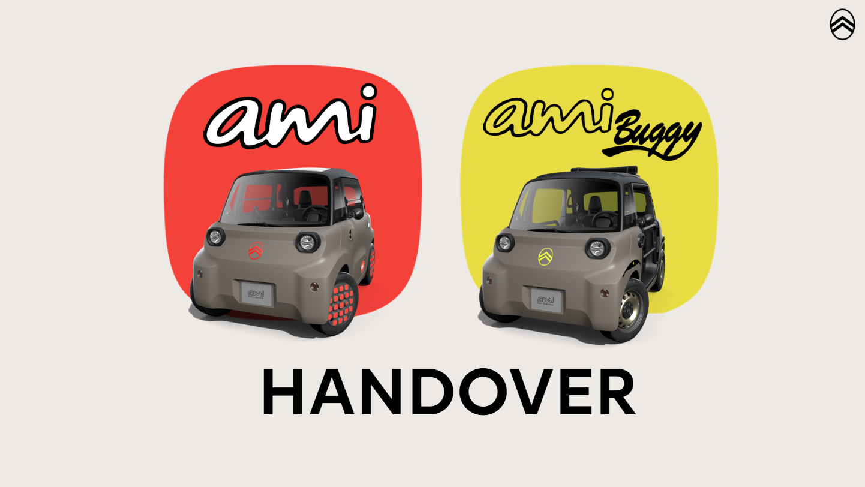
COVER
AUDIO
TESTO

Slide 2

AUDIO
Hey there!
Urban mobility has never been this cool!
Forget traffic jams, parking stress, and high costs.
TESTO

Slide 3
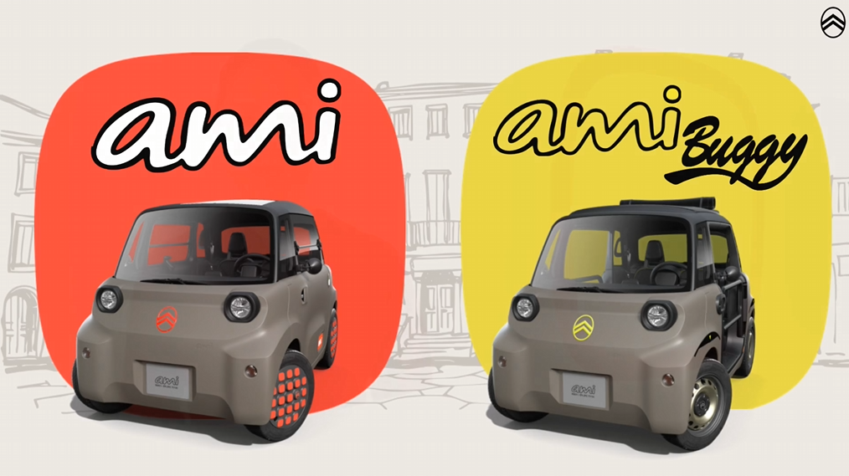
AUDIO
Meet the New Citroën AMI and Ami Buggy!
TESTO

Slide 4
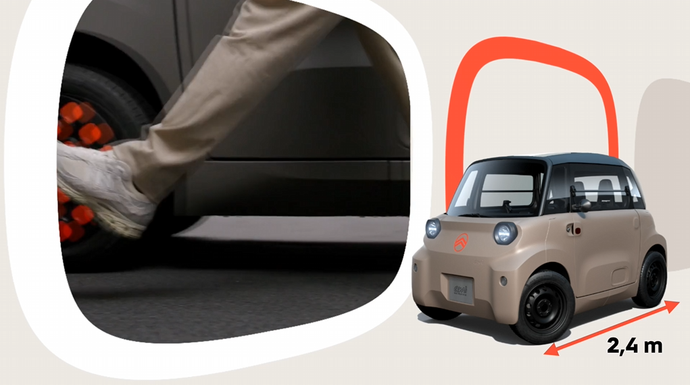
AUDIO
Easy to drive, even easier to park. The Citroën Ami’s compact 2,4m length and 7,20 m turning radius make it ideal for city driving and tight parking spaces.
TESTO
2,4 M

Slide 5
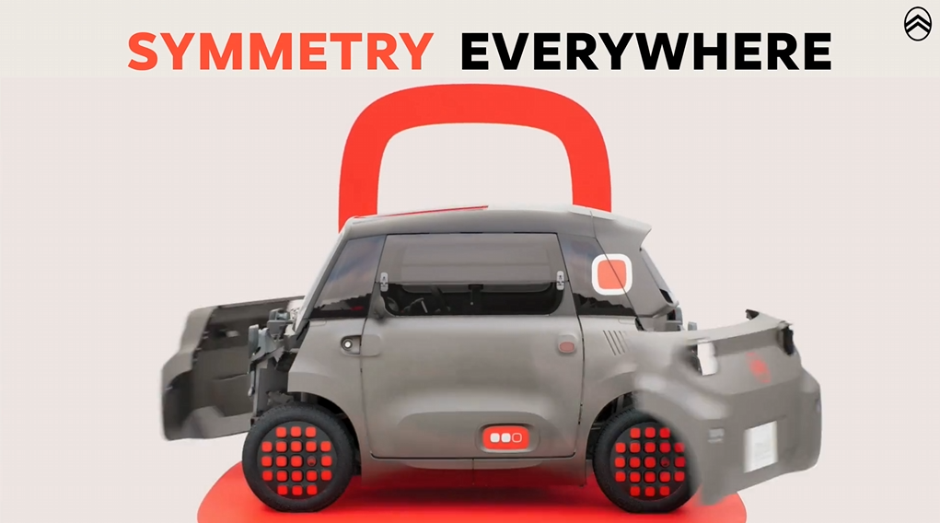
AUDIO
What makes it truly iconic?
Symmetry everywhere – front, back, sides... even the doors!
TESTO
SYMMETRY EVERYWHERE

Slide 6

AUDIO
The driver’s door opens backwards
The passenger’s door opens forwards, like a regular one.
Why? Same parts mean less waste, more savings, and a greener planet.
TESTO
BETTER FOR THE PLANET

Slide 7
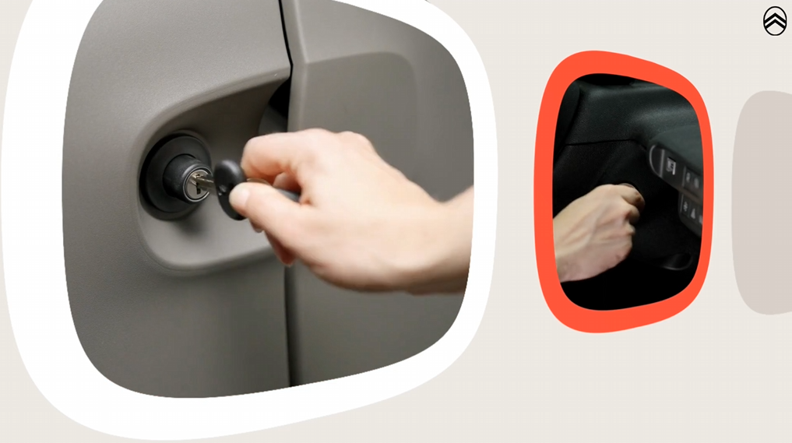
AUDIO
Two keys, two roles:
One lock and unlocks the doors
One starts the drive
Keep them both with you — Ami doesn’t roll without both.
TESTO

Slide 8
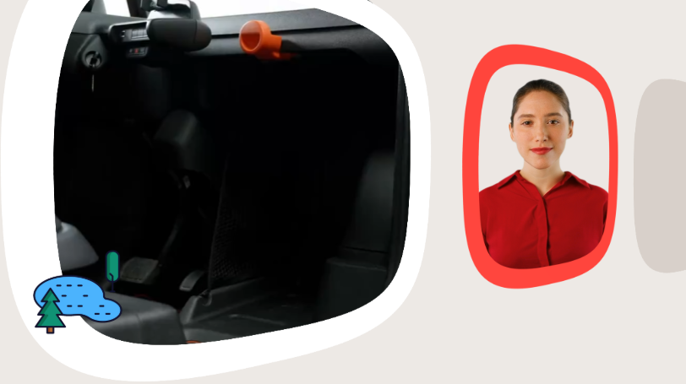
AUDIO
How about a weekend with friends? Just drop your suitcase in the passenger spot and you’re good to go.
TESTO

Slide 9
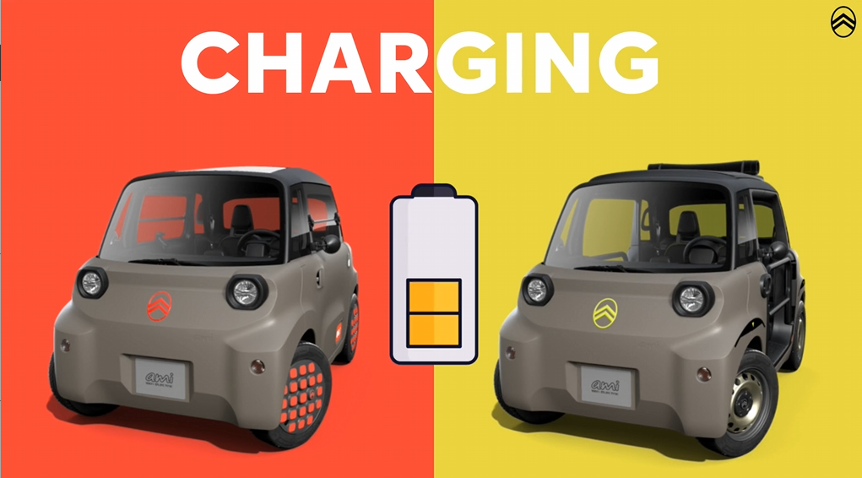
AUDIO
Charging? Easy as a smartphone
TESTO
CHARGING

Slide 10
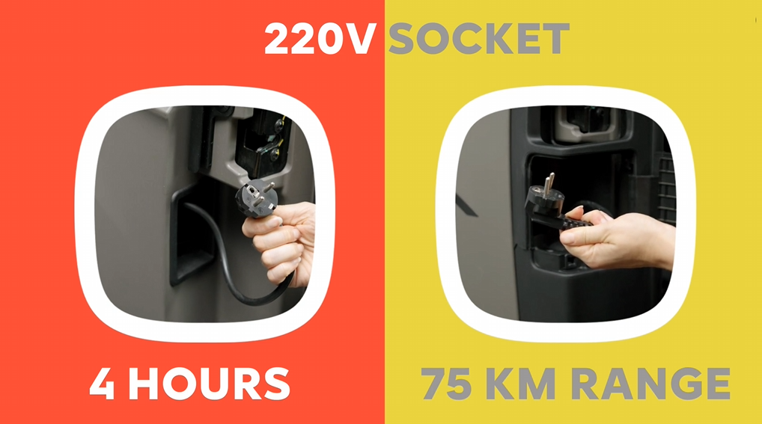
AUDIO
Plug into any 220V socket and you're ready to go in just 4 hours for a full 75 km range.
TESTO
220V SOCKET
4 HOURS
75 KM RANGE

Slide 11
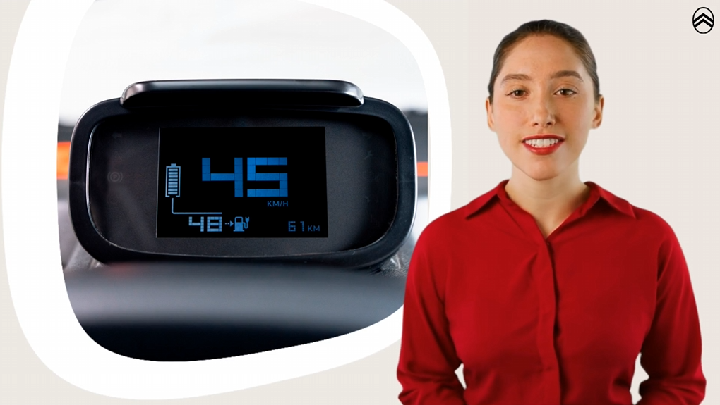
AUDIO
With a top speed of 45 km/h, it's perfect for zipping around town.
TESTO

Slide 12
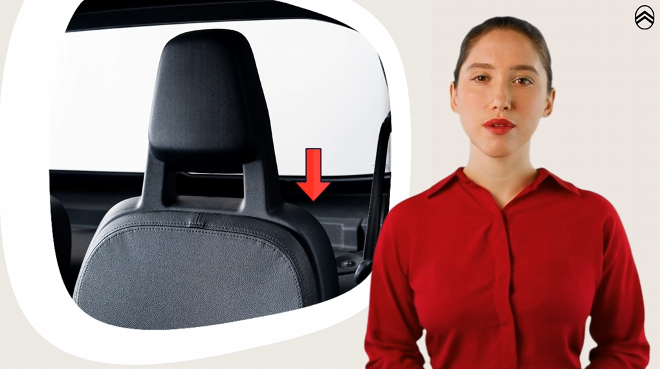
AUDIO
Washer Fluid? Just Behind You.
TESTO

Slide 13
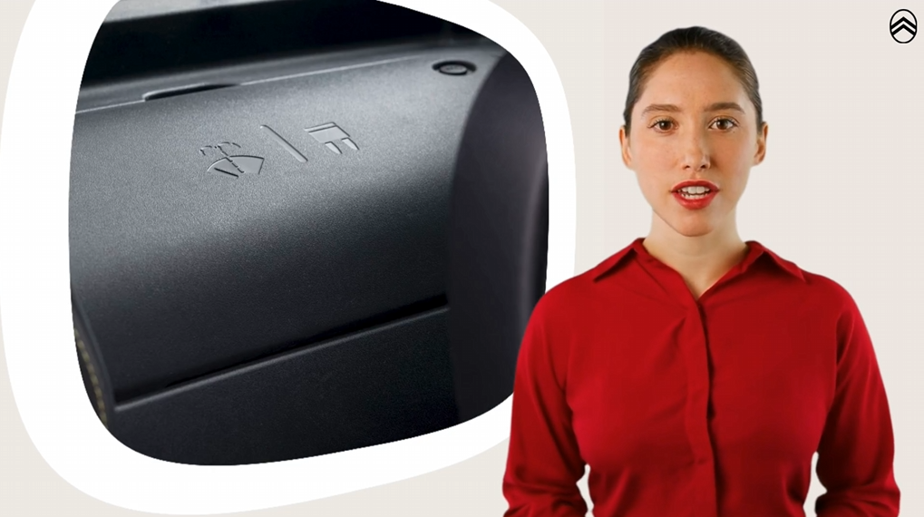
AUDIO
Behind the driver’s seat, under the central black cover, you’ll find the washer fluid tank. Just open the cap with the windshield symbol and fill it up.
TESTO

Slide 14
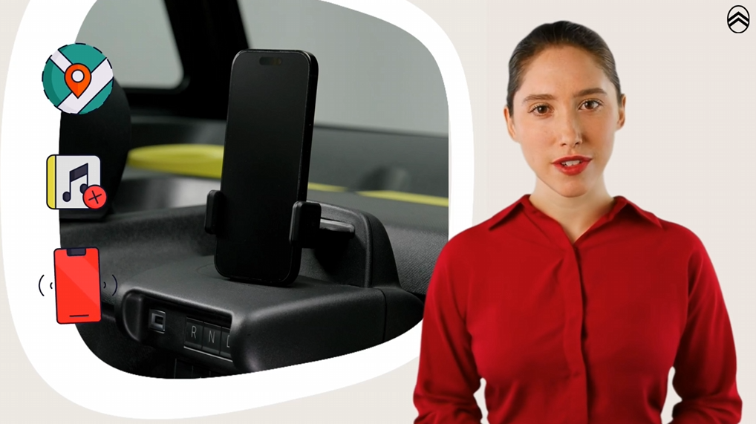
AUDIO
Stay connected with My Ami Play, giving you access to navigation, music, calls, and radio all at your fingertips.
TESTO

Slide 15
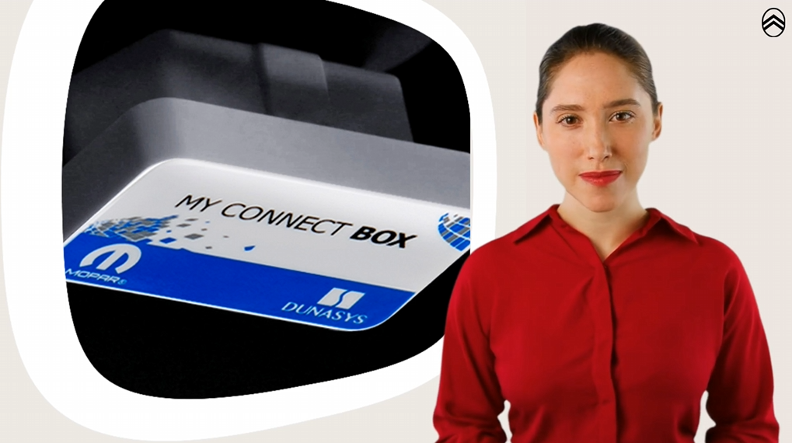
AUDIO
My Connect Box keeps you updated on battery, range, mileage, and maintenance, ensuring a smooth ride every time.
TESTO

Slide 16

AUDIO
Spicy, Icy, or Minty? Personalize your AMI with Color Packs!
TESTO

Slide 17
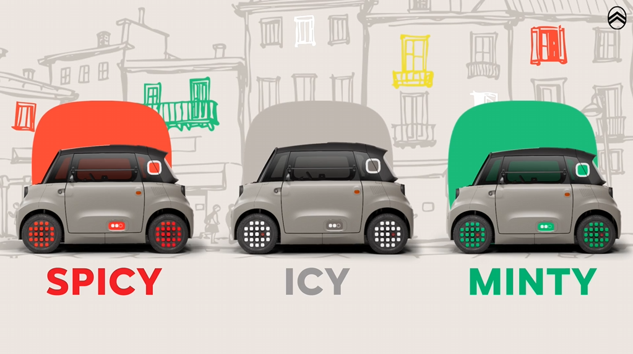
AUDIO
SPICY – Bold red details for a fiery look ICY – Cool, fresh icy blue accents MINTY – Vibrant green for a fresh style.
TESTO
SPICY
ICY
MINTY

Slide 18
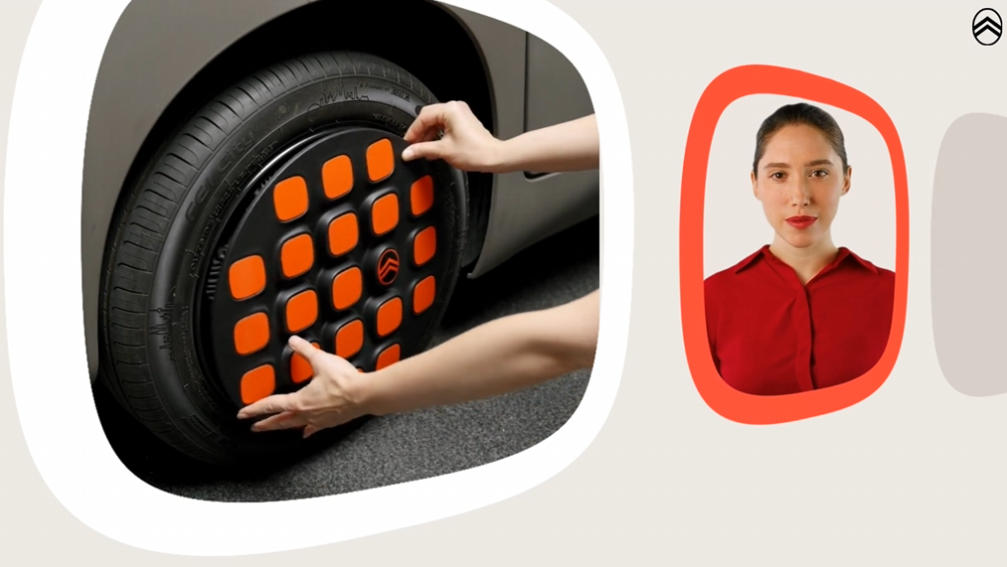
AUDIO
You install the packs yourself. If you get tired of the style, you can buy a new pack and change it. It’s easy to do.
TESTO

Slide 19
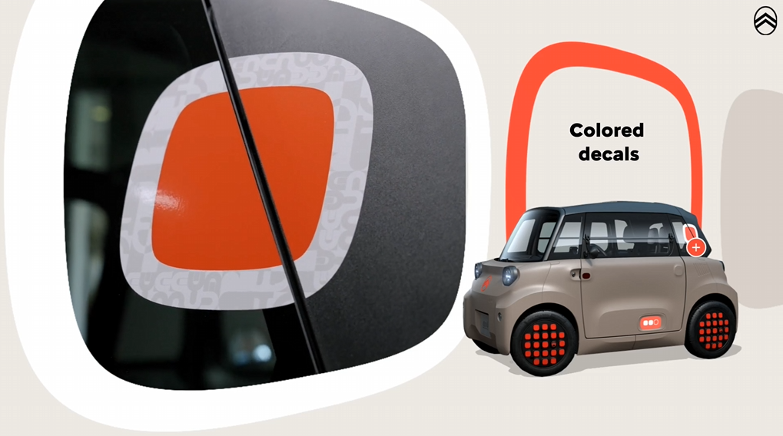
AUDIO
Each Color Pack for the New Citroën AMI includes:
Colored decals for the rear windows.
TESTO
Colored decals

Slide 20
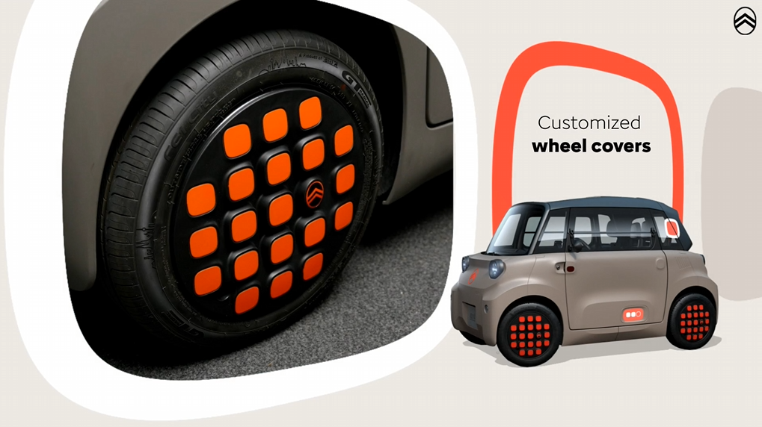
AUDIO
Customized wheel covers for a unique look.
TESTO
Customized wheel covers

Slide 21
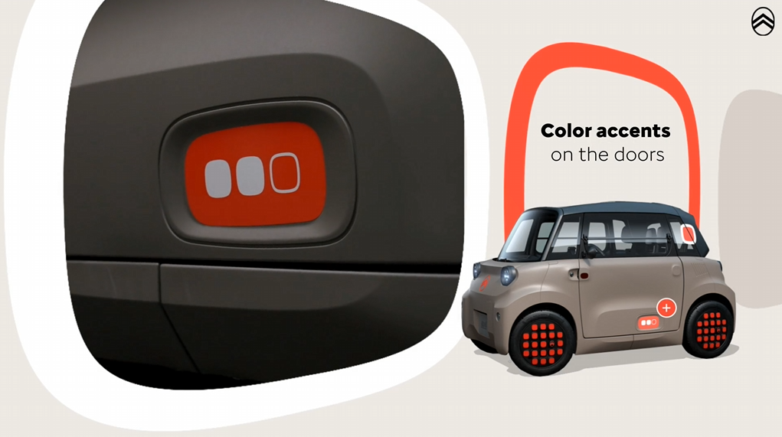
AUDIO
Color accents on the doors, enhancing the design.
TESTO
Color accents on the doors

Slide 22
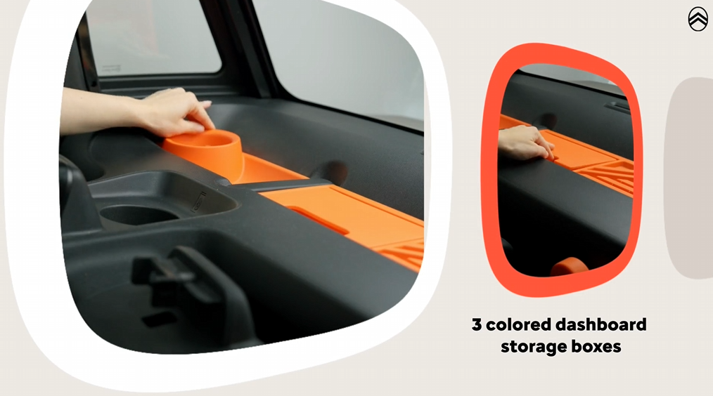
AUDIO
3 colored dashboard storage boxes
TESTO
3 colored dashboard storage boxes

Slide 23
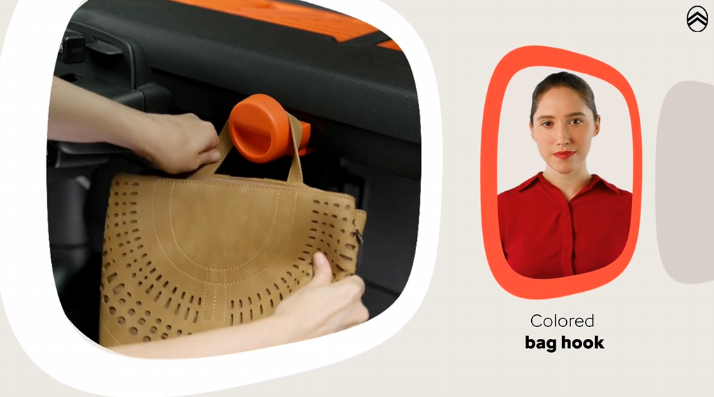
AUDIO
Colored bag hook
TESTO
Colored bag hook

Slide 24
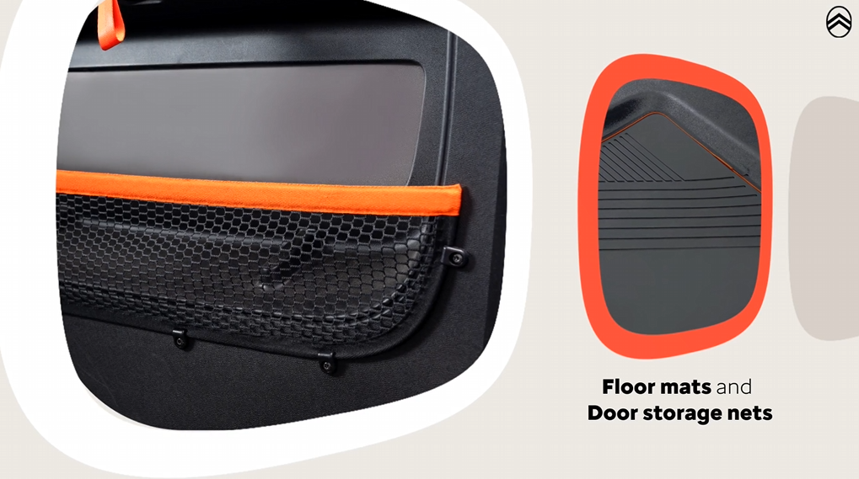
AUDIO
Floor mats with colored edging and
Door storage nets with matching color band
TESTO
Floor mats and Door storage nets

Slide 25

AUDIO
Love adventure? AMI Buggy is here!
TESTO

Slide 26
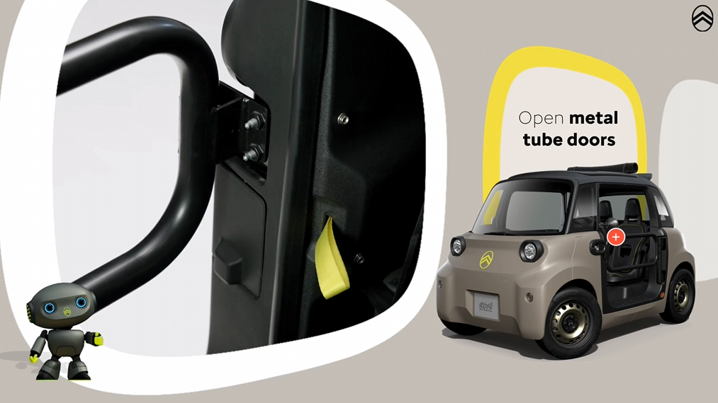
AUDIO
What's different from Citroën Ami?
Open metal tube doors for a raw, adventurous look
TESTO

Slide 27
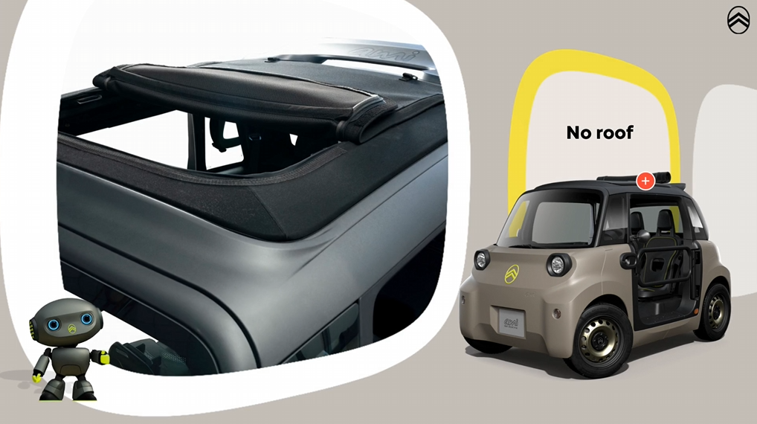
AUDIO
No roof, just sky – pure open-air freedom
TESTO

Slide 28

AUDIO
Let's discover together what's inside the Palmeira Pack.
TESTO
PALMEIRA Pack

Slide 29
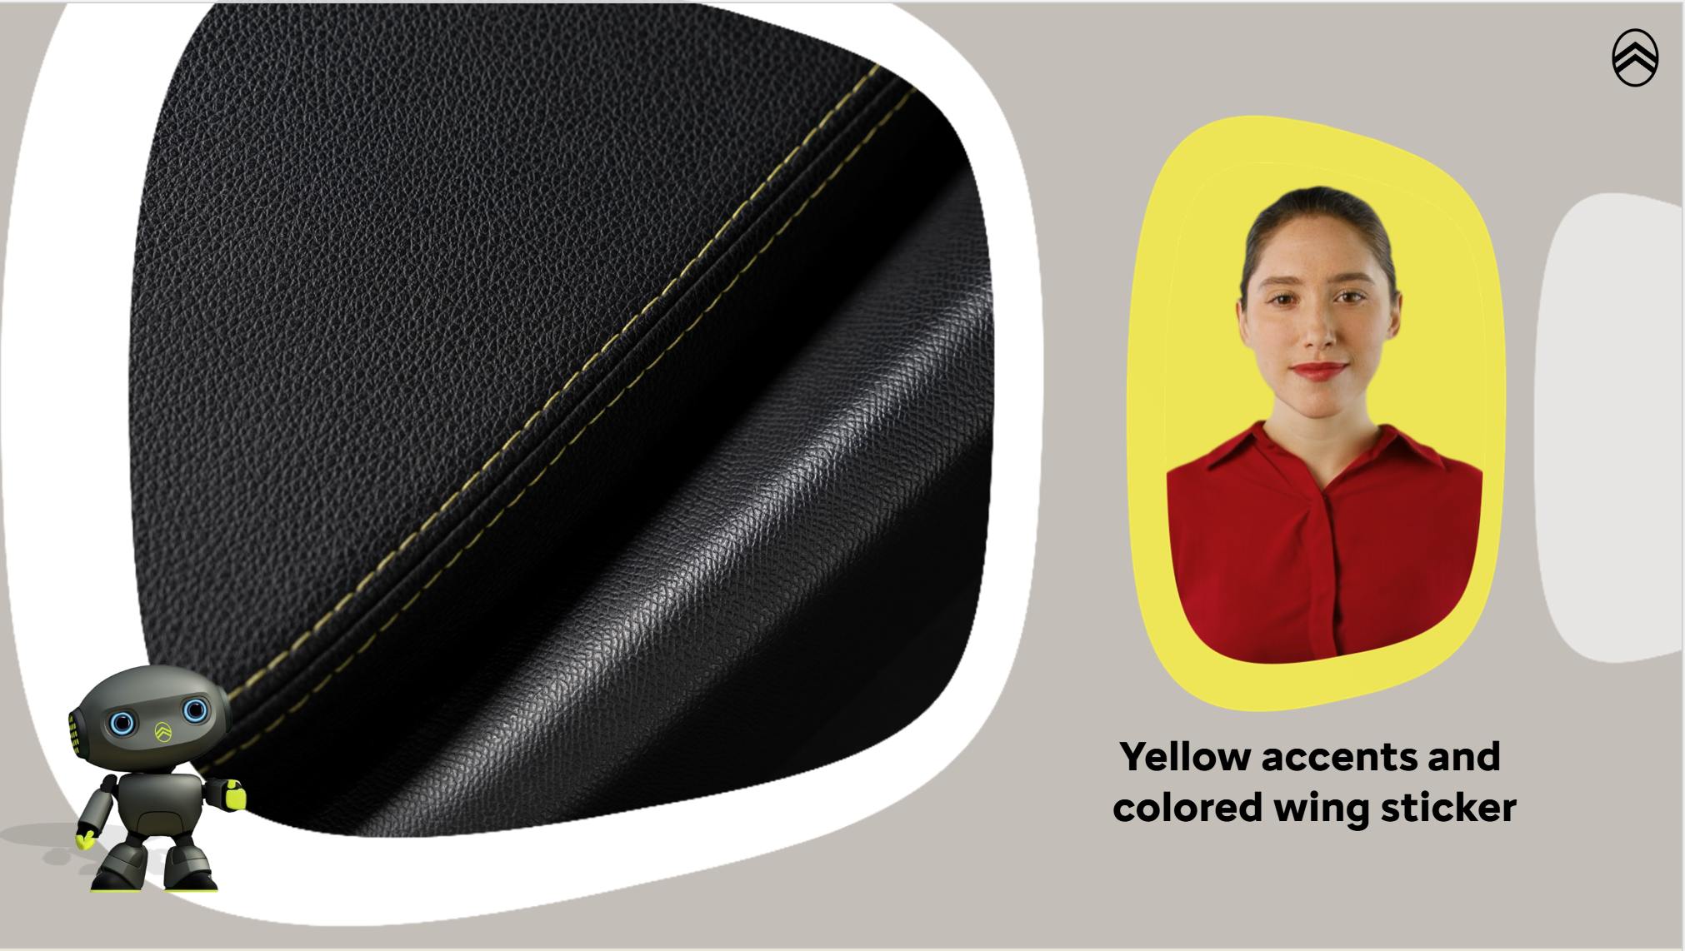
AUDIO
Yellow accents on stitching and colored wing sticker
TESTO
Yellow accents and colored wing sticker

Slide 30
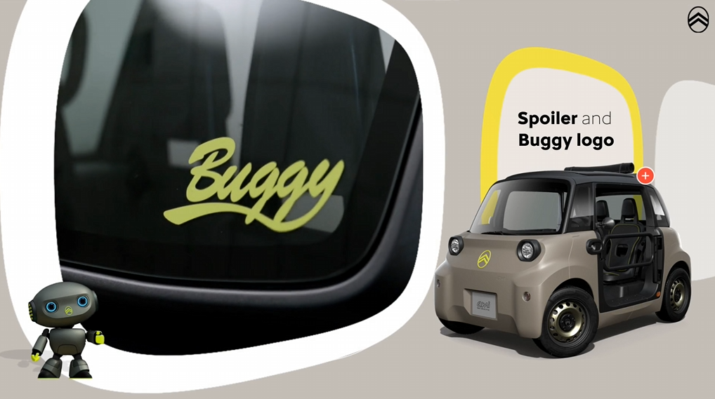
AUDIO
Spoiler and Buggy logo for a sporty, outdoor feel
TESTO

Slide 31
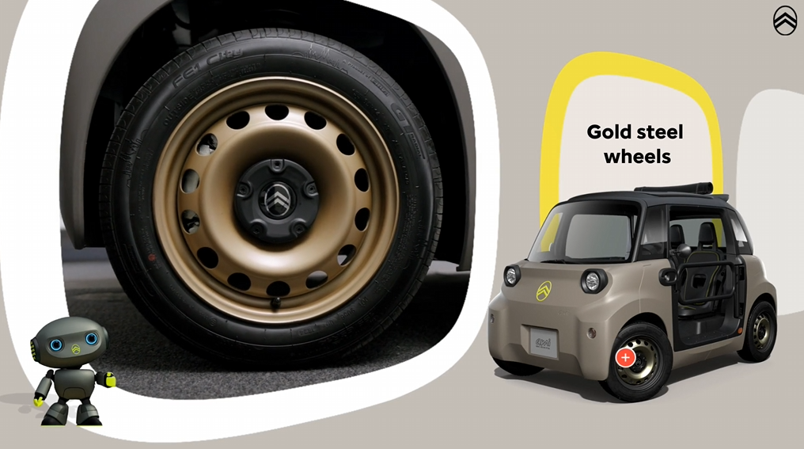
AUDIO
Gold steel wheels with black mini hubcaps
TESTO
Gold steel wheels

Slide 32
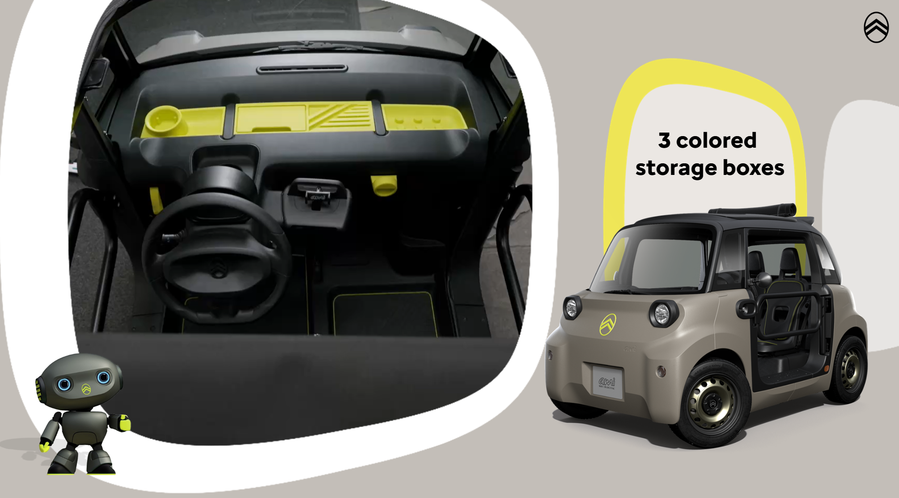
AUDIO
The Interior includes 3 colored storage boxes for the dashboard,
TESTO
3 colored storage boxes

Slide 33
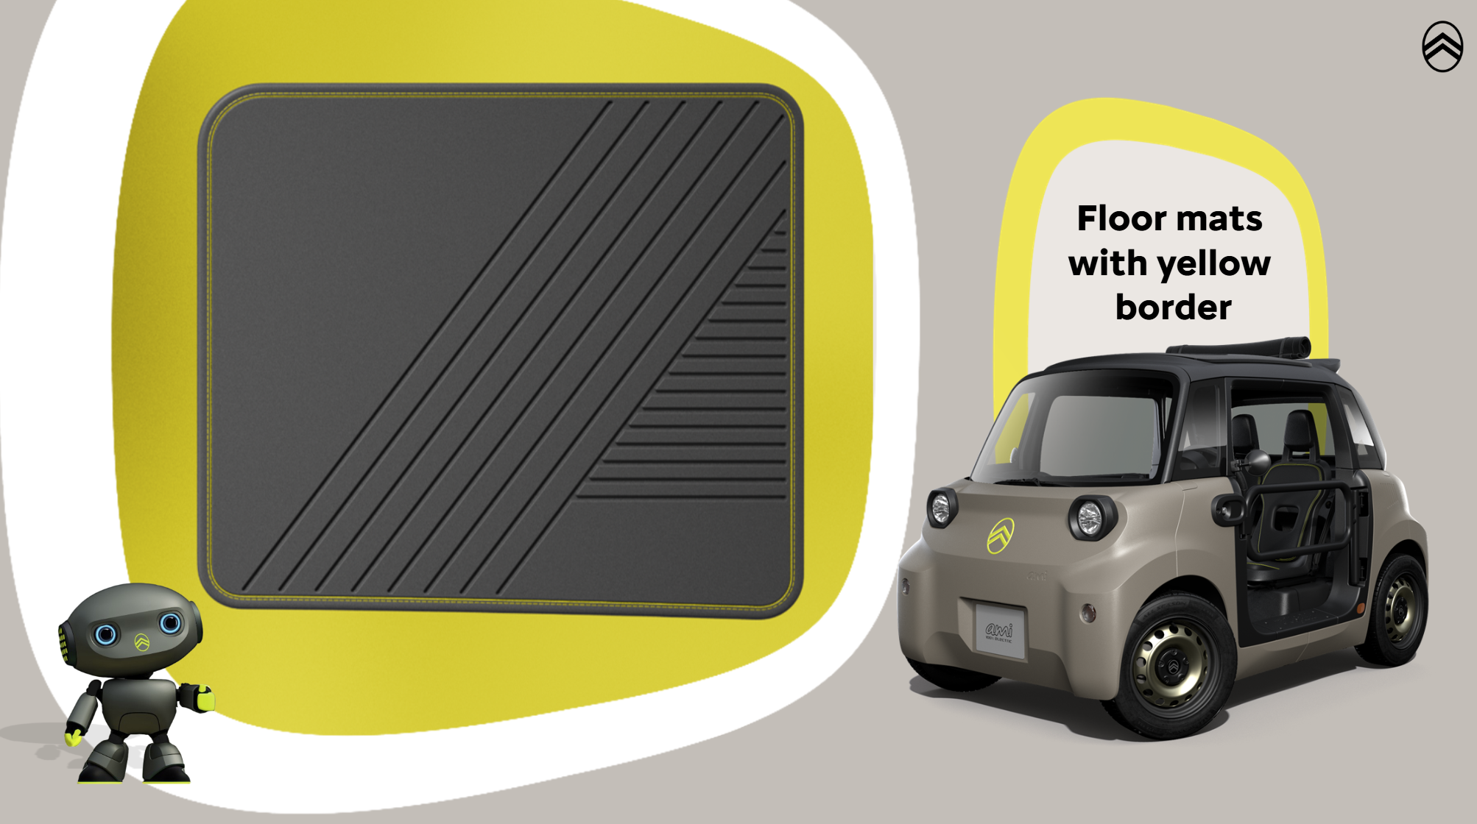
AUDIO
Floor mats with yellow border,
TESTO
Floor mats with yellow border

Slide 34
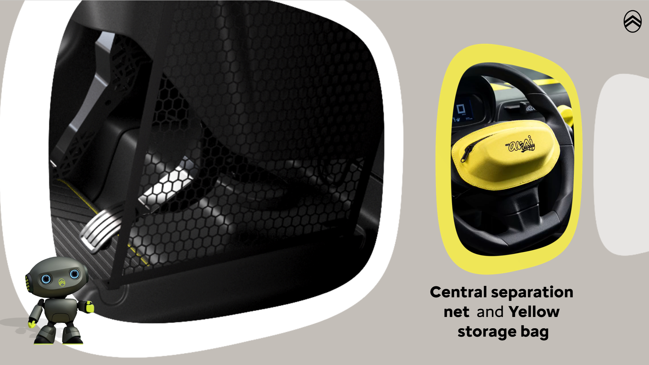
AUDIO
Central separation net, Yellow storage bag on the steering wheel.
TESTO
Central separation net and Yellow storage bag

Slide 35

AUDIO
Andy the mascot on the dashboard adds a playful touch
TESTO
Andy the mascot

Slide 36
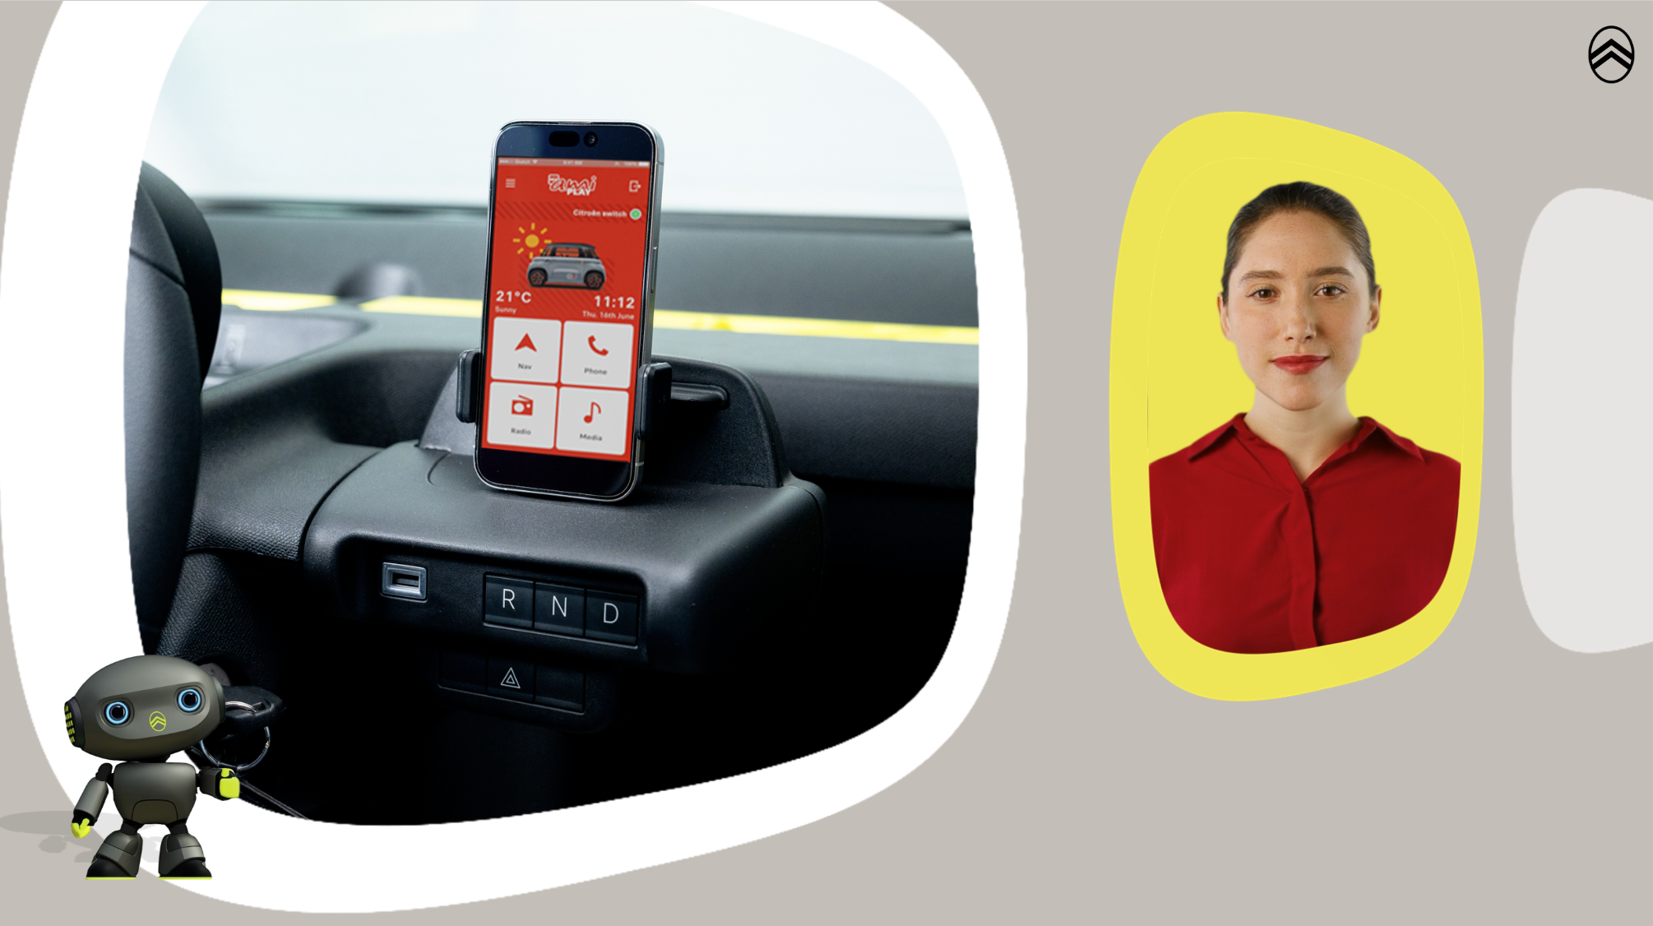
AUDIO
And of course, also in the palmeira pack you can find a joyful Infotainment thanks to My Ami Play with Citroën Switch and My Connect Box.
TESTO

Slide 37
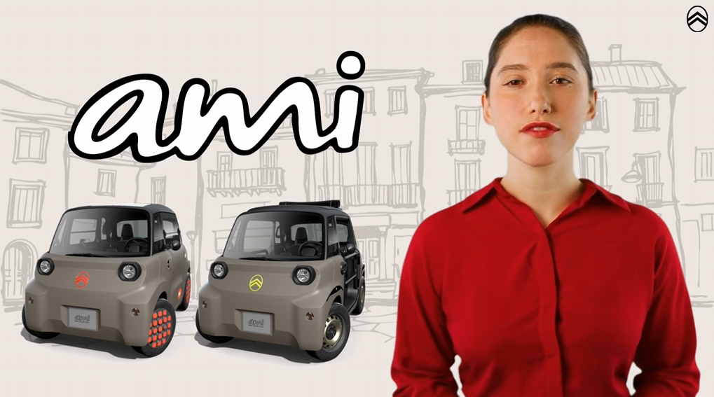
AUDIO
AMI isn't just a ride—it's freedom, fun, and the future of mobility.
TESTO

